Slide 2
What We Have Today ?
.NET API → Zip → WebApp (Windows) ICO/Charlotte/Wilbur
.NET Code → Docker → WebApp (Docker-Linux) Tannhauser
Next/Node → Docker → WebApp (Docker-Linux) Partnerships/Car-value
Next/Node → Zip → WebApp(Linux) SMC
Next → Build Artifacts on Target→ Azure Static Web App Junk Drawer
.NET function → Zip → Func App(Windows) Picsy/SMC Function
.NET function → Docker → Func App(Docker-Linux) Oliver

Slide 3
What is ACA ?
Serverless container service that supports microservice applications and robust autoscaling capabilities without the overhead of managing complex infrastructure.
Enables you to run microservices and containerized applications on a serverless platform that runs on top of Azure Kubernetes Service.
ACA uses k8s under the hood .
K8S – To run containerized application with its rich container orchestration features.
AKS => Managed K8S
ACA => Managed AKS

Slide 4
Diff between ACA and AKS
AKS | ACA
Partially Managed Service | Fully Managed Service
More control flexibility and extensibility | More black box and opinionated
More maintenance and operational work | Less maintenance and operation overhead
Extensive k8s competence needed | Foundational k8s competence needed

Slide 5
Common Use Cases
Deploying API endpoints
Hosting background processing applications
Handling event-driven processing
Running microservices

Slide 6
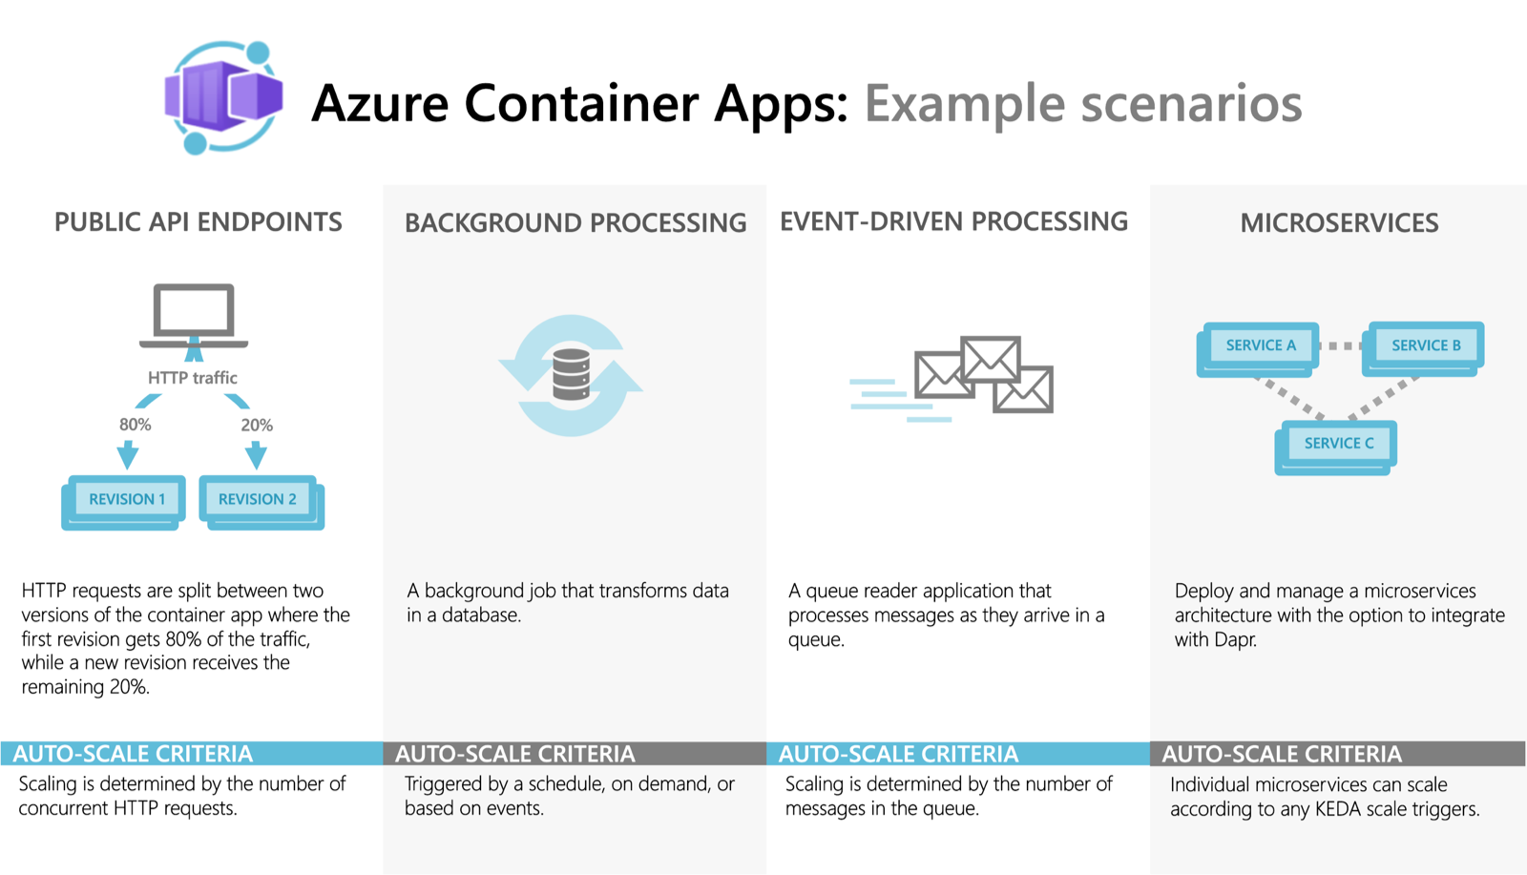

Slide 7
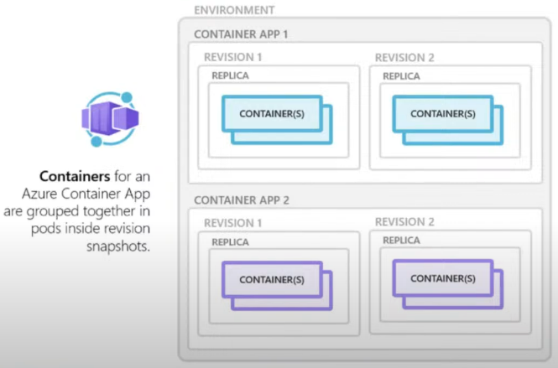
ACA - Overview

Slide 8
Features
Use the Azure CLI extension, Azure portal or Azure Resource Manager templates to manage your applications.
Enable HTTPS or TCP ingress without having to manage other Azure infrastructure.
Build microservices with Dapr and access its rich set of APIs.
Run jobs on-demand, on a schedule, or based on events.
Add Azure Functions and Azure Spring Apps to your Azure Container Apps environment.
Use specialized hardware for access to increased compute resources.
Run multiple container revisions and manage the container app's application lifecycle.
Autoscale your apps based on any KEDA-supported scale trigger. Most applications can scale to zero.

Slide 9
Features Cont..
Split traffic across multiple versions of an application for Blue/Green deployments and A/B testing scenarios.
Use internal ingress and service discovery for secure internal-only endpoints with built-in DNS-based service discovery.
Run containers from any registry, public or private, including Docker Hub and Azure Container Registry (ACR).
Provide an existing virtual network when creating an environment for your container apps.
Securely manage secrets directly in your application.
Monitor logs using Azure Log Analytics.
Override (already generous) quotas to increase limits on a per-account basis.

Slide 10
ACA Plans/Billing Model
Azure Container Environments Types
Workload profile - Run serverless apps with support for scale-to-zero and pay only for resources your apps use with the consumption profile. You can also run apps with customized hardware and increased cost predictability using dedicated workload profiles.
Consumption only – Run serverless apps with support for scale-to-zero and pay only for resources your apps use.

Slide 11
Demo 1 – CSharp Api
Revisions
Single Mode - Only one active revision . Existing revision waits for the new revision to start successfully before getting deactivated. So, no downtime.
Multiple Mode - Can have multiple active revisions – Good for traffic splitting
Labels – We can label revisions .
Use of secrets and environment variables.
Health Probes - Startup/liveness/readiness
Logs - App insights . Stores the name of the container in cloud_role_instance .
Rollbacks are easier – “env vars are specific to revisions”

Slide 12
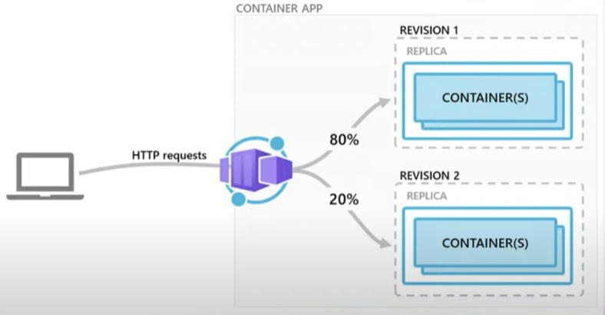
Demo- ACA revision and traffic splitting
Notes:
Good for traffic splitting , Blue green deployment etc

Slide 13
Limitations
No access to underlying k8s apis and control plane
Privileged containers are not supported
URL/Path-based routing not supported out of the box
Use Proxy Servers like NGINX or YARP either in a dedicated container or as part of existing app container
Windows containers are not supported
Azure container instance can be an alternative

Slide 14
Scaling
HTTP traffic
Event-driven processing
CPU or memory load
Any KEDA-supported scaler

Slide 15
Some clarifications
Docker file is not required to deploy to ACA .. Looks like ADO task can just take code path and deploy.
Restarting single container is not possible . Will need to depend on liveness endpoint to get a container restarted when needed.

Slide 16
What is Dapr ?
Distributed Application Runtime.
Born in Microsoft .
Open-Source project by CNCF (Cloud Native Computing Foundation)
Can be used with any language
Can run on prem , k8s , any public cloud.
Runs alongside the main service/app as a side car container when enabled.
Written in Go Lang .

Slide 17
Why Dapr ?
Challenges in implementing microservices implementation
Recovering state after failures
Service discovery and calling other microservices
Integration with external resources
Async communication between diff services
Distributed tracing
Measuring message calls and performance across components and network services

Slide 18
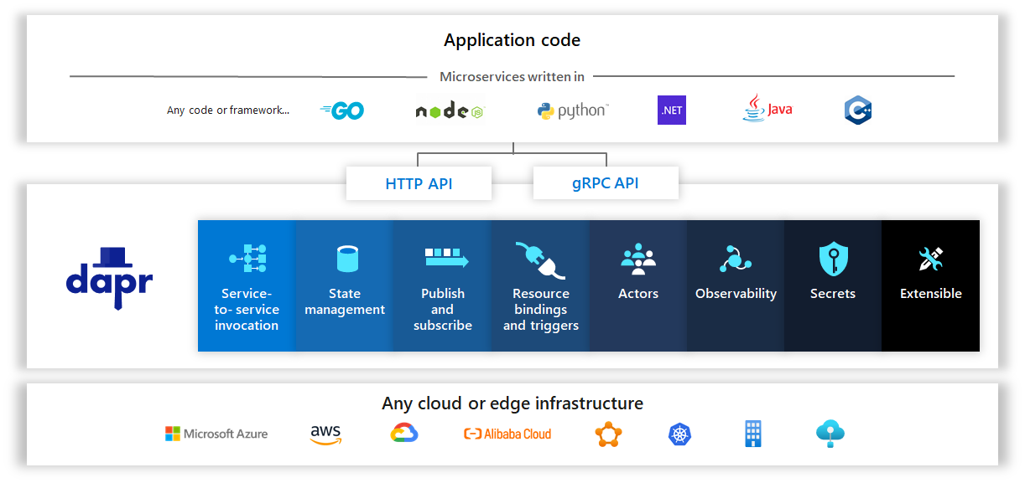
Very high-level view of Dapr

Slide 19
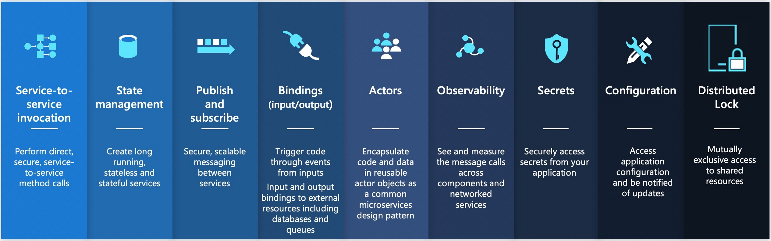
Dapr – Building blocks
A building block - modular component which encapsulates best practices and can be accessed over standard HTTP or gRPC APIs.
Total 9 building blocks – all are exposed through public facing apis that can be called from your code and can be configured using components to implement the building block’s capability

Slide 20
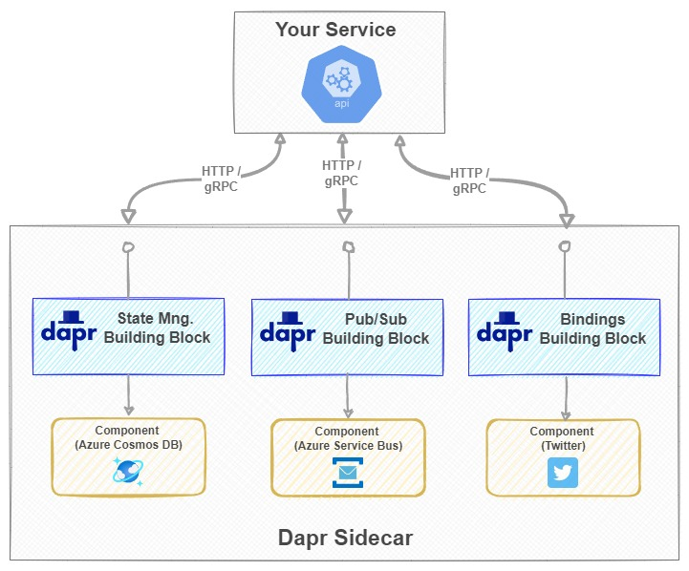
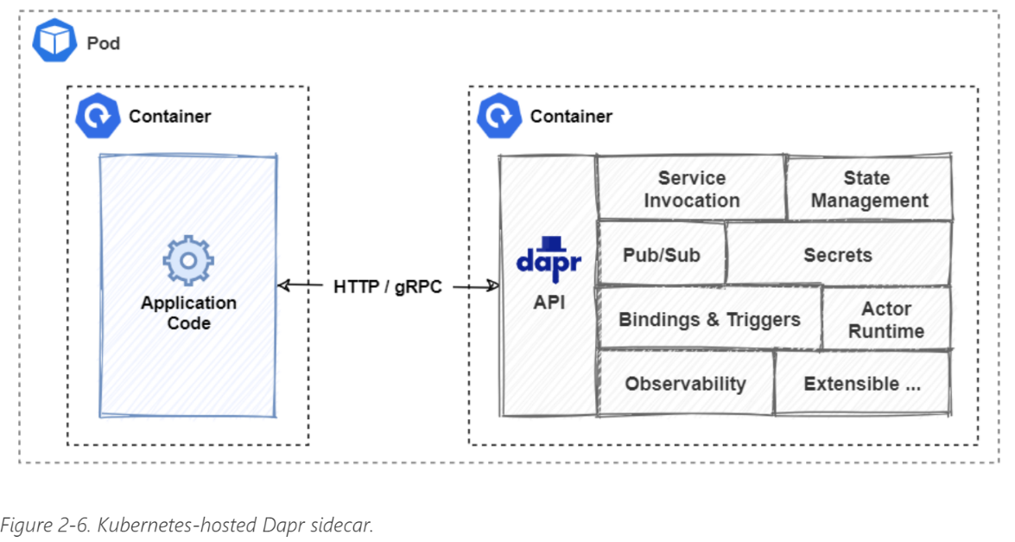
How Dapr Works?
Running alongside main app as a sidecar container.
Runs in a separate memory process, provides isolation and encapsulation as they are not part of main service , but connected to it.
Enables each to have its own runtime env and be built on diff programming platforms
Our service has no SDK, library, or direct reference to the underlying component.
We can change the underlying component with no code change

Slide 21
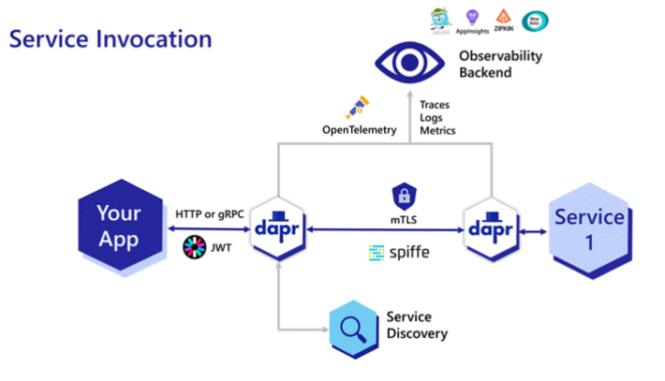
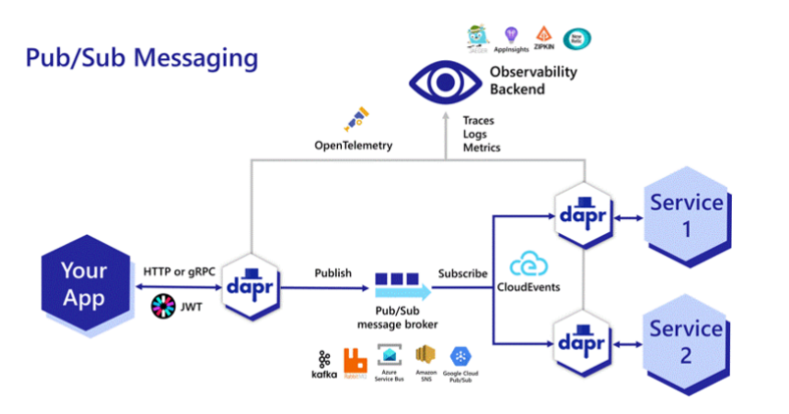
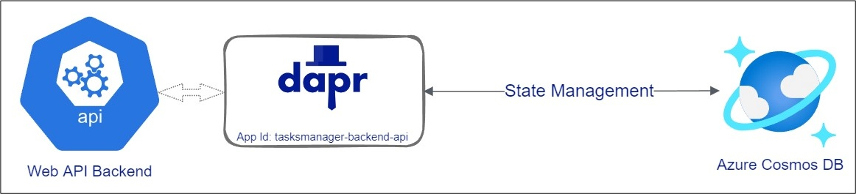
Dapr – Service Invocation , pub/sub , Stage Management & observability Block

Slide 22
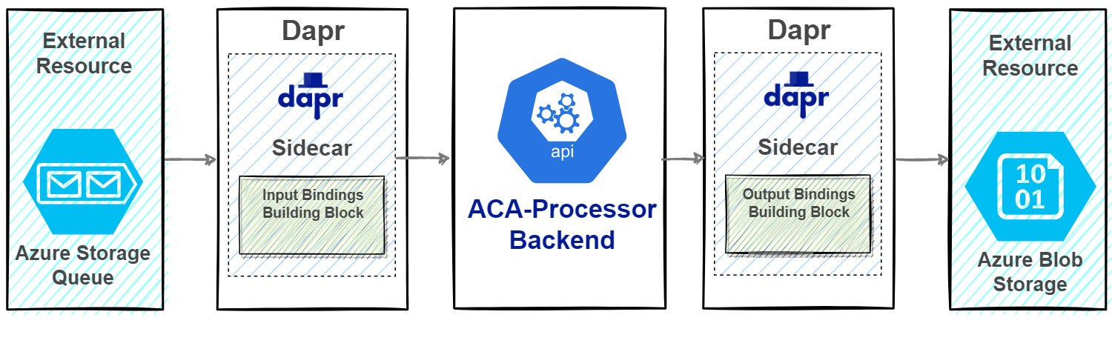
Dapr – Input & Output binding - Interacting with External Systems
https://docs.dapr.io/reference/components-reference/supported-bindings/

Slide 23
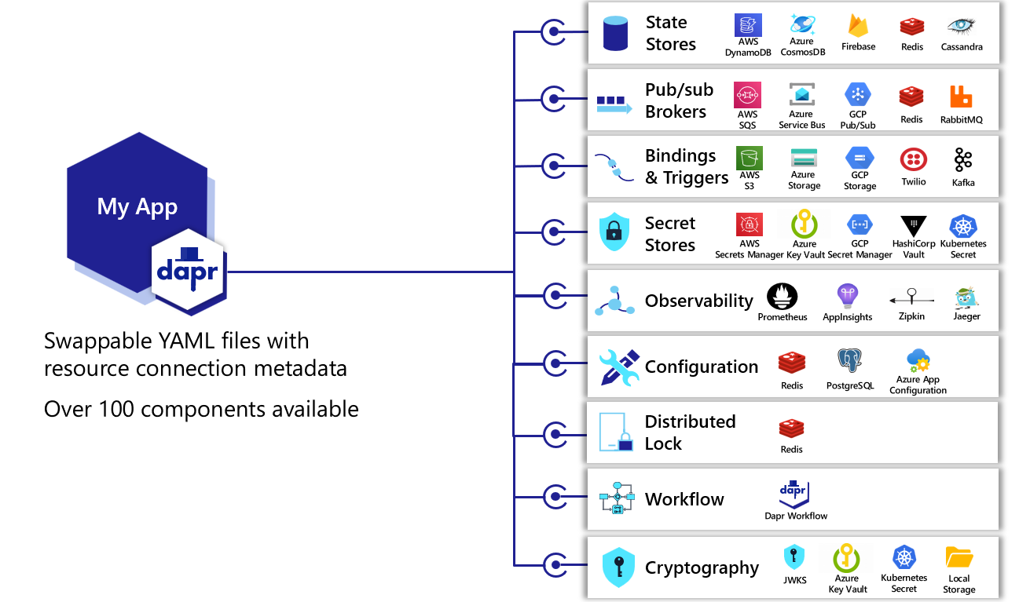
Dapr – Building blocks & supported components

Slide 24
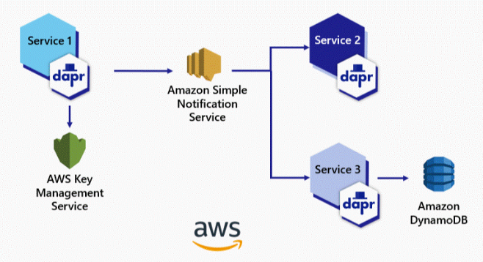
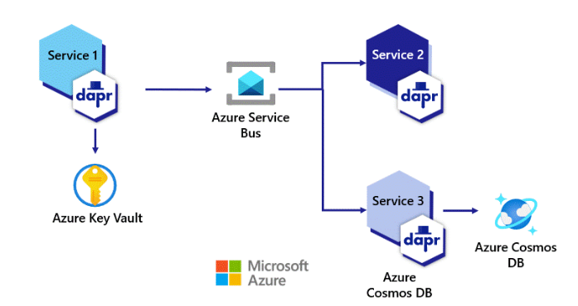
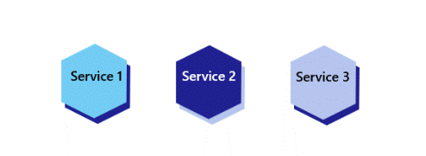
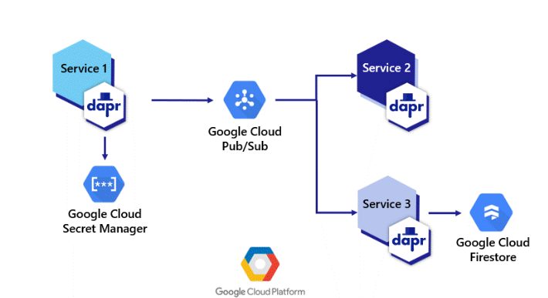
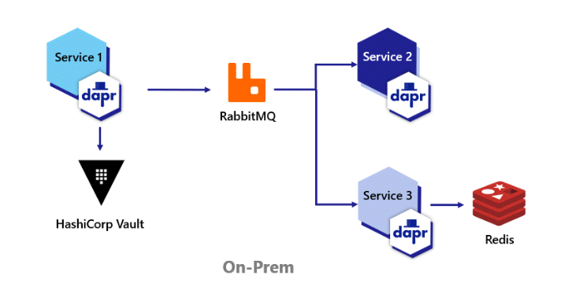
Build portable applications

Slide 25
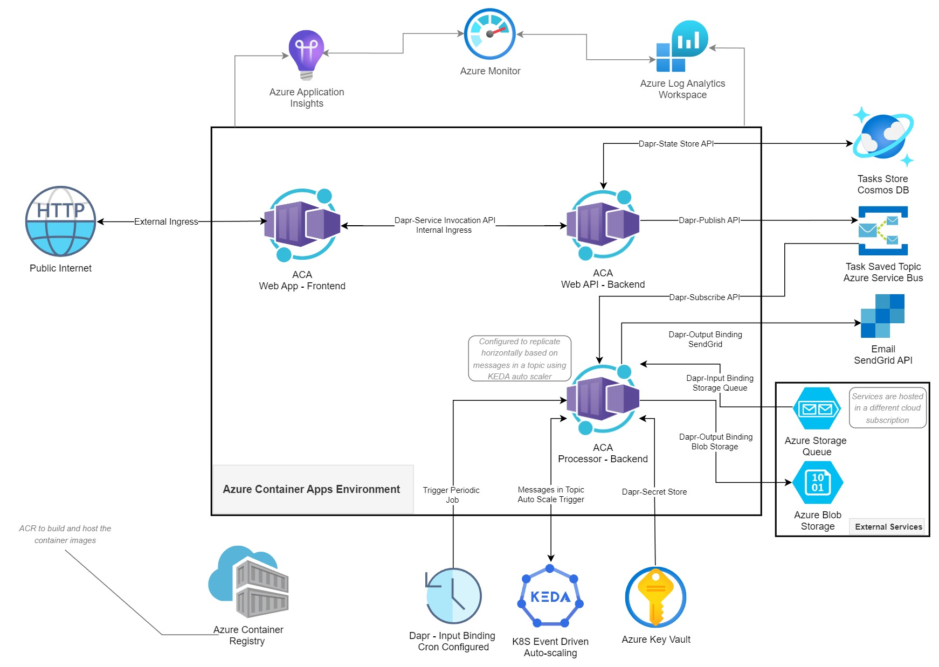
Demo App – Frontend UI ,Backend API & Backend Processor – With Dapr

Slide 26
Good links
https://github.com/dotnet-architecture/eBooks/blob/1ed30275281b9060964fcb2a4c363fe7797fe3f3/current/dapr-for-net-developers/Dapr-for-NET-Developers.pdf

Slide 27
Dapr – Running locally
Docker compose
In Docker desktop
self hosted ..no need of docker

