Slide 1
CS++
Programming Basics
Python & Processing
By David Lynch

Slide 2
Class 1 - Introduction to Python, Processing and computing in general.
What will we cover?
Brief history of computers and programming languages.
Reasons for learning python over other languages
Learning about the Python environment
Writing basic programs in Python
Learning about the Processing environment
Basic digital art in processing

Slide 3
What is computer science?
Computer science is a branch of mathematics to do with the study of computation and the design of computers.
A computer is a device which can take inputs such as instructions and data, manipulate that data, perform arithmetic operations on it and output the result.
The computers we use today take their instructions and data in the form of binary numbers.
01000011 01010011 00101011 00101011 = ‘CS++’ in binary.
Key topics in computer science include:
Algorithms & Data Structures.
Discrete mathematics
Cryptography
Many more

Slide 4
What are the parts of a computer?

Slide 5
How do computers read instructions?
Computers take their instructions in something called machine code.
01 00 02 00 4D 59 20 42 61 6C 6C 73 20 68 75 72 74 20 52 45 41 4C 20 42 41 44 21 21 21 00 00 00 01 1B 03 3B 24 00 00 00 03 00 00 00 00 F0 FF FF 58 00 00 00 20 F0 FF FF 40 00 00 00 19 F1 FF FF 80 00 00 00 00 00 00 00 14 00 00 00 00 00 00 00 01 7A 52 00 01 78 10 01 1B 0C 07 08 90 01 00 00 14 00 00 00 1C 00 00 00 D8 EF FF FF 26 00 00 00 00 44 07 10 00 00 00 00 24 00 00 00 34 00 00 00 A0 EF FF FF 20 00 00 00 00 0E 10 46 0E 18 4A 0F 0B 77 08 80 00 3F 1A 3B 2A 33 24 22 00 00 00 00 1C 00 00 00 5C 00 00 00 91 F0 FF FF 1F 00 00 00 00 41 0E 10 86 02 43 0D 06 5A 0C 07 08
Machine Code is super tough to write so we invented programming languages!

Slide 6
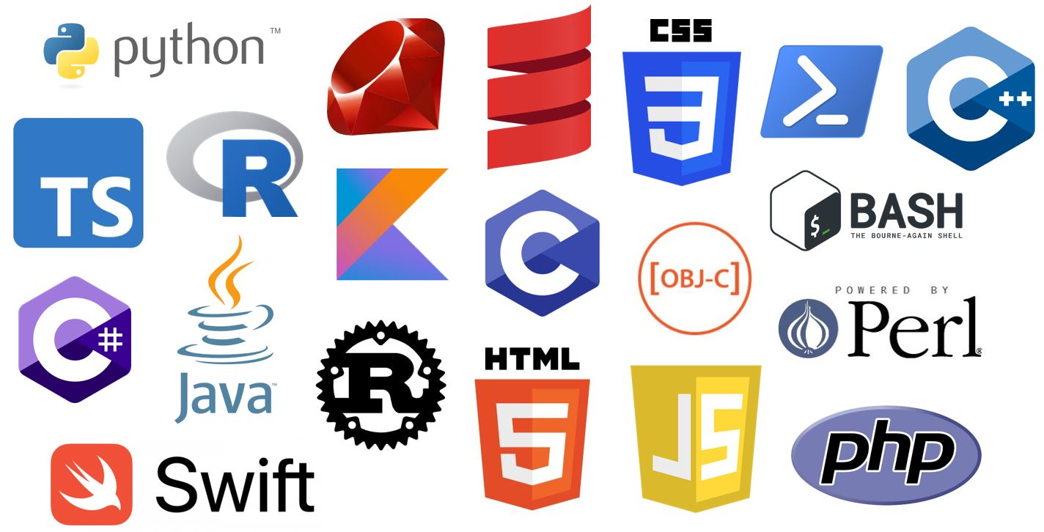
Programming Languages
Programming Languages convert human readable code into machine code. Through special software such as compilers and interpreters.
The first programming language was Assembly language, but thousands more have been made ever since.
A few of the most popular languages:

Slide 7

Python
Let’s get to the good stuff!

Slide 8
What is Python?
Python is a high level, general purpose programming language.
It was invented in 1991 by Guido Van Rossum.
It’s secured it’s place as one of the most popular programming language.
It was designed with the intention of making programming easy for beginners and experts alike.

Slide 9
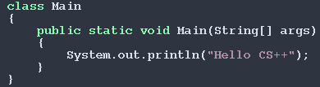
Why Python?
Less code more results
Simple syntax
Flexible
Weak and dynamic type system.
Hello CS++ program in Java and Python respectively

Slide 10
Basic Python functions.
print() - Print will write some text to the screen.
e.g
print(“Hello world”)
print(“Hello”, “World”)
input() - Input will take text typed from the keyboard and write it to a variable.
e.g
input(“Please enter your name”)
input(“What age are you?”)

Slide 11
Escape Characters
Escape characters are special characters which allow us to format text we’re printing to the screen. We can think of these as simulating pressing keys like enter etc.
‘\n’ - The newline character. Gives the same effect as pressing enter/return.
‘\t’ - The tab character Gives the same effect as pressing tab.

Slide 12
LESS TALKING MORE CODING!
Let’s get to it!

Slide 13
Some basic exercises
Print “Hello CS++” to the screen.
Print “Hello I love” and “PROGRAMMING” on two separate lines using the same print statement.
Take an input which prompts “Hello, how are you?”
Take an input which prompts “Hello, what is your name?” and print “Nice to meet you [name]” with the same print statement.

Slide 14

Processing
Time to get artistic!

Slide 15
What is processing?
Processing is a tool used for creating digital art using code!
It has support for both 2D and 3D graphics!
It was originally written with Java programmers in mind but has a Python mode.
We will be using the Python mode.

Slide 16
The Processing Environment
Processing has some special keywords and functions we need to go over before we get started.
size(w,h) : The size function tells processing what size to make the window where we will draw our graphics.
settings() : Settings is a function called by processing before it runs the sketch. We use this to set things like the size of the screen.
setup() : Setup is called once, as soon as the sketch starts.
draw() : Draw is called 60 times per second by processing and it’s where we’re going to put the majority of our code!

Slide 17
Environment Variables
Processing has many built in environment variables that describe different things about our program as it’s running.
width : this is the width of our sketch in pixels
height : the height of our sketch in pixels
frameCount : the amount of frames we have drawn since we started the sketch
mouseX : the x coordinate of the mouse on the screen
mouseY : the y coordinate of the mouse on the screen
We will look more into these later on when we start doing more complicated stuff.

Slide 18
How we actually draw stuff!
Processing has a bunch of built in functions that let us describe shapes and colours easily.
2D primitives:
square(x, y, w) -> x : x coordinate | y : y coordinate | w : width of each side
rect(x, y, w, h) -> x : x coordinate | y : y coordinate | w, h : width and height
triangle(x1, y1, x2, y2, x3, y3) -> x_{n},y_{n} : coordinates of nth point
circle(x, y, r) -> x : x coordinate | y : y coordinate | r : diameter
ellipse(x, y, w, h) -> x : x coordinate | y : y coordinate | w, h : width and height

Slide 19
Let’s get colouring!
fill(c1, c2, c3) - Fill will colour all the shapes below it unless there is another call to fill or noFill() is called. | -> c1 : colour 1, c2 : colour 2, c3 : colour 3
noFill() : Will make all shapes below it the same colour as the background
stroke(c1, c2 , c3) - Stroke will make the outlines of all the shapes below it unless there is another call to stroke or noStroke()
colorMode() - This function allows us to switch between colouring things in using the RGB colour system or the HSB colour system.

Slide 20
Some artistic prompts
REQUIREMENTS
Sketch should be 500 x 500px
SKETCHES
Make a screen with a black background.
Add a red square to the screen in the top left corner.
Add a green circle to the top right corner.
Add a blue triangle to the bottom left corner.
Add a white ellipse to the bottom right corner

Slide 21
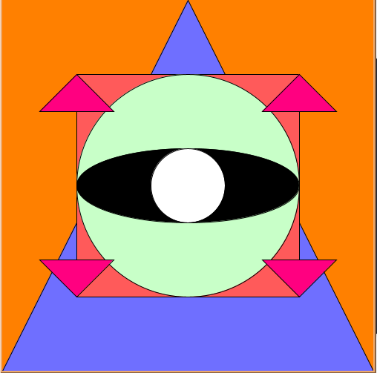
Let’s recreate this image!

