Slide 1
CS++
Creative Coding
Class
By David Lynch 2022

Slide 2
What we covered last week
Python
Conditional looping.
Lists.
Parsing instructions to our own little interpreter.
Processing
Brief Recap of the environment
Recap of shapes, colouring and input.

Slide 3
What we will cover this week.
Python
What functions are.
How functions are implemented in Python.
Defining our own functions.
Processing
More processing functions to do cool math and art.
Implementing functions in our sketches.

Slide 4
What is a function?
If you recall, a variable is a symbolic representation of data.
Similar to variables, a function is a symbolic representation of instructions.
We can use functions to store parts of our programs and call upon them when we wish.
Examples of functions are print(), input() etc.

Slide 5
How do we call functions?
We call functions by typing the name of the function and then adding a ().
E.g exit(), sayHi()
If our functions take arguments then we will add the arguments in the brackets.
E.g print(“Hello World”), background(111,111,255)

Slide 6
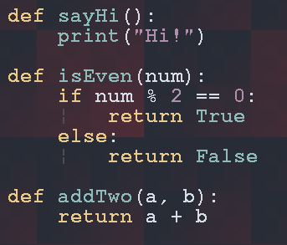
How do we define our own functions?
In Python we define our own functions. With this structure.
def [function name]([function arguments]):
function body
Examples :

Slide 7
The return keyword.
Return is a special control flow operator which tells Python to exit from the function that is currently executing.
The primary use of return is to return a value from the function to somewhere outside of it.
For example the function input() returns a string.

Slide 8

Type hinting in Python
Since Python is dynamically and weakly typed it means we can re-assign variables with data that isn’t it’s original type.
If we include functions into this type system it means that we can pass variables of any type into functions and return any type of data from a function too.
NOTE: Python will not enforce these type hints, it’s just for documentation.

Slide 9
Functions are first class data types!
Python treats functions as any other data type meaning that it has all the flexibility of other data types. This means that we can re-assign functions to be other data or assign variables to be functions.
This gives us a lot of cool ways to use functions in our Python programs!

Slide 10
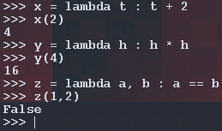
Lambda Expressions λ
Lambda expressions allow us to define anonymous functions.
What do we mean by anonymous functions? Anonymous can mean something doesn’t have a name.
We define lambda expressions with the following syntax:
lambda [args] : expression
Note that there’s no return statement,
this is because lambda expressions evaluate the statement and automatically return the value.

Slide 11
Some Functional Problems!
Define a function which prints “Hello, CS++”
Make it so you can pass a string to the function and it will print that string.
Define a function which lets you add two numbers together.
Add an extra argument to the function so that the programmer can choose the operation
The operation should be passed as a string eg: ‘+’
Write a function where you take a list and a number as an argument. Return True or False if the number is in said list.
Write a function for each math operation (+, -, *, /, **, //, %) where it will perform these operations on two numbers. Add all these functions to a list and then use a for loop to call them all. You can use lambda expressions for this problem.

Slide 12
It’s processing time!
We’re gonna go through previous material we didn’t get to cover last week!

