Slide 1
CS++
Creative Coding Class
By David Lynch 2022

Slide 2
What we covered last week?
PYTHON | PROCESSING
Storing Data in Variables. | Taking user input from the keyboard.
Python’s type system. | Taking input from the mouse.
Mathematical and boolean operators. | Implementing more dynamic sketches
Evaluating if/elif/else conditions in Python | Using inputs to affect our sketches

Slide 3
What we’re gonna cover this week
Python.
Conditional looping concepts.
Composite data types.
Implementing while and for loops.
The enhanced for loop.
Processing
Implementing our new ideas from Python.
More processing functions to do cool math and art.

Slide 4
Conditional looping
Conditional looping is when a program repeats a certain task while a condition is true. Conditional looping is the final step in making a computational system turing complete!
Turing Completeness: Turing completeness is when a computational system can be used to implement any algorithm.

Slide 5
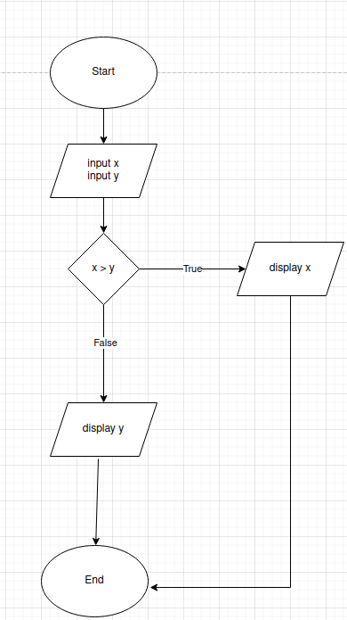
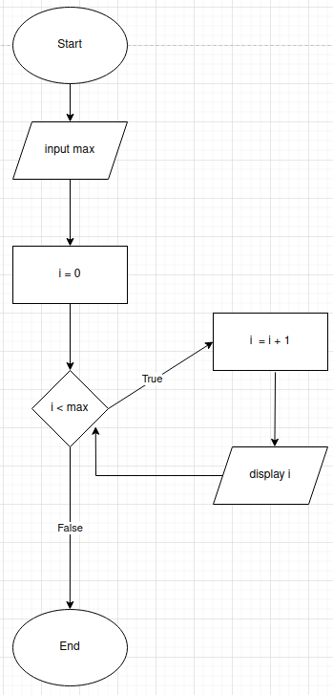
Flowcharts
if condition vs while loop

Slide 6
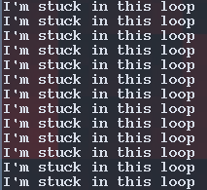
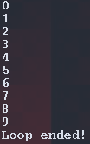

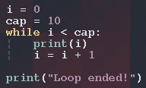
While loop
A while loop is a portion of our program we wish to repeat as long as a certain condition is true. In Python we define a while loop as follows
while [condition]:
operations to perform

Slide 7
Indentation syntax
Unlike other languages which use curly braces to denote control flow like C/++, Java etc.
Python uses indentation, meaning that any code meant to be executed by an if statement, while loop, for loop or function has to be indented relative to it.
Most editors will automatically do this for you. It’s something to be mindful of since you can get a lot of bugs and errors without proper use of indentation.
Indentation: Blank space at the beginning of a line

Slide 8
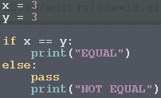
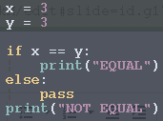
Indentation example
OUTPUT:
EQUAL
Proper indentation
vs
Improper indentation
OUTPUT:
EQUAL
NOT EQUAL

Slide 9
The dangers of while loops and how to counter them.
While loops can be dangerous since we can easily get caught in infinite loops.
An Infinite Loop is when a segment of code will run on repeat forever.
This occurs because the condition the while loop is checking always evaluates to True.
The only way an infinite loop can be stopped is if you kill the program or turn off your computer!
Another way is to use the break keyword
break : This is a special keyword in python which will force your program to exit the loop.

Slide 10

Safer looping using FOR loops
For loops are more controlled than while loops since they have a predefined start and end to it.
for loops and while loops are identical under the hood since they both involve conditional looping. For loops come with more features which are good for code safety and readability.
SYNTAX :
for item in range(start,end):
#loop body
0
1
2
3
4

Slide 11
Composite Data Types: Lists
Lists are a way of structuring our data in a contiguous format.
They allow us to store multiple items in a single variable.
We can define lists using square brackets and each element is separated using commas.
Lists are ordered, changeable and they allow duplicates.
EXAMPLE :
list_1 = [1, 2, 3, 4, 5]
list_2 = [“Hello”, “I”, “Like”, “Burgers”]

Slide 12
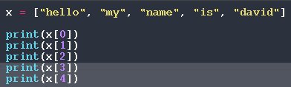
Accessing elements of a list
Lists are indexed so their elements can be accessed by using a number.
It’s important to note that the indices of the list start with 0.
EXAMPLE of list accessing:
hello
my
name
is
david

Slide 13
Split: An in intro to string methods.
Split is a method that allows us to break strings into a list of strings using a special delimiter.
If we call the method without any arguments the default delimiter is space. If we pass a string argument it will be used as the delimiter
“hello my name is David”.split() => [“hello”,”my , ”name”,”is”,”David”]
“Burgers\are\yummy”.split(‘\’) => [“Burgers”,”are”,”yummy”]

Slide 14
Loopy and Listy Problems
Print all the numbers between 0 and 10
Using input, ask the user what their favourite food is and only exit if it’s “burgers”
Hint: You’ll need the break keyword
Find how many prime numbers there are between 0 and 100
Hint: You’ll need 2 loops to solve this.
Given the array [0, 11, 15, 67, 22, 54 ]. Square all the values in the array and THEN print the array.
Given the string “CS++ is very cool!” split it and print all the elements of the list
Write a parser which can perform operations on a list of 4 number using the format [instruction][value] (WE WILL DO THIS TOGETHER IN CLASS)
‘i’ increments a value
‘d’ decrements a value
‘s’ squares a value
‘o’ outputs all values
Sample program : “i1 i2 i3 i4 d2 s3 o”

Slide 15
Processing math functions
dist(x1,y1,x2,y2) : Returns the distance between points (x1,y1) and (x2, y2)
sin(theta) : Takes the angle theta in radians and returns the sine of that angle.
cos(theta) : Takes the angle theta in radians and returns the cosine of that angle.
radians(theta) : Converts the angle theta from degrees to radians.
degrees(theta) : Converts the angle theta from radians to degrees.
map(value, start1, stop1, start2, stop2) : Maps the value from range(start1, stop1) to range(start2,stop2)

Slide 16


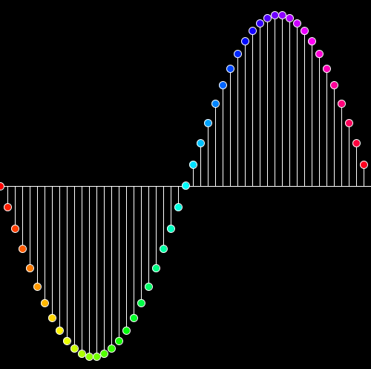
Let’s re-create some images!

