Slide 1
Mathematics for Computer Science B: Analysis
Lecture 1
2024/25 sophie.stevens@bristol.ac.uk

Slide 2
What’s in this section of the course
Differentiation
Partial differentiation
Solving differential equations
Optimisation
Taylor series and numerical solutions
Complex numbers and modular arithmetic

Slide 3
I expect that you’ve already seen…
Differentiation (with one variable)
Integration
Taylor series (?)

Slide 4
Applications of calculus in Computer Science
Activity: Where do you think you’ll use this section of the course throughout your degree?

Slide 5
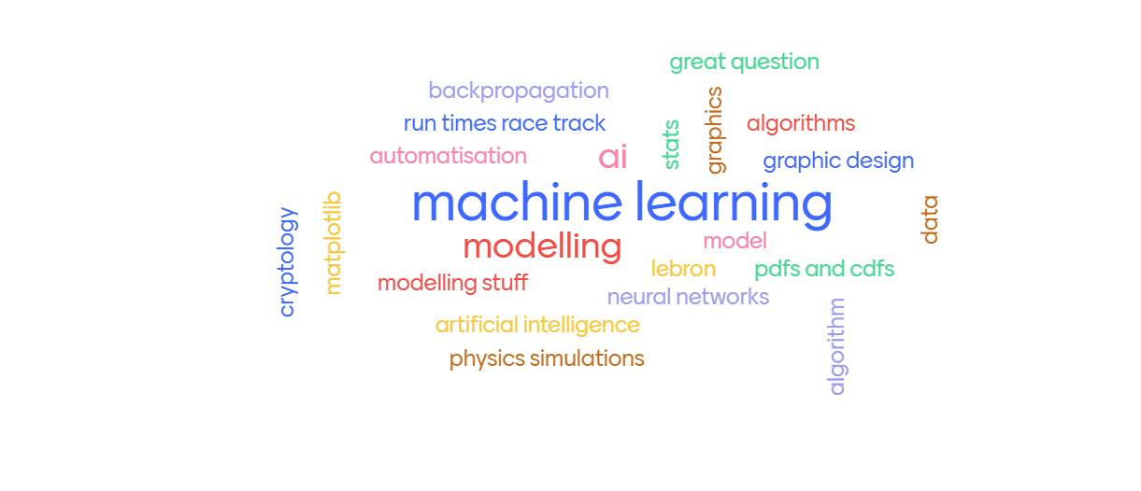
Applications of calculus in Computer Science
https://www.menti.cm/alxsnfjw66m1

Slide 6
Board work: differentiation
In which we derive the formula for the derivative

Slide 7

Rules for differentiation
Sums:
$$\frac{d}{dx}\left[f(x) + g(x)\right] = \frac{d}{dx}f(x) + \frac{d}{dx}g(x)$$
Multiplication by a constant:
$$\frac{d}{dx}\left[cf(x)\right] =c\frac{d}{dx}f\left(x\right)$$
Products : $\frac{d}{dx}f(x)g(x)=f(x)\frac{d}{dx}g(x) + g\left(x\right)\frac{d}{dx}f(x)$

Slide 8

Derivatives of common functions
Polynomials:
$$\frac{d}{dx}x^{n}=nx^{n−1}$$
Trigonometric functions:
$$\frac{d}{dx}\sin\left(x\right)=\cos\left(x\right)$$
Exponential function:
$$\frac{d}{dx}e^{x}=e^{x}$$
Logarithmic function:
$$\frac{d}{dx}\ln\left(x\right)=\frac{1}{x}$$

Slide 9

The Chain Rule
If $y=f(u)$ and $u=g(x)$ then
$$\frac{dy}{dx}=\frac{dy}{du} \frac{dg}{dx}$$
Example: [board]

Slide 10

Notation
Leibniz : $\frac{dy}{dx}$
Lagrange: $y′(x)$
Newton: $\dot{y}(x)$

Slide 11

Notation: differentiate at a point
Leibniz : $\frac{dy}{dx}|_{x=a}$
Lagrange: $y′(a)$
Newton: $\dot{y}(a)$

Slide 12
Summary
Differentiation from infinitesimals perspective
Rules for differentiation…
… especially the Chain Rule
Derivatives of common functions

