Slide 1
Mathematics for Computer Science B: Analysis
Lecture 2
2024/25 sophie.stevens@bristol.ac.uk

Slide 2
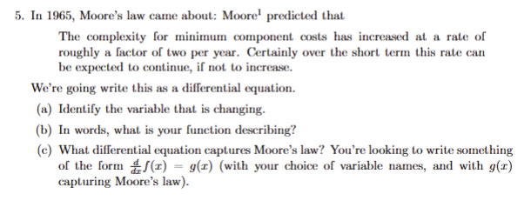

Workshop 1 summary:
$$\frac{d}{dt}C\left(t\right)=C(t−1)$$

Slide 3

Workshop 1 summary:
$log\left(x\right)=\ln\left(x\right)$ for Extra Question 1
Show that $\frac{d}{dx}log\left(x\right)=\frac{1}{x}$
$e^{\ln\left(x\right)}=\ln\left(e^{x}\right)=x$
Use the chain rule to differentiate both sides

Slide 4
Today we’ll look at
Maxima and minima
Multivariate differentiation
Gradient operator
Hessian matrix

Slide 5
Maxima and minima
A gradient is either increasing or decreasing or constant
Unless it’s constant everywhere, if the gradient is constant then it’s just finished increasing or decreasing. The graph could (locally) look like:
Local maximum Local minimum

Slide 6
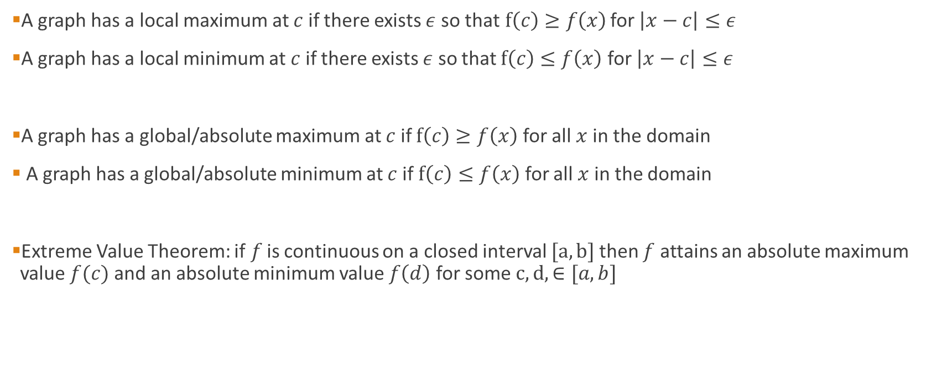
Maxima and minima
A graph has a local maximum at $c$ if there exists $ε$ so that$f\left(c\right)≥f\left(x\right)$ for $\left|x−c\right|≤ε$
A graph has a local minimum at $c$ if there exists $ε$ so that $f\left(c\right)≤f\left(x\right)$ for $\left|x−c\right|≤ε$
A graph has a global/absolute maximum at $c$ if $f\left(c\right)≥f\left(x\right)$ for all $x$in the domain
A graph has a global/absolute minimum at $c$ if $f\left(c\right)≤f\left(x\right)$ for all $x$ in the domain
Extreme Value Theorem: if$f$is continuous on a closed interval $[a,b]$then $f$ attains an absolute maximum value $f(c)$ and an absolute minimum value $f\left(d\right)$ for some $c,d,∈[a,b]$

Slide 7
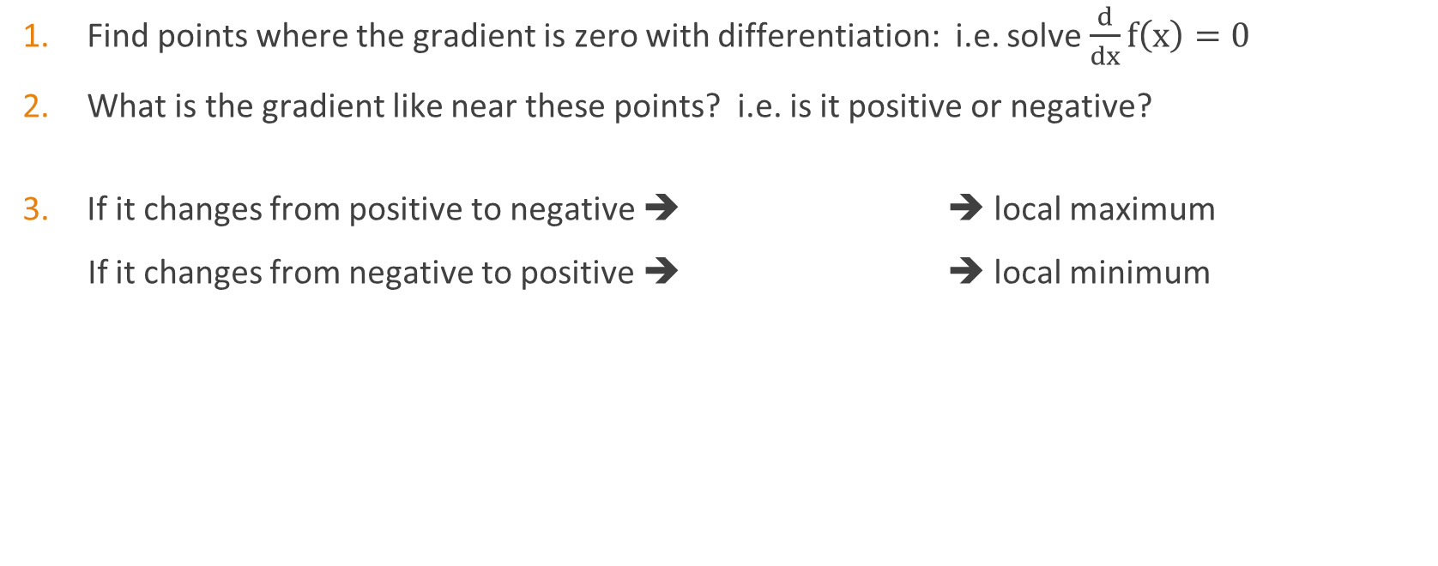
Maxima and minima with differentiation
Find points where the gradient is zero with differentiation: i.e. solve $\frac{d}{dx}f\left(x\right)=0$
What is the gradient like near these points? i.e. is it positive or negative?
If it changes from positive to negative ➔ ➔ local maximum
If it changes from negative to positive ➔ ➔ local minimum

Slide 8
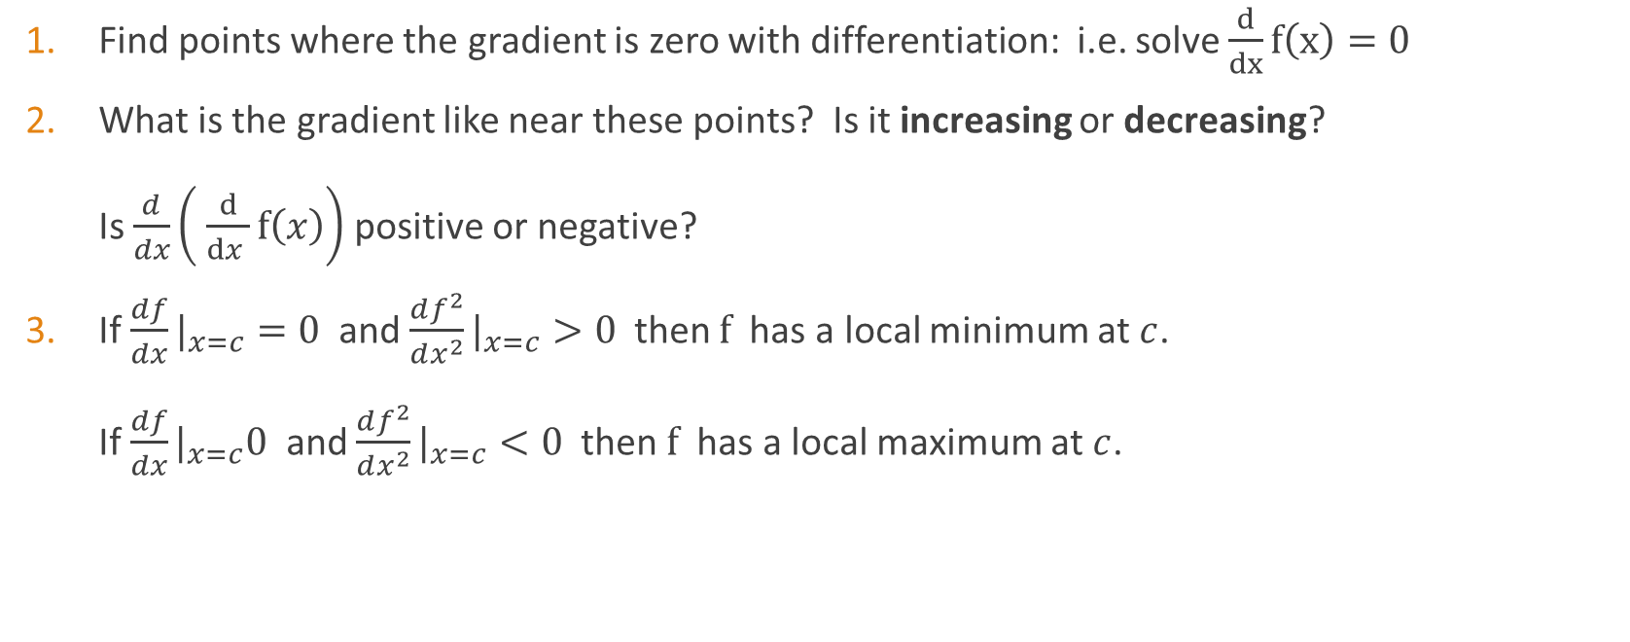
Maxima and minima with higher order differentiation
Find points where the gradient is zero with differentiation: i.e. solve $\frac{d}{dx}f\left(x\right)=0$
What is the gradient like near these points? Is it increasing or decreasing? Is $\frac{d}{dx}\left( \frac{d}{dx }f\left(x\right)\right)$positive or negative?
If$\frac{df}{dx}|_{x=c}=0$ and$\frac{df^{2}}{dx^{2}}|_{x=c}>0$then $f$has a local minimum at $c$. If $\frac{df}{dx}|_{x=c}0$ and $\frac{df^{2}}{dx^{2}}|_{x=c}<0$then $f$has a local maximum at $c$.

Slide 9
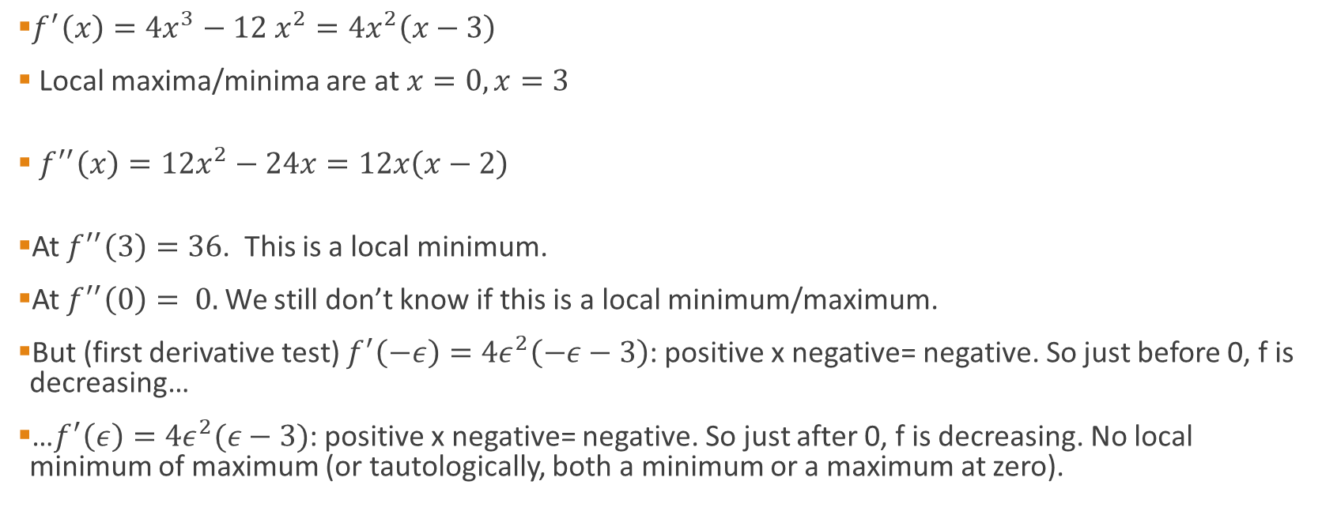

Example: $y=x^{4}−4x^{3}$
$f^{′}\left(x\right)=4x^{3}−12 x^{2}=4x^{2}\left(x−3\right)$
Local maxima/minima are at $x=0, x=3$
$f^{′′}\left(x\right)=12x^{2}−24x=12x\left(x−2\right)$
At $f^{′′}\left(3\right)=36$. This is a local minimum.
At $f^{′′}\left(0\right)= 0.$We still don’t know if this is a local minimum/maximum.
But (first derivative test) $f^{′}\left(−ε\right)=4ε^{2}\left(−ε−3\right)$: positive x negative= negative. So just before 0, f is decreasing…
…$f^{′}\left(ε\right)=4ε^{2}(ε−3)$: positive x negative= negative. So just after 0, f is decreasing. No local minimum of maximum (or tautologically, both a minimum or a maximum at zero).

Slide 10
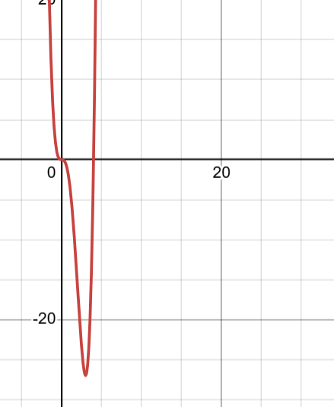
Example: $y=x^{4}−4x^{3}$

Slide 11
Multivariate differentiation

Slide 12
Multivariate differentiation
Functions of two or more variables are very common. e.g. area of a cuboid = base x width x height.
What happens if we change one of these variables at a time?
To find the rate of change with one variable, we ‘zoomed in’ until the function looked like a line.
For two variables, we’ll zoom in until the function looks like a plane. This is the tangent plane.

Slide 13
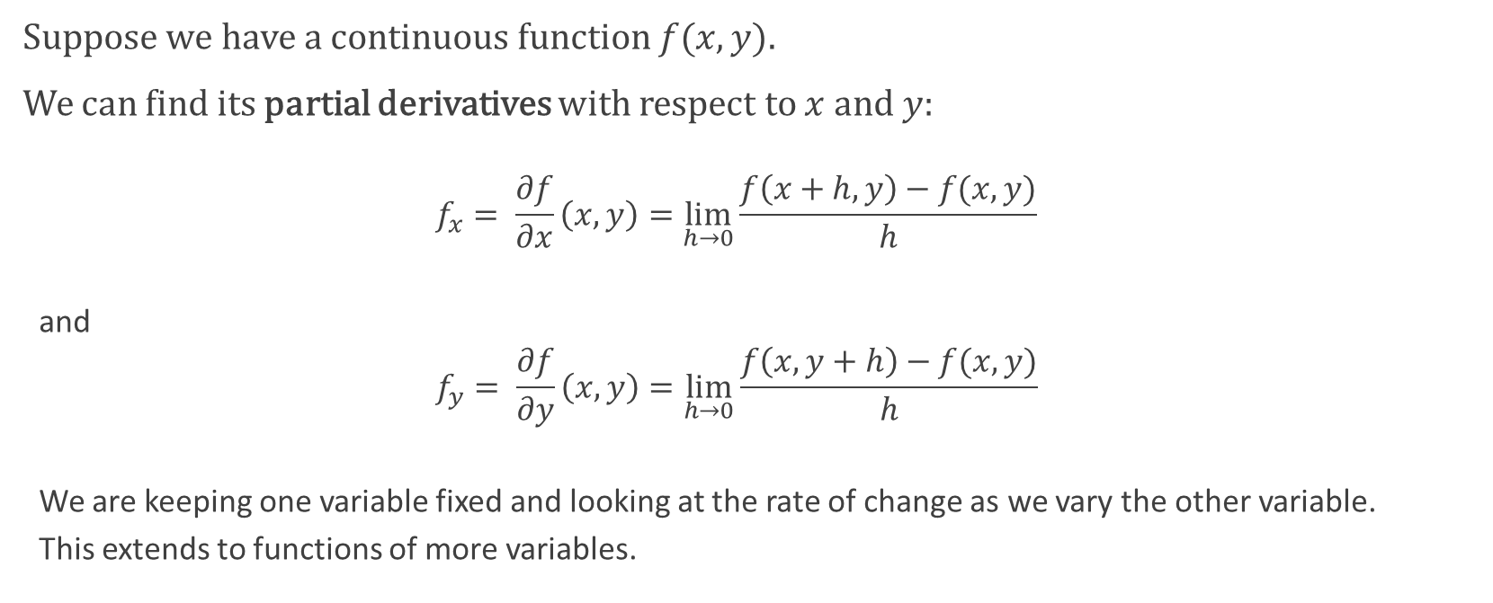
Partial derivative
Suppose we have a continuous function $f(x,y)$.
We can find its partial derivatives with respect to $x$and $y$:
$$f_{x}= \frac{∂f}{∂x}\left(x,y\right)=\lim_{h→0}\frac{f\left(x+h, y\right)−f(x,y)}{h}$$
and
$$f_{y}= \frac{∂f}{∂y}\left(x,y\right)=\lim_{h→0}\frac{f\left(x, y+h\right)−f(x,y)}{h}$$
We are keeping one variable fixed and looking at the rate of change as we vary the other variable.
This extends to functions of more variables.

Slide 14

Partial derivative example 1
$f\left(x,y\right)=x^{2}y$
$f_{x}=\lim_{h→0 }\frac{{ \left(x+h\right)}^{2}y−x^{2}y}{h}{= }$ $\lim_{h→0 }\frac{2hxy−h^{2}y}{h}{= } 2xy$
$f_{y}=\lim_{h→0 }\frac{x^{2}(y+h)−x^{2}y}{h}{= } \lim_{h→0 }\frac{x^{2}h}{h}{= } x^{2}$

Slide 15

Partial derivative example 2
$f\left(x,y\right)=\sin\left(\frac{x}{1+y} \right)$
$f_{x}=\cos\left(\frac{x}{1+y}\right)\frac{∂}{∂x}\left(\frac{x}{1+y }\right)=\cos\left(\frac{x}{1+y}\right)\frac{1}{1+y}$
$f_{y}=\cos\left(\frac{x}{1+y}\right)\frac{∂}{∂y}\left(\frac{x}{1+y }\right) =−cos\left(\frac{x}{1+y}\right)\frac{x}{{\left(1+y\right)}^{2}}$
We used the chain rule!

Slide 16
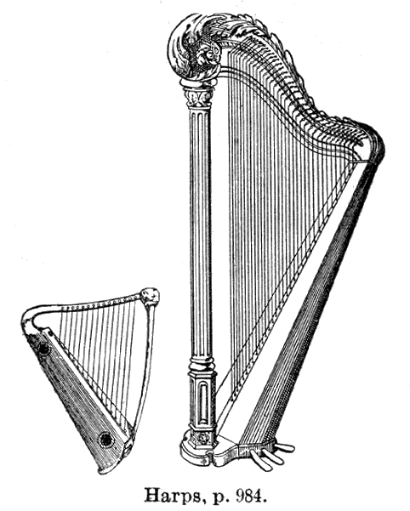
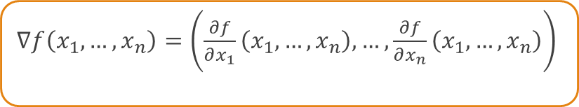

Nabla: vector of partial derivatives
$∇f\left(x_{1},…, x_{n}\right)=\left(\frac{∂f}{∂x_{1}}\left(x_{1},…,x_{n}\right),…,\frac{∂f}{∂x_{n}}\left(x_{1},…, x_{n}\right)\right)$
Example: $f\left(x,y\right)=x^{2}y$
$∇f\left(x,y\right)=\left(2xy, x^{2}\right)$
Measures how f changes in the x and y directions

Slide 17
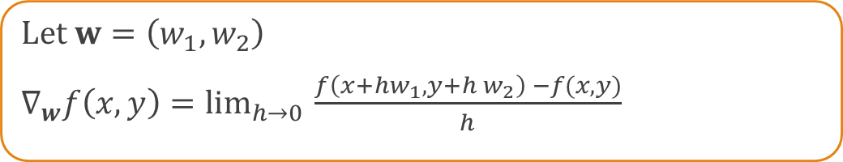
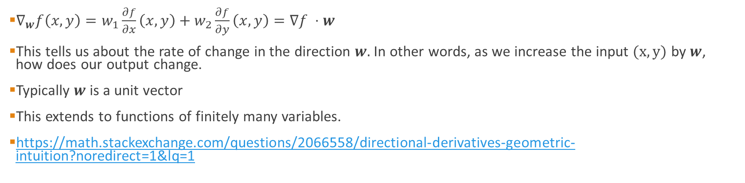
Derivative along a vector
Let $w=\left(w_{1},w_{2}\right)$
$∇_{w}f\left(x,y\right)=\lim_{h→0 }{\frac{f\left(x+hw_{1}, y+h w_{2}\right) −f(x,y)}{h}}$
$∇_{w}f\left(x,y\right)=w_{1}\frac{∂f}{∂x}\left(x,y\right)+w_{2}\frac{∂f}{∂y}\left(x,y\right)=∇f ⋅w$
This tells us about the rate of change in the direction $w.$ In other words, as we increase the input $(x,y)$ by $w$, how does our output change.
Typically $w$is a unit vector
This extends to functions of finitely many variables.
https://math.stackexchange.com/questions/2066558/directional-derivatives-geometric-intuition?noredirect=1&lq=1

Slide 18
Why do we care about the directional derivative?
If you’re walking up a hill…
If you’re optimising in one ‘direction’
Reverse application – to find the direction that’s increasing the fastest

Slide 19
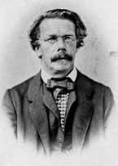
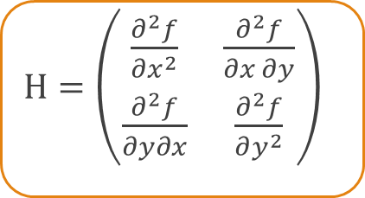
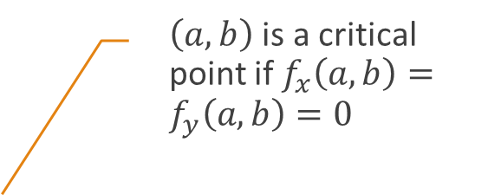
Extrema: the Hessian matrix
Is my multivariate equation increasing or decreasing?
$H=\left(\begin{matrix}\frac{∂^{2}f}{∂x^{2}} & \frac{∂^{2}f}{∂x ∂y} \\ \frac{∂^{2}f}{∂y∂x} & \frac{∂^{2}f}{∂y^{2}}\end{matrix}\right)$
$\left(a,b\right)$ is a critical point if $f_{x}\left(a,b\right)=f_{y}\left(a,b\right)=0$
The eigenvalues of the Hessian at critical points tell us if we have a maximum or minimum.
Both eigenvalues negative: maximum
Both eigenvalues positive: minimum
One positive and one negative: saddlepoint
Zero eigenvalue: ??

Slide 20
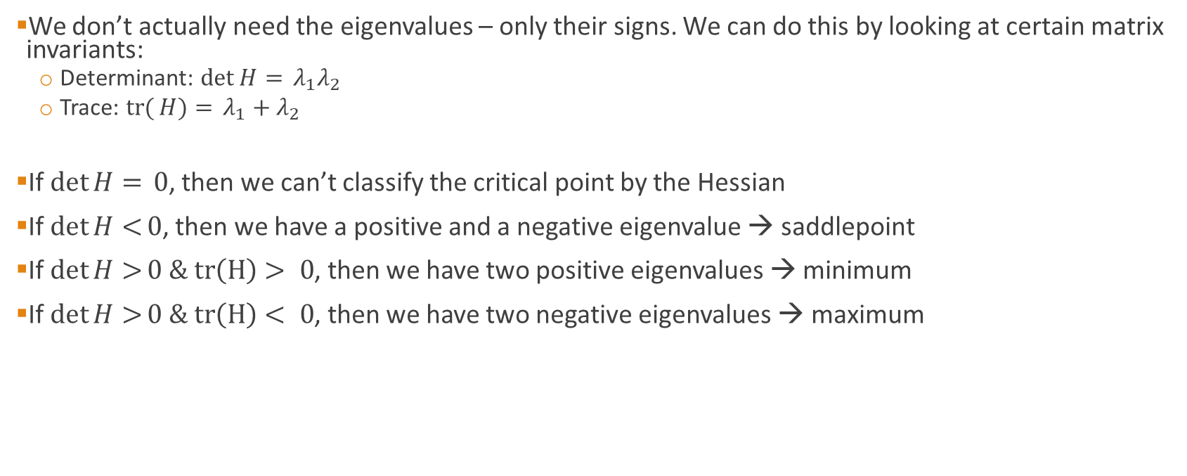
Classifying Eigenvalues
We don’t actually need the eigenvalues – only their signs. We can do this by looking at certain matrix invariants:
Determinant: $\det{H= }λ_{1}λ_{2}$
Trace: $tr({H)= }λ_{1}+λ_{2}$
If $\det{H= }0$, then we can’t classify the critical point by the Hessian
If $\det{H<}0$, then we have a positive and a negative eigenvalue → saddlepoint
If$\det{H>}0 \& tr\left(H\right)> 0$, then we have two positive eigenvalues → minimum
If$\det{H>}0 \& tr\left(H\right)< 0$, then we have two negative eigenvalues → maximum

Slide 21

Example on board
$f\left(x,y\right)=x^{3}+x^{2}y −y^{2}−4y$

Slide 22
Summary
Maxima and minima via derivatives
Partial derivatives
Nabla and directional derivative
Hessian matrix
Hessian matrix eigenvalues: tricks

Slide 23
Feedback
Stop:
Start:
Continue:

