Slide 1
3. Differential equations
Lecture 3
2024/25 sophie.stevens@bristol.ac.uk

Slide 2
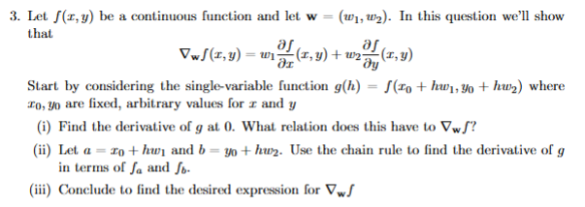
Workshop 2 summary:

Slide 3
What we’ll cover today:
Solving differential equations
Classification of ODEs
First order linear homogeneous ODEs
First order linear inhomogeneous ODEs
Second order linear homogeneous ODEs
(Second order linear inhomogeneous ODEs)

Slide 4

Solving a differential equation by direct integration
Example 1:
$\frac{df}{dt}=t^{2}+2$ and $f\left(0\right)=5$
Example 2:
$\frac{df}{dt}=2f$
[on board]

Slide 5
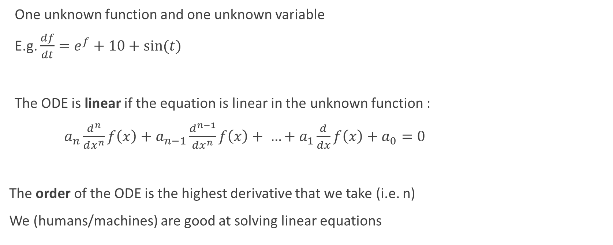
Ordinary Differential Equations (ODEs)
One unknown function and one unknown variable
E.g. $\frac{df}{dt}=e^{f}+10+\sin{(t)}$
The ODE is linear if the equation is linear in the unknown function :
$a_{n}\frac{d^{n}}{dx^{n}}f\left(x\right)+a_{n−1}\frac{d^{n−1}}{dx^{n}}f\left(x\right)+ …+a_{1}\frac{d}{dx}f\left(x\right)+a_{0}=0$
The order of the ODE is the highest derivative that we take (i.e. n)
We (humans/machines) are good at solving linear equations

Slide 6

Classification Examples
$f′(t)=e^{f}+10+\sin{(t)}$
$f_{x}(x, t)={xe}^{f\left(x,t\right)}+10x^{3}+\sin{(t)}$
$f^{′}\left(t\right)=20f^{′′}\left(t\right)+f$
$f′′(t)=f\left(t\right)f′(t)$
ODE; non-linear, 1st order
Not an ODE
ODE; linear; 2nd order
ODE; non-linear, 2nd order

Slide 7

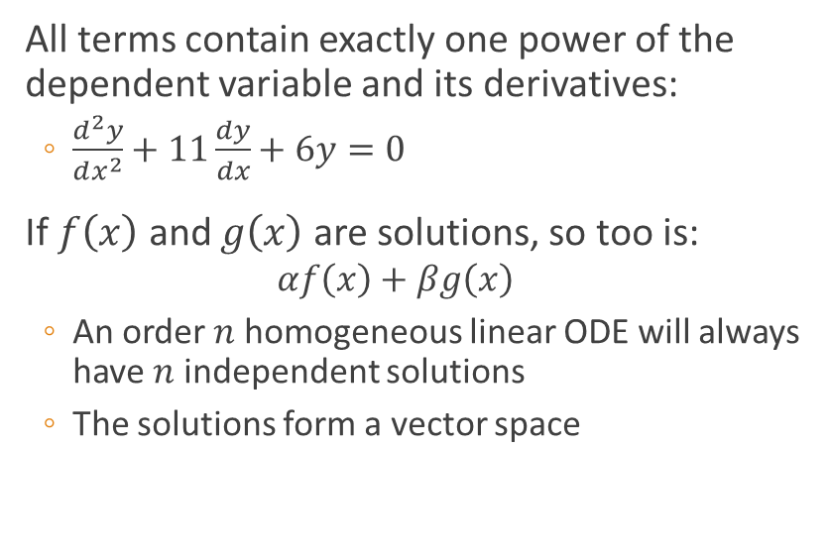
Types of linear ODE
Homogeneous
Inhomogeneous
All terms contain exactly one power of the dependent variable and its derivatives:
$\frac{d^{2}y}{dx^{2}}+11\frac{dy}{dx}+6y=0$
If $f\left(x\right)$ and $g\left(x\right)$ are solutions, so too is:
$$αf\left(x\right)+βg\left(x\right)$$
An order $n$ homogeneous linear ODE will always have $n$ independent solutions
The solutions form a vector space
The right hand is not 0:
E.g. $\frac{dy}{dx}$ + 5 y = 6t

Slide 8

Solving first order homogeneous equations
$y′\left(x\right)+A\left(x\right) y\left(x\right)=0$
Direct integration
Using an Ansatz : typically a good guess is $ce^{rx}$
Example: [board]

Slide 9
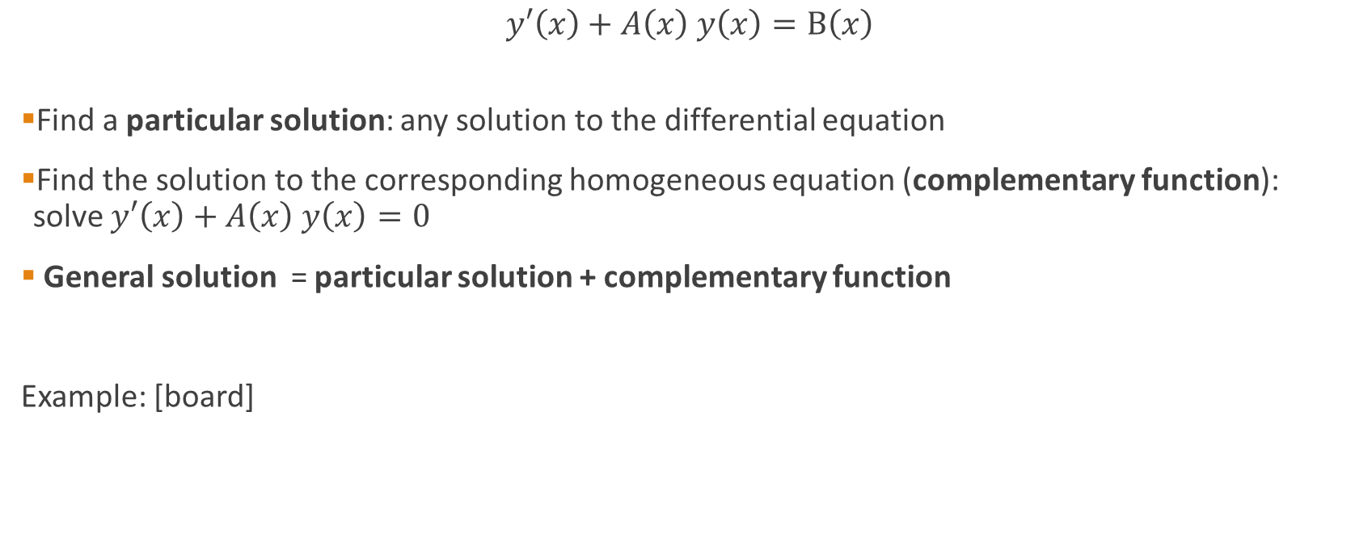
Solving first order inhomogeneous equations
$y′\left(x\right)+A\left(x\right) y\left(x\right)=B\left(x\right)$
Find a particular solution: any solution to the differential equation
Find the solution to the corresponding homogeneous equation (complementary function): solve $y′\left(x\right)+A\left(x\right) y\left(x\right)=0$
General solution = particular solution + complementary function
Example: [board]

Slide 10

Solving second order homogeneous equations
$y^{′′}\left(x\right)+A\left(x\right)y^{′}\left(x\right)+B\left(x\right)y\left(x\right)=0$
Let’s assume $A\left(x\right)$and $B\left(x\right)$ are constants
Ansatz 1: try $y=ae^{rx}$
Ansatz 2: try $y=a_{1}e^{r_{1}x}+a_{2}e^{r_{2}x}$
Example: [board]

Slide 11
Summary
Direct integration sometimes works
Classification of ODEs (order, linear, homogeneous, inhomogeneous)
First order linear homogeneous ODEs (via Direct Integration or Ansatz)
First order linear inhomogeneous ODEs (solution = particular solution + complementary function)
Second order linear homogeneous ODEs

