Slide 1
5. Approximating functions and the Taylor series
Lecture 5
2024/25 sophie.stevens@bristol.ac.uk

Slide 2
Workshop 4 summary:
Both algorithms…
In real life…
Aim to find the minimum of a function
Are iterative and (hopefully) converse to a minimum
Require a stopping condition
Are inexact
Can get stuck in local minima
Can equally well find the maximum
Used in machine learning and neural networks
“Cost function” optimised by Gradient Descent
Nelder-Mead then Gradient Descent is often a good strategy

Slide 3
What we’ll cover today:
Linear Approximations of functions
Approximating roots (Newton’s method)
Approximating functions (Taylor series)

Slide 4
Linear approximation

Slide 5
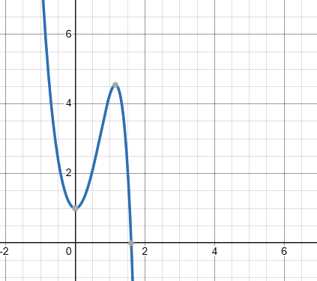
Linear Approximation of a function

Slide 6

Linear approximation of a function
Linear approximation of $f$ at $x=a$:
$$L\left(x\right)=f\left(a\right)+f′(a)(x−a)$$
This is related to the gradient/tangent:
$$f^{′}\left(a\right)=\frac{f\left(x\right) −f(a)}{x−a}$$

Slide 7
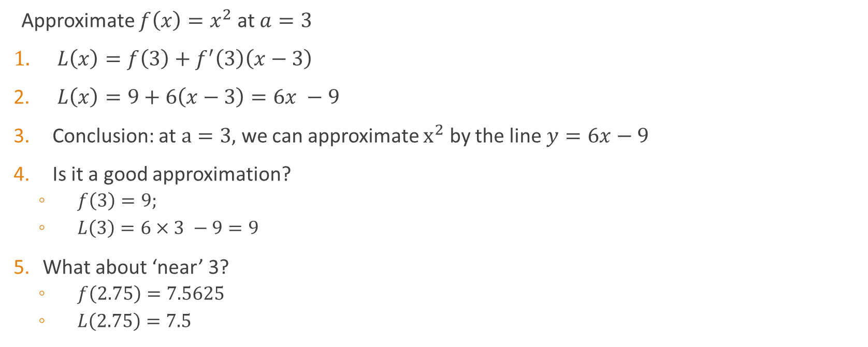
Example
Approximate $f\left(x\right)=x^{2}$ at $a=3$
$L\left(x\right)=f\left(3\right)+f^{′}\left(3\right)\left(x−3\right)$
$L\left(x\right)=9+6\left(x−3\right)=6x −9$
Conclusion: at $a=3,$we can approximate $x^{2}$ by the line $y=6x−9$
Is it a good approximation?
$f\left(3\right)=9;$
$L\left(3\right)=6×3 −9=9$
What about ‘near’ 3?
$f\left(2.75\right)=7.5625$
$L\left(2.75\right)=7.5$

Slide 8
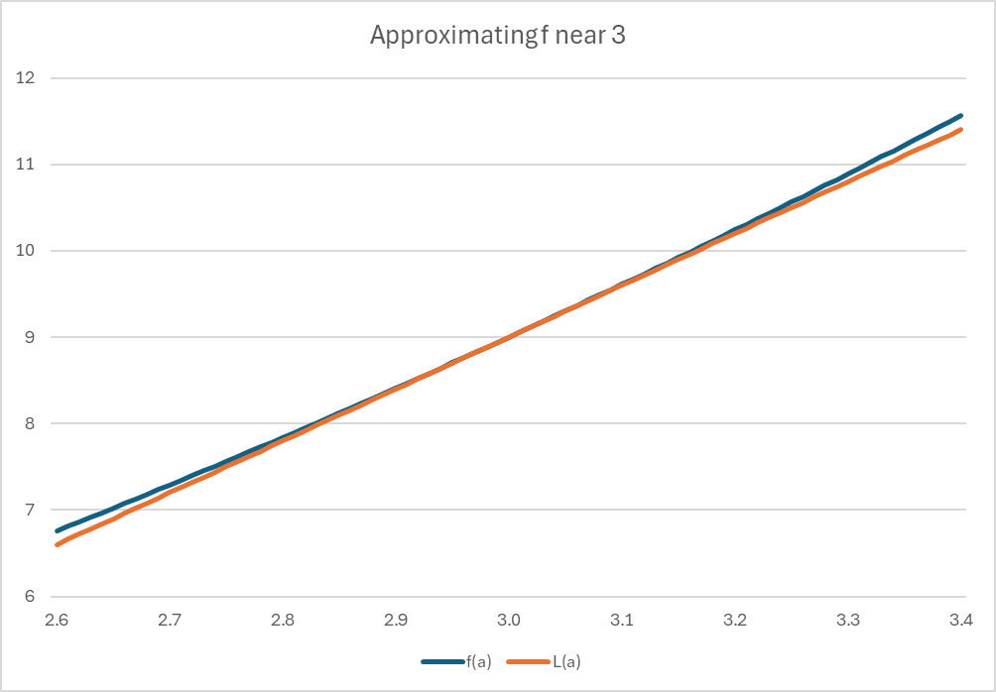
Example cont.

Slide 9
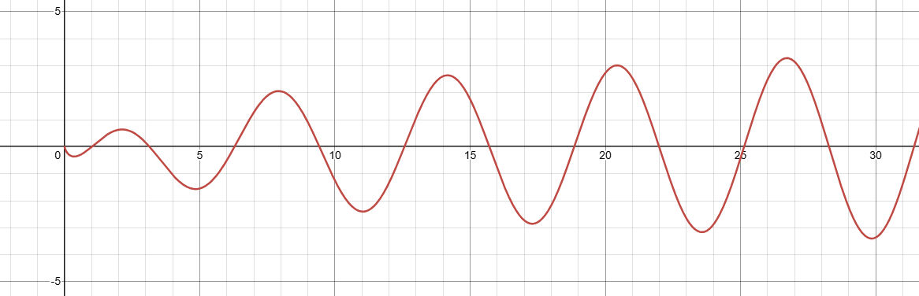

A more complicated example
Approximate $f\left(x\right)=\sin\left(x\right)\ln\left(x\right)$ at $a=3$
$f^{′}\left(x\right)=\cos\left(x\right)\ln\left(x\right)+\frac{\sin\left(x\right)}{x}$
$L\left(x\right)=f\left(3\right)+f^{′}\left(3\right)\left(x−3\right)=$ $0.155 – 1.04\left(x−3\right)$
$L\left(x\right)= 3.28 – 1.04x$

Slide 10
Example cont.

Slide 11
Newton’s method
Numerical root finding

Slide 12
Can we find a root of this function?

Slide 13


Approximating roots of $f(x)$ (Newton’s method)
$$x_{n+1}=x_{n}−\frac{f(x_{n})}{f′(x_{n})}$$
Example: $f\left(x\right)=x^{2}−1$
$x_{0}=5$
$x_{1}=5 −\frac{25−1}{2×5}$ = 2.6
Etc.
CODE:
x = 5
for _ in range(10):
x = x-(x**2-1)/(2*x)
print(x)

Slide 14

Why does Newton’s method work?
We’d like to find $x_{1}.$ We have $x_{0}$.
The linear approximation of $f$ at $x_{0}$ is:
$$L\left(x_{1}\right)=f\left(x_{0}\right)+f′(x_{0})(x_{1}−x_{0})$$
We want a root of $f$, so we set LHS to 0:
$$0= f\left(x_{0}\right)+f′(x_{0})(x_{1}−x_{0})$$
Now we rearrange to get:
$$x_{1}=x_{0}−\frac{f\left(x_{0}\right)}{f^{′}\left(x_{0}\right)}$$

Slide 15



Newton’s method geometrically
$$x_{1}$$
$$x_{2}$$
$$x_{0}$$

Slide 16
Taylor series
Higher order approximations of functions

Slide 17


A dilemma
I really want to know what $e^{7}$ is, but I’ve forgotten the value of $e$
Our dilemma generalised: We’d like to understand how a function behaves, but the function difficult to calculate/analyse
Pic: https://santecares.com/2019/08/30/infographic-understanding-the-stages-of-memory-loss/

Slide 18

A solution!
We’ll approximate our function by a polynomial!
Remember a polynomial (of degree $t$) looks like:
$$a_{0}+a_{1}x+a_{2}x^{2}+ …+a_{t}x^{t}$$
Polynomials are quick to compute and easy to analyse
Our goal: make our function look like a polynomial

Slide 19

Taylor series expansion
Goal: Approximate $f(x)$ at the point $x=a$ by a polynomial $g(x)$
$$g\left(x\right)=c_{0}+\left(x−a\right)c_{1}+{\left(x−a\right)}^{2}c_{2}+ …+{\left(x−a\right)}^{M}c_{M}$$
We know that $f\left(x\right)$ is differentiable at $x=a.$
We need to find the coefficients $c_{i}$ so that $f\left(a\right)≈g(a)$

Slide 20
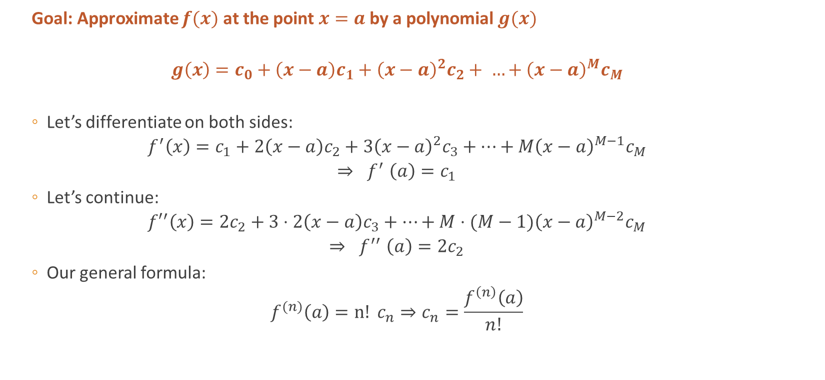
Taylor series expansion
Goal: Approximate $f(x)$ at the point $x=a$ by a polynomial $g(x)$
$$g\left(x\right)=c_{0}+\left(x−a\right)c_{1}+{\left(x−a\right)}^{2}c_{2}+ …+{\left(x−a\right)}^{M}c_{M}$$
Let’s differentiate on both sides:
$$f^{′}\left(x\right)=c_{1}+2\left(x−a\right)c_{2}+3{\left(x−a\right)}^{2}c_{3}+…+M{\left(x−a\right)}^{M−1}c_{M}$$
$${⇒ f}^{′}\left(a\right)=c_{1}$$
Let’s continue:
$${f′}^{′}\left(x\right)=2c_{2}+3⋅2\left(x−a\right)c_{3}+…+M⋅(M−1){\left(x−a\right)}^{M−2}c_{M}$$
$${⇒ f}^{′′}\left(a\right)={2c}_{2}$$
Our general formula:
$$f^{(n)}\left(a\right)=n! c_{n}⇒c_{n}=\frac{f^{\left(n\right)}\left(a\right)}{n!}$$

Slide 21

Taylor series expansion
We’ve found that a polynomial approximation of $f\left(x\right)$ at $x=a$ is given by
$$g\left(x\right)=f\left(a\right)+\left(x−a\right)f^{′}\left(a\right)+{\left(x−a\right)}^{2}\frac{f′′(a)}{2!} + …+{\left(x−a\right)}^{M}\frac{f^{\left(M\right)}(a)}{M!}$$
More succinctly:
$$g\left(x\right)= \sum_{i=0}^{M}{\frac{{\left(x−a\right)}^{i}}{i! }}f^{\left(i\right)}(a)$$
This is the Taylor series expansion of $f\left(x\right)$ at $x=a$

Slide 22

Examples: [on board]
$e^{x}$
$\ln\left(1+x\right)$
$√x$

Slide 23
Why do we use Taylor series expansion?
Gives an nth order approximation of a function
The approximation is better as n increases

Slide 24
Summary
The derivative can be used to give a linear approximation of a function
We can use this to find roots of a function numerically, using Newton’s method
We can use higher order derivatives to give us a better approximation of a function using Taylor series expansion

