Slide 1
6. Complex numbers
Lecture 6
2024/25 sophie.stevens@bristol.ac.uk

Slide 2
Workshop 5 summary:

Slide 3
What we’ll cover today:
Complex numbers
More about solving ODEs now we know about complex numbers
What I expect you to know for the exam

Slide 4
Complex Numbers

Slide 5

What is an imaginary number?
Philosophically, what is $\sqrt{2}$?
A number that, when multiplied by itself, gives 2
$i=\sqrt{−1}$
What is $\sqrt{−1}$?
A number that, when multiplied by itself, gives -1

Slide 6
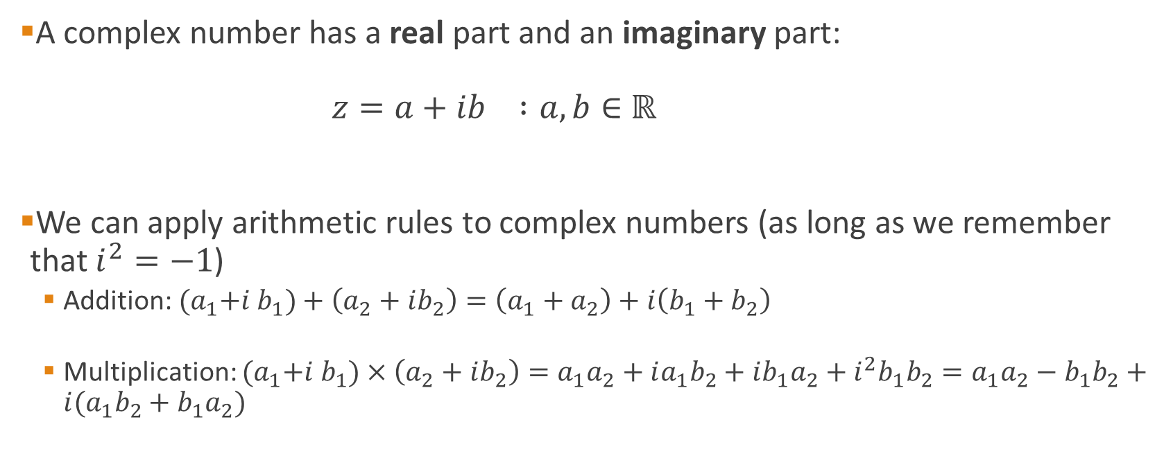
What is a complex number?
A complex number has a real part and an imaginary part: $z=a+ib :a,b∈$ ℝ
We can apply arithmetic rules to complex numbers (as long as we remember that $i^{2}=−1$)
Addition: ${(a}_{1}+i b_{1})+\left(a_{2}+ib_{2}\right)=\left(a_{1}+a_{2}\right)+i\left(b_{1}+b_{2}\right)$
Multiplication: ${(a}_{1}+i b_{1})×\left(a_{2}+ib_{2}\right)=a_{1}a_{2}+ia_{1}b_{2}+ib_{1}a_{2}+i^{2}b_{1}b_{2}=a_{1}a_{2}−b_{1}b_{2}+i(a_{1}b_{2}+b_{1}a_{2})$

Slide 7


Examples with arithmetic
Addition
Multiplication
$$\left(5+3i\right)+\left(2+2i\right)$$
$$=7+5i$$
$$\left(5+3i\right)−\left(2+2i\right)$$
$$=3+i$$
$$\left(5+3i\right)×\left(2+2i\right)$$
$=5×2+5×2i+3i×2+3i×2i$
$=10+10i+6i+6i^{2}$
$=10 −6+16i$
$=4+16i$

Slide 8

Important attributes
Let $z=a+ib :a,b∈$ ℝ
The complex conjugate of $z$ is:
$$z^{∗}=\overline{z}=a−ib$$
The absolute value of z is:
$$\left|z\right|=\sqrt{zz^{∗}}=\sqrt{\left(a+ib\right)\left(a−ib\right)}=\sqrt{a^{2}+b^{2}}$$

Slide 9

Example
$z=5+3i$
Complex conjugate: $z^{∗}=5−3i$
Absolute value: $\left|z\right|=\sqrt{\left(5+3i\right)\left(5−3i\right)}$
$\left(5+3i\right)\left(5−3i\right)=5^{2}−15i+15i −3i^{2}=25+9=34$
$$⇒ \left|z\right|=\sqrt{34 }$$

Slide 10
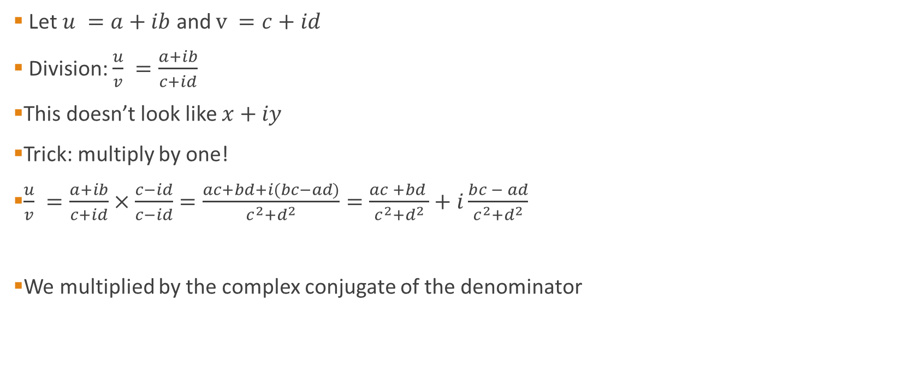
What about division?
Let $u =a+ib$ and $v =c+id$
Division: $\frac{u}{v} =\frac{a+ib}{c+id}$
This doesn’t look like $x+iy$
Trick: multiply by one!
$\frac{u}{v} =\frac{a+ib}{c+id}×\frac{c−id}{c−id}=\frac{ac+bd+i(bc−ad)}{c^{2}+d^{2}}=\frac{ac +bd }{c^{2}+d^{2}}+i\frac{bc − ad}{c^{2}+d^{2}}$
We multiplied by the complex conjugate of the denominator

Slide 11

Example
$\frac{5+3i }{2+2i}=\frac{5+3i }{2+2i}×\frac{2−2i }{2−2i}$
Denominator: $\left(2+2i\right)\left(2−2i\right)=2^{2} −2^{2}i^{2}=8$
Numerator: $\left(5+3i\right)\left(2−2i\right)=10 −10i+6i −6i^{2}=16 −4i$
$\frac{5+3i }{2+2i}=\frac{16 −4i }{ 8}=2 −\frac{1}{2}i$

Slide 12
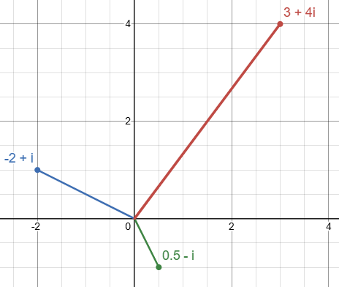
Visualising complex numbers

Slide 13
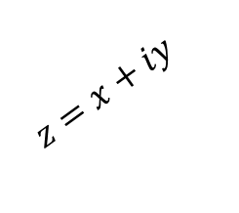

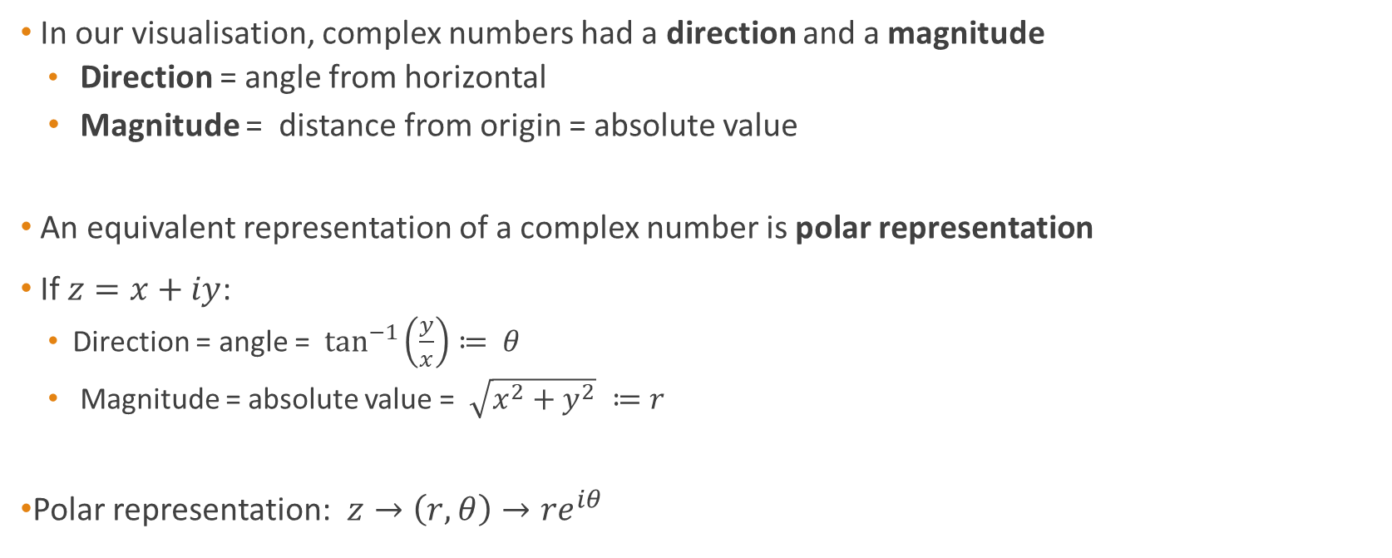



Polar representation
In our visualisation, complex numbers had a direction and a magnitude
Direction = angle from horizontal
Magnitude = distance from origin = absolute value
An equivalent representation of a complex number is polar representation
If $z=x+iy$:
Direction = angle = $\tan^{−1}\left(\frac{y}{x}\right)≔ θ$
Magnitude = absolute value = $\sqrt{x^{2}+y^{2}} ≔r$
Polar representation: $z→\left(r,θ\right)→re^{iθ}$
$z=x+iy$
$$y$$
$$θ$$
$$x$$
$$\tan\left(θ\right)=\frac{y}{x}$$

Slide 14
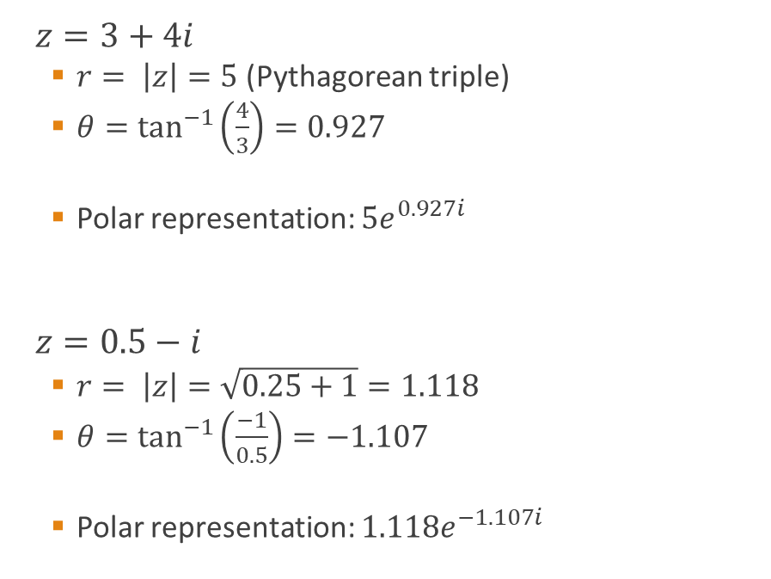
Example
$z=3+4i$
$r= \left|z\right|=5$ (Pythagorean triple)
$θ=\tan^{−1}\left(\frac{4}{3}\right)=0.927$
Polar representation: $5e^{0.927i}$
$z=0.5−i$
$r= \left|z\right|=\sqrt{0.25+1}=1.118$
$θ=\tan^{−1}\left(\frac{−1}{0.5}\right)=−1.107$
Polar representation: $1.118e^{−1.107i}$

Slide 15
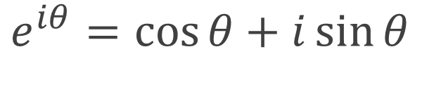
Euler’s formula
$e^{iθ}=\cos{θ+i\sin{θ}}$

Slide 16

Arithmetic with polar representation
Suppose $z=x+iy= re^{iθ}$
$z^{n}={\left(x+iy\right)}^{n}= ???$
$z^{n}={\left(re^{iθ}\right)}^{n}=r^{n} e^{inθ}$
Suppose $z^{′}=x^{′}+iy^{′}=r^{′}e^{iθ^{′}}$
$z z^{′}=\left(x+iy\right)\left(x^{′}+iy^{′}\right)= ???$
$z z^{′}=\left(re^{iθ}\right)\left(r^{′}e^{iθ^{′}}\right)=r r^{′}e^{i(θ+θ^{′})}$

Slide 17

Differentiation with complex numbers?
$f:ℂ→ℂ$
$f^{′}\left(z\right)=\lim_{h→0}{\frac{f\left(z+h\right)−f(z)}{h}}$

Slide 18
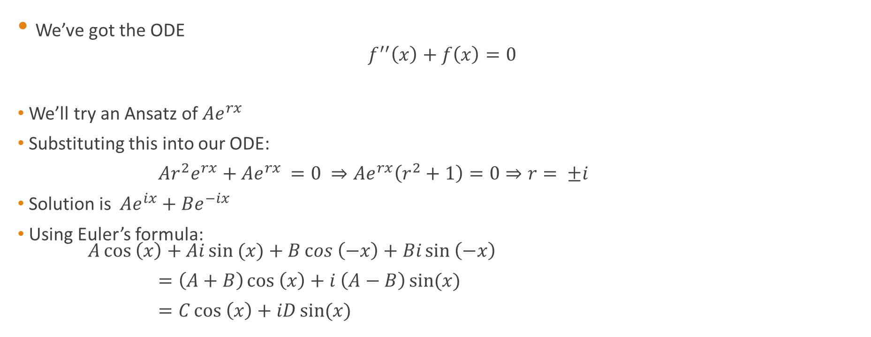
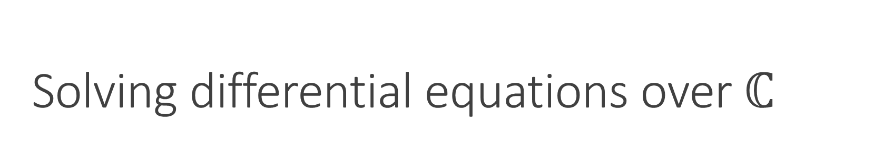
Solving differential equations over $ℂ$
We’ve got the ODE
$${f^{′′}\left(x\right)+f\left(x\right)=0}^{ }$$
We’ll try an Ansatz of $Ae^{rx}$
Substituting this into our ODE:
$Ar^{2}e^{rx}+Ae^{rx }=0 ⇒Ae^{rx}\left(r^{2}+1\right)=0⇒r= ±i$
Solution is $Ae^{ix}+Be^{−ix}$
Using Euler’s formula: $A\cos\left(x\right)+Ai\sin{(x)}+B\cos\left(−x\right)+Bi\sin\left(−x\right)$
$=\left(A+B\right)\cos\left(x\right)+i \left(A−B\right)\sin{(x)}$
$=C\cos\left(x\right)+iD\sin{(x)}$

Slide 19
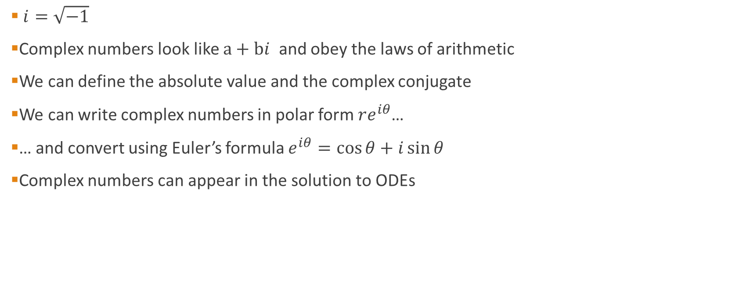
Complex numbers summary
$i=\sqrt{−1}$
Complex numbers look like $a+bi$ and obey the laws of arithmetic
We can define the absolute value and the complex conjugate
We can write complex numbers in polar form $re^{iθ}$…
… and convert using Euler’s formula $e^{iθ}=\cos{θ}+i\sin{θ}$
Complex numbers can appear in the solution to ODEs

Slide 20
What have we seen in this section of Maths B?
Differentiation
Partial differentiation; classifying maxima and minima via Hessian; Gradient
ODEs (linear, homogeneous, inhomogeneous)
Optimisation (Gradient descent, Nelder-Mead)
Approximating functions (Linear Approximation, Newton root finding, Taylor series)
Complex numbers

Slide 21
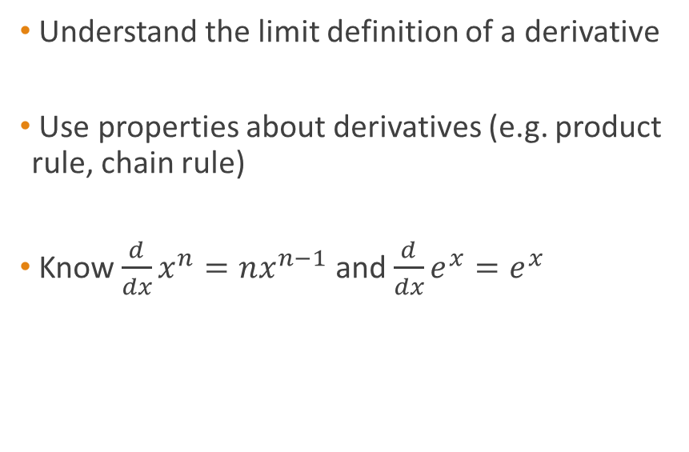
Lecture 1: Differentiation
I expect you to…
I do not expect you to…
Understand the limit definition of a derivative
Use properties about derivatives (e.g. product rule, chain rule)
Know $\frac{d}{dx}x^{n}=nx^{n−1}$ and $\frac{d}{dx}e^{x}=e^{x}$
Find the derivatives of functions from the limit definition
Prove properties about derivatives (e.g. chain rule)
Remember ‘obscure’ (e.g. trigonometric) derivatives

Slide 22
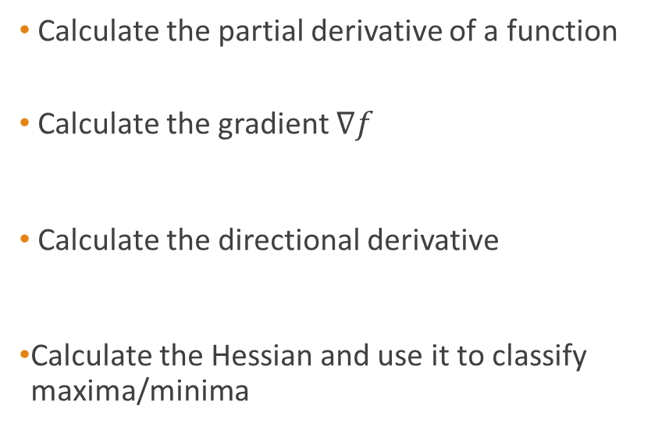
Lecture 2: Partial Differentiation
I expect you to…
I do not expect you to…
Calculate the partial derivative of a function
Calculate the gradient $∇f$
Calculate the directional derivative
Calculate the Hessian and use it to classify maxima/minima
Apply the limit definition of a partial derivative
Prove properties about partial derivatives
Use the chain rule (as in Q3 on WS2)

Slide 23
Lecture 3: ODEs
I expect you to…
I do not expect you to…
Classify an ODE (e.g. linear, homogeneous)
Solve an ODE by direct integration/separation of variables
Solve first order linear homogeneous equations
Solve first order linear inhomogeneous equations (using Complementary Function + Particular Solution)
Solve second order linear homogeneous equations
Find ‘obscure’ particular solutions
Solve ODEs that are vastly different to what we’ve seen in the worksheets
Apply anything beyond simple integration techniques

Slide 24
Lecture 4: Optimisation
I expect you to…
I do not expect you to…
Use calculus directly to optimise a function when possible
Know the Gradient Descent algorithm
Understand the structure of Gradient Descent/Nelder Mead (e.g. initial guess, iterations, stopping conditions)
Know the details of the Nelder-Mead algorithm
Apply Nelder-Mead Algorithm

Slide 25
Lecture 5: Taylor Series
I expect you to…
I do not expect you to…
Know about linear approximation
Apply Newton’s root-finding method
Remember and apply the Taylor series to a differentiable function
Memorise the Taylor series of functions

Slide 26
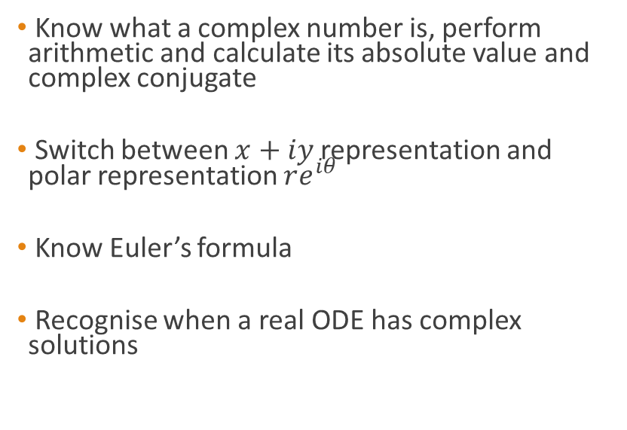
Lecture 6: Complex numbers
I expect you to…
I do not expect you to…
Know what a complex number is, perform arithmetic and calculate its absolute value and complex conjugate
Switch between $x+iy$ representation and polar representation $re^{iθ}$
Know Euler’s formula
Recognise when a real ODE has complex solutions
Suddenly start working with complex functions
Know when a complex function is differentiable

