Slide 1

Computer Systems B
COMS20012
Introduction to Operating Systems and Security

Slide 2

FCFS, SJF, SRTF, Round Robin

Slide 3

Simple Scheduling
A set of job Jx to schedule
  Job arrival time a_{x}
  Job running time r_{x}
Only one job at a time (multicore later this week)

Slide 4
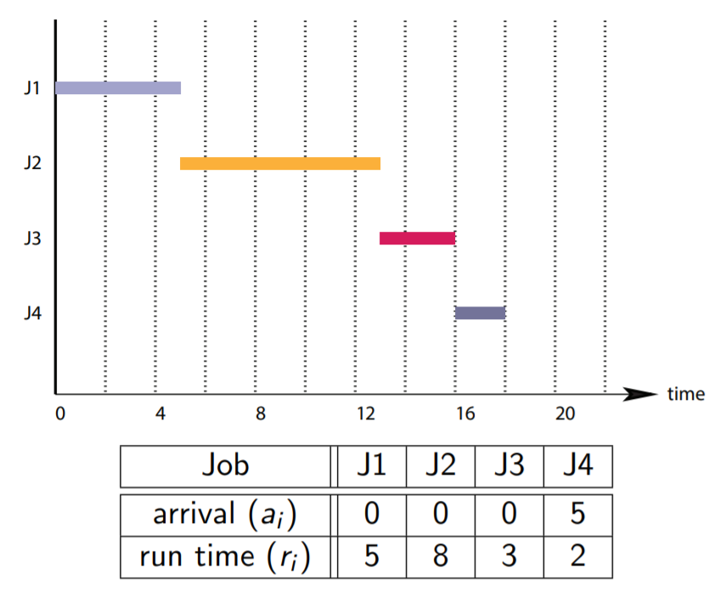
First come first served
Jobs run in order of arrival
Simple
No starvation
If you remember week 5 that is
how early computers worked

Slide 5
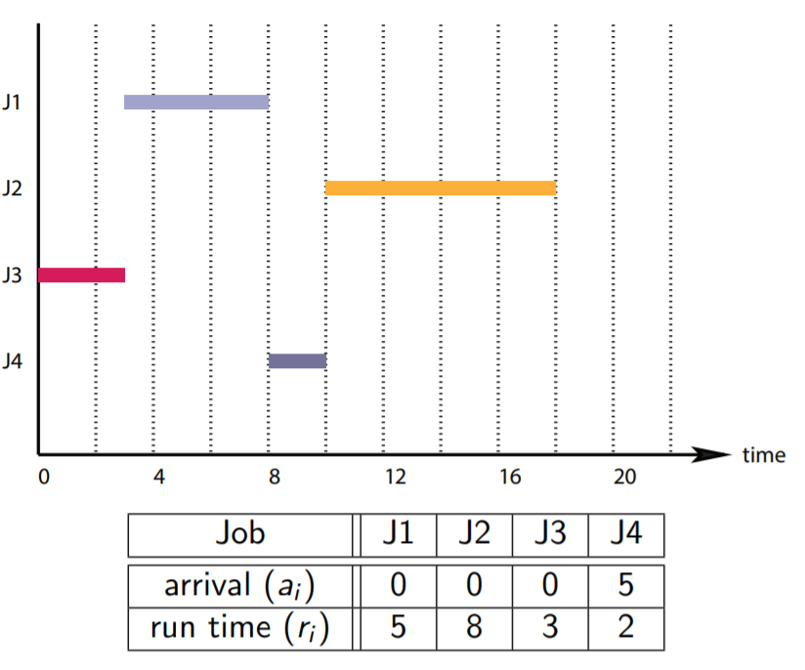
Shortest Job First
Jobs run in increasing order of
runtime
Minimize the average turnaround
time
Starvation is possible

Slide 6
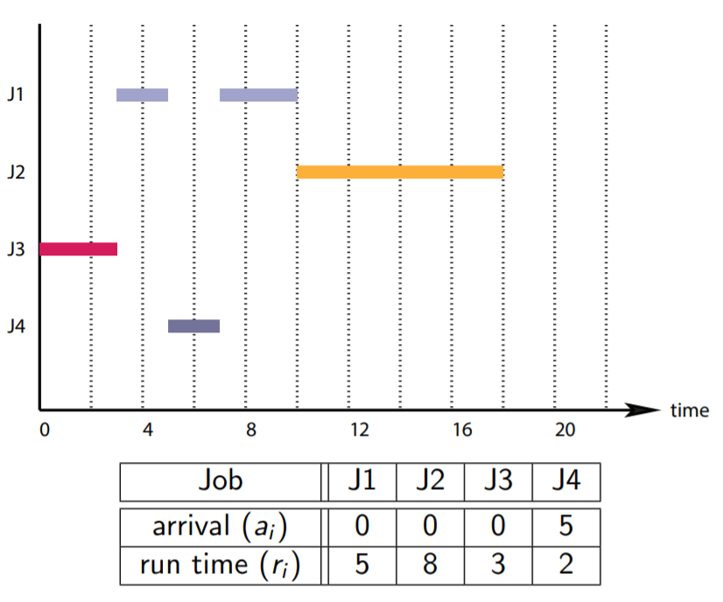
Shortest Remaining Time First
Preemptive version of SJF
Arriving jobs can preempt running
jobs
Select job with the shortest
remaining time
Starvation is possible

Slide 7

Problems?

Slide 8
Problems
Obviously, starvation
How do you predict running time in practice?
  Imagine a modern interactive application (e.g., video game)
No illusion of concurrency
  Job make progress until they are completed
  … or pre-empted by a “quicker” job for some algorithms

Slide 9
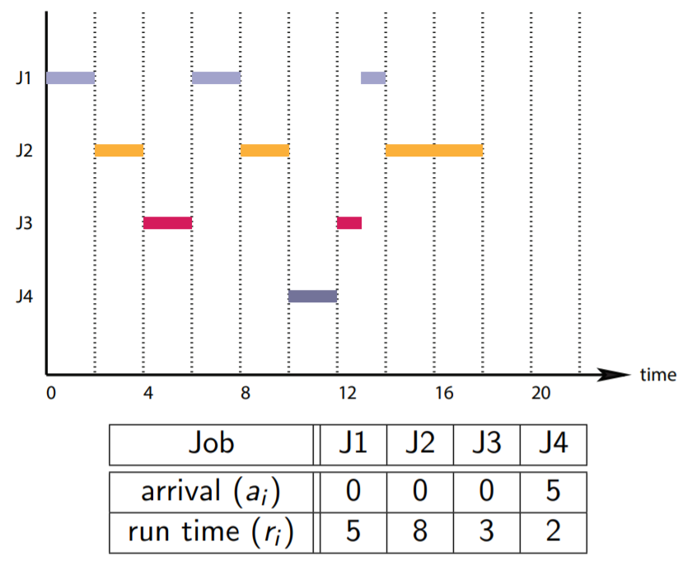
Round Robin
Preemptive FCFS
  Pick jobs as they arrive
  Execute them for a quantum
  (a.k.a. time slice)
OS/161 scheduler
Switch between thread at regular
time interval
  Implemented via hardware timer
Provide the illusion of concurrency

Slide 10
How does it work?
Week 6 Video 5
We saw how trap were handled
We focused on syscall
Here we want to look at timer interrupt
… let’s see how hardware interrupt are handled

Slide 11
How does it work?
Week 6 Video 5
We saw how trap were handled
We focused on syscall
Here we want to look at timer interrupt
… let’s see how hardware interrupt are handled
Pause the video and look through the code as needed

Slide 12
How does it work?
kern/arch/mips/locore/trap.c
Our trap logic
Line 188
  Call to mainbus_interrupt which handles the interrupt logic
Implemented in kern/arch/sys161/dev/lamebus_machdep.c
Line 298
In this function we determine the cause of the interrupt

Slide 13
How does it work?
What happens on hardware timer?
  Reset the timer (line 318)
  Call to hardclock (line 320)
hardclock is implemented in kern/thread/clock.c
  Line 93
thread_consider_migration
  Implemented in kern/thread/thread.c (line 881)
  Migrate to another core (we discuss that more later)
schedule
  Implemented in kern/thread/thread.c (line 855)
  Does nothing
  Can be used to implement more complex algorithm (future video this week)
thread_yield

Slide 14
thread_yield
Implemented in kern/thread/thread.c (line 840)
Calls thread_switch (line 500)
  Implement the logic to pick the next thread to execute!

Slide 15
thread_yield
Implemented in kern/thread/thread.c (line 840)
Calls thread_switch (line 500)
  Implement the logic to pick the next thread to execute!
We dig into this in the next video!

Slide 16
Thank you

