Slide 1

Computer Systems B
COMS20012
Introduction to Operating Systems and Security

Slide 2

Scheduling across multiple cores

Slide 3

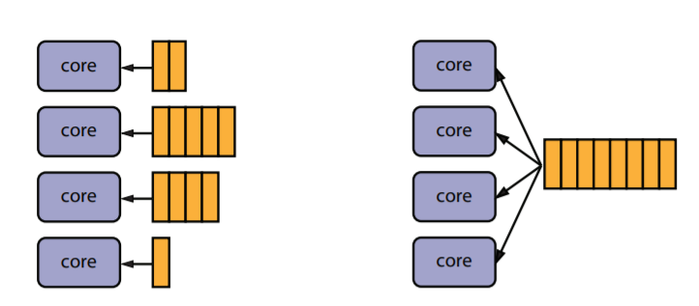
Two possible approaches
Per-core queues
Shared queue
Which scales better?
Which offers better performance?

Slide 4
Scalability
Contention and scalability
  Access to the shared queue is a critical section, mutual exclusion is needed
  As the number of cores grow, contention to access the resource become a problem
Per-core design scale to many core

Slide 5
Performance
As a thread run, the data it accesses is loaded in the CPU cache(s)
If thread changes CPU, the data needs to be loaded again
Affinity between a thread and one core grows because the cached data
Per-core approach benefit from this affinity by keeping threads on the same core
This is not the case for shared queue design

Slide 6
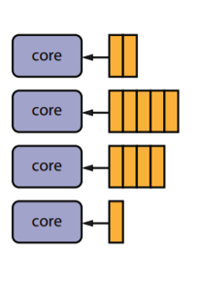
Load balancing
In per-core design, queues may have different length
This create load imbalance across cores
  Cores may be idle why others are busy
  Threads on lightly loaded core have more CPU time
  than threads on heavy loaded ones
Non-issue in shared queue design
Per-core designs need a mechanism to balance
the load across all cores
  Migrate threads from lightly loaded core to heavy loaded
  ones

Slide 7

Pause the video
Open kern/thread/thread.c
Resume the video

Slide 8
kern/thread/thread.c
thread_consider_migration defined line 881
Called from hardclock function (kern/thread/clock.c line 93)
  Watch Week 7 Video 2 again if confused
Line 889-901
  Calculate average load per core (one_share)
  Load on current core (my_count)
Line 902-904
  If bellow average load nothing to do
Line 906-913
  Build a list of thread to migrate (victims)
  Remove them from the thread running on the current core (&curcpu->c_runqueue)

Slide 9
kern/thread/thread.c
Line 915-966
  Find a core bellow average load (line 921)
  Migrate victim threads to that core
Line 973-982
  Internal management
  Put back thread that could not be assigned
  Clean up data structure

Slide 10
Thank you

