Slide 1

Computer Systems B
COMS20012
Introduction to Operating Systems and Security

Slide 2

Files on disk

Slide 3

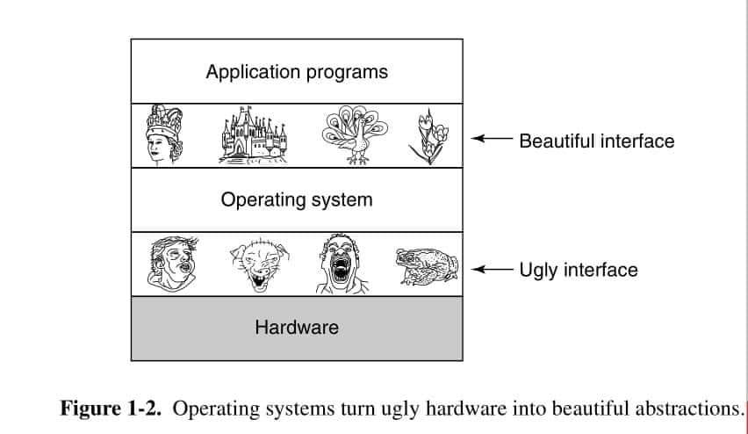
It is all about abstractions
OS see storage as a large addressable array of bytes
User space wants better abstraction
  Naming: /pics/meme.jpg instead of bytes between 24,048 to 28,156
  Performance optimization
    Caching
    Pre-fetching
  Transparent sector/block management
  Reliability in case of crash/power failure
Modern Operating Systems, by Andrew Tanenbaum, Herbert Bos, Pearson

Slide 4
Files and Directories
File: linear region of bytes that can grow and shrink
  Associated with metadata
    A name (e.g., meme.jpg)
    Size in bytes
    Access permissions (read/write/execute)
    Statistics (e.g., creation and access dates)
  OS is agnostic to the content of the file (userspace is to interpret it)
Directory: container for files and other directories
  Associate with a name + metadata
  Nested directories can create a hierarchy (e.g., /home/bob/pictures/meme.jpg)

Slide 5
File as a single extent (1960’s file systems)
File 1 Metadata
File metadata
  Starting sector
  Length in byte (last sector may not be fully used)
Advantages
  Simple
  Small metadata
  Good sequential and random I/O
Problems
  How much space to allocate to new files
  What to do if a file grow beyond its allocation? Or Shrink?
  External fragmentation
contiguous
sector
File 2 Metadata
contiguous
sector

Slide 6
File as a collection of extents (IBM 360, ext4)
Advantage
  Metadata remain relatively small
  Almost as good sequential I/O
    Sequential offset calculation a bit tricky
  Almost as good random I/O
Challenges
  How large the initial extent should be?
  What to do if a file grows or shrink?
  Improve on fragmentation!
…
contiguous
sector

Slide 7
Files as linked list: (FAT)
Advantages
  Easy to shrink and grow
  Low internal and external fragmentation
  Sequential offset calculation is easy
Disadvantages
  Need to go through the list to find the part ones need
  Some metadata at the end of each data block
  Sequential I/O requires lots of seeks (on hard drive mechanical movement)

Slide 8
Files as flat indices
Array mapping ranges to a block
Advantages
  Offset is easy to calculate
  Low fragmentation
Disadvantages
  Maximum file size is fixed by number of entries in an index
  Sequential I/O requires lots of seeks (on hard drive mechanical movement)

Slide 9
Files as hybrid indices (FFS, ext2, ext3)
Top level index contains: direct pointers, indirect pointers, doubly indirect pointers etc.
Advantages
  Efficient for small files (do not materialize unused indirect list)
  Big maximum file size (function of depth and index size)
  Low fragmentation
Disadvantages
  Sometimes multiple disk access for a single read/write (need to fetch indirections)
  Still require a large number of seek

Slide 10
Managing free space
Extent
Break the disk
  Fixed sized extents (4kb, 8kb, 12kb, …., 4MB)
  Sorted by size arbitrary sized extents
Maintain a list of unallocated extent
Allocating N bytes of free space
  e.g., best fit, worst fit, first fit etc.
Trade-offs
    Internal fragmentation
    External fragmentation
    Speed of finding match
Fixed size block
Typically use bitmap to indicate which blocks are in use
Allocation metadata is very compact
Finding a single empty block is straightforward
… finding region of N free blocks is more tedious

Slide 11
Thank you

