Slide 1

Computer Systems B
COMS20012
Introduction to Operating Systems and Security

Slide 2
authentication:
who are they ?
authorisation:
are they allowed to do this ?
accountability:
what have they done?

Slide 3

Authentication

Slide 4
authentication
You can authenticate with something you ...
?
?
?

Slide 5
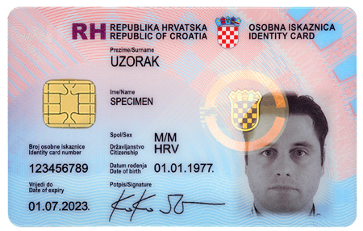
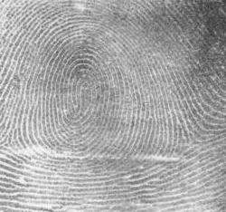
authentication
You can authenticate with something you ...
know e.g. a password
have e.g. an ID card
are e.g. biometrics
p@s$w0rD

Slide 6
authentication
You can authenticate with ...
sth. you know e.g. a password
sth. you have e.g. an ID card
sth. you are e.g. biometrics
your location
your behaviour
extra factors, becoming much more widespread

Slide 7
Authorization

Slide 8

authorization
Occur after authentication
Verify and enforce rights to perform actions or access data
More on this topic in Lecture 10

Slide 9
Accountability

Slide 10
accountability
Keep a record of what happened
  Event logs
  File access logs
  etc.
Investigating computer misuse: forensics
Detecting misuse: intrusion detection
More on this in Year 4 unit Systems & Software Security

Slide 11

This week focus: authentication

Slide 12
Thank you

