Slide 1

Computer Systems B
COMS20012
Introduction to Operating Systems and Security

Slide 2

Passwords

Slide 3

What is a password?
Secret shared between a user and a service
Simplest implementation?

Slide 4
What is a password?
Secret shared between a user and a service
Simplest implementation?
  Table: usr -> passwd

Slide 5
Threat 1
Attacker have access to the table

Slide 6
What is a password?
Secret shared between a user and a service
Simplest implementation?
  Table: usr -> passwd
  Not great
  Table: usr -> Hash(passwd)
  We assume hash cannot be reverted

Slide 7

Problem?

Slide 8
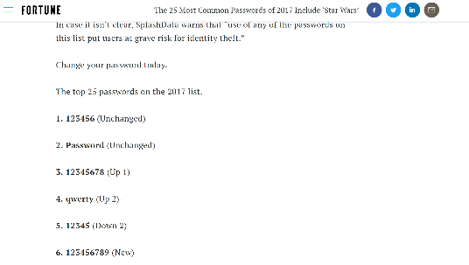
Skewed distribution

Slide 9
Skewed distribution
Top 100,000 passwords
  https://github.com/danielmiessler/SecLists/blob/master/Passwords/Common-Credentials/10-million-password-list-top-100000.txt
>20% of users

Slide 10
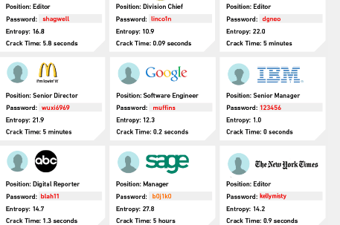
Skewed distribution

Slide 11
How attacker use this?
Dictionary attack
Go through the list of most used password
Check for a match

Slide 12
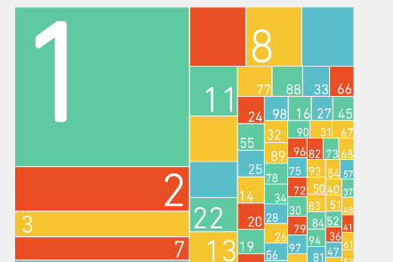
Solution? (bad one)
Ask the user to add some specific characters

Slide 13
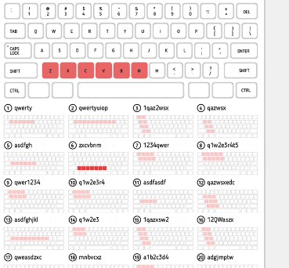
Solution? (bad one)
No word from the dictionary

Slide 14
Solution? better hash
usr -> hash(password)
Hash -> low computational cost
More costly hash
  Eg.PBKDF2, Bcrypt etc…
Still not a solution!

Slide 15
Rainbow table
Attacker
  password -> Hash1(password), Hash2(password) etc…
  If your website use a framework the attacker knows the hash function
Try to find a match in the service table
Due to password distribution likely to get a match
Computational cost is independent from the hash function
  One time cost

Slide 16
Solution? Salt
Hash(salt, password)
Different salt per password (for and across users)
Salt does not need to be a secret
  Defeat rainbow table
  Increase cost of dictionary attack
Not a panacea
  If your password is 1234
  Arms race

Slide 17
Thank you

