Slide 1

Computer Systems B
COMS20012
Introduction to Operating Systems and Security

Slide 2

Threat 2
The recovery problem

Slide 3

Password recovery
External knowledge
  Social Media
  Famous people
  Environment vulnerability
  etc…
Social engineering
  Fake e-mail
  Fake website
  Ask over the phone
  etc…
Entropy of recovery is very bad! Entropy = Min(Ent(password), Ent(Recovery))
  e.g. what’s your favorite color? (likely red or blue)
  User selected questions are terrible (e.g. 2+3)

Slide 4

Examples

Slide 5
E-mail recovery
Policy: you need to know the password to access an account

Slide 6
E-mail recovery
Policy: you need to know the password to access an account
… or you need to know the answer to the recovery questions?

Slide 7
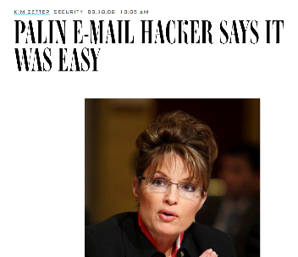
E-mail recovery
Policy: you need to know the password to access an account
… or you need to know the answer to the recovery questions?

Slide 8
E-mail recovery
Policy: you need to know the password to access an account
… or you need to know the answer to the recovery questions?
DoB, ZIP, where did you
meet your partner?
Just Google it!

Slide 9
E-mail recovery
Policy: you need to know the password to access an account
… people started to get more creative

Slide 10
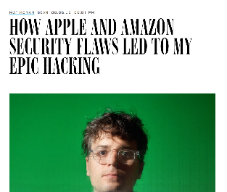
E-mail recovery
Policy: you need to know the password to access an account
… people started to get more creative
Took over twitter account
deleted google account etc.
A real story!

Slide 11
What happened?
Took over twitter account, deleted google account etc.
GMail
Reset

Slide 12
What happened?
Took over twitter account, deleted google account etc.
GMail
Reset
Recovery
e-mail (apple)

Slide 13
What happened?
Took over twitter account, deleted google account etc.
GMail
Reset
Recovery
e-mail (apple)
Reset

Slide 14
What happened?
Took over twitter account, deleted google account etc.
GMail
Reset
Recovery
e-mail (apple)
Reset
Last 4 digits of credit card #

Slide 15
What happened?
Took over twitter account, deleted google account etc.
Amazon
GMail
Reset
Recovery
e-mail (apple)
Reset
Last 4 digits of credit card #

Slide 16
What happened?
Took over twitter account, deleted google account etc.
Amazon
Can add CC#
GMail
Reset
Recovery
e-mail (apple)
Reset
Last 4 digits of credit card #

Slide 17
What happened?
Took over twitter account, deleted google account etc.
Amazon
Can add CC#
Reset
GMail
Reset
Recovery
e-mail (apple)
Reset
Last 4 digits of credit card #

Slide 18
What happened?
Took over twitter account, deleted google account etc.
Amazon
Can add CC#
Reset
GMail
Reset
Need CC#
Recovery
e-mail (apple)
Reset
Last 4 digits of credit card #

Slide 19
What happened?
Took over twitter account, deleted google account etc.
Amazon
Can add CC#
Reset
GMail
Reset
Need CC#
*****1234
*****4567
Recovery
e-mail (apple)
Reset
Last 4 digits of credit card #

Slide 20
What happened?
Took over twitter account, deleted google account etc.
Amazon
Can add CC#
Reset
GMail
Reset
Need CC#
*****1234
*****4567
Recovery
e-mail (apple)
Reset
Twitter
More…
Last 4 digits of credit card #

Slide 21
E-mail recovery
Individual policies made sense
Did not take in consideration the larger environment
Now?
  Two factor authentication etc…
  Until someone find a vulnerability?

Slide 22
Thank you

