Slide 1

Computer Systems B
COMS20012
Introduction to Operating Systems and Security

Slide 2

A brief history of
Operating Systems

Slide 3

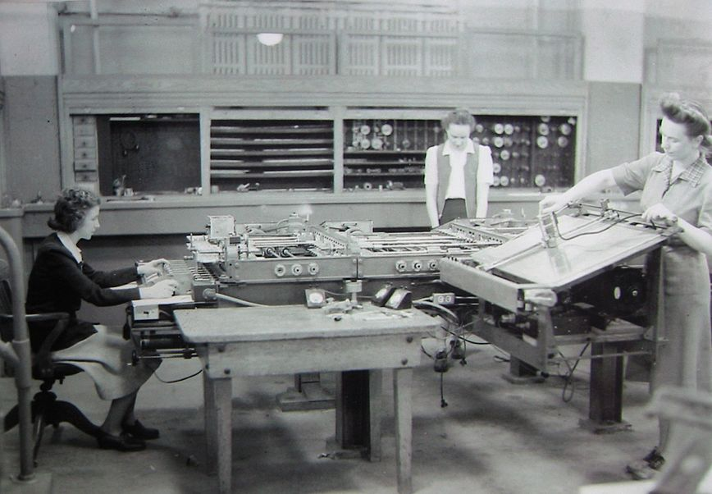
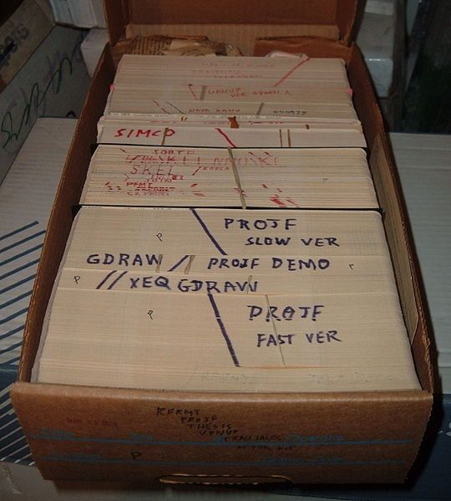
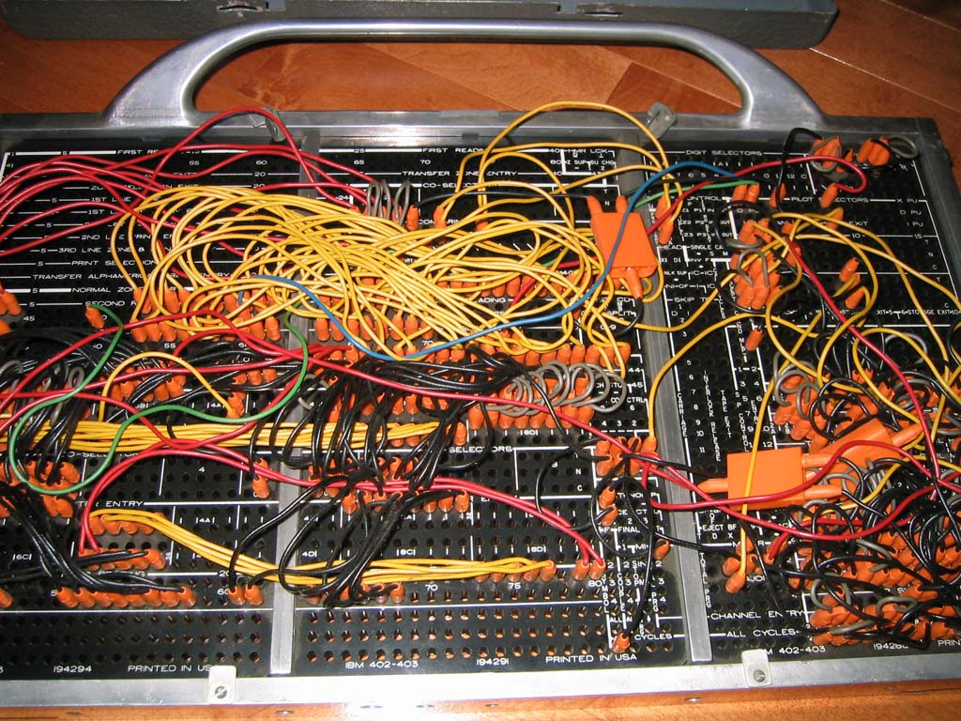
Phase 0: no operating systems (1940-1955)
Computer are exotic experimental equipments
Program in machine language
Use plugboard to direct computer
Program manually loaded via card decks
Goal: churn table of numbers (e.g. accounting)
Progress:
  People develop libraries that they share with each others
  These libraries are the precursor to today OSs

Slide 4
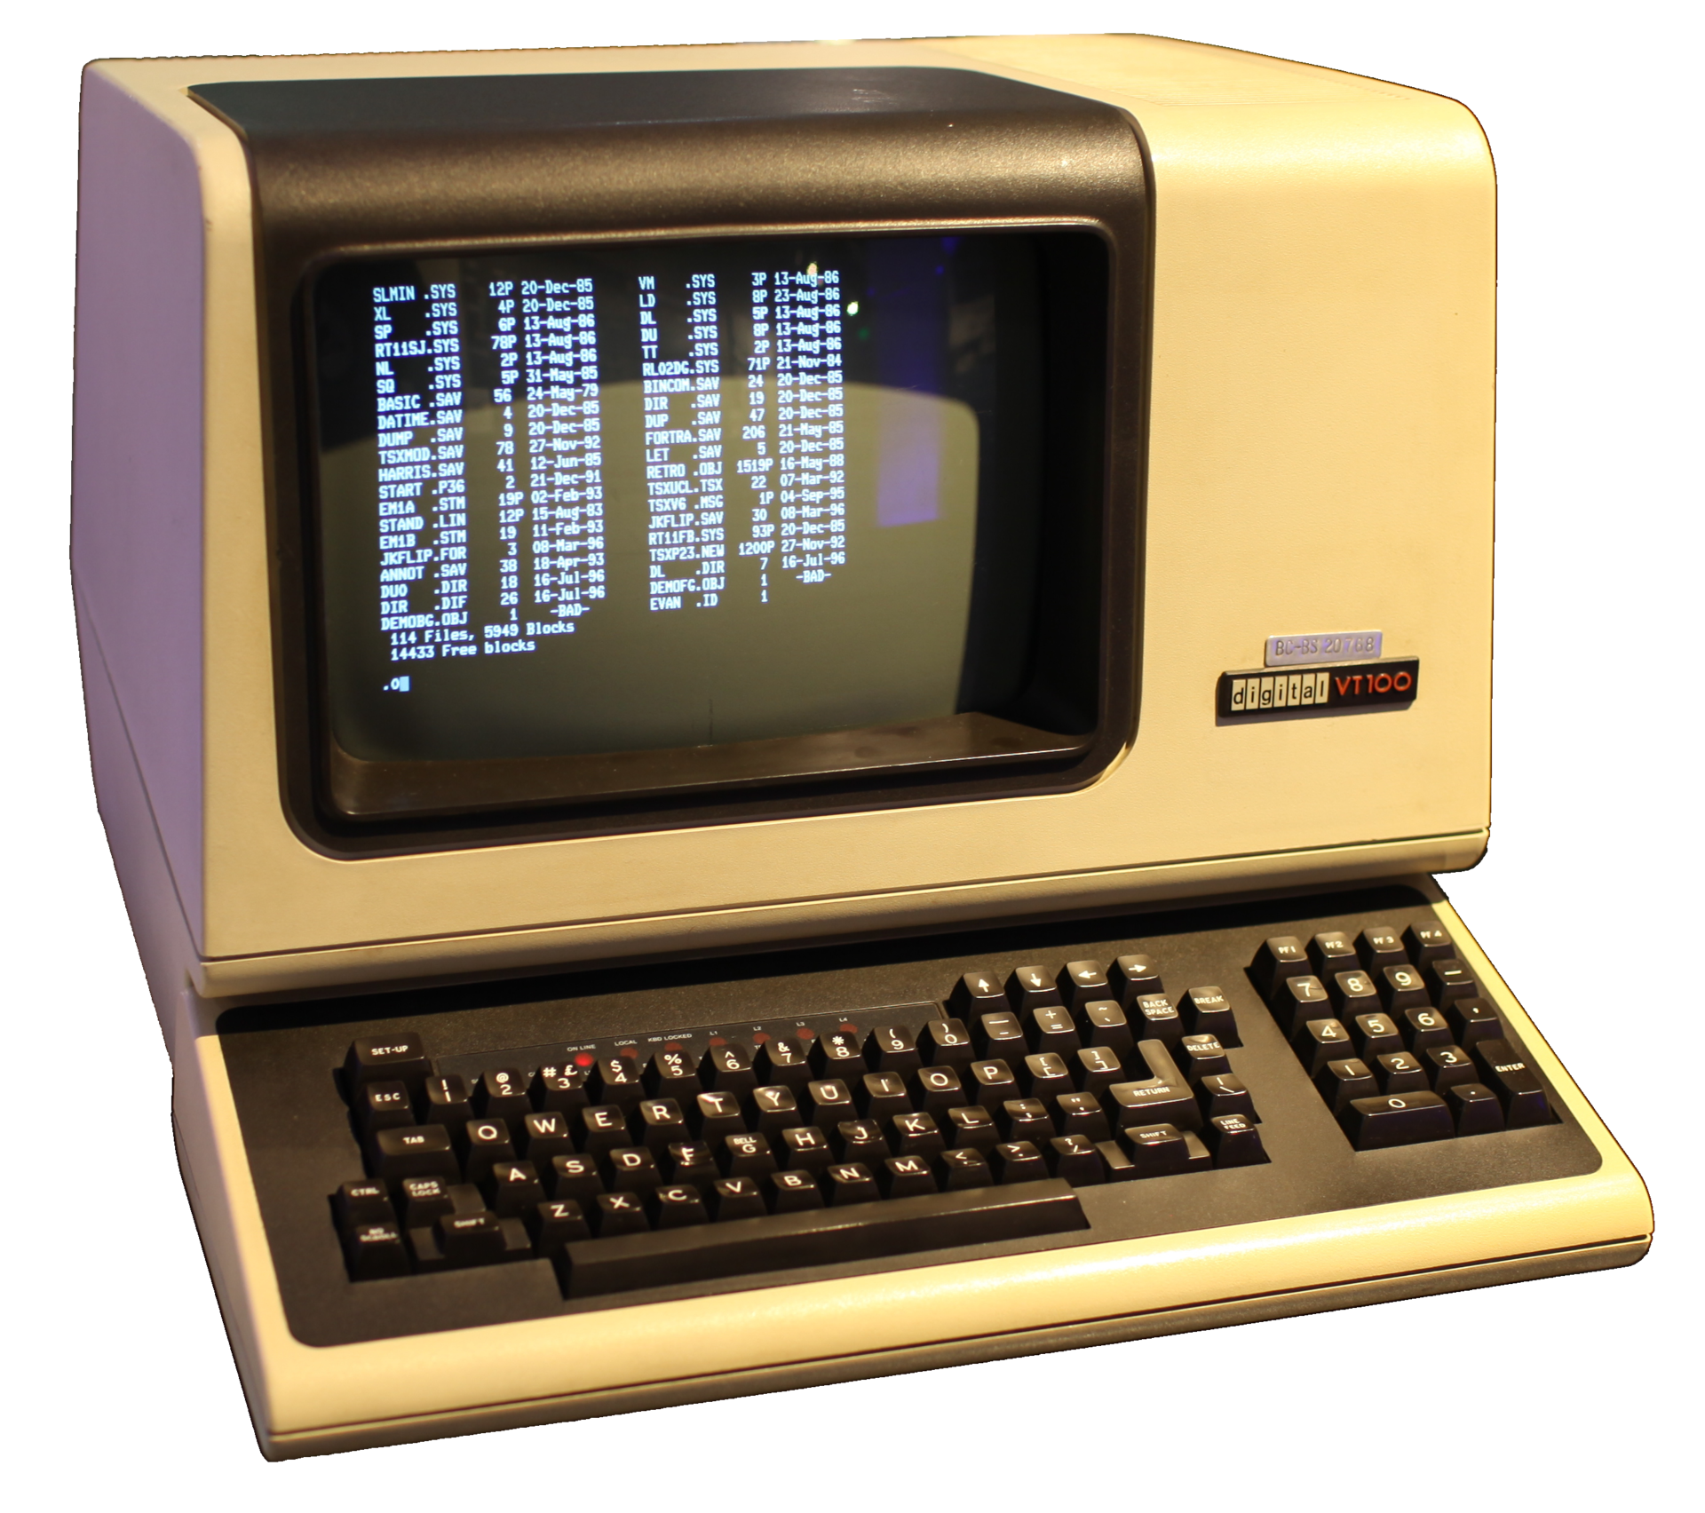
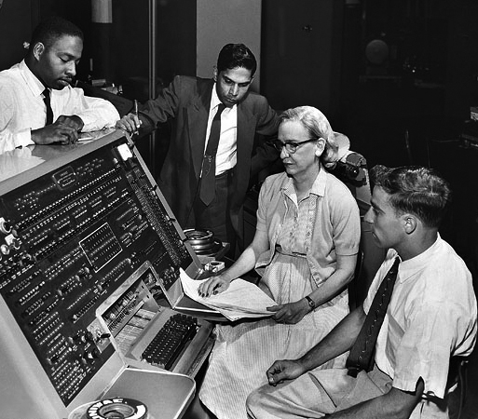
Phase 1: Expensive computers, cheap people (1955-1970)
Move the users away from the computer, give them (dumb) terminal
OS is a batch monitors, a program that:
  Load a user job
  Run it
  Move to the next
Program fails? Record memory, save it, move on
Efficient use of hardware (less “downtime”)
Hard to debug

Slide 5
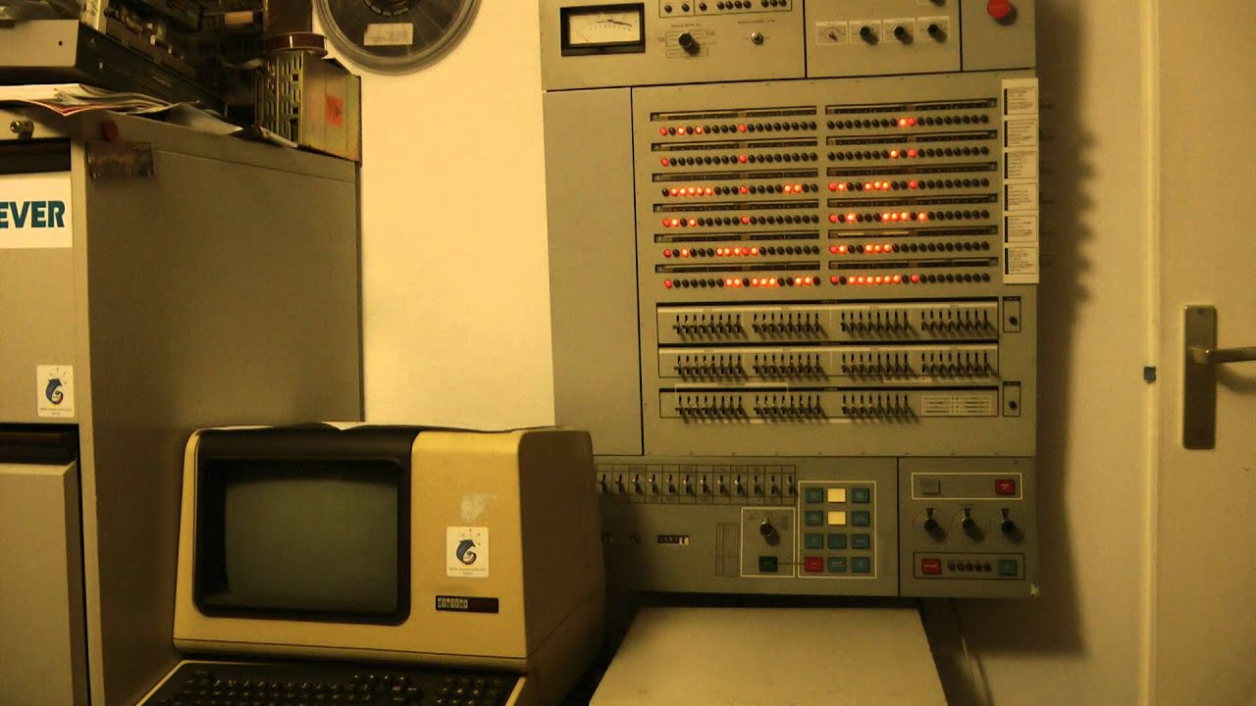
Phase 1: Technology
Problems:
  Utilization is low (one job at a time)
  No protection between different jobs
  Short jobs get stuck behind long one
Solutions:
  Hardware to the rescue: memory protection (separate code and data) and relocation (i.e. non-absolute addresses)
  Multiprogramming: many users share the system
  Scheduling: let short job finish quickly
  OS must manage interactions between concurrent things (you learn that it is not easy last term)
  OS becomes an important area of research
  OS/360: first OS to run on a family of machine (big and small)

Slide 6
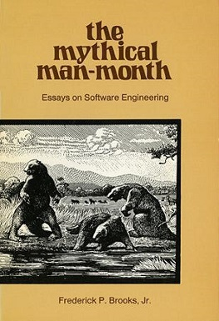
Phase 1: the bad
Operating Systems did not really work
OS/360 introduced in 1963… worked in 1968
Systems were enormously complicated
Written in assembly code
No structured programming
(extra read) The Mythical Man-Month

Slide 7
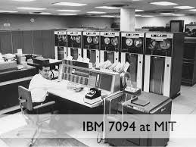
Phase 2: expensive computers, expensive people (1970-1980)
Help people to be more productive
Interactive timesharing: many people use the same machine at once
Terminals are cheap: everyone get one! (e.g. Airline systems)
Emergence of the file systems
Try to give reasonable response time (avoid trashing)
CTSS
  Developed at MIT
  One of the first time sharing system
  Pioneered much of the work on scheduling
  Motivation for MULTICS
MULTICS
  Joint development by MIT, Bell Labs, General Electric
  One computer for everyone, people will buy computing as they buy electricity
  Many seminal ideas: protected rings, hierarchical file systems, devices as files

Slide 8
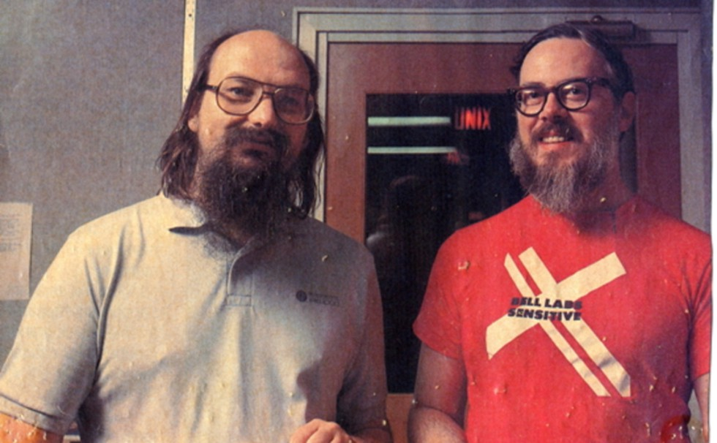
Phase 2: UNIX
Ken Thompson (former MULTICS’ guy) wanted to use an old computer available at Bell Lab
He and Dennis Ritchie built a system built by programmers for programmers
Originally in assembly. Rewritten in C by Ritchie and Thompson
New idea: portable OS (i.e. not tied to a specific hardware)
Universities got the code for experimentation
Berkeley added virtual memory support
DARPA selected UNIX as its networking platform (ARPANET)
UNIX becomes a commercial OS
Important ideas popularized by UNIX
  OS written in a high-level language (C)
  OS is portable across hardware platforms
  Pipes
  Mountable file systems
  Many, many more

Slide 9
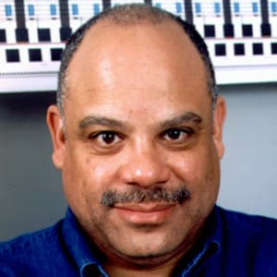
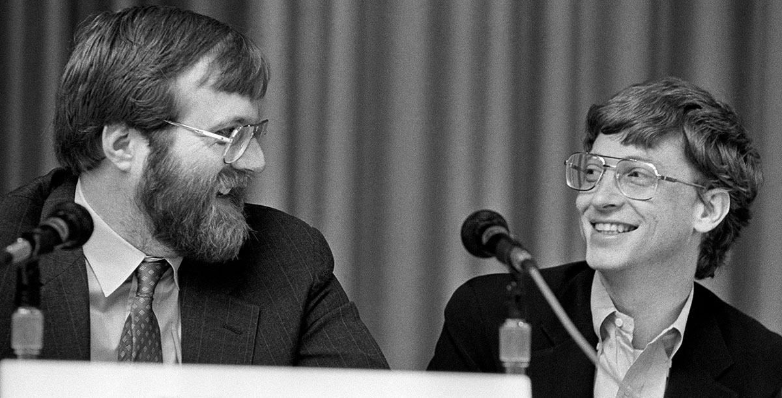
Phase 3: cheap computer, expensive people (1980-1990)
Put a computer in each terminal!
CP/M first personal computer operating system.
IBM needed an OS for its PC, CP/M behing schedule
Approached Bill Gates (Microsoft) to build one
Gates approached Seattle Computer Products, bought 86-DOS, and created MS-DOS
Goal: run CP/M programs and be ready quickly
Market is broken horizontally
  Hardware
  OSes
  Applications

Slide 10
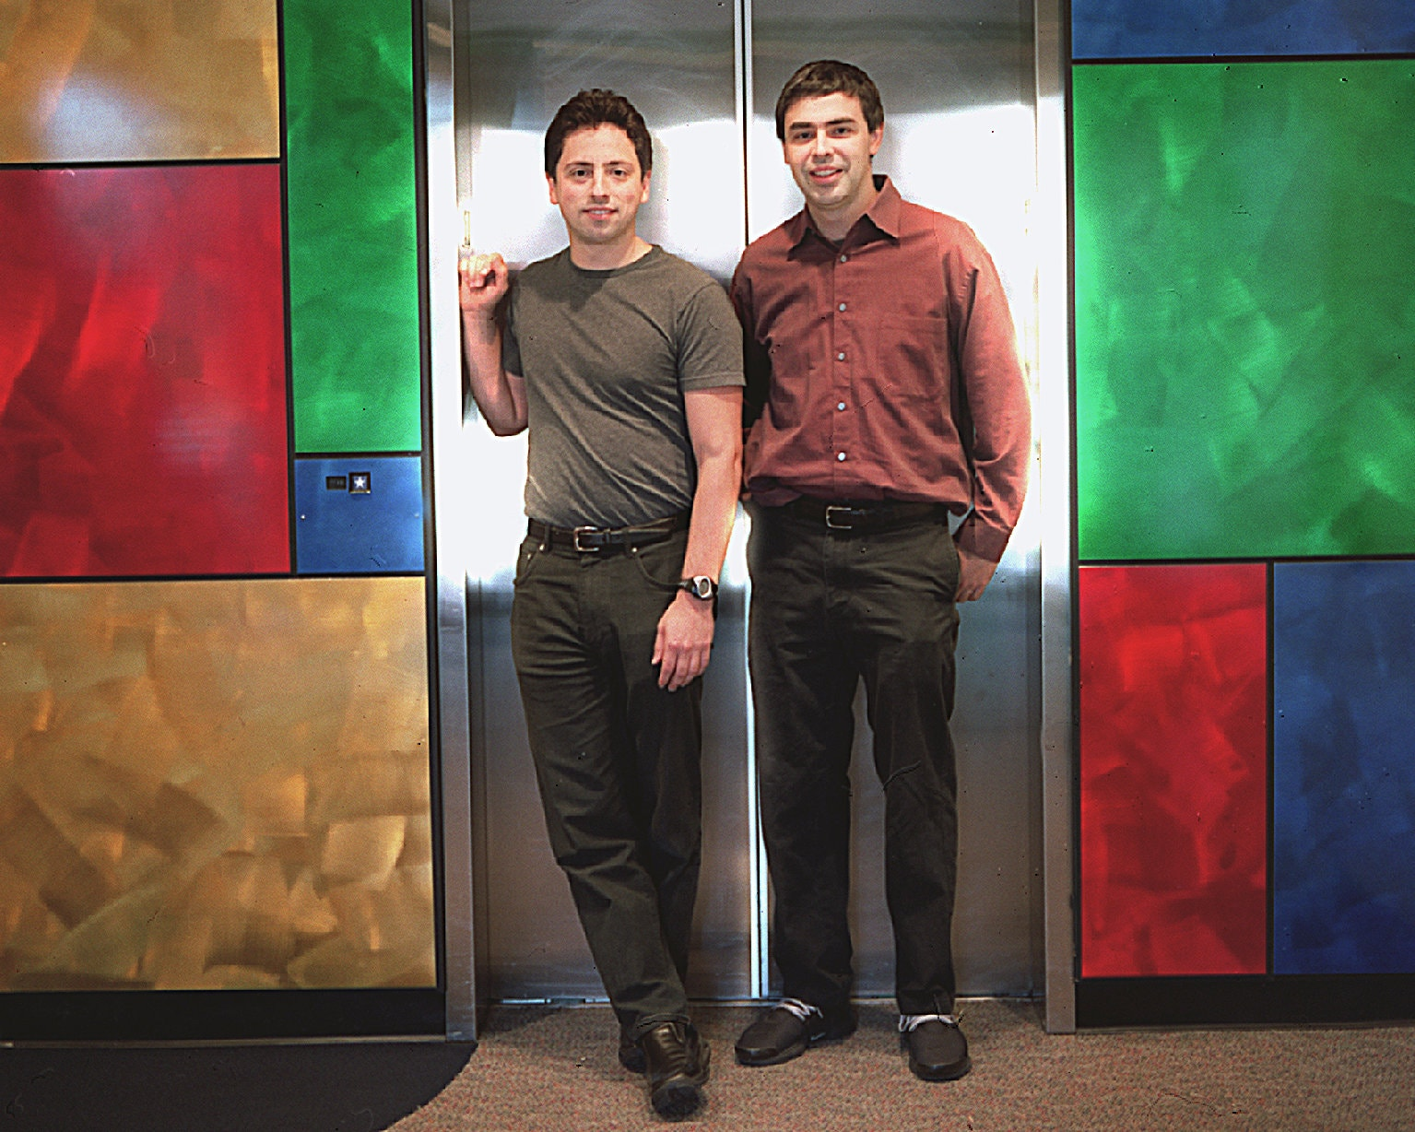
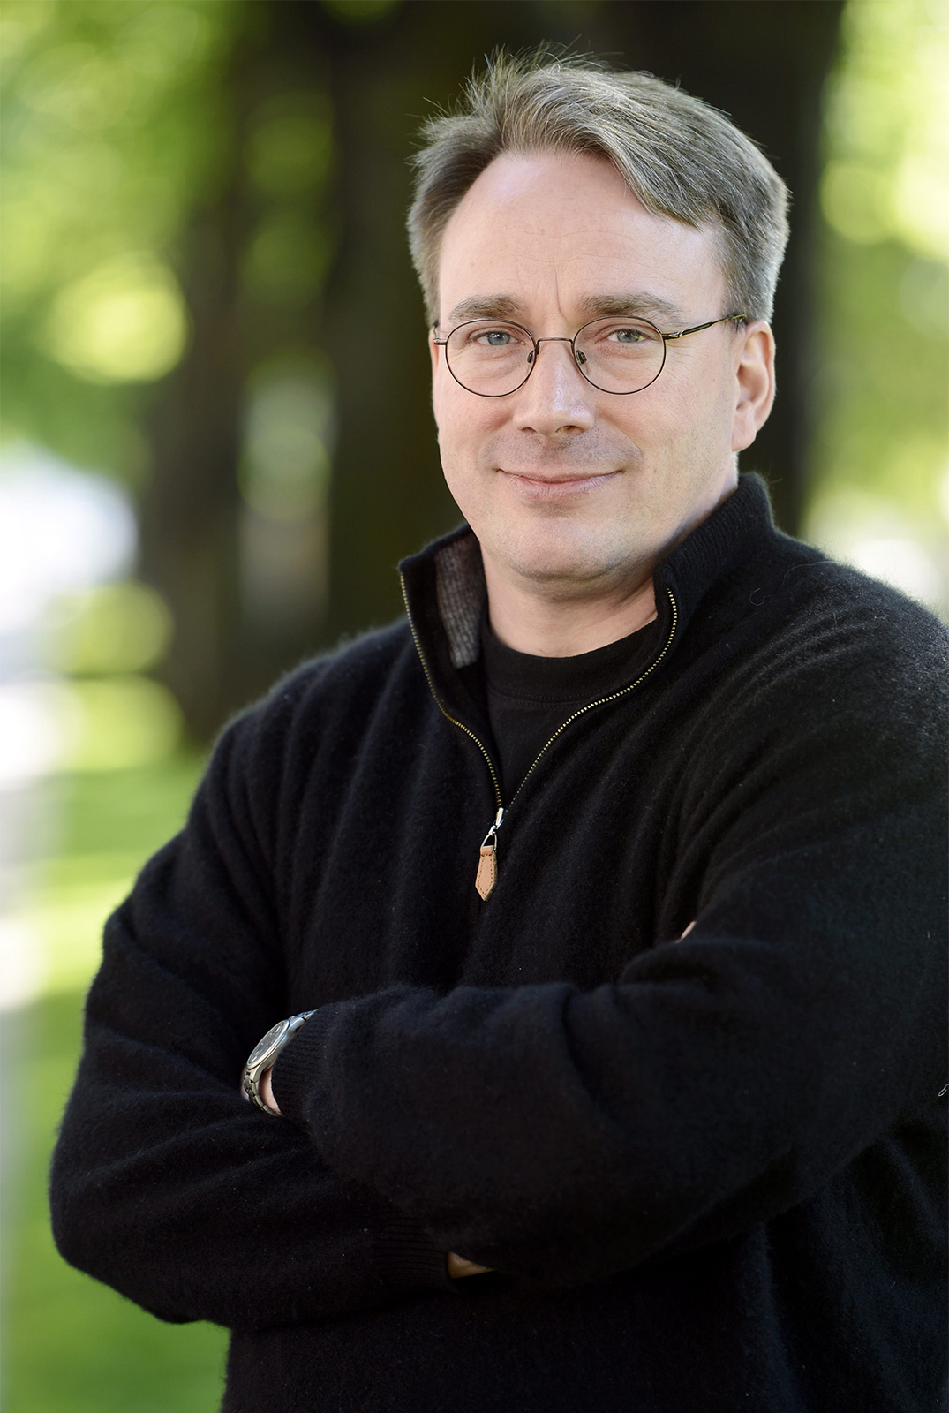
Phase 4: Networked Systems (1990s-today)
Connectivity is paramount!
People want to share
Networked applications propel industry
  Email
  Web
Protection and multiprogramming less important for individual machines
Protection and multiprogramming more important for servers
New network-based architectures
  Clusters
  Grids
  Distributed Operating Systems
  Cloud
Linux everywhere! (except in workstations)

Slide 11
Phase 5: the beginning of something new?
Are we on the verge of something new?
IoT, smartphones etc.

Slide 12
Thank you

