Slide 1

Computer Systems B
COMS20012
Introduction to Operating Systems and Security

Slide 2

OS structure

Slide 3




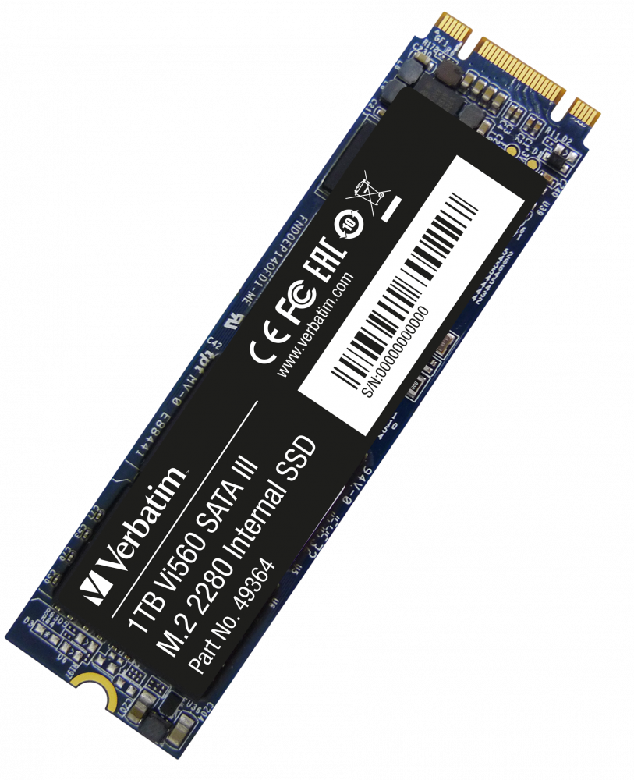
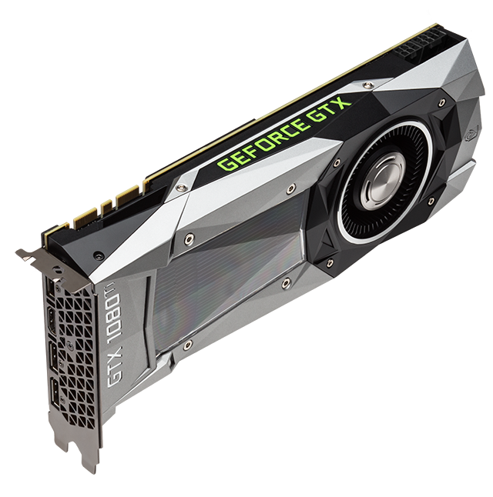
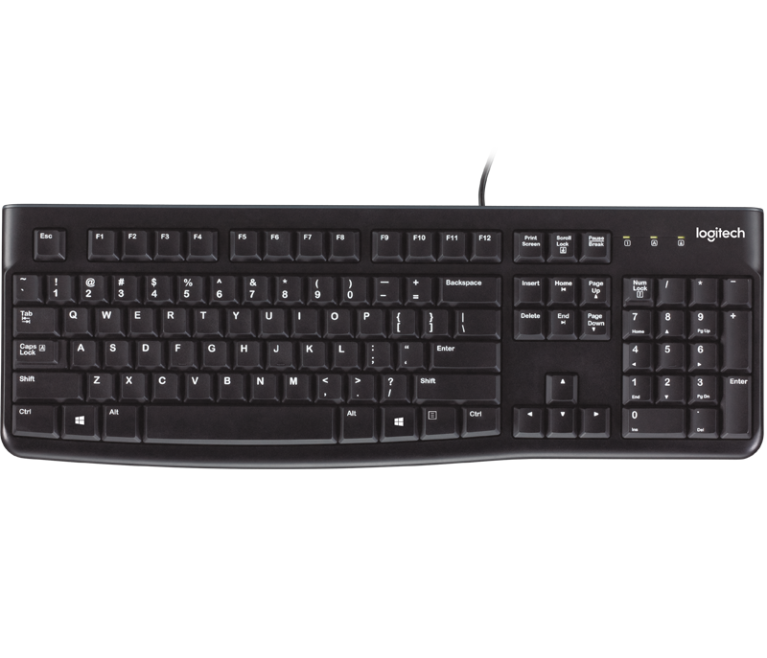
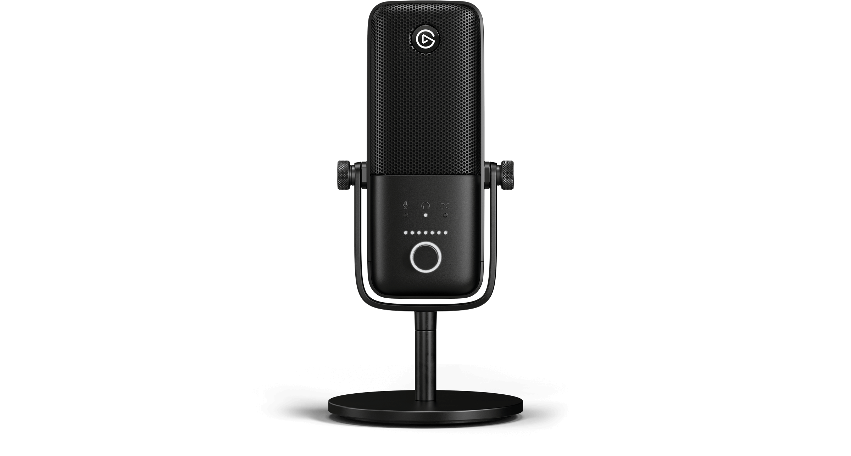
What is an OS?
Protection Boundary
Kernel
File System Networking
Device Drivers Processes
Virtual Memory
Hardware/Software Interface

Slide 4
Protection Boundaries
Multiple privilege levels
Different software can run with different privileges
Processors provide at least two different modes
  User space: how “regular” program run (e.g. steam)
  Kernel mode: How the kernel run
The mode determine a number of things
  What instructions may be executed
  How addresses are translated
  What memory locations can be accessed (through translation)

Slide 5
Example Intel
Four modes
  Ring 0: most privileged run the kernel here
  Ring 1/2: ignored in most environment. Can run less privileged code (e.g. third party device drivers or virtual machine monitors etc.)
  Ring 3: where “normal” processes live
Memory is divided in segments
  Each segment has a privilege level (0 to 3)
  Processor maintain a current privilege level (CPL) generally the CPL of the segment containing the instruction currently executing
  Can read/write in segment when CPL >= segment privilege
  Cannot directly call code in segment where CPL < segment privilege

Slide 6
Example MIPS
Standard two modes processor
  User mode: access CPU registers; flat uniform virtual memory address space
  Kernel mode: can access memory mapping hardware and special registers

Slide 7
Changing Protection Level
How do we transfer control between applications and kernel?
When do we transfer control between applications and kernel?

Slide 8
How?
Fundamental concept trap
There is different types of trap which relate to the when

Slide 9
When?
Sleeping beauty approach
  Wait for something to happens to wake up the kernel
  What might that be?
    System calls: an application wants the operating to do something on its behalf (e.g. access some hardware)
    Exceptions: an application does unintentionally something it should not (e.g. divide by zero, read an address it should not etc.)
    Interrupts: An asynchronous event (e.g. I/O completion)
Alarm clock approach
  Set a timer that generate an interrupt when it finishes

Slide 10
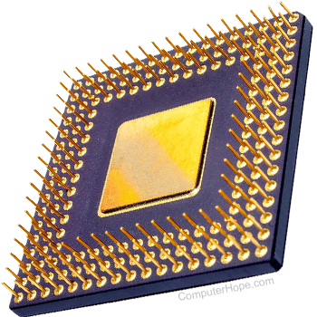
Trap
Each type of trap is assigned a number. For example
  System call: 1
  Timer interrupt: 2
  Disk interrupt: 3
The kernel build a table that map trap number to function addresses to be executed
These functions are called trap handlers
Done!
Trap Handler 1
Trap Handler 3
WAKE UP!
Trap handler table

Slide 11
Example MIPS
MIPS has 5 distinct traps, and their addresses are hardwired
  One each for: reset, NMI (non-maskable interrupt), fast-TLB loading and debug
  Sys161 does not support NMI and debug
  One for everything else (software must then do further dispatch)
Vital information are set in specific registers. For example:
  The EPC (program counter) tell you which instruction caused an exception
  Cause register indicate the source of the trap
    Interrupt
    Exception
    System call
    And what specific type it was
  Status register indicate
    The mode the processor was when it happened (i.e. user/kernel)
    States about which kind of interrupt are enabled

Slide 12
Example Intel
Hardware register
  Traditionally called PIC (Program Interrupt Controller)
  … then APIC (advanced PIC)
  … more recently LAPIC (local APIC) one per core
Remember
  X86 has multiple protection level (4)
  Cannot call code in a different level
  This needs to be handled
Interrupt Descriptor Table (IDT)
  Point to special objects called gate
  Raises the CPL
  When returning from a gate drops CPL to is original level
First 32 gates reserved for hardware defined traps
Remaining available to software using the INT (interrupt) instruction.
For system calls Linux uses a single desginated INT instruction
  Dispatch via software in the same we saw for MIPS

Slide 13
Thank you

