Slide 1

Computer Systems B
COMS20012
Introduction to Operating Systems and Security

Slide 2

Threads and zombies

Slide 3


Checkpoint
thread_yield
Core logic where the scheduler switch between threads
Implemented in kern/thread/thread.c (line 500)

Slide 4
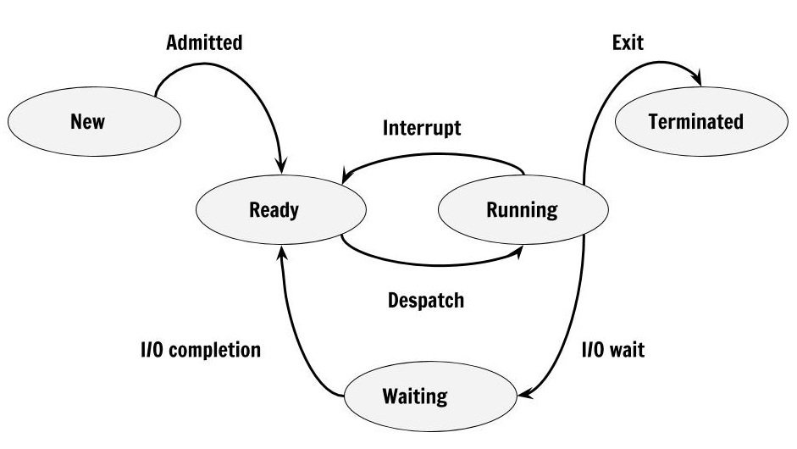
Thread states

Slide 5
Thread states
New
  Newly created thread
  This is the state while the thread is being initialized
  Does not exists as such in OS161
Ready
  The thread has been initialized
  It is waiting to be run
Run
  The thread is currently being executed
Waiting
  The thread is waiting on some IO completion
  Sleeping in OS161
Terminated
  The thread has finished executed and is waiting to be cleaned up
  This are the zombies in OS161

Slide 6
Note
Some schedulers may implement more states
This is the basic and minimum logic you need

Slide 7

Pause the video
Open kern/thread/thread.c
Resume the video

Slide 8
thread_yield
Line 500: function start
Line 616-639 switch to a new state
  Go to sleep (i.e., wait on IO)
  Go back to ready (i.e., let another thread execute due to the scheduler)
  Become a zombie (i.e., wait for the data to be cleaned up)
On line 620 calls thread_make_runnable
  Implemented line 465
  Interesting bit is line 482
    Add thread to the tail of a per cpu queue
Line 660-669
  Pick the head of the per cpu queue to be the next one to execute
Line 678-682
  Switch between the threads (see last week videos)
Line 731-end
  Clean up things and get things ready

Slide 9
Checkpoint
This is how you implement a basic round robin scheduler
In the next videos we will see more complex algorithms
The more adventurous can try to implement more complex algorithms for OS/161 (this is entirely optional)
We have seen all the basic building blocks to do so at this point

Slide 10
Thank you

