Slide 1

Computer Systems B
COMS20012
Introduction to Operating Systems and Security

Slide 2

MLFQ

Slide 3

Multi-level Feedback Queue
Widely used (Windows and Mac use a variant)
  It was used by Linux in the past too
Objective: good response time for interactive thread, non-interactive thread make as much progress as possible
  Key idea: interactive threads are frequently blocked, waiting for user inputs, network packets etc.
Approach: give higher priority to interactive thread so they run when they are ready
Problem: how to identify interactive threads?

Slide 4
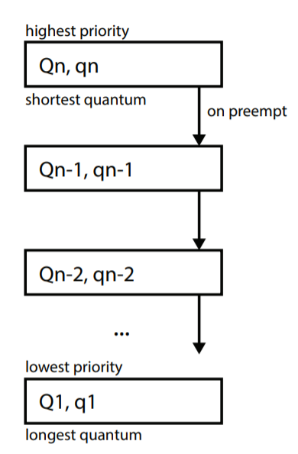
MLFQ algorithm
n round-robin queue sorted by order of priority
The higher the priority the shortest the quantum
Select thread from the highest priority queue
  Go down if no thread is available
  Continue until a thread to run is found
After a thread is preempted it is moved to a lower queue
When a thread wake-up from waiting on I/O it is put in the highest priority queue
Interactive threads often “block” waiting on input
  they will live often in high priority queue
  non interactive threads naturally fall to the bottom

Slide 5
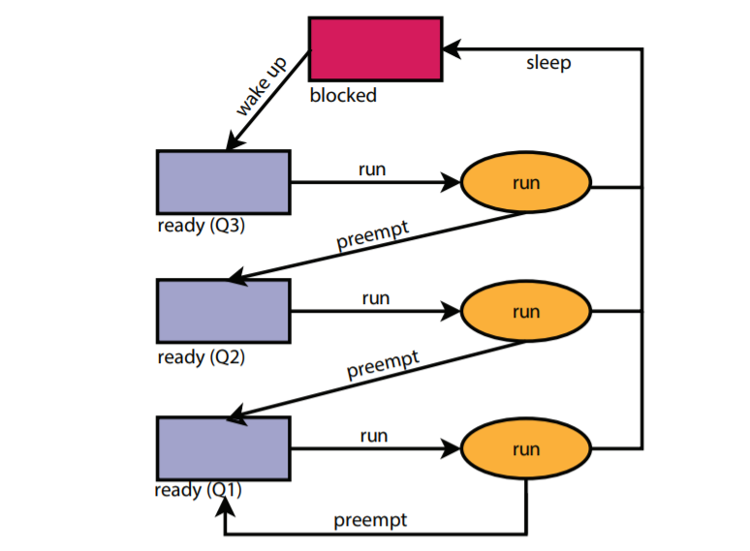
MLFQ example
Potential starvation
problem?

Slide 6
MLFQ example
Potential starvation
problem?
Threads in Q1 cannot run
if threads are continuously
added to Q3

Slide 7
MLFQ example
Potential starvation
problem?
Threads in Q1 cannot run
if threads are continuously
added to Q3
Periodically move thread
from Q1 to Q3

Slide 8
MLFQ example
T1 and T2 start in Q3
T1
T2

Slide 9
MLFQ example
T1 is selected to run
T2
T1

Slide 10
MLFQ example
T1 is preempted
  Pushed to Q2
T2 is selected to run
T2
T1

Slide 11
MLFQ example
A new thread T3 is added
T3
T2
T1

Slide 12
MLFQ example
T2 terminates
T3 is selected
T3
T1

Slide 13
MLFQ example
T3
T3 block
T1 is selected
T1

Slide 14
MLFQ example
T3
T3 is waking up what to
do?
T1

Slide 15
MLFQ example
T3 is woken up
  Pushed to Q3
Many version of MLFQ
preempt low priority
threads when interactive
ones wake up
T1 is preempted
  Pushed into Q1
T3
T1

Slide 16
MLFQ example
T3 is selected to run
T3
T1

Slide 17
Note
You’ve seen the building blocks for this in OS161 in previous videos
  Preemption logic
  Queues
  How to set quantum
  etc.
You could relatively easily implement this if you wanted to

Slide 18
Thank you

