Slide 1

Access Control
Hastily covered by Gretch Hallett
Email: gretch.hallett@bristol.ac.uk
Dr. Sana Belguith

Slide 2




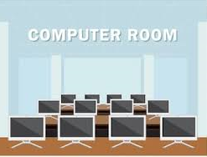




Access Control Example
!
!
Student
Access the university building
Access the computer lab
No access the staff room
Access the computer lab
Access the university building
Access the staff room
Staff Member
No access to the university building
!
!
!
!
NO ID
The staff room isn’t actually locked…
Nor is the CS building…
And even if it were, we probably don’t want to enforce it
External

Slide 3

Access Control Example
Identification
Authentication
Enforcement Mechanism
Authorisation
It’s always a fun game to see
If you can convince this one to
Let you in anyway… I’m staff and
If you don’t let me in you’re gonna
Have to tell the students the lecture’s
Cancelled works well…
Student
Student
Staff Member
Staff Member
NO ID
NO ID
External
External
Present Identity
Present Photo ID
Check ID by Security Agent
Staff Member Access

Slide 4
What is Access Control
personal data, content, hardware, ...
users, programs, ...
operation, parameters, ...
The ability to allow only authorized users, programs or processes system or resource access
The granting or denying, according to a particular security model, of certain permissions to access a resource
An entire set of procedures performed by hardware, software and administrators, to monitor access, identify users requesting access, record access attempts, and grant or deny access based on pre-established rules.
Subject
Access request
Object

Slide 5
Access Control Basic Elements
• concept equates with that of process typically held accountable for the actions they initiate
• often have three classes: owner, group, world
subject entity capable of Accessing objects
Access Control
access right describes the way in which a subject may access an object
Object resource to which access is controlled
• entity used to contain and/or receive information
• protection depends on the environment in which access control operates
• e.g. read, write, execute, delete, create, search

Slide 6
Access Control < Authorization Logic
That approach to access control is the traditional ”high level” one… but access control has been around FOREVER.
The earliest academic approaches were Blaze et al.’s PolicyMaker and KeyNote which acted as Trust Management systems…
What we want is a signed attestation from a trusted authority (a signed permission slip) from *someone* to say this action is okay…
Here the authority is the signer, the principles are any people involved and the subject is whatever is on the permission slip. The policy is the all the rules stapled together…
Γ ⊨ authority says subject may X

Slide 7
Access Control: Domains and Applications
Social Networks
Web Browsers
Operating Systems
Firewalls
Okay so these are some places you may have a
Heading in the settings called “Access Control”
But in reality this is being enforced every where
Just because any authorization decision *will* have
A policy associated with it… even if that policy is
Just ”yes”.
Formally: Γ ⊨ ⊤
Notes:
Do you use social networks ?
Where re do you think you are applying AC?

Slide 8
Access Control Methods
Again, this is an oversimplification.
Various styles of access control policy exist, and any system may implement as many of them as it likes when describing what is permitted.
These terms are just used to describe broad strategies…
Ultimately its all just a question of style
Mandatory Access Control
Discretionary Access Control
Role Based Access Control
Attribute Based Access Control
Multiple Access Control Policies. DAC, MAC, RBAC are not mutually exclusive.
A system may implement two or even three of these policies for some or all types of access.

Slide 9
Discretionary Access Control (DAC)
Oh no…
I’m going to get all grumpy here…
scheme in which an entity may enable another entity to access some resource
often provided using an access matrix
  one dimension consists of identified subjects that may attempt data access to the resources
  the other dimension lists the objects that may be accessed
each entry in the matrix indicates the access rights of a particular subject for a particular object
rule enforcement may be waived or modified by some users.

Slide 10
Discretionary access control is where the subject itself carries the authorization policy, and it is capable of passing that policy to another authority for enforcement (it’s at the subject’s discretion)
In the case of the UNIX DAC, this is at the file owner’s discretion.
First formalized by the US Department of Defence in the Trusted Systems Evaluation Criteria (TSEC 🌈)
This is about you controlling who can do what with your stuff

Slide 11
Access Control Matrix
ACM is a matrix of all principals and objects.
The matrix entries describe the permissions for Subjects, Objects, and operations
Can determine
  Who can access an object
  What objects can be accessed by a subject
  What operations a subject can perform on an object
Problem: maintaining such a matrix can be difficult.
If the matrix is corrupted then all controls is lost.
Ehhh… no harder or more corruptible than storing any other bit of information…

Slide 12
Access Control Matrix
Suppose the private key file for J is object O1: Only J can read the key
Suppose the public key file for J is object O2: All can read, only J can modify
Suppose all can read and write from object O3
What’s the access matrix?
 | O1 | O2 | O3
J | ? | ? | ?
S2 | ? | ? | ?
S3 | ? | ? | ?
 | O1 | O2 | O3
J | R | R, W | R, W
S2 | N | R | R, W
S3 | N | R | R, W

Slide 13
Least Privilege
Least privilege is that the security policy ought to allow a principle the minimum number of actions to complete their work.
The Principle of Least Privilege states that a subject should be only given those privileges needed for it to complete its task.
If a subject does not need an access right, the subject should not have that right.
Limit permissions to those required and no more
Consider three processes for user J
Restrict privilege of the process O3 to prevent leaks
 | O1 | O2 | O3
J | R | R, W | N
S2 | N | R | R, W
S3 | N | R | R, W
The umask on a Linux system by default is 022 (group and other may not write to a new file)…
is this failing to meet least privilege?
Is this a vulnerability or a permissive default? Don’t get too het up about least privilege…

Slide 14
Access Control Lists (ACLs)
This is just storing a matrix in adjacency list form…
It’s still a massive matrix, just stored differently.
We do not want to store one massive matrix.
Instead we can store each column of the matrix with the object it refers to.
For example:
(O2,(J,RW), (S2,R), (S3,R))
 | O1 | O2 | O3
J | R | R, W | R, W
S2 | N | R | R, W
S3 | N | R | R, W

Slide 15
Traditional UNIX File Access Control
I’m going to assume you all actually know this, because you’ve been using Linux for years at this point?
Yell if I need to go slowly!
“set user ID”(SetUID)
“set group ID”(SetGID)
  system temporarily uses rights of the file owner / group in addition to the real user’s rights when making access control decisions
  enables privileged programs to access files / resources not generally accessible
superuser
  is exempt from usual access control restrictions
  has system-wide access

Slide 16
Access Control Lists (ACLs) in UNIX
modern UNIX systems support ACLs: FreeBSD, OpenBSD, Linux, Solaris
FreeBSD
  Setfacl command assigns a list of UNIX user IDs and groups
  any number of users and groups can be associated with a file
  read, write, execute protection bits
  a file does not need to have an ACL
  includes an additional protection bit that indicates whether the file has an extended ACL
when a process requests access to a file system object two
steps are performed:
  step 1 selects the most appropriate ACL: owner, named users, owning / named groups, others
  step 2 checks if the matching entry contains sufficient permissions

Slide 17
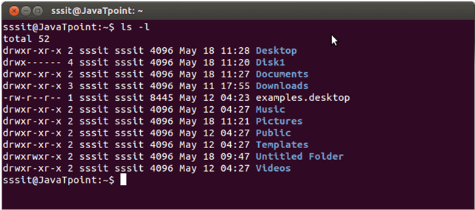
Access Control in Unix/Linux
Unix/Linux/Mac use ACL, with groups.
“uid” set when you log on.
Linux Kernel then dynamically enforces the ACLS.
ls –l displays files with their ACL
root owns everything (“get root” = control the system)

Slide 18
The UNIX Access Control List
The permissions
The owner
size
File name
-rw-r----
1
bob
staff
6
9 Aug 22:18
Test.txt
Link Counter
The group
The date

Slide 19
UNIX File Permissions
Permissions:
  r: read permission
  w: write permission
  x: execution permission
  -: no permissions
File Type:
- : file
d : directory
b/c: device file
Owner permissions
D
RWX
RWX
RWX
File type
Group permissions
Other permissions

Slide 20
Mandatory Access Control (MAC)
So the mandatory part is that it is mandated by an authority and individual files/principles can’t circumvent that.
Systems administrator sets the policy as to who can access what
Typical implementations of you might see:
  SELinux: NSA’s patches for Linux to add a MAC. Complex but powerful.
  AppArmour: Canonical’s simplified MAC system based on paths
  Sandboxd which is Apple’s
Policies can be applied to more than just files
For example: “The web browser can access files in the downloads folder ONLY”
Rules are enforced on every attempted access, not at the discretion of any system user;
This is used to enforce security policies at an organizational level… and clearances.
e.g. a SECRET user may not read TOPSECRET files

Slide 21

SELinux basics
You define types that get added to files and processes by the policy…
You define contexts and domains in which the labels matter… (via a lot of macros)
The label grants whether an action is permitted when a given context is active…
allow httpd_t mysqld_etc_t:dir {
getattr search open read lock ioctl
};

Slide 22
Role-Based Access Control
Role-based access control (RBAC) is a widely used security framework claimed to be especially appropriate for commercial settings.
Unlike access control policies that assign permissions to subjects, RBAC associates permissions with functions/jobs/roles within an organization.
A role is a collection of job functions. Roles within a bank might include: president, manager, trainer, teller, auditor, janitor, etc.

Slide 23
Role-Based Access Control
Associate permissions with job functions
  Each job defines a set of tasks
  The tasks need permissions
  The permissions define a role
• Bank Teller:
  Read/Write to client accounts
  Cannot create new accounts
  Cannot create a loan
Role defines only the permissions allowed for the job

Slide 24
Role-Based Access Control
An individual has:
a set of authorized roles, which it is allowed to fill at various times;
a set of active roles, which it currently occupies.
Roles have an associated set of transactions, which are the activities that someone in that role is permitted to carry out.
The set of transactions can be organization specific: open an account, cash a check, transfer funds, etc.

Slide 25
Role-Based Access Control
The following are the three primary RBAC rules:
  Role assignment: A subject can execute a transaction only if the subject has an active role.
  Role authorization: A subject’s active role must be an authorized role for that subject.
  Transaction authorization: A subject can execute a transaction only if the transaction is authorized for one of the subject’s active roles.
Note that a subject can have multiple roles. For example, a bank president might also act as a teller.

Slide 26
Attribute-based Access Control
In the attribute-based access control mechanism, access rights are defined upon attributes.
The users’ identities are not used anymore to define access rights.
In ABAC, to get access, users need to prove their possession of the required attributes. Thus, users are authenticated to the server to prove their rights.
ABAC is an extension of RBAC where users’ roles are more generalized.
User access rights are expressed using a set of attributes.

Slide 27
Sandbox
Sandboxing is a cybersecurity procedure in which you run code, analyze it, and code in a secure, enclosed environment on a system that resembles end-user working environments. It is intended to prevent the potential threat from entering the network and is commonly used to scrutinize unknown or non-secure code.

Slide 28
Running Untrusted Code
We often need to run buggy/untrusted code:
–programs from untrusted Internet sites: toolbars, viewers, codecs for media player
–old or insecure applications
–legacy software
=> Goal: if application “misbehaves,” kill it.
Kill it is, perhaps, an oversimplification…
Depending on what we’re sandboxing we might want to just log, deny or return dummy data…

Slide 29
Examples
Web Pages: Your browser essentially sandboxes the web pages it loads. Web pages can run JavaScript code, but this code can not do anything it wants — if JavaScript code tries to access a local file on your computer, the request will fail.
PDFs: Adobe Reader now runs PDF files in a sandbox, preventing them from escaping the PDF viewer and tampering with the rest of your computer.
In general, any application that runs in a VM (i.e. a browser or interpreter) is to a degree sandboxed… but that sandbox tends to be fairly permissive by default

Slide 30
Examples
Mobile Apps: Mobile platforms run their apps in a sandbox. Apps for iOS, Android, and Windows 8 are restricted from doing many of the things standard desktop applications can do. The sandbox disconnects the applications, stopping them from interfering with one another.
Windows Programs: User Account Control functions as a bit of a sandbox, essentially restricting Windows desktop applications from modifying system files without first asking you permission. User Account Control just restricts access to system files and system- wide settings.

Slide 31
Benefits of Sandboxing
Prevents zero-day attacks:
Zero-day threats exploit unknown security flaws. They are highly hazardous because manufacturers cannot issue patches unless they fully comprehend the exploited vulnerability.
Sandboxing software performs admirably in isolating these menaces. Though there is no assurance that it will prevent zero-day manipulations, sandboxing most often works for damage limitation by distancing the potential danger from the remainder of the network.
Enhances other security programs
Sandboxing is an excellent complement to specific other security software, ranging from action monitoring programs to antivirus programs. Conversely, sandboxing software shields against spyware strains that your virus protection may struggle to detect.

Slide 32
Benefits of Sandboxing
Helps examine presumably malicious programs for threats
If you’re dealing with new vendors or untrustworthy software sources, you can try out a new application for threats before incorporating it.
Allows rigorous software tests before they are released
Software changes should be thoroughly tested before they are released to the public. Sandboxing can be used to test new code for possible risks before it officially launches. Therefore, it has a vital role to play in application security.
And in more general keeps the principle of least privilege by ensuring that things cannot touch things that do not concern them.
Earliest example is chroot(2) and it was intended as a mechanism to keep the runtime of an application local to it more than a security tool

Slide 33
How To Sandbox Any Program
Virtual Machines: A virtual machine program like VirtualBox or VMware creates virtual hardware devices that it uses to run an operating system.
This entire operating system is essentially sandboxed, as it does not have access to anything outside of the virtual machine.
Using other tools: Sandboxie, Bufferzone

Slide 34
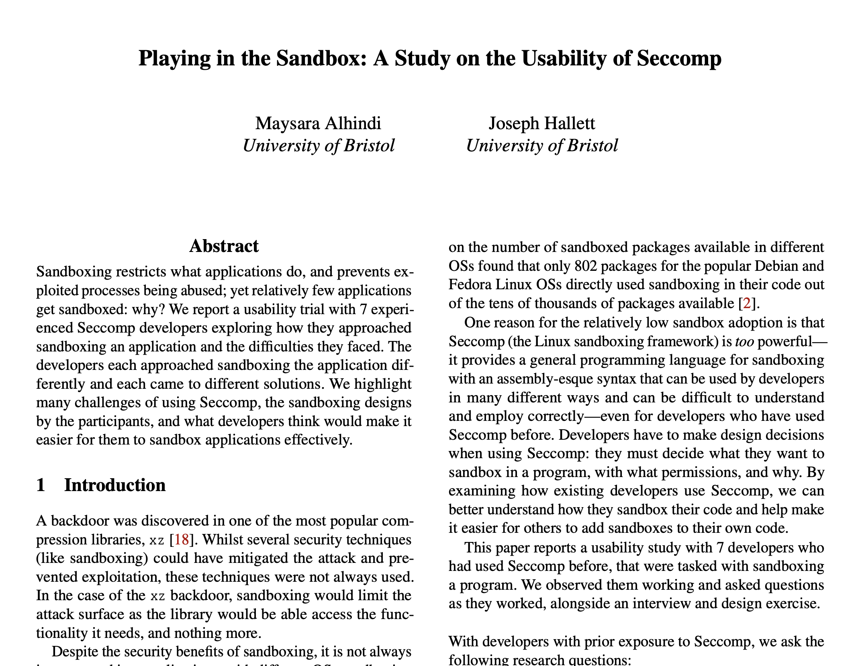
Seccomp
https://www.usenix.org/conference/soups2025/presentation/alhindi
Linux’s sandboxing mechanism is called seccomp…
It is a weird assembly language implemented atop a programming language for firewall rules (BPF)
You define arbitrary rules for system calls and can programmatically inspect arguments
No one can use it comfortably.

Slide 35
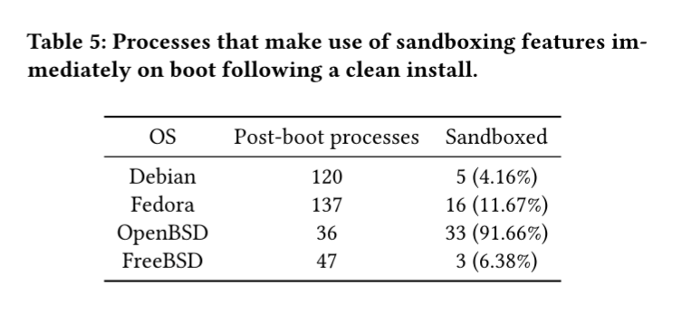
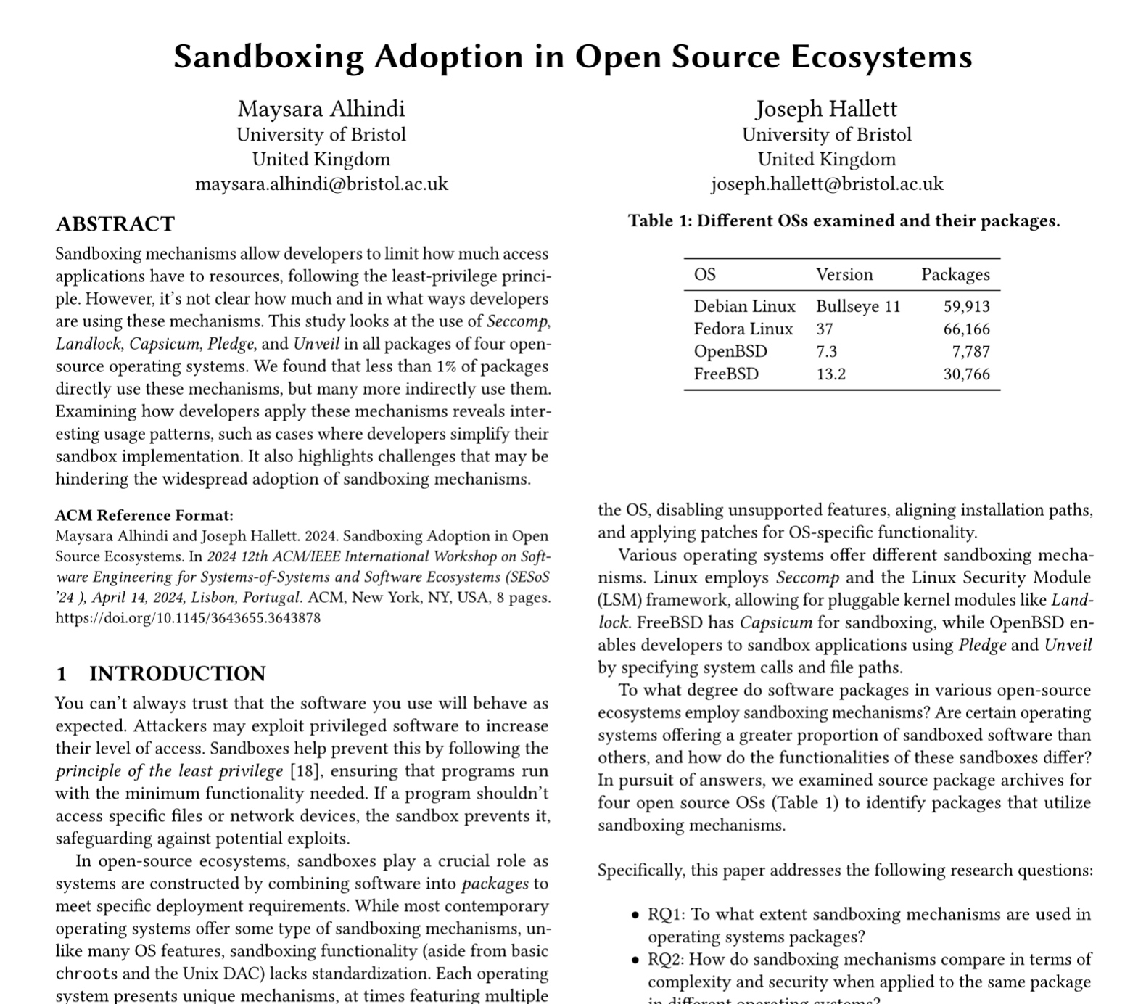
No seriously…
We did this study looking at what got
Sandboxed in various Linuxen and BSDs…
Barely any of the Linuxen sandbox things by default…
And when they do… they tend to try and copy the default rules of OpenBSD where everything is
Sandboxed by default…
why?

Slide 36
pledge(2) and unveil(2)
OpenBSD has two sandboxing mechanisms…
pledge reduces the systemcalls you can make to a predefined list
  for example, net for networking, libc for libc
unveil says whether you can see a file…
  everything else is hidden once you pledge to use it
There is no way to disable it once enabled… just 2 systemcalls
EVERYTHING uses it
(OpenBSD can make everything use it because the OS and its runtime update together and are controlled… not built from disparate components like Linux is… so they do the work or core and send changes upstream for packages… and because its two easily auditable lines…)

Slide 37
Reading references
  [1] Stallings, W., Cryptography and Network Security: Principles and Practice, 7th ed., 2017, Pearson.
  [2] Goodrich M. and Tamassia Roberto, Introduction to computer security, Boston, MA : Pearson, 2011.
  [3]- Bishop M., Introduction to computer security, Chapter 12, first printing, 2004.
  [4] Prevelakis, V. and Spinellis, D., 2001, June. Sandboxing Applications. In USENIX Annual Technical Conference, FREENIX Track (pp. 119-126).
  [5] Greamo, C. and Ghosh, A., 2011. Sandboxing and virtualization: Modern tools for combating malware. IEEE Security & Privacy, 9(2), pp.79-82.

