Slide 1


Introduction to Fuzzing
Hastily covered by Gretch Hallett
Email: jo.hallett@bristol.ac.uk
Dr. Sana Belguith
Sana.belguith@bristol.ac.uk

Slide 2
Fuzzing
No, it is not about Fuzzy logic
Neither about fuzzy set membership
Security Software Testing
Memory Corruption Bugs
Exploitable
References:
1. book (Chapter 1, section 1.3): Fuzzing for Software Security Testing and Quality Assurance. Ari Takanen, Jared DeMott, Charlie Miller
2. Article "Fuzzing: Hack, Art, and Science” By P. Godefroid
Notes:
You have already faced bugs in the lab right, memory corruption buffer overflow and so on
Security testing to find bugs but also to tell you whether they are exploitable
For more info, check these books

Slide 3
How do we track how many bugs we have?
All software is buggy
We try and fix the bugs
It would be nice if we could tell people which updates fix which bugs, and which bugs are being actively exploited and share…
If only we had some sort global bug database for security vulnerabilities…

Slide 4
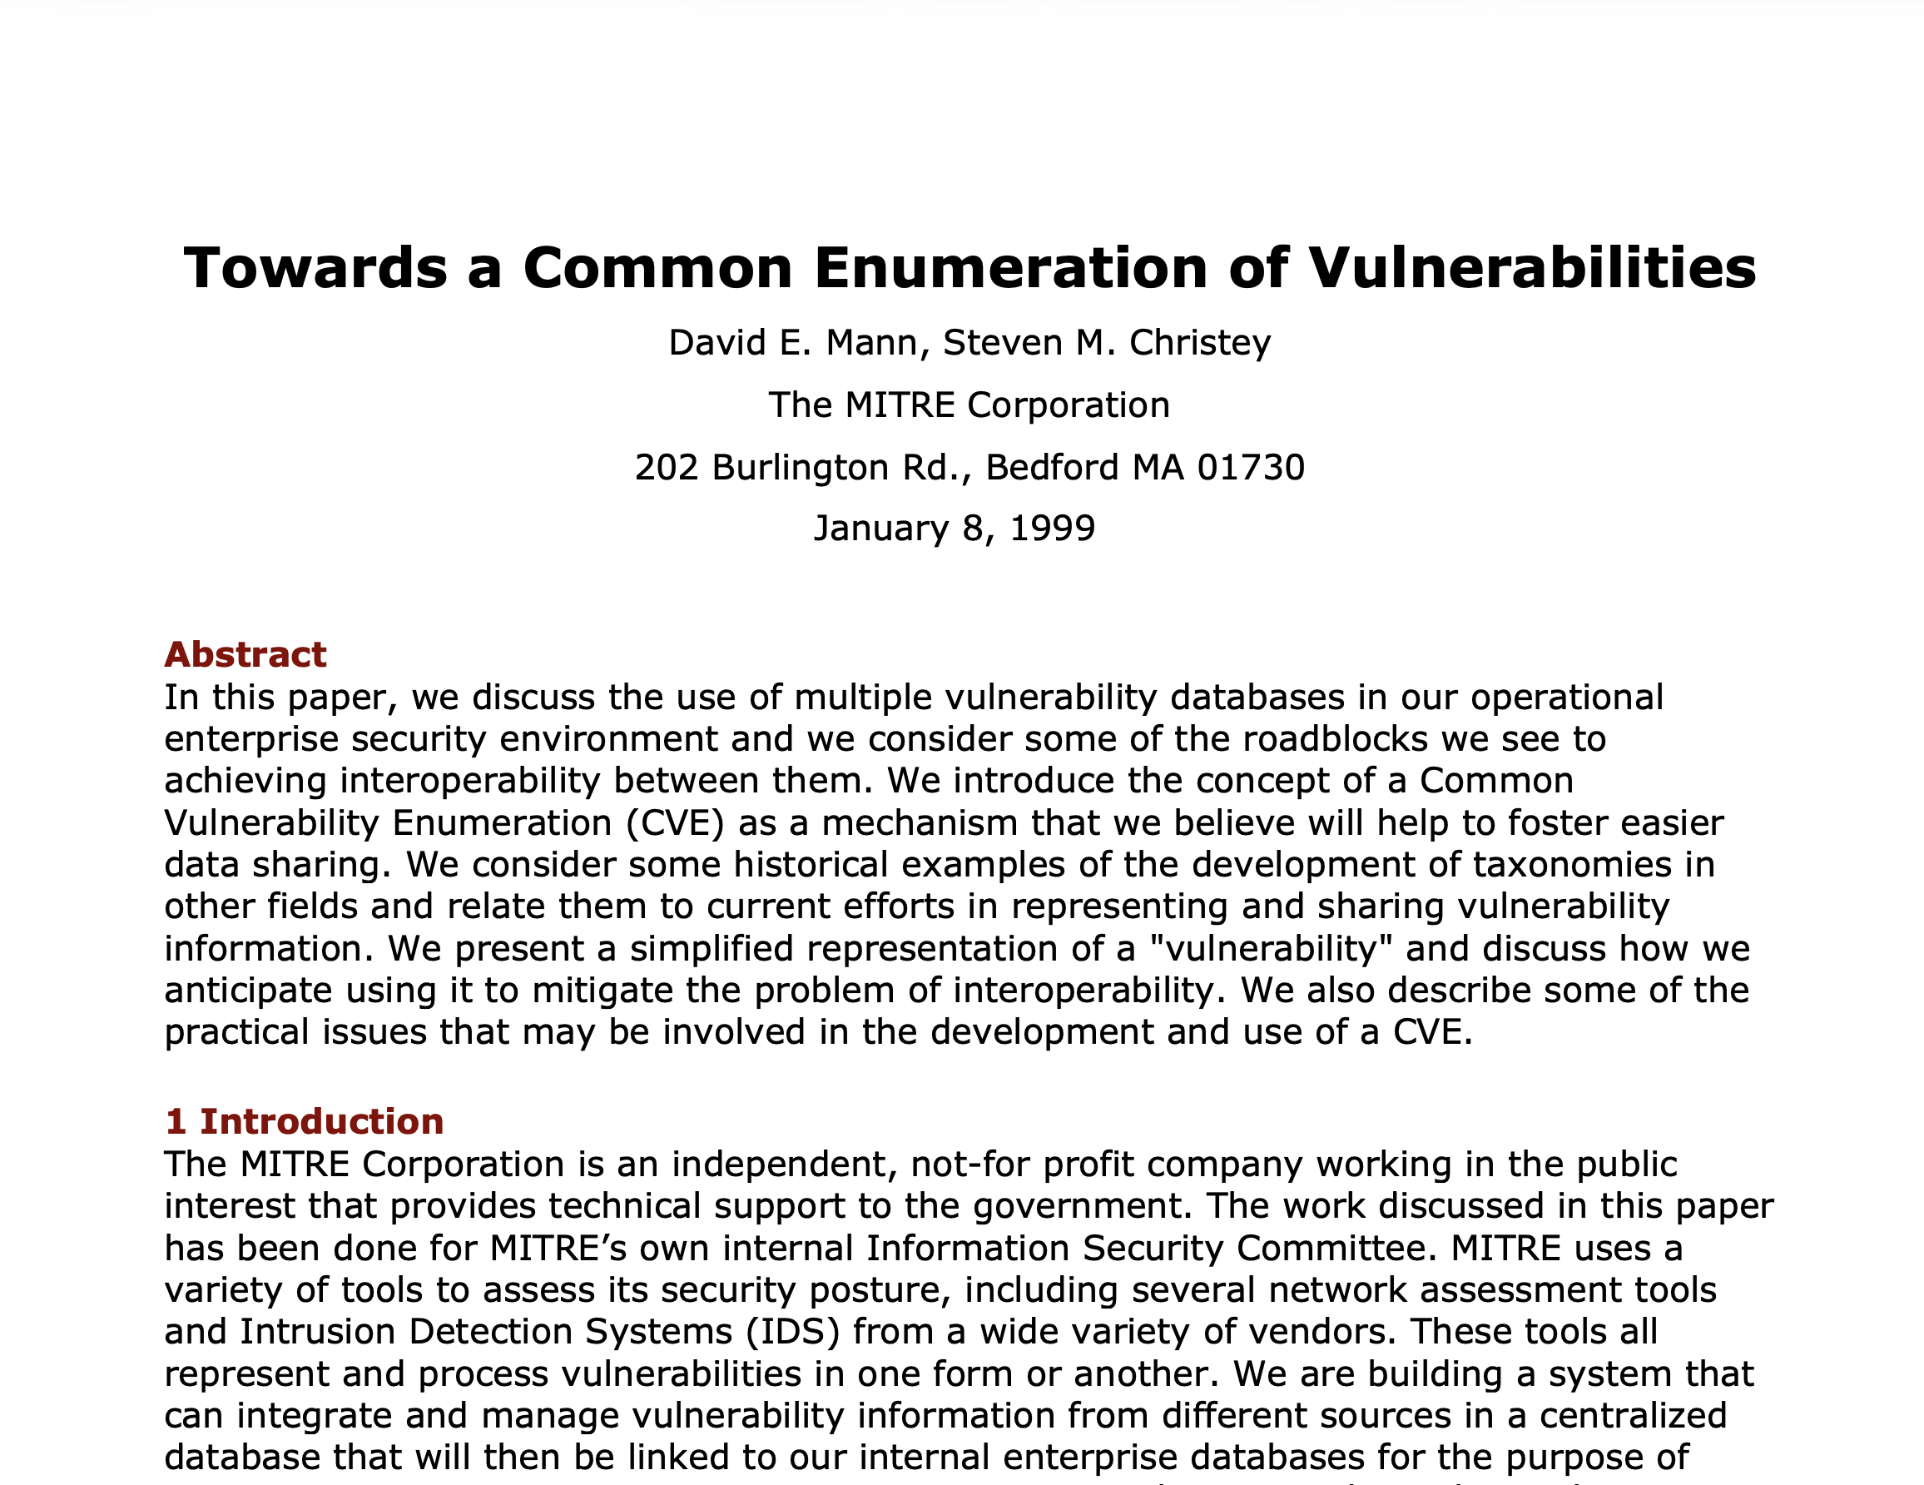
CVE
Common Vulnerabilities Enumeration
Back In 1999 David Mann and Steven Christey at MITRE/Purdue Uni write a paper and publish the first list
Companies can apply to become CVE Numbering Authorities (CNAs) and assign bugs numbers for some software (e.g. Linux Foundation for Linux)
Security researchers start to judge
themselves by how many CVEs they
can get assigned
  (this is stupid)

Slide 5
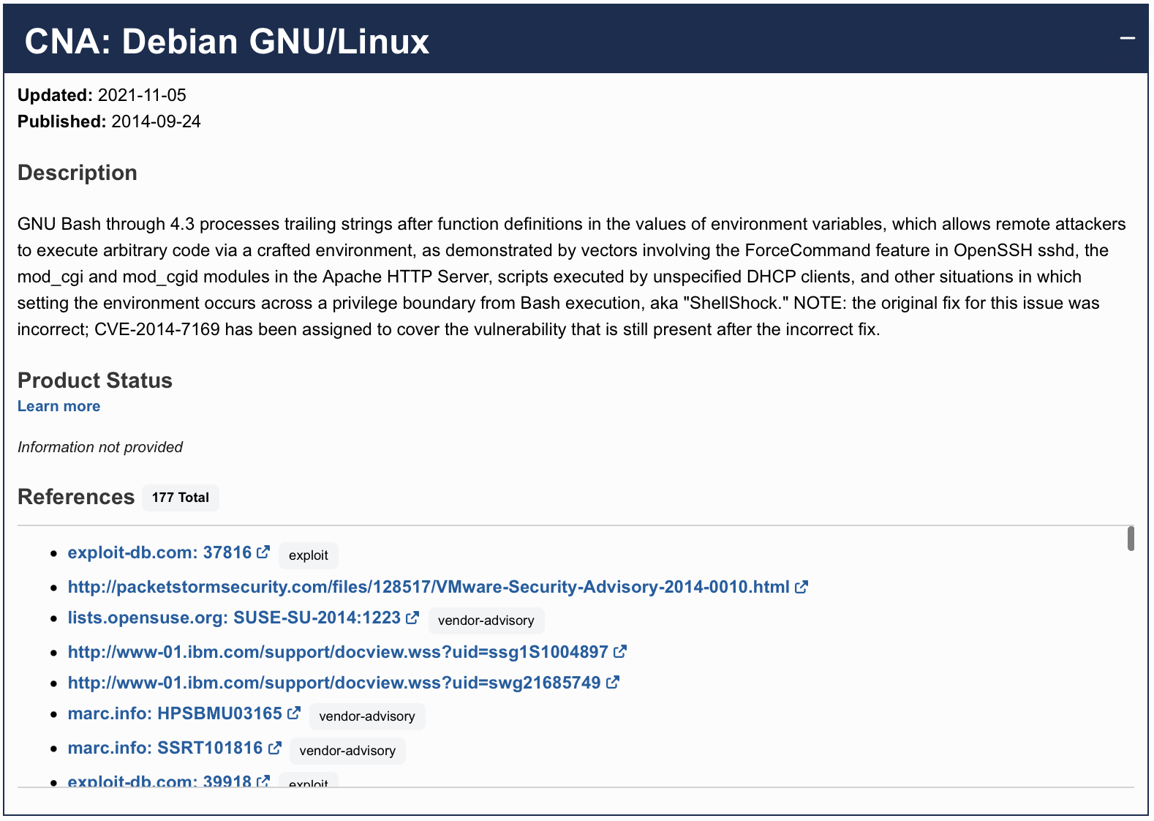

Slide 6
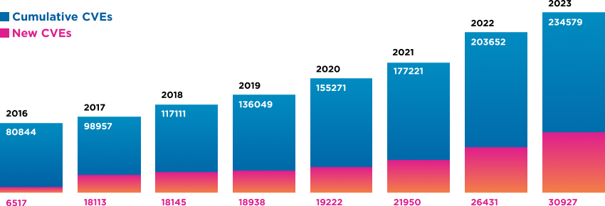
Why do we care?
As of 2024 it got SO MUCH WORSE: 40k CVEs then 48k CVEs last year, because AI has started applying for them (and some CNAs will give you a CVE for ANYTHING…)
Have I mentioned I *hate* AI?
https://www.skyboxsecurity.com/resources/report/vulnerability-threat-trends-report-2024/

Slide 7
The Plan
Memory corruption vulnerabilities
Fuzzing- finding vulnerabilities
Types of Fuzzing
Some existing solutions

Slide 8
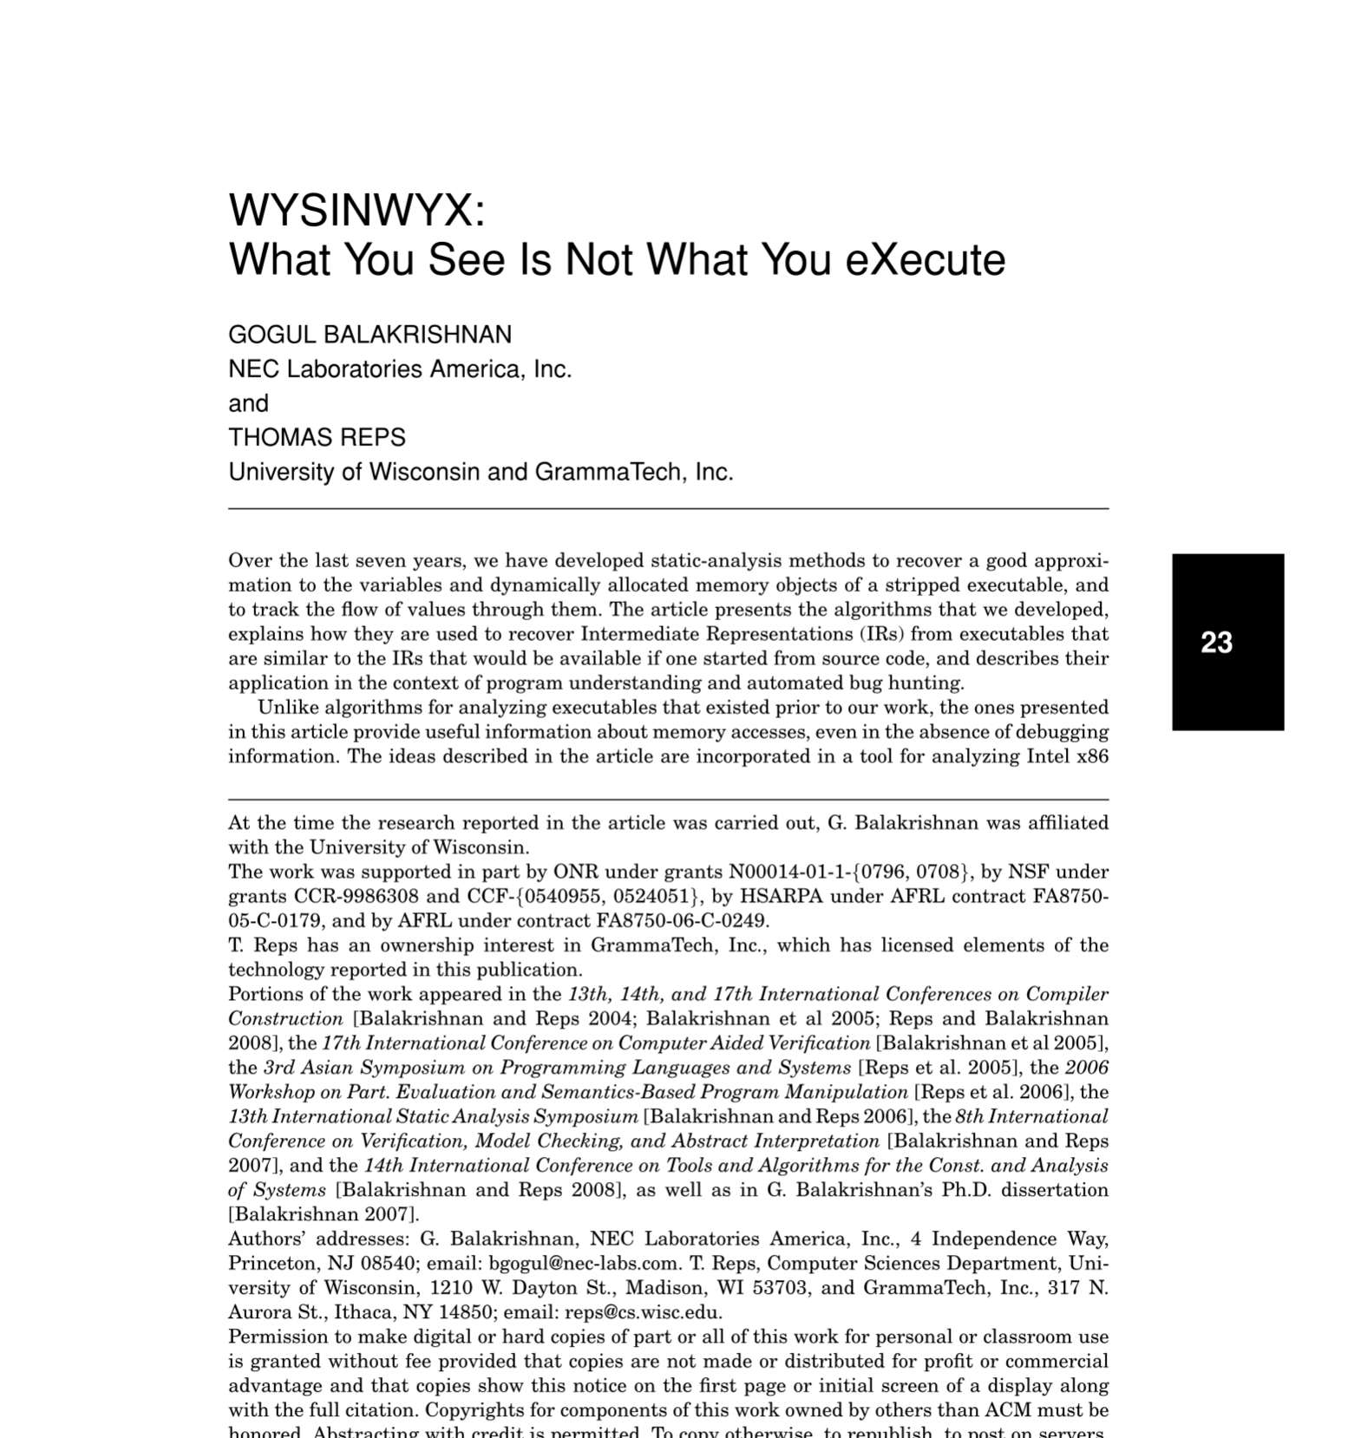
Memory Corruption Vulnerabilities
WYSINWYX: What You See Is Not What You eXecute by G. Balakrishnan et. al.
  Higher level code -> low-level representation
  Seemingly separate variables -> contiguous memory addresses
Contiguous memory locations allow for boundary
violations!
I kinda low-key hate this paper… it makes it seem like they invented hacking when less academic folk have been doing this for 30 years prior… — Gretch
Notes:
For more details, you can read the paper
In short when we do not allocate memory properly we would end up with vulnerabilities that can be used to run attacks as you have seen in the labs
What memory related problems we have covered ?

Slide 9
Example
#include <stdio.h>
int get_cookie(){
return rand();
}
int main(){
int cookie;
char name[40];
cookie = get_cookie();
gets(name);
if (cookie == 0x41424344)
printf("You win %s\n!", name);
else
printf("better luck next time\n");
return 0;
}

Slide 10
Example
#include <stdio.h> int get_cookie(){
return rand();} int main(){
int cookie; char name[40];
cookie = get_cookie(); gets(name);
if (cookie == 0x41424344) printf("You win %s\n!", name);
else printf("better luck next time :("); return 0;
name
}

Slide 11
Example
#include <stdio.h> int get_cookie(){
return rand();} int main(){
int cookie; char name[40];
cookie = get_cookie(); gets(name);
if (cookie == 0x41424344) printf("You win %s\n!", name);
else printf("better luck next time :("); return 0;
name
cookie
}

Slide 12
Example
#include <stdio.h> int get_cookie(){
return rand();} int main(){
int cookie; char name[40];
cookie = get_cookie(); gets(name);
if (cookie == 0x41424344) printf("You win %s\n!", name);
else printf("better luck next time :("); return 0;
}
name
cookie
Saved RET
Buffer Overflow!
Notes:
What can we create if we supply a very long string more than 40 bites ?
Therefore you will overflow the written address

Slide 13
Example
#include <stdio.h> int get_cookie(){
return rand();} int main(){
int cookie;
name
char name[40];
cookie
cookie = get_cookie();
Random Value
gets(name);
Saved RET
if (cookie == 0x41424344) printf("You win %s\n!", name);
else printf("better luck next time :("); return 0;
}
Memory corruption

Slide 14
Side effects
Over/underflow
Sensitive data corruption
Control data corruption (control hijacking)

Slide 15
Side effects
Over/underflow
Sensitive data corruption
Control data corruption (control hijacking)
If exploit is done properly, Otherwise crash!

Slide 16

Fuzzing
It started on a dark and stormy night…. [Barton P. Miller, late1980s]
https://pages.cs.wisc.edu/~bart/fuzz/Foreword1.html
Notes:
Sitting in my apartment in Madison in the Fall of 1988, there was a wild midwest thunderstorm pouring rain and lighting up the late night sky.
He was logged on to the Unix system in my office via a dial-up phone line over a 1200 baud modem. With the heavy rain, there was noise on the line and that noise was interfering with my ability to type sensible commands to the shell and programs that I was running. It was a race to type an input line before the noise overwhelmed the command.
This fighting with the noisy phone line was not surprising. After all, this was just before error-correcting modems were available.
What did surprise me was the fact that the noise seemed to be causing programs to crash. And more surprising to me were the programs that were crashing -- common Unix utilities that we all use everyday.
The scientist in me said that we need to make a systematic investigation to try to understand the extent of the problem and the cause.
That semester, I was teaching the graduate Advanced Operating Systems course at the University of Wisconsin. Each semester in this course, we hand out a list of suggested topics for the students to explore for their course project. I added this testing project to the list; the text for this project description appears in the break-out box below.
In the process of writing the project description, I needed to give this kind of testing a name. I wanted a name that would evoke the feeling of random, unstructured data. After trying out several ideas, I settled on the term fuzz.
Three groups attempted the fuzz project that semester and two failed to achieve any crash results. Lars Fredriksen and Bryan So formed the third group, and were more talented programmers and more careful experimenters; they succeeded well beyond my expectations. As we reported in the first fuzz paper [1990], they could crash or hang between 25-33% of the utility programs on the seven Unix variants that they tested.

Slide 17
Sitting in my apartment in Madison in the Fall of 1988, there was a wild midwest thunderstorm pouring rain and lighting up the late night sky. He was logged on to the Unix system in my office via a dial-up phone line over a 1200 baud modem. With the heavy rain, there was noise on the line and that noise was interfering with my ability to type sensible commands to the shell and programs that I was running. It was a race to type an input line before the noise overwhelmed the command. This fighting with the noisy phone line was not surprising. After all, this was just before error-correcting modems were available.
What did surprise me was the fact that the noise seemed to be causing programs to crash. And more surprising to me were the programs that were crashing -- common Unix utilities that we all use everyday.
The scientist in me said that we need to make a systematic investigation to try to understand the extent of the problem and the cause.
That semester, I was teaching the graduate Advanced Operating Systems course at the University of Wisconsin. Each semester in this course, we hand out a list of suggested topics for the students to explore for their course project. I added this testing project to the list; the text for this project description appears in the break-out box below. In the process of writing the project description, I needed to give this kind of testing a name. I wanted a name that would evoke the feeling of random, unstructured data. After trying out several ideas, I settled on the term fuzz.
Three groups attempted the fuzz project that semester and two failed to achieve any crash results. Lars Fredriksen and Bryan So formed the third group, and were more talented programmers and more careful experimenters; they succeeded well beyond my expectations. As we reported in the first fuzz paper [1990], they could crash or hang between 25-33% of the utility programs on the seven Unix variants that they tested.

Slide 18
Fuzzing
Security testing technique
Run program on many abnormal/malformed inputs, look for unintended
behavior, e.g. crash.
  An observable (measurable) side effect is essential
  Should be scalable
Underlying assumption: if the unintended behavior is dependent on input, an
attacker can craft such an input to exploit the bug.
Crash
Notes:
Normally memory corruption works results in a crash most of the time. there are some exceptions,
Observable side effect is essential, it does not tell you about the bug exactly by looking at the bug itself but it detects the side effect that indicates the presence of the bug
Very scalable, running as many inputs as you can to detect bugs, several thousands input in a short time
You can use any large complex real world application
Dynamic technique, so we have to run the program and provide some inputs
Then we look out for crashes and if it HAPPENS THEREFORE the crash is dependant on the input so we can craft the input to exploit the bug
Because as we said from the beginning we are looking for exploitable bugs
If for a program you run it with a valid input and it behaves normally, then when you use a crafted input and the program crashes therefore there is a relation between that inout and the crash
And therefore an attacker can craft such an input exploit that bug
So whenever fuzzing is showing a crash there is a high chance that this is an indication for exploitable vulnerability

Slide 19
Types of Fuzzing
Input based: mutational and Generative (grammar based)
Application based: black-box and white-box
Input Strategy: memory-less and evolutionary

Slide 20
Input Generation
Mutation Based: mutate seed inputs to create new test inputs:
Simple strategy is to randomly choose an offset and change the byte.
Pros: easy to implement and low overhead
Cons: highly structured inputs will become invalid quickly → low coverage.
Notes:
Diagram Create a new input from an existing input
Image input to image viewer, we start with I, then we change I the way we want
Easy and low overhead
Especially for highly structured files for example XML, when you change bits you change the structure and the parser will suffer because you have changed the structure

Slide 21
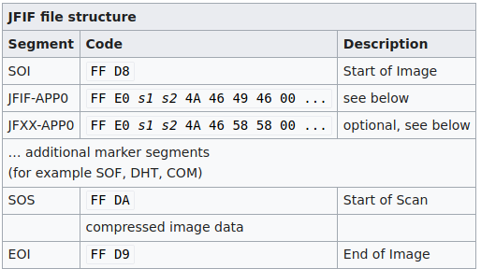
JPEG file format
Every week someone finds a new vulnerability in JPEG decoders it seems… lots issued last year…

Slide 22
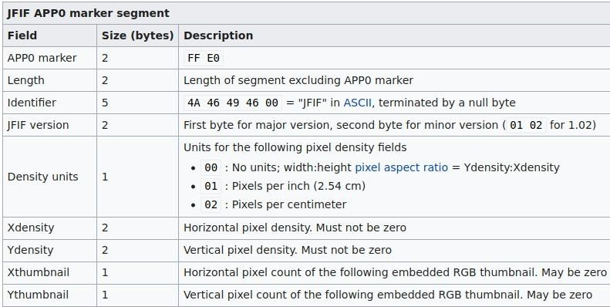
JPEG file format

Slide 23
Input Generation
●
Generation (Grammar) Based:
learn/create the format/model of the input
generate new inputs based on the learned model
e.g. well-known file formats (jpeg, xml, etc.)
Pros: Highly effective for complex structured input parsing
applications → high coverage
Cons: expensive as models are not easy to learn or obtain.
Notes:
Diagram Parsing
Opposite to mutation
Input is crafted according to the structure
Input always follows some data structure that we need to obey
Pros: different from mutation based
Why we are focusing on parsing
Always for input for any application, we always have inputs
Highlevel application: we have input parsing and then manipulation
So if we are giving an inout that does not follow the format, the parsing part will not complete the parsing
If the parser is all right, we pass to manipulation
If not we will stop in the parsing
In reality the manipulation is where almost everything happens in an application so if we do not reach this part it means we cannot find any vulnerability
So the best ALWAYS TO pass parsing si we can detect vulnerability in manipulation phase
Learning these formats is not easy, many times we donot have access these models, for example to a recent time we could notknow the precise format of word fro example
And even if it is opensource, the are so complex so we cannot learn everything about such a format not talking about crafting an input for it

Slide 24
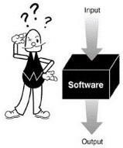
Application Monitoring
Blackbox: Only interface is known.
Notes:
We do not know what is happening inside

Slide 25
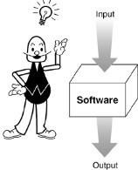
Application Monitoring
Blackbox: Only interface is known.
Whitebox: Application can be analysed/monitored.
Notes:
Have source code of the application we can do all types of analysis

Slide 26

Problem with Traditional Fuzzing
Blackbox + mutation: Aiming with luck!
... //JPEG parsing
read(fd, buf, size);
if (buf[1] == 0xD8 && buf[0] == 0xFF)
// interesting code here
else
pr_exit(“Invalid file”);
Notes:
Combinatin
Random input and we hope that we will hit crash
Random testing where do not know what to target
Checks first bytes
Random fuzzing, 256 possible values

Slide 27
Problem with Traditional Fuzzing
Apply more heuristics to:
  Mutate better
  Learn good inputs
Apply more analysis (static/dynamic) to understand the application behavior.
But remember the scalability factor!
Notes:
What we can do about it
Rather than doing random mutation we can learn about some possible keywords about the application
Find some structure
And also apply more analysis
Because these analysis will imply time and resources

Slide 28

Problem with Traditional Smart Fuzzing
smart fuzzing: Aiming with educated guess!
Notes:
Smart is traditional with more educated guee=sssing
We still guessing but while knowing direction

Slide 29
Evolutionary Fuzzing
Rather than throwing inputs, evolve them.
Underlying assumption:
Inputs are parsed enough before going further deep in execution
Evolve is, perhaps, the wrong word… we want to find the pathways through the program that lead to crashes… and then tweak them to see if we can get worse crashes.
Evolution of inputs that lead to death
Notes:
Changing inout while changing offsets I1 => I2 I3 I4 I5
We go back to the parsing then manipulation
If instructions sequensal
Change input that passes one if and change it further …
Higher chances to pass through parsing

Slide 30
Evolving A Fuzzer
Q
inputs

Slide 31
Evolving A Fuzzer
Seed Input
Bitflip, replace, arithmetic
Q
Mutate at offset X
inputs

Slide 32

Evolving A Fuzzer
Bitflip, replace, arithmetic
Q
Mutate at offset X
inputs
Execute and monitor edges (BB)
Notes:
Edges: are which side of intsructions are executed

Slide 33
Evolving A Fuzzer
Bitflip, replace, arithmetic
Q
Mutate at offset X
New edge
?
inputs
Execute and monitor edges (BB)

Slide 34
Evolving A Fuzzer
Bitflip, replace, arithmetic
Q
Mutate at offset X
New edge
?
inputs
Execute and monitor edges (BB)
Yes, add input to Q

Slide 35
Evolving A Fuzzer
Bitflip, replace, arithmetic
Q
No, (perhaps) try more mutation
Mutate at offset X
New edge
?
inputs
Execute and monitor edges (BB)
Yes, add input to Q
Notes:
Diagram

Slide 36
Evolving A Fuzzer
Bitflip, replace, arithmetic
Q
No, (perhaps) try more mutation
Mutate at offset X
New edge
?
inputs
Code
Execute and monitor edges (BB)
coverage-
Maximize it!
Yes, add input to Q

Slide 37
Evolving A Fuzzer
Bitflip, replace, arithmetic
Q
No, (perhaps) try more mutation
Mutate at offset X
New edge
?
inputs
Code
Execute and monitor edges (BB)
coverage-
Maximize it!
You do something to maximize CC
Yes, add input to Q
Notes:
Changing offset with dictionary keywords

Slide 38

Fuzzing- A balancing Act
scalability
Blind- mutation
performance
Fuzzer

Slide 39

Fuzzing- A balancing Act
scalability
Monitoring
Blind- mutation
performance
Fuzzer
Notes:
You want to understadnd what is happening inside the app

Slide 40

Fuzzing- A balancing Act
Analysis A
scalability
Monitoring
Blind- mutation
performance
Fuzzer

Slide 41

Fuzzing- A balancing Act
scalability
Analysis B
performance
Analysis A
Monitoring
Blind- mutation
Fuzzer

Slide 42

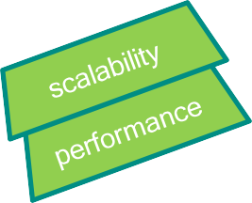
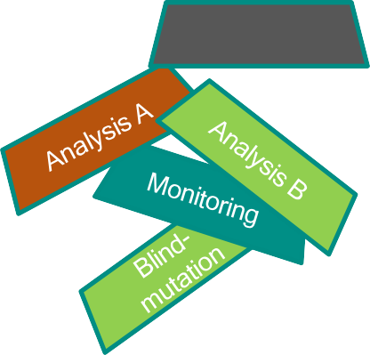
Fuzzing- A balancing Act
Analysis C
Static analysis and complex tricks are clever but slow and it rapidly stops working…
Fuzzer

Slide 43

Fuzzing- A balancing Act
Analysis C
Analysis B
Analysis A
scalability
Monitoring
Blind- mutation
performance
But if you can do static analysis *cleverly* this is the dream; but it rarely works…
Happy Advanced Fuzzer
Notes:
Analysis in a very efficient way

Slide 44
Evolutionary Fuzzing
What should be the feedback to evolve?
  Code-coverage based fuzzing
    Most of the contemporary fuzzers: AFL, AFLFast, Driller, VUzzer, ProbeFuzzer, CollAFL, Angora, QSYM, Nautilus, …
    Uses code-coverage as the proxy metric for the effectiveness of a fuzzer
  Directed fuzzing
    Not much explored (BuzzFuzz, AFLGo, ParmeSan…)
    There should be a way to find the destination and a sense of direction.
Notes:
Diagram
If input is executing sime instructions that you have not seen before that means it is evolving
The more code you fuzz and execute the more effective a fuzzer is
Dit=rected fuzzing you will target a specific path
If you have an issue in one node you will try input that goes that direction

Slide 45
Evolving A Fuzzer
AFL
Open source from Google
We will use in next lab

Slide 46
Conclusions
Fuzzing – seems easy unless you try it!
Scalability and performance cannot be negotiated much!
  A good engineering, hardware assisted monitoring
A good place to try program analysis techniques
  Possibility to compromise correctness to make them scalable
Software will remain integral part of the cyber world- make it secure!
But now it’ll be written by AI and it can fuzz itself… sigh.
I think I’m starting to get bitter.

