Slide 1
Software Tools Lecture 2
The shell, shell scripting, and a bunch of silly commands that you just need to know
Gretchen Hallett

Slide 2
Progression
Last time, we talked about how to connect to a computer and run basic commands
This week, its how we use the command line
And how to automate it

Slide 3
Learning the shell will take time and practice
Its not enough to understand the theory
  You have to use it
If you switch to it *entirely* for the next month at least…
  You’ll be really slow at first, but it will get easier and easier and you won’t look back
  ...and the exam will be easy
If you don’t you’ll still struggle in 4th year/work

Slide 4
Arguments
Command
Flags
prompt
$ ls -l –-human-readable /

Slide 5

I think of commands in three groups
Those for getting information
Those for filtering information
Those for doing stuff
(Some can do all three)

Slide 6

I want to find all the markdown files in my current folder (or the immediate subfolders within it)
I want to see how many mention Joseph

Slide 7
$ ls ./**
./README.md ./permissions.pdf ./pipes_1.pdf ./pipes_2.pdf ./scripting_1.pdf ./scripting_2.pdf ./shell.pdf ./slides.md
./lab:
permissions.md pipes.md script.md shell.md
** is a bash-ism for listing all files recursively... useful but non standard!

Slide 8

Pipes!
> takes output from the left and creates a new file in the path on the right; and >> which appends the output to the file instead of overwriting it
< which takes the contents of the path on the right and feeds it into the output of the command on the left
Pipes are one of the most powerful features of the shell
| takes the output of whatever is on the left hand side and pipes it in as input to the right hand side

Slide 9

$ ls ./** | tr '\t' '\n'
./README.md
./permissions.pdf
./pipes_1.pdf
./pipes_2.pdf
./scripting_1.pdf
./scripting_2.pdf
./shell.pdf
./slides.md
./lab:
permissions.md
pipes.md
script.md
shell.md

Slide 10
$ ls ./** | tr '\t' '\n'
./README.md
./permissions.pdf
./pipes_1.pdf
./pipes_2.pdf
./scripting_1.pdf
./scripting_2.pdf
./shell.pdf
./slides.md
./lab:
permissions.md
pipes.md
script.md
shell.md
The tr command transliterates characters from its first argument and replaces them with characters from its second
So take the tabulated output of ls, and replace tabs (\t) with newlines (\n)!
I just want the files ending in .md though… so lets filter again

Slide 11
$ ls ./** | tr '\t' '\n' | grep ‘.md’
./README.md
./slides.md
permissions.md
pipes.md
script.md
shell.md
Reuse grep from last week to search...

Slide 12
$ find . -name \*.md
./README.md
./lab/permissions.md
./lab/pipes.md
./lab/script.md
./lab/shell.md
./slides.md
There is almost always more than one way of doing things
Now I want to go through each of these files and search them

Slide 13
$ for f in $(find . -name \*.md);
do
echo “${f}”;
done
./README.md
./lab/permissions.md
./lab/pipes.md
./lab/script.md
./lab/shell.md
./slides.md
For iterates
$() is a splice!

Slide 14
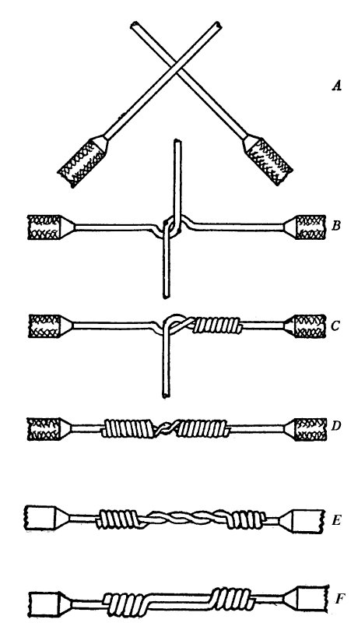
SPLICES
Sometimes we want to use the output of a shell command to build the next one
Using $() or `` (old notation) takes the command inside, runs it and replaces itself on the prompt with the output
There is also <() which replaces the output of the command with a temporary file containing the output

Slide 15
$ for f in $(find . -name \*.md);
do
echo “${f}”;
done
./README.md
./lab/permissions.md
./lab/pipes.md
./lab/script.md
./lab/shell.md
./slides.md
For iterates
$() is a splice!

Slide 16
Shells have loops and if statements, but the syntax is funky and they’re treated as builtins not commands
for var in 1 2 3; do echo “${var}”; done
for var in $(seq 1 3); do
echo “other ways to count”;
done
(See ${IFS} for how to change the separator)

Slide 17
Shells have loops and if statements, but the syntax is funky and they’re treated as builtins not commands
if test “${x}” -gt 3; then echo ‘x > 3’; fi
if [ “${x}” -gt 3 ]; then echo still true; fi
if [[ “${x} -gt 3 ]]; then echo with a builtin; fi
test “${x}” -gt 3
if $?; then echo yes...; done
[[ “${x}” -gt 3 ]] && echo still...

Slide 18
$ for f in $(find . -name \*.md);
do
grep -iH joseph “${f}”;
done
./README.md: Joseph smells!
Lets find the files that still mention Jo
There’s only one but really I’d like a count...

Slide 19
You can create variables in a shell
x=5 (no spaces round =) sets x to the string “5”
${x} gets the value of x and inserts it into the string (always wrap in “” unless you know what your doing)
files=”$(ls *.md)” makes ${files} be the output of ls
Most shells will let you do magic with variables
${x:?x is not defined} will throw an error if x isn’t set for example.

Slide 20
$ for f in $(find . -name \*.md);
do
matches=$(grep -iH joseph “${f}”);
printf “%d match” $(wc -l <<<${matches}”)
echo ${matches}
done
1 matches
./README.md:Joseph smells!
Only one!
I could change it by hand… but I am very very lazy

Slide 21
$ for f in $(find . -name \*.md);
do
sed -ie ‘s/Joseph/Gretchen/g’ \
$(grep -iH joseph “${f}” | cut -d: -f1)
done
Use the stream editors to make the edit in place

Slide 22
$ find . -name \*.md -exec sed -ie ‘s/Joseph/Gretchen/g’ {} \+
I could reduce this further to a oneliner but this isn’t the only unit I teach…
And it is still too long

Slide 23
$ transition() {
find . -name \*.md \
-exec sed -ie ‘s/Joseph/Gretchen/g’ {} \+;
}
So lets make it a built in function… then we can just call that
But this will disappear when I start a new shell...

Slide 24
If I want the function to stick around I could stick it in my ~/.profile file. The shell reads this every time it starts up and would recreate the function each time
This is great when I want to override default behaviour (cp() { /bin/cp -a $@; }) for example but for complex scripts gets a bit unweildy
(or ~/.bashrc or ~/.bash_profile if I use bash (most Linux); or ~/.zshrc if I use zsh (Macs and some Linux) or ~/.kshrc on OpenBSD...
...but I use Bash and just stick source ~/.profile in all those files and stick to the POSIX stuff mostly… which uses ~/.profile

Slide 25
What happens when a program loads?
Linux supports *many* different program formats… but the most common are ELF (a compiled binary) and shellscript…
When an ELF file is exec’d it is passed to the dynamic linker (/usr/lib/ld-linux.so.2) to have the appropriate libraries loaded…
But if the file is a text file and starts with #! then something special happens...

Slide 26
#! /usr/bin/env bash
# This is a shell script. Everything in it will be sent line by
# line to the program listed after the #! (pronounced shèbang)
# If I wanted the script to be interpreted by Python I could
# write #! /usr/local/bin/python3
# But because every system puts the programs in a slightly
# different place… better to use /usr/bin/env python3 which will
# find the right place for the system you’re on… yay portability!
echo “The program’s name is ${0} and the arguments passed are ${@}!”
if [[ ! -z “${masochist}” ]]; then
1>&2 echo “[WARNING]: Advanced!”
echo “...try and find a #! line for a C file”
echo “that compiles and runs it as a program ;-)”
fi

Slide 27
With the script written we just need to do two more things… normally text files aren’t executable; so you can’t run them
$ chmod +x myscript
We can then run it by passing the shell the full path to it ${PWD}/myscript (or wherever you saved it) but its easier if we install it onto the
${PATH}...

Slide 28
The ${PATH} variable is where the system will look for scripts to run. First matching program on the path wins. You are free to update it.
$ echo “${PATH}”
/usr/share/Modules/bin:/usr/local/cuda-11.4/bin:/usr/local/bin:/usr/bin:/usr/local/sbin:/usr/sbin:/opt/puppetlabs/bin:/var/lib/snapd/snap/bin:/opt/software/bin:/home/jh18636/perl5/bin
Adding export PATH=“${PATH}:~/.local/bin/” to your .profile is usually sensible, then you can copy your scripts there and they should just work.
Adding . Or prepending your scripts folder to the path can lead to trolling/vulnerabilities. If you need to modify a system program use ~/.profile instead

Slide 29
Within a shell script… normal programming rules apply…
But it is like programming in a shell… and you *might* want to turn off some of the hacky stuff…
If a shell command fails… we normally just run the next one… but in a program we might want to trigger an error…
set -e # Exit on first error
set -o pipefail # If a command in a pipe fails… then stop
More exist! They’re useful… but append key commands with
a_random_command_that_fails || \
echo “This has all gone wrong!”
So you can tell when things break!

Slide 30
If you suffix a command with a & it runs in the background
If you start a command and hit Control-Z it is suspended (stopped and you’re returned to the shell)
  Run fg to start it again, bg to background it, or jobs to see suspended things; wait to wait until everythings completed
If you want to kill a command hit Control-C
If you want to signal no more input: Control-D
If it’s really crashed Control-Z and then use the kill command
If you want to see what a program is doing hit Control-T (but few things support it)

Slide 31
WE COULD JUST GO THROUGH A SUPER LONG LIST FROM POSIX OF EVERY COMMAND LINE TOOL YOU MIGHT EVER WANT TO USE BUT THAT SOUNDS BORING, DULL AND TEDIOUS, ESPECIALLY FOR ME...

Slide 32
awk :: useful tool for dealing with files
basename :: just the filename
bc :: maths stuff
cat :: join files
comm :: find common lines
cp :: copy files
crontab :: run commands at a time
cut :: extract fields from lines
dd :: bulk write to disks/tapes
df :: find free space
diff :: find differences
du :: how much space is this using
ed :: the standard text editor… (for use when you don’t have a screen)
env :: inspect environment variables
file :: what are you looking it?
finger :: what are other people doing
gz :: compress stuff
head :: get the top of a file
install :: like cp with permissions
kill :: kill a process
less/more :: view a long file
ln :: alias files and folder
man :: THE MANUAL
mkdir :: make a directory
mv :: rename stuff
patch :: automated changing of stuff
perl :: better (?) shellscript
ps :: what’s running?
read :: input
rm :: delete stuff
screen :: suspend terminal sessions and have multiple sessions in a single terminal (and connect to a serial console) (see also tmux)
sendmail :: send email on a commandline (you’ll need a mailserver though)
source :: read another file
sed :: editing pipes
sort :: sorts
strings :: get things that look like text from a file
stty :: configure your terminal
tail :: get the bottom
tar :: archive stuff
tee :: write stuff to a file and look at it
trap :: signals
uniq :: remove duplicates
wait :: wait for backgrounded processes
wall :: terrible chat
wc :: count lines, words or characters
xargs :: helps avoid looping
yes :: helps avoid typing yes a lot
(also these logic ops)
&& :: if command on left succeeds run command on right
|| :: if command on left fails run command on right

Slide 33
But maybe lets just try writing things and giving it a go?
Oh but all those utilities on the last slide are still examinable...
Read the man pages ;-)
(Yes, I am evil)

Slide 34
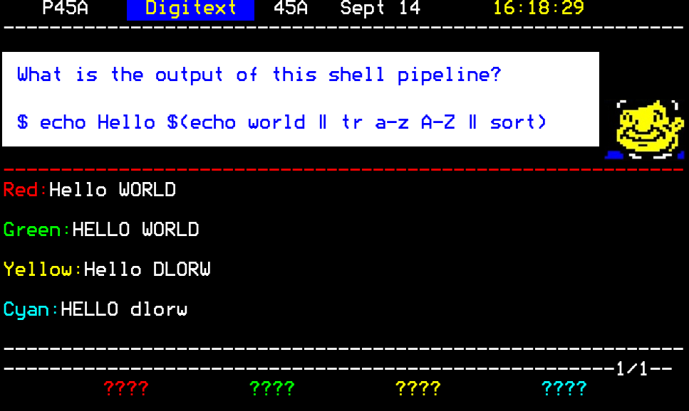

Slide 35
