Slide 1
Software Tools
Lecture 3: Regular Expressions
grep, sed, awk and everything they can do
Gretchen Hallett

Slide 2
Last Time...
We introduced shellscripting and showed how to write more complex tools
We wrote a script together!

Slide 3
This time...
We’re going to go over regular expressions as a tool for matching stuff
We’re going to introduce grep as a tool for searching
We’re going to introduce sed and awk as a way of processing text with regular expressions
And I’m going to mention perl as a more general purpose way of doing all that

Slide 4


Slide 5
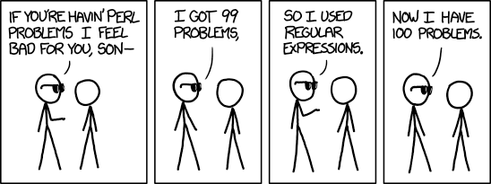

Slide 6
Regular expressions are a language for matching text
Based on a finite state machine
Notoriously finicky and brittle
Incredibly useful for 99% of text based problems, in practice
Also called re, regex, regexp...

Slide 7
A perfectly normal Regular expression to match email addresses (that almost works)
(?:[a-z0-9!#$%&'*+/=?^_`{|}~-]+(?:\.[a-z0-9!#$%&'*+/=?^_`{|}~-]+)*|"(?:[\x01-\x08\x0b\x0c\x0e-\x1f\x21\x23-\x5b\x5d-\x7f]|\\[\x01-\x09\x0b\x0c\x0e-\x7f])*")@(?:(?:[a-z0-9](?:[a-z0-9-]*[a-z0-9])?\.)+[a-z0-9](?:[a-z0-9-]*[a-z0-9])?|\[(?:(?:25[0-5]|2[0-4][0-9]|[01]?[0-9][0-9]?)\.){3}(?:25[0-5]|2[0-4][0-9]|[01]?[0-9][0-9]?|[a-z0-9-]*[a-z0-9]:(?:[\x01-\x08\x0b\x0c\x0e-\x1f\x21-\x5a\x53-\x7f]|\\[\x01-\x09\x0b\x0c\x0e-\x7f])+)\])

Slide 8
WTF is that piece of...?!

Slide 9
Regular expressions have a habit of getting out of hand quickly
Consider them write-only code
  ...Because you will forget how the work
They are a regular language so are bounded in complexity... (no arbitrary recursion)
Their syntax is easy though...

Slide 10
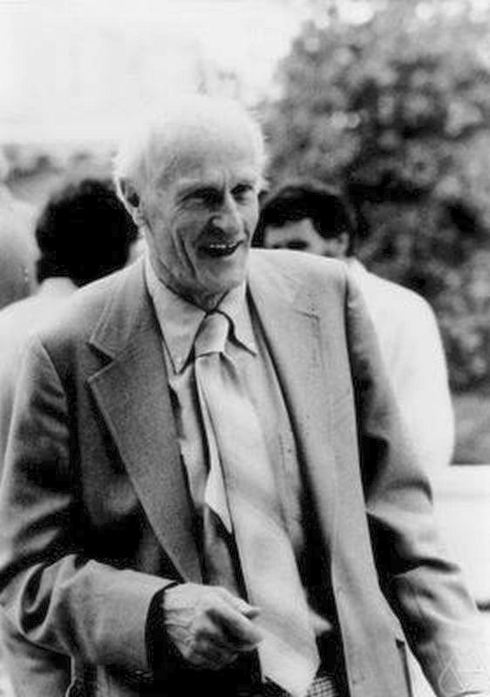
Regular expressions we’re first described back in the 1950s by Stephen Cole Kleene...
They were widely integrated in UNIX tools back before there were standards...
By the time POSIX standardized things there were multiple competing standards
POSIX: Basic and Extended RE
Perl and Perl Compatible Regular Expressions (PCRE)
We will stick to POSIX Basic RE...
But I use Perl in real life

Slide 11
How to read a regular expression
Start at the left one item at a time...
  If it matches the string then keep going
  Otherwise backtrack and try again (possible at the next character)
Most regular expressions are greedy
  They will always match as much as possible

Slide 12
.
Matches any character

Slide 13
^
Matches the start of a line

Slide 14
$
Matches the end of a line
(don’t ask about multiline regexp)

Slide 15
brian.
Matches a ‘b’ followed by an ‘r’ followed by an ‘i’ followed by an ‘a’ followed by an ‘n’ followed by anything

Slide 16
[nigel]
Matches one of any of the characters in the word ‘nigel’

Slide 17
[^nigel]
Matches anything but one of the characters in the word ‘nigel’

Slide 18
[a-z0-9]
Matches any character in the space ‘a’ through to ‘z’ and ‘0’ through to ‘9’

Slide 19
\( \)
Matches whatever is inside the \( \)
AS A SINGLE STANDALONE THING

Slide 20
why does the standalone bit matter\?
Matches “why does the standalone bit matte” or “why does the standalone bit matter”

Slide 21
\?
Matches the thing before it once or zero times

Slide 22
colou\?r
matches English and American spellings of “colour”

Slide 23
\+
Matches the thing that came before it one or more times

Slide 24
\+\?
Matches the thing that came before it one or more times, zero or one time

Slide 25
\*
Matches the thing that came before it zero or more times
(no I’m not changing color for this)

Slide 26
squ\(ee\)\+
Matches excited noises with an even number of ‘e’s

Slide 27
squ\(e\{2\}\)+
Matches excited noises with an even number of ‘e’s

Slide 28
squ\(e\{2,3\}\)+
Matches excited noises with a number of ‘e’s thats a multiple of two or three
(leaving numbers off either side of the comma makes it an open range)
(ooh we’re back to red!)

Slide 29
\1
Matches whatever was matched within the nth (normally 1-9) \( \) expression

Slide 30
\([:alpha:]\+\) \1 \1
Matches triple tautonyms (animals whose Latin name is the same word three times like ‘gorilla gorilla gorilla’)

Slide 31
Congratulations!
You now know regular
expressions
(The extended and Perl ones usually leave off the backslashes and make you escape the literal characters; and in the Perl case add a TONNE useful extra stuff)

Slide 32
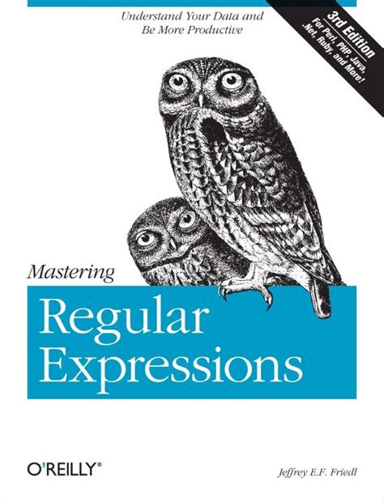
If you want to know more I like this book (but it’s rather old now...)
By more I mean how they’re implemented and don’t just wanna read a load of theory papers (but you should read the theory papers they’re great)

Slide 33
grep for search
So I’ve given you this *great* tool for matching text how are we going to use it?
sed for replace
(and more)
awk for more general manipulation
perl as a programming language

Slide 34
grep is a search tool for text documents.
It’s name comes from the ed editor command to search
global /regexp/ print → g/re/p
It prints all lines in its input that match a regexp passed as an argument
Faster alternatives exist... (see ripgrep) but don’t behave the same, or aren’t always available
-i :: case insensitive
-E or -P :: extended or Perl (non-POSIX) regexp
-o :: only matching string not line
-v :: inverted matching
-R :: search folder recursively

Slide 35
How many words in English contain double letters?
I have a dictionary at /usr/share/dict/words...
I can remember the wc command can count lines...

Slide 36
$ grep -i ‘\(.\)\1’ /usr/share/dict/words | wc -l
50988
# What about 2 or more double letters? (-c for count)
$ grep -ic ‘\(.\)\1.*\(.\)\2’ /usr/share/dict/words
4137
# Lets simplify...
$ grep -ic ‘\(\(.\)\2.*\)\{2\}’ /usr/share/dict/words
4137
# What about 3 or more?
$ grep -ic ‘\(\(.\)\2.*\)\{3\}’ /usr/share/dict/words
170

Slide 37
# So where does it end?
# seq generates a sequence of numbers (man seq)...
# column formats tabluar data
$ for n in $(seq 2 6); do hits=$(grep -ic “\\(\\(.\\)\\2.*\\)\\{$n\\}” words) printf “%d double letters,%d\n” “$n” “$hits” done | column -ts ,
2 double letters: 4137
3 double letters: 170
4 double letters: 4
5 double letters: 0
6 double letters: 0
# (Yes I hate escaping regex in strings... lookup Perl ones)
# killeekillee possessionlessness subbookkeeper successlessness
# Wow, possessionlessness it’s always ‘ss’,
# ...and ‘subbookkeeper’ it’s always a different letter and...
# ...they’re one after another! That’s really cool!

Slide 38
sed is a programable editor for streams (pipes and files)
The command syntax says has is borderline unintelligible, especially if you want to write long complicated things with lots of branching.
It basically looks like a kind of horrific single letter assembly language. For any real problem I’d use a proper programming language, but for quick jobs it is indispensable
-n :: don’t print lines by default
-E :: extended regexp
-i :: edit files in place

Slide 39
# Look you can grep with sed!
$ sed -n '/\(\(.\)\2.*\)\{4\}/p' /usr/share/dict/words killeekillee possessionlessness subbookkeeper successlessness
# The // bit matches the line, and the p prints it
# Lets make the double letters upper case...
$ </usr/share/dict/words sed -n '/\(\(.\)\2.*\)\{4\}/p' | gsed ‘s/\(.\)\1/\U\1\1/g’ kiLLEEkiLLEE
poSSeSSionleSSneSS
suBBOOKKEEper
suCCeSSleSSneSS
# nb. POSIX sed doesn’t have the \U uppercase trick
# I’ve used GNU sed (the default on Linux) instead here
# which is installed on my system as gsed

Slide 40
The sed s command works as follows s/target/replacement/flags
Where target and replacement are regular expressions
The most common flags you’ll encounter are:
- g :: do the replacement more than once per-line
- i :: do the replacement case insensitively
There is also a y command that does substitution ciphers between ranges of letters
$ echo “0x1FFF3BB0” | sed ‘y/ABCDEF/abcdef/’
...but I’d use the tr command instead of sed here
99% of what you’ll use sed for is search and replace

Slide 41
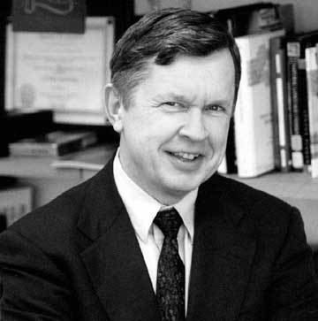
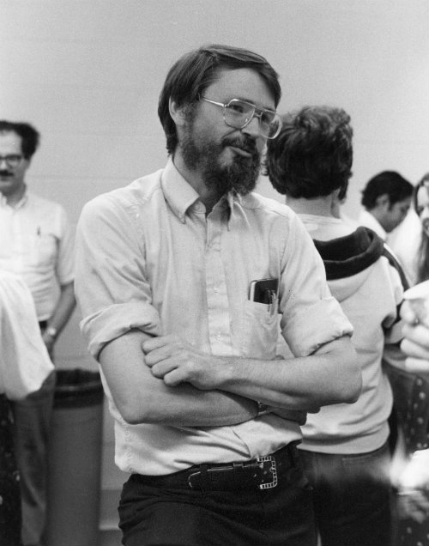
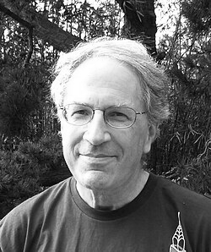
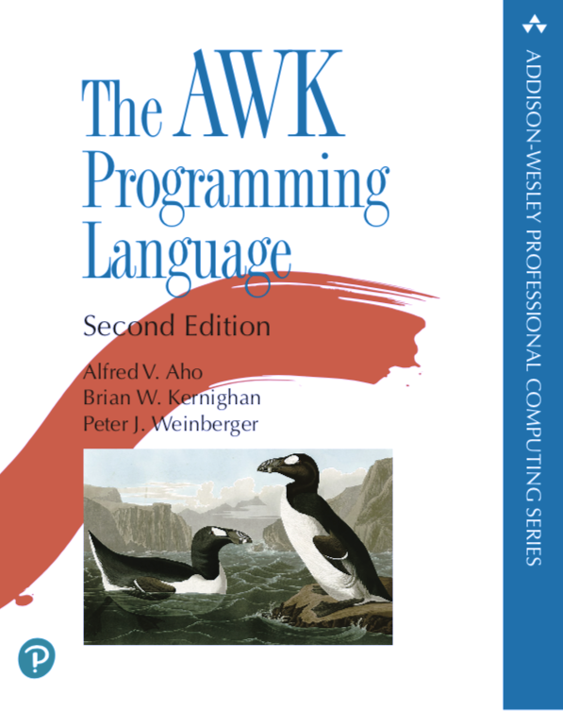
awk is for when you need to deal with semi structured data. It is a programming language with a focus on line based input and manipulation
Named for:
Alfred Aho
Peter Weinberger
Brian Kernighan

Slide 42
$ cat receipt
# Gretch
Salad,4.99
Iced Tea,2.99
Cake,2.00
# Matt
Steak,19.99
Whiskey (Neat),10.00
Another steak,19.99
Me and Matt have gone for lunch!
We have our receipt that looks like the following:
Who ordered,Item ordered,Cost
Me and Matt have gone for lunch!
We have our receipt that looks like the following:
# Orderer
Item ordered,Cost

Slide 43
# Lets leave the money out of it
# To do this lets set our field separator to , and just print
# the first thing
# In AWK everything in the { } block is run on every line...
$ awk -F, '{print $1}' <receipt
# Gretch
Salad
Iced Tea
Cake
# Matt
Steak
Whiskey (Neat)
Another steak

Slide 44
# No we need money, Matt’ll pay he’s a gentleman but he needs a total...
BEGIN { } and END { } blocks are run at the beginning or the end.
Note that some things are implicit: print on its own prints the whole line (like print $0); I didn’t initialize sum either
(BEGIN { sum=0 })
$ awk -F, '
{ sum+=$2; print
}
END { print "\n# Total\n-----," sum
}' <receipt
| column -ts,
# Gretch
Salad 4.99
Iced Tea 2.99
Cake 2.00
# Matt
Steak 19.99
Whiskey (Neat) 10.00
Another steak 19.99
# Total
----- 59.96

Slide 45
# No a running total...
$ awk -F, '
{sum+=$2; print $0, ","sum
} END { print "\n# Total\n-----," sum
}' <receipt | column -ts,
# Gretch 0
Salad 4.99 4.99
Iced Tea 2.99 7.98
Cake 2.00 9.98
9.98
# Matt 9.98
Steak 19.99 29.97
Whiskey (Neat) 10.00 39.97
Another steak 19.99 59.96
# Total
----- 59.96

Slide 46
# Urgh it’s impacting on the named headers...
If we add /re/ before a block we can choose whether to apply it
$2 ~ /re/ tests whether field 2 matches the regex
$ awk -F, '
$2~/^$/ { print }
$2!~/^$/ { sum+=$2; print $0, ","sum;
} END { print "\n# Total\n-----," sum
}' <receipt | column -ts,
# Gretch
Salad 4.99 4.99
Iced Tea 2.99 7.98
Cake 2.00 9.98
# Matt
Steak 19.99 29.97
Whiskey (Neat) 10.00 39.97
Another steak 19.99 59.96
# Total
----- 59.96

Slide 47
# No I should really pay may own bills, even if Matt does want to be nice... and besides he spent 5× what I did...
See this is the stuff awk is good at... you can do what you could easily do in a spreadsheet on the commandline
(In roughly the same amount of time if you spend years learning awk... I’m not selling this well but still)
$ awk -F, '$2~/^$/ { if(sum>0){ print "-----," sum; sum=0;
} print;
}
$2!~/^$/ { sum+=$2; print $0, ","sum;
}' <receipt | column -ts,
# Gretch
Salad 4.99 4.99
Iced Tea 2.99 7.98
Cake 2.00 9.98
----- 9.98
# Matt
Steak 19.99 19.99
Whiskey (Neat) 10.00 29.99
Another steak 19.99 49.98
----- 49.98

Slide 48
There is plenty more you can do with awk... but I wanna move on...
Tools like the shell, grep, sed and awk exist as separate utilities because they were written in anger by people needed a quick tool to do a job...

Slide 49
UNIX philosophy dictates write small tools that do one thing well...
But when programming we don’t want to have to keep the syntaxes of 12 different tools in our heads

Slide 50



Perl is a general purpose programming language, that has a *lot* of features and workflow around manipulating text as we’ve been doing...
It’s basically a more stable, and more portable version of shellscript with a lot of nice tools baked in...
Raku (formerly Perl 6) is a fork of the language with more cool things (PEG grammars!) that’s slightly more modern (but still very much Perl)

Slide 51

https://theweeklychallenge.org

Slide 52
BEFOREHAND: close door, each window & exit; wait until time.
open spellbook, study, select it, confess, tell, deny;
write it, print the hex while each watches,
reverse "its length", write again;
kill spiders, pop them, chop, split, kill them.
unlink arms, shift, wait & listen (listening, wait),
sort the flock (then, warn "the goats". kill "the sheep");
kill them, dump qualms, shift moralities,
values aside, each one;
die sheep, die, reverse system
you accept (reject, respect);
next step,
kill next sacrifice, each sacrifice,
wait, redo ritual until "all the spirits are pleased";
do it ("as they say").
do it(*everyone***must***participate***in***forbidden**s*e*x*).
return last victim; package body;
exit crypt (time, times & "half a time") & close it,
select (quickly) & warn next victim;
AFTERWORDS: tell nobody.
wait, wait until time;
wait until next year, next decade;
sleep, sleep, die yourself and
rest at last

