Slide 1
Software Tools
Lecture 01: Sysadmining
Gretchen Hallett

Slide 2
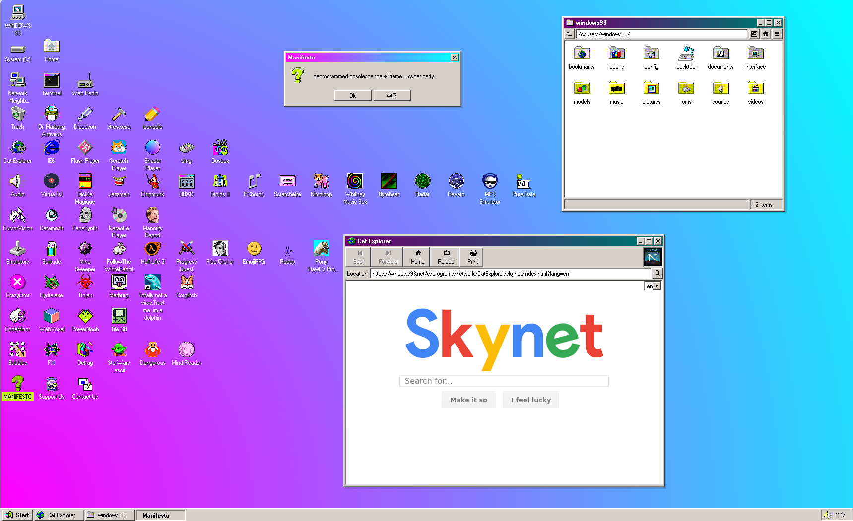
Everyone here is probably used to an OS that looks like this, right?
Nice graphical interface… icons… a search bar...

Slide 3
$ echo “The computers we’re going to be using for this unit look rather different...”

Slide 4
$ echo “The computers we’re going to be using for this unit look rather different…”
The computers we’re going to be using for this unit look rather different…
$

Slide 5


The shell is a *bit* scary at first… but you will get used to it
It is one of the oldest ways of interacting with a computer and ONCE you get to grips with it is INCREDIBLY powerful; if a bit ecclectic
The trick to getting used to it is just to use it!

Slide 6
So lets have a look at the terminal!
$ ls -l --human-readable ~

Slide 7
So lets have a look at the terminal!
The prompt: the terminal is waiting for you to type a command
$ ls -l --human-readable ~
Macs tend to use % instead of $… (they use zsh instead of bash)
Some prompts get very fancy and give you extra information!

Slide 8
So lets have a look at the terminal!
$ ls -l --human-readable ~
The command is the first thing you type after the prompt. The ls command lists files.

Slide 9
So lets have a look at the terminal!
Arguments come after the command: this third one is a special
symbol used to refer to your home folder on this computer
$ ls -l --human-readable ~

Slide 10
So lets have a look at the terminal!
Flags are special arguments that modify how the command works.
Short ones have one dash and a single letter
Long ones have two and a more readable name
$ ls -l --human-readable ~
(Usually! Other conventions exist)
(Java likes one dash for both!)
(Windows uses / instead of -!)
You can run it with <Return> !

Slide 11
So lets have a look at the terminal!
$ ls -l --human-readable ~
-rwx------ 1 gretch bristol 4.6K Jun 24 14:54 nigel.jpg
The output is displayed below… its a picture of my cat!
Shall we open it?

Slide 12
So lets have a look at the terminal!
$ ls -l --human-readable ~
-rwx------ 1 gretch bristol 4.6M Jun 24 14:54 nigel.jpg
$ cat nigel.jpg
/\-/\ The terminal isn’t good at pictures, sadly…
( o.o ) ...just text
>^<
Some modern terminals (and even a few really old ones) can do images…
Search for the kitty-graphics-protocol or sixels to find out more!

Slide 13

Wait a minute… How am I possibly meant to know that the command to see what files I have happens to be ls?
Isn’t it dir on Windows? This doesn’t seem intuitive…
Infact, it seems borderline hostile to users...
We are going to come back to the shell
properly next week…
You are going to have to learn it
IT IS EXAMINABLE
(and will be on there)
It is going to take a few weeks of use...
Just immerse yourself and it will come...

Slide 14

Also there is a manual to tell you how everything in your system works (that is specific to *your* system and not general help like Google and StackOverflow give you…)
Run man man to see the man tools manual… press q to quit, / to search, j/k to scroll
Run man -k or apropos to search the manual for things
And see man intro for beginner stuff!
The man pages are great…
If a little old fashioned

Slide 15

While there are standards that describe how a system should behave…
Very few systems follow them precisely… most vary a little… some vary a lot.
We will try and stick to POSIX with the lab machines as our (examinable) standard…
If you try and complete this unit with something that isn’t a lab machine you are going to be sad
While there are standards that describe how a system should behave…
Very few systems follow them precisely… most vary a little… some vary a lot.
We will try and stick to POSIX with the lab machines as our (examinable) standard…
If you try and complete this unit with something that isn’t a lab machine you are going to be sad
If you’re running Linux
- It’ll probably be fine…
If you’re running a Mac most stuff will work EXCEPT:
- Virtualization (virtualbox/vagrant will not work)
- The debugging lab
If you have Windows
- WSL will *sometimes* work (but break in weird ways
- Powershell / CMD.EXE will never work
The TAs are explicitly told NOT to help you
with non-lab systems… just use the lab machine

Slide 16

So how am I going to complete this unit on my shiny new gaming laptop if I don’t want to touch the filthy, dirty lab machines that are gross…
A) I was an undergrad here (20 years ago)
The machines are pretty much the same.
B) and so we come to our first software tool...

Slide 17

If you want to make (secure) connections between two or more computers it is *staggeringly* useful...
The SSH protocol lets you login and run commands on remote computers. It runs on port 22
OpenSSH is the most common implementation of the protocol; developed alongside the OpenBSD operating system

Slide 18

$ ssh evelyn@imac
$ ssh -X evelyn@imac firefox
See man sftp or man scp if you want to copy files remotely instead
(or kermit)
Evelyn
imac
MAGIC OF NETWORKS

Slide 19
Actually the *first* time you connect it’ll say...
The authenticity of host 'sdf.org (205.166.94.16)' can't be established.
ED25519 key fingerprint is: SHA256:ZjwbO7AU8rHJExYrmZS2LqGZ7WfdoELfMrF54W92PYA
This key is not known by any other names.
Are you sure you want to continue connecting (yes/no/[fingerprint])?
Get a friend with *physical access to the machine* to run...
$ ssh-keyscan -q -t ed25519 localhost
...to check

Slide 20


Why might you want to check the key? Seems pretty pointless?
Normally yes, but you can do some neat evil with OpenSSH
Don’t look up arp spoofing as a means for doing this!
Smith tricks Evelyn into connecting to them instead of the iMac
Resends everything Evelyn sends to the iMac and sends responses
...but maybe records everything that happens
...and maybe tweaks somethings!

Slide 21
$ tree -L 1 /
/
├── bin -> usr/bin
├── boot
├── dev
├── etc
├── home
├── lib -> usr/lib
├── lost+found
├── media
├── mnt
├── opt
├── proc
├── root
├── run
├── sbin -> usr/sbin
├── srv
├── sys
├── tmp
├── usr
└── var
Binary programs go in bin/
Bootloader stuff goes in boot/
Device files (raw disks) are in /dev/
Configuration goes in etc/
Programs for the root user go in sbin/
Temporary files go in /tmp
Files being served go in srv/ or var/
run/ is for runtime things on Linux
/usr contains the same again but its stuff that your OS thinks that you need rather than the base OS (Linux doesn’t use this so /bin/ and /usr/bin are the same but not /etc for no good reason)
/usr/local contains the same again but its stuff you’ve locally installed on this specific machine.
/opt might contain the same.
And then you’ll get a shell…
So what are you meant to do with this system?
Yes we know this makes no sense…
It’s old and evolved over time

Slide 22
$ /usr/local/bin/tree -L 1 -f /
/
|-- /altroot
|-- /bin
|-- /bsd
|-- /bsd.booted
|-- /bsd.rd
|-- /bsd.sp
|-- /dev
|-- /etc
|-- /home
|-- /mnt
|-- /root
|-- /sbin
|-- /sys -> usr/src/sys
|-- /tmp
|-- /usr
`-- /var
$ mount
/dev/sd1a on / type ffs (local)
/dev/sd1k on /home type ffs (local, nodev, nosuid)
/dev/sd1d on /tmp type ffs (local, nodev, nosuid)
/dev/sd1f on /usr type ffs (local, nodev)
/dev/sd1g on /usr/X11R6 type ffs (local, nodev)
/dev/sd1h on /usr/local type ffs (local, nodev, wxallowed)
/dev/sd1j on /usr/obj type ffs (local, nodev, nosuid)
/dev/sd1i on /usr/src type ffs (local, nodev, nosuid)
/dev/sd1e on /var type ffs (local, nodev, nosuid)
On my OpenBSD machine it’s different again
A Mac will be different again
As will WSL
Just know the rough conventions

Slide 23

Package Managers and APT
On Linux we have multiple ways to install new software. We can compile and install it manually (./configure; make; make install)
We can download and install prebuilt software manually (don’t do this, but if you must in /opt)
Or we can ask the OS to get software and install it for us all automatically. The tool we need for this on the VMs we give you in the labs is called apt
It is the default package manager for Debian Linux (and anything derived from it like Ubuntu or Windows Subsystem for Linux)
The other package manager you’ll see is dnf for RPM based distributions of Linux. Many (many many) others exist
Macs have a thing called brew.sh that you should *absolutely* look into

Slide 24
$ apt search 'common lisp compiler'
elpa-gcl27/stable,stable 2.7.1-4 all
GNU Common Lisp compiler
gcl/stable 2.6.14-19 arm64
GNU Common Lisp compiler
gcl-doc/stable,stable 2.6.14-19 all
Documentation for GNU Common Lisp
gcl27/stable 2.7.1-4 arm64
GNU Common Lisp compiler
gcl27-doc/stable,stable 2.7.1-4 all
Documentation for GNU Common Lisp
gcl27-tk/stable 2.7.1-4 arm64
GNU Common Lisp compiler
gcl27-tk-doc/stable,stable 2.7.1-4 all
Documentation for GNU Common Lisp
sbcl/stable 2:2.5.2-1 arm64
Common Lisp compiler and development system
$ apt install sbcl
Error: Could not open lock file /var/lib/dpkg/lock-frontend - open (13: Permission denied)
Error: Unable to acquire the dpkg frontend lock (/var/lib/dpkg/lock-frontend), are you root?
$ sudo !!
sudo apt install sbcl
Installing:
sbcl
Suggested packages:
sbcl-doc sbcl-source slime
Summary:
Upgrading: 0, Installing: 1, Removing: 0, Not Upgrading: 3
Download size: 8,885 kB
Space needed: 41.4 MB / 22.6 GB available
Get:1 http://deb.debian.org/debian trixie/main arm64 sbcl arm64 2:2.5.2-1 [8,885 kB]
!! is bash for the whole of the previous command typed… more shortcuts exist!

Slide 25

Linux (and most UNIXes) have a concept of users, where each user only has control over the minimum things they need to work
The root user (uid=0, Charlie Root) is all powerful
If you want to do something that could mess up the system for other users (like installing/removing/changing) software…
Only the root user is allowed to do it.
So why not always just be root?
Because if you get used to being root always you’ll forget why you shouldn’t be root and will break things and swear a lot.
You can *temporarily* become root with the sudo command (or doas… or pk-exec… or su -c… or ...)

Slide 26
Users, groups, and the UNIX DAC
UNIX systems *traditionally* control access to everything through files.
Almost everything is treated as a file which you can read, write or execute (RWX).
Every file is owned by exactly one user and one group (see them with ls -l).
All users belong at least one group.
Permission to read, write or execute any file is granted based on the user, the group, and for everyone else
And they traditionally like to express these permissions as octal number for no good reason.

Slide 27
Users, groups, and the UNIX DAC
UNIX systems *traditionally* control access to everything through files.
(...but other mechanisms exist nowadays too)
Almost everything is treated as a file which you can read, write or execute (RWX).
(except directories, daemons, and some kernel memory structures)
Every file is owned by exactly one user and one group (see them with ls -l).
-rwxr-x--- root wheel my-cool-script.sh
All users belong at least one group.
uid=1000(goblin) gid=1000(goblin) groups=1000(goblin), 0(wheel), 9(wsrc), 1002(_config),
Permission to read, write or execute any file is granted based on the user, the group, and for everyone else
(So I’d be able to read and execute the script but not write)
And they traditionally like to express these permissions as octal number for no good reason.
RWX = 1112 = 78, R-x = 1012 = 58, ---= 0002 = 08

Slide 28
Users, groups, and the UNIX DAC
Use chmod to change permissions (see man page for modern non-octal syntax)
Use chown to change owning user and groups
Directories are a bit weird
- If you want to be able to cd into a directory you need the execute bit set
- If you want to be able to read the contents of a directory you need the read bit set
There are also special bits for files:
- If the setuid bit is set on an executable it runs as the owning user not the executing user
(this is how sudo works)
- If a directory has the setgid bit set new files are owned by the group of the directory not the group of the creating process
- If the sticky bit is set then only root or the directory’s owner can delete (unlink) files

Slide 29
Users, groups, and the UNIX DAC
The directory of what users and groups exist and who belongs to what is kept in /etc/passwd and /etc/group; user passwords are sometimes kept in /etc/shadow:
$ grep goblin /etc/passwd
goblin:*:1000:1000:Gretchen Hallett,,,:/home/goblin:/usr/local/bin/bash
$ grep wheel /etc/group
wheel:*:0:root,goblin
$ sudo grep goblin /etc/shadow
goblin:$y$jB5$dd4SiZKOlEYBmM4PAdo9q.$mlrcNj9S.IBwLFoYxkL0Ik8POhU2UM1xXGUNnzK8Hj4:20426:0:99999:7:::
See the man pages (particularly section 5).

Slide 30
Right so we can login…
We can install software...
What are we going to do with it?
Most people don’t use a computer for the sheer joy of computing...

Slide 31
Well we probably want to run some things to let us do more interesting things!
Like a web/gopher/gemini/finger server to host our art!
An IRC server so we can chat with our friends!
An IRC bouncer so we can keep logged into all our IRC servers!
A mastodon server so we can have private social media with no ads for our friends!
A streaming server so we can share all our legitimately acquired media!
A Git server to share our code with others!
A podcast aggregator so we can listen to radio!
A Minecraft server so you don’t have to long for the mines!
We *can* do all these things by just running the programs…
But its easier and *safer* to have them managed by the OS
gophernicus
unrealIRCd
soju
snac
Jellyfin
audiobookshelf
I, personally, do not understand the appeal of Minecraft. I was in uni when the first betas appeared and couldn’t get into it… that you (and my kids) are playing a 15 year old game still boggles my mind
Now lets ignore the fact that I *still* play Pokemon and Super Mario World ROM hacks...

Slide 32

There are *several* service managers for Linux…
The “normal” one is Lennart Poettering’s systemd
Systemd is polarizing…
- It replaced a bunch of shellscripts with
Microsoft-style system management
- It breaks UNIX/POSIX tradition (sometimes
for a good reason, sometimes not)
- It tries to standardize Linux (which goes
against what makes it fun)
- The project has massive scope-creep
- You can automate a lot with it once you bother
to learn it
- It requires you to use Linux and not other OSs
NB. I think my view is it’s fine but its taken a long time to get here, and I’m glad I don’t normally run Linux and have to use it day to day...

Slide 33
Systemd wants to manage everything… its not 453 real things
$ systemctl status
● gretchs-debian-server
State: running
Units: 453 loaded (incl. loaded aliases)
Jobs: 0 queued
Failed: 0 units
Since: Thu 1970-01-01 01:00:04 BST; 56 years 7 months ago
systemd: 257.13-1~deb13u1
Tainted: unmerged-bin
CGroup: /
├─init.scope
│ └─1 /sbin/init
├─system.slice
│ ├─ModemManager.service
│ │ └─127933 /usr/sbin/ModemManager
│ ├─NetworkManager.service
│ │ └─127921 /usr/sbin/NetworkManager --no-daemon
lines 1-16
Ignore this (systemd scope creep)
WTF?

Slide 34
$ journalctl -n 3 # show last three system logs
Aug 12 14:55:54 gretchs-server sudo[128327]: pam_unix(sudo:session): session closed for user root
Aug 12 14:56:13 gretchs-server tailscaled[76077]: control: NetInfo: NetInfo{varies=false ipv6=false ipv6os=true udp=true icmpv4=false derp=#8 port>
Aug 12 14:56:13 gretchs-server tailscaled[76077]: magicsock: endpoints changed: 80.0.38.136:6007 (stun), 80.0.38.136:41641 (stun), 80.0.38.136:600>
$ systemctl start sshd # turn sshd on
$ systemctl enable sshd # run it at boot
$ systemctl enable --now sshd # turn it on and run it at boot
$ journalctl -u sshd --since ‘10min ago’ # see logs from ten mins ago
-- No entries --
$ journalctl -u sshd --boot # see logs since boot
-- No entries --
# grep -R sshd /var/log/ # still nothing?

Slide 35
$ systemctl status sshd
● ssh.service - OpenBSD Secure Shell server
Loaded: loaded (/usr/lib/systemd/system/ssh.service; enabled; preset: enabled)
Active: active (running) since Wed 2026-08-12 13:25:47 BST; 1h 26min ago
Invocation: 8f09b4464b91443eba94e661e6505275
Docs: man:sshd(8)
man:sshd_config(5)
Main PID: 126792 (sshd)
Tasks: 1 (limit: 8796)
CPU: 250ms
CGroup: /system.slice/ssh.service
└─126792 "sshd: /usr/sbin/sshd -D [listener] 0 of 10-100 startups"
Aug 12 13:25:47 gretchs-server systemd[1]: Starting ssh.service - OpenBSD Secure Shell server...
Aug 12 13:25:47 gretchs-server sshd[126792]: Server listening on 0.0.0.0 port 22.
Aug 12 13:25:47 gretchs-server sshd[126792]: Server listening on :: port 22.
Aug 12 13:25:47 gretchs-server systemd[1]: Started ssh.service - OpenBSD Secure Shell server.
Aug 12 14:30:38 gretchs-server sshd-session[128089]: Accepted publickey for goblin from 100.86.61.81 port 38105 ssh2: ED25519 SHA256:IfKZuXbSEleOp>

Slide 36
$ cat /etc/systemd/system/sshd.service
[Unit]
Description=OpenBSD Secure Shell server
Documentation=man:sshd(8) man:sshd_config(5)
After=network.target nss-user-lookup.target auditd.service
ConditionPathExists=!/etc/ssh/sshd_not_to_be_run
[Service]
EnvironmentFile=-/etc/default/ssh
ExecStartPre=/usr/sbin/sshd -t
ExecStart=/usr/sbin/sshd -D $SSHD_OPTS
ExecReload=/usr/sbin/sshd -t
ExecReload=/bin/kill -HUP $MAINPID
KillMode=process
Restart=on-failure
RestartPreventExitStatus=255
Type=notify
RuntimeDirectory=sshd
RuntimeDirectoryMode=0755
[Install]
WantedBy=multi-user.target
Alias=sshd.service

Slide 37
$ sudo dmesg -H # get the kernel’s log (if you’re still stuck)
[Jul27 13:52] Booting Linux on physical CPU 0x0000000000 [0x410fd083]
[ +0.000000] Linux version 6.18.34+rpt-rpi-v8 (serge@raspberrypi.com) (aarch64-linux-gnu-gcc-14 (Debian 14.2.0-19) 14.2.0, GNU ld (GNU Bin>
[ +0.000000] KASLR enabled
[ +0.000000] random: crng init done
[ +0.000000] Machine model: Raspberry Pi 4 Model B Rev 1.4
[ +0.000000] efi: UEFI not found.
[ +0.000000] Reserved memory: created CMA memory pool at 0x000000000e400000, size 512 MiB
[ +0.000000] OF: reserved mem: initialized node linux,cma, compatible id shared-dma-pool
[ +0.000000] OF: reserved mem: 0x000000000e400000..0x000000002e3fffff (524288 KiB) map reusable linux,cma
[ +0.000000] OF: reserved mem: 0x000000003ef74d20..0x000000003ef74e01 (0 KiB) nomap non-reusable nvram@0
[ +0.000000] OF: reserved mem: 0x000000003ef74ae0..0x000000003ef74cdf (0 KiB) nomap non-reusable nvram@1
[ +0.000000] NUMA: Faking a node at [mem 0x0000000000000000-0x00000001ffffffff]
[ +0.000000] Faking node 0 at [mem 0x0000000000000000-0x0000000103ffffff] (4160MB)
[ +0.000000] Faking node 1 at [mem 0x0000000104000000-0x00000001ffffffff] (4032MB)
[ +0.000000] NODE_DATA(0) allocated [mem 0x103ffd280-0x103ffffff]
[ +0.000000] NODE_DATA(1) allocated [mem 0x1feff6280-0x1feff8fff]
[ +0.000000] Zone ranges:
[ +0.000000] DMA [mem 0x0000000000000000-0x000000003fffffff]
[ +0.000000] DMA32 [mem 0x0000000040000000-0x00000000ffffffff]
[ +0.000000] Normal [mem 0x0000000100000000-0x00000001ffffffff]

Slide 38

We have covered:
- basic shell syntax
- how to log on to the lab machines remotely
- hinted at man-in-the-middle attack
- discussed common filesystem hierarchy
- the package manager
- the sudo command
- the UNIX DAC
- users and groups
- starting services
- getting access to the logs

Slide 39
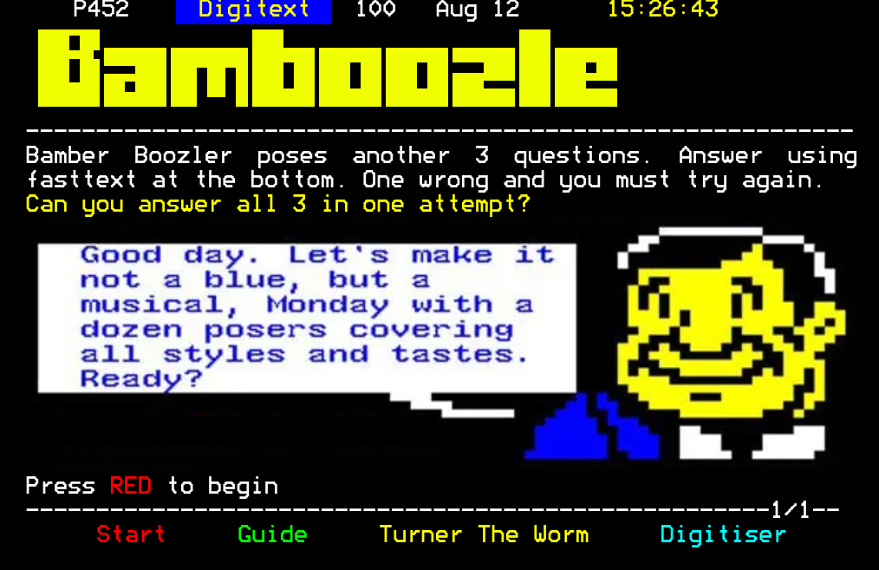

Slide 40
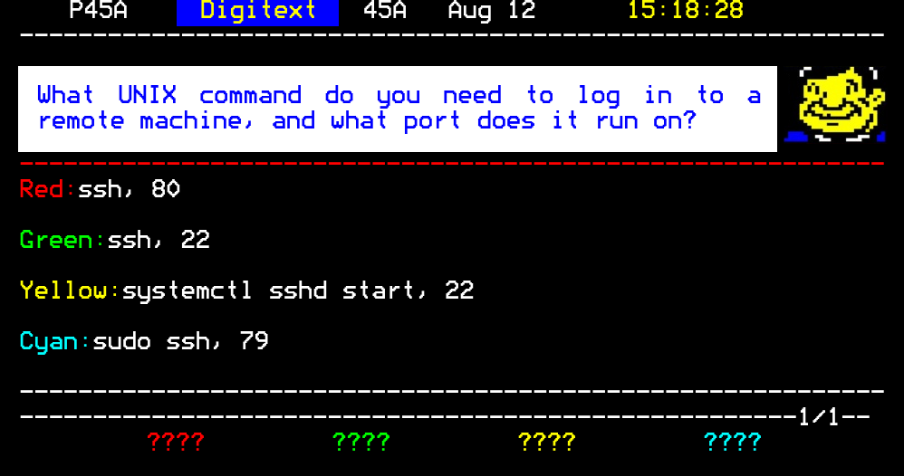

Slide 41
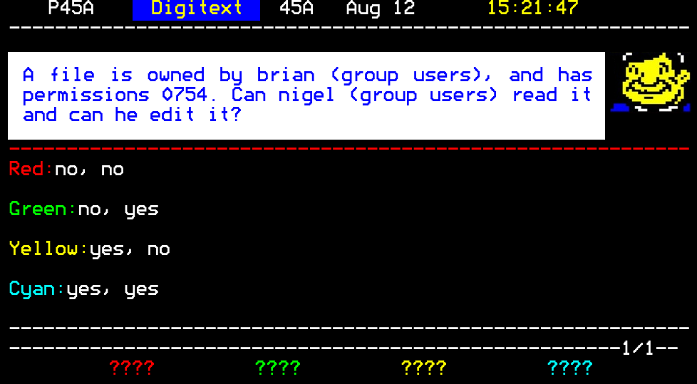

Slide 42
