Slide 1

Software Tools
Stuff you should know...

Slide 2
“Software Tools taught me the value of actually reading the damned manual”
--- Leah Liddle (Employed programmer, former Conversion student)
“Taught me all tools I use day to day. Definitely the most useful and practical unit”
--- Iris Rosoga (Employed programmer, former senior TA and undergraduate)
“Software tools taught me a computer is a blessing and a curse. You learn how to use them effectively, but then you have to use them effectively. 10/10”
--- Damien McGeer (Unemployed bum PhD student, former senior TA and undergraduate)

Slide 3
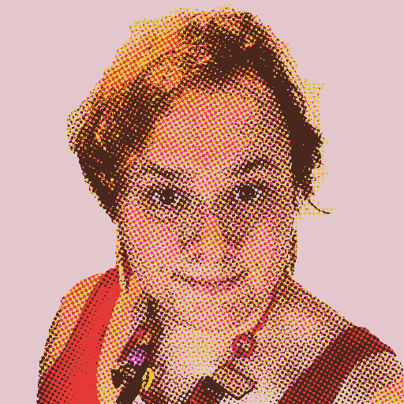
I am Gretchen Jo Hallett
(You still need Jo or Joseph for some things if you want to Google me
...don’t call me that in the real world)
jo.hallett@bristol.ac.uk
I am a lecturer in cyber security
My research looks at how we help people to get security right
I used to be a system’s engineer
I’ve used Linux for 20 years (since I first came to Bristol as an Undergrad)
I’m nice, but weird

Slide 4
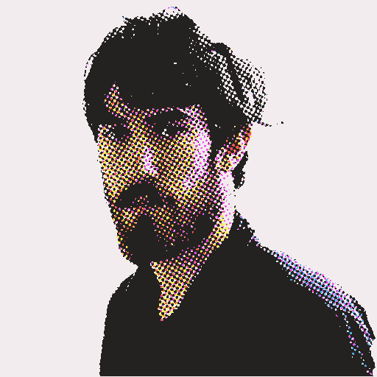
This is Matthew Edwards
matthew.edwards@bristol.ac.uk
He’s a senior lecturer in cyber security
His research is about how people do naughty things online and on darknets
He also has been using Linux for forever
He’s also nice, but weird
…but in a completely different way!

Slide 5
This unit is about teaching you to use a computer as a grown up, not as a user
As such we teach it to (almost) all incoming students
(Undergrads say hi to the conversion MSc students)
You get a lecture all together…
And then a two-hour lab apart
(though we won’t care which you come to… after the first few weeks)
Me and Matt will be at all of them
If you need to speak to us… this is the easiest way
(There will also be a small army of TAs sloping off…
feel free to make them help you)

Slide 6
Everything is examinable
- Lecture content
- Reading we point you towards
- Lab materials
There are two exams
- One on the first 10 weeks of material
- One on the second 10 weeks of material
- You need 40/50% overall to pass
- Both are four-way multiple choice
- Both are open book
- We do not care how you take notes
- We do not care how many notes you take

Slide 7
Come to lectures!
(Students who do… tend to do better)
Come to labs!
(You need to build the muscle memory of how to use UNIX)
(There’s no attendance requirement)
(Things won’t work, but we can help you...)
Ask questions!
(We like talking to you!)
(If you need an alternative explanation we can provide it)
(You don’t need to call us Professor or Doctor: Gretch and Matt is fine!)
This isn’t school!
(We like it if you pass, but we will let you fail)
(We have no say over your final grade)

Slide 8
...you’re paying how much for this degree and yet you’re not making full use of us, and using ChatGPT instead?!??
Seriously… make us work!

