Slide 1







Spelling Bee
Foundation 4

Slide 2
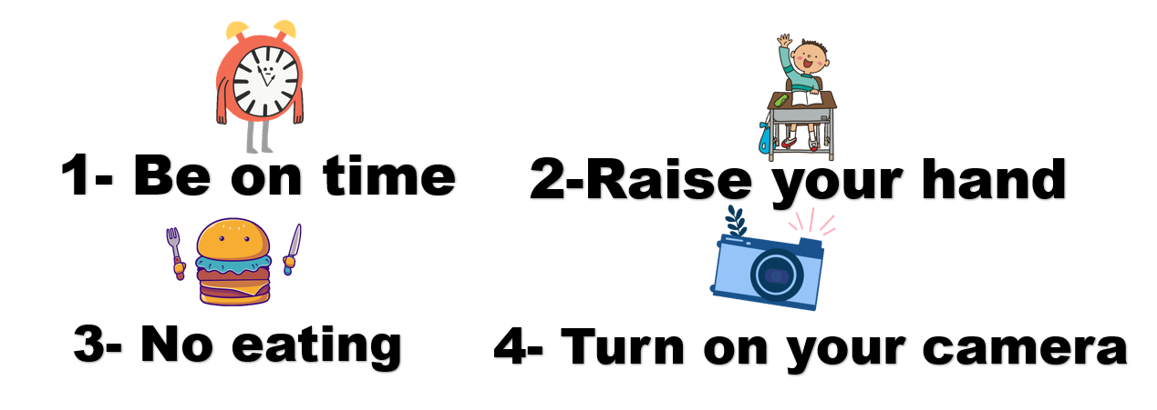
Class Rules

Slide 3
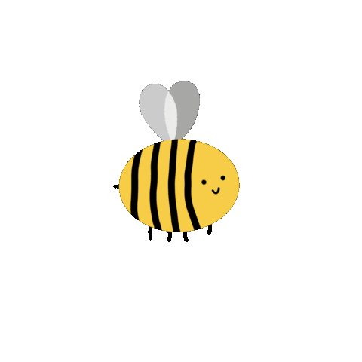
Are you ready?

Slide 4

Round 1
Look and read!
https://www.baamboozle.com/game/2850730

Slide 5

Are you ready?
Great Job!

Slide 6

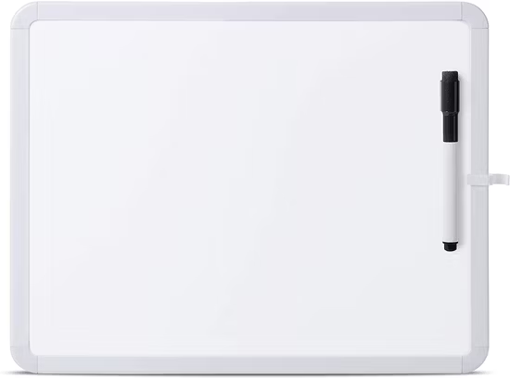
Round 2
Listen and write!

Slide 7

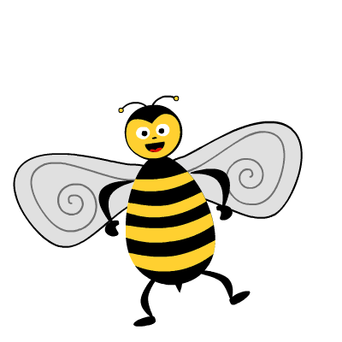
Are you ready?
Amazing!

Slide 8

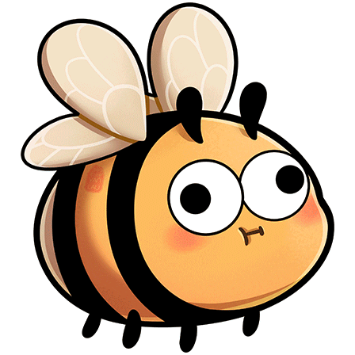
Break
Time

Slide 9
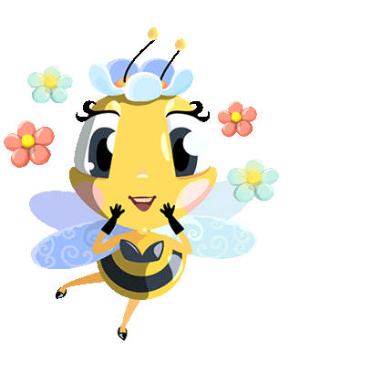
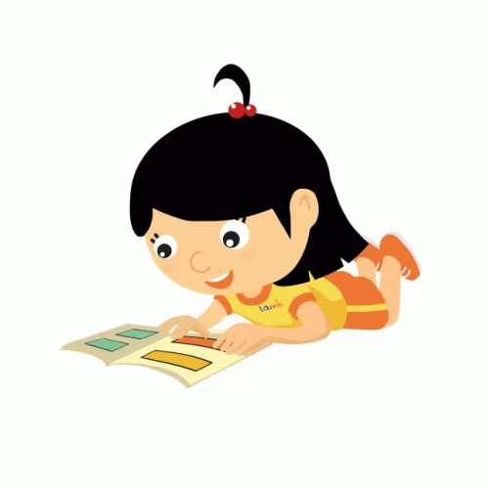
Round 3
“Story time”

Slide 10

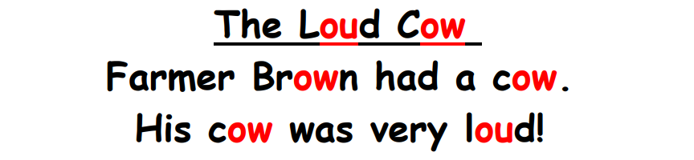
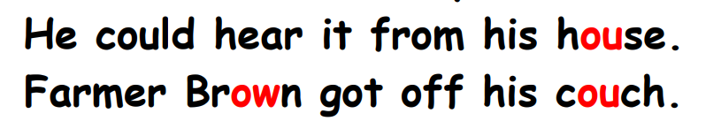
Story

Slide 11
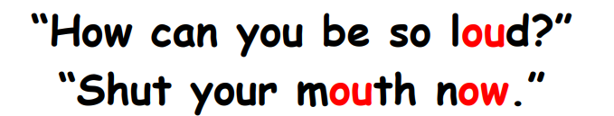
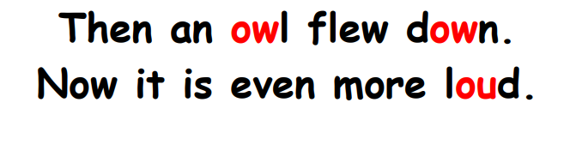
Story

Slide 12
Story

Slide 13
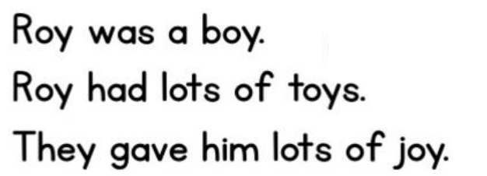
Story

Slide 14
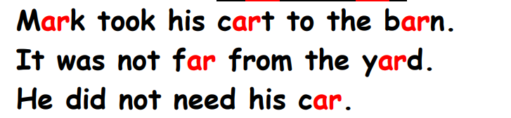
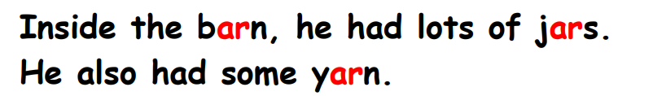
Story

Slide 15
Story

Slide 16


Story

Slide 17


Story

Slide 18
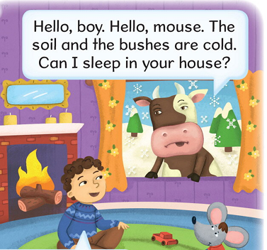
Story

Slide 19
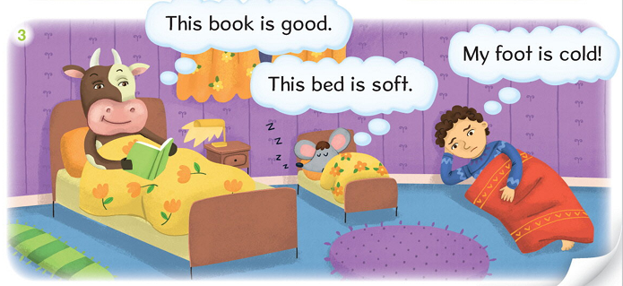
Story

Slide 20
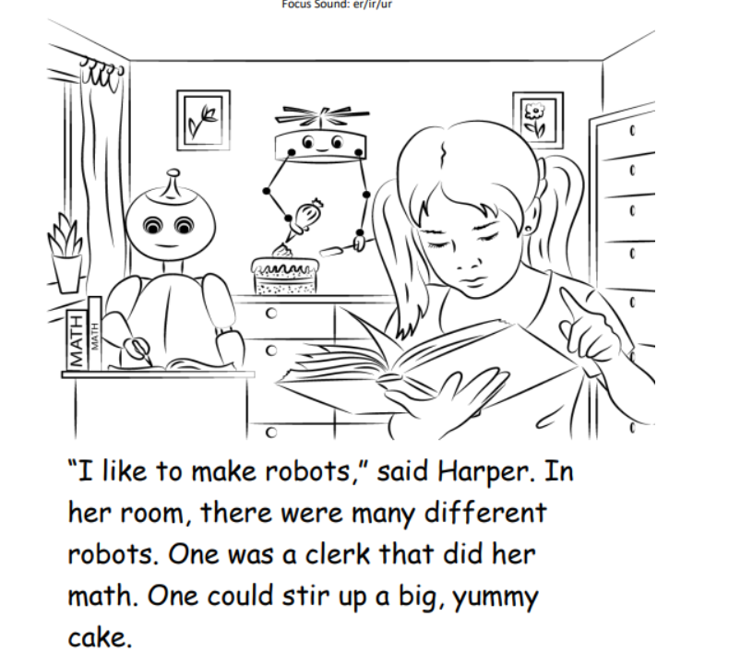
Story

Slide 21

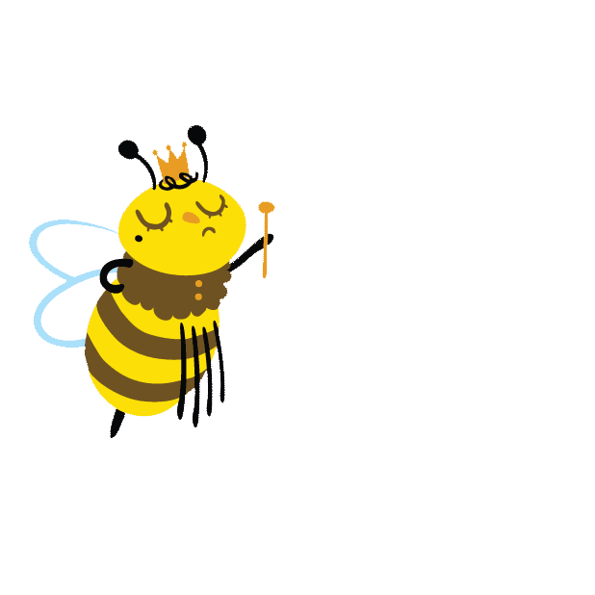

Winner:

Slide 22

THANK YOU
Foundation 4

