Slide 1
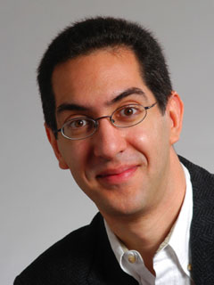
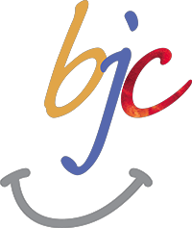

Dilemma of being a cyborg
CS10 : The Beauty and Joy of Computing Lecture #5 Programming Paradigms
2012-02-01
UC Berkeley EECS Lecturer SOE Dan Garcia
Story details the move to Digital of many things precious to us – music, photos, videos. Is there something lost in the process? and what happens when that data is deleted. YOUR backup solution?
http://www.nytimes.com/2012/01/29/magazine/what-happens-when-data-disappears.html

Slide 2
Programming Paradigms Lecture
What are they?
Most are Hybrids!
The Four Primary ones
Functional
Imperative
Object-Oriented
OOP Example: Skecthpad
Declarative
Turing Completeness
Summary

Slide 3

What are Programming Paradigms?
en.wikipedia.org/wiki/Programming_paradigm
“The concepts and abstractions used to represent the elements of a program (e.g., objects, functions, variables, constraints, etc.) and the steps that compose a computation (assignation, evaluation, continuations, data flows, etc.).”
Or, a way to classify the style of programming.

Slide 4
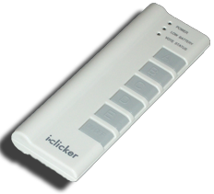
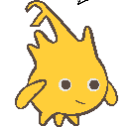
Of 4 paradigms, how many can BYOB be?
byob.berkeley.edu
1 (functional)
1 (not functional)
2
3
4
Notes:
e) 4

Slide 5
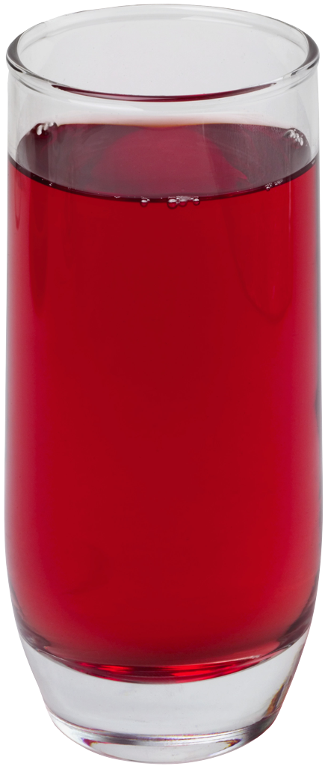
Most Languages Are Hybrids!
This makes it hard to teach to students, because most languages have facets of several paradigms!
Called “Multi-paradigm” languages
Scratch too!
It’s like giving someone a juice drink (with many fruit in it) and asking to taste just one fruit!

Slide 6
Functional Programming (review)
en.wikipedia.org/wiki/Functional_programming
Computation is the evaluation of functions
Plugging pipes together
Each pipe, or function, has exactly 1 output
Functions can be input!
Features
No state
E.g., variable assignments
No mutation
E.g., changing variable values
No side effects
Examples (tho not pure)
Scheme, Scratch BYOB
f(x)=(x+3)* x
x
x 3
x
+
f
*

Slide 7
Imperative Programming
en.wikipedia.org/wiki/Imperative_programming
“Sequential” Programming
Computation a series of steps
Assignment allowed
Setting variables
Mutation allowed
Changing variables
Like following a recipe. E.g.,
Procedure f(x)
ans = x
ans = ans
ans = (x+3) * ans
return ans
Examples: (tho not pure)
Pascal, C
f(x)=(x+3)* x

Slide 8
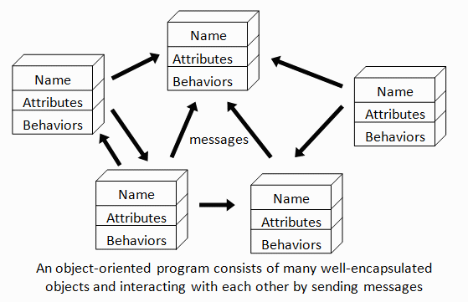
Object-Oriented Programming (OOP)
en.wikipedia.org/wiki/Object-oriented_programming
Objects as data structures
With methods you ask of them
These are the behaviors
With local state, to remember
These are the attributes
Classes & Instances
Instance an example of class
E.g., Fluffy is instance of Dog
Inheritance saves code
Hierarchical classes
E.g., pianist special case of musician, a special case of performer
Examples (tho not pure)
Java, C++
www3.ntu.edu.sg/home/ehchua/programming/java/images/OOP-Objects.gif

Slide 9
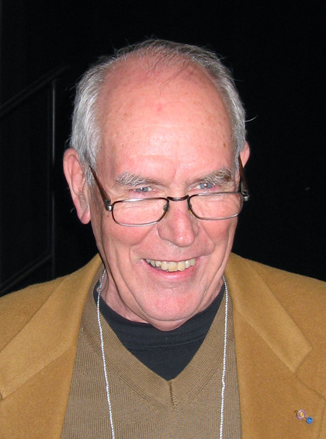
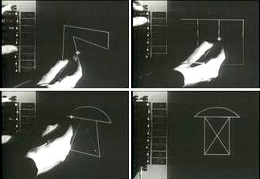

OOP Example : SketchPad
en.wikipedia.org/wiki/Sketchpad
Dr. Ivan Sutherland
“Father of Computer Graphics”
1988 Turing Award (“Nobel prize” for CS)
Wrote Sketchpad for his foundational 1963 thesis
The most impressive software ever written
First…
Object-oriented system
Graphical user interface
non-procedural language
Spent the past few years doing research @ Berkeley in EECS dept!

Slide 10
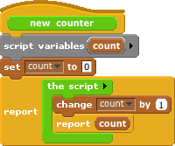
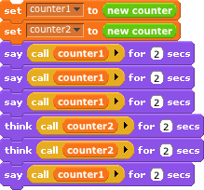

OOP in BYOB

Slide 11
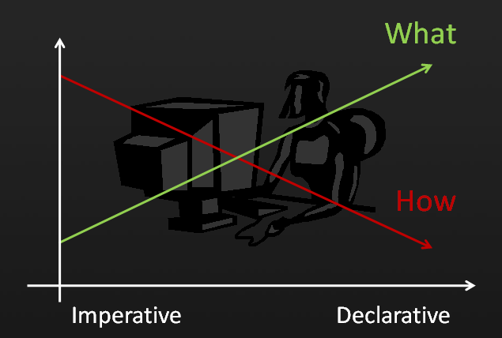
Declarative Programming
en.wikipedia.org/wiki/Declarative_programming
Express what computation desired without specifying how it carries it out
Often a series of assertions and queries
Feels like magic!
Sub-categories
Logic
Constraint
We saw in Sketchpad!
Example: Prolog
Anders Hejlsberg “The Future of C#” @ PDC2008 channel9.msdn.com/pdc2008/TL16/

Slide 12
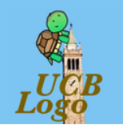
Declarative Programming Example
Five schoolgirls sat for an examination. Their parents – so they thought – showed an undue degree of interest in the result. They therefore agreed that, in writing home about the examination, each girl should make one true statement and one untrue one. The following are the relevant passages from their letters:
Betty
Kitty was 2nd
I was 3rd
Ethel
I was on top
Joan was 2nd
Joan
I was 3rd
Ethel was last
Kitty
I came out 2nd
Mary was only 4th
Mary
I was 4th
Betty was 1st

Slide 13
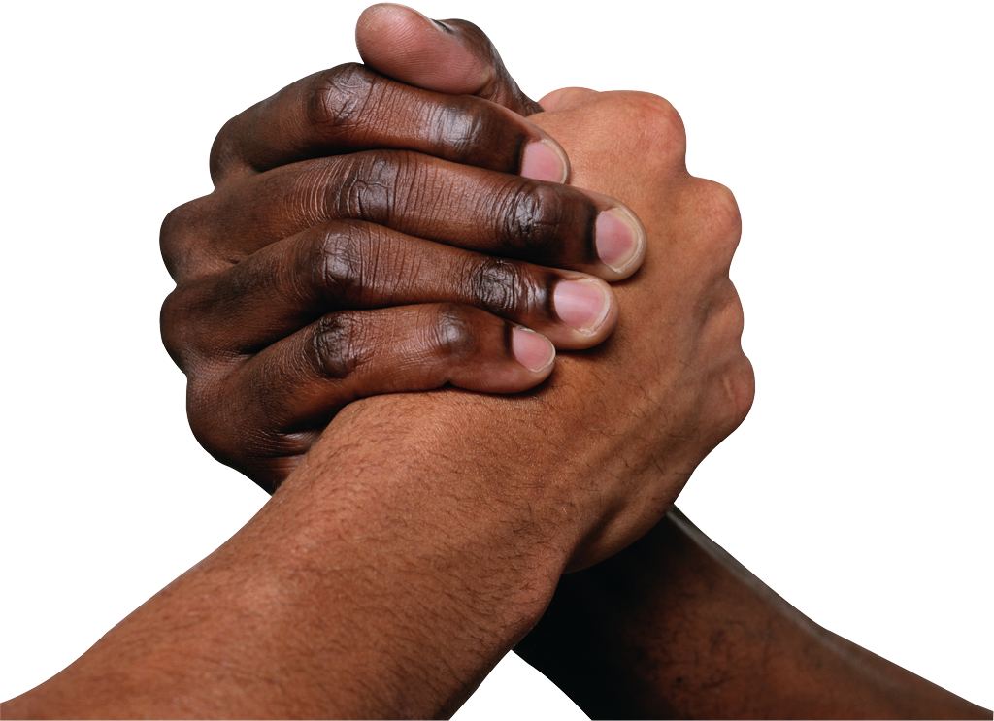
Of 4 paradigms, what’s the most powerful?
Functional
Imperative
OOP
Declarative
All equally powerful

Slide 14
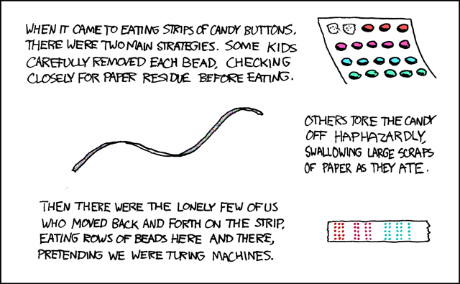
Turing Completeness
en.wikipedia.org/wiki/Turing_completeness ironphoenix.org/tril/tm/
A Turing Machine has an infinite tape of 1s and 0s and instructions that say whether to move the tape left, right, read, or write it
Can simulate any computer algorithm!
A Universal Turing Machine is one that can simulate a Turing machine on any input
A language is considered Turing Complete if it can simulate a Universal Turing Machine
A way to decide that one programming language or paradigm is just as powerful as another
Turing Machine by Tom Dunne
Xkcd comic “Candy Button Paper”

Slide 15
Ways to Remember the Paradigms
en.wikipedia.org/wiki/Programming_paradigm
Functional
Evaluate an expression and use the resulting value for something
Imperative
First do this and next do that
Object-oriented
Send messages between objects to simulate the temporal evolution of a set of real world phenomena
Declarative
Answer a question via search for a solution
www.cs.aau.dk/~normark/prog3-03/html/notes/paradigms_themes-paradigm-overview-section.html

Slide 16
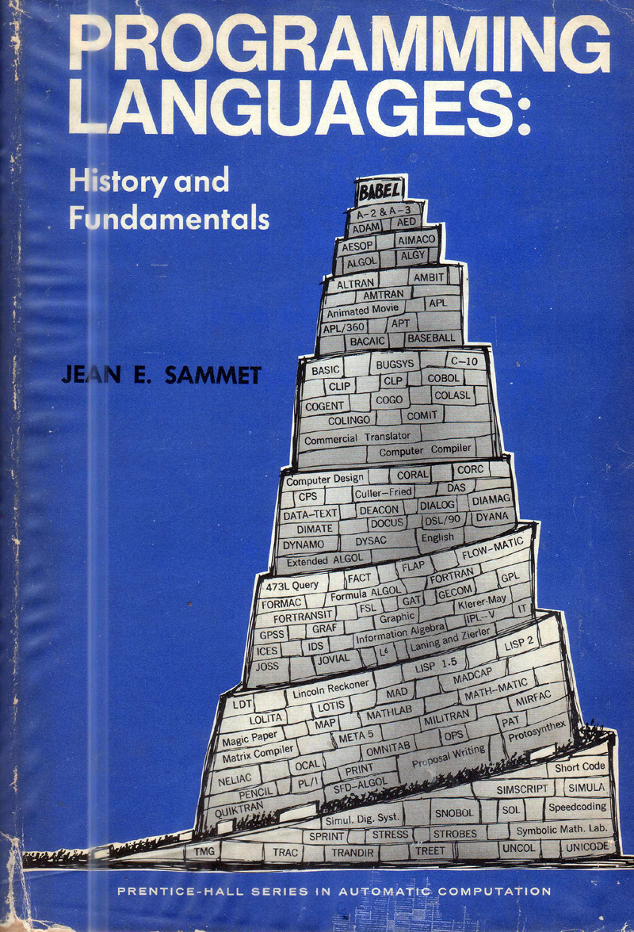
Summary
Each paradigm has its unique benefits
If a language is Turing complete, it is equally powerful
Paradigms vary in efficiency, scalability, overhead, fun, “how” vs “what” to specify, etc.
Modern languages usually take the best from all
E.g., Scratch
Can be functional
Can be imperative
Can be object-oriented
Can be declarative

