Slide 1
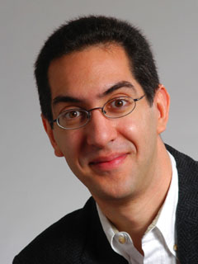


CS10 chosen as uc online pilot!
CS10 : The Beauty and Joy of Computing Lecture #10 Social Implications of Computing
2012-02-27
Anyone watching online?
UC Berkeley EECS Lecturer SOE Dan Garcia
Project spec is posted
You have a few chapters of reading during these weeks, don’t wait...
CS10 has been chosen as one of 30 courses (all across 10 UC campuses) to receive Pilot funding for online instruction! We’ll have 1080p time-indexed videos, “instructor does the class” videos, and mini-quizzes througout.
Your project partners may be in different sections, try to attend “Project Work” labs together
Read BYOB project tips!
onlineeducation.universityofcalifornia.edu

Slide 2

Overview
META: This course is NOT just about programming!
Lecs + Reading: Big ideas
Labs: Programming
Disc: Distillation
META: plug CS195 Social Implications of Computers
Computers in Education
Most important use?
Judah Schwartz’ continuum
RSA Animate “Changing Education Paradigms”
UC Online Pilot

Slide 3

Peer Instruction (thanks to BH)
The most important use of computers in education so far...
Web search
Arithmetic drill programs
Word processing
iclicker-like technologies
Social networking
Notes:
Answer: D (includes everything in which the computer poses a question and you have to answer in a computer-readable form, which so far means multiple choice)

Slide 4

Answer
“Multiple choice tests have changed what counts as knowledge in schools. Open-ended questions were the norm 30 years ago. The kind of knowledge you can report on multiple-choice tests is unimportant in the big scheme of things, and what’s really important is not what you already know, but how you can take what you already know and apply it something you’ve never seen before. Multiple choice tests make that hard. Teaching follows tests! The folks who invented Standardized Testing didn’t foresee how it would affect what knowledge means! (unintended consequence)” – Brian Harvey

Slide 5
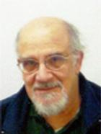
Computers in Education (open?)
Judah Schwartz
Myphysicslab demo ASSIST movie

Slide 6
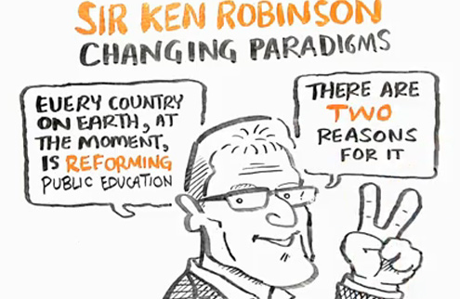
RSA Animate : Changing Education Paradigms
www.youtube.com/watch?v=zDZFcDGpL4U

Slide 7
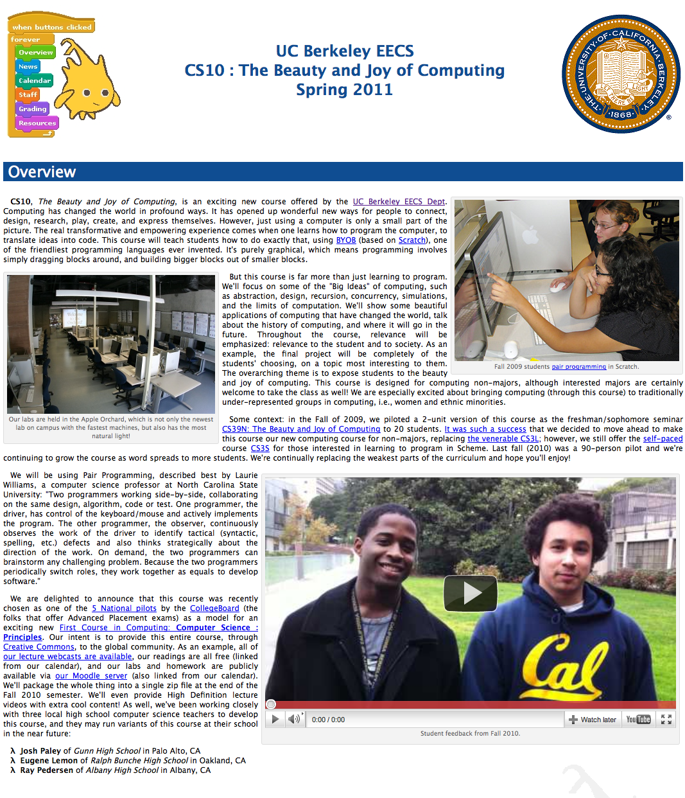
UC Berkeley Online Pilot
groups.ischool.berkeley.edu/onlineeducation/
Basics of Pilot
Blended vs Online
What should we do?
How can CS10 be the course for everyone?
How can we use peers?
What’d help you most?
Would you take this course if it’d been offered at another UC?
Does f2f matter?

Slide 8
Taking CS10 Online
The most effective thing for your learning, if you were taking CS10 online (remotely)…
“Test yourself” mini-quizzes
Mini-programming challenges
Tree-structure interface to lectures
1080p High-Definition archived lectures
“Instructor takes the class” videos of us doing labs, HW, exams
Notes:
Answer: D (includes everything in which the computer poses a question and you have to answer in a computer-readable form, which so far means multiple choice)

