Slide 1
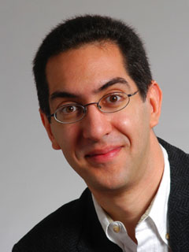

Ipad 2 announced today
CS10 The Beauty and Joy of Computing Lecture #11 : Recursion II
2011-03-02
UC Berkeley EECS Lecturer SOE Dan Garcia
Hello to Yue Li, CS Associate Prof, Nat. U of Defense Technology,
Hunan, CHINA
Will Apple continue to thrall its users with outstanding technology amidst tons of competition from its Android Rivals? Will Steve Jobs make an appearance? Will you buy one?
www.apple.com

Slide 2
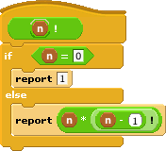
How the Computer Works … n!
Factorial(n) = n! Inductive definition:
n! = 1 , n = 0
n! = n * (n-1)!, n > 0
Let’s act it out…
“Little people”, or “subcontractor” model
5!
n | n!
0 | 1
1 | 1
2 | 2
3 | 6
4 | 24
5 | 120

Slide 3

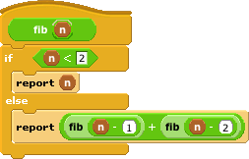
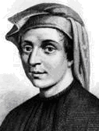
How the Computer Works … fib(n)
en.wikipedia.org/wiki/Fibonacci_number www.ics.uci.edu/~eppstein/161/960109.html
Inductive definition:
fib(n) = n , n < 2
fib(n) = fib(n-1)+fib(n-2), n > 1
Let’s act it out…
“contractor” model
fib(5)
n | fib(n)
0 | 0
1 | 1
2 | 1
3 | 2
4 | 3
5 | 5
Let’s now: trace… (gif from Ybungalobill@wikimedia)
Leonardo de Pisa aka, Fibonacci

Slide 4
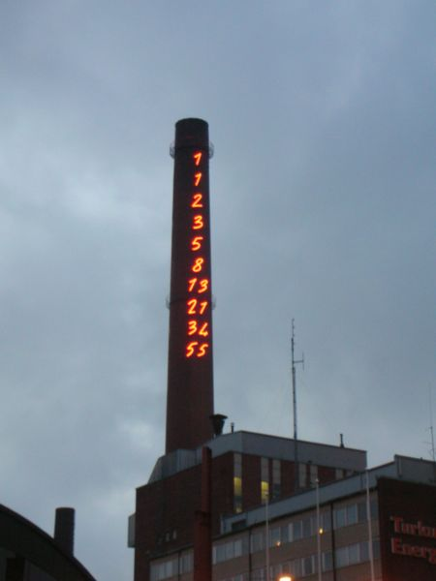
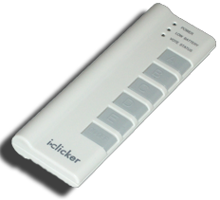
Order of growth of # of calls of fib(n)
Constant
Logarithmic
Linear
Quadratic
Exponential
Chimney of Turku Energia, Turku, Finland featuring Fibonacci sequence in 2m high neon lights. By Italian artist Mario Merz for an environmental art project. (Wikipedia)

Slide 5
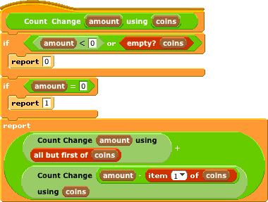
Counting Change (thanks to BH)
Given coins {50, 25, 10, 5, 1} how many ways are there of making change?
5: 2 (N,5 P)
10
4 (D, 2N, N 5P, 10P)
15
6 (DN,D5P,3N,2N5P,1N10P,15P)
100?

Slide 6
Call Tree for “Count Change 10 (10 5 1)”
Skip Coin
Use Coin

Slide 7
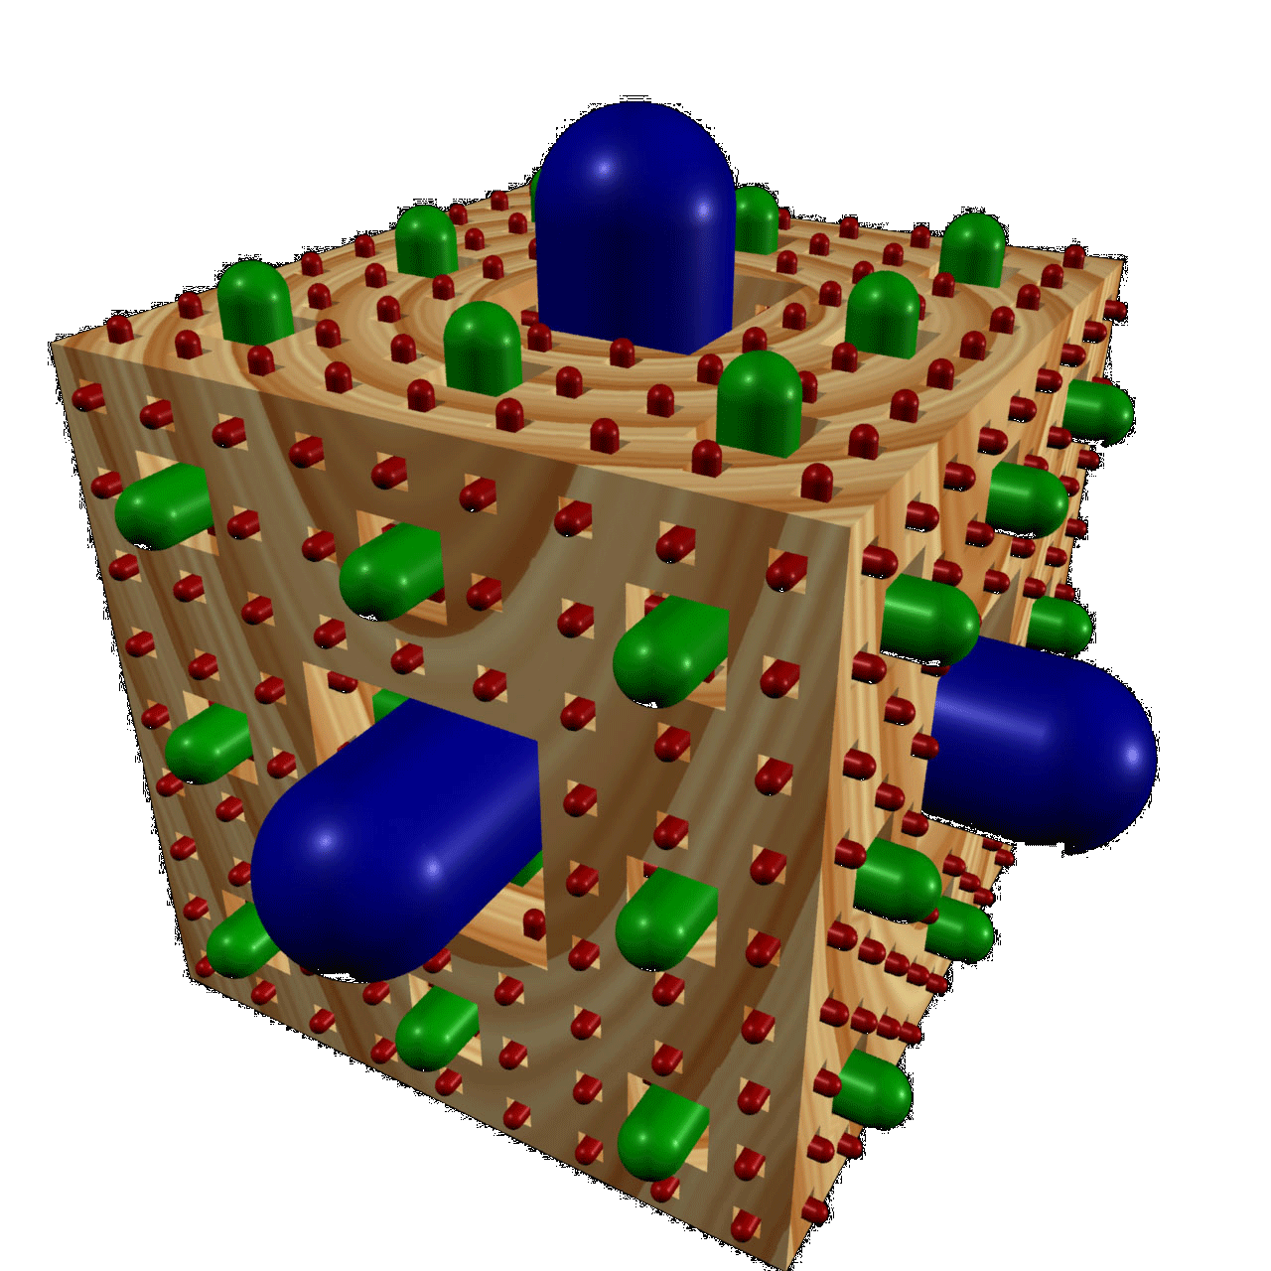
Summary
It’s important to understand the machine model
Recursion is a very powerful idea, and one way to separate good from great
Menger Cube by Dan Garcia

