Slide 1
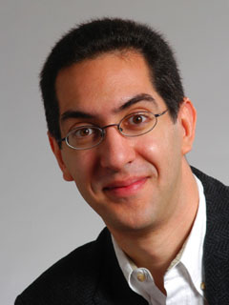
Kinect could estimate age!
CS10 The Beauty and Joy of Computing Lecture #11 : Recursion II
2011-10-10
UC Berkeley EECS Lecturer SOE Dan Garcia
Microsoft filed a patent that proposed to use the 3D depth camera to estimate the age of the viewer (height, head-width to shoulder-width, torso length to overall height), and automatically restrict access to content. Tech-savvy kids usu override controls, we’re told.
www.geekwire.com/2011/microsoft-idea-kinect-body-scans-estimate-age-automate-parental-controls

Slide 2
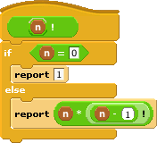
How the Computer Works … n!
Factorial(n) = n! Inductive definition:
n! = 1 , n = 0
n! = n * (n-1)!, n > 0
Let’s act it out…
“Little people”, or “subcontractor” model
5!
n | n!
0 | 1
1 | 1
2 | 2
3 | 6
4 | 24
5 | 120

Slide 3
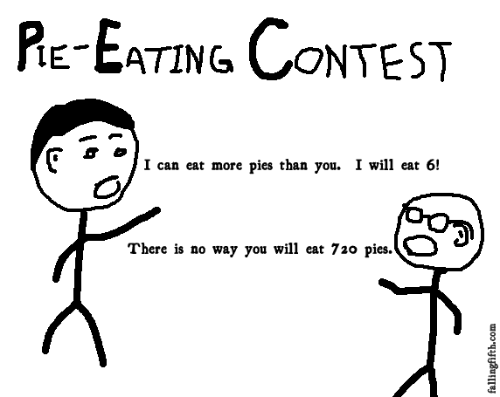
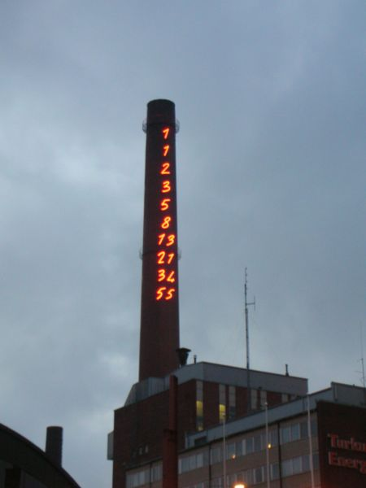
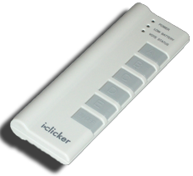
Order of growth of # of calls of n!
Constant
Logarithmic
Linear
Quadratic
Exponential
(source: FallingFifth.com)

Slide 4

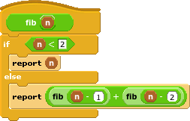
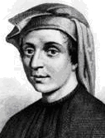
How the Computer Works … fib(n)
en.wikipedia.org/wiki/Fibonacci_number www.ics.uci.edu/~eppstein/161/960109.html
Inductive definition:
fib(n) = n , n < 2
fib(n) = fib(n-1)+fib(n-2), n > 1
Let’s act it out…
“contractor” model
fib(5)
n | fib(n)
0 | 0
1 | 1
2 | 1
3 | 2
4 | 3
5 | 5
Let’s now: trace… (gif from Ybungalobill@wikimedia)
Leonardo de Pisa aka, Fibonacci

Slide 5
Order of growth of # of calls of fib(n)
Constant
Logarithmic
Linear
Quadratic
Exponential
Chimney of Turku Energia, Turku, Finland featuring Fibonacci sequence in 2m high neon lights. By Italian artist Mario Merz for an environmental art project. (Wikipedia)

Slide 6
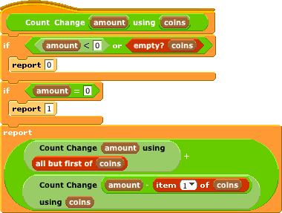
Counting Change (thanks to BH)
Given coins {50, 25, 10, 5, 1} how many ways are there of making change?
5: 2 (N,5 P)
10
4 (D, 2N, N 5P, 10P)
15
6 (DN,D5P,3N,2N5P,1N10P,15P)
100?

Slide 7
Call Tree for “Count Change 10 (10 5 1)”
⬅ Skip Coin
Use Coin ➔
D?
N?
D
P?
N?
P?
P?
NN
P?
P?
P?
P?
P?
P?
P?
P?
P?
N 5P
P?
P?
P?
10P

Slide 8
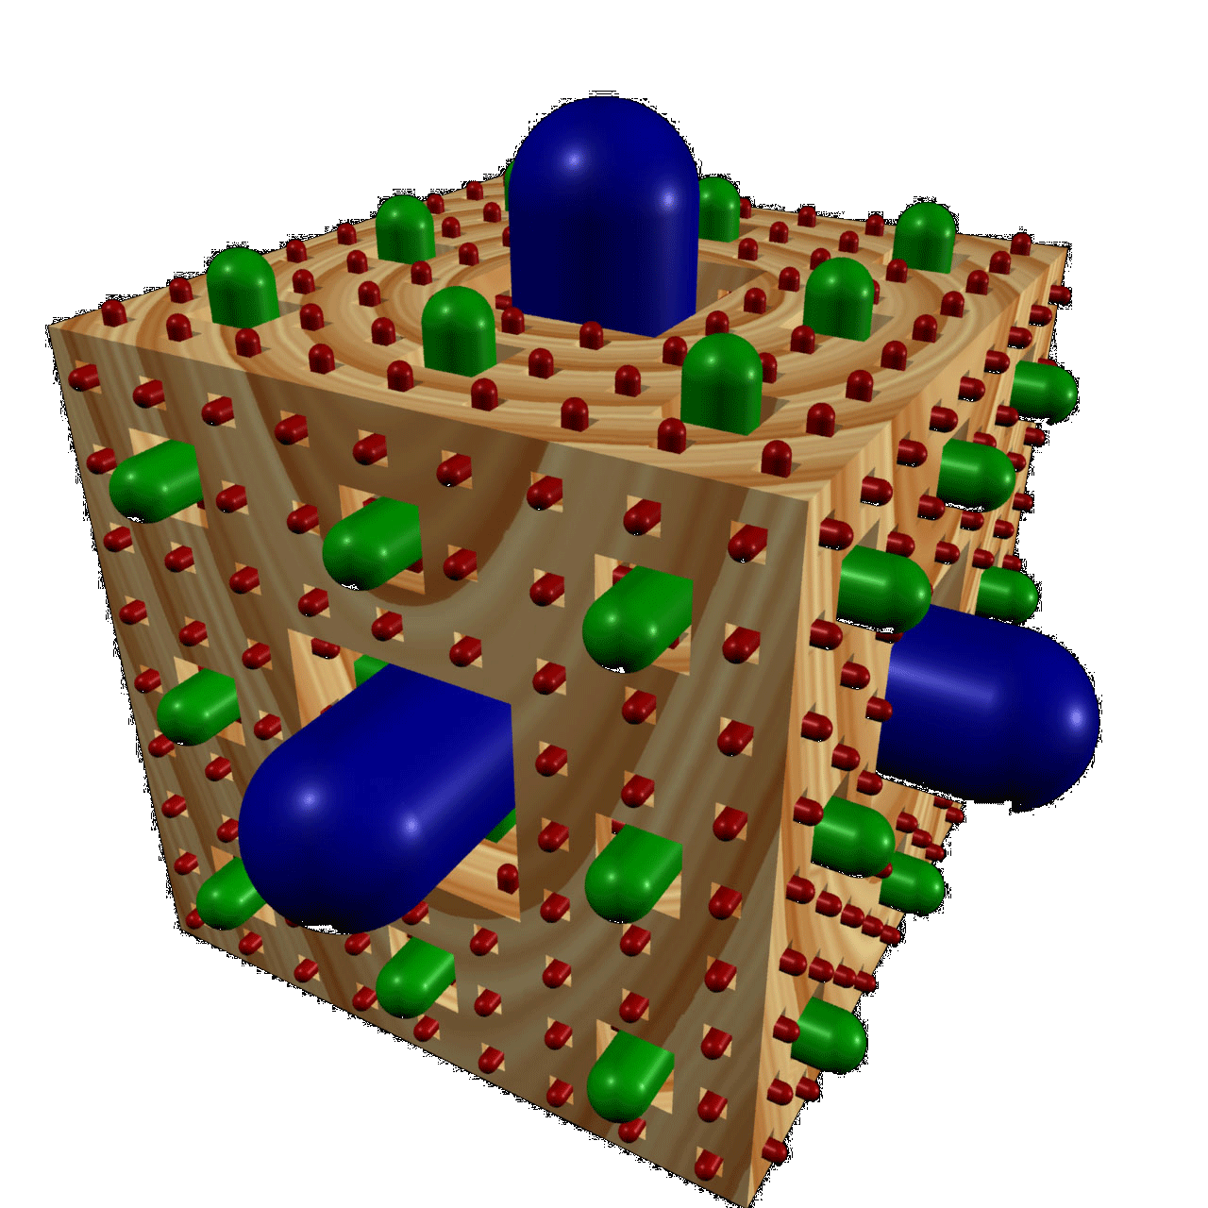
Summary
It’s important to understand the machine model
It’s often the cleanest, simplest way to solve many problems
Esp those recursive in nature!
Recursion is a very powerful idea, and one way to separate good from great
Menger Cube by Dan Garcia

