Slide 1
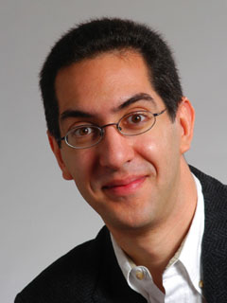
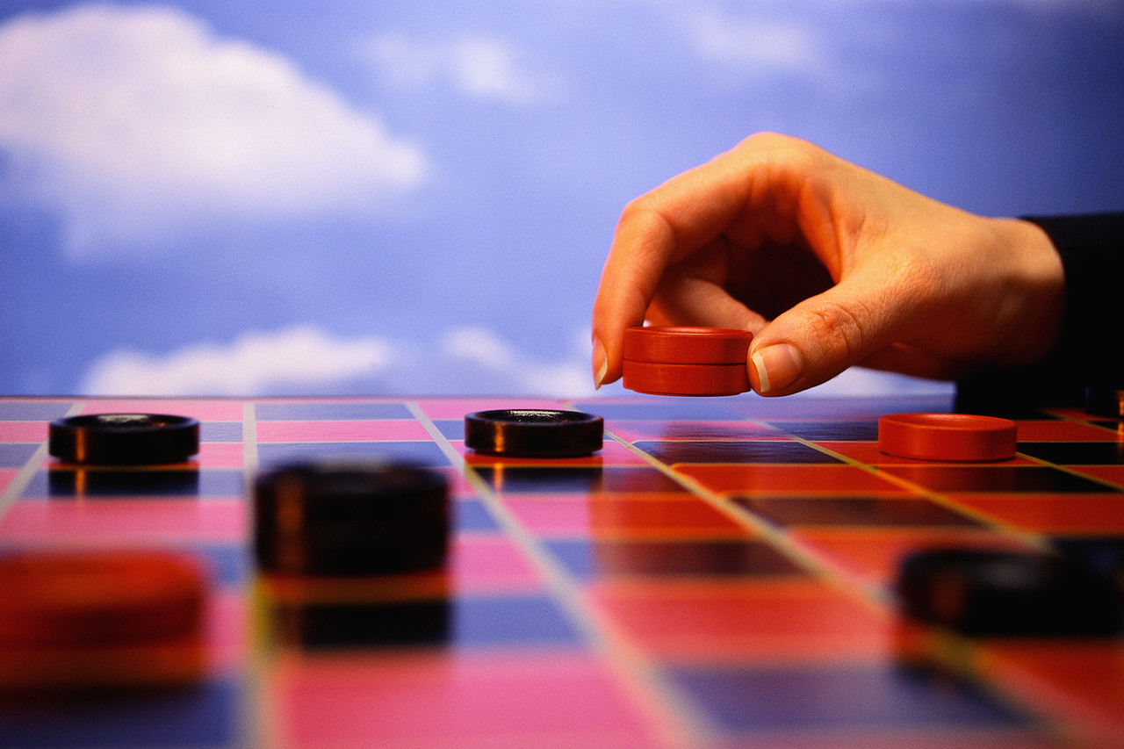
Checkers solved in 2007!
CS10 The Beauty and Joy of Computing Lecture #22 : Computational Game Theory
2010-11-17
UC Berkeley EECS Lecturer SOE Dan Garcia
A 19-year project led by Prof Jonathan Schaeffer, he used dozens (sometimes hundreds) of computers and AI to prove it is, in perfect play, a … draw! This means that if two Gods were to play, nobody would ever win!
www.cs.ualberta.ca/~chinook/

Slide 2
Computational Game Theory
History
Definitions
Game Theory
What Games We Mean
Win, Lose, Tie, Draw
Weakly / Strongly Solving
Gamesman
Dan’s Undergraduate R&D Group
Demo!!
Future

Slide 3
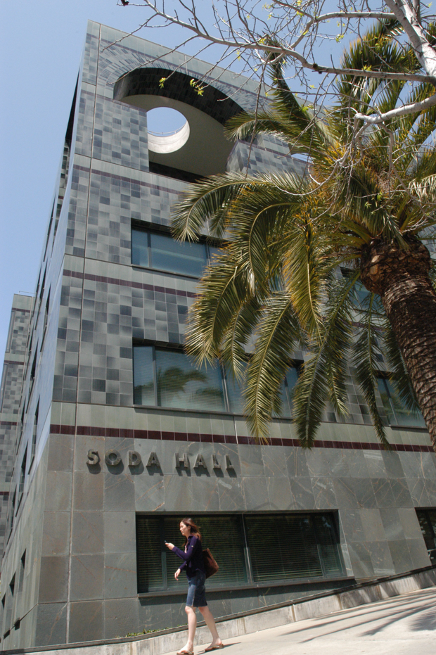
Computer Science … A UCB view
www.eecs.berkeley.edu/Research/Areas/
CS research areas:
Artificial Intelligence
Biosystems & Computational Biology
Computer Architecture & Engineering
Database Management Systems
Graphics
Human-Computer Interaction
Operating Systems & Networking
Programming Systems
Scientific Computing
Security
Theory
…

Slide 4
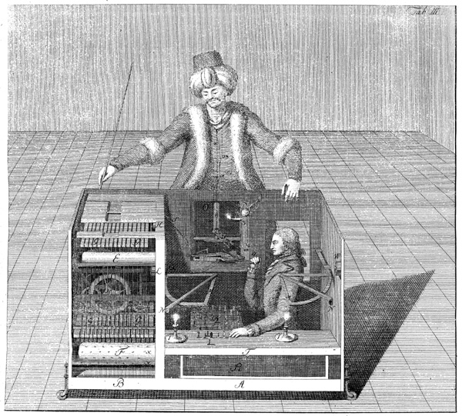
The Turk (1770)
en.wikipedia.org/wiki/The_Turk
A Hoax!
Built by Wolfgang von Kempelen
to impress the Empress
Could play a strong game of Chess
Thanks to Master inside
Toured Europe
Defeated Benjamin Franklin & Napoleon!
Burned in an 1854 fire
Chessboard saved…
The Mechanical Turk (1770)

Slide 5
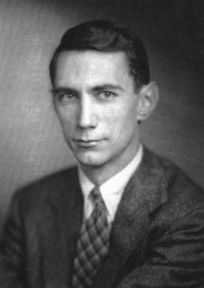
Claude Shannon’s Paper (1950)
en.wikipedia.org/wiki/Claude_Shannon#Shannon.27s_computer_chess_program
The “Father of Information Theory”
Founded the digital computer
Defined fundamental limits on compressing/storing data
Wrote “Programming a Computer for Playing Chess” paper in 1950
C. Shannon, Philos. Mag. 41, 256 (1950).
All chess programs today have his theories at their core
His estimate of # of Chess positions called “Shannon #”
Claude Shannon (1916-2001)

Slide 6
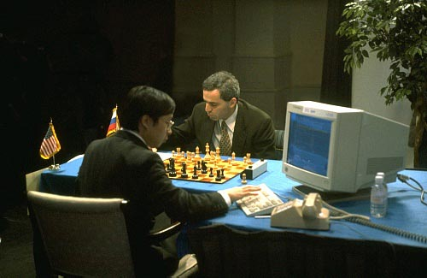
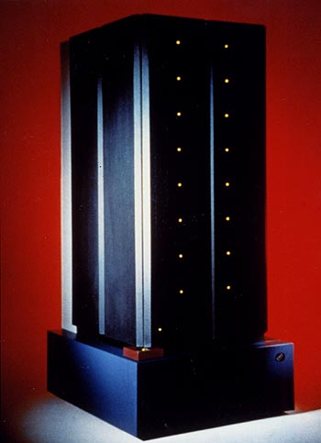
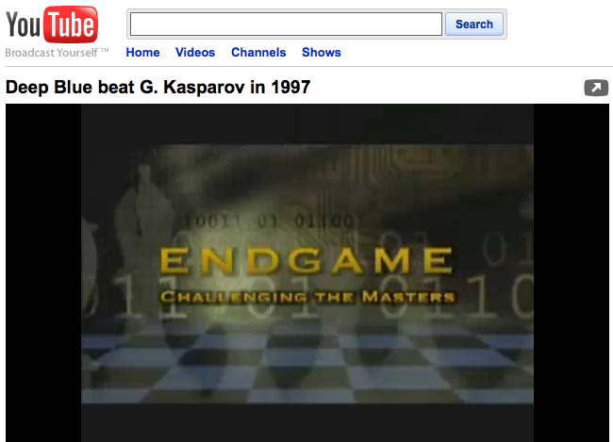
Deep Blue vs Garry Kasparov (1997)
en.wikipedia.org/wiki/Deep_Blue_(chess_computer)
Kasparov World Champ
1996 Tournament
First game DB wins a classic!
But DB loses 3 and draws 2 to lose the 6-game match 4-2
In 1997 Deep Blue upgraded, renamed “Deeper Blue”
1997 Tournament
GK wins game 1
GK resigns game 2
even though it was draw!
DB & GK draw games 3-5
Game 6 : 1997-05-11 (May 11th)
Kasparov blunders move 7, loses in 19 moves. Loses tournament 3 ½ - 2 ½
GK accuses DB of cheating. No rematch.
Defining moment in AI history
IBM’s Deep Blue vs Garry Kasparov

Slide 7
What is “Game Theory”?
www.cs.berkeley.edu/~ddgarcia/eyawtkagtbwata
Combinatorial
Sprague and Grundy’s 1939 Mathematics and Games
Board games
Nim, Domineering, dots and boxes
Film: Last Year in Marienbad
Complete info, alternating moves
Goal: Last move
Computational
R. C. Bell’s 1988 Board and Table Games from many Civilizations
Board games
Tic-Tac-Toe, Chess, Connect 4, Othello
Film : Searching for Bobby Fischer
Complete info, alternating moves
Goal: Varies
Economic
von Neumann and Morgenstern’s 1944 Theory of Games and Economic Behavior
Matrix games
Prisoner’s dilemma, auctions
Film : A Beautiful Mind (about John Nash)
Incomplete info, simultaneous moves
Goal: Maximize payoff

Slide 8
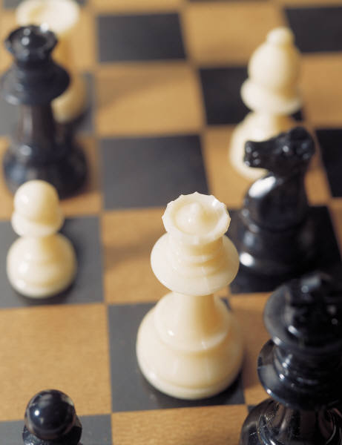
What “Board Games” do you mean?
No chance, such as dice or shuffled cards
Both players have complete information
No hidden information, as in Stratego & Magic
Two players (Left & Right) usually alternate moves
Repeat & skip moves ok
Simultaneous moves not ok
The game can end in a pattern, capture, by the absence of moves, or …

Slide 9
What’s in a Strong Solution
For every position
Assuming alternating play
Value … (for player whose turn it is)
Winning (∃ losing child)
Losing (All children winning)
Tieing (!∃ losing child, but ∃ tieing child)
Drawing (can’t force a win or be forced to lose)
Remoteness
How long before game ends?
W
L
...
...
W
W
W
L
W
W
W
W
T
D
D
...
...
W
W
W
T
W
W
W
W

Slide 10
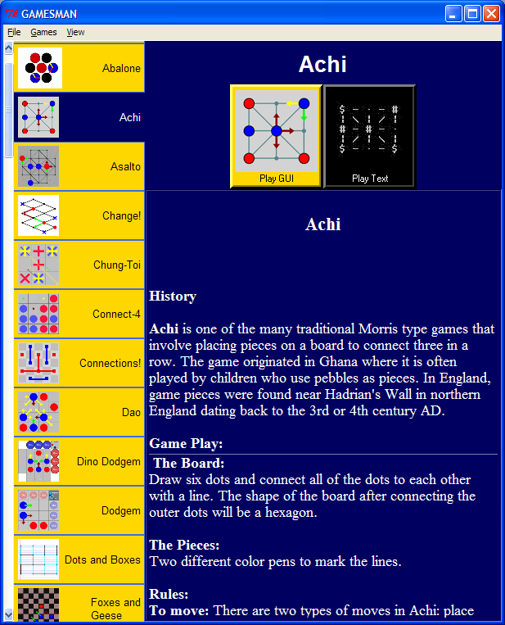
GamesCrafters
We strongly solve abstract strategy games and puzzles
70 games / puzzles in our system
Allows perfect play against an opponent
Ability to do a post-game analysis

Slide 11
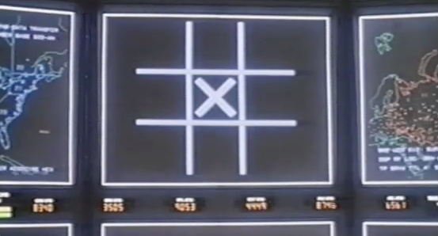
What did you mean “strongly solve”?
Wargames (1983)

Slide 12
Weakly Solving A Game (Checkers)
Thanks to Jonathan Schaeffer for this slide…
Workers: positions to search
Master:
main line of
play to consider
Endgame databases
(solved)
Log of Search Space Size

Slide 13
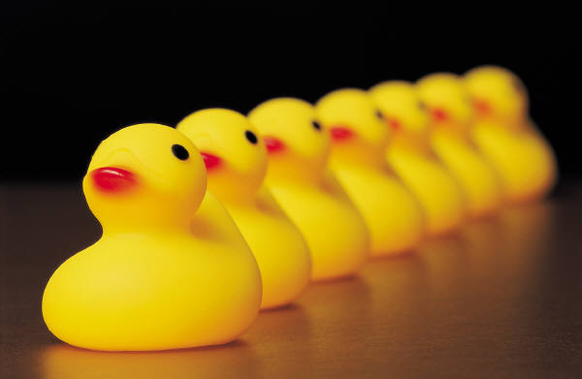
Strong Solving Example: 1,2,…,10
Rules (on your turn):
Running total = 0
Rules (on your turn):
Add 1 or 2 to running total
Goal
Be the FIRST to get to 10
Example
Ana: “2 to make it 2”
Bob: “1 to make it 3”
Ana: “2 to make it 5”
Bob: “2 to make it 7” → photo
Ana: “1 to make it 8”
Bob: “2 to make it 10” I WIN!
7 ducks (out of 10)

Slide 14
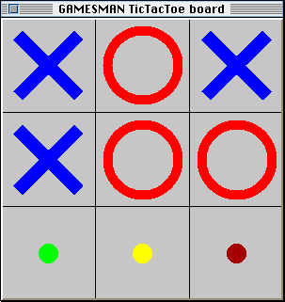
Example: Tic-Tac-Toe
Rules (on your turn):
Place your X or O in an empty slot on 3x3 board
Goal
If your make 3-in-a-row first in any row / column / diag, win
Else if board is full with no 3-in-row, tie
Misére is tricky
3-in-row LOSES
Pair up and play now, then swap who goes 1st
Values Visualization for Tic-Tac-Toe

Slide 15
Tic-Tac-Toe Answer Visualized!
Recursive Values Visualization Image
Misére Tic-tac-toe
Outer rim is position
Inner levels moves
Legend
Lose
Tie
Win
Misére Tic-Tac-Toe 2-ply Answer

Slide 16

GamesCrafters
GamesCrafters.berkeley.edu
Undergraduate Computational Game Theory Research Group
300 students since 2001
We now average 20/semester!
They work in teams of 2+
Most return, take more senior roles (sub-group team leads)
Maximization (bottom-up solve)
Oh, DeepaBlue (parallelization)
GUI (graphical interface work)
Retro (GUI refactoring)
Architecture (core)
New/ice Games (add / refactor)
Documentation (games & code)

Slide 17
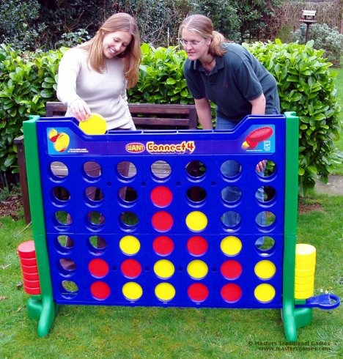
Connect 4 Solved, Online!
We’ve just finished a solve of Connect 4!!
It took 30 Machines x 8 Cores x 1 weeks
Win for the first player (go in the middle!)
3,5 = tie
1,2,6,7 = lose

Slide 18
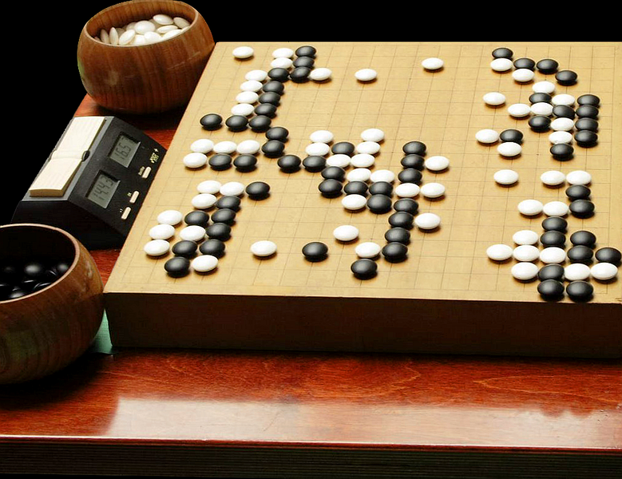
Future
Board games are exponential in nature
So has been the progress of the speed / capacity of computers!
Therefore, every few years, we only get to solve one more “ply”
One by one, we’re going to solve them and/or beat humans
We’ll never solve some
E.g., hardest game : Go
17408965065903192790718823807056436794660272495026354119482811870680105167618464984116279288988714938612096988816320780613754987181355093129514803369660572893075468180597603
Go’s search space ~ 3³⁶¹

