Slide 1
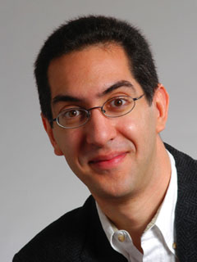

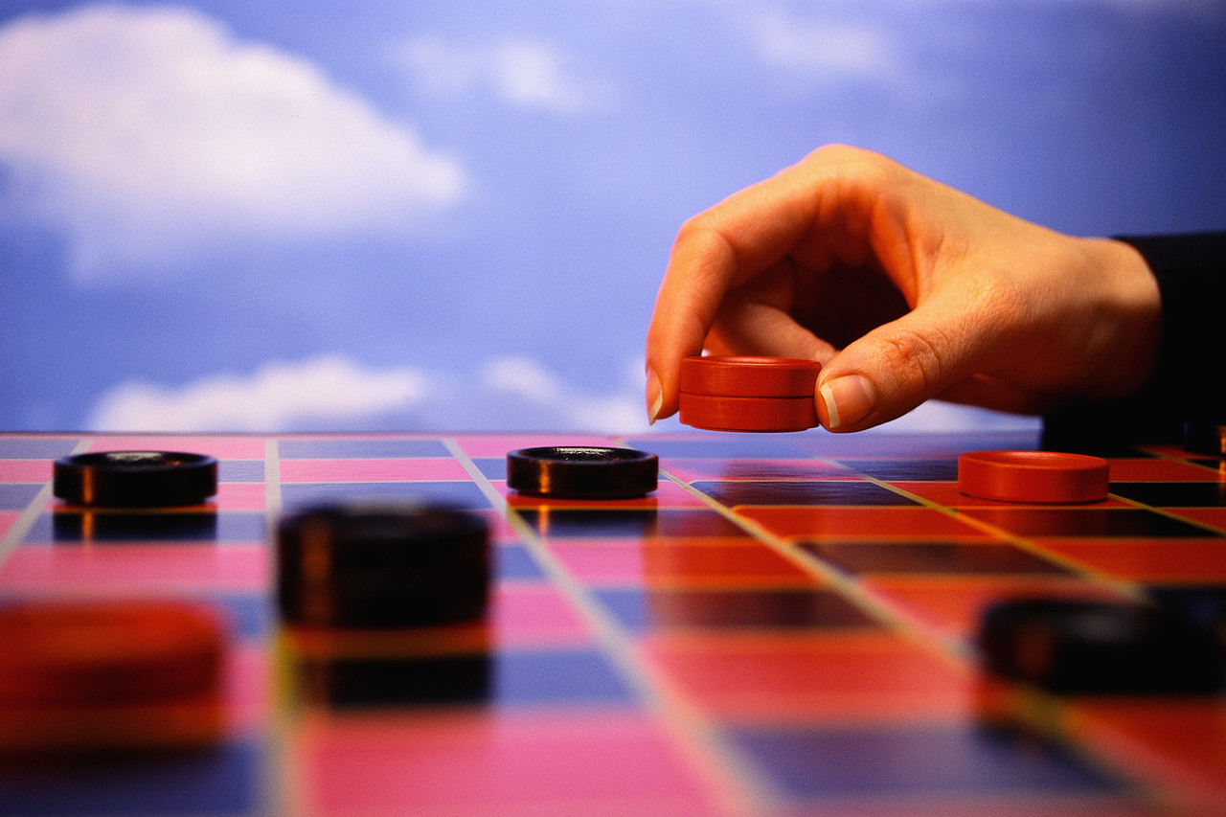
Checkers solved!
CS10 : The Beauty and Joy of Computing Lecture #16 : Computational Game Theory
2012-03-12
UC Berkeley EECS Lecturer SOE Dan Garcia
Summer courses (CS61A, CS70) avail
Form a learning community!
A 19-year project led by Prof Jonathan Schaeffer, he used dozens (sometimes hundreds) of computers and AI to prove it is, in perfect play, a … draw! This means that if two Gods were to play, nobody would ever win!
www.cs.ualberta.ca/~chinook/

Slide 2
Computational Game Theory
History
Definitions
Game Theory
What Games We Mean
Win, Lose, Tie, Draw
Weakly / Strongly Solving
Gamesman
Dan’s Undergraduate R&D Group
Demo!!
Future

Slide 3
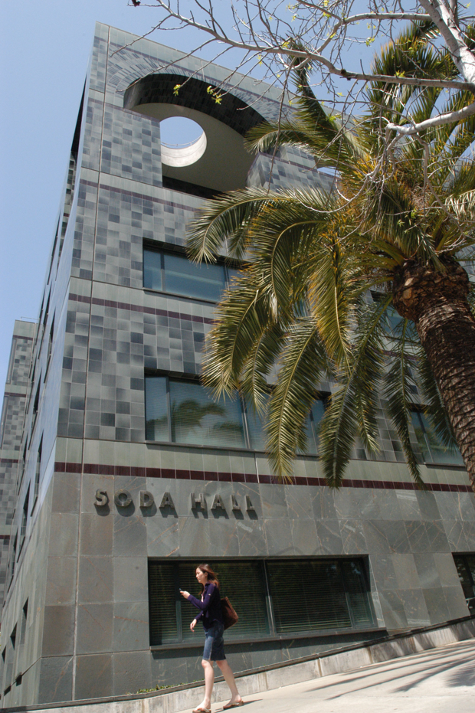
Computer Science … A UCB view
www.eecs.berkeley.edu/Research/Areas/
CS research areas:
Artificial Intelligence
Biosystems & Computational Biology
Computer Architecture & Engineering
Database Management Systems
Graphics
Human-Computer Interaction
Operating Systems & Networking
Programming Systems
Scientific Computing
Security
Theory
…

Slide 4
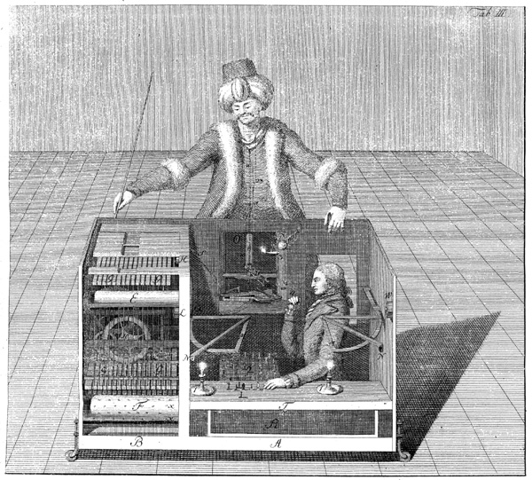
The Turk (1770)
en.wikipedia.org/wiki/The_Turk
A Hoax!
Built by Wolfgang von Kempelen
to impress the Empress
Could play a strong game of Chess
Thanks to Master inside
Toured Europe
Defeated Benjamin Franklin & Napoleon!
Burned in an 1854 fire
Chessboard saved…
The Mechanical Turk (1770)

Slide 5
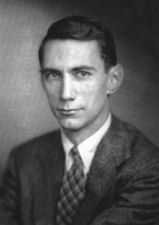
Claude Shannon’s Paper (1950)
en.wikipedia.org/wiki/Claude_Shannon#Shannon.27s_computer_chess_program
The “Father of Information Theory”
Founded the digital computer
Defined fundamental limits on compressing/storing data
Wrote “Programming a Computer for Playing Chess” paper in 1950
C. Shannon, Philos. Mag. 41, 256 (1950).
All chess programs today have his theories at their core
His estimate of # of Chess positions called “Shannon #”
Now proved < 2¹⁵⁵ ~ 10^{46.7}
Claude Shannon (1916-2001)

Slide 6
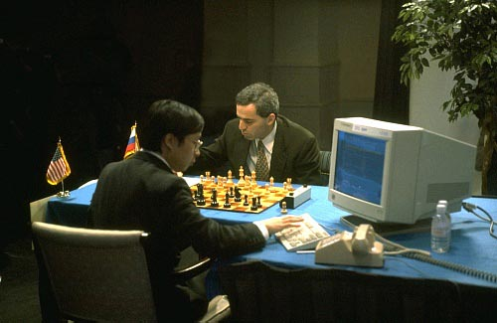
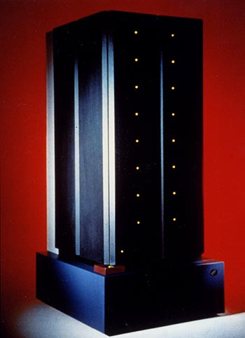
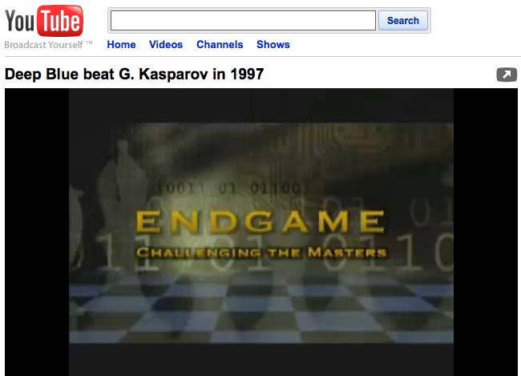
Deep Blue vs Garry Kasparov (1997)
en.wikipedia.org/wiki/Deep_Blue_(chess_computer)
Kasparov World Champ
1996 Tournament – Deep Blue
First game DB wins a classic!
But DB loses 3 and draws 2 to lose the 6-game match 4-2
In 1997 Deep Blue upgraded, renamed “Deeper Blue”
1997 Tournament – Deeper Blue
GK wins game 1
GK resigns game 2
even though it was draw!
DB & GK draw games 3-5
Game 6 : 1997-05-11 (May 11th)
Kasparov blunders move 7, loses in 19 moves. Loses tournament 3 ½ - 2 ½
GK accuses DB of cheating. No rematch.
Defining moment in AI history
IBM’s Deep Blue vs Garry Kasparov

Slide 7
What is “Game Theory”?
www.cs.berkeley.edu/~ddgarcia/eyawtkagtbwata
Combinatorial
Sprague and Grundy’s 1939 Mathematics and Games
Board games
Nim, Domineering, dots and boxes
Film: Last Year in Marienbad
Complete info, alternating moves
Goal: Last move
Computational
R. C. Bell’s 1988 Board and Table Games from many Civilizations
Board games
Tic-Tac-Toe, Chess, Connect 4, Othello
Film : Searching for Bobby Fischer
Complete info, alternating moves
Goal: Varies
Economic
von Neumann and Morgenstern’s 1944 Theory of Games and Economic Behavior
Matrix games
Prisoner’s dilemma, auctions
Film : A Beautiful Mind (about John Nash)
Incomplete info, simultaneous moves
Goal: Maximize payoff

Slide 8
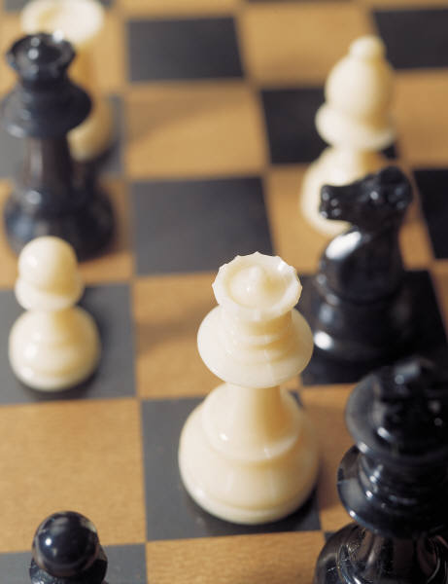
What “Board Games” do you mean?
No chance, such as dice or shuffled cards
Both players have complete information
No hidden information, as in Stratego & Magic
Two players (Left & Right) usually alternate moves
Repeat & skip moves ok
Simultaneous moves not ok
The game can end in a pattern, capture, by the absence of moves, or …

Slide 9
What’s in a Strong Solution
For every position
Assuming alternating play
Value … (for player whose turn it is)
Winning (∃ losing child)
Losing (All children winning)
Tieing (!∃ losing child, but ∃ tieing child)
Drawing (can’t force a win or be forced to lose)
Remoteness
How long before game ends?
W
L
...
...
W
W
W
L
W
W
W
W
T
D
D
...
...
W
W
W
T
W
W
W
W

Slide 10
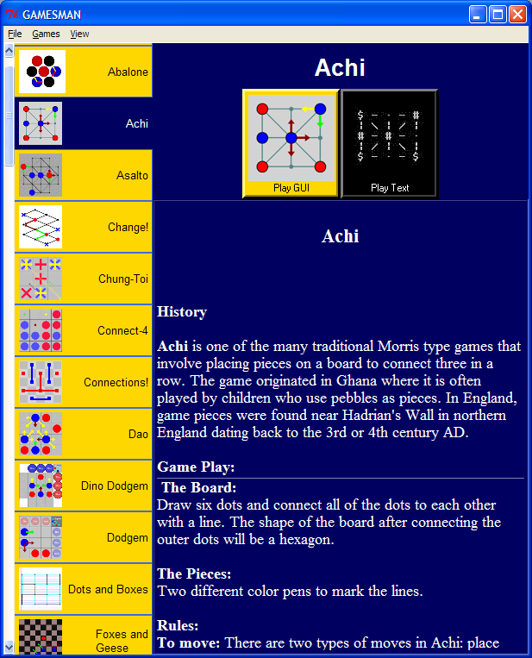
GamesCrafters
We strongly solve abstract strategy games and puzzles
70 games / puzzles in our system
Allows perfect play against an opponent
Ability to do a post-game analysis

Slide 11
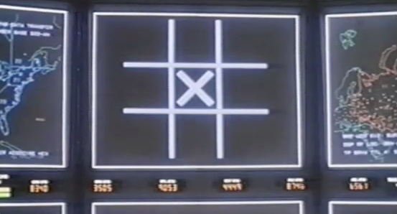
What did you mean “strongly solve”?
http://youtu.be/NHWjlCaIrQo
Wargames (1983)

Slide 12
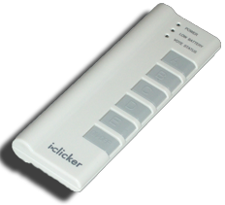
Peer Instruction
Every year computer power (speed, storage) is growing exponentially, so eventually they’ll be able to strongly solve the world’s board games.
I’m happy when a game is strongly solved.
12
a) FF
b) FT
c) TF
d) TT
The English grandmaster Nigel Short says that chess computers, which now regularly beat the top human players, are taking away some of the mystery of the game. He likens them to “chainsaws chopping down the Amazon.”

Slide 13
Weakly Solving A Game (Checkers)
Thanks to Jonathan Schaeffer @ U Alberta for this slide…
Workers: positions to search
Master:
main line of
play to consider
Endgame databases
(solved)
Log of Search Space Size

Slide 14
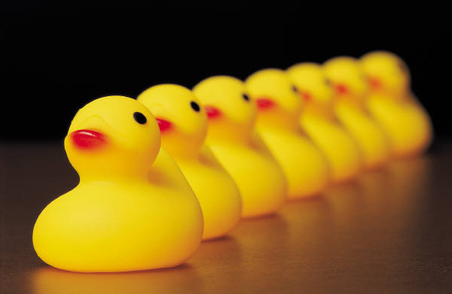
Strong Solving Example: 1,2,…,10
Rules (on your turn):
Running total = 0
Rules (on your turn):
Add 1 or 2 to running total
Goal
Be the FIRST to get to 10
Example
Ana: “2 to make it 2”
Bob: “1 to make it 3”
Ana: “2 to make it 5”
Bob: “2 to make it 7” → photo
Ana: “1 to make it 8”
Bob: “2 to make it 10” I WIN!
7 ducks (out of 10)

Slide 15
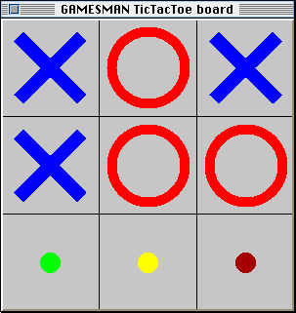
Example: Tic-Tac-Toe
Rules (on your turn):
Place your X or O in an empty slot on 3x3 board
Goal
If your make 3-in-a-row first in any row / column / diag, win
Else if board is full with no 3-in-row, tie
Misére is tricky
3-in-row LOSES
Pair up and play now, then swap who goes 1st
Values Visualization for Tic-Tac-Toe

Slide 16
Tic-Tac-Toe Answer Visualized!
Recursive Values Visualization Image
Misére Tic-tac-toe
Outer rim is position
Inner levels moves
Legend
Lose
Tie
Win
Misére Tic-Tac-Toe 2-ply Answer

Slide 17

GamesCrafters (revisited)
GamesCrafters.berkeley.edu
Undergraduate Computational Game Theory Research Group
300 students since 2001
We now average 20/semester!
They work in teams of 2+
Most return, take more senior roles (sub-group team leads)
Maximization (bottom-up solve)
Oh, DeepaBlue (parallelization)
GUI (graphical interface work)
Retro (GUI refactoring)
Architecture (core)
New/ice Games (add / refactor)
Documentation (games & code)

Slide 18
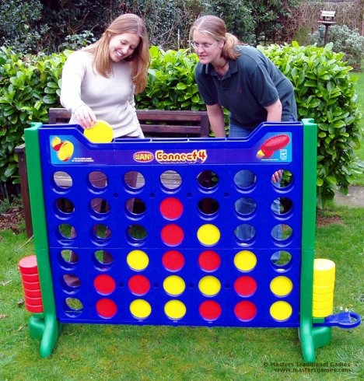
Connect 4 Solved, Online!
http://nyc.cs.berkeley.edu:8080/gcweb/ui/game.jsp?game=connect4
We’ve just finished a solve of Connect 4!!
It took 30 Machines x 8 Cores x 1 weeks
Win for the first player (go in the middle!)
3,5 = tie
1,2,6,7 = lose
Come play online!

Slide 19
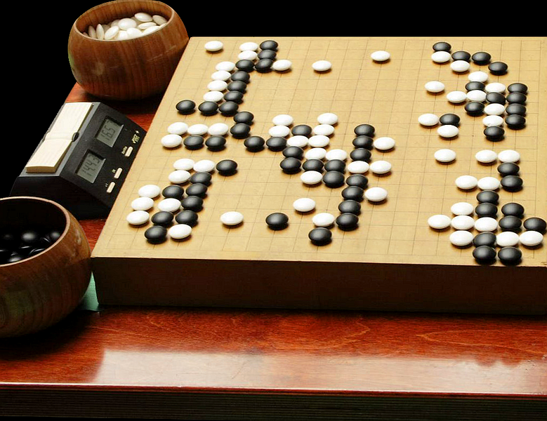
Future
Gamescrafters.berkeley.edu
Board games are exponential
So has been the progress of the speed / capacity of computers!
Therefore, every few years, we only get to solve one more “ply”
One by one, we’re going to solve them and/or beat humans
We’ll never solve some
E.g., hardest game : Go
Strongly solving (GamesCrafters)
We visit EVERY position, and know value of EVERY position
E.g., Connect 4
Weakly solving (Univ Alberta)
We prove game’s value by only visiting SOME positions, so we only know value of SOME positions
E.g., Checkers
17408965065903192790718823807056436794660272495026354119482811870680105167618464984116279288988714938612096988816320780613754987181355093129514803369660572893075468180597603
Go’s search space ~ 3³⁶¹

