Slide 1
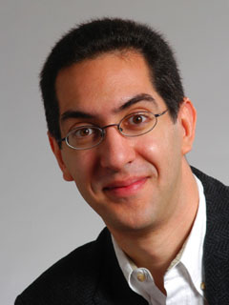
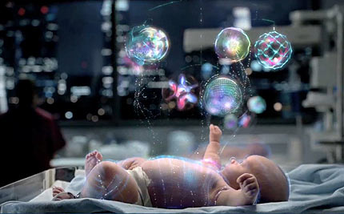
Watson in a hospital!
CS10 The Beauty and Joy of Computing Lecture #21 Artificial Intelligence
2011-04-13
UC Berkeley EECS Lecturer SOE Dan Garcia
IBM’s Watson is being used by researchers in Canada to “provide early warnings when babies in a NICU may acquire a hospital-borne infection”.
www.technologyreview.com/computing/37373/

Slide 2
Lecture Overview
Definition
What intelligent things do people do?
Videos of awesome examples of AI
Turing Test

Slide 3
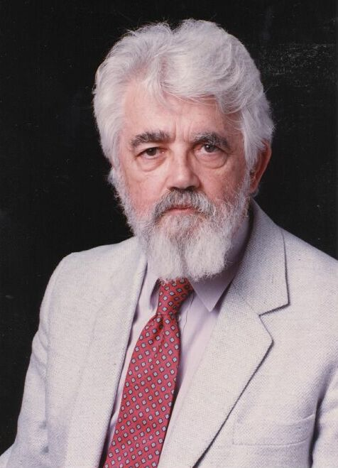
AI Definition by John McCarthy
“Getting a computer to do things which, when done by people, are said to involve intelligence”
Finesses the idea of whether a computer has consciousness, whether they have rights, etc

Slide 4
What intelligent things do people do?
en.wikipedia.org/wiki/Artificial_intelligence
Planning
(Machine) Learning
Natural Language Processing
Motion and manipulation
Perception
Creativity
General Intelligence

Slide 5
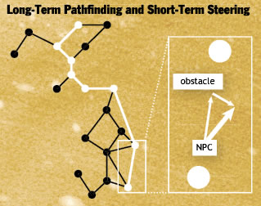
Planning (from Video Games lecture)
Range of intelligence
Low: simple heuristics
Medium: pathfinding
High: Learns from player
Dynamic difficulty
Must hold interest
“Simple to learn, difficult to master is the holy grail of game design.”
Cheating AI (e.g.,racing)
www.businessweek.com/innovate/content/aug2008/id20080820_123140.htm
en.wikipedia.org/wiki/Dynamic_game_difficulty_balancing
en.wikipedia.org/wiki/Game_artificial_intelligence
queue.acm.org/detail.cfm?id=971593

Slide 6
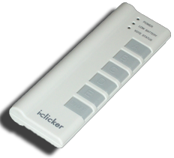
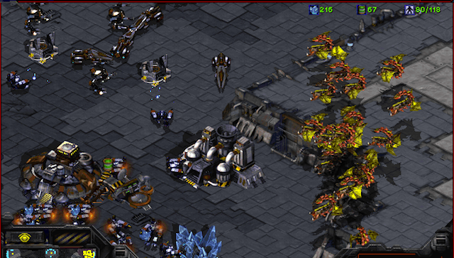
Peer Instruction
The WORLD’S BEST AI StarCraft player is from:
Google
IBM (folks who did Watson)
Stanford
Berkeley
MIT

Slide 7
Machine Learning
en.wikipedia.org/wiki/Machine_learning
“A program learns if, after an experience, it performs better”
Algorithm Types
Supervised learning
Give a system input & output training data, and it produces a classifier
Unsupervised learning
Goal: determine how data is organized, or clustered
Reinforcement learning
No training data, real-time corrections adjust behavior

Slide 8
Peer Instruction
The BEST interaction I’ve had with phone-based natural language AI systems was:
Awesome
Good
Fair
Poor
Terrible

Slide 9
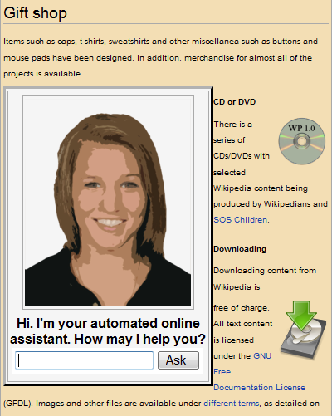
Natural Language Processing
en.wikipedia.org/wiki/Natural_language_processing
Form of HCI
Known as “AI-complete” problem
Requires extensive knowledge of world
Statistical NLP
Imagine a supervised learning system trained on all text of Web
It could easily correct your text (and guess what you’d say) by seeing what’s common

Slide 10
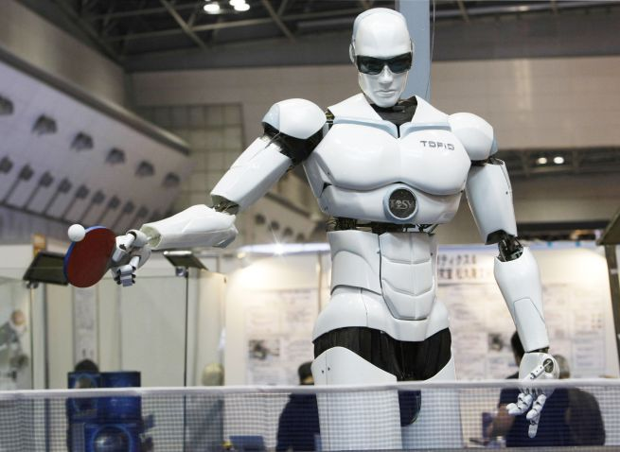

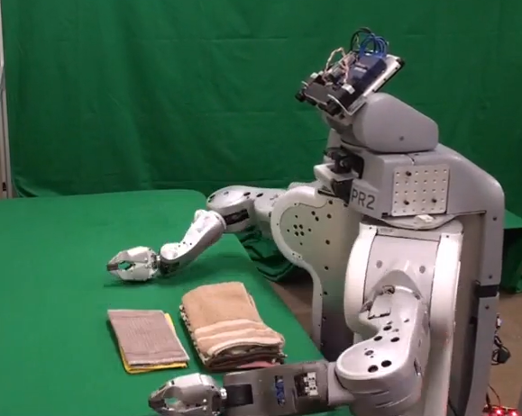

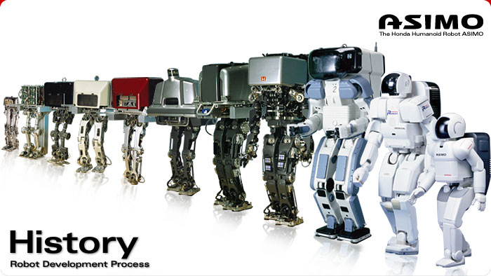
Robotics
en.wikipedia.org/wiki/Robotics
For many, the coolest and scariest part of AI
Also involves HCI
Combines fields of AI
Speech recognition
Synthetic voice
Machine vision
Planning
IPRE believes every one should have their own personal robot!
TOPIO, the ping-pong playing robot
ASIMO Humanoid robot from Honda
UC Berkeley’s towel-folder

Slide 11
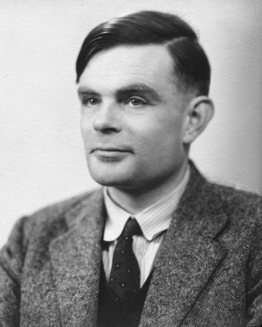
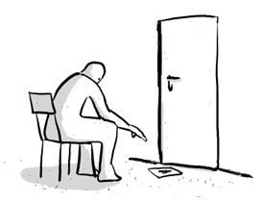
Turing Test for Intelligence
en.wikipedia.org/wiki/Turing_test
In 1950, Turing defined a test of whether a machine could “think”
“A human judge engages in a natural language conversation with one human and one machine, each of which tries to appear human. If judge can’t tell, machine passes the Turing test”
John Searle argued against the test via the Chinese room experiment, in which someone carries on a conversation by looking up phrases in a book. Does that person understand Chinese?

Slide 12
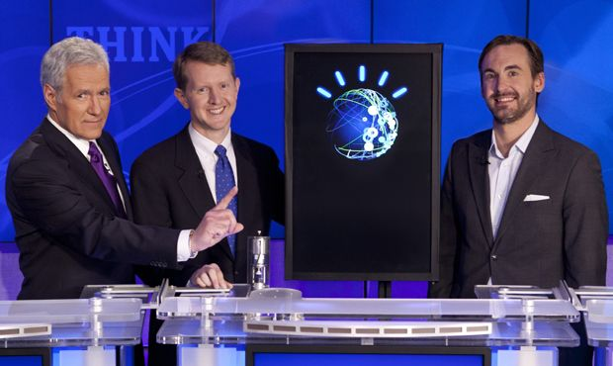
Summary
Common Sense knowledge important
Despite early hype, AI has shown recent success
AI systems excel in things computers are good at
big data (using web to parse language)
constrained worlds (chess, math)
It’s getting better at…
Speech recognition (albeit slowly)
Real-time robotics
CS188 : Artificial Intelligence
One of the most popular courses on campus!

