Slide 1
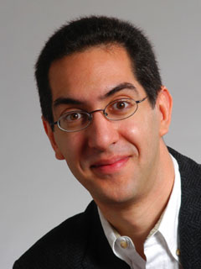

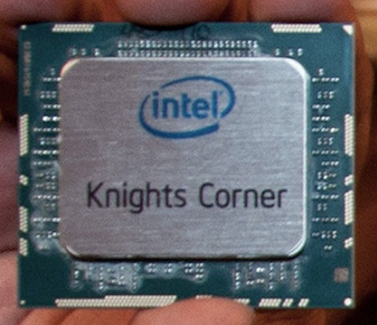
Intel shows off 50-core chip
CS10: The Beauty and Joy of Computing Lecture #23 Future of Computing
2012-04-18
UC Berkeley EECS Lecturer SOE Dan Garcia
Intel has demonstrated a 50-core chip that can reach a sustained 1 Teraflops. How many? 1,000,000,000,000 floating-point ops a sec!!
It’s meant as a co-processor, and it layers transistors in “3D” for higher density.
http://gizmodo.com/5860038/intels-newest-chip-has-50-cores-and-will-eat-your-family

Slide 2
Lecture Overview
Where will today’s computers go?
Quantum Computing
DNA Computing
Biological Machines
Smart Grid + Energy

Slide 3
Computer Technology - Growth!
Processor
Speed 2x / 2 years (since ’71)
100X performance last decade
When you graduate: 4 GHz, 32 Cores
Memory (DRAM)
Capacity: 2x / 2 years (since ’96)
64x size last decade.
When you graduate: 128 GibiBytes
Disk
Capacity: 2x / 1 year (since ’97)
250X size last decade.
When you graduate: 16 TeraBytes
Kilo (10³) & Kibi (2¹⁰)
⬇
Mega (10⁶) & Mebi (2²⁰)
⬇
Giga (10⁹) & Gibi (2³⁰)
⬇
Tera (10¹²) & Tebi (2⁴⁰)
⬇
Peta (10¹⁵) & Pebi (2⁵⁰)
⬇
Exa (10¹⁸) & Exbi (2⁶⁰)
⬇
Zetta (10²¹) & Zebi (2⁷⁰)
⬇
Yotta (10²⁴) & Yobi (2⁸⁰)

Slide 4
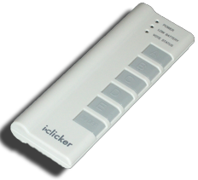
Peer Instruction
What was recently proposed to go after Yotta? (i.e., 10²⁷)
Lotta
Lotsa
Wholelotta
Hella
Zillion

Slide 5
Kilo, Mega, Giga, Tera, Peta, Exa, Zetta, Yotta
Kid meets giant Texas people exercising zen-like yoga. – Rolf O
Kind men give ten percent extra, zestfully, youthfully. – Hava E
Kissing Mentors Gives Testy Persistent Extremists Zealous Youthfulness. – Gary M
Kindness means giving, teaching, permeating excess zeal yourself. – Hava E
Killing messengers gives terrible people exactly zero, yo
Kindergarten means giving teachers perfect examples (of) zeal (&) youth
Kissing mediocre girls/guys teaches people (to) expect zero (from) you
Kinky Mean Girls Teach Penis-Extending Zen Yoga
Kissing Mel Gibson, Teddy Pendergrass exclaimed: “Zesty, yo!” – Dan G
Kissing me gives ten percent extra zeal & youth! – Dan G (borrowing parts)

Slide 6
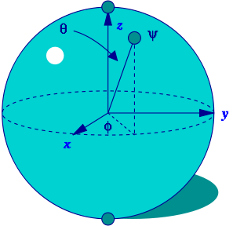
Quantum Computing (1)
Proposed computing device using quantum mechanics
This field in its infancy…
Normally: bits, which are either 0 or 1
Quantum: qubits, either 0, 1 or “quantum superposition” of these
This is the key idea
If you have 2 bits, they’re in exactly one of these:
00, 01, 10 or 11
If you have 2 qubits, they’re in ALL these states with varying probabilities
A Bloch sphere is the geometric representation of 1 qubit
en.wikipedia.org/wiki/Quantum_computer

Slide 7
Quantum Computing (2)
Imagine a problem with these four properties:
The only way to solve it is to guess answers repeatedly and check them,
There are n possible answers to check,
Every possible answer takes the same amount of time to check, and
There are no clues about which answers might be better: generating possibilities randomly is just as good as checking them in some special order.
…like trying to crack a password from an encrypted file
A normal computer
would take (in the worst case) n steps
A quantum computer
can solve the problem in steps proportional to √n
Why does this matter?

Slide 8
Quantum Computing (3)
Say the password is exactly 72 bits (0/1)
That’s 2⁷² possibilities
Let’s say our Mac lab attacked the problem
30 machines/lab * 8 cores/machine * 3 GHz (say 3 billion checks per second/core)
= 720,000,000,000 checks/sec/lab
= 720 Gchecks/sec/lab
Regular computers
2⁷² checks needed / 720 Gchecks/sec/lab
≈ 6.6 billion sec/lab
≈ 208 years/lab
72-qubit quantum computers in timeαto √2⁷² = 2³⁶
2³⁶ checks needed / 720 Gchecks/sec/lab
≈ 0.1 sec/lab

Slide 9
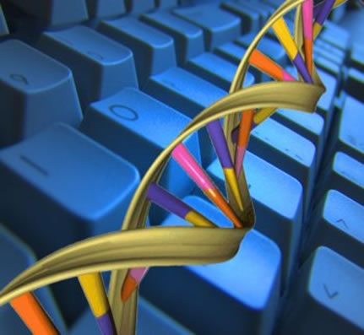
DNA Computing
Proposed computing device using DNA to do the work
Take advantage of the different molecules of DNA to try many possibilities at once
Ala parallel computing
Also in its infancy
In 2004, researchers claimed they built one
Paper in “Nature”
en.wikipedia.org/wiki/DNA_computing

Slide 10
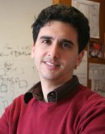
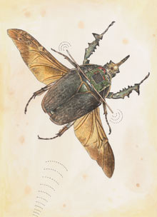
Biological Machines
www.eecs.berkeley.edu/~maharbiz/Cyborg.html
Michel Maharbiz and his team at Cal have wired insects (here a giant flower beetle) and can control flight
Implated as Pupa
Vision
Imagine devices that can collect, manipulate, store and act on info from environment

Slide 11
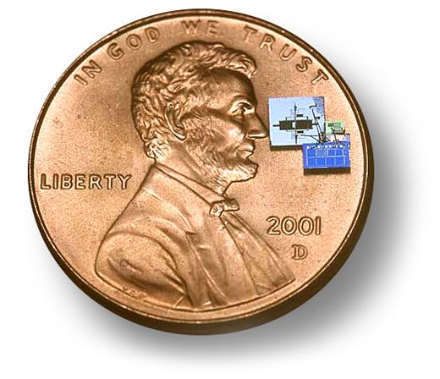
Smart Grid + Energy
Arguably the most important issue facing us today is climate change
Computing can help
Old: generators “broadcast” power
New: “peer-to-peer”, with optimal routing
From: ability (to power) To: according to need
Energy
Computing helps with climate modeling and simulation
“Motes”, or “Smart dust” are small, networked computing measurement devices
E.g., could sense no motion + turn lights off

Slide 12
Peer Instruction
What is the most exciting future for computing?
Evolution (not revolution) in computing architectures
Quantum computing
DNA computing
Energy
Wet computing (ala Matrix)

Slide 13
Summary
What a wonderful time we live in; we’re far from done
What about privacy?
Find out the problem you want to solve
Computing can and will help us solve it
We probably can’t even imagine future software + hardware breakthroughs

