Slide 1
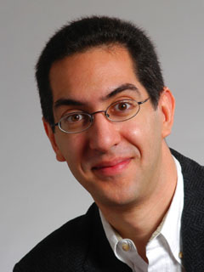

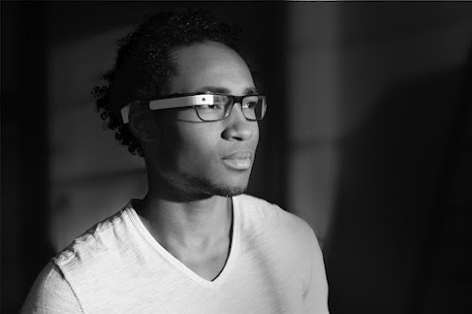
Google glasses, next “it”?
Invite your friends to take CS10 next sem!
CS10: The Beauty and Joy of Computing Lecture #25 Summary & Farewell
2012-04-25
UC Berkeley EECS Lecturer SOE Dan Garcia
Lab this week is Survey (0:30), online final (1:20)
CS10 final party Wednesday 6-8pm in the Woz!!!
Google’s “Project Glass” hopes to bring all services from Android to a display you carry with you on your glasses. Next big thing?
Discussion this week is important – course feedback + summary
g.co/projectglass

Slide 2
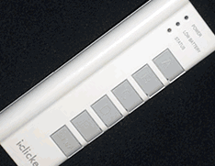
I must own & wear these glasses!!!
Strongly disagree
Mildly disagree
Neutral
Mildly agree
Strongly agree

Slide 3
Upcoming Calendar
Sun | Mon | Tue | Wed | Thu | Fri | Sat
04/22 | 04/23 | 04/24 | 04/25 Lec: Farewell + Surveys Lab: Feedback + Online Final | 04/26 Lab: Feedback + Online Final | 04/27 Lab: Survey + Online Final Discussion (Final Thoughts) Final Project Due @ 11:59pm | 04/28
04/29 | 04/30 Final Project Due with slip @ 11:59pm | 05/01 | 05/02 CS10 Party! 6-8pm (food) Woz Lounge in Soda (430 Soda) | 05/03 | 05/04 Final Project Movies due @ 11:59pm | 05/05
05/06 Review Session 6-9pm 2050 VLSB | 05/07 | 05/08 | 05/09 Paper Final Exam 10 Evans 7-10pm
RRR Week
FinalsWeek

Slide 4
Administrivia: Become active!
Online Exam details
No exam handed out unless you’ve filled in both HKN + our survey
No “study sheets” needed / allowed since you have access to BYOB
Final Exam details
Only bring pen{,cil}s, three 8.5”x11” handwritten sheets (writing on both sides).
Leave backpacks, books, calculators, cells & pagers home!
Everyone must take ALL of the final!
If you did well in CS10 and want to be on staff?
Usual path: Lab Assistant  Reader  TA
LA: sign up w/Jenny Jones in 395 Soda before 1st week of semester
Reader/TA forms: www.cs/~juliea/
I strongly encourage anyone who gets an B or above in the class to follow this path…

Slide 5
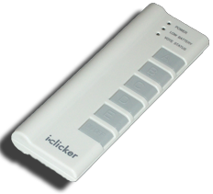
Clickers were worth the time spent
Strongly Agree
Moderately agree
Neutral
Moderately disagree
Strongly disagree

Slide 6
Exciting Future Implications
Need to revisit chronic unsolved problem
Parallel programming!!
Implications for applications:
Computing power available >>> (choose your favorite supercomputer from a decade ago) on an economical die inside your watch, cell phone or PDA
On your body health monitoring
Google + library of congress on your PDA
As devices continue to shrink…
The need for great HCI (human-computer interfaces) is as critical as ever! (voice, gesture, etc)

Slide 7
Taking advantage of Cal Opportunities
“The Godfather answers all of life’s questions” – Heard in “You’ve got Mail”
Why were we the #2 Univ in the WORLD?
Research, reseach, research!
Whether you want to go to grad school or industry, you need someone to vouch for you!
…as is the case with the Mob
Techniques
Find out what you like, do lots of web research (read published papers), hit OH of Prof, show enthusiasm & initiative
http://research.berkeley.edu/
http://researchmatch.heroku.com/
So says the 2004 ranking from the “Times Higher Education Supplement”

Slide 8
Ok, I’m hooked! Where do I go next?
CS Major / Minor
You are here
CS61A
In Python, one big idea every week. Awesome!
CS61B
In Java, data structures, algorithms and software engineering (lite)
CS61C
In C and MIPS, Great ideas in computer architecture (parallelism)

Slide 9
Opportunities Fall 2012
CS61A (1st course in CS major)
Structure and Interpretation of Computer Programs
CS9 series (learn a second language)
I would recommend Python next, CS9H
GamesCrafters (Game Theory R & D)
Develop SW, analysis on 2-person games of no chance. (e.g., go, chess, connect-4, nim, etc.)
Req: Game Theory / SW Interest
MS-DOS X (Mac Student Developers)
Learn to program Macintoshes.
Req: Interest. Owning a mac helps, not required.
Taught as a DeCal by MS-DOS X veterans
UCBUGG (Recreational Graphics)
Develop computer-generated images, animations.
Req: 3D interest
Taught as a DeCal by UCBUGG veterans

Slide 10

Review: 5 components of any Computer
In the future, what’ll be the most important computer component?
Computer
Processor
Devices
Control
(“brain”)
Memory
Input
Control
Datapath
Memory
Input
Output
Datapath (“brawn”)
Output
Notes:
That is, any computer, no matter how primitive or advance, can be divided into five parts:
1. The input devices bring the data from the outside world into the computer.
2. These data are kept in the computer’s memory until ...
3. The datapath request and process them.
4. The operation of the datapath is controlled by the computer’s controller.
All the work done by the computer will NOT do us any good unless we can get the data back to the outside world.
5. Getting the data back to the outside world is the job of the output devices.
The most COMMON way to connect these 5 components together is to use a network of busses.

Slide 11


Peer Instruction Opinion
“Forget cloning. Forget TVs on your wrist watch. The biggest invention of the next 100 years will be the ability to directly connect your brain to a machine, aka wet computing.” – Dan Garcia
A macaque monkey at Duke University can already control a robotic arm with thought.
DARPA interested for mind-control robots & flying
Virtual Reality achieved with proper I/O interfacing…
Jose Carmena, UCB EECS Prof Research: Brain-Machine Interface www.eecs.berkeley.edu/~carmena/

Slide 12

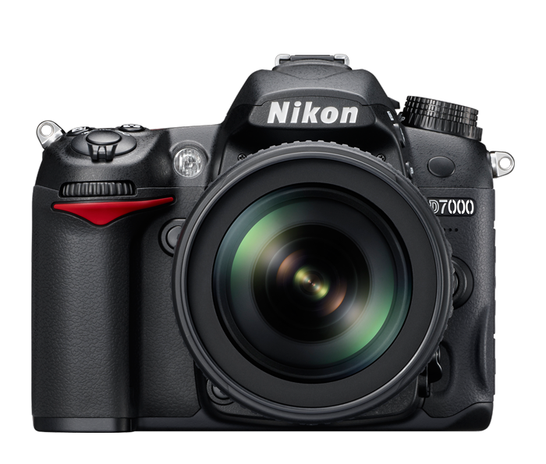
Penultimate slide: Thanks to the staff!
TAs
Luke Segars
Navin Eluthesen
Yaniv “Rabbit” Assaf
Pierce Vollucci
Aijia Yan
Samir Makhani
Readers
Shreya Lakhan-Pal
Kylan Nieh
Max Dougherty
Aatash Parikh
Christian Pedersen
Ian Birnam
Lab Assistants
Joanna Abot
Carlos Asuncion
Michael Ball
Jose Batilando
Madeeha Ghori
Dylan Harris
Alysha Jivani
David Lau
Trace Levinson
Vivian Lo
Jennifer Ma
Mark Miyashita
Lauren Mock
Christian Pedersen
Emily Shiue
Peter Sujan
Kou Takahama
Minh Tran
Alice Wang
Ruoyang Wang

Slide 13
The Future for Future Cal Alumni
What’s The Future?
New Millennium
Ubiquitous & Quantum Computing, Nanotechnology, 10 M “volunteer” CPUs, the Parallel revolution...
Rapid Changes in Technology (e.g., voice input!)
World’s 2nd Best Education
Never Give Up!
“The best way to predict the future is to invent it” – Alan Kay
The Future is up to you!

