Slide 1
Beyond Blocks: Python
Session #1
Beyond Blocks : Python : Session #1 by Glenn Sugden is licensed under a Creative Commons Attribution-NonCommercial-ShareAlike 3.0 Unported License.

Slide 2
Goals
Quick introduction to Python
  Not a tutorial or “how to”
  Hope is that you’ll want to learn (more)
Advantages over higher level languages
Challenges of programming syntax
  Hope is that “foreign” syntax becomes less intimidating and more approachable

Slide 3

Installation: Mac Check
Beyond Blocks: Python #1
  Open Terminal
  Type “python” and hit return
      (without the quotes)
  Type “print ‘hello world’” return
      print ‘hello world’
  The result should be:

Slide 4
Beyond Blocks: Python #1
Installation: Windows Check
Get Python to "print" something with these instructions:
  http://docs.python.org/faq/windows.html
(You only have to get to the "Many people use the interactive mode as a convenient yet highly programmable calculator" paragraph)

Slide 5
Beyond Blocks: Python #1
Installation: More Information
Computer Science Circles : Run Python at Home
    cemclinux1.math.uwaterloo.ca/~cscircles/wordpress/run-at-home/

Slide 6
Beyond Blocks: Python #1
Installation: Version Check
[/Users/headcrash]> python -VPython 2.7.2
We’ll be talking about version 2.7.2 in here,
although version 3.2.2 is the “latest” (as of today).
If curious, there’s more version info at:
http://docs.python.org/whatsnew/index.html

Slide 7
Beyond Blocks: Python #1
Installation: Version Check
[/Users/headcrash]> python -VPython 2.7.2
We’ll be talking about version 2.7.2 in here,
although version 3.2.2 is the “latest” (as of today).
If curious, there’s more version info at:
http://docs.python.org/whatsnew/index.html

Slide 8
Beyond Blocks: Python #1
Why used “text based” programming?
<Fibonacci demo>

Slide 9
Beyond Blocks: Python #1
Compiled vs. Interpreted
Compiled
  Usually much faster
  Ability to edit and save program.
  Mac: python [filename.py] in Terminal.
  Win: python [filename.py] on command line (or run under Idle)

Slide 10
Beyond Blocks: Python #1
Compiled vs. Interpreted
Interpreted
  Ability to try out commands interactively.
  Mac: (just) python in Terminal.
  Win: (just) python on command line or launch the Idle executable

Slide 11

BYOB Python

Slide 12


BYOB Python
Variables

Slide 13

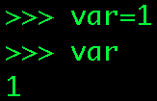
BYOB Python
Variables

Slide 14

BYOB Python
Variables

Slide 15
BYOB Python
Variables

Slide 16
BYOB Python
Variables
NOTE:
Assignment doesn’t
“evaluate” to anything, so nothing is printed!

Slide 17

BYOB Python
Variables

Slide 18

BYOB Python
Variables

Slide 19

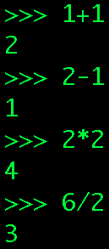
BYOB Python
Operators

Slide 20
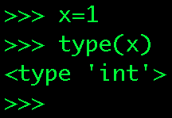
BYOB Python
Types
  Everything in Python has an internal “type”
  Types are determined dynamically
    x = 1
    x now has the type “int”:
      (short for “integer”)
We’ll talk about this “script” (or function) later...

Slide 21
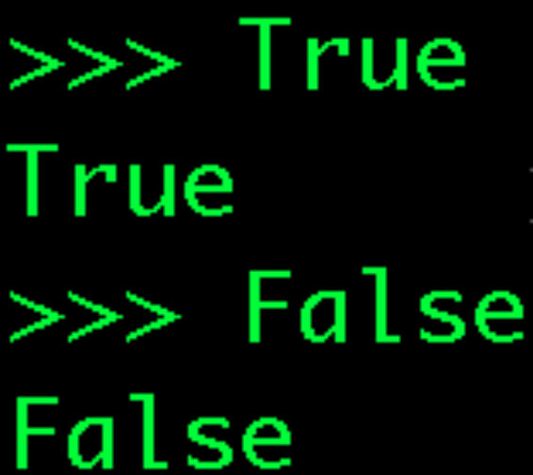


BYOB Python
Types: bool
  ‘bool’ is short for boolean
  ‘bool’s can have two values:
    True
    False

Slide 22
BYOB Python
Types: bool
  ‘bool’ is short for boolean
  ‘bool’s can have two values:
    True
    False
NOTE: Upper case is important!

Slide 23
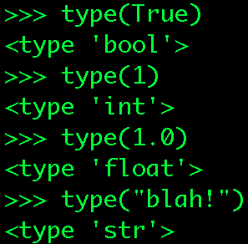
BYOB Python
Types: function type()
This function returns the type that Python has assigned the identifier.

Slide 24

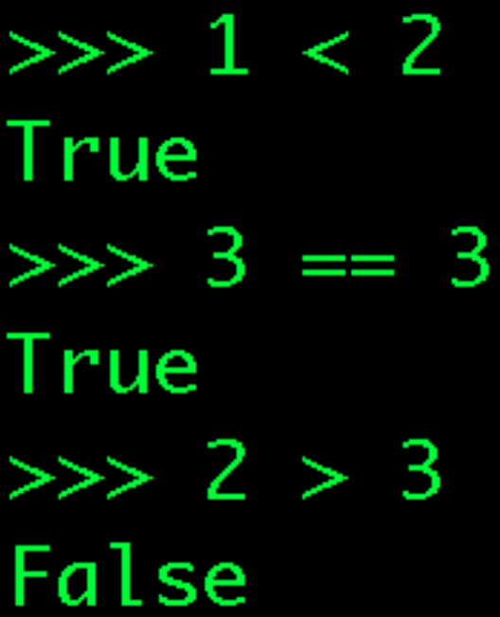
BYOB Python
Operators

Slide 25
BYOB Python
Operators
Note the double =s!
= means assign, == means compare
Very common source of bugs!

Slide 26
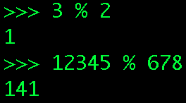
BYOB Python
Operators

Slide 27
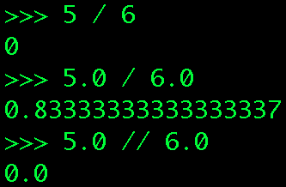

BYOB Python
Sidebar: Division (integer vs. real/float)

Slide 28
BYOB Python
Sidebar: Division (integer vs. real/float)
Same operator, “/,” but
output type depends on input types!

Slide 29
BYOB Python
Sidebar: Division (integer vs. real/float)
Same operator, “/,” but
output type depends on input types!

Slide 30
BYOB Python
Sidebar: Division (integer vs. real/float)
“Force” integer division

Slide 31
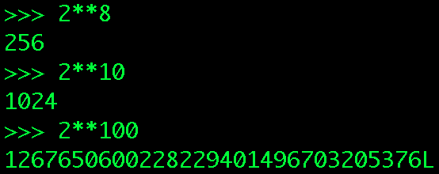
BYOB Python
Sidebar: Exponent
x
x
BYOB has e and 10 ,
but Python can do any base & exponent!

Slide 32
BYOB Python
Sidebar: Exponent
What’s that “L?”

Slide 33
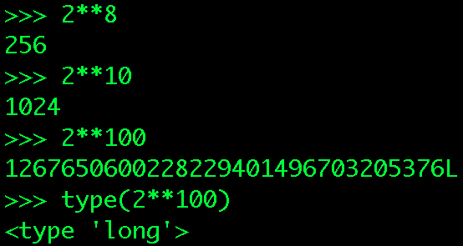
BYOB Python
Sidebar: Exponent

Slide 34
BYOB Python
Sidebar: Exponent
Just (for now) means:
“a really big integer.”

Slide 35
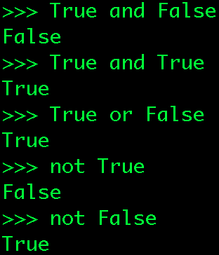

BYOB Python
Operators

Slide 36
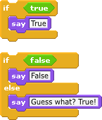
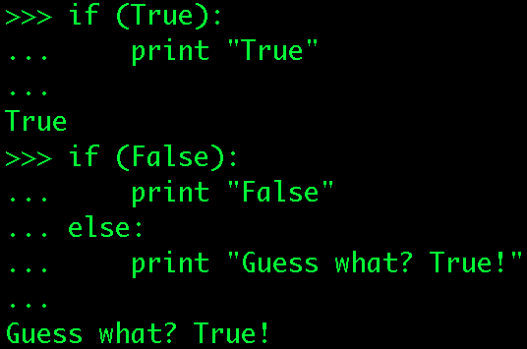
BYOB Python
Conditionals

Slide 37
BYOB Python
Conditionals

Slide 38
BYOB Python
Conditionals
Notice the colon and indentation syntax!

Slide 39
BYOB Python
Conditionals
Notice the colon and indentation syntax!

Slide 40
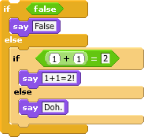
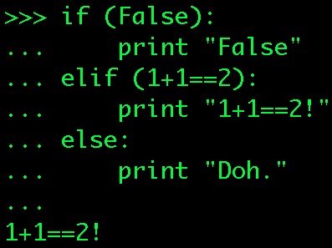
BYOB Python
Conditionals

Slide 41
BYOB Python
Conditionals

Slide 42
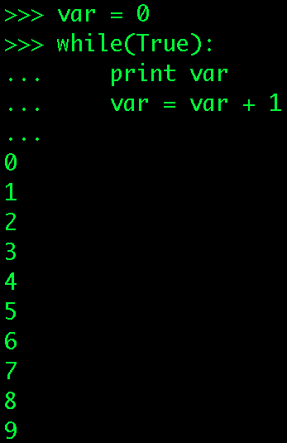

BYOB Python
Loops

Slide 43
BYOB Python
Loops

Slide 44
BYOB Python
Loops
Note the indentation (again)!

Slide 45
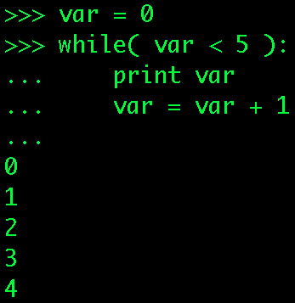
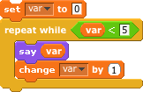
BYOB Python
Loops

Slide 46
BYOB Python
Loops

Slide 47
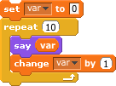

BYOB Python
More Loops

Slide 48
BYOB Python
Moar [sic] Loops
There isn’t really an exact equivalent of this in Python...
We’ll talk more about this in Session #2...

Slide 49

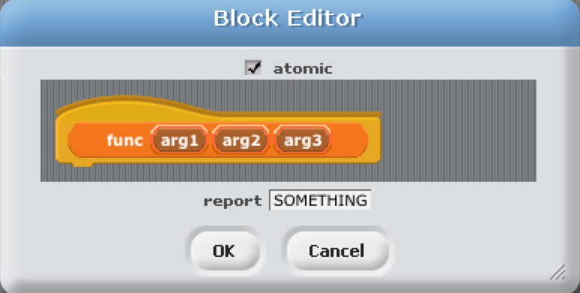
BYOB Python
Calling functions (the syntax) looks like this:
Equivalent to creating & running a BYOB block:
Functions: Calling

Slide 50
BYOB Python
Calling functions (the syntax) looks like this:
Equivalent to creating & running a BYOB block:
Functions: Calling

Slide 51
BYOB Python
Calling functions (the syntax) looks like this:
Equivalent to creating & running a BYOB block:
Functions: Calling

Slide 52
BYOB Python
Calling functions (the syntax) looks like this:
Equivalent to creating & running a BYOB block:
Functions: Calling

Slide 53
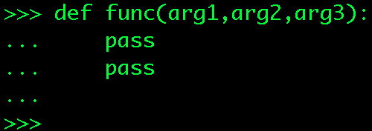
BYOB Python
Functions : Defining
Keyword: DEF

Slide 54
BYOB Python
Functions : Defining
Name of the function

Slide 55
BYOB Python
Functions : Defining
“Arguments,” or inputs to the function

Slide 56
BYOB Python
Functions : Defining
Indentation: the key to “scope.”
We’ll talk about “scope” later...

Slide 57
BYOB Python
Functions : Defining
pass: Python’s “placeholder” or NOP
NOP: short for “NO OPeration”
(or do nothing...)

Slide 58
BYOB Python
Functions : Defining
pass: Python’s “placeholder” or NOP
NOP: short for “NO OPeration”
Functions must have a body!

Slide 59
BYOB Python
Functions : Defining
Hitting Return/Enter (on an empty line)
“closes” (finishes) the definition.

Slide 60
BYOB Python
Sidebar: Keywords
and del from not while
as elif global or with
assert else if pass yield
break except import print
class exec in raise
continue finally is return
def for lambda try
  Words reserved by Python
    List at: docs.python.org/reference/lexical_analysis.html

Slide 61
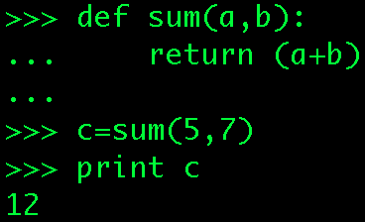
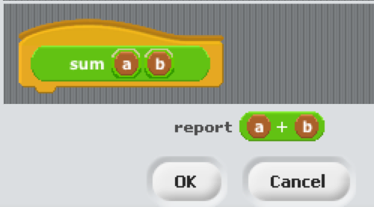
BYOB Python
Functions : Returning Values

Slide 62
BYOB Python
Functions : Returning Values

Slide 63
BYOB Python
Functions : Returning Values
“return” and “report” are equivalent!

Slide 64
BYOB Python
Functions : Returning Values
What is the type of the variable ‘c’?

Slide 65
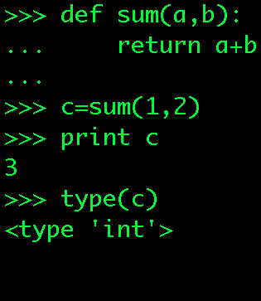
BYOB Python
Functions : Type? It depends!

Slide 66
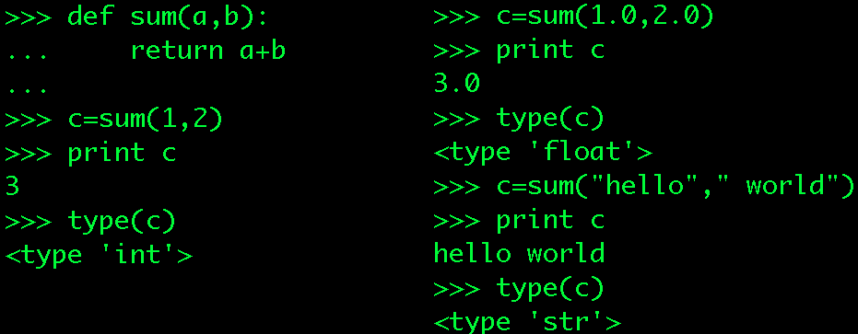
BYOB Python
Functions : Type? It depends!

Slide 67
BYOB Python
Functions : C’s type? It depends!
!

Slide 68
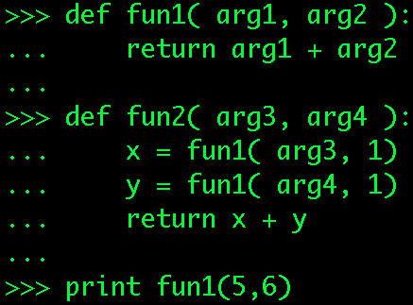

BYOB Python
Functions : Practice
What will this print?

Slide 69
BYOB Python
Functions : Practice

Slide 70
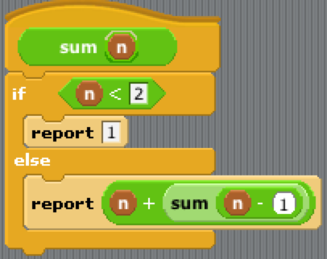
BYOB Python
Functions : Recursion!

Slide 71
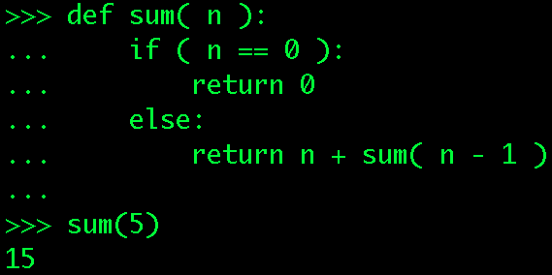
BYOB Python
Functions : Recursion!

Slide 72
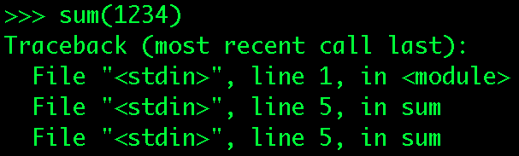
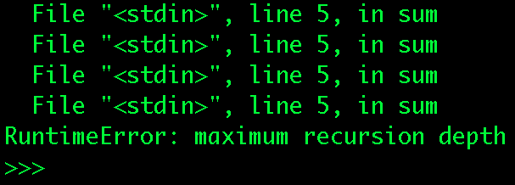
BYOB Python
Functions : Recursion! Within Reason!
•
•
•

Slide 73
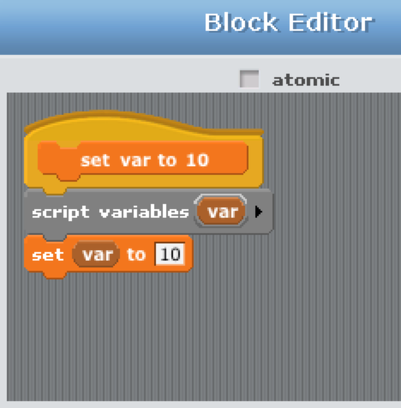

BYOB Python
Functions : Scoping
Script
in
Sprite

Slide 74
BYOB Python
Functions : Scoping
What value of var
will be “said?”

Slide 75
BYOB Python
Functions : Scoping
ERROR!
var doesn’t exist
(in this scope)!

Slide 76
BYOB Python
Functions : Scoping
ERROR!
var doesn’t exist
(in this scope)!

Slide 77
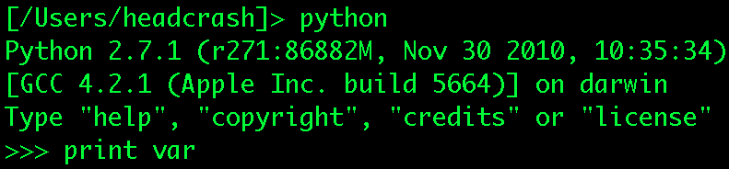
BYOB Python
Functions : Scoping
What value of var will be printed?

Slide 78
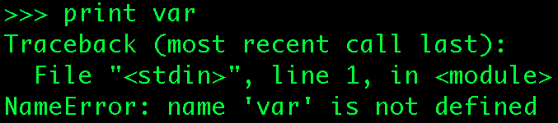
BYOB Python
Functions : Scoping
ERROR!
Don’t worry about these lines for now...

Slide 79
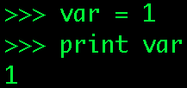
BYOB Python
Functions : Scoping
Now var is declared, defined, AND initialized!

Slide 80
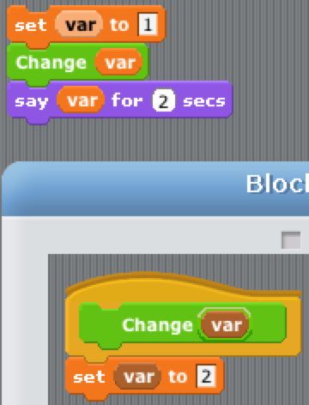
BYOB Python
Functions : Scoping
What value of var will be “said”?

Slide 81

BYOB Python
Functions : Scoping

Slide 82
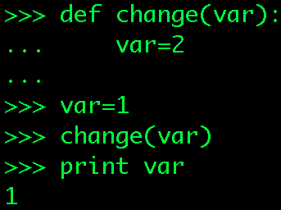
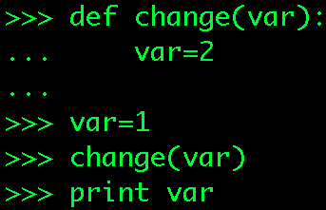
BYOB Python
Functions : Scoping
What value of var will be printed?

Slide 83
BYOB Python
Functions : Scoping

Slide 84
BYOB Python
Functions : Scoping
This is another very common source of bugs!

Slide 85
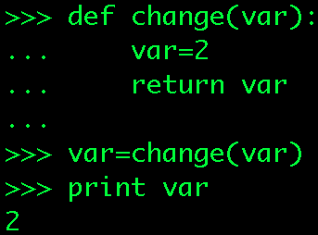
BYOB Python
Functions : Scoping
This is more likely what you wanted...

Slide 86

BYOB Python
Importing
cosine(radians)

Slide 87
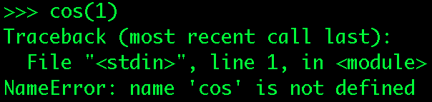
BYOB Python
Importing
ERROR!
Hmmmm....

Slide 88
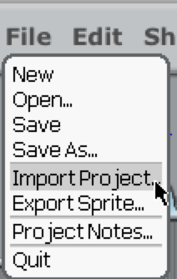
BYOB Python
Importing
“math” module

Slide 89
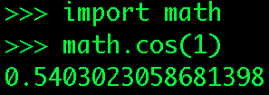
Beyond Blocks: Python #1
Importing

Slide 90
Beyond Blocks: Python #1
Importing
module.function(args)

Slide 91

Beyond Blocks: Python #1
Importing, help!

Slide 92
Beyond Blocks: Python #1
Importing, help!
module.function

Slide 93
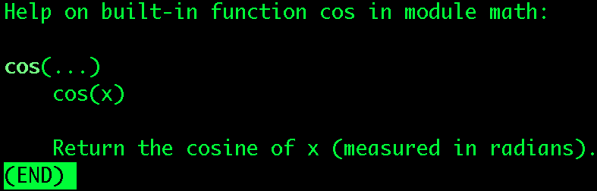
Beyond Blocks: Python #1
Importing, help!

Slide 94

Beyond Blocks: Python #1
Help!

Slide 95
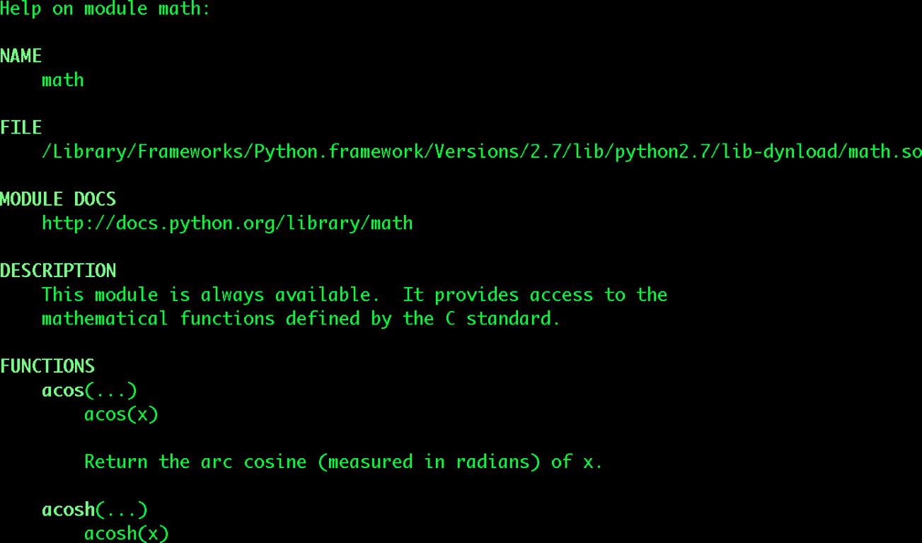
Beyond Blocks: Python #1
Help!
•
•
•

Slide 96
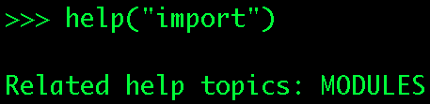
Beyond Blocks: Python #1
Help!
Python keyword

Slide 97
Beyond Blocks: Python #1
Help!
Note the quotes!

Slide 98
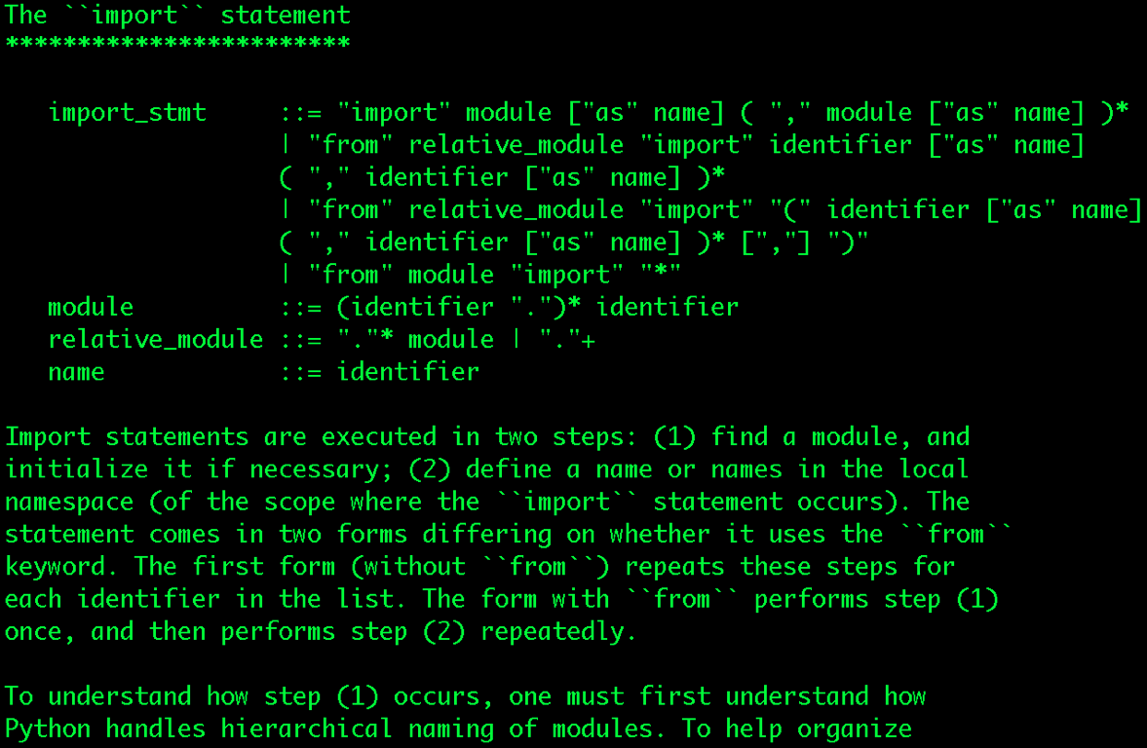
Beyond Blocks: Python #1
Help!
•
•
•

Slide 99
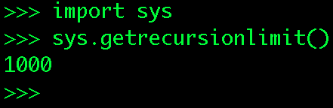
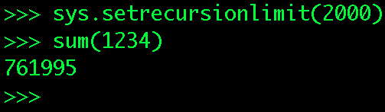
Beyond Blocks: Python #1
Sidebar: “sys” module

Slide 100
Beyond Blocks: Python #1
More Information
Python.org: www.python.org
Python Docs: www.python.org/doc/
Python Modules: docs.python.org/modindex.html

Slide 101
Beyond Blocks: Python #1
More Information
Computer Science Circles: Python
  cemclinux1.math.uwaterloo.ca/~cscircles/wordpress/using-this-website/
Dive Into Python: diveintopython.org/toc/
Cal’s Self-Paced Center:
inst.eecs.berkeley.edu/~selfpace/class/cs9h/
How to Think Like a Computer Scientist (Python Version)
        www.greenteapress.com/thinkpython/thinkCSpy/html/

