Slide 1
Beyond Blocks: Python
Session #2
Data Structures

Slide 2
Data Structures (overview)
Review
Sequences
  Iterators
  Operators
Sets
  Operators
Dictionaries
  Hash Tables

Slide 3
Data Structures (overview)
Review & some new introductions
Sequences
  Iterators
  Operators
Sets
  Operators
Dictionaries
  Hash Tables

Slide 4
Review++
Typing, built-in types
Variables
Looping and conditionals
Functions
Recursion
This week’s content
  Strings and string operators
  Lists

Slide 5
Review++
Typing, built-in types
Variables
Looping and conditionals
Functions
Recursion
This week’s content
  Strings and string operators
  Lists

Slide 6
Typing, (Some) Built-In Types
Weak-typing vs. Strong-typing
  aka - Dynamic vs. Static-typing
Numeric types
  <int>, <float>, <long>, <complex>
Sequence types
  <str>, <unicode>, <list>, <tuple>, <buffer>, <range>
New: Collection types
  <set>, <frozenset>, <dict>

Slide 7
Typing, (Some) Built-In Types
Weak-typing vs. Strong-typing
  aka - Dynamic vs. Static-typing
Numeric types
  <int>, <float>, <long>, <complex>
Sequence types
  <str>, <unicode>, <list>, <tuple>, <buffer>, <range>
New: Collection types
  <set>, <frozenset>, <dict>

Slide 8
Variables
Simple assignments
Multiple assignments
Weakly/Dynamically typed
  type() function
“Mutable” vs. “Immutable”
  We’ll see more of these as examples

Slide 9
Variables
Simple assignments
Multiple assignments
Weakly/Dynamically typed
  type() function
“Mutable” vs. “Immutable”
  We’ll see more of these as examples

Slide 10
Looping and Conditionals
While loops
If statements with boolean comparisons
  Parenthetical evaluation
  or, and, not, <, <=, >, >=, ==, =, is, is not
For loops (e.g. “for x in range(0,10):”)
  We’ll talk more about ranges later...

Slide 11
Looping and Conditionals
While loops
If statements with boolean comparisons
  Parenthetical evaluation
  or, and, not, <, <=, >, >=, ==, =, is, is not
For loops (e.g. “for x in range(0,10):”)
  We’ll talk more about ranges later...

Slide 12
Functions
How to define them
Variable scope
  Global scope & keyword
Returning values
  Returning multiple values

Slide 13
Functions
How to define them
Variable scope
  Global scope & keyword
Returning values
  Returning multiple values

Slide 14
Recursion
How to write a recursive function
Factorial(n)?
IsPalindrome(word)?
  IsPalindrome is left as an exercise for the reader...

Slide 15
Sequences (overview)
Str “”
  Raw & Unicode (256 vs. 65535 chars.)
List []
Tuple ()
Buffer
Range
  Range vs. xRange
    We’ll talk more about xRange later...
http://docs.python.org/library/stdtypes.html#typesseq

Slide 16
Sequences (overview)
Str “” - immutable
  Raw & Unicode (256 vs. 65535 chars.)
List [] - mutable
Tuple () - immutable
Buffer
Range - mutable-ish
  Range vs. xRange
    We’ll talk more about xRange later...
http://docs.python.org/library/stdtypes.html#typesseq

Slide 17
Strings and String Operators
Sequence (or “list” or “array”) of chars
Quoting
  Single vs. double vs. triple and mixing
Printing
  Formatted and unformatted
Concatenation, finding length, etc.
  help(“string”)
Slicing and slicing notation [::]
http://docs.python.org/library/stdtypes.html#string-methods

Slide 18
Lists
Collection of any type
  Including itself!
Indexing (BYOB: Item () of [])
Modifying (Replace item () of [] with ())
Slicing and slicing notation (i.e., [::])
  Exactly the same as string notation!
Operators
  append(x), insert(i,x), count(x), sort(), etc.
http://docs.python.org/library/stdtypes.html#mutable-sequence-types

Slide 19
Tuples (|ˈtjuːp(ə)l| :)
Immutable
  Same as strings
Also contains any type of element(s).
Syntax ()
What are the advantages of using them?
  Faster and “Safer,”
  Can be used as Dictionary keys
    More on dictionaries later...

Slide 20
Buffers
“Buffer objects are not directly supported by Python syntax, but can be created by calling the built-in function buffer(). They don’t support concatenation or repetition.”
http://docs.python.org/library/stdtypes.html#sequence-types-str-unicode-list-tuple-bytearray-buffer-xrange

Slide 21
Ranges (and xRanges)
Range syntax (start, stop, step)
  Results in a list []
xRange
  “Lazy Evaluation”
  Results in an xrange instance...
    More about this later...
http://docs.python.org/library/stdtypes.html#xrange-type

Slide 22
Iterators
Syntax
  i = iter(object)
Usage
  i.next()
Why does Python have them?
  You’ll see...
http://docs.python.org/library/stdtypes.html#iterator-types

Slide 23
Sequence (general) Operators
elem in & not in sequence
+ & *
slice [::]
len()
min() & max()
even map() & reduce() !
Many, many more:
  http://docs.python.org/library/stdtypes.html#typesseq

Slide 24
Sets
NO duplicate members (unique)
Unordered
Syntax: set([1,2,3,4]) or set(“blah”)
NO array-like indexing (e.g., s[0])
  Iterators are used instead...

Slide 25
Set Operators
len(s)
s.add(elem)
elem in & not in s
remove & pop & -
Iteration
Union, intersection, isdisjoint, etc.
Much, much more:
  help(“set”)
  http://docs.python.org/library/stdtypes.html#set

Slide 26
Dictionaries
Syntax
  {key:value}
Adding elements
  dict[key]=value
Printing contents
Accessing elements
  dict[key]
Keys
  Looking for specific keys (has_key() & “in”)
  Iterating over (iterkeys())
http://docs.python.org/library/stdtypes.html#dict

Slide 27
How Do Dictionaries Work, and Why Use Them?
Hash table based
  Hash codes & array indexes
Very fast look-up time (i.e., O(C) )
Classic trade-off:
  Speed and space

Slide 28
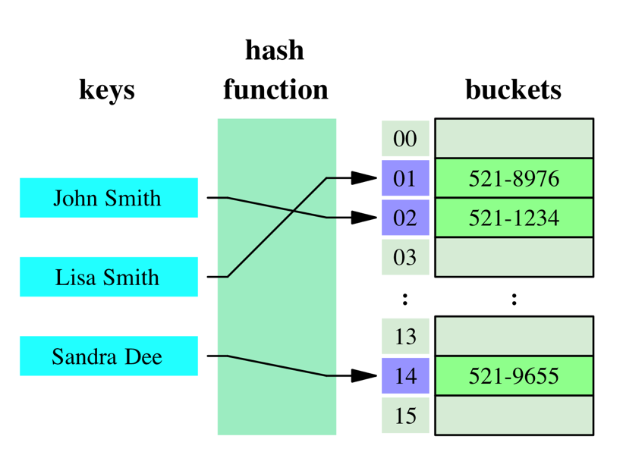
Dictionaries = Hash Tables
http://en.wikipedia.org/wiki/File:Hash_table_3_1_1_0_1_0_0_SP.svg

Slide 29
“Class()?”
http://docs.python.org/library/stdtypes.html
You may have noticed that these containers are defined as “class()”es...
  class dict([arg])
  class set([iterable])
...stay tuned for Session #3:
  Object Oriented Programming!

Slide 30
Class()!
http://docs.python.org/library/stdtypes.html
You may have noticed that these containers are defined as “class()”es...
  class dict([arg])
  class set([iterable])
...stay tuned for Session #3:
  Object Oriented Programming!

Slide 31
More Information
Sequences & Methods
  http://docs.python.org/library/stdtypes.html
Coding Bat (Great practice!)
  http://codingbat.com/python
Google’s Python Class
  http://code.google.com/edu/languages/google-python-class/
  Exercises (More practice!)
    http://code.google.com/edu/languages/google-python-class/exercises/basic.html

