Slide 1
CS10 Final Review
Programming

Slide 2
Concept Review
Loops & Variables
Conditionals
Lists
Algorithms & Complexity
Concurrency
Recursion
Data Structures
Hash Tables
Lamdas & HOFs

Slide 3
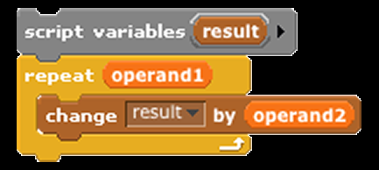

Loops & Variables
Multiplying operand1 by operand2
Correct?

Slide 4
Loops & Variables
Multiplying operand1 by operand2
No! Why?

Slide 5

Loops & Variables
Multiplying operand1 by operand2
Uninitialized Variable

Slide 6
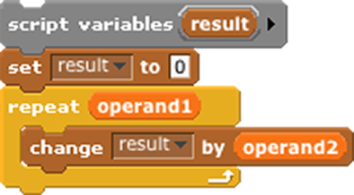

Loops & Variables
Multiplying operand1 by operand2
Initialized Variable!

Slide 7
Loops & Variables
Be sure that your
variables are initialized to a
correct / known / sane value!

Slide 8
Loops & Variables
Multiplying operand1 by operand2
Correct now?

Slide 9

Loops & Variables
Multiplying operand1 by operand2
What if operand1 is negative? Or a “real” number like 2.3?

Slide 10
Loops & Variables
Be sure that your
looping conditions
are valid!

Slide 11
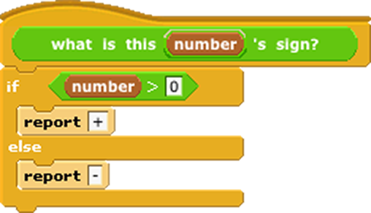
Conditionals
Reports “+” for positive numbers, “-” for negative numbers.
Correct?

Slide 12
Conditionals
Reports “+” for positive numbers, “-” for negative numbers.
No! Why?

Slide 13

Conditionals
Reports “+” for positive numbers, “-” for negative numbers.
What about
number = 0?

Slide 14
Loops & Variables
Conditionals
Be sure that your conditionals handle all possible cases!
Double-check edge cases, or inputs that fall on either side of your predicate.

Slide 15
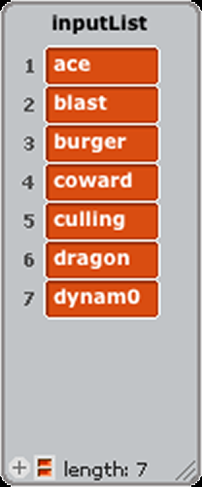
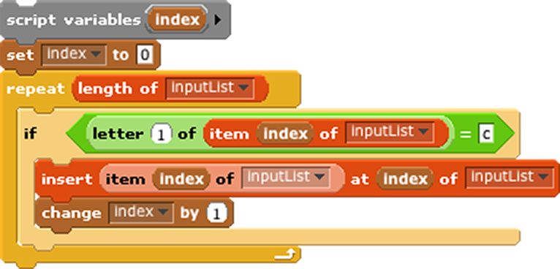
Lists
Duplicate words
beginning with ‘c’
Does this correctly loop over list?

Slide 16
Lists
Duplicate words
beginning with ‘c’
No! Why?

Slide 17

Lists
Duplicate words
beginning with ‘c’
Index within conditional!

Slide 18
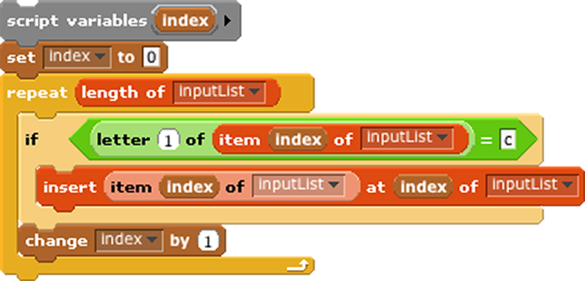

Lists
Duplicate words
beginning with ‘c’
Correct now?

Slide 19
Lists
Duplicate words
beginning with ‘c’
No! Why?

Slide 20

Lists
Duplicate words
beginning with ‘c’
Off by 1!

Slide 21


Lists
Duplicate words
beginning with ‘c’
Correct now?

Slide 22
Lists
Duplicate words
beginning with ‘c’
No! Why?

Slide 23

Lists
Duplicate words
beginning with ‘c’
The list keeps changing size!

Slide 24
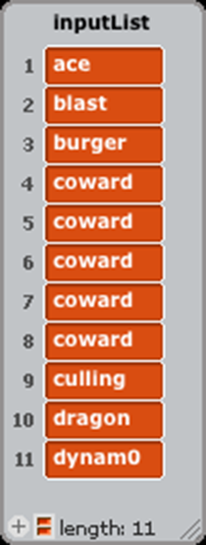

Lists
Duplicate words
beginning with ‘c’
The list keeps changing size!

Slide 25
Lists
How do you correct it?
Here is one solution...

Slide 26
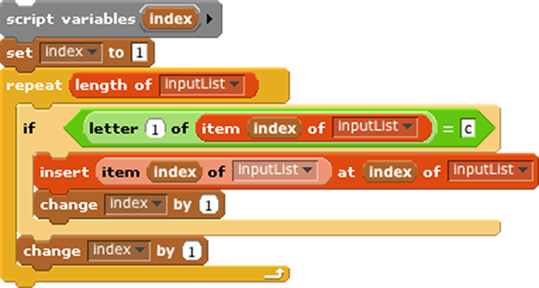

Lists
Duplicate words
beginning with ‘c’
Push the index past the inserted item...

Slide 27
Lists
Seems pretty “kludgy” though...
Here is a much, much better solution...
http://en.wikipedia.org/wiki/Kludge

Slide 28
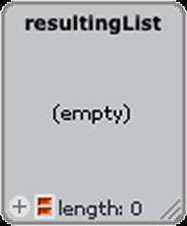

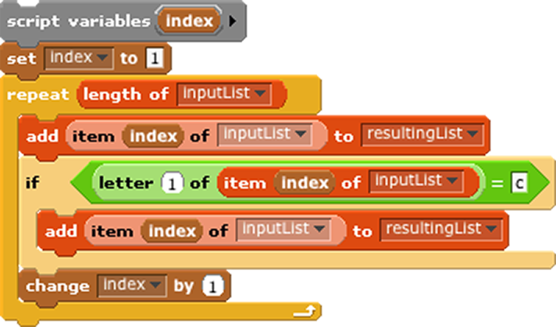


Lists
Duplicate words
beginning with ‘c’
Make a new, resulting list!

Slide 29
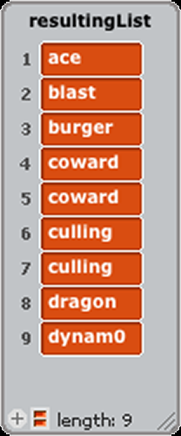

Lists
Duplicate words
beginning with ‘c’
Much better! And our original list is still intact!

Slide 30
Check-Lists
Be sure indexes are correct during the entire loop.
BYOB starts list indexing at 1
If the input list changes size during the loop, your index will be off!

Slide 31
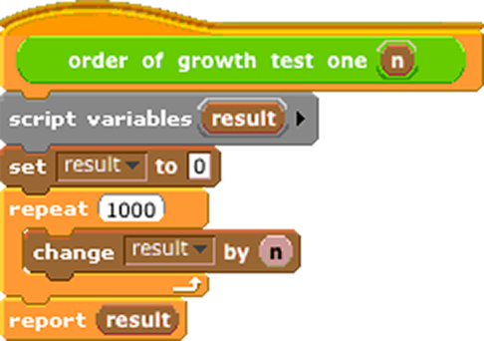
Algorithms & Complexity
Order of growth?

Slide 32
Algorithms & Complexity
Constant: O(c)
Reason: No matter what “n” is, the loop always repeats 1000 times.

Slide 33
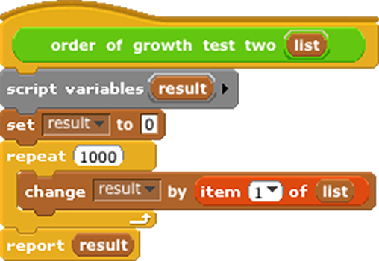
Algorithms & Complexity
Order of growth?

Slide 34
Algorithms & Complexity
Still Constant: O(c)
Reason: No matter what the list is, the loop always repeats 1000 times.

Slide 35
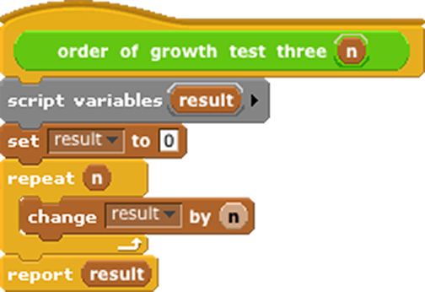
Algorithms & Complexity
Order of growth?

Slide 36
Algorithms & Complexity
Linear: O(n)
Reason: Number of operations proportional to the input size (n)

Slide 37
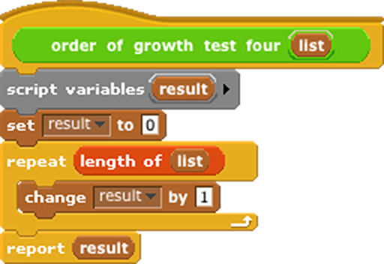
Algorithms & Complexity
Order of growth?

Slide 38
Algorithms & Complexity
Still Linear: O(n)
Reason: Number of operations proportional to the input size (length)

Slide 39
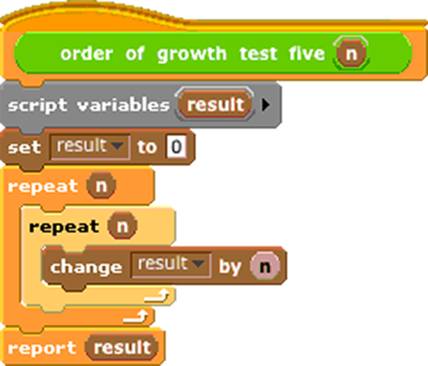
Algorithms & Complexity
Order of growth?

Slide 40
Algorithms & Complexity
Quadratic: O(n²)
Reason: Number of operations proportional to the square of the size of the input data (n)

Slide 41
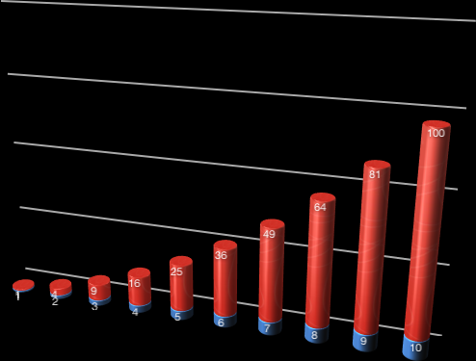


Algorithms & Complexity
# of operations
Input size
Quadratic: O(n²)

Slide 42
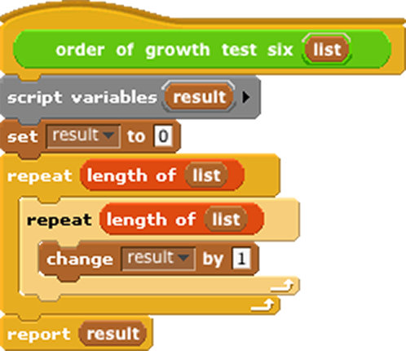
Algorithms & Complexity
Order of growth?

Slide 43
Algorithms & Complexity
Still Quadratic: O(n²)
Reason: Number of operations proportional to the square of the size of the input data (length)

Slide 44
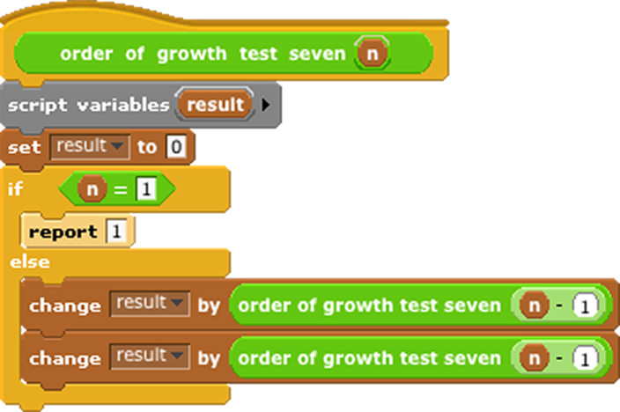
Algorithms & Complexity
Order of growth?

Slide 45
Algorithms & Complexity
Exponential: O(c^{n})
Reason: the recursive call is run twice for each value of n.

Slide 46
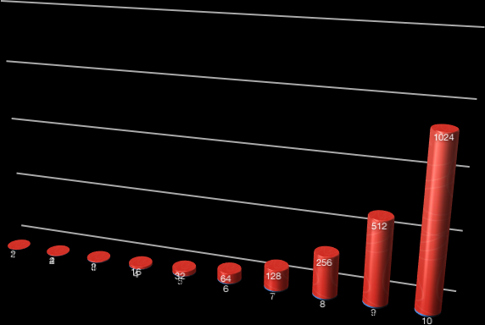

Algorithms & Complexity
# of operations
Input size
Exponential: O(2^{n})

Slide 47
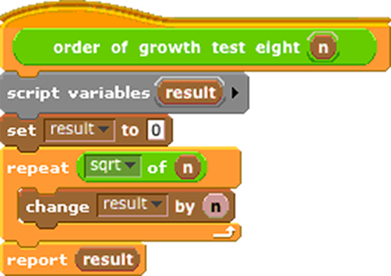
Algorithms & Complexity
Order of growth?

Slide 48
Algorithms & Complexity
Logarithmic: O(Logcn)
Reason: the number of times the loop runs grows far more slowly (square root) than “n”

Slide 49
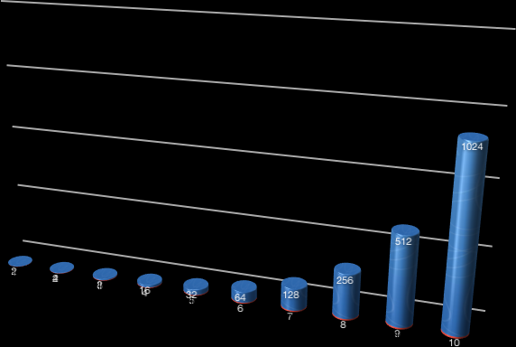


Algorithms & Complexity
Note that these have traded places!
Input size
# of operations
Logarithmic: O(Log n)
2

Slide 50
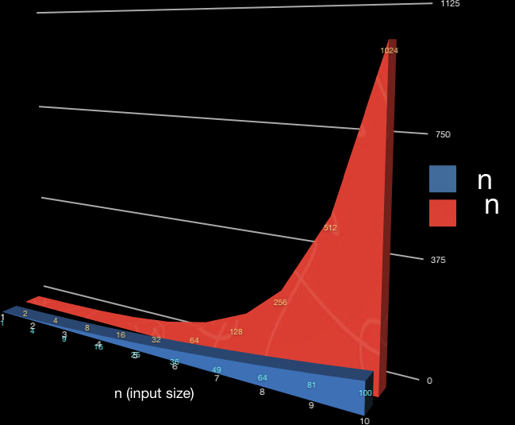

Algorithms & Complexity
²
Compare!
2
Note that linear growth doesn’t even register on this graph!

Slide 51
Algorithms & Complexity
Consider the number of times the calculation repeats, rather than specific inputs.

Slide 52




Algorithms & Complexity
Examples
Constant
Linear
Quadratic
Exponential
Logarithmic
Hash Table Lookup
Text or List Length
Square Matrix Calcs.
  (Naïve) Sorting
Recursive Fractals
Binary Searches

Slide 53
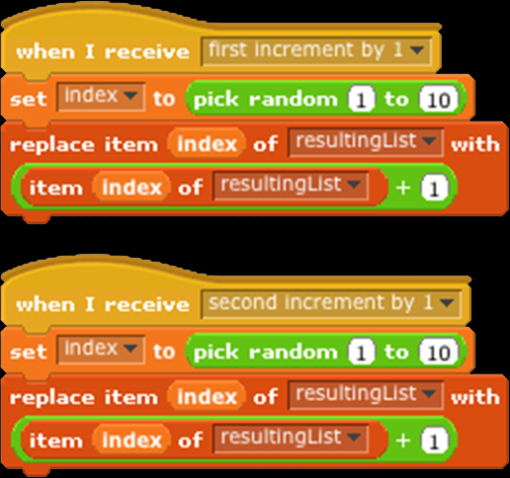
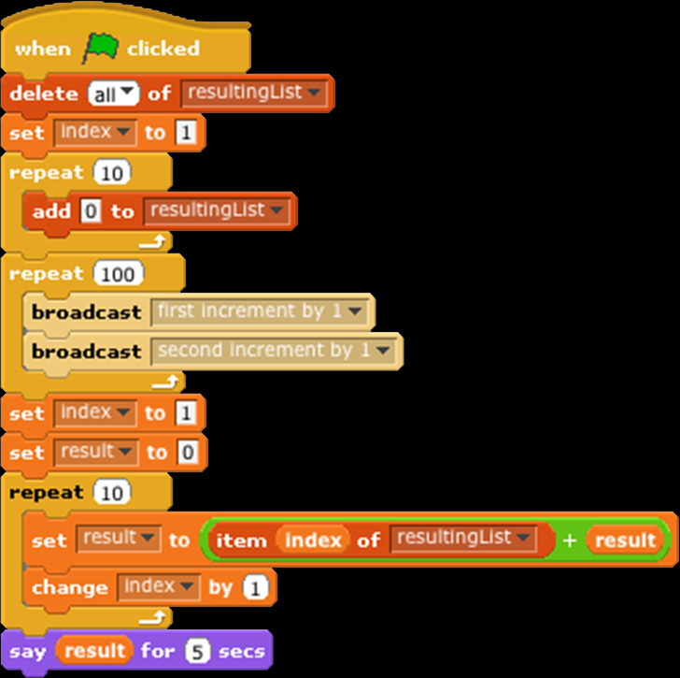
Concurrency
List adds up
to 200?

Slide 54
Concurrency
List adds up
to 200?
No! Why?

Slide 55


Concurrency
These might choose the same number at the same time!
List adds up
to 200?
No! Why?

Slide 56
Concurrency
List adds up
to 200?
Anything else?

Slide 57


Concurrency
No “wait” here means these might access the same indexes (or not access them at all), by interrupting a broadcast script that is already running!
List adds up
to 200?
No! Why?

Slide 58
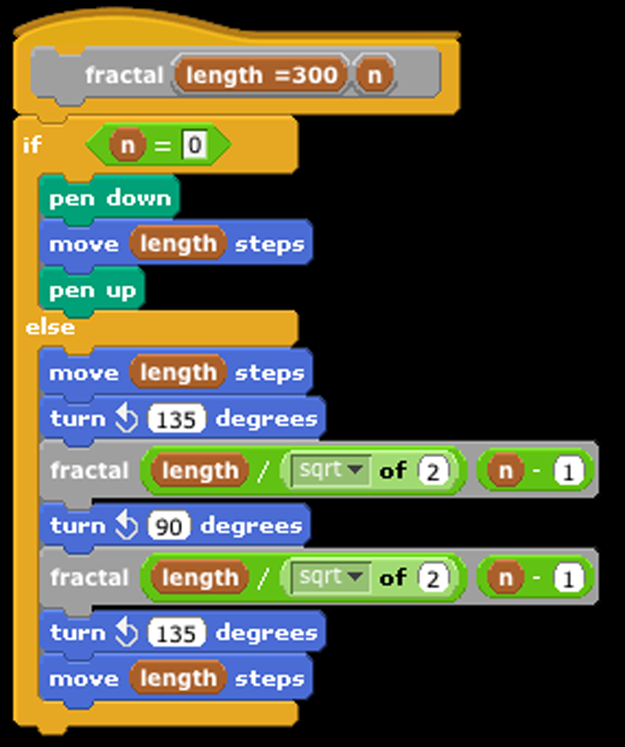

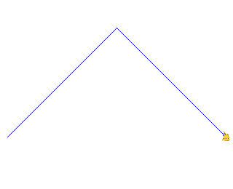
Recursion
n=0
n=1

Slide 59

Recursion
n=2
n=4
n=3
n=∞

Slide 60
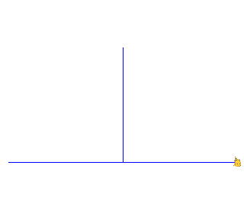
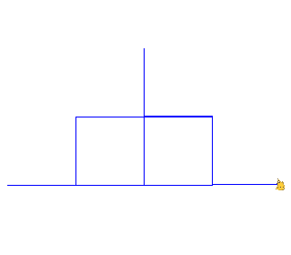
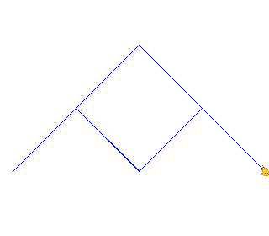
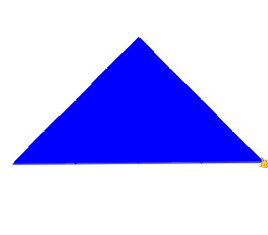
Recursion
n=2
n=4
n=3
n=∞

Slide 61
Recursion
An algorithmic technique where a function, in order to accomplish a task, calls itself with some part of the task.
Recursive solutions involve two major parts:
Base case(s), in which the problem is simple enough to be solved directly,
Recursive case(s). A recursive case has three components:
  Divide the problem into one or more simpler or smaller parts of the problems,
  Invoke the function (recursively) on each part, and
  Combine the solutions of the parts into a solution for the problem.
Depending on the problem, any of these may be trivial or complex.
http://inst.eecs/~cs3l/sp09/lectures/L06/2009SpCS3L06.html

Slide 62
Data Structure : Hash Tables
Can we use “MapReduce” to build a hash table?
(we’ll come back to that...)

Slide 63
Lambdas & HOFs
What is a Lambda?
What is a Higher-Order Function (HOF)?

Slide 64
Lambdas & HOFs
  A “First Class” Procedure
    “Function as Data”

Slide 65
Lambdas & HOFs
What is a Higher-Order Function (HOF)?
  In mathematics and computer science, higher-order functions, functional forms, or functionals are functions which do at least one of the following:
take one or more functions as an input
output a function
http://en.wikipedia.org/wiki/Higher-order_function

Slide 66
Lambdas & HOFs
Useful HOFs (you can build your own!)
map Reporter over List
  Report a new list, every element E of List becoming Reporter(E)
keep items such that Predicate from List
  Report a new list, keeping only elements E of List if Predicate(E)
combine with Reporter over List
  Combine all the elements of List with Reporter(E)
  This is also known as “reduce”
Acronym example
keep ➔ map ➔ combine
http://inst.eecs.berkeley.edu/~cs10/sp11/lec/17/src/2011-03-30-CS10-L17-DG-HOF-I.pptx

Slide 67
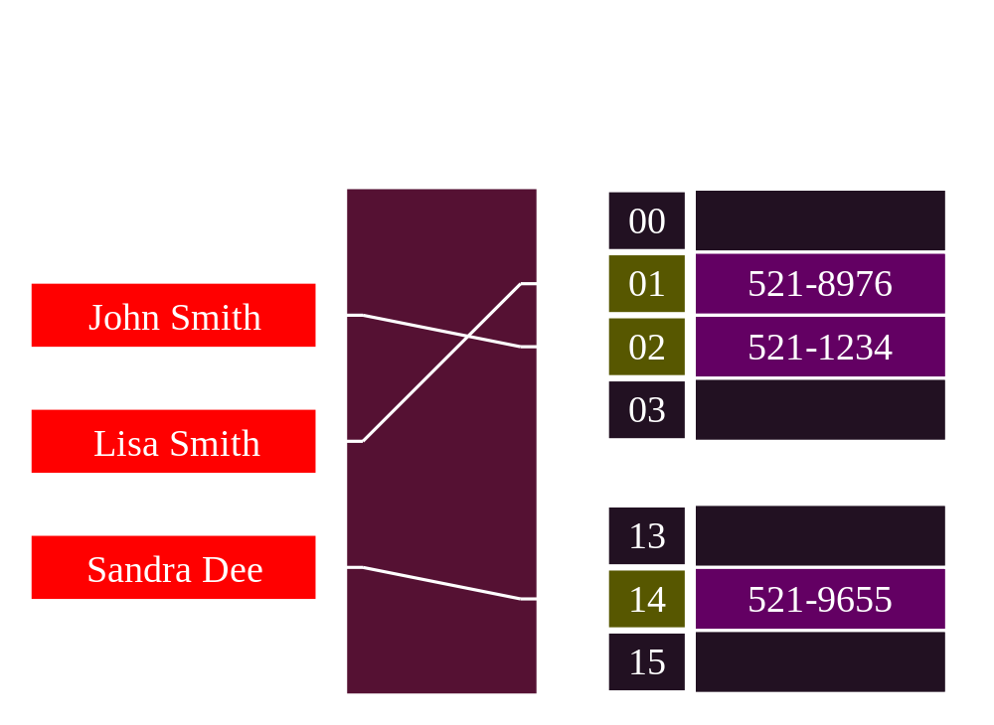
Data Structure : Hash Tables

Slide 68
Data Structure : Hash Tables
Determine size of hash table.
Hashing function (algorithm) to generate keys (index) from values (items).
Modulo key (index) by hash table size.
Store key and value in hash table at the resulting index.
Find key in table using above algorithms (reading value instead of storing it).
http://en.wikipedia.org/wiki/Hash_table

Slide 69
Data Structure : HOF/Hash Tables
Can we use “MapReduce” to build a hash table?

Slide 70
Data Structure : HOF/Hash Tables
Yes!
Try to program one on your own... it’s great practice with HOFs, Lists, etc.!
I will post the solution to Piazzza...

