Slide 1

Algorithms and Data Structures 2 CS 1501
Fall 2021
Sherif Khattab
ksm73@pitt.edu
(Slides are adapted from Dr. Ramirez’s and Dr. Farnan’s CS1501 slides.)

Slide 2
Goals of the course
To learn to convert non-trivial algorithms into programs
Various issues will always pop-up during implementation
Such as?...
To see and understand differences in algorithms and how they affect the run-times of the associated programs
Different solutions can be compared using many metrics
Notes:
Input and output
Language being used and its features / limitations
Data structures to use
Debugging

Slide 3
Contact Info
Course website: http://www.cs.pitt.edu/~skhattab/cs1501/
Instructor: Sherif Khattab ksm73@pitt.edu
OH: https://khattab.youcanbook.me
Tu: 10-noon; Th: 10-noon and 3-6; F: 8-10 and 3-4
6307 Sennott Square, Virtual Office: https://pitt.zoom.us/my/khattab
Teaching Team:
TBD
Recitations start this week!
Communication
End of week newsletter
Piazza, Canvas Messages, Email (Please expect a response within 72 hours)

Slide 4
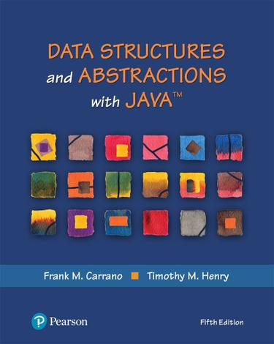
Textbook
Algorithms (4th Edition)
Robert Sedgewick and Kevin Wayne
Data Structures and Abstractions with Java (5th Edition)
Frank M. Carrano and Timothy M. Henry

Slide 5
Grades
40% on best four out of five programming assignments
posted on Canvas and submitted on Gradescope
20% homework assignments on Gradescope
20% exams: 12% on higher grade and 8% on lower
10% lab exercises; mostly autograded
10% mini-quizzes: on Top Hat during each lecture
Bonus Opportunities
1% Bonus on CourseMIRROR Reflections (to be explained later today)

Slide 6
Canvas Walkthrough
Lectures posted on Tophat by end of each lecture day
Lecture and recitation recordings under Panopto Video
RedShelf Inclusive Access
Piazza for discussion
Gradescope and autograding policies
Academic Integrity
NameCoach

Slide 7
Expectations
Your continuous feedback is important!
Anonymous Qualtrics survey
Midterm and Final OMET
Your engagement is valued and encouraged.

Slide 8
Lecture structure (mostly)
Time | Description
~5 min before and after class | Informal chat
~25 min | Announcements, review of reflections, and QA on assignments/labs/homework problems
~40 min | Lecturing
~5 min | Tophat questions and/or activities
~5 minutes | QA and muddiest points/reflections

Slide 9
Why is this class (notoriously) hard?
Lots of concepts
Attend lectures and recitations (if you absolutely cannot attend live, watch the video recordings)
Study often!
Put effort into the weekly homework assignments
Programming Assignments are relatively hard
Refresh your Java programming (CS 0445) and debugging skills
Start early and show up to office hours!

Slide 10
CourseMIRROR Mobile App
This semester we will use an educational technology tool, called CourseMIRROR.
CourseMIRROR is a mobile app that prompts student to reflect on their learning experiences.
You will receive 1% points of extra credit for your participation when the response rate is 60% or more.
If you have an iOS device (iPhone or iPad), please go to Apple App Store and search for “CourseMIRROR” and then install it to your device.
If you have an Android device (smartphone or tablet), please go to Google Play Store and search for ”CourseMIRROR v2” and then install it to your device.
After creating an account, you need to go to your email to confirm your account. (If you do not receive a confirmation email, please check your spam folder(s) too).
10

Slide 11
CourseMIRROR Mobile App
You will need a passcode to find our course within the CourseMIRROR app. Passcode for your class hdihcq (all lower case) and for the MW 3:00 pm section is tyunqf. (all lower case).
Please watch the tutorial videos regarding how to install and use the app via https://www.youtube.com/channel/UC-DzfOmeS1l5fBDLL2qwYzQ
If you have any trouble with the app, you may send an email to coursemirror.development@gmail.com
11

Slide 12
How to determine an algorithm’s performance
Implement it and measure performance
Any problems with this approach?
Algorithm Analysis
Determine resource usage as a function of input size
Measure asymptotic performance
Performance as input size increases to infinity
Notes:
Storytime:
Implemented a new algorithm and it runs forever
Problem with the algorithm?
Or just a bug?
What if the implementation doesn't end up being worth it?
What if the algorithm is infeasible?
STILL USEFUL!
Experimental evaluation
Benchmarking

Slide 13
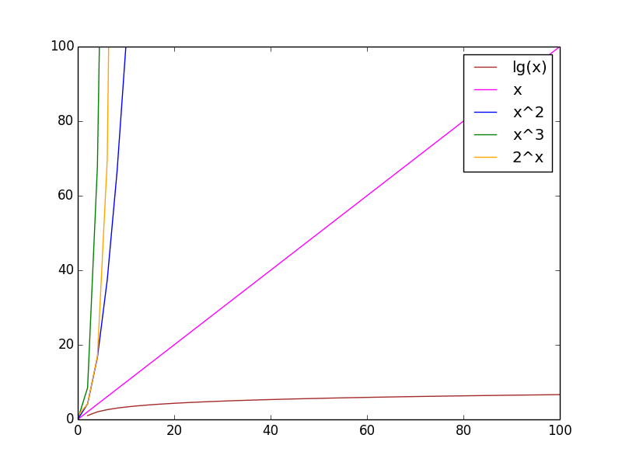
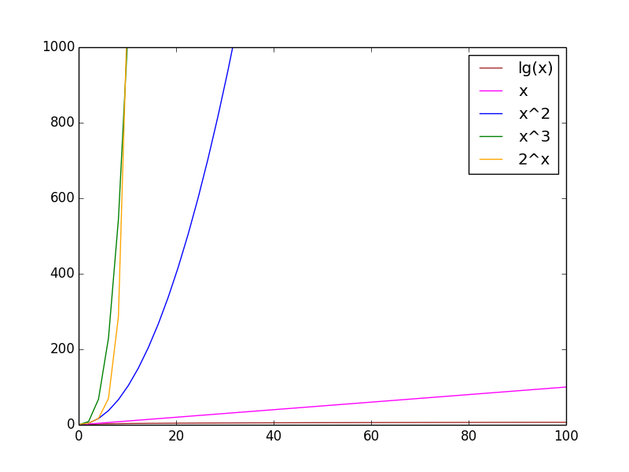
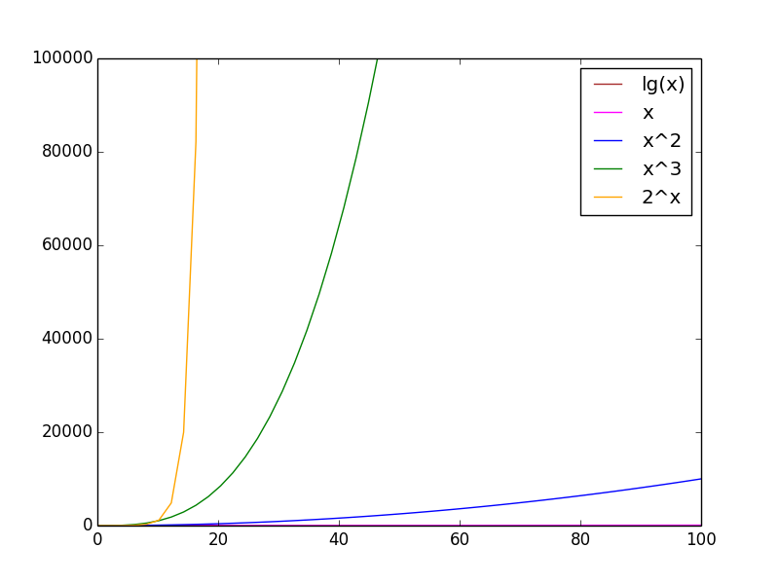
Asymptotic performance
Focus more on the rate of growth than on exact values
How fast the function increases when the input increases

Slide 14
Common orders of growth
Constant - 1
Logarithmic - log n
Linear - n
Linearithmic - n log n
Quadratic - n²
Cubic - n³
Exponential - 2^{n}
Factorial - n!

Slide 15
Quick algorithm analysis
Ignore multiplicative constants and lower terms
Notes:
Wait, we just compared some function (e.g., n³) to the function modelling our runtime??
Can we use O for other resources??
YES! memory!

Slide 16
Definition of Big O?
Big O
Upper bound on asymptotic performance
As we go to infinity, function representing resource consumption will not exceed specified function
E.g., Saying runtime is O(n³) means that as input size (n) approaches infinity, actual runtime will not exceed n³
Notes:
OK, so not exactly n³, but not greater than n³, got it

Slide 17
Big O isn't the whole story
Big Omega
Lower bound on asymptotic performance
Theta
Upper and Lower bound on asymptotic performance
Exact bound
Tilde approximation
Same as Theta but with constant factors

Slide 18
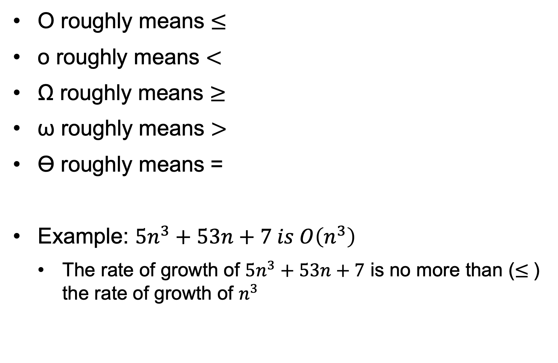
The Big O Family
O roughly means $≤$
o roughly means $<$
Ω roughly means $≥$
ω roughly means $>$
ϴ roughly means =
Example: $5n^{3}+53n+7 is O\left(n^{3}\right)$
The rate of growth of $5n^{3}+53n+7$ is no more than ($≤$) the rate of growth of $n^{3}$

