Slide 1

Algorithms and Data Structures 2 CS 1501
Fall 2021
Sherif Khattab
ksm73@pitt.edu
(Slides are adapted from Dr. Ramirez’s and Dr. Farnan’s CS1501 slides.)

Slide 2
Announcements
Homework 1 is due this Friday at 11:59 pm
Recitations started last week
Please watch the video
Tophat questions assigned as homework

Slide 3

Last lecture …
Extracting the rate of growth of a function
Ignoring lower-order terms and multiplicative constants
The Big O family
A technique for modeling runtime of algorithms
$\sum_{all statements}{Cost∗frequency}$

Slide 4
Muddiest points
The Big O and why the rest of the family is important
knowing which of the Big O family to use for different situations
Formal definitions
Log N vs. N
The wording when we talk about faster runtime versus faster rate of growth
The formula of analyzing the threesum example
why in the 3 sums example O(3^n) was a valid answer

Slide 5
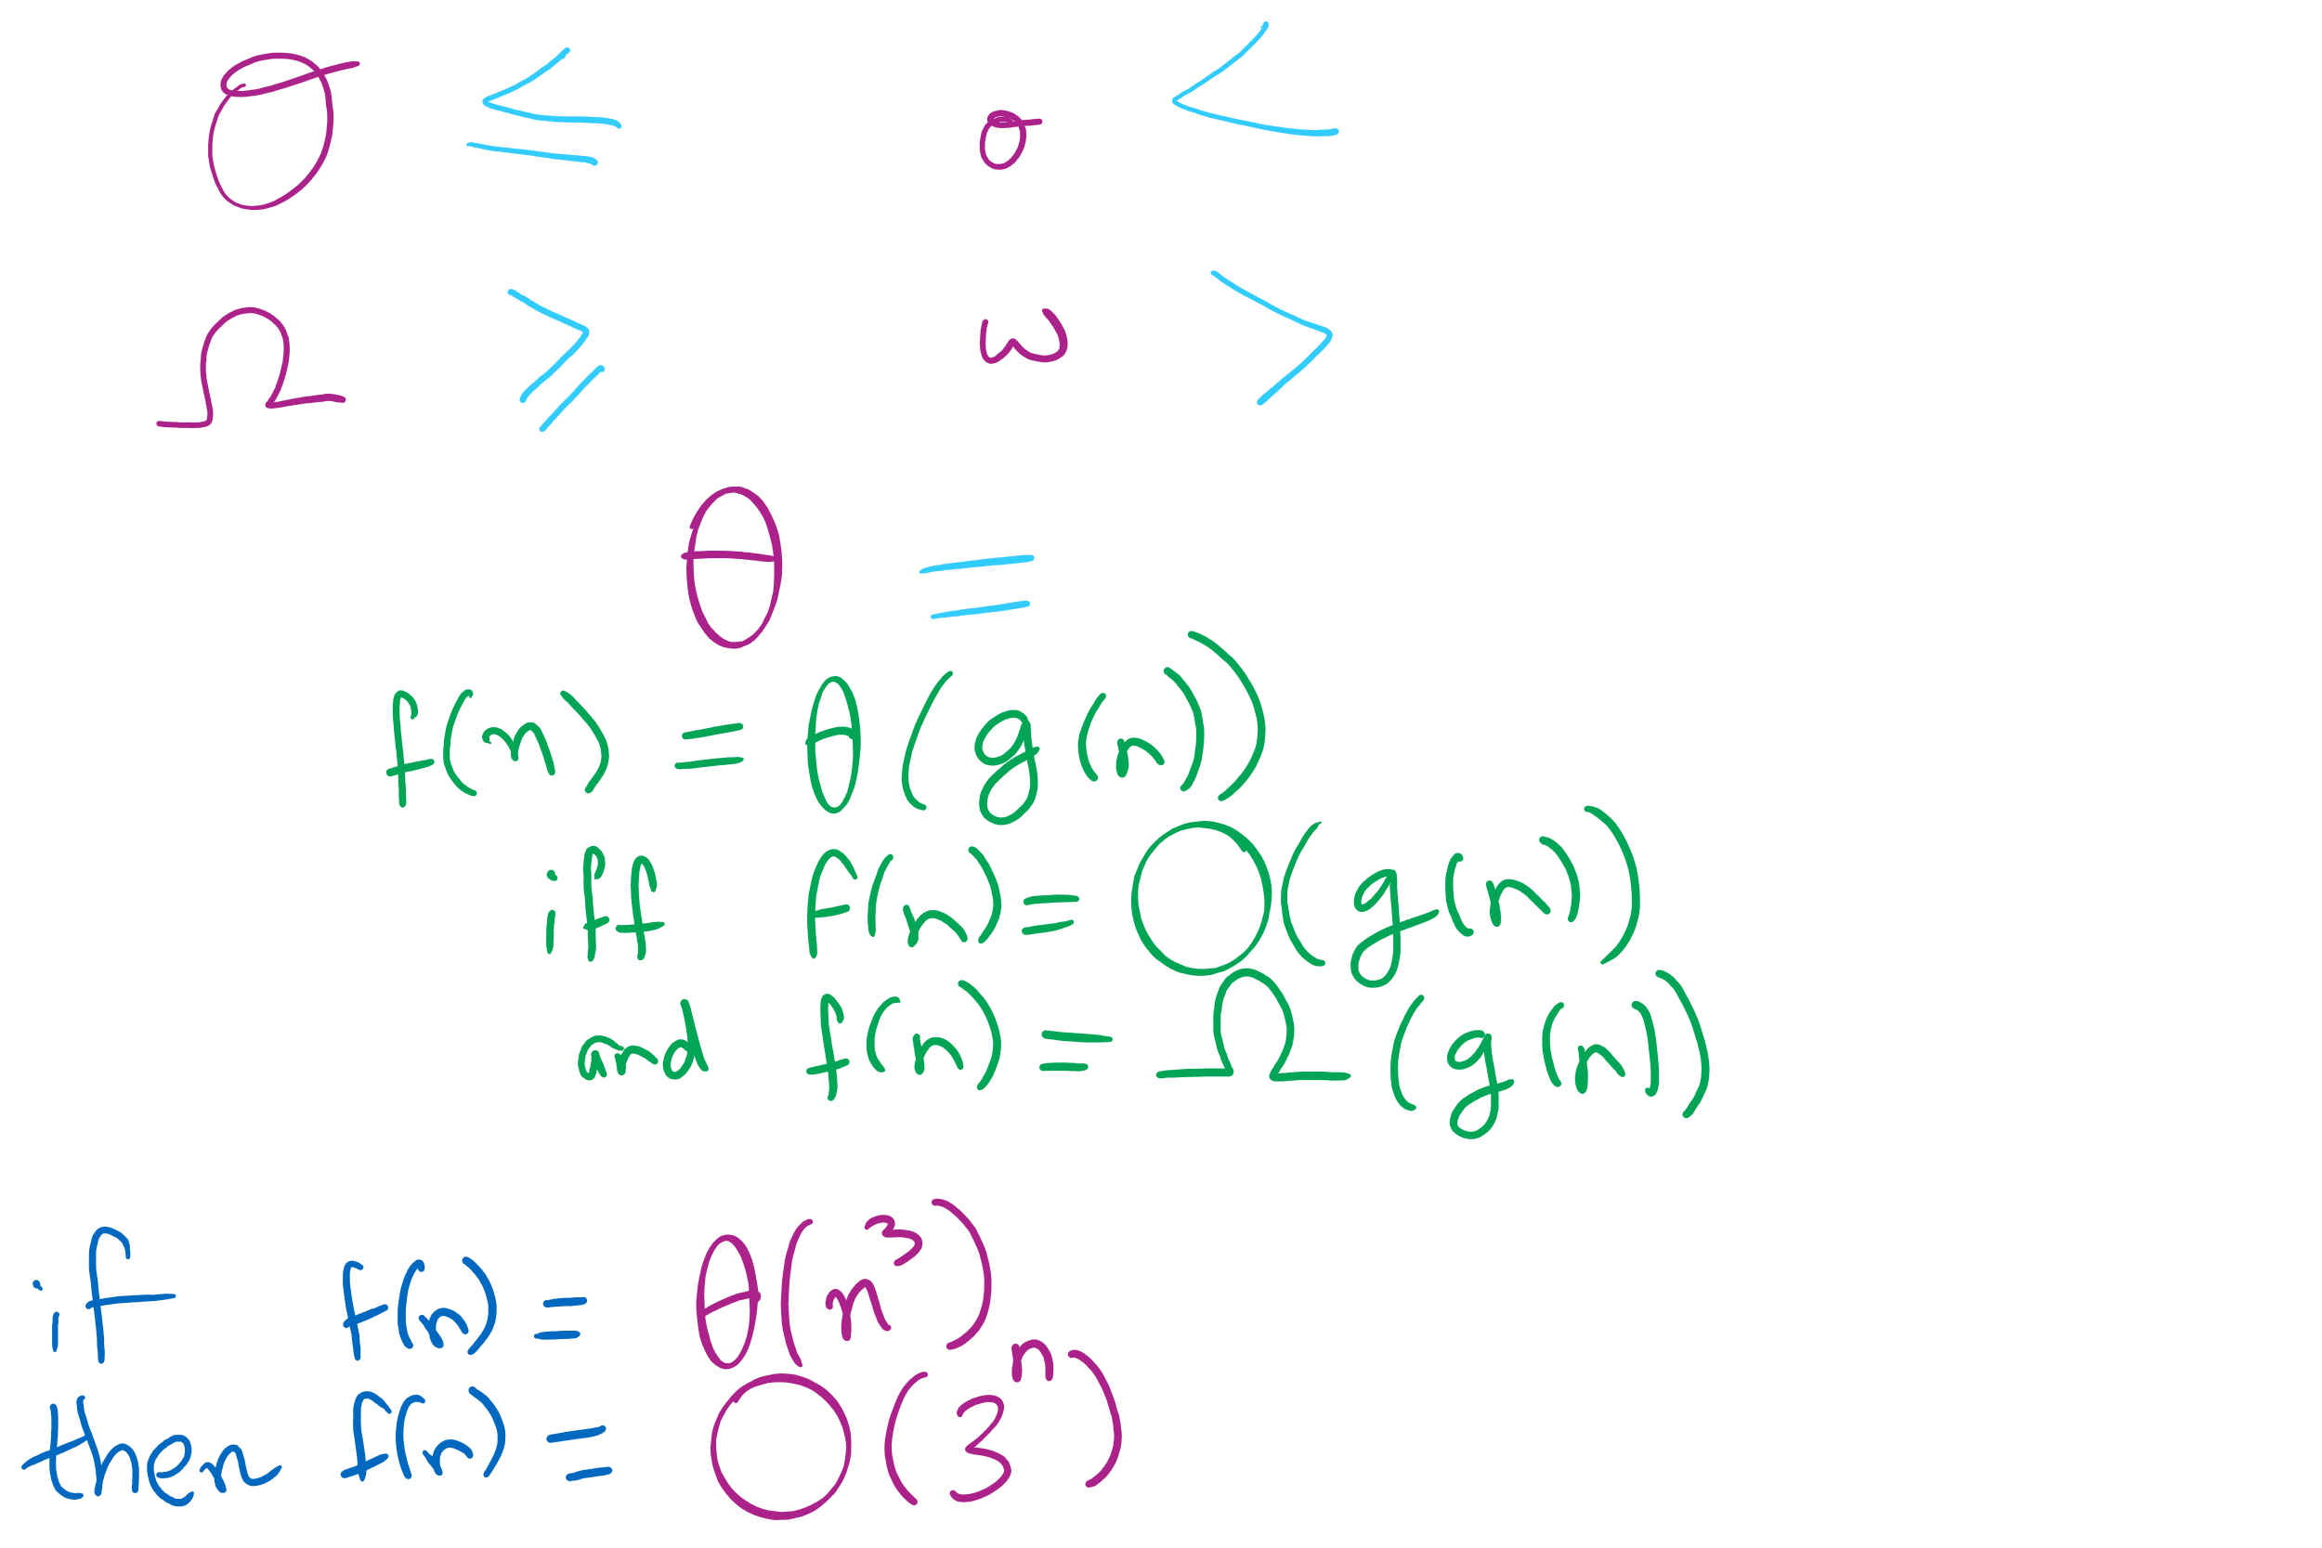
Big O Family

Slide 6
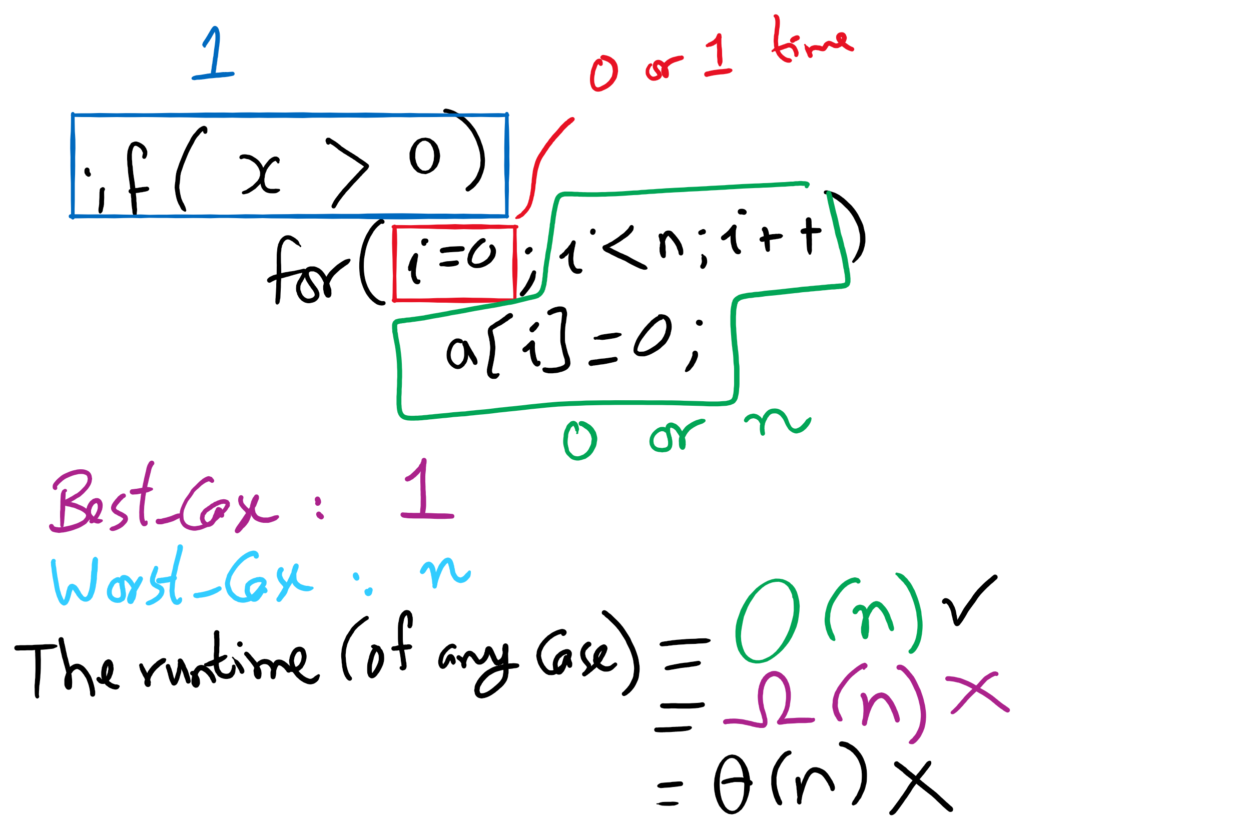
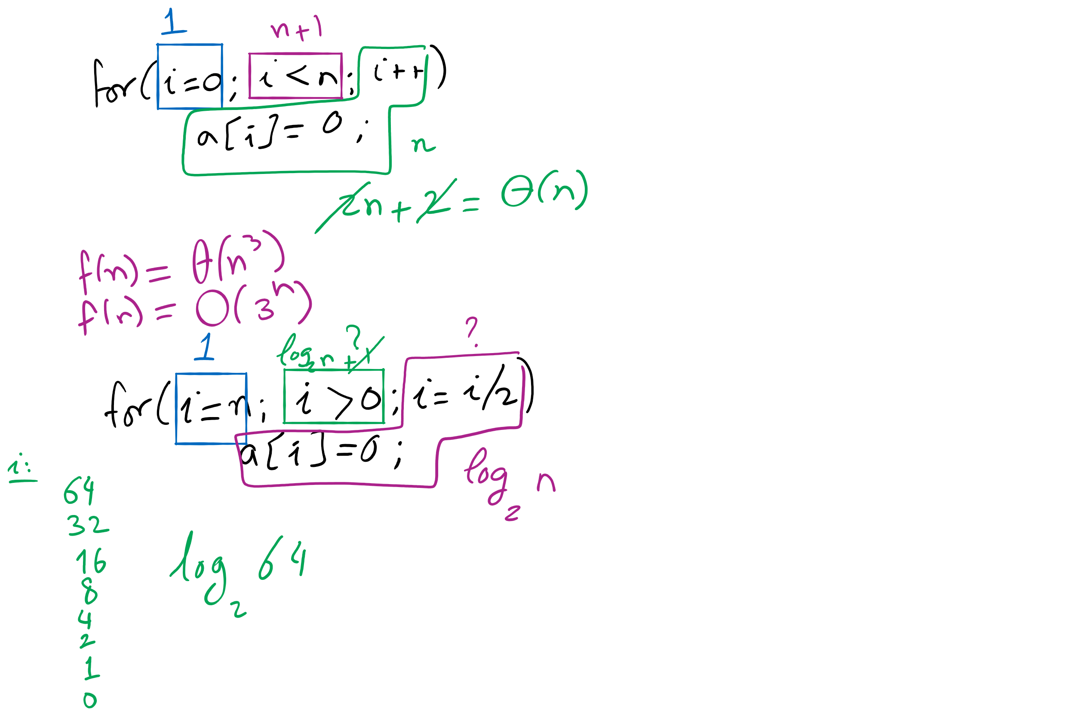
Algorithm Analysis Examples

Slide 7
ThreeSum algorithm analysis
public static int count(int[] a) { int n = a.length; int cnt = 0; for (int i = 0; i < n; i++) { for (int j = i+1; j < n; j++) { for (int k = j+1; k < n; k++) { if (a[i] + a[j] + a[k] == 0) { cnt++; } } } } return cnt; }
Notes:
grey:
time: t₄
freq: 1
yellow:
time: t₃
freq: n
blue:
time: t₂
freq: sum i=0 to n-1 ( sum j=i+1 to n-1 (1))
= n²/2 - n/2
red:
time: t₁
freq: sum i=0 to n-1 ( sum j=i+1 to n-1 ( sum k=j+1 to n-1 (1)))
= n³/6 - n²/2 + n/3
purple
time: t₀
freq: x (depends on if statement, min 0 max same as red)
SUM UPPER BOUNDS: INCLUSIVE

Slide 8
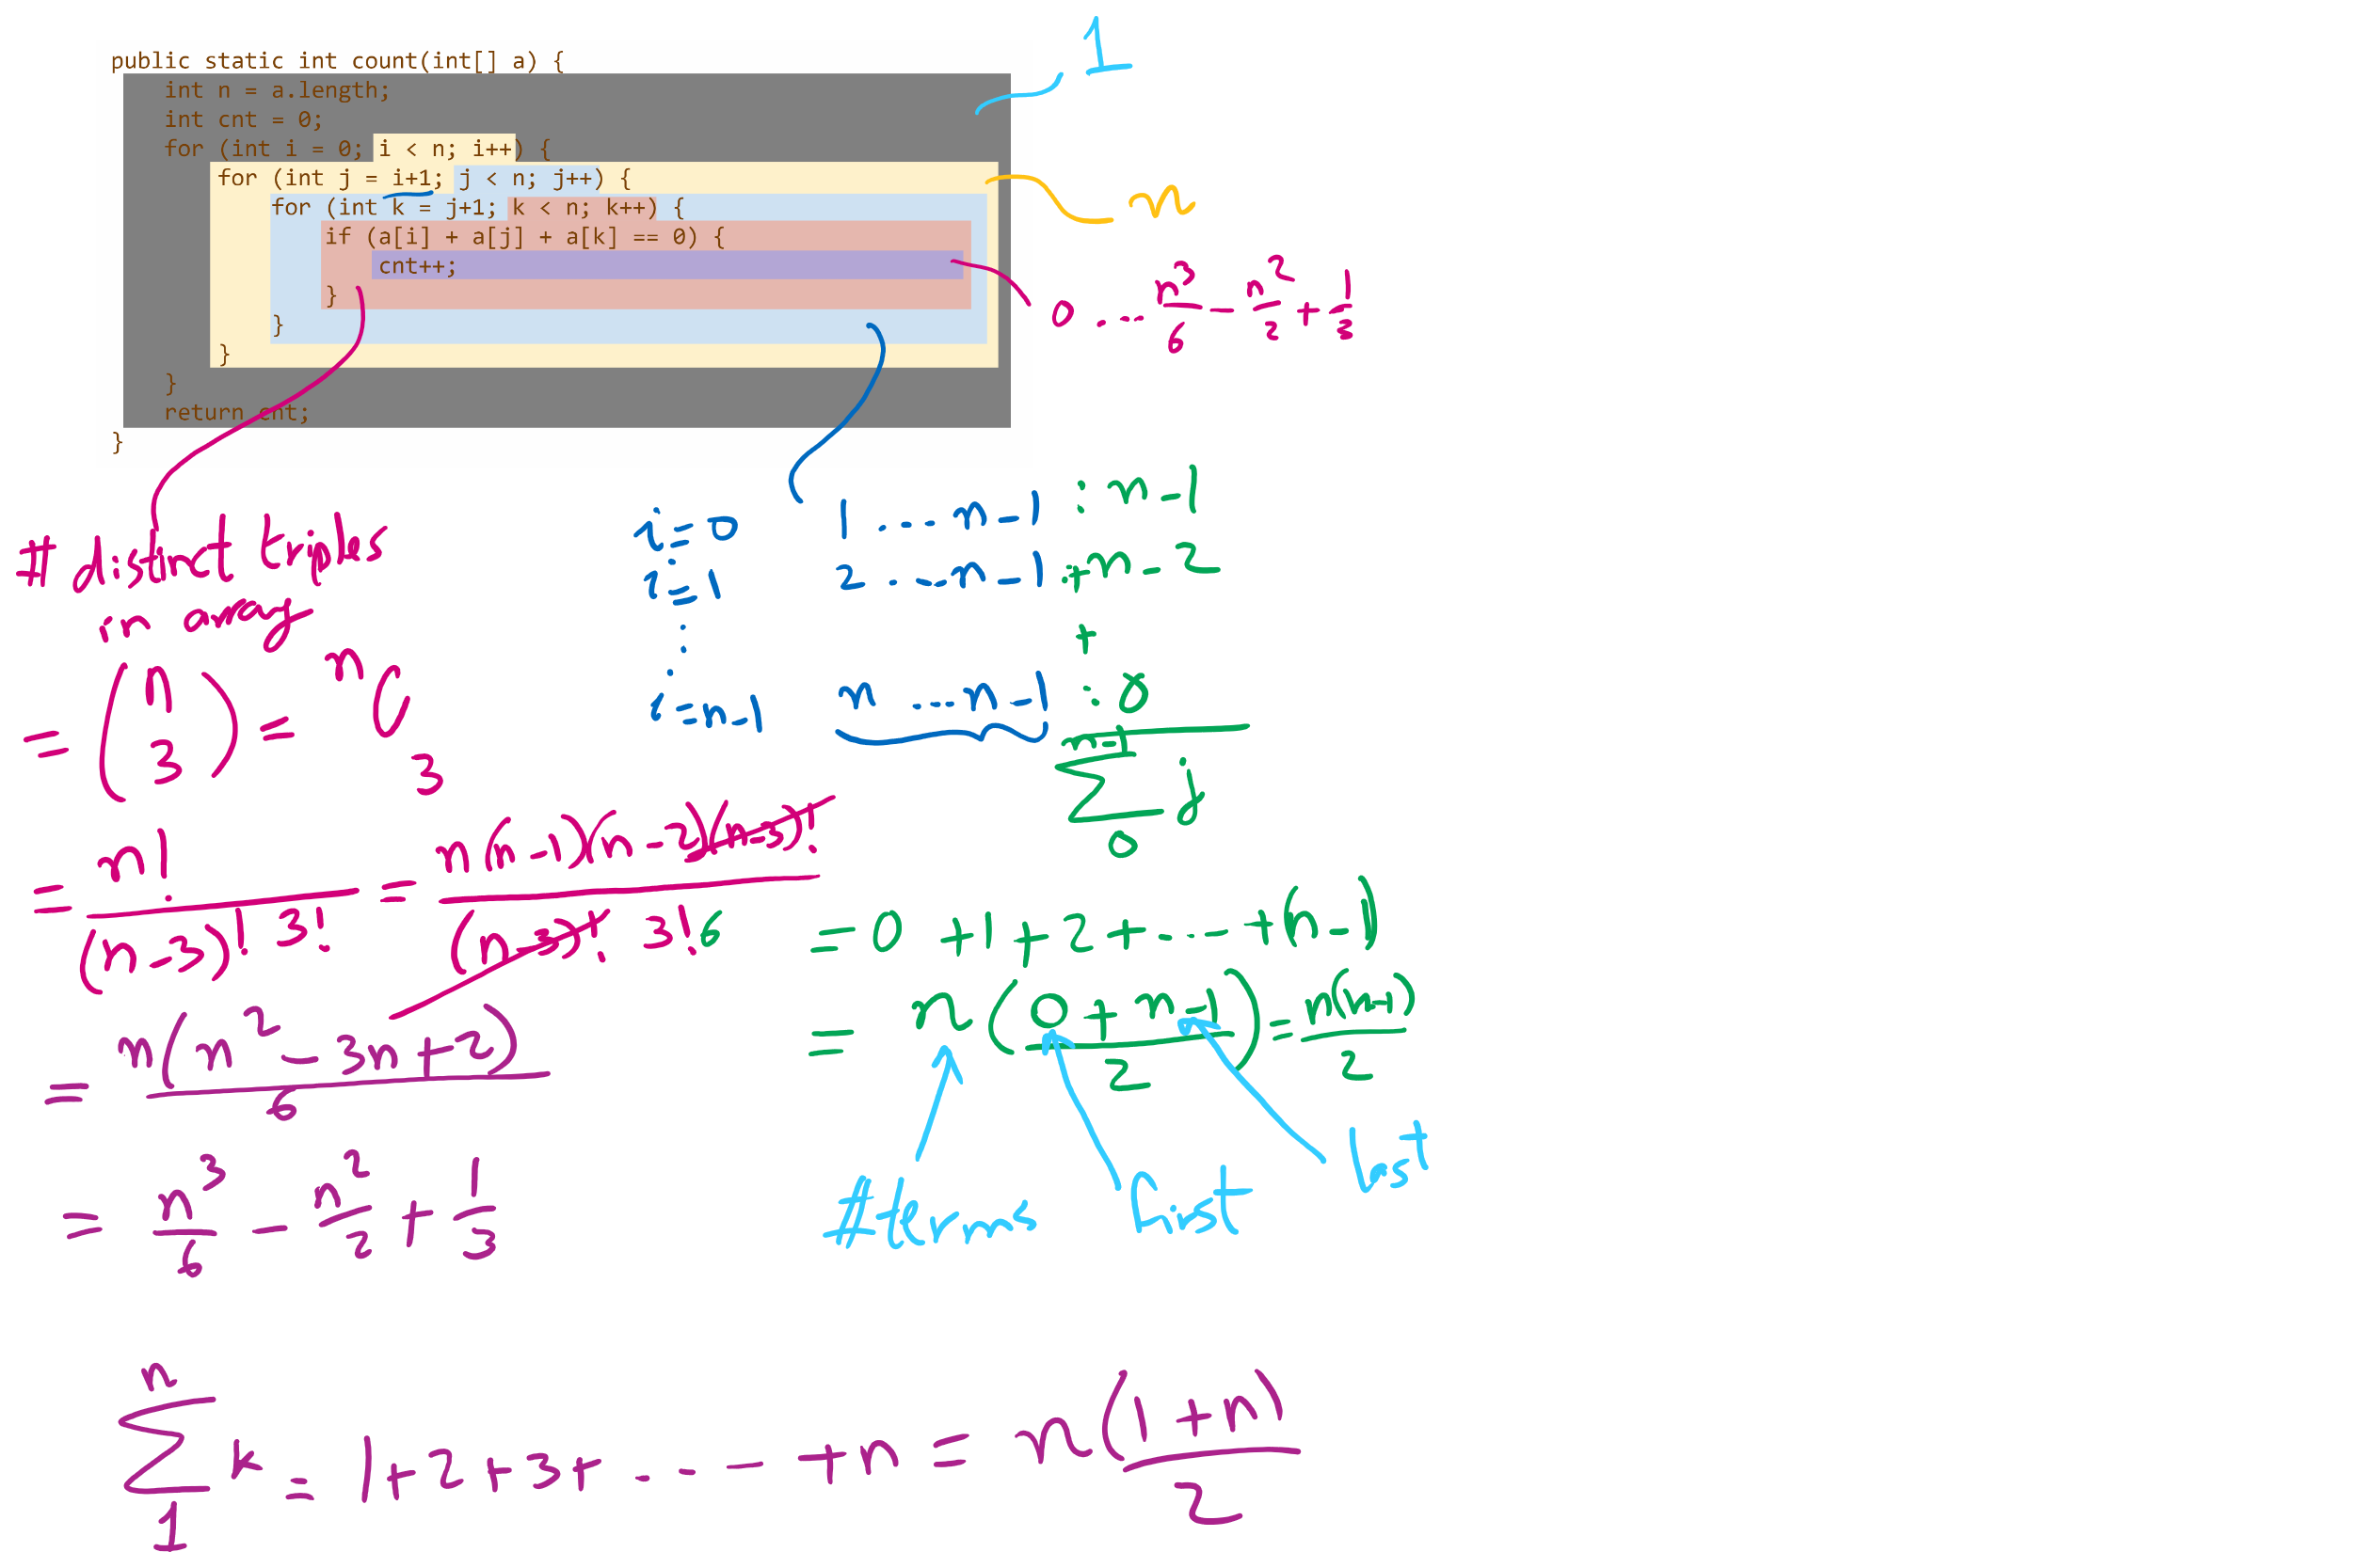
Runtime Modeling (1)

Slide 9
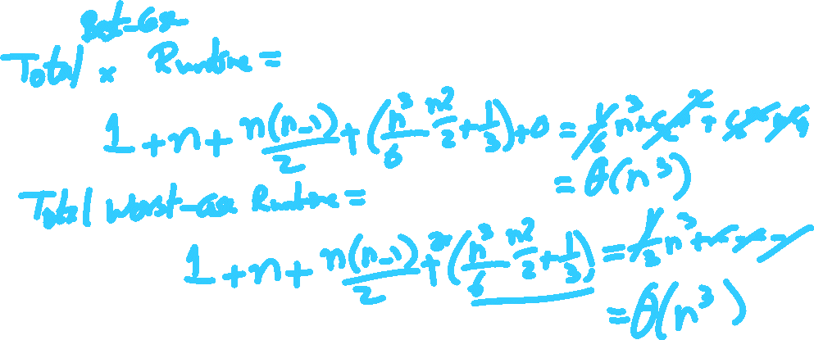
Runtime Modeling (2)

Slide 10
A better algorithm for ThreeSum
What if we sorted the array first?
Pick two numbers, then binary search for the third one that will make a sum of zero
a[i] = 10, a[j] = -7, binary search for -3
Still have two for loops, but we replace the third with a binary search
Runtime now?
What if the input data isn't sorted?
What about the sorting time?
Notes:
New runtime:
Θ(n² log n)
Sort time:
O(n log n)
done before our search, dominated by search time
Asymptotically insignificant

Slide 11
Bubble sort
Simply go through the array comparing pairs of items, swap them if they are out of order
Repeat until you make it through the array with 0 swaps
<T extends Comparable<? super T>> void bubbleSort(T [] a) {
boolean swapped;
do {
swapped = false;
for(int j = 1; j < a.length; j++) {
if (less(a[j], a[j-1]))
{ exch(a, j-1, j); swapped = true; }
}
} while(swapped);
}
Notes:
grey
t₃
1
yellow
t₂
x (x varies from 0 .. n)
red
t₁
sum i=1 to x (sum j=1 to n (1))
= n² (assuming x == n)
purple
t₀
y (y varies from 0 .. n²)

Slide 12
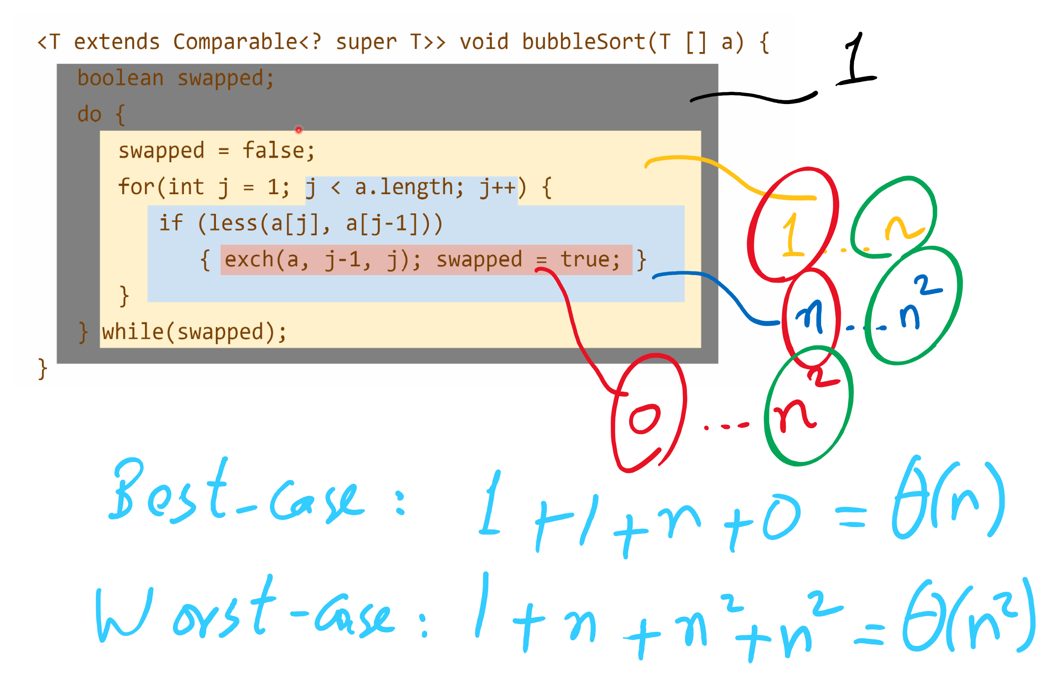
Runtime Modeling

Slide 13
Bubble sort example
SWAPPED!
1
5
3
3
5
3
1
4
1
4
5
4
1
5
10

Slide 14
“Improved” bubble sort
void bubbleSort(Comparable[] a) {
boolean swapped;
int to_sort = a.length;
do {
swapped = false;
for(int j = 1; j < to_sort; j++) {
if (less(a[j], a[j-1]))
{ exch(a, j-1, j); swapped = true; }
}
to_sort--;
} while(swapped);
}
Notes:
grey
t₃
1
yellow
t₂
x (x varies from 0 .. n)
red
t₁
sum i=1 to x (sum j=1 to n-i (1))
= n²/2 - n/2 (assuming x == n)
purple
t₀
y (y varies from 0 .. n²/2 - n/2)

Slide 15
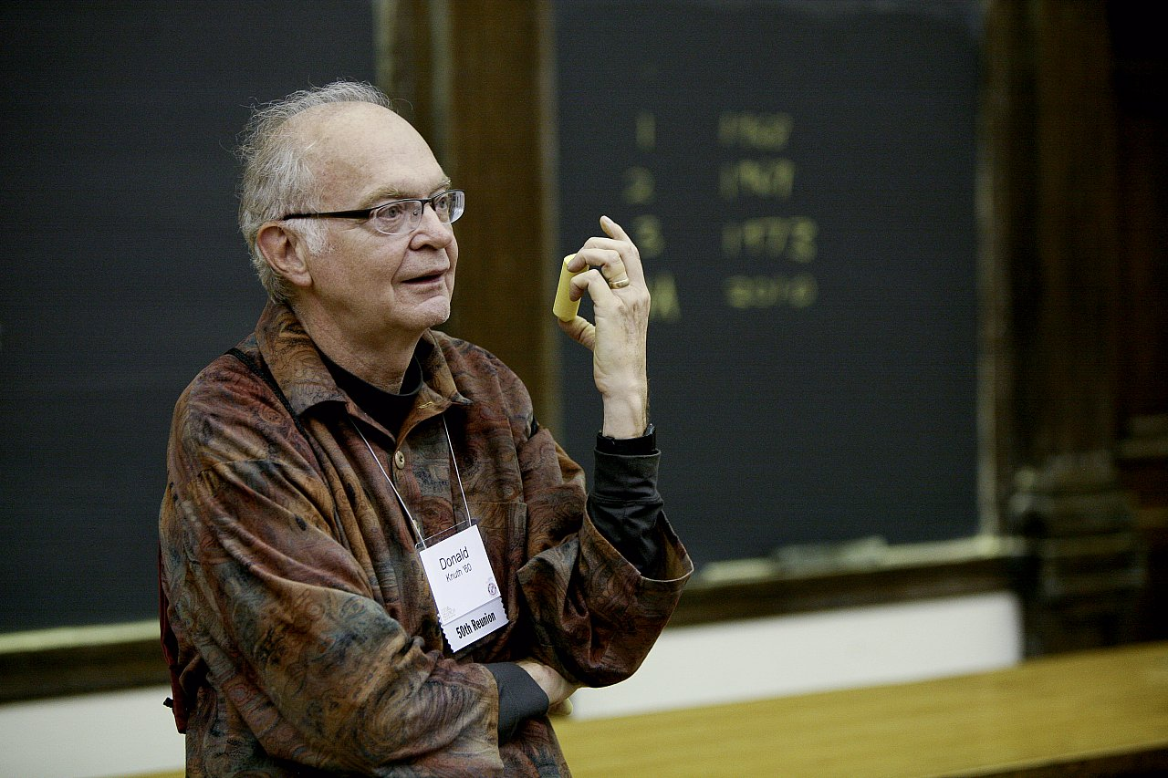
How bad is it?
Runtime:
O(n²)
"[A]lthough the techniques used in the calculations [to analyze the bubble sort] are instructive, the results are disappointing since they tell us that the bubble sort isn't really very good at all."
Donald Knuth
The Art of Computer Programming

Slide 16
Brute-force (or exhaustive) search
Find the solution to a problem by considering all potential solutions and selecting the correct one(s)
Run-time is bounded by the number of potential solutions
n³ potential solutions means cubic run-time
2^{n} potential solutions means exponential run-time

Slide 17
Password cracking
Brute force password attacks depend on the length of the password, hence the insecurity of short passwords
We can view the series of guesses we make as a tree
Each path from root to leaf is an attempted solution

Slide 18
PIN cracking example
Root
0
1
2
...
9
00
01
02
...
09
000
001
002
...
009
0000
0001
0002
...
0009

Slide 19
Search space size
This tree will enumerate 10^{n} different PINs
n is the length of the PIN
So for our case 10⁴ = 10,000 different PINs
Note that this is (for a computer) tiny
What would be a long password for a computer?
Say 128 bits long
2^{n} different passwords
2¹²⁸ = 340282366920938463463374607431768211456
Assuming a supercomputer can check 33860000000000 passwords per second...
And we’ll on average find the correct password after guessing half the possibilities…
We should be able to crack a 128 bit password on our supercomputer in 1.59 x 10¹⁷ years using brute force
Notes:
39-digit number
33 x 10¹²
Not all of those strings contain all valid characters though, so how can we cut down the number of checks?

