Slide 1

Algorithms and Data Structures 2 CS 1501
Fall 2021
Sherif Khattab
ksm73@pitt.edu
(Slides are adapted from Dr. Ramirez’s and Dr. Farnan’s CS1501 slides.)

Slide 2
Announcements
Upcoming deadlines:
2/26: Lab 4 and Homework 5
3/12: Assignment 2
Tophat questions are due one week after each lecture
Midterm OMET Surveys are now open
Midterm Exam on 3/3
3-day time-window to start the exam

Slide 3
Last lecture …
radix search tries
multiway tries

Slide 4
Muddiest points (1/3)
How does search miss approach a better average runtime than search hit
the difference between theta（b) and log N
what does “b” mean in a runtime of theta(b)?
The exact definition of symbol table ADT

Slide 5
Muddiest Points (2/3)
RST
runtime
how to keep track of keys if they are not explicitly stored? Non-null is valid key but which key is it?
what a node of an RST looks like
What the corresponding value of a key actually is
what do you mean we are placing the corresponding value at the leaf in the redix tri insertion? or what does V repersent? does it represent the actual value like 4 or (0100)?
Still a bit confused what it would like when we store values in intermediate nodes of an RST, like what would be in an intermediate node that stores something vs. one that is a normal director node
Storing shorter bit strings in the BST. How do you know to check at an internal node for a value?

Slide 6
Muddiest Points (3/3)
multiway RST
string tries runtime. you lost me on the further analysis slide
analyzing the run time, I didn't understand how did we put the numbers in the log etc.
How R is the branching factor
How to find branching factor
What nodes contain values in a string rst
keeping track of w, log n, b for different structures

Slide 7
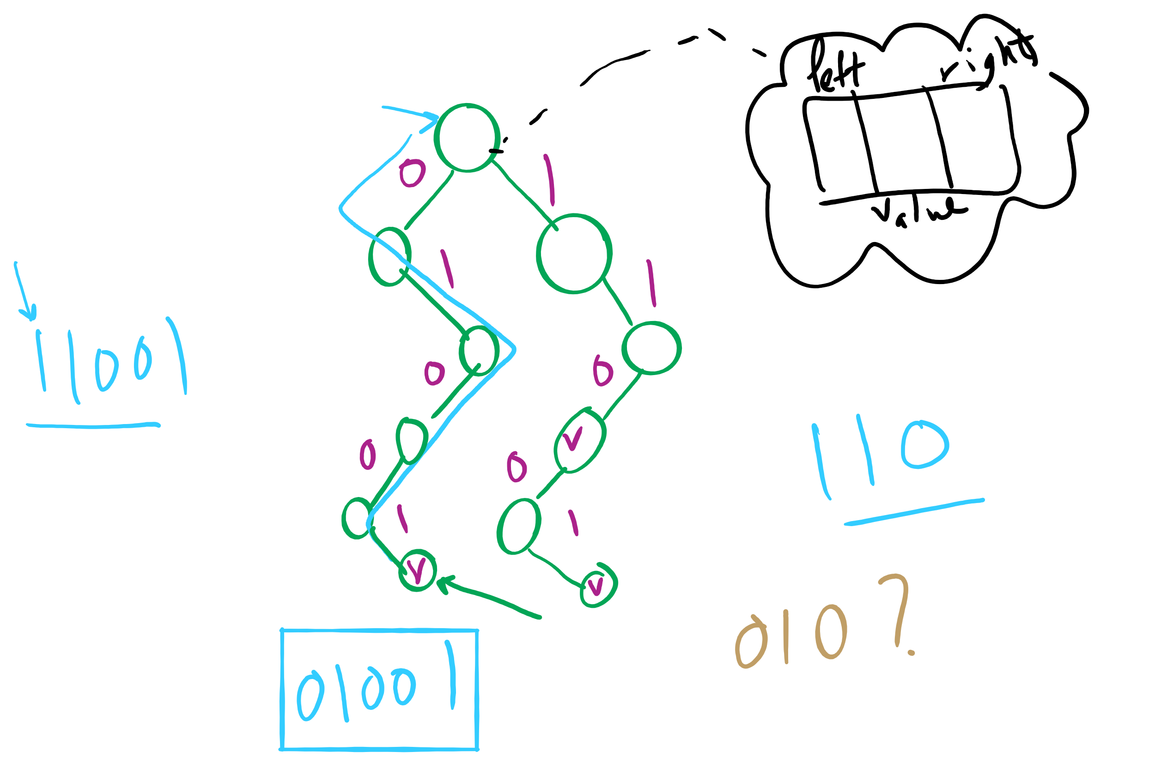
Binary RST

Slide 8
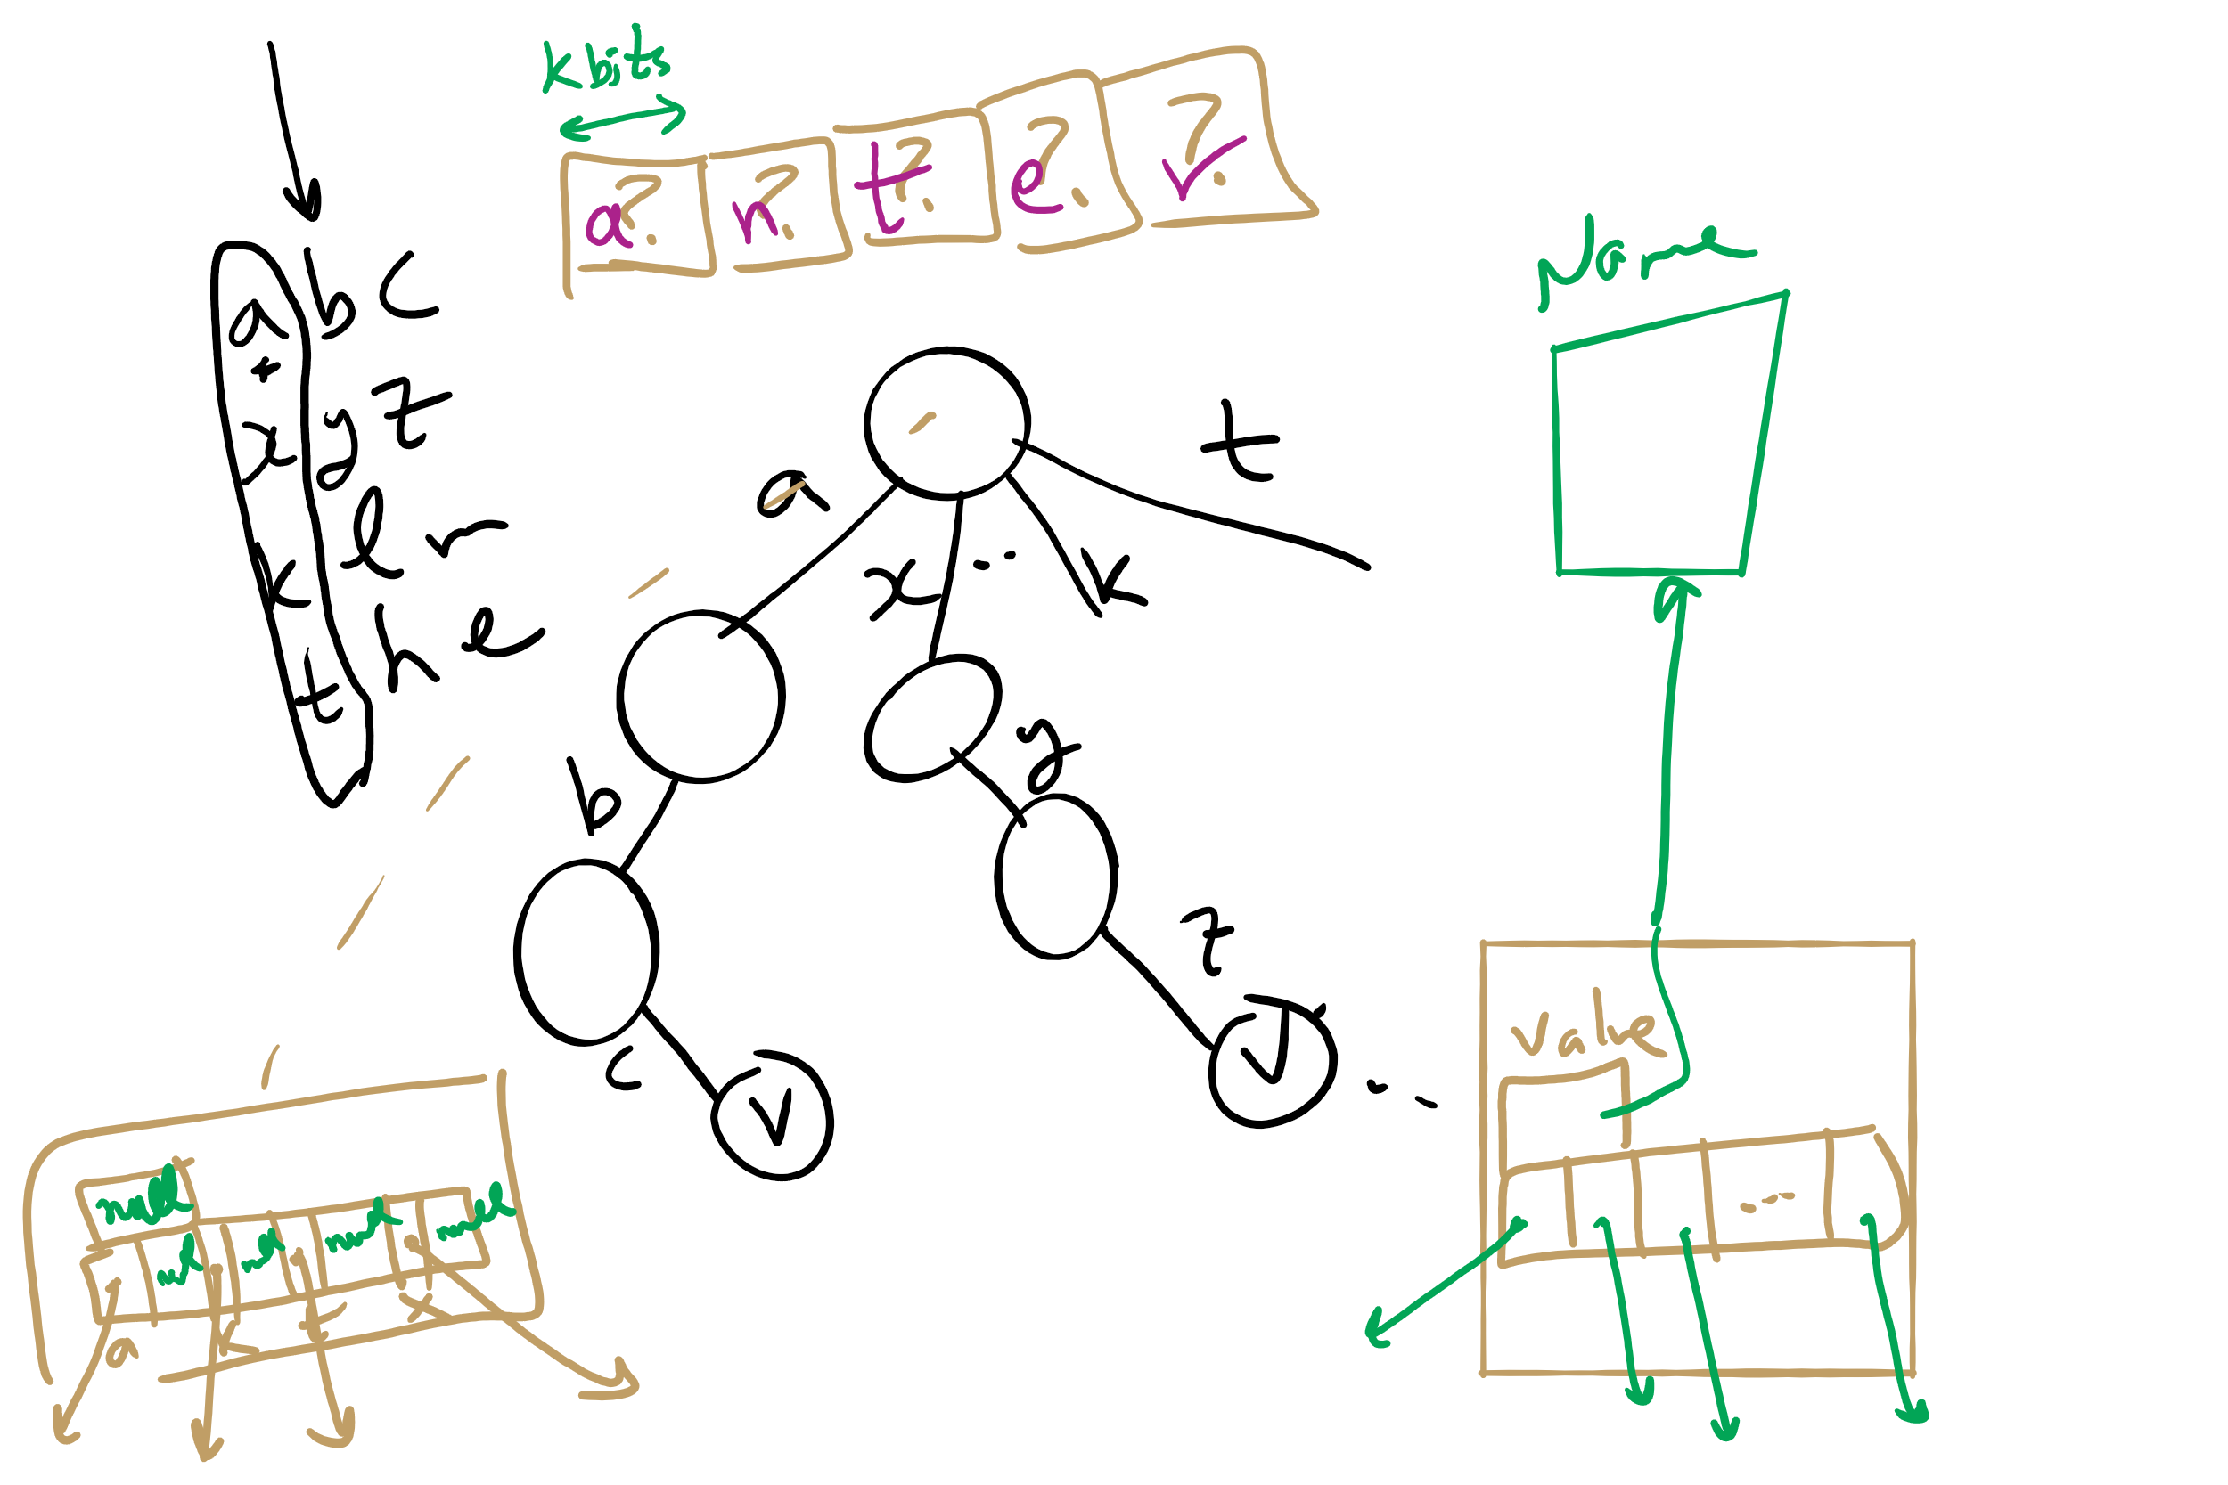
Multi-way RST

Slide 9
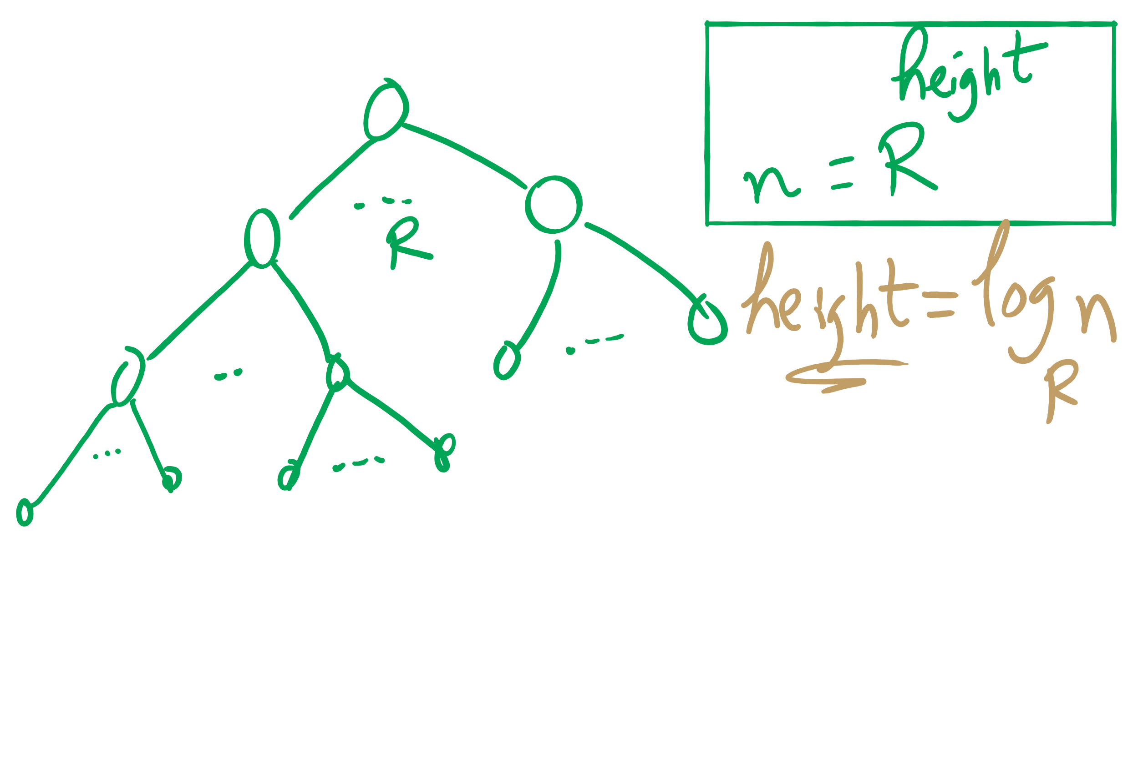
Search Miss

Slide 10
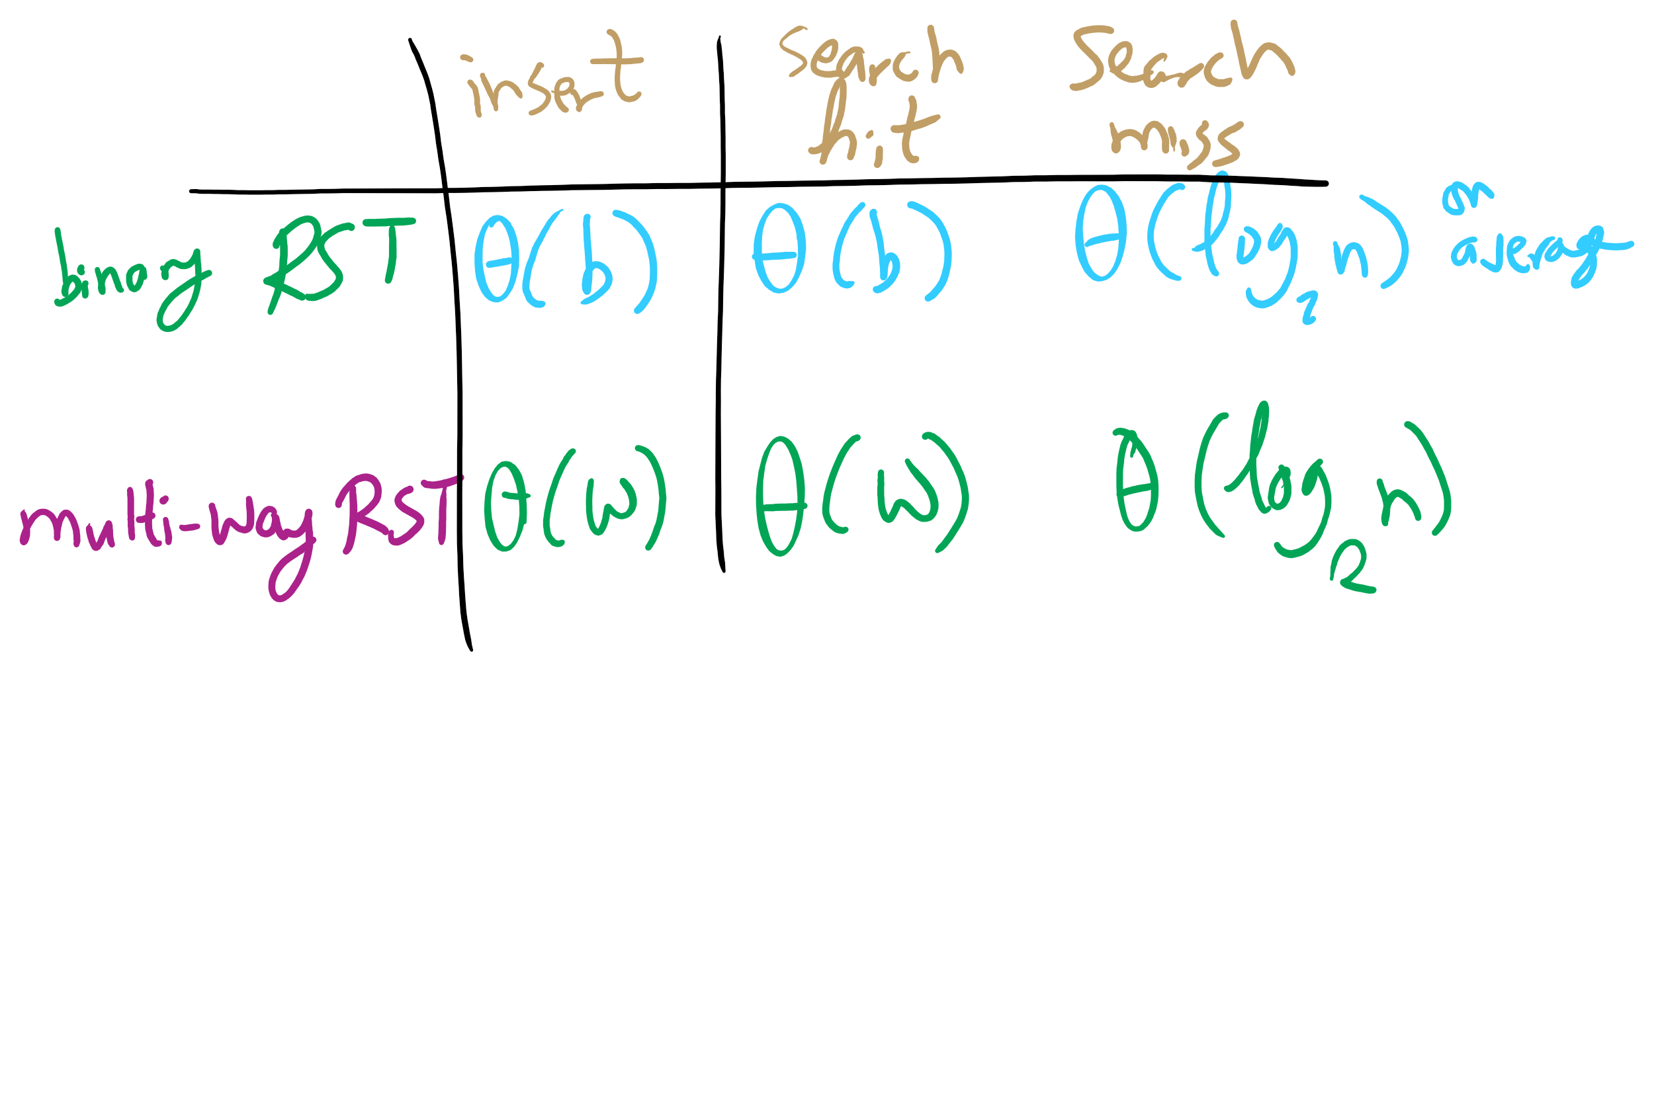
Summary of running time

Slide 11
This Lecture
de la Briandais trees
Introduction to Compression

Slide 12
R-way trie example
Val:
Next
A
B
C
D
E
F
G
H
I
J
K
L
M
N
O
P
Q
R
S
T
U
V
W
X
Y
Z
Val:
Next
A
B
C
D
E
F
G
H
I
J
K
L
M
N
O
P
Q
R
S
T
U
V
W
X
Y
Z
Val:
Next
A
B
C
D
E
F
G
H
I
J
K
L
M
N
O
P
Q
R
S
T
U
V
W
X
Y
Z
Val:
0
Next
A
B
C
D
E
F
G
H
I
J
K
L
M
N
O
P
Q
R
S
T
U
V
W
X
Y
Z
Val:
Next
A
B
C
D
E
F
G
H
I
J
K
L
M
N
O
P
Q
R
S
T
U
V
W
X
Y
Z
Val:
1
Next
A
B
C
D
E
F
G
H
I
J
K
L
M
N
O
P
Q
R
S
T
U
V
W
X
Y
Z

Slide 13
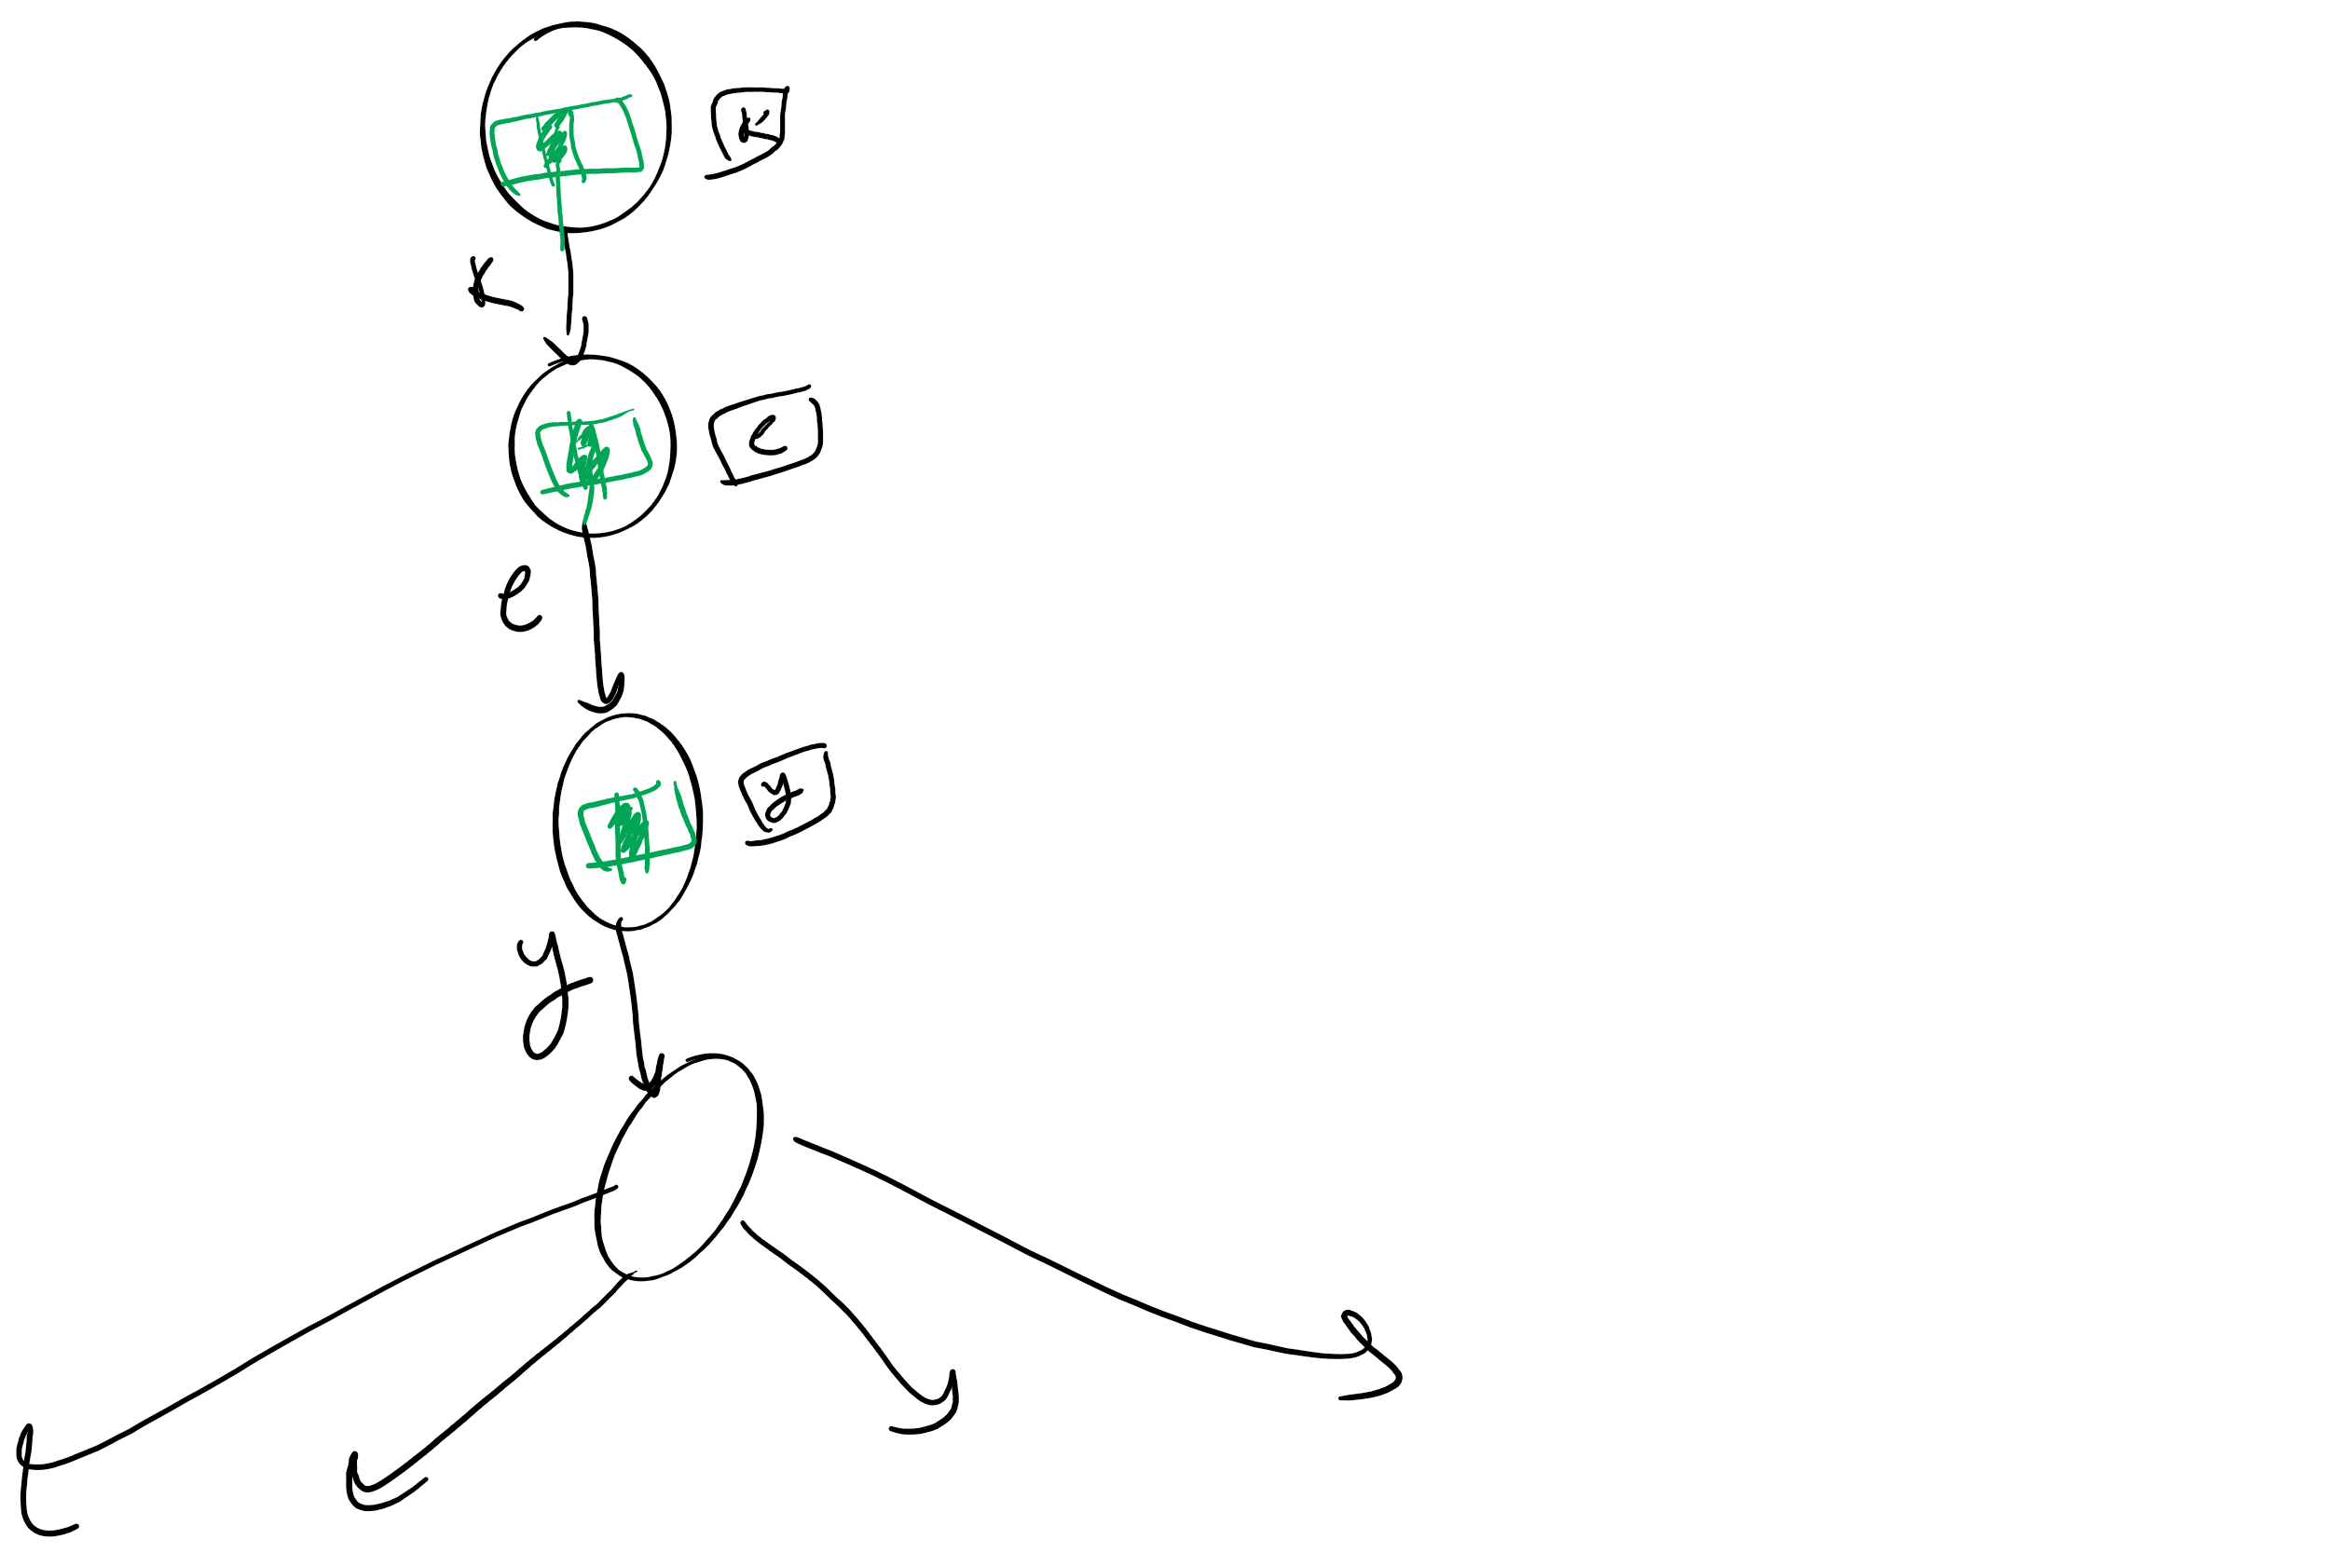
So what’s the catch?
Space!
Considering 8-bit ASCII, each node contains 2⁸ references!
This is especially problematic as in many cases, alot of this space is wasted
Common paths or prefixes for example, e.g., if all keys begin with “key”, thats 255*3 wasted references!
At the lower levels of the trie, most keys have probably been separated out and reference lists will be sparse

Slide 14
De La Briandais tries (DLBs)
Replace the .next array of the R-way trie with a linked-list

Slide 15
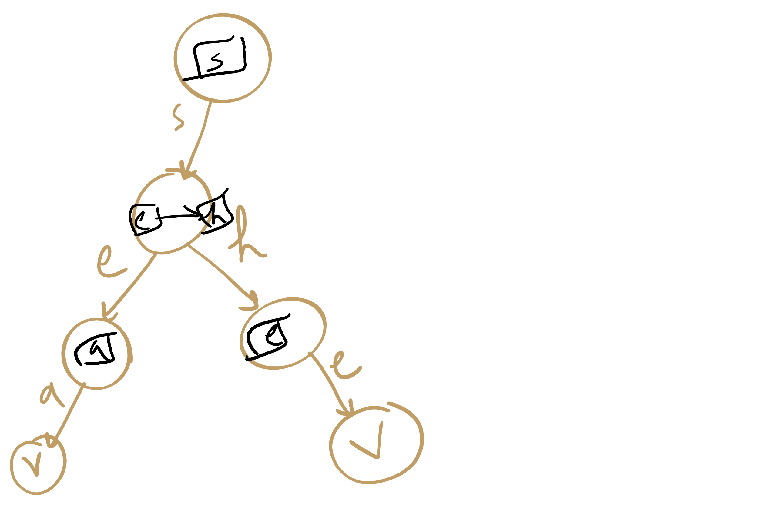
DLB Example

Slide 16
DLB Example 2
S
B
T
H
E
Y
H
E
L
A
^
E
^
L
L
^
^
L
S
S
^
^
Notes:
note here we use explicit termination character vs value check, can do either though

Slide 17
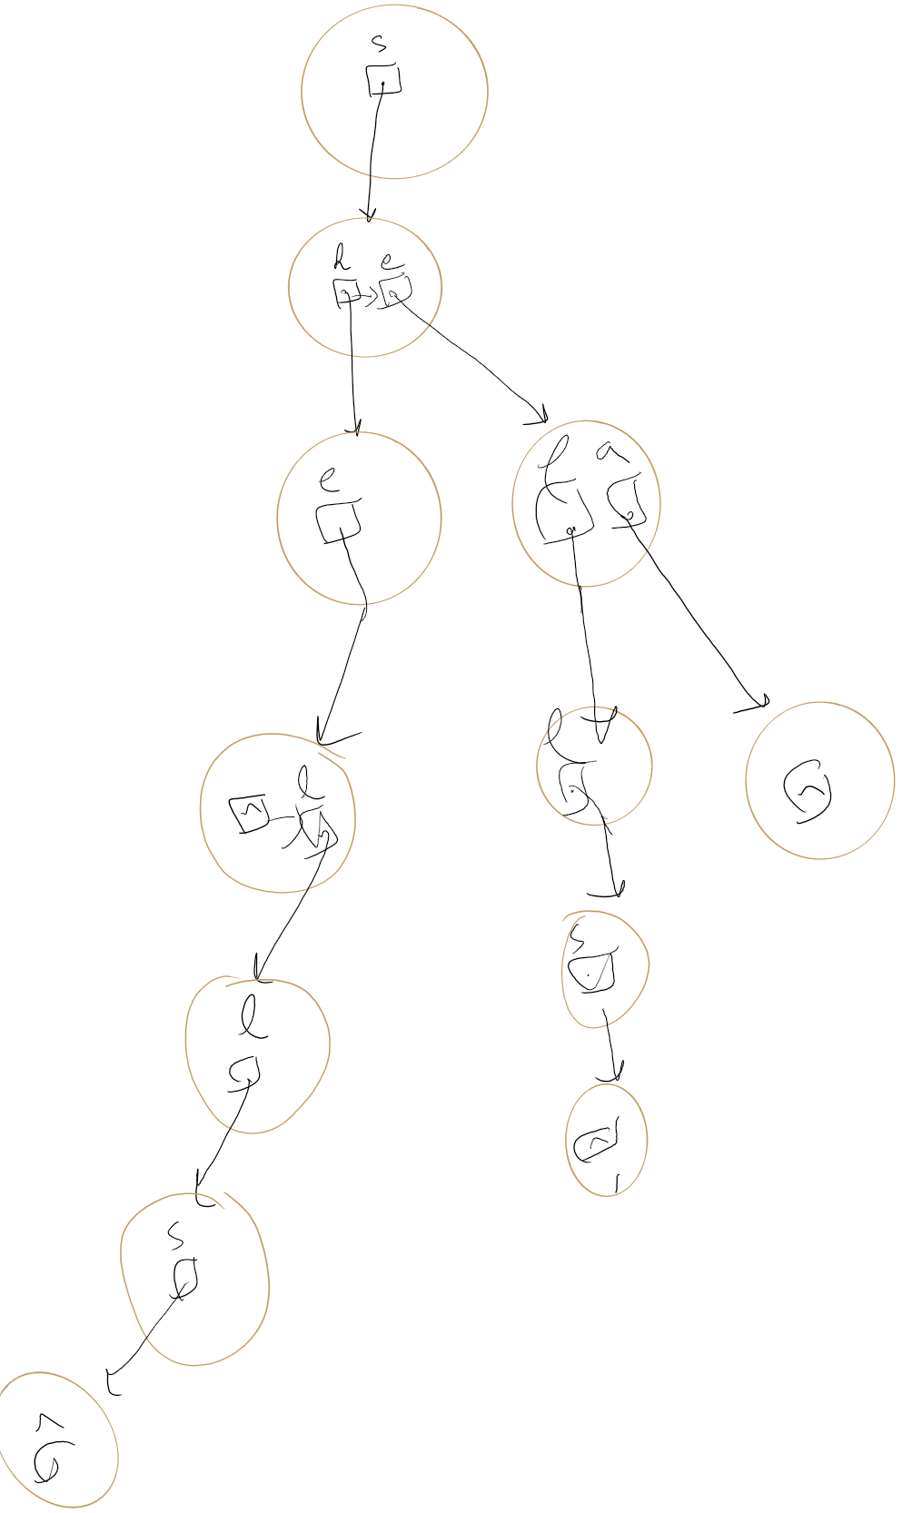
DLB Example 2

Slide 18
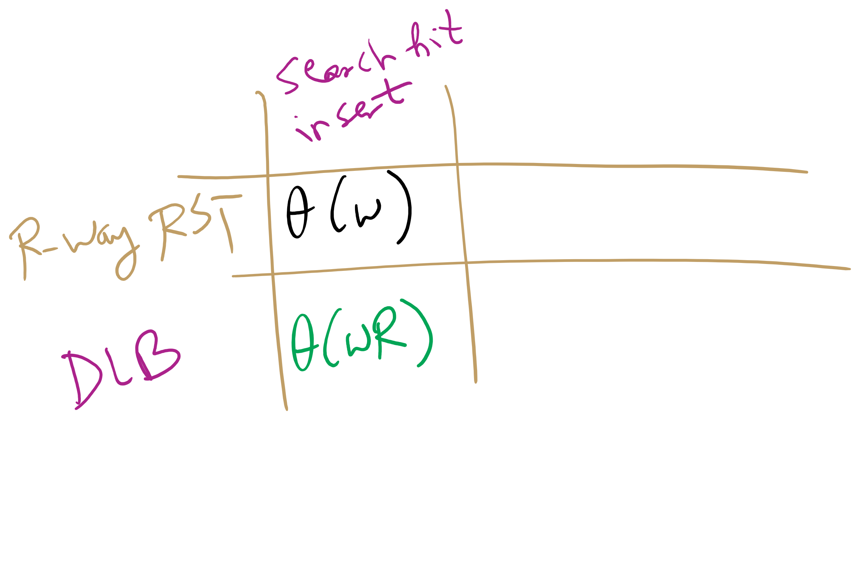
DLB analysis
How does DLB performance differ from R-way tries?
Which should you use?
Notes:
Differences:
No wasted space!
But search/insert are now Θ(wR)
In the worst case, we have to iterate through all R characters in the alphabet for each node
When to use one over another?
For implementations with alot of sparse nodes are expected, use a DLB
Runtime will still be close to Θ(w) for sparse nodes
For dense nodes, stick with R-way tries
If most of the alphabet is a valid reference for most nodes, you won’t get a whole lot of space savings with DLBs

Slide 19
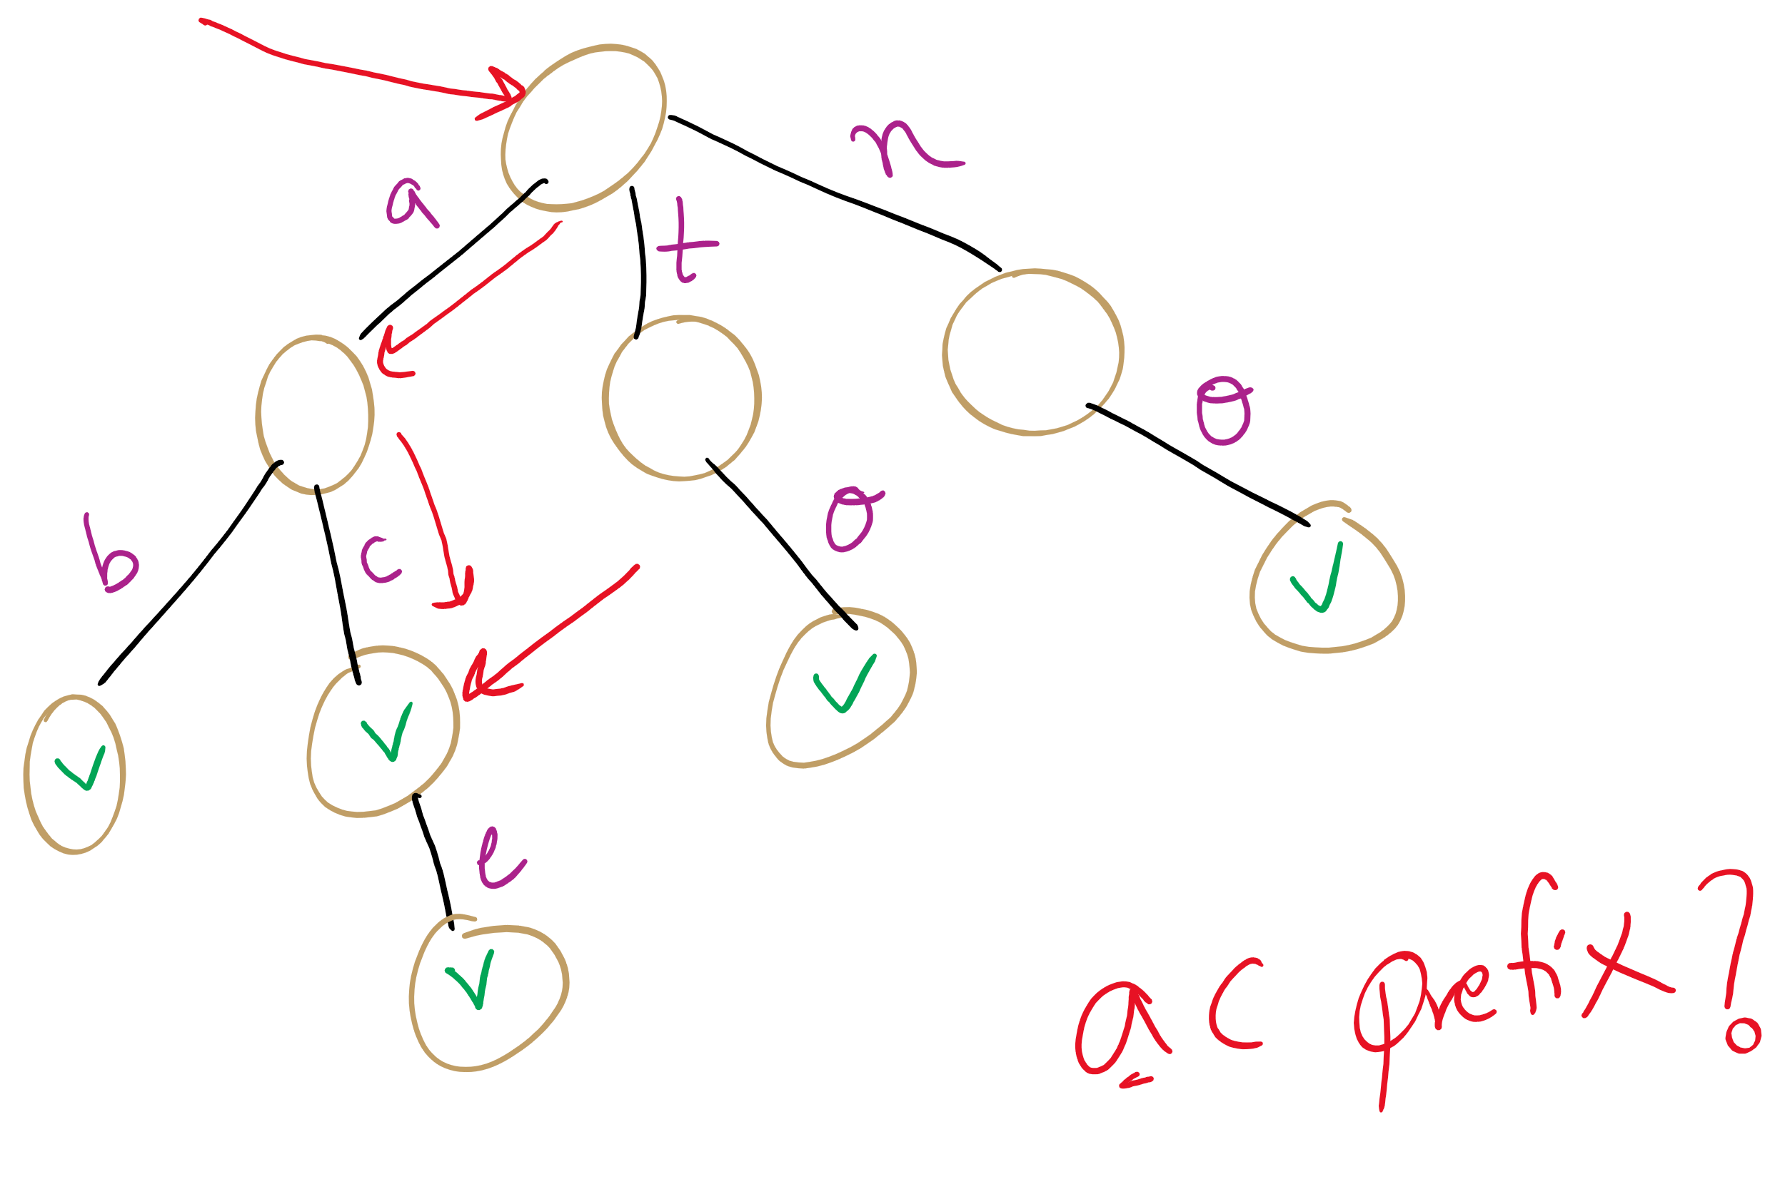
Searching
So far we’ve continually assumed each search would only look for the presence of a whole key
What about if we wanted to know if our search term was a prefix to a valid key?
Notes:
What structures would be amenable to this? Why?
Can implement another function that doesn’t require a non-null val, just a path through the entire key string
Are two functions really needed?
Could write a single function that returns 4 values
Word/prefix not found
Found as a prefix only, not a valid key
Found as a valid key, not a prefix to anything else
Found as a valid key, also a prefix

Slide 20
Final notes on Search Tree/Tries
We did not present an exhaustive look at search trees/tries, just the sampling that we’re going to focus on
Many variations on these techniques exist and perform quite well in different circumstances
Ternary search Tries
R-way tries without 1-way branching
See the table at the end of Section 5.2 of the text

Slide 21
What is compression?
Represent the “same” data using less storage space
Can get more use out a disk of a given size
Can get more use out of memory
E.g., free up memory by compressing inactive sections
Faster than paging
Built in to OSX Mavericks and later
Can reduce the amount of data transmitted
Faster file transfers
Cut power usage on mobile devices
Two main approaches to compression...

Slide 22
Lossy Compression
D
Compress
C
Expand
D’
Information is permanently lost in the compression process
Examples:
MP3, H264, JPEG
With audio/video files this typically isn’t a huge problem as human users might not be able to perceive the difference

Slide 23
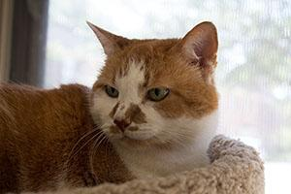

Lossy examples
MP3
“Cuts out” portions of audio that are considered beyond what most people are capable of hearing
JPEG
40K
28K

Slide 24
Lossless Compression
D
Compress
C
Expand
D
Input can be recovered from compressed data exactly
Examples:
zip files, FLAC
Notes:
differences? anecdotally, a 600MB cd compresses to ~80MB mp3 and ~250MB flac

Slide 25
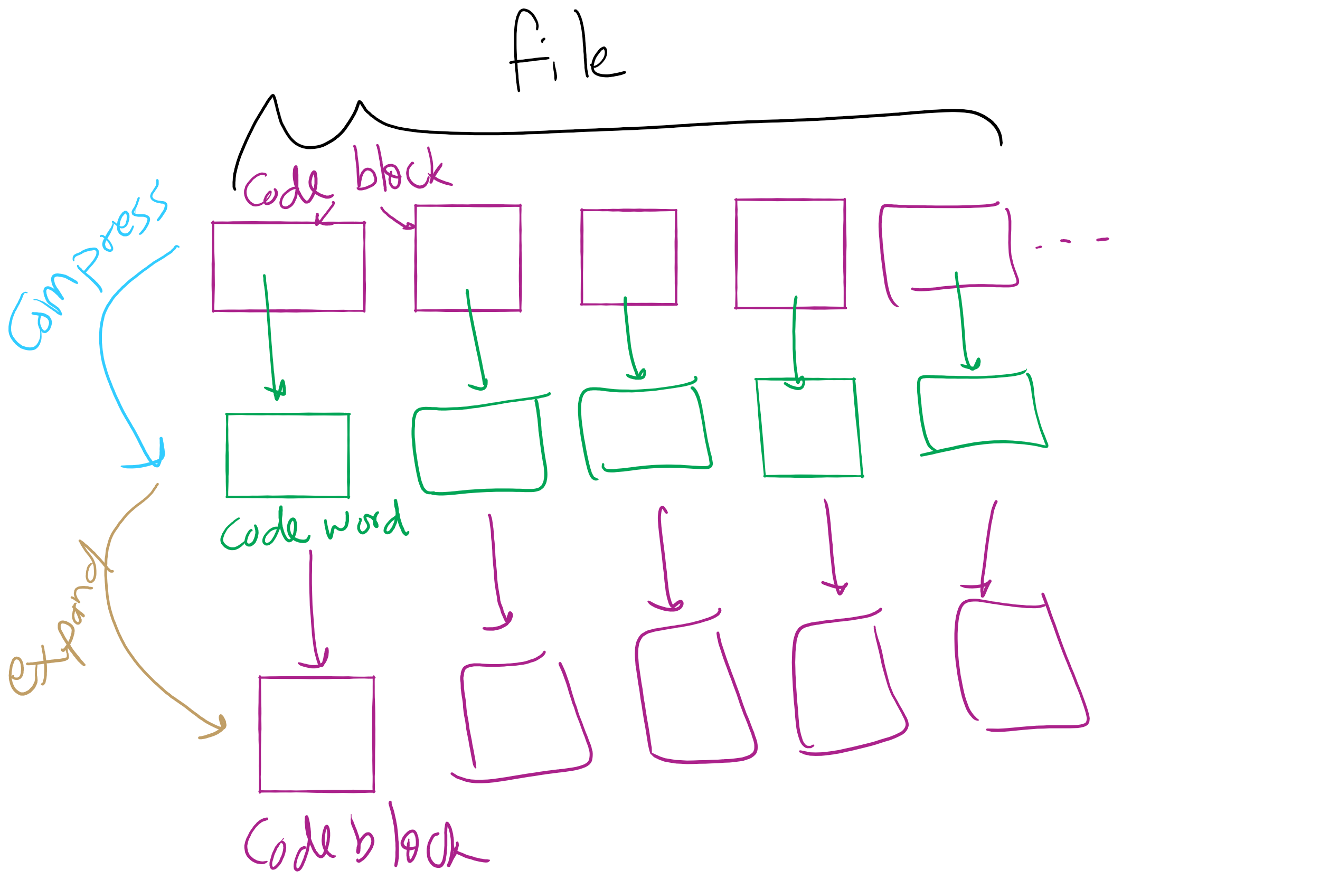
Lossless Compression Framework

Slide 26
Huffman Compression
Works on arbitrary bit strings, but pretty easily explained using characters
Consider the ASCII character set
Essentially blocks of codes
In general, to fit R potential characters in a block, you need lg R bits of storage per block
Consequently, n bits storage blocks represent 2^{n} characters
Each 8 bit code block represents one of 256 possible characters in extended ASCII
Easy to encode/decode

Slide 27
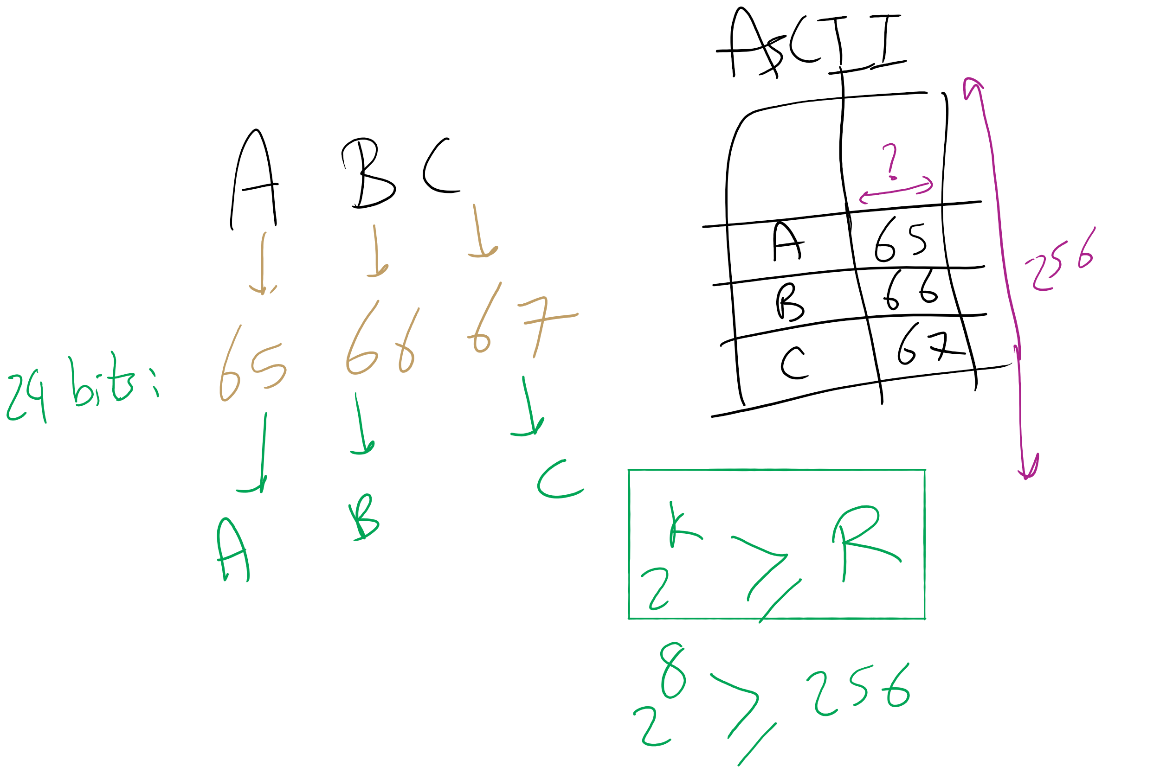
ASCII Encoding

