Slide 1

Algorithms and Data Structures 2 CS 1501
Fall 2021
Sherif Khattab
ksm73@pitt.edu
(Slides are adapted from Dr. Ramirez’s and Dr. Farnan’s CS1501 slides.)

Slide 2
Announcements
Upcoming deadlines:
3/5: Lab 5 and Homework 6
3/12: Assignment 2
Tophat questions are due one week after each lecture
Midterm Exam open today around 5:00 pm until 3/6 at 11:59 pm.
3-day time-window to start the exam
open-book and open-notes
75 minutes
Practice midterm

Slide 3
Last lecture …
Huffman Compression

Slide 4
Muddiest points
Binary I/O
usage and purpose of the buffer
How to express a Trie as a bit string
writing/retereiving the binary code for compression
connecting the dots in the huffman encoding tree
isn't it very inefficient to use a whole function call per bit write?
Really hope there could be some review for midterm. At least go through the old questions if possible, please.
When to use RST vs DLB
Huffman compression code
Where is the division between the tree and the compression
huffman decompression
choosing lowest weighted trees
Constructing the "trie" from Huffman compression
why array is used for encoding & RST for decoding

Slide 5
This Lecture
Huffman Compression (contd.)
Run-length encoding

Slide 6
Binary I/O
private static void writeBit(boolean bit) { // add bit to buffer buffer <<= 1; if (bit) buffer |= 1; // if buffer is full (8 bits), write out as a single byte N++; if (N == 8) clearBuffer();
}
writeBit(true);
writeBit(false);
????????
???????0
???????1
??????10
?????100
?????101
????1010
???10100
??101000
?1010000
10100000
10100001
buffer:
00000000
writeBit(true);
writeBit(false);
writeBit(false);
0
1
2
3
4
5
6
7
8
writeBit(false);
N:
0
writeBit(false);
writeBit(true);

Slide 7
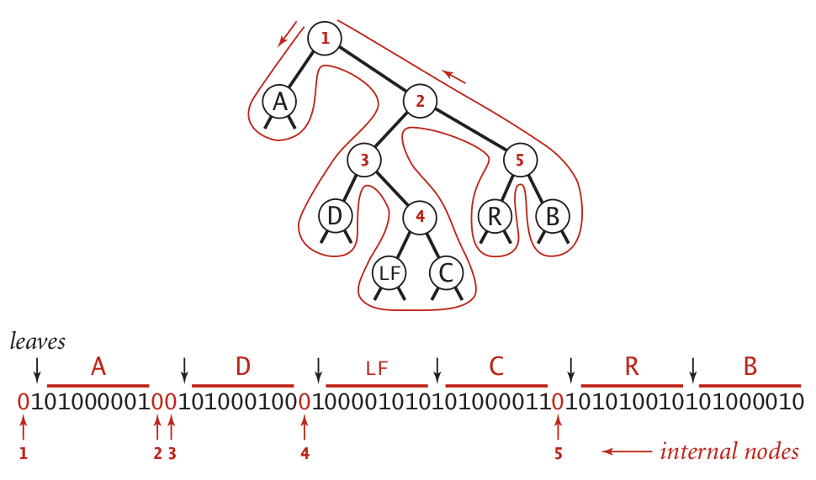
Representing tries as bitstrings

Slide 8
Binary I/O
private static void writeTrie(Node x){
if (x.isLeaf()) {
BinaryStdOut.write(true);
BinaryStdOut.write(x.ch);
return;
}
BinaryStdOut.write(false);
writeTrie(x.left);
writeTrie(x.right);
}
private static Node readTrie() {
if (BinaryStdIn.readBoolean())
return new Node(BinaryStdIn.readChar(), 0, null, null);
return new Node('\0', 0, readTrie(), readTrie());
}
Notes:
tracing through to verify that this code works is left as an exercise to the students

Slide 9
Huffman pseudocode
Encoding approach:
Read input
Compute frequencies
Build trie/codeword table
Write out trie as a bitstring to compressed file
Write out character count of input
Use table to write out the codeword for each input character
Decoding approach:
Read trie
Read character count
Use trie to decode bitstring of compressed file

Slide 10
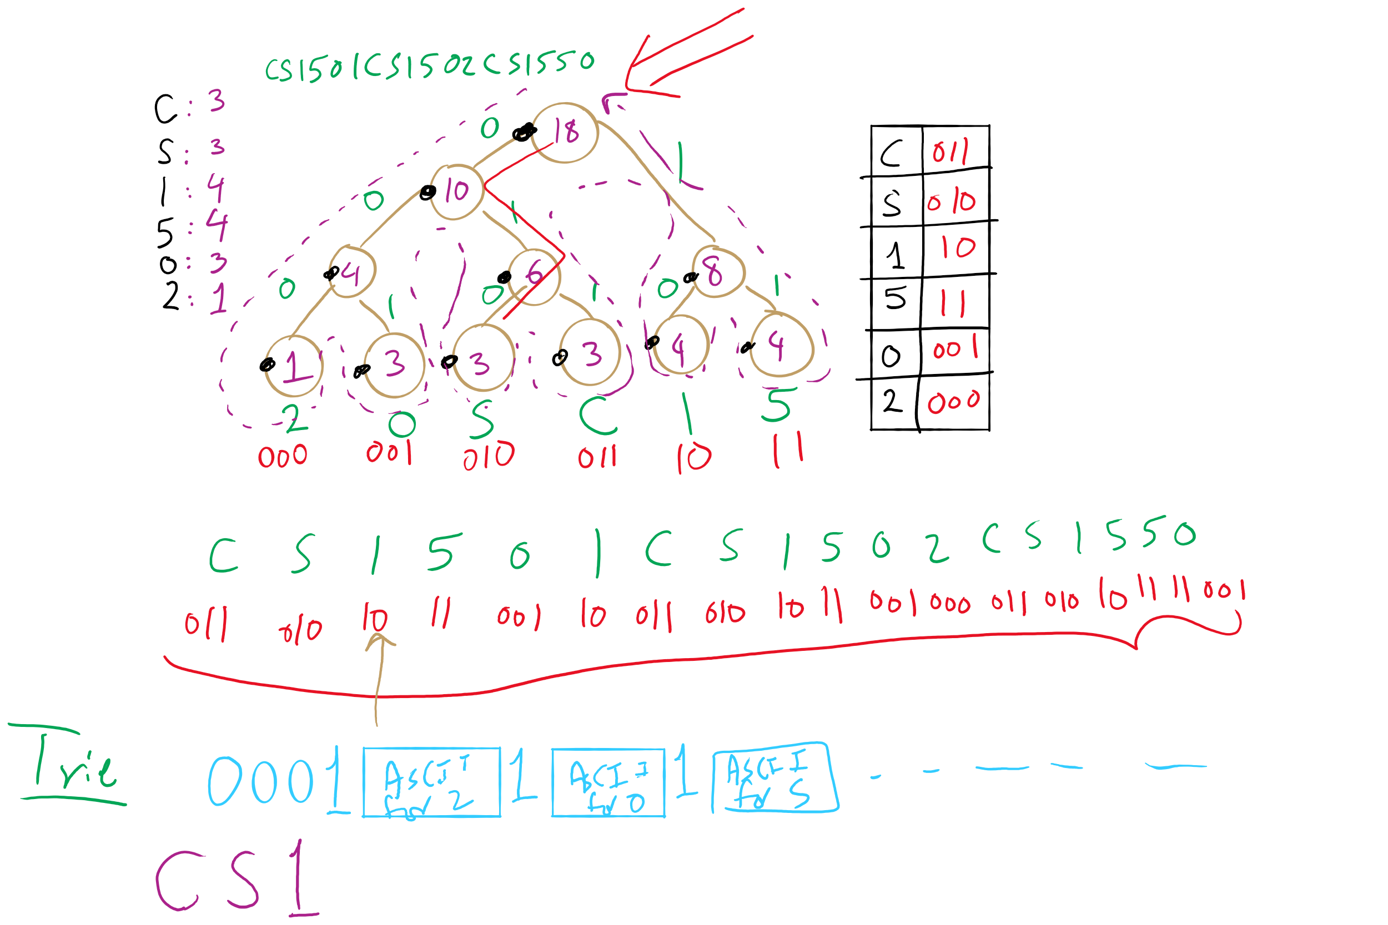
Huffman Compression Example

Slide 11
How do we determine character frequencies?
Option 1: Preprocess the file to be compressed
Upside: Ensure that Huffman’s algorithm will produce the best output for the given file
Downsides:
Requires two passes over the input, one to analyze frequencies/build the trie/build the code lookup table, and another to compress the file
Trie must be stored with the compressed file, reducing the quality of the compression
This especially hurts small files
Generally, large files are more amenable to Huffman compression
Just because a file is large, however, does not mean that it will compress well!

Slide 12
How do we determine character frequencies?
Option 2: Use a static trie
Analyze multiple sample files, build a single tree that will be used for all compressions/expansions
Saves on trie storage overhead…
But in general not a very good approach
Different character frequency characteristics of different files means that a code set/trie that works well for one file could work very poorly for another
Could even cause an increase in file size after “compression”!

Slide 13
How do we determine character frequencies?
Option 3: Adaptive Huffman coding
Single pass over the data to construct the codes and compress a file with no background knowledge of the source distribution
Not going to really focus on adaptive Huffman in the class, just pointing out that it exists...

Slide 14
Ok, so how good is Huffman compression
ASCII requires 8m bits to store m characters
For a file containing c different characters
Given Huffman codes {h₀, h₁, h₂, …, h_{(c-1)}}
And frequencies {f₀, f₁, f₂, …, f_{(c-1)}}
Sum from 0 to c-1: |h_{i}|* f_{i}
Total storage depends on the differences in frequencies
The bigger the differences, the better the potential for compression
Huffman is optimal for character-by-character prefix-free encodings
Proof in Propositions T and U of Section 5.5 of the text

Slide 15
That seems like a bit of a caveat...
Where does Huffman fall short?
What about repeated patterns of multiple characters?
Consider a file containing:
1000 A’s
1000 B’s
…
1000 of every ASCII character
Will this compress at all with Huffman encoding?
Nope!
But it seems like it should be compressible...

Slide 16
Run length encoding
Could represent the previously mentioned string as:
1000A1000B1000C, etc.
Assuming we use 10 bits to represent the number of repeats, and 8 bits to represent the character…
4608 bits needed to store run length encoded file
vs. 2048000 bits for input file
Huge savings!
Note that this incredible compression performance is based on a very specific scenario…
Run length encoding is not generally effective for most files, as they often lack long runs of repeated characters

