Slide 1

Algorithms and Data Structures 2 CS 1501
Fall 2021
Sherif Khattab
ksm73@pitt.edu
(Slides are adapted from Dr. Ramirez’s and Dr. Farnan’s CS1501 slides.)

Slide 2
Announcements
Upcoming deadlines:
3/12: Assignment 2, Lab 6, and Homework 7
Tophat questions are due one week after each lecture
Women in Data Science Conference
http://www.stat.cmu.edu/wids/

Slide 3
Last lecture …
Compression
LZW
Theoretical limits

Slide 4
Muddiest points (1/2)
LZW
benefit
How LZW chooses what string each iteration
what are the numbers that we're adding to the 2nd column of the LZW table
how exactly are lzw expansion vs compresion different?
more explanation about corner case
What exactly is a corner case?
how lzw expansion solves the issue of being one step ahead of compression
does expansion always has one step later than compression?
When exactly to use huffman compression over lzw
lzw expansion
when it is ahead of compression
trade off of longer/shorter code word size
variable width codewords
how it's possible to start with a fixed length codeword and gradually increase the size of it
increase in size of the codebook

Slide 5
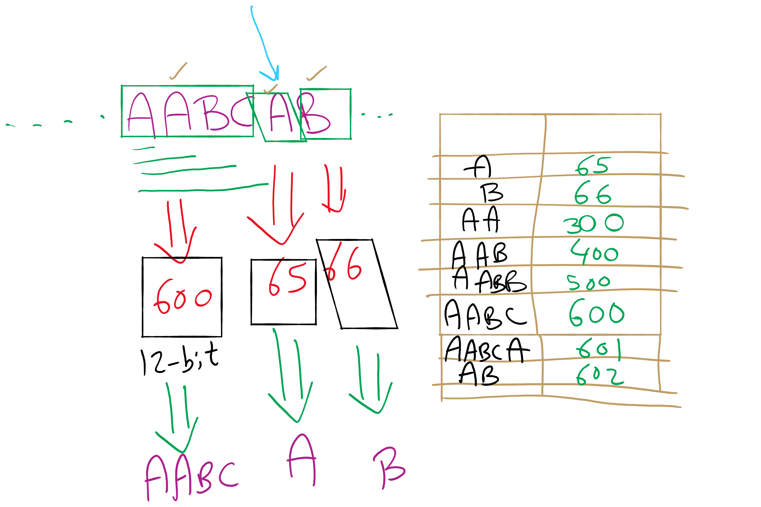
LZW Example

Slide 6
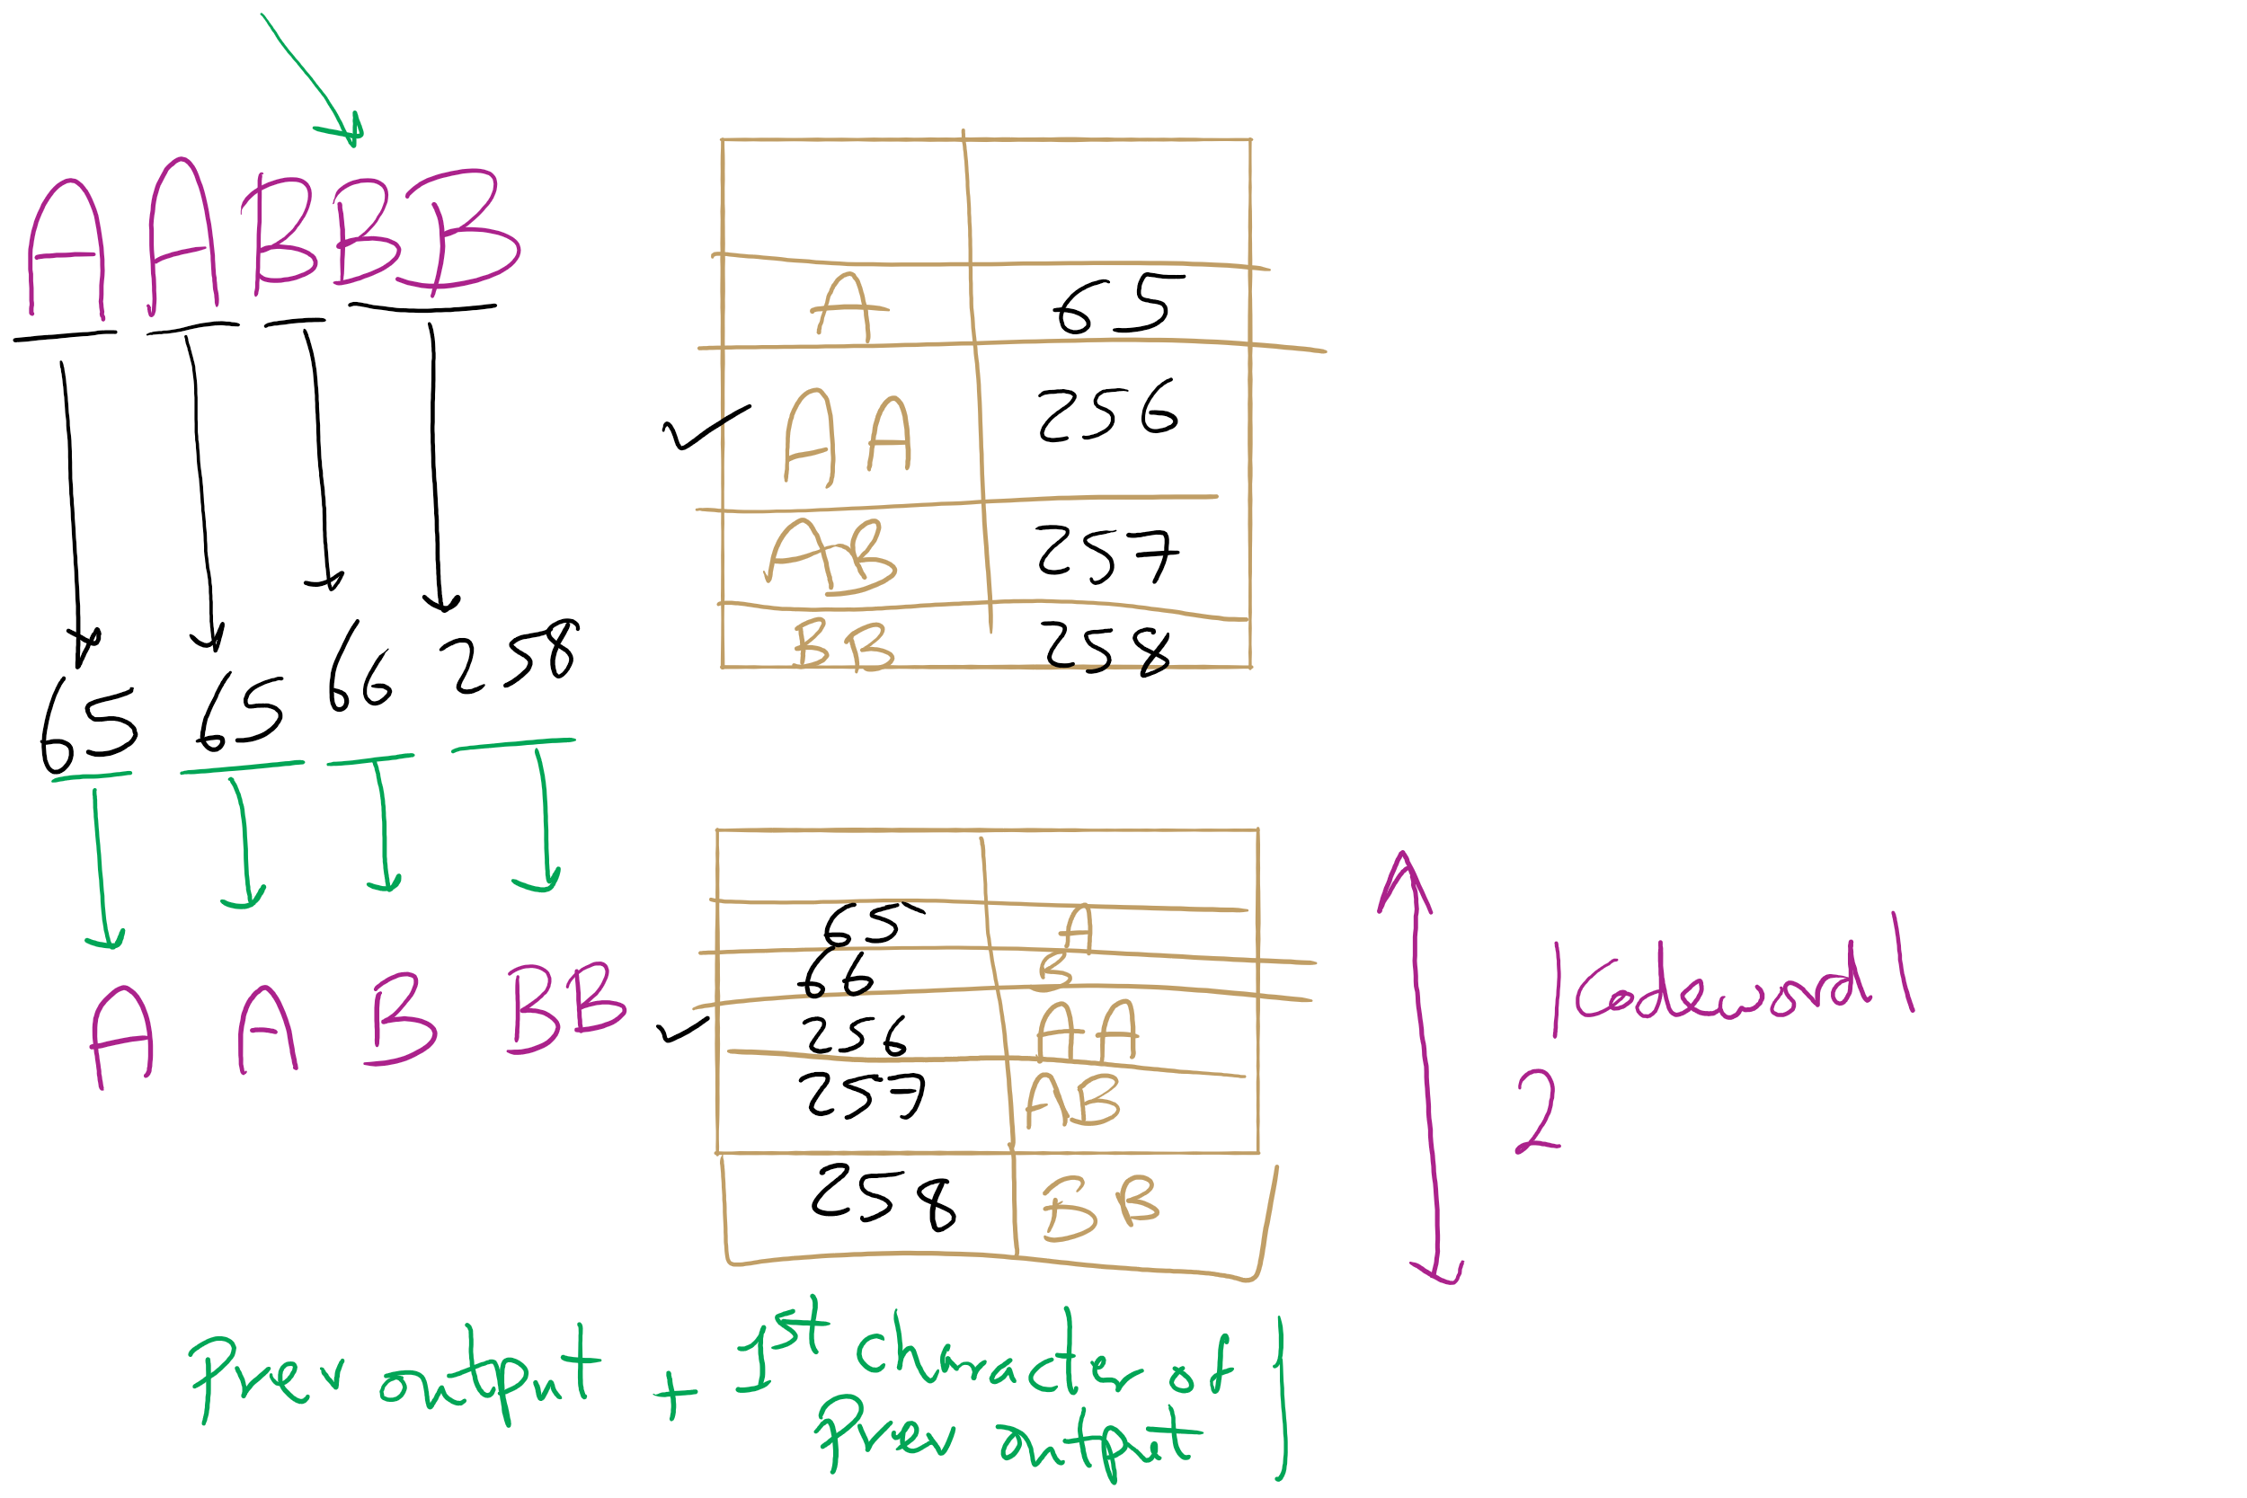
LZW Corner Case

Slide 7
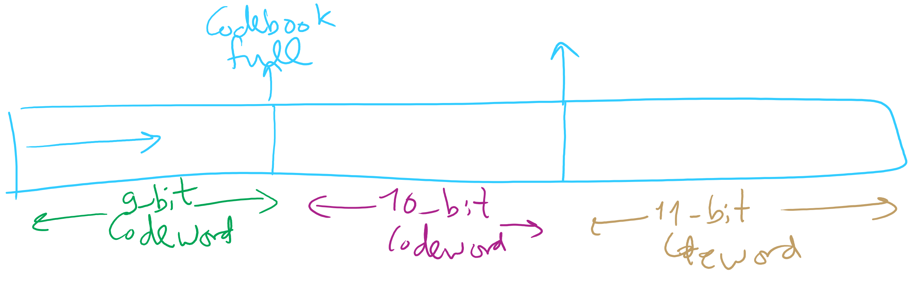
Adaptive Codeword Size

Slide 8
Muddiest points (2/2)
Entropy
Can you elaborate on the Entropy equation?
Talking about the upper limits of compressing a file, how does quantum computing and qubits come in to play? Will they allow us to surpass our file compression limits?
lab6 second TODO (probably bc I know almost nothing abt hash tables)
deflate

Slide 9
This Lecture
Shannon Entropy
Graphs

Slide 10
Information theory in a single slide...
Founded by Claude Shannon in his paper “A Mathematical Theory of Communication”
Entropy is a key measure in information theory
Slightly different from thermodynamic entropy
A measure of the unpredictability of information content
By losslessly compressing data, we represent the same information in less space
Hence, 8 bits of uncompressed text has less entropy than 8 bits of compressed data
Notes:
1948

Slide 11
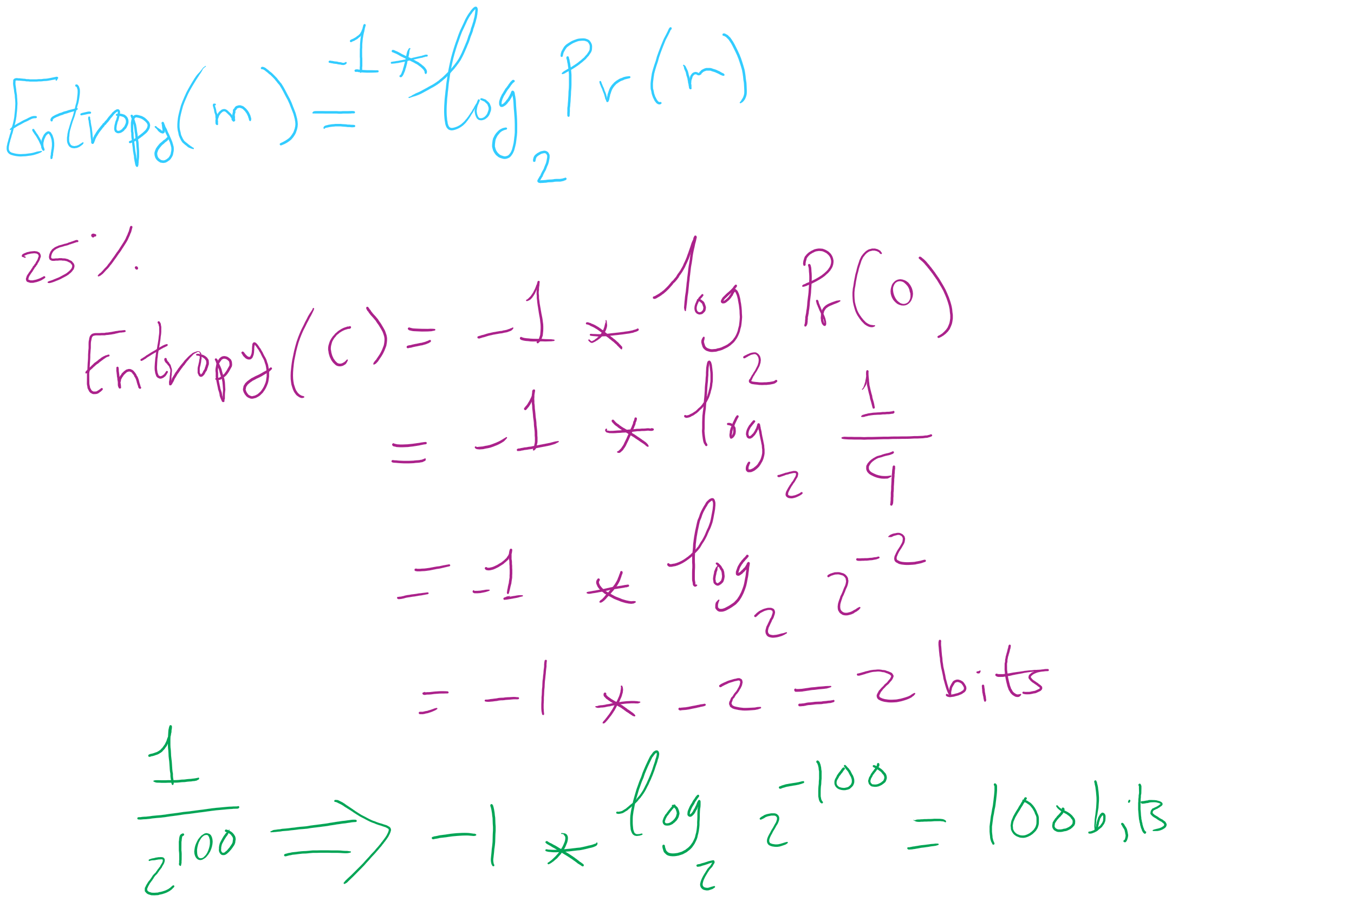
Entropy Equation

Slide 12
Entropy applied to language:
Translating a language into binary, the entropy is the average number of bits required to store a letter of the language
Entropy of a message * length of message = amount of information contained in that message
On average, a lossless compression scheme cannot compress a message to have more than 1 bit of information per bit of compressed message
Uncompressed, English has between 0.6 and 1.3 bits of entropy per character of the message

Slide 13
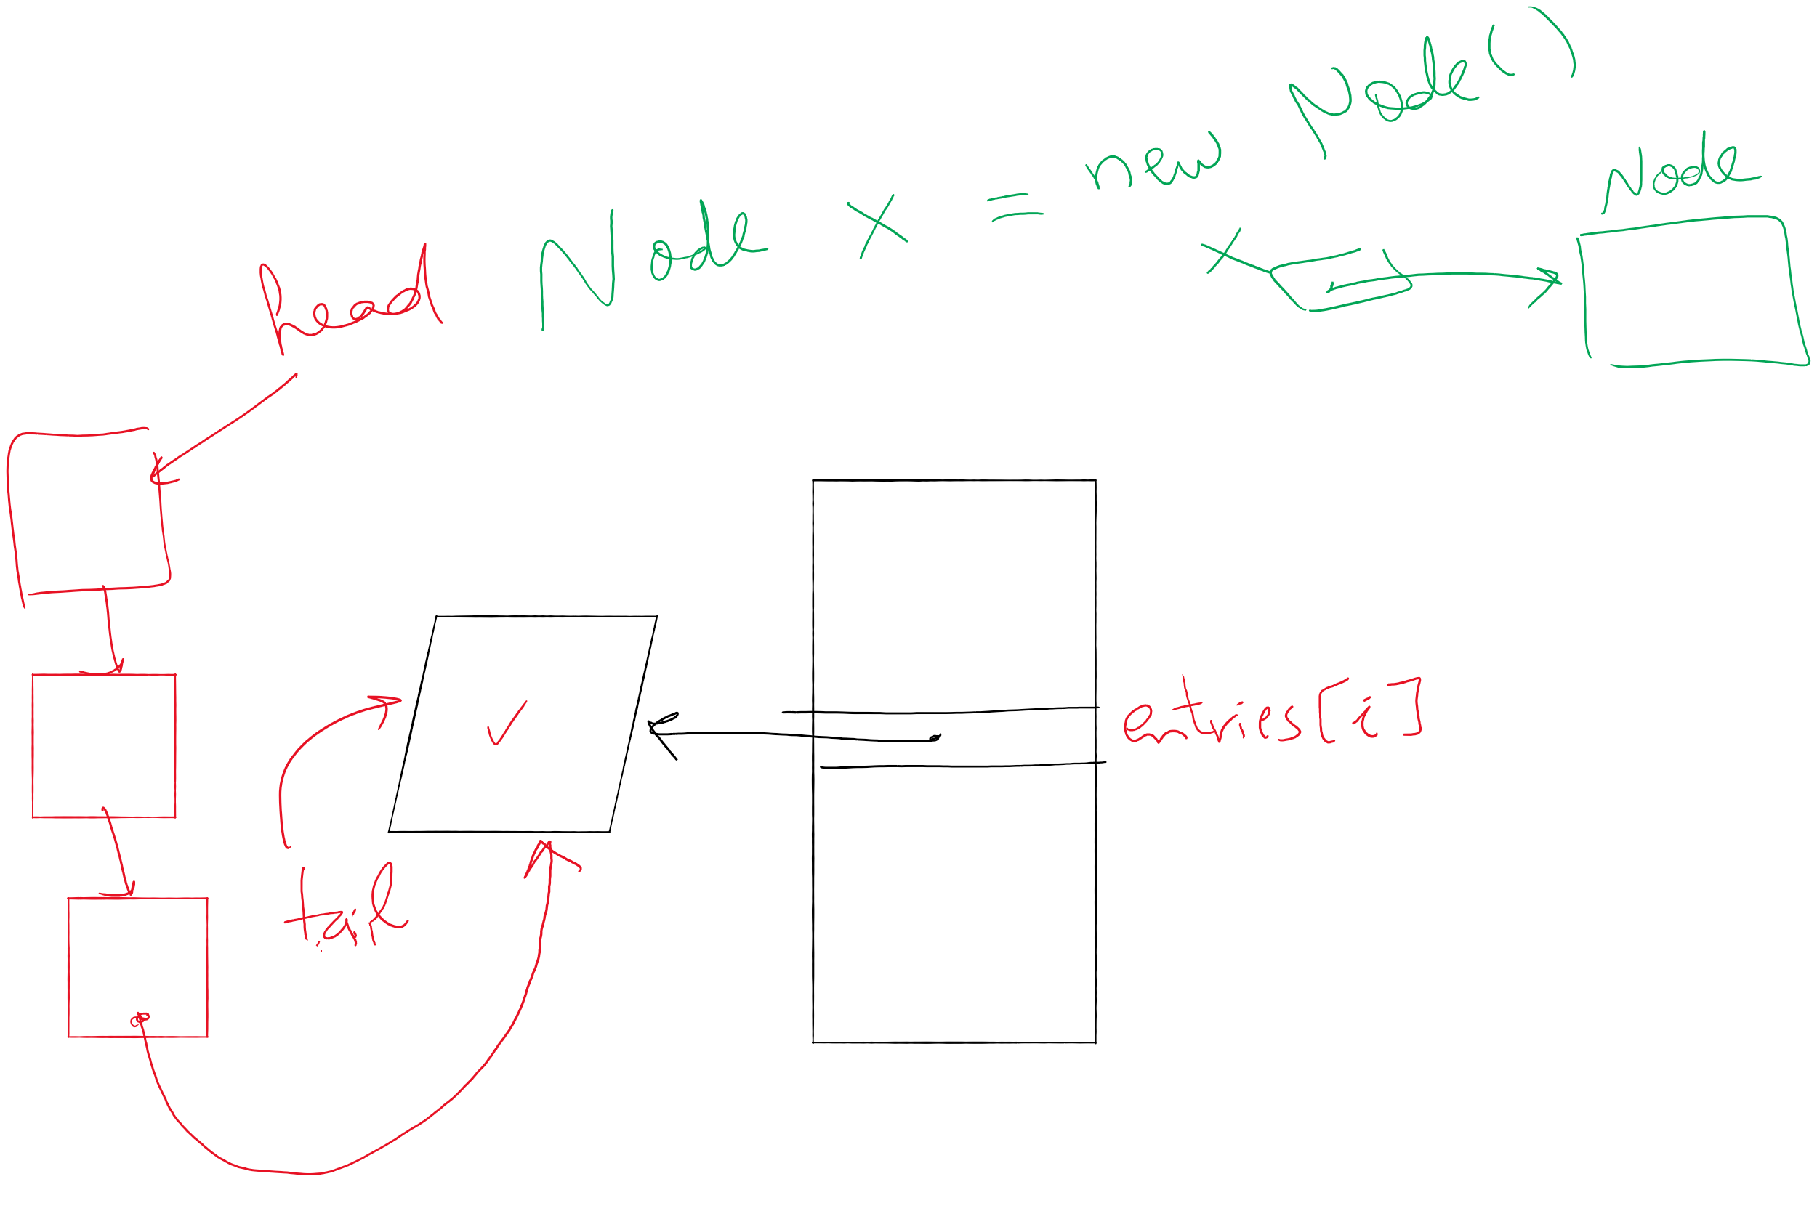
Lab 6

Slide 14



A final note on compression evaluation
"Weissman scores" are a made-up metric for Silicon Valley (TV)
Notes:
first: Prof. Tsachy (Itschak) Weissman (Stanford Dept. of EE)
second: Vinith Misra, advised by Weissman while getting his PhD from Stanford, now at IBM
Misra was a technical advisor to silicon valley team, made the shows technical contributions seem like something experts could watch a powerpoint on and buy

Slide 15
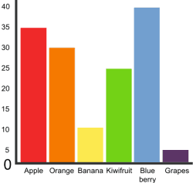
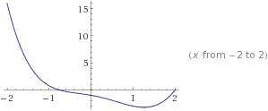
Graphs!
5
3
4
0
2
1

Slide 16
Graphs
A graph G = (V, E)
Where V is a set of vertices
E is a set of edges connecting vertex pairs
Example:
V = {0, 1, 2, 3, 4, 5}
E = {(0, 1), (0, 4), (1, 2), (1, 4), (2, 3), (3, 4), (3, 5)}
5
3
4
0
2
1

Slide 17
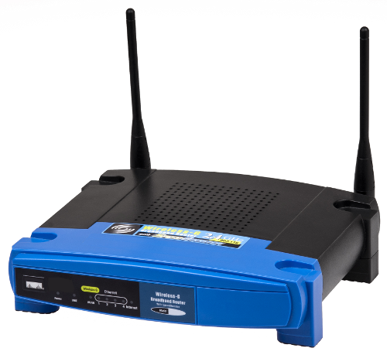
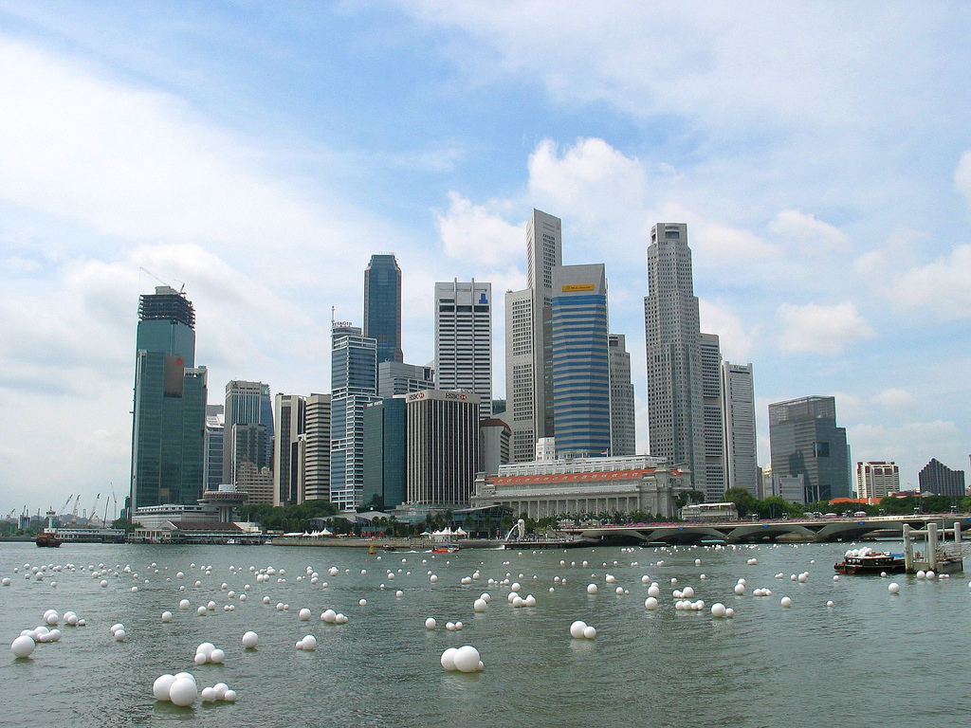
Why?
Can be used to model many different scenarios

Slide 18
Some definitions
Undirected graph
Edges are unordered pairs: (A, B) == (B, A)
Directed graph
Edges are ordered pairs: (A, B) != (B, A)
Adjacent vertices, or neighbors
Vertices connected by an edge

Slide 19
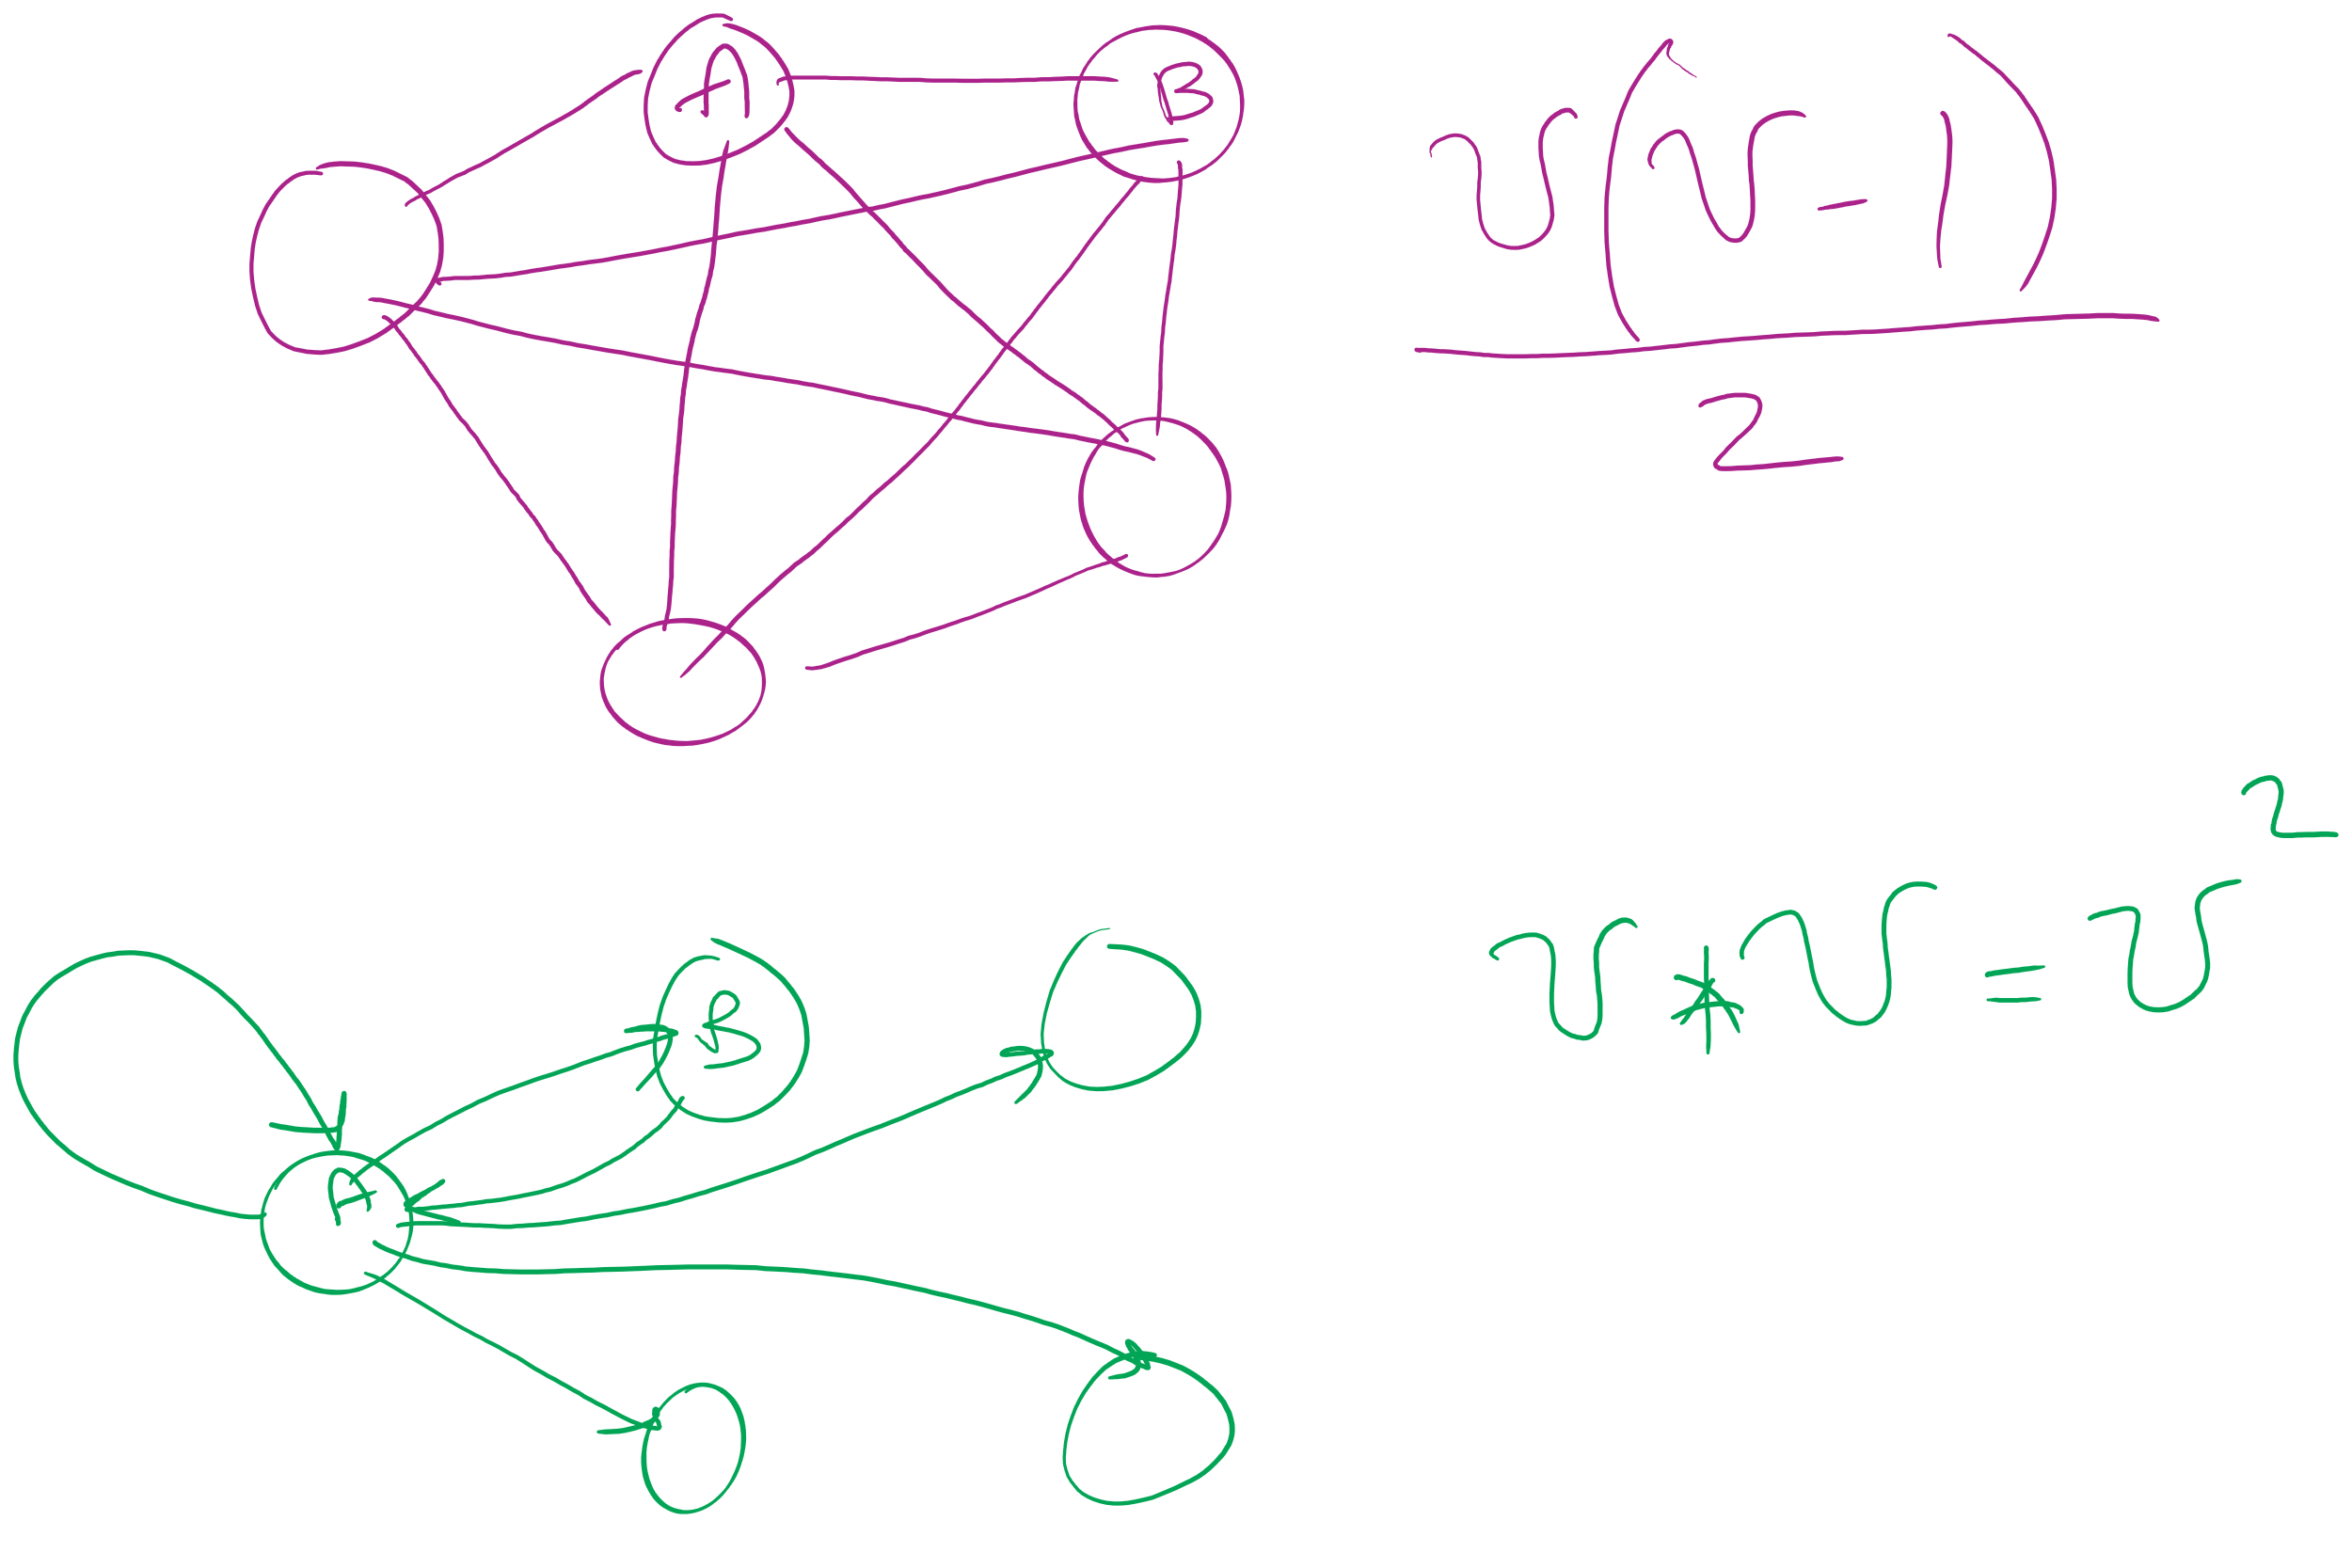
Graph sizes
Let v = |V|, and e = |E|
Given v, what are the minimum/maximum sizes of e?
Minimum value of e?
Definition doesn’t necessitate that there are any edges…
So, 0
Maximum of e?
Depends…
Are self edges allowed?
Directed graph or undirected graph?
In this class, we'll assume directed graphs have self edges while undirected graphs do not
Notes:
directed (w/ self edges)
v vertices each with edges to v vertices
v²
undirected (no self edges)
v vertices with edges to v-1 vertices
BUT remember for undirected, (1, 2) == (2, 1)
v(v - 1) / 2
(v² - v) / 2

Slide 20
More definitions
A graph is considered sparse if:
e <= v lg v
A graph is considered dense as it approaches the maximum number of edges
I.e., e == MAX - ε
A complete graph has the maximum number of edges
Notes:
v² - ε for directed
((v² - v) / 2) - ε for undirected
Have we seen “sparse” and dense before?
yes -- with tries, for sparse tries DLB is better; for dense, R-way tries are better

Slide 21
Question:
5
5
==
or
!=
3
4
4
3
0
0
2
1
1
2
?
Notes:
Different spatial representations of the same vertices/edges are considered the same graph

Slide 22
Representing graphs
Trivially, graphs can be represented as:
List of vertices
List of edges
Performance?
Assume we're going to be analyzing static graphs
I.e., no insert and remove
So what operations should we consider?
Notes:
We haven’t talked about problems to solve yet, but can you imagine tasks you might want to do with graphs?

Slide 23
Using an adjacency matrix
Rows/columns are vertex labels
M[i][j] = 1 if (i, j) ∈ E
M[i][j] = 0 if (i, j) ∉ E
 | 0 | 1 | 2 | 3 | 4 | 5
0 | 0 | 1 | 0 | 0 | 1 | 0
1 | 1 | 0 | 1 | 0 | 1 | 0
2 | 0 | 1 | 0 | 1 | 0 | 0
3 | 0 | 0 | 1 | 0 | 1 | 1
4 | 1 | 1 | 0 | 1 | 0 | 0
5 | 0 | 0 | 0 | 1 | 0 | 0

Slide 24
Adjacency matrix analysis
Runtime?
Space?
Notes:
Time:
Check edge existence in Θ(1)
Θ(v) to find the neighbors of a vertex
Θ(v²) time to initialize
Space:
Θ(v²) memory
Regardless of |E|

Slide 25
Adjacency lists
Array of neighbor lists
A[i] contains a list of the neighbors of vertex i
0
1
2
3
4
5
1
0
1
2
0
3
4
2
3
4
1
4
5
3

Slide 26
Adjacency list analysis
Runtime?
Space?
Notes:
Time:
Θ(d) to check edge existence/find the neighbors of a vertex
Where d is the degree of a vertex
# of neighbors
Can be up to Θ(v) to check edge existence/find the neighbors of a vertex
Space:
Θ(v + e) memory
Plus overhead of node use
Could be much less than v²

Slide 27
Comparison
Where would we want to use adjacency lists vs adjacency matrices?
What about the list of vertices/list of edges approach?
Notes:
Adjacency matrix is better for dense graphs
Adjacency list is better for sparse graphs
Lists approach is bad
Aside from not storing redundant edge info for undirected graphs, worse than adj list

