Slide 1

Algorithms and Data Structures 2 CS 1501
Fall 2021
Sherif Khattab
ksm73@pitt.edu
(Slides are adapted from Dr. Ramirez’s and Dr. Farnan’s CS1501 slides.)

Slide 2
Announcements
Upcoming deadlines:
3/19: Lab 7 and Homework 8
Tophat questions are due one week after each lecture

Slide 3
Last lecture …
Shannon Entropy
Graph
definitions
representation

Slide 4
Muddiest points (1/2)
Graph representation
if you have a matrix how do you know if it’s undirected or directed? will it always be undirected or do you just have to see if it’s reflected
Implementation of directed vs undirected graphs in adjacency lists.
how a directed graph would work in an adjacency list
Adjacency list analysis
will the runtimes of the adjacency list and matrix be different for a directed graph
Review on the cases where Adjacency lists are better than adjacency matrices.
Are the FSMs and Turing Machines we learn in 1502 examples/subtypes of graphs and am I correct in saying that they are directed graphs because of the states and the transitions?
What are the benefits of adjacent lists over the matrix?
the different runtimes for determining if two vertices are neighbors vs. retrieving a list of neighbors
Runtime bounds of adjacency lists (feel like both ops are omega(1) & O(e)?)
why the space of adjacency list is theta(v+e) instead of theta(v+2e)? I think there are 2e nodes.

Slide 5
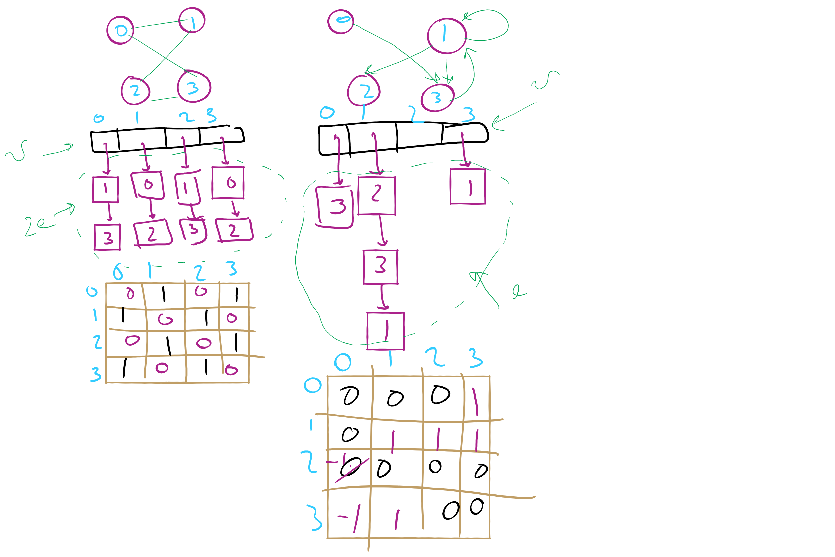
Graph Representation Example 1

Slide 6
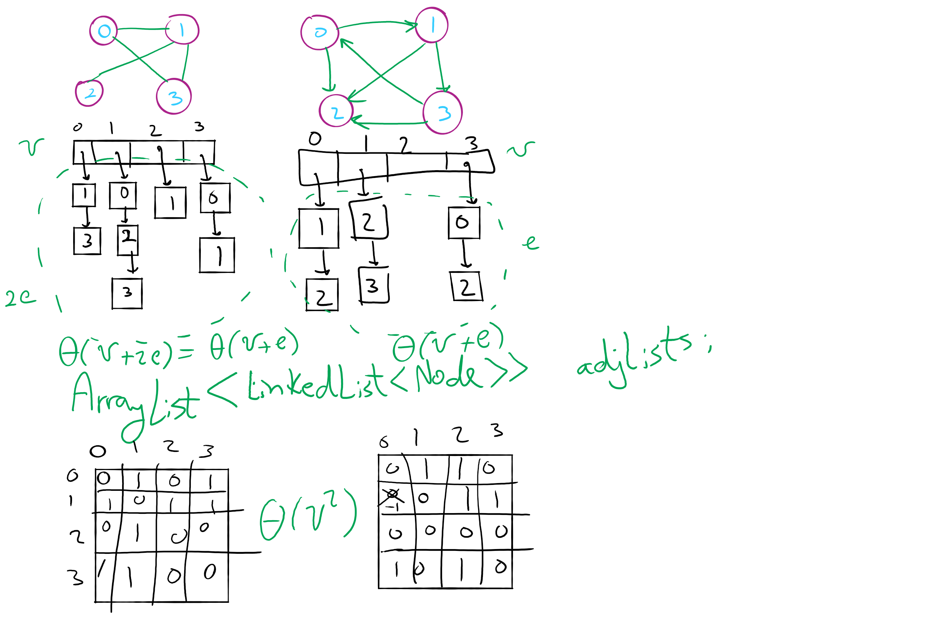
Graph Representation Example 2

Slide 7
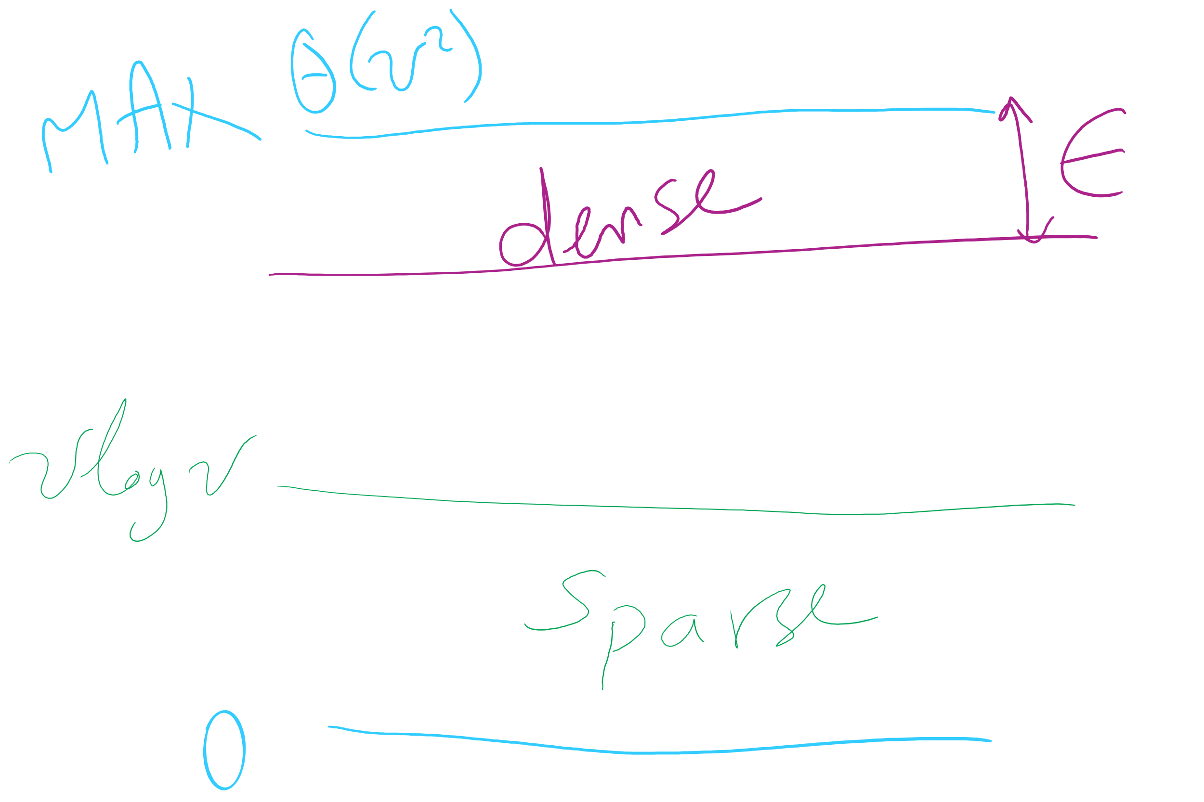
Graph Density

Slide 8
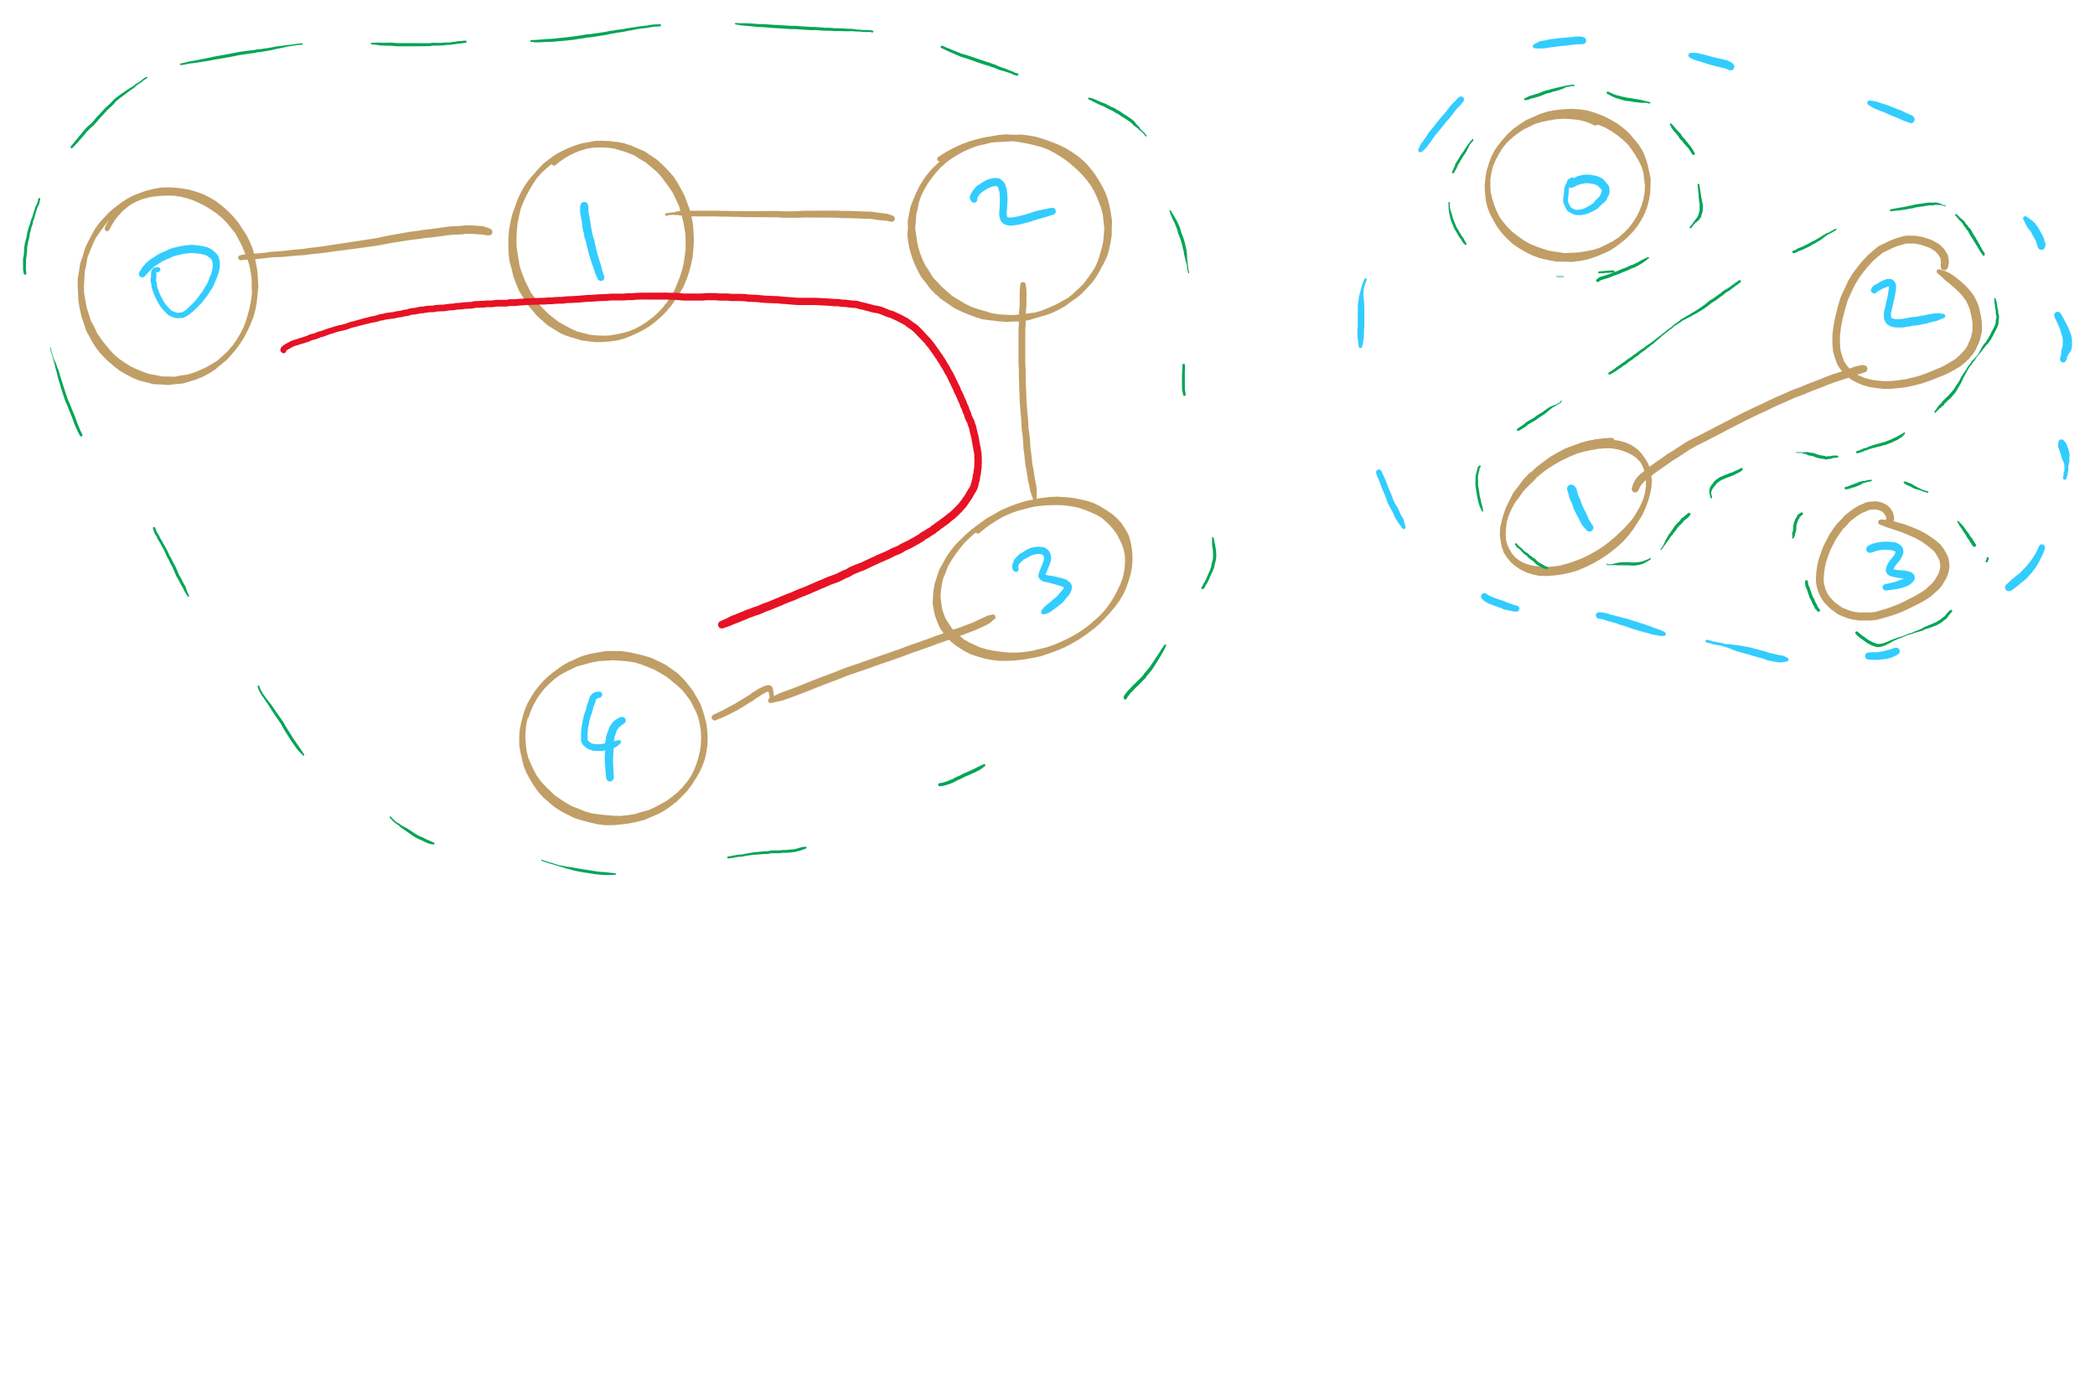
Sparse Graphs

Slide 9
Muddiest points (2/2)
for dense graphs, what exactly does "approaching max number of edges mean?"
graph density calculation
sparse vs. dense graph
when calculating how dense a graph is, what is epsilon representing?What is an application of a graph with no edges? And could a graph with no edges be represented with an unsorted array or unsorted LinkedList?
How to tell what is a neighbor in a directed graph. i.e. is the vertex with the arrow pointing at it or away from it the neighbor?
What a sparse graph looks like
Is there more significance to the entropy of a file than the minimum amount of bits that it can be compressed to?

Slide 10
This Lecture
Graph Traversal
BFS
DFS
Articulation points
Minimum Spanning Tree
Prim’s algorithm

Slide 11
Comparison
Where would we want to use adjacency lists vs adjacency matrices?
What about the list of vertices/list of edges approach?
Notes:
Adjacency matrix is better for dense graphs
Adjacency list is better for sparse graphs
Lists approach is bad
Aside from not storing redundant edge info for undirected graphs, worse than adj list

Slide 12
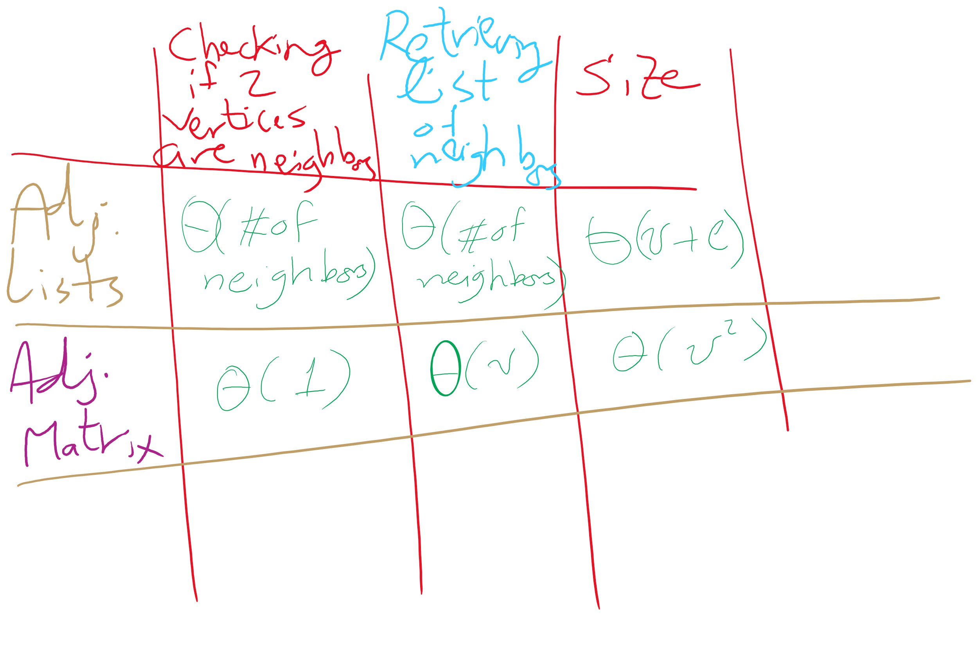
Adjacency Matrix vs. Adjacency Lists

Slide 13
Even more definitions
Path
A sequence of adjacent vertices
Simple Path
A path in which no vertices are repeated
Simple Cycle
A simple path with the same first and last vertex
Connected Graph
A graph in which a path exists between all vertex pairs
Connected Component
Connected subgraph of a graph
Acyclic Graph
A graph with no cycles
Tree
?
A connected, acyclic graph
Has exactly v-1 edges
Notes:
Difference between Connected graph and Complete graph?
Connected means there is a path from vertA to vertB
Complete means maximum number of edges in graph (so, vertA has edge to vertB)

Slide 14
Graph traversal
What is the best order to traverse a graph?
Two primary approaches:
Depth-first search (DFS)
“Dive” as deep as possible into the graph first
Branch when necessary
Breadth-first search (BFS)
Search all directions evenly
I.e., from i, visit all of i’s neighbors, then all of their neighbors, etc.

Slide 15
DFS
Already seen and used this throughout the term
For tries…
For Huffman encoding…
Can be easily implemented recursively
For each vertex, visit first unseen neighbor
Backtrack at deadends (i.e., vertices with no unseen neighbors)
Try next unseen neighbor after backtracking

Slide 16
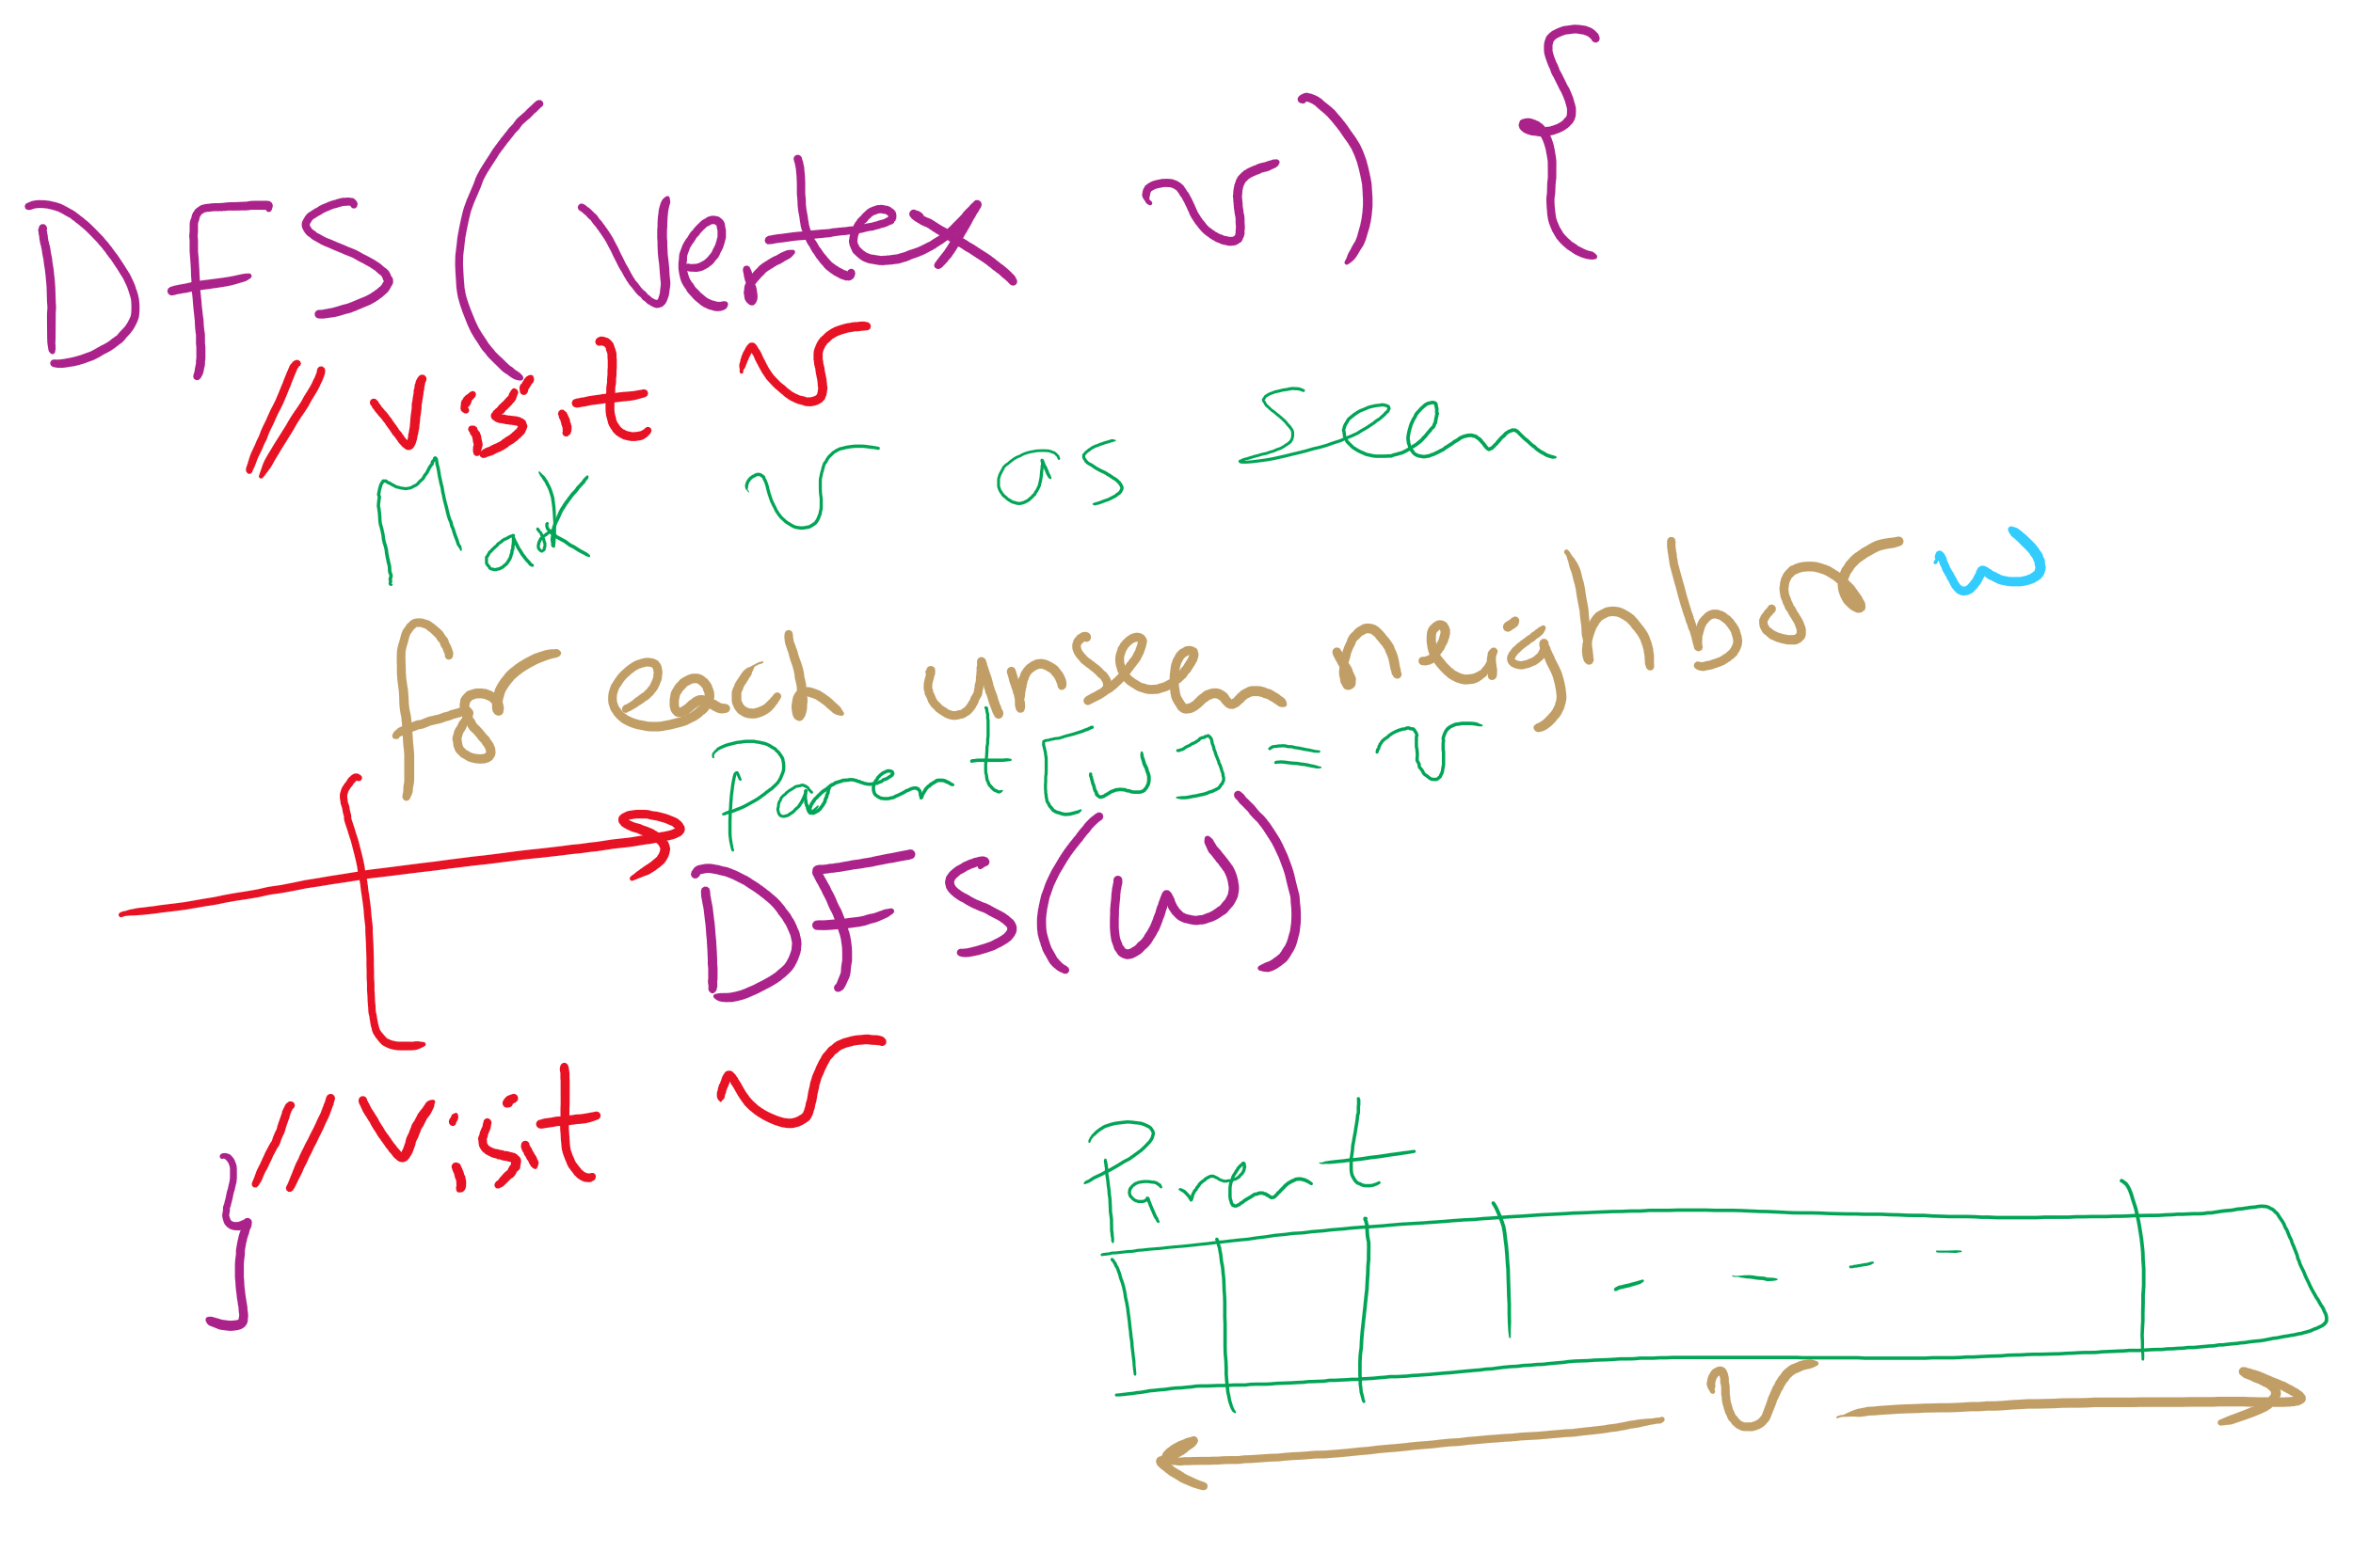
DFS Pseudo-code

Slide 17
DFS example
5
5
3
4
3
4
0
0
2
2
1
1

Slide 18
DFS example 2
0
0
2
1
2
1
3
3
6
6
4
5
4
5
7
7
9
9
8
8

Slide 19
BFS
Can be easily implemented using a queue
For each vertex visited, add all of its neighbors to the queue
Vertices that have been seen but not yet visited are said to be the fringe
Pop head of the queue to be the next visited vertex
See example

Slide 20
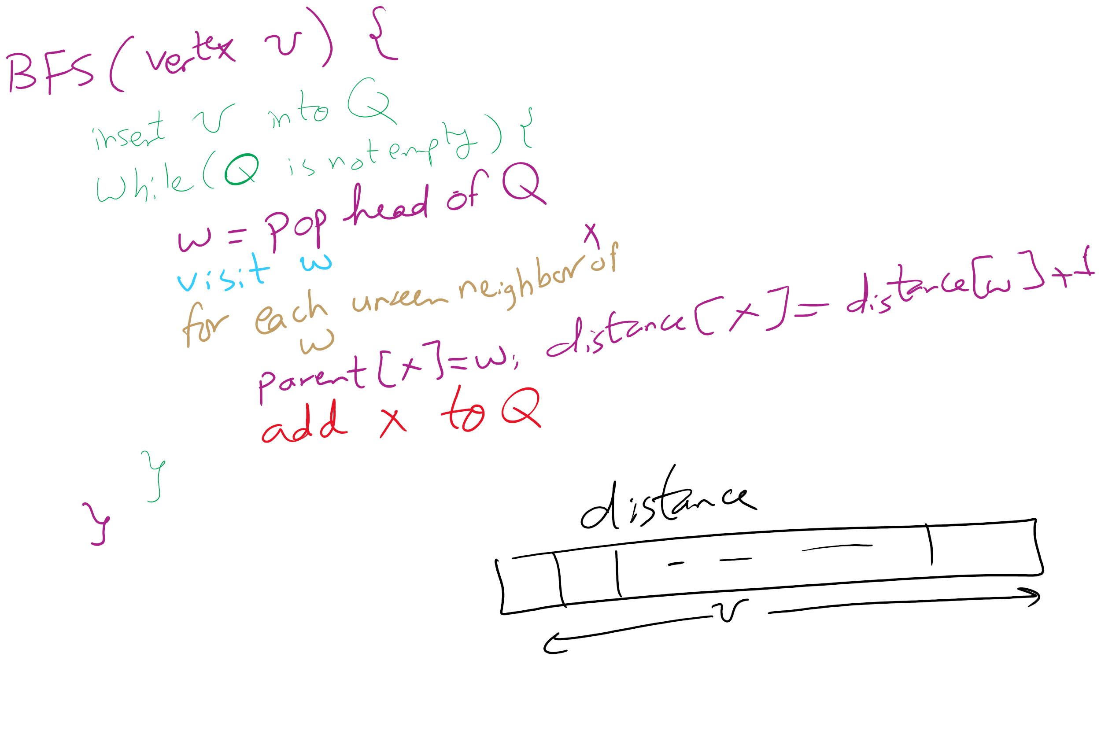
BFS Pseudo-code

Slide 21
BFS example
Q
0
0
1
7
2
1
2
1
2
9
3
3
6
6
3
8
4
5
4
5
4
7
7
5
9
9
6
8
8
Notes:
note that we are building connected, acyclic graphs with both bfs and dfs (will define on next slide)
get students to pick out that we are also doing shortest paths with bfs

Slide 22
Shortest paths
BFS traversals can further be used to determine the shortest path between two vertices

Slide 23
Analysis of graph traversals
At a high level, DFS and BFS have the same runtime
Each vertex must be seen and then visited, but the order will differ between these two approaches
How will the representation of the graph affect the runtimes of of these traversal algorithms?
Notes:
Adjacency matrix
Θ(v) to consider all neighbors
To traverse a row/column of the matrix
Doing this for each of v vertices leads to Θ(v²) runtime
Adjacency list
Must consider the neighbor list of each vertex in the array
So, we must visit every vertex in the whole adjacency list
Θ(v + e)

Slide 24
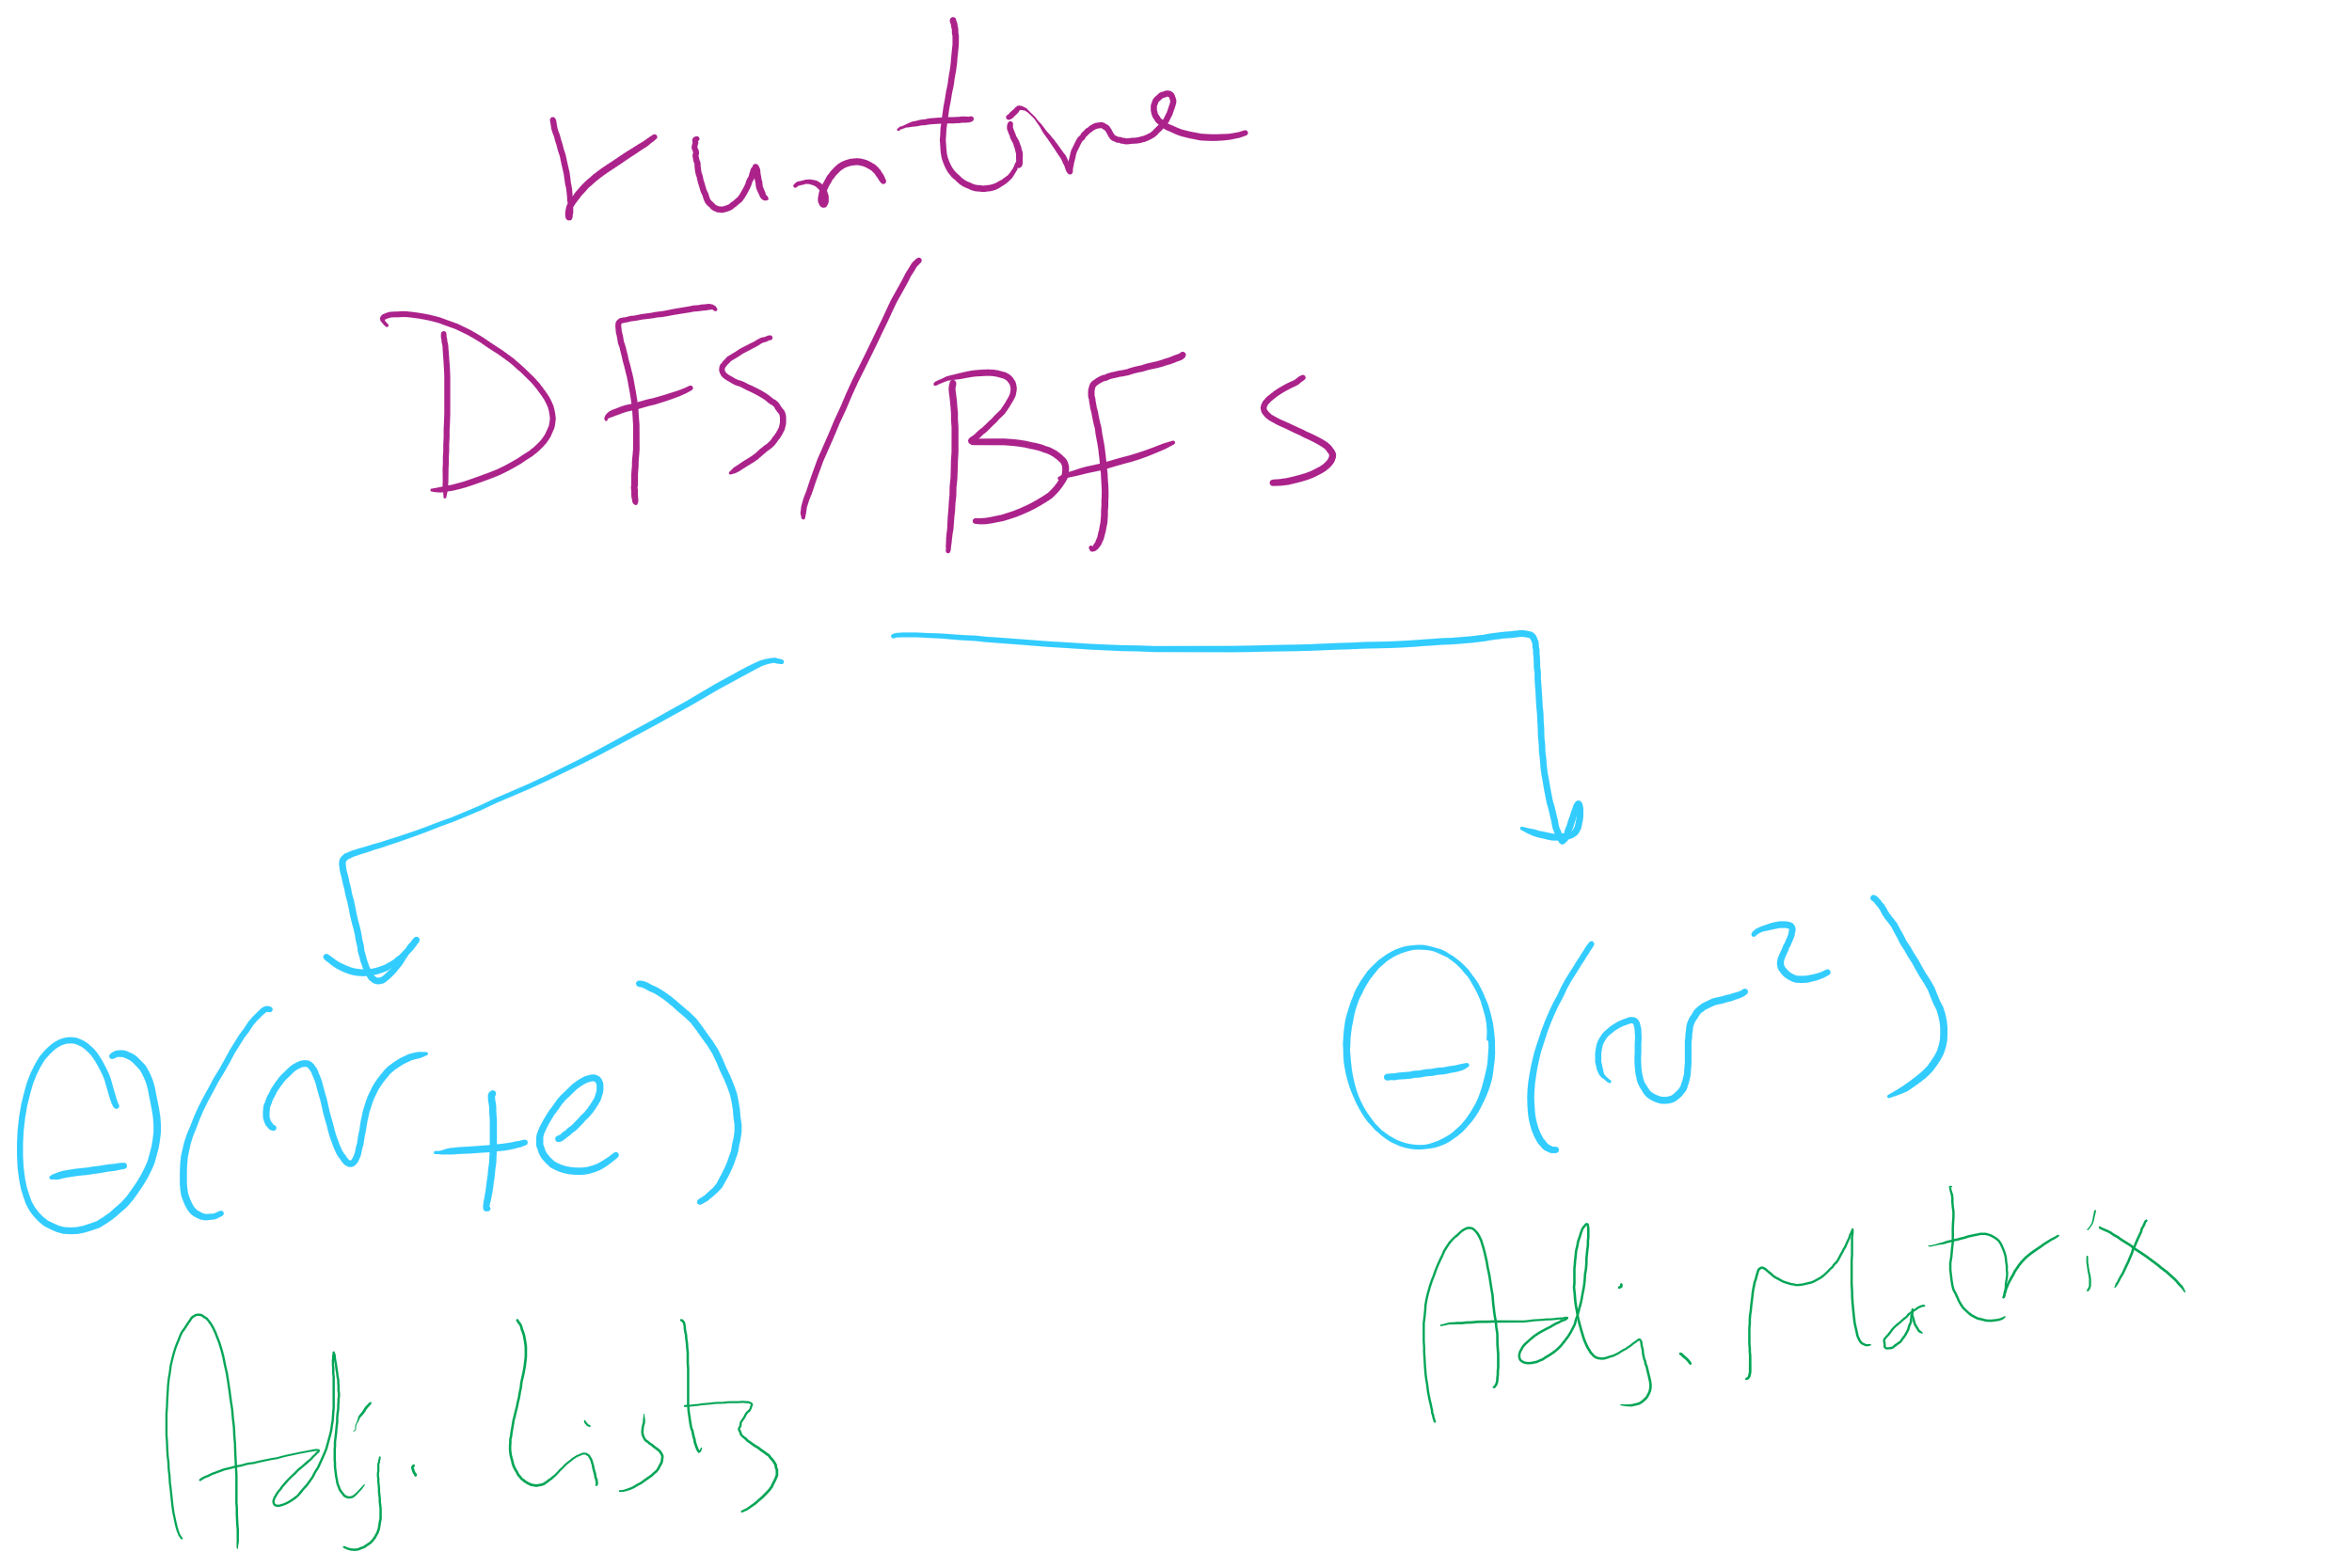
Runtime of BFS/DFS

Slide 25
DFS and BFS would be called from a wrapper function
If the graph is connected:
dfs()/bfs() is called only once and returns a spanning tree
Else:
A loop in the wrapper function will have to continually call dfs()/bfs() while there are still unseen vertices
Each call will yield a spanning tree for a connected component of the graph

Slide 26
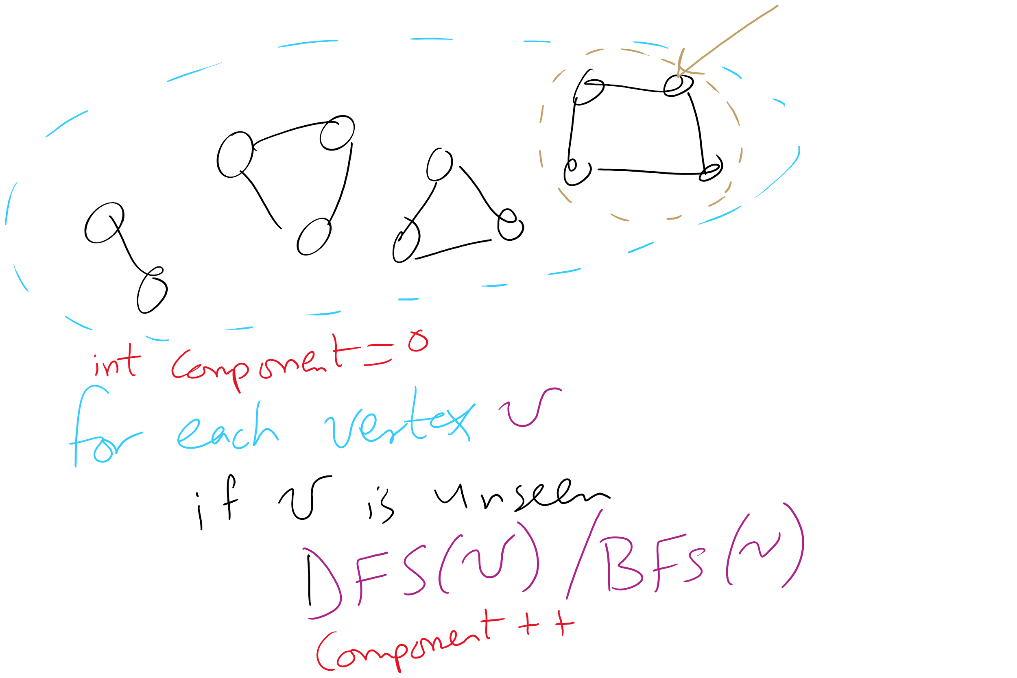
Wrapper function and connected components

Slide 27
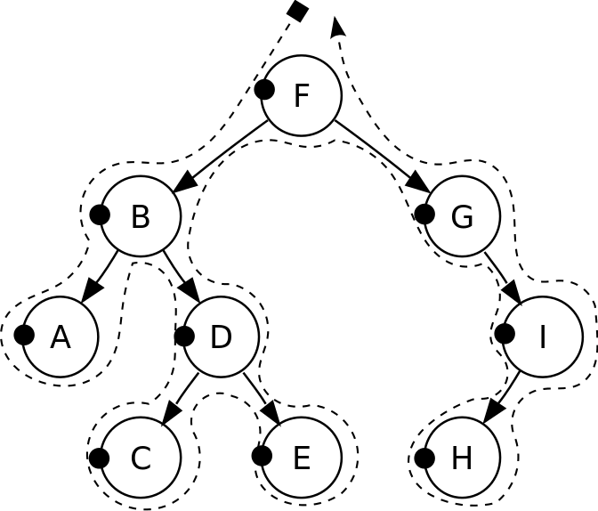
DFS pre-order traversal
Notes:
F, B, A, D, C, E, G, I, H
Seen before when we talked about marshalling huffman tries to the compressed file
Good for evaluating Polish notation

Slide 28
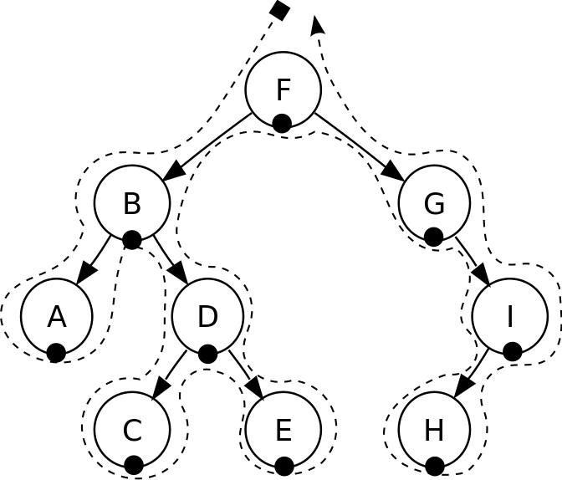
DFS in-order traversal
Notes:
A, B, C, D, E, F, G, H, I
Seen when we wanted to enumerate all values stored in a B-tree (motivating the need for a B+tree)
Good for sorted ordering (if dealing with sorted data structure)

Slide 29
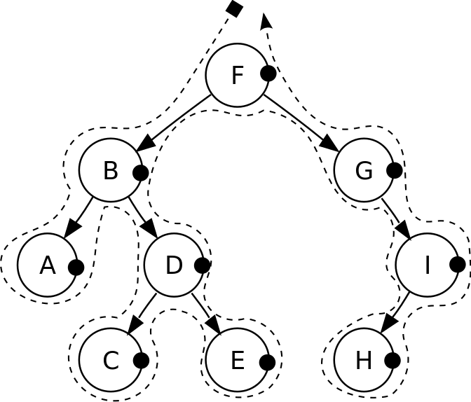
DFS post-order traversal
Notes:
A, C, E, D, B, H, I, G, F
Good for reverse Polish notation

Slide 30
Biconnected graphs
A biconnected graph has at least 2 distinct paths (no common edges or vertices) between all vertex pairs
Any graph that is not biconnected has one or more articulation points
Vertices, that, if removed, will separate the graph
Any graph that has no articulation points is biconnected
Thus we can determine that a graph is biconnected if we look for, but do not find any articulation points

Slide 31
Finding articulation points
Variation on DFS
Consider building up the spanning tree
Have it be directed
Create “back edges” when considering a vertex that has already been visited in constructing the spanning tree
Label each vertex v with with two numbers:
num(v) = pre-order traversal order
low(v) = lowest-numbered vertex reachable from v using 0 or more spanning tree edges and then at most one back edge
Min of:
num(v)
Lowest num(w) of all back edges (v, w)
Lowest low(w) of all spanning tree edges (v, w)

Slide 32
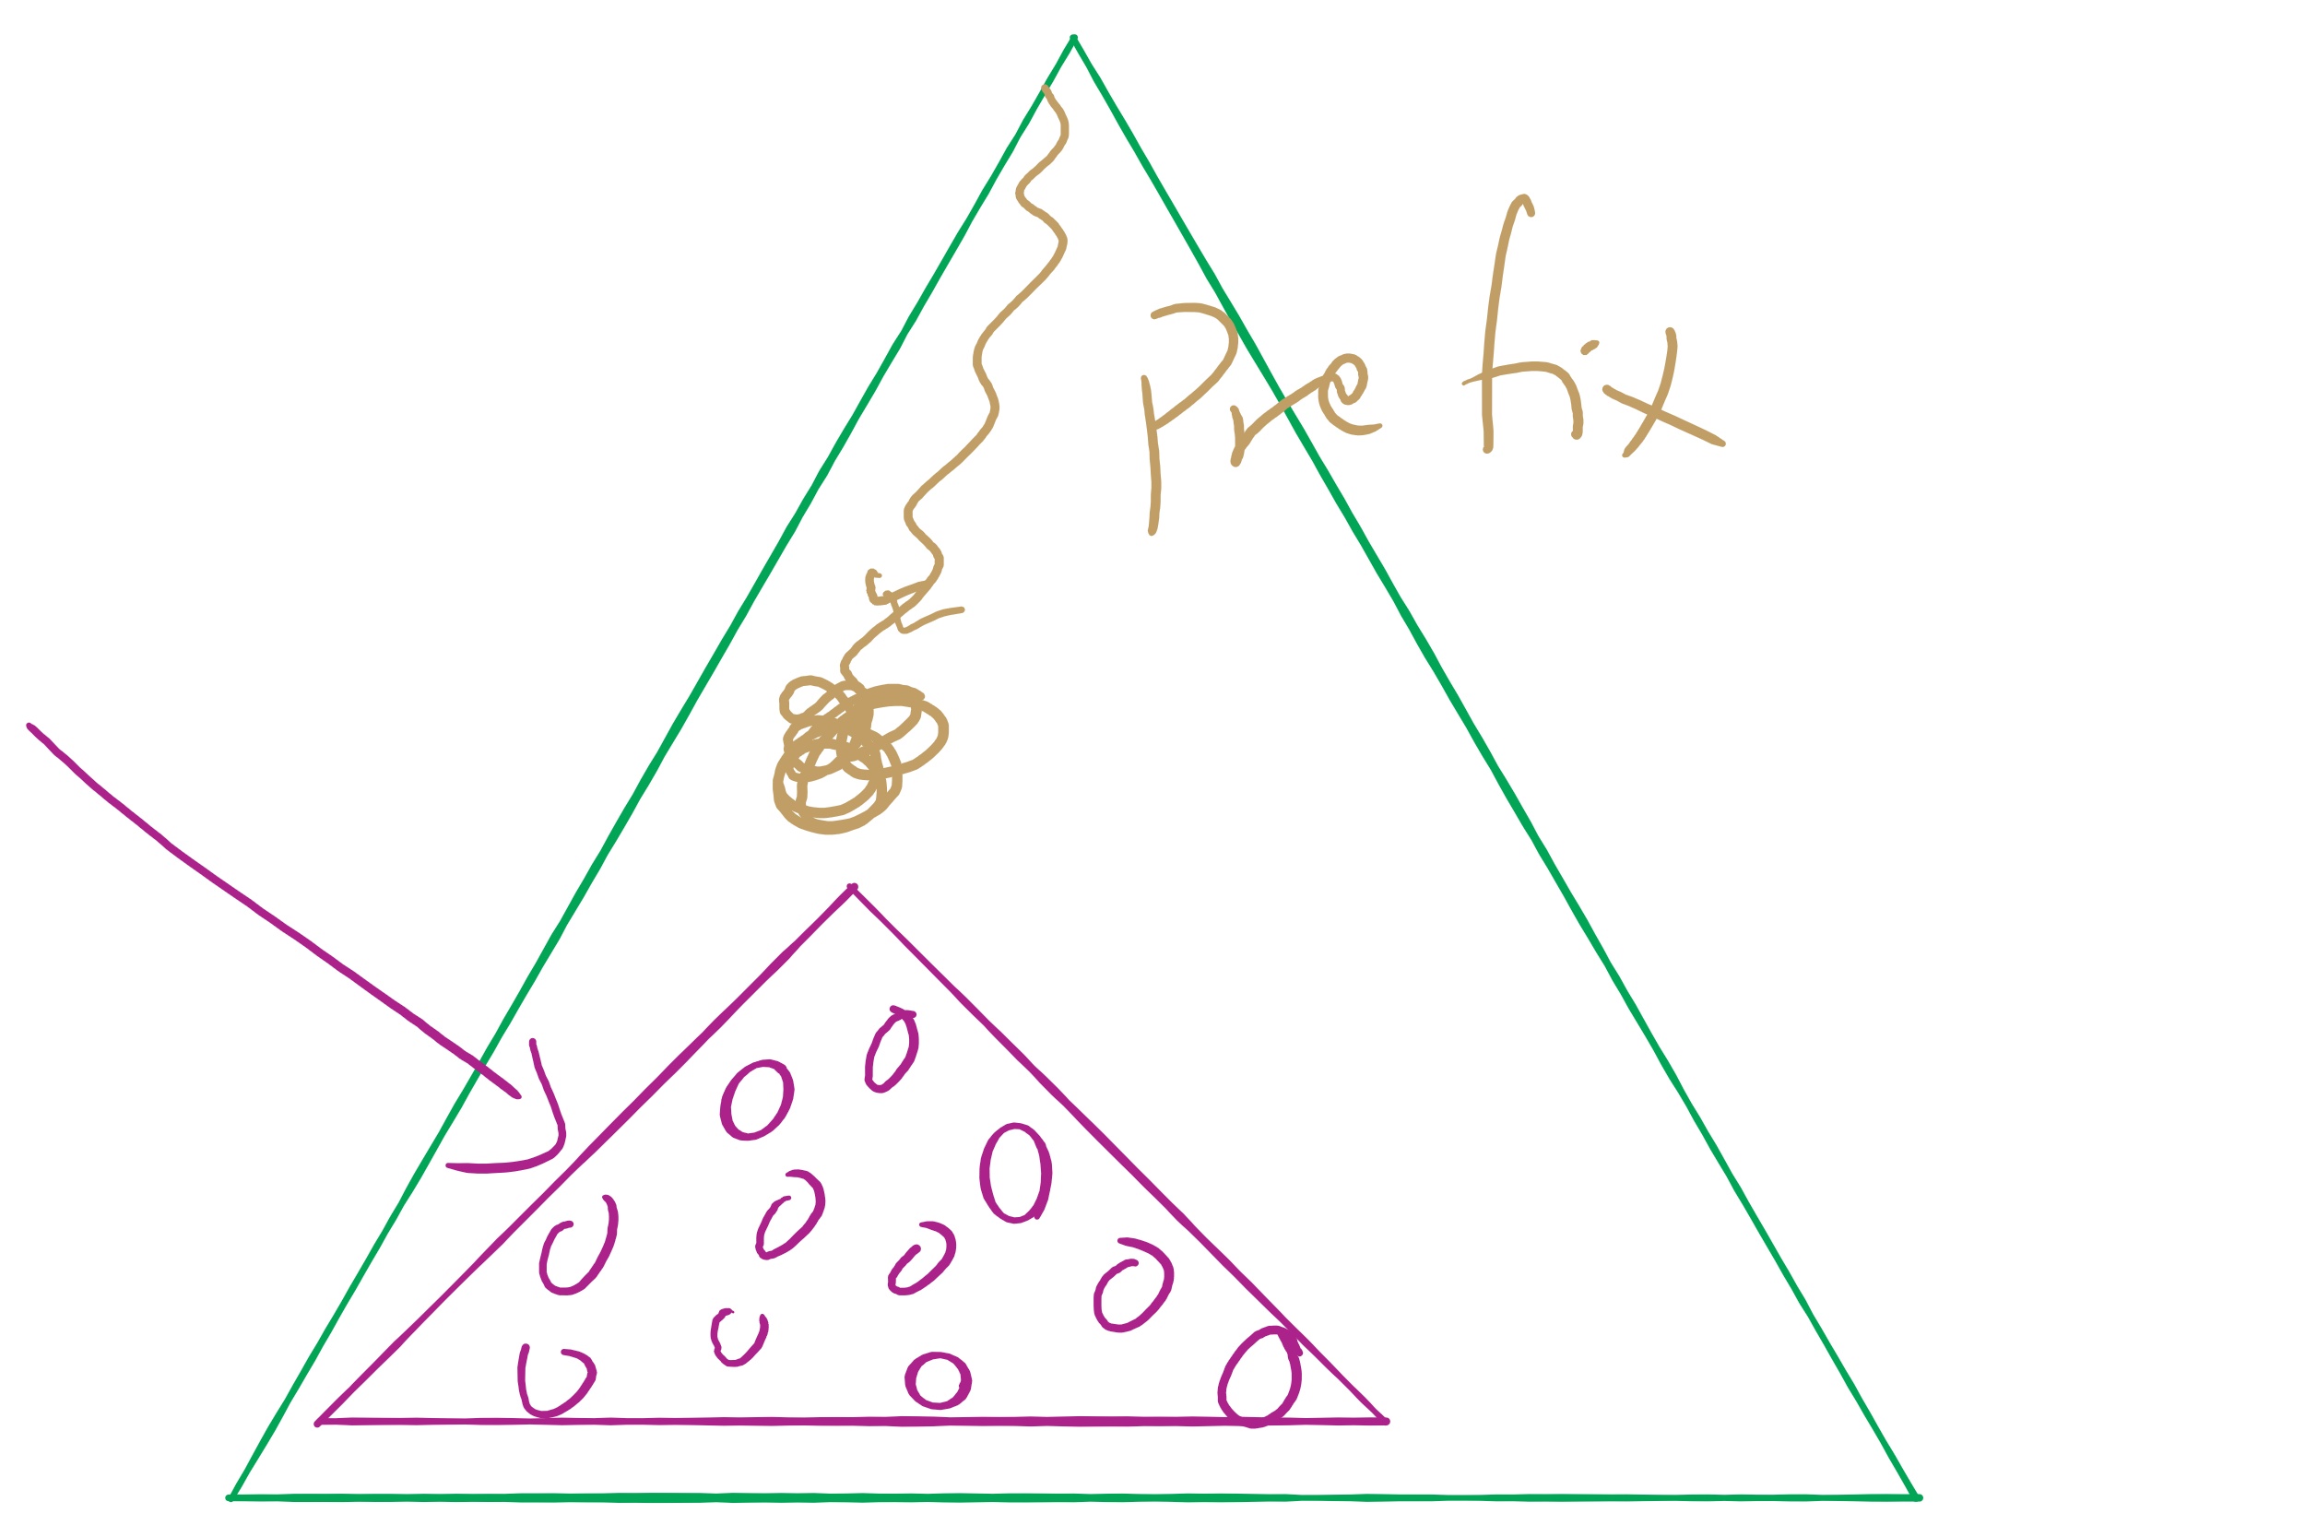
Assignment 2 runtime analysis

