Slide 1

Algorithms and Data Structures 2 CS 1501
Fall 2021
Sherif Khattab
ksm73@pitt.edu
(Slides are adapted from Dr. Ramirez’s and Dr. Farnan’s CS1501 slides.)

Slide 2
Announcements
Upcoming deadlines:
3/26: Lab 7 and Homework 9
3/30: Assignment 3
4/2: Lab 8
Tophat questions are due one week after each lecture

Slide 3
Last lecture …
Articulation Points using DFS
Minimum Spanning Tree
Prim’s Algorithm

Slide 4
Muddiest points (1/2)
Prim’s MST Algorithm
How does prim algorithm works?
Runtime of basic and enhanced
when calculating the run-time of v^3, why you choose v/2 term as the largest one?
why the previous run-time for Prim's is v^3 but the latter one is v^2 while both of them are Prim's? Is it because that the latter one is a more optimal advancement of Prim's?
updating arrays for improved prim's algorithm
got lost when updating the parent and best edge arrays
keeping track of which nodes are green or gray
implementing Prim's algorithm
What would pseudocode for Prim's algorithm look like

Slide 5
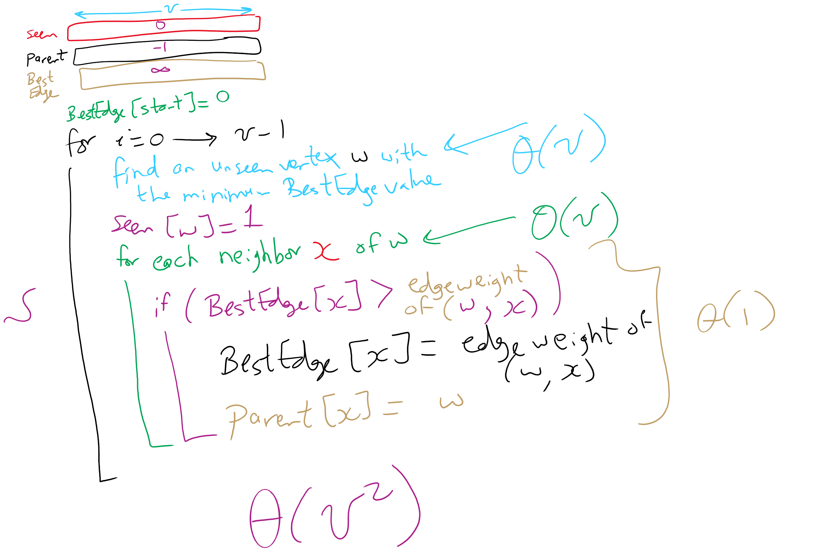
Prim’s MST Algorithm

Slide 6
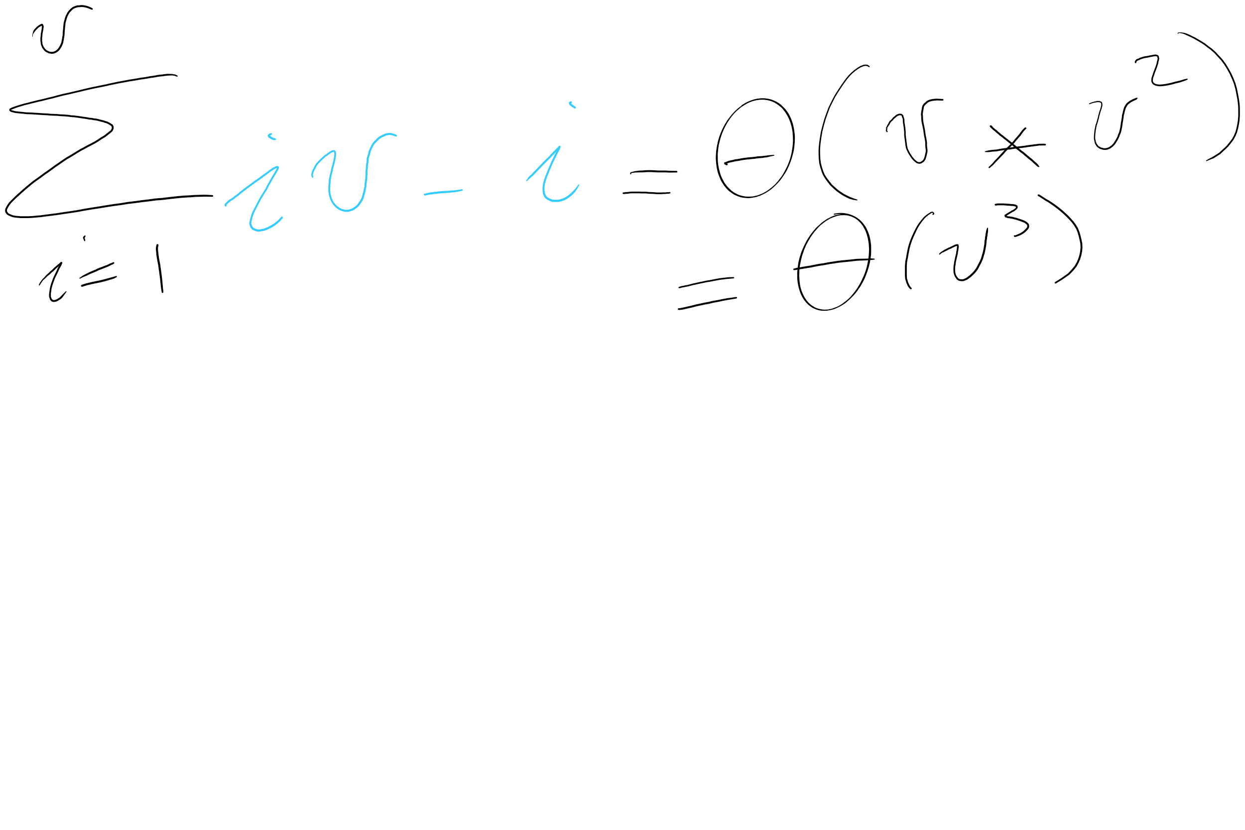
Runtime of naïve implementation of Prim’s

Slide 7
Muddiest points (2/2)
Algorithm to find an articulation point
what is the method for finding articulation point called using low and num and does it affect finding MSTs?
could you reiterate what low is in Prim’s?
finding low value in articulation points
when you determine the articulation point, the second case is when root has more than 1 child. What does "more thaan one child" mean in a graph?
How do you determine the weights of the edges?
travelling salesman problem

Slide 8
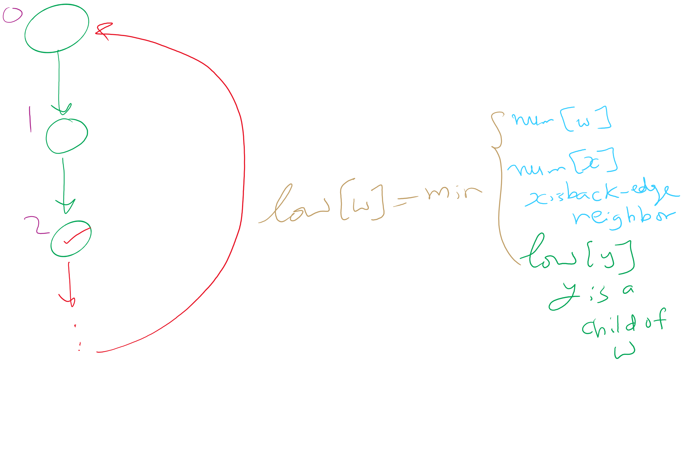
Articulation Points Algorithm

Slide 9
This Lecture
Priority Queue

Slide 10
We mentioned priority queues in building Huffman tries
Primary operations they needed:
Insert
Find item with highest priority
E.g., findMin() or findMax()
Remove an item with highest priority
E.g., removeMin() or removeMax()
How do we implement these operations?
Simplest approach: arrays

Slide 11
Unsorted array PQ
Insert:
Add new item to the end of the array
Θ(1)
Find:
Search for the highest priority item (e.g., min or max)
Θ(n)
Remove:
Search for the highest priority item and delete
Θ(n)
Runtime for use in Huffman tree generation?
Notes:
Θ(n²)
have to perform 2*n removals

Slide 12
Sorted array PQ
Insert:
Add new item in appropriate sorted order
Θ(n)
Find:
Return the item at the end of the array
Θ(1)
Remove:
Return and delete the item at the end of the array
Θ(1)
Runtime for use in Huffman tree generation?
Notes:
Θ(n²)
Have to insert n initial trees

Slide 13
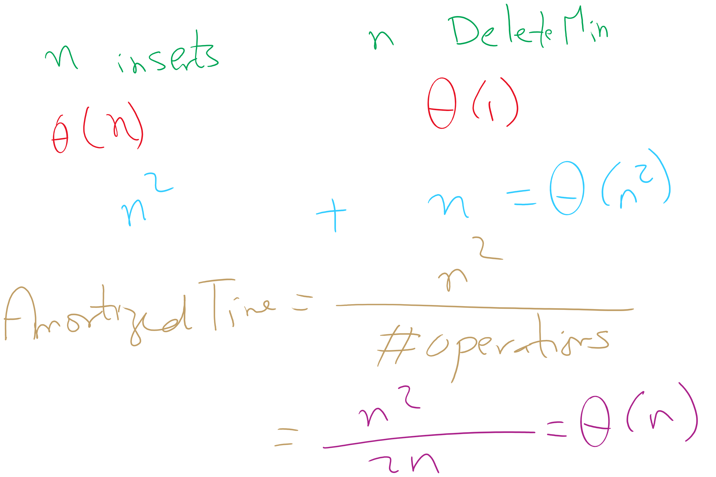
Amortized Time

Slide 14
So what other options do we have?
What about a binary search tree?
Insert
Average case of Θ(lg n), but worst case of Θ(n)
Find
Average case of Θ(lg n), but worst case of Θ(n)
Remove
Average case of Θ(lg n), but worst case of Θ(n)
OK, so in the average case, all operations are Θ(lg n)
No constant time operations
Worst case is Θ(n) for all operations

Slide 15
Is a BST overkill?
Our find and remove operations only need the highest priority item, not to find/remove any item
Can we take advantage of this to improve our runtime?
Yes!

Slide 16
The heap
A heap is complete binary tree such that for each node T in the tree:
T.item is of a higher priority than T.right_child.item
T.item is of a higher priority than T.left_child.item
It does not matter how T.left_child.item relates to T.right_child.item
This is a relaxation of the approach needed by a BST
The heap property

Slide 17
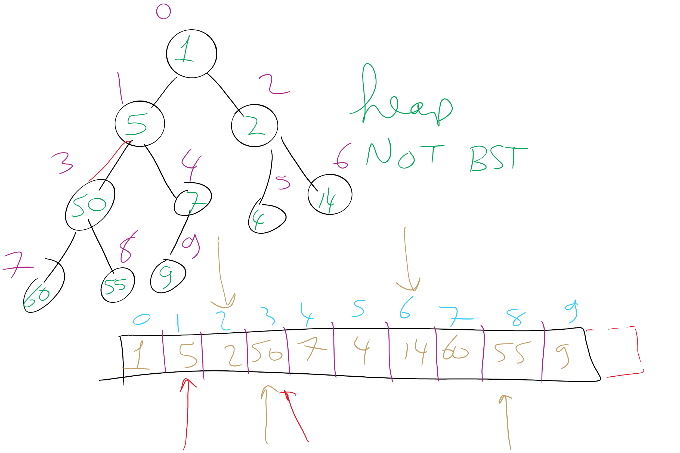
Heap Example

Slide 18
Heap PQ runtimes
Find is easy
Simply the root of the tree
Θ(1)
Remove and insert are not quite so trivial
The tree is modified and the heap property must be maintained

Slide 19
Heap insert
Add a new node at the next available leaf
Push the new node up the tree until it is supporting the heap property

Slide 20
Min heap insert
Insert: 7, 42, 37, 5, 8, 15, 12, 9, 3
7
5
3
3
5
15
7
12
5
42
37
42
37
15
3
5
7
9
8
15
12
9
42
9
3
Notes:
Insert: 7, 42, 37, 5, 8, 15, 12, 9, 3

Slide 21
Heap remove
Tricky to delete root…
So let's simply overwrite the root with the item from the last leaf and delete the last leaf
But then the root is violating the heap property…
So we push the root down the tree until it is supporting the heap property

Slide 22
Min heap removal
3
9
42
5
7
NO!
5
9
8
7
42
8
12
9
7
8
9
42
37
15
42
9
Notes:
Remove 2x, illustrate to students you need to be careful how you swap on the way down (with the "NO!")

Slide 23
Heap runtimes
Find
Θ(1)
Insert and remove
Height of a complete binary tree is lg n
At most, upheap and downheap operations traverse the height of the tree
Hence, insert and remove are Θ(lg n)

Slide 24
Heap implementation
Simply implement tree nodes like for BST
This requires overhead for dynamic node allocation
Also must follow chains of parent/child relations to traverse the tree
Note that a heap will be a complete binary tree…
We can easily represent a complete binary tree using an array

Slide 25
Storing a heap in an array
Number nodes row-wise starting at 0
Use these numbers as indices in the array
Now, for node at index i
parent(i) = ⌊(i - 1) / 2⌋
left_child(i) = 2i + 1
right_child(i) = 2i + 2
For arrays indexed from 0
Notes:
Insert: 7, 42, 37, 5, 8, 15, 12, 9, 3

Slide 26
Heap Sort
Heapify the numbers
MAX heap to sort ascending
MIN heap to sort descending
"Remove" the root
Don’t actually delete the leaf node
Consider the heap to be from 0 .. length - 1
Repeat
37
12
42
3
5
42
7
15
8
9
42
15
37
42
9
37
5
9
7
42
8
15
9
37
15
37
42
37
42
15
12
7
9
15
37
12
42
8
9
8
37
7
15
42
5
9
3

Slide 27
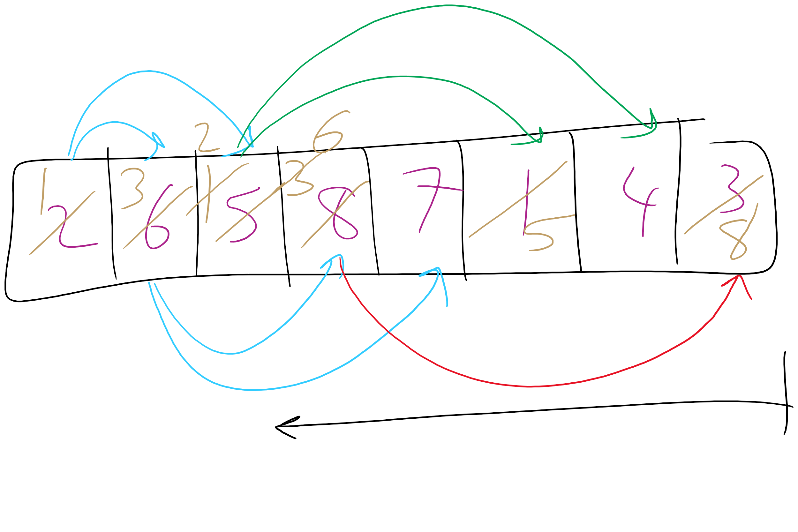
Heapify Operation

