Slide 1

Algorithms and Data Structures 2 CS 1501
Fall 2021
Sherif Khattab
ksm73@pitt.edu
(Slides are adapted from Dr. Ramirez’s and Dr. Farnan’s CS1501 slides.)

Slide 2
Announcements
Upcoming deadlines:
4/2: Lab 8 and Homework 10
4/2: Assignment 3 (extended deadline)
4/9: Lab 9
Tophat questions are due one week after each lecture

Slide 3
Last lecture …
Priority Queue
Definition
Operations
Heap implementation
Heap Sort
Heapify

Slide 4
Muddiest points (1/2)
all the things with the heap
how do we define priority q's
Heap operations
heap removal
heaps runtimes
how to determine amortized runtime
Heap Implementation
sorting a heap in an array
the benefit of using an array to represent the heap
array memory allocation management for array implementation of heap

Slide 5
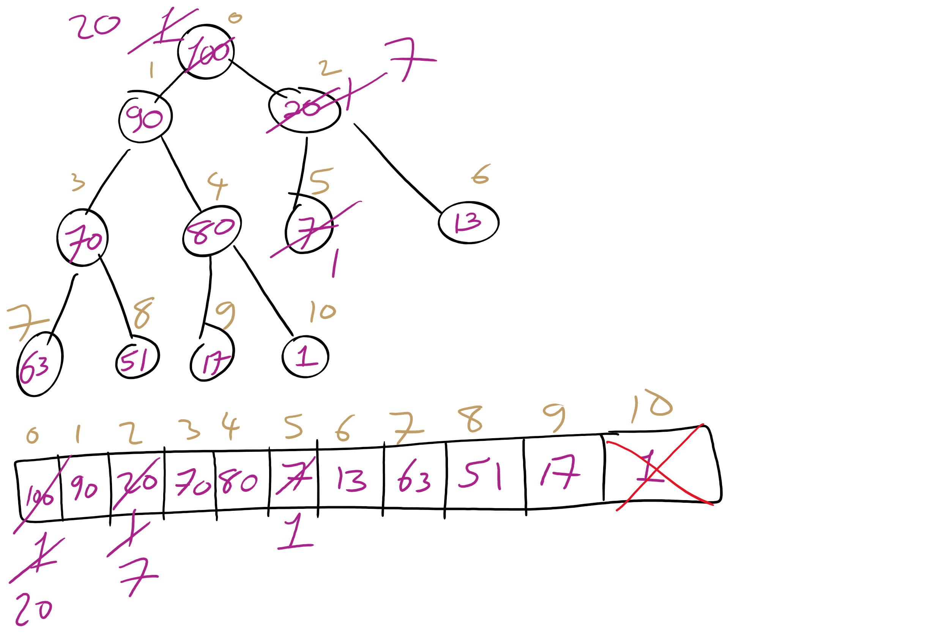
Heap RemoveMax Example

Slide 6
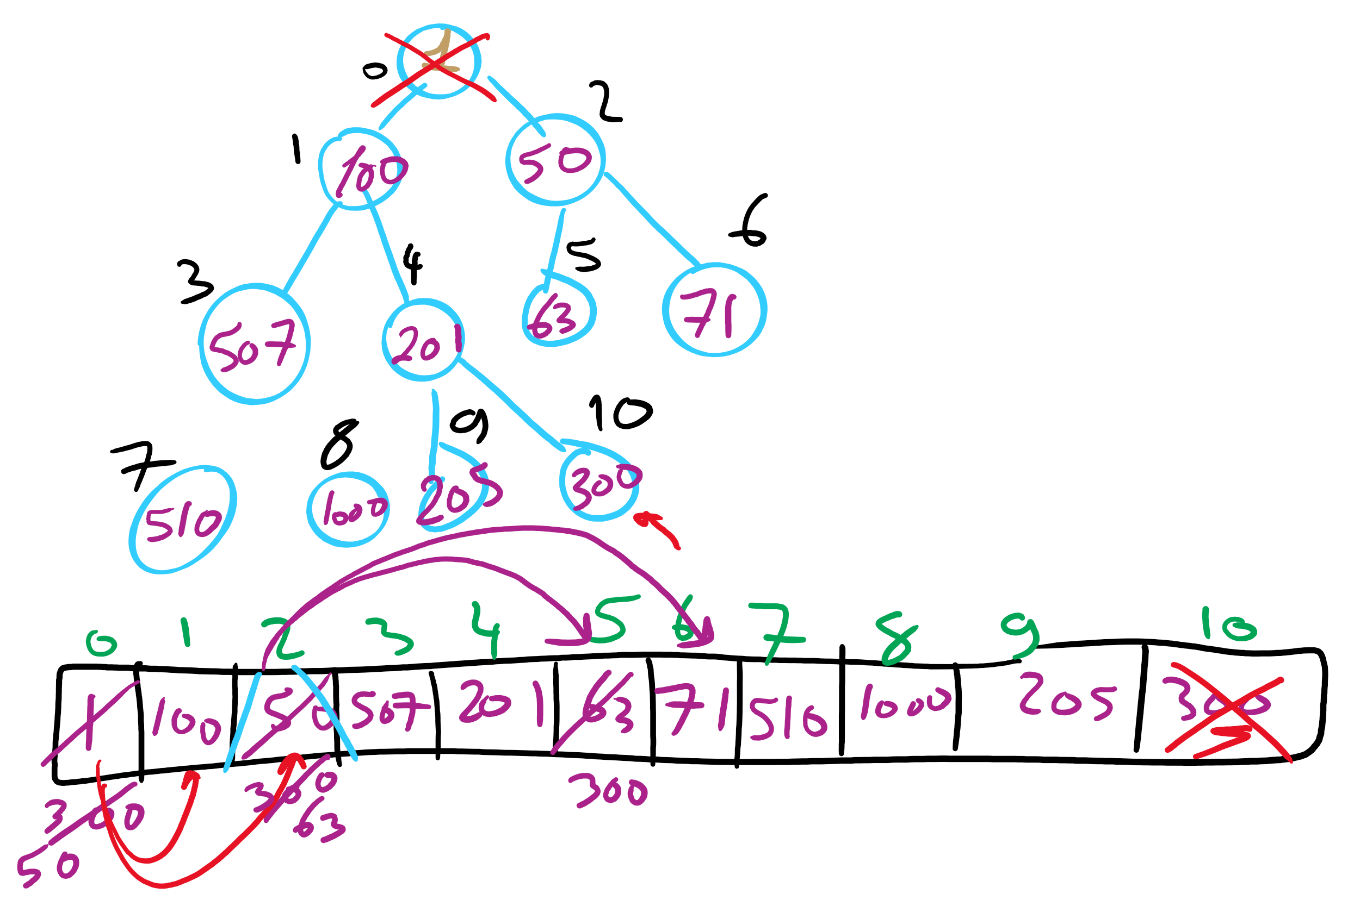
Heap RemoveMin Example

Slide 7
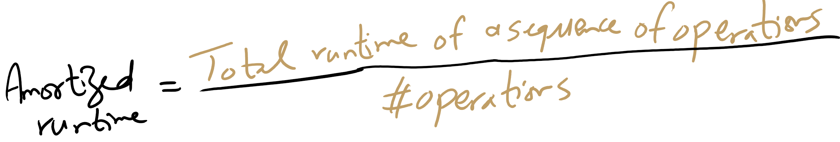
Amortized Runtime

Slide 8
Muddiest points (2/2)
Prim’s Algorithm
the purpose of the prim’s algorithm
heap in prims algorithm
What would we use the PQs for in Prim's algorithm? To keep track of the lows?
HeapSort
pseudocode for heap sort
heapifying process and how it differs from heap sort
How do we mark an element outside of an array for a heap sort?

Slide 9
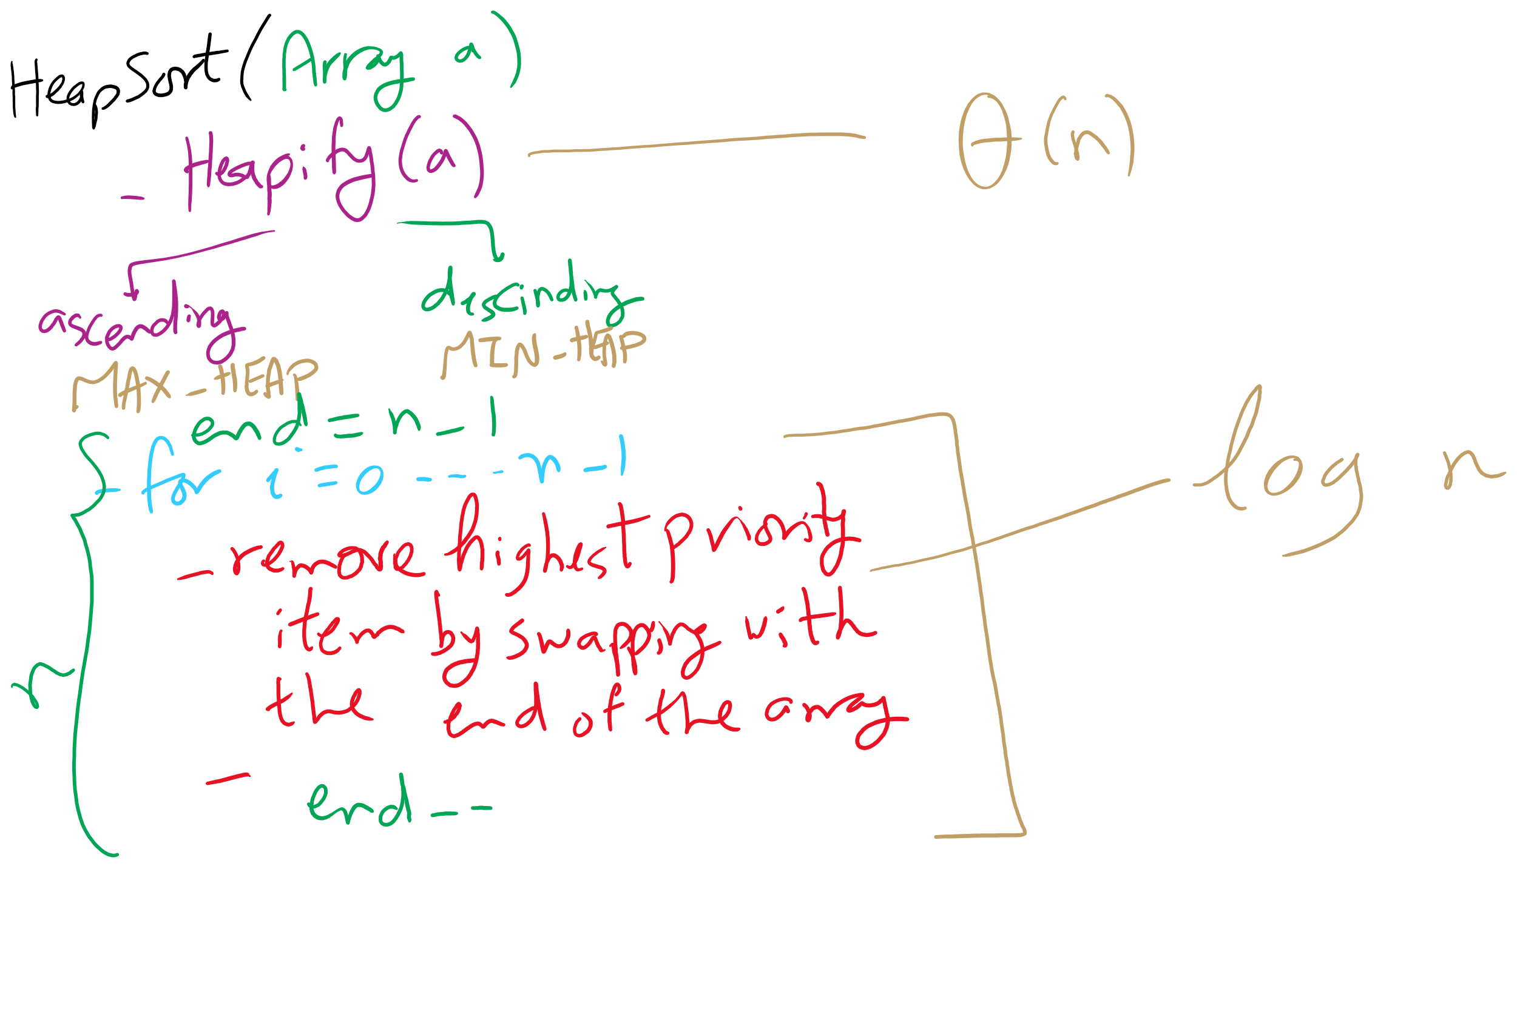
HeapSort Pseudo-code

Slide 10
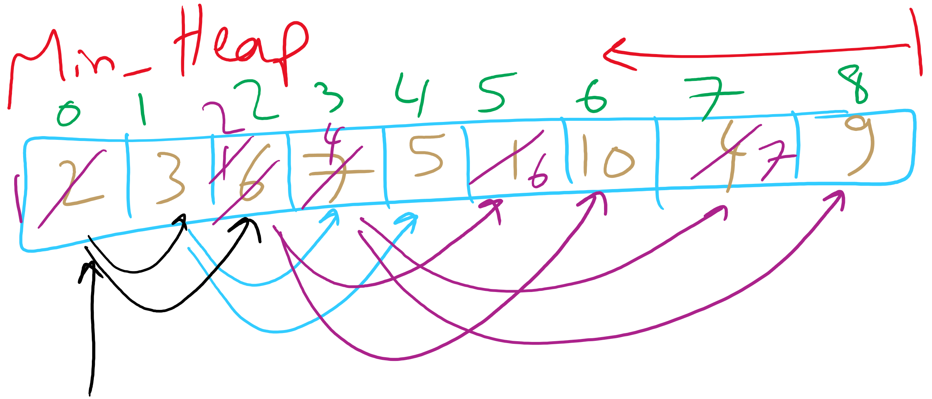
Heapify Example

Slide 11
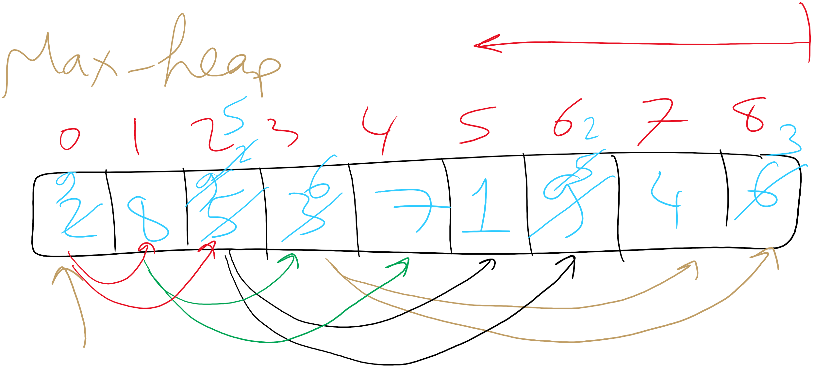
Heapify Example

Slide 12
This Lecture
Minimum Spanning Tree
Kruskal’s
Union-Find
Weighted Shortest Paths
Dijkstra’s

Slide 13
Heap sort analysis
Runtime:
Worst case:
n log n
In-place?
Yes
Stable?
No

Slide 14
Storing Objects in PQ
What if we want to update an Object?
What is the runtime to find an arbitrary item in a heap?
Θ(n)
Hence, updating an item in the heap is Θ(n)
Can we improve of this?
Back the PQ with something other than a heap?
Develop a clever workaround?

Slide 15
Indirection
Maintain a second data structure that maps item IDs to each item’s current position in the heap
This creates an indexable PQ

Slide 16
Indirection example setup
Let's say I'm shopping for a new video card and want to build a heap to help me keep track of the lowest price available from different stores.
Keep objects of the following type in the heap:
class CardPrice implements Comparable<CardPrice>{
public String store;
public double price;
public CardPrice(String s, double p) { … }
public int compareTo(CardPrice o) {
if (price < o.price) { return -1; }
else if (price > o.price) { return 1; }
else { return 0; }
}
}

Slide 17
Indirection example
n = new CardPrice("NE", 333.98);
a = new CardPrice("AMZN", 339.99);
x = new CardPrice("NCIX", 338.00);
b = new CardPrice("BB", 349.99);
Indirection
"NE":0
"NE":2
"AMZN":1
"AMZN":0
"AMZN":1
Update price for NE: 340.00
"NCIX":0
"NCIX":2
"NCIX":3
"NCIX":1
"BB":0
"BB":3
"BB":1
Update price for NCIX: 345.00
Update price for BB: 200.00
a
b
b
x
n
a
x
x
a
x
n
b
Notes:
How are our runtimes affected?
space utilization?
how should we implement the indirection?
what are the tradeoffs?

Slide 18
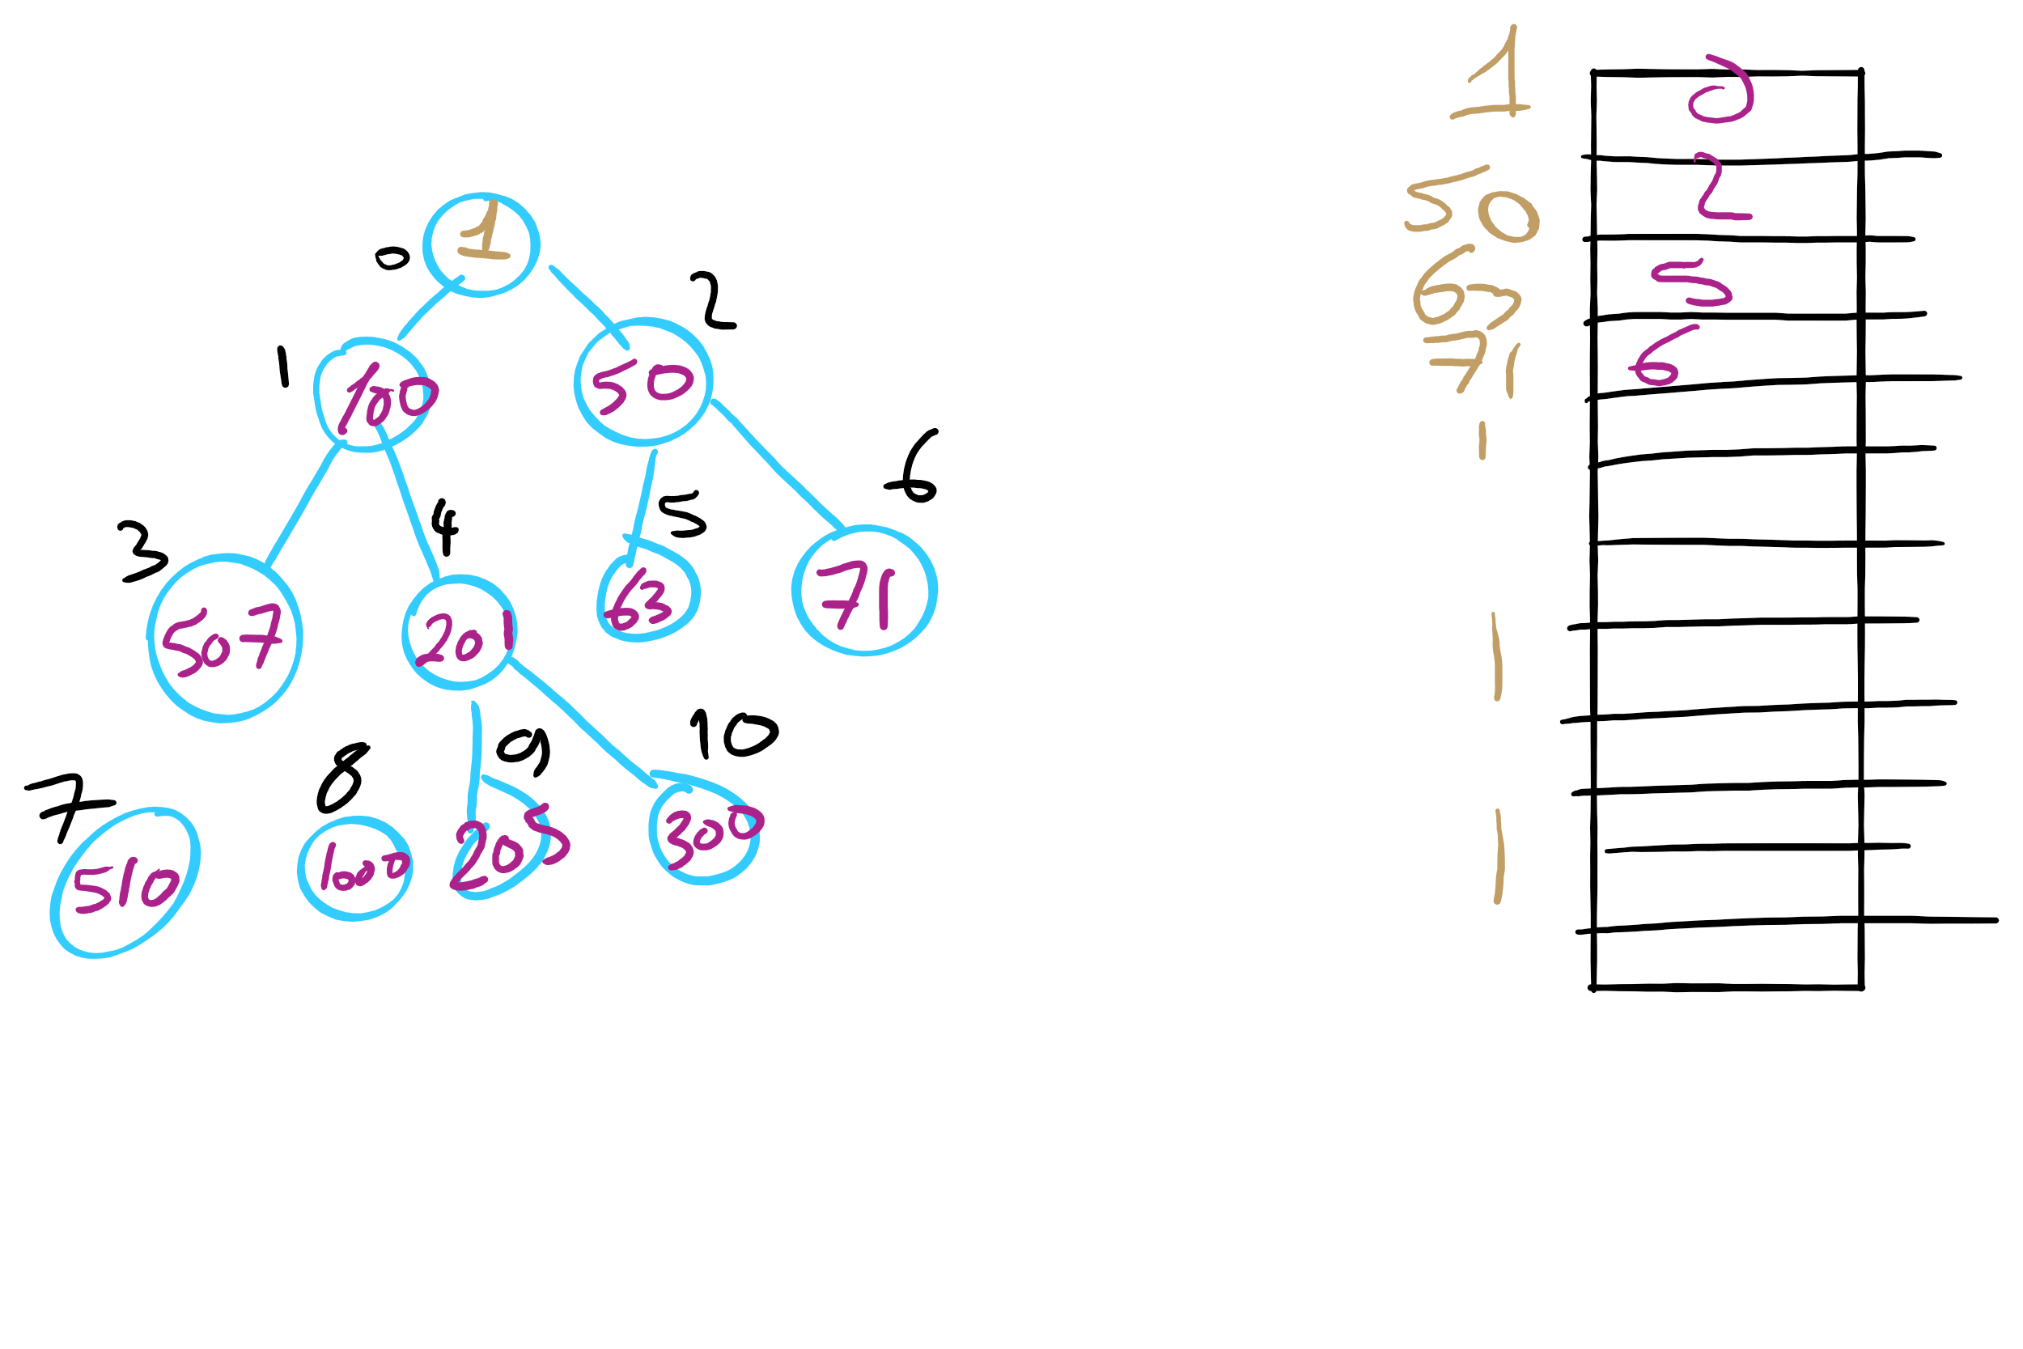
Indexable PQ Example

Slide 19
Prim’s MST: What about a faster way to pick the best edge?
Sounds like a job for a priority queue!
Priority queues can remove the min value stored in them in Θ(lg n)
Also Θ(lg n) to add to the priority queue
What does our algorithm look like now?
Visit a vertex
Add edges coming out of it to a PQ
While there are unvisited vertices, pop from the PQ for the next vertex to visit and repeat
Notes:
Change in runtime?
θ(d) work to list neighbors,
in the worst case, v == d, so no asymptotic improvement, but a practical one.
Less memory required to store the graph
but doesn't affect memory required to run the algorithm, still need 2 * θ (v) to store parent and best edge arrays
this version of Prim's just adds all edges to a PQ
before we constrained ourselves to only maintain v best edges to look at
how do we get the best of both?
indexable pq

Slide 20
Prim's with a priority queue
0
0
PQ:
6
5
1
1
3
1: (0, 2)
1
3
2: (5, 3)
5
5
3: (1, 4)
2
2
3
2
4: (2, 5)
6
4
5: (2, 3)
5: (0, 3)
4
5
4
5
6
5: (2, 1)
6: (0, 1)
6: (2, 4)
6: (5, 4)

Slide 21
Runtime using a priority queue
Have to insert all e edges into the priority queue
In the worst case, we’ll also have to remove all e edges
So we have:
e * Θ(lg e) + e * Θ(lg e)
= Θ(2 * e lg e)
= Θ(e lg e)
This algorithm is known as lazy Prim’s
Notes:
discuss why this isn't lg v for PQ operations, lead to how we constrained number of best edges before to be v, lead to indexable PQ discussion

Slide 22
Do we really need to maintain e items in the PQ?
I suppose we could not be so lazy
Just like with the adjacency matrix implementation, we only need the best edge for each vertex
PQ will need to be indexable
This is the idea of eager Prim’s
Runtime is Θ(e lg v)

Slide 23
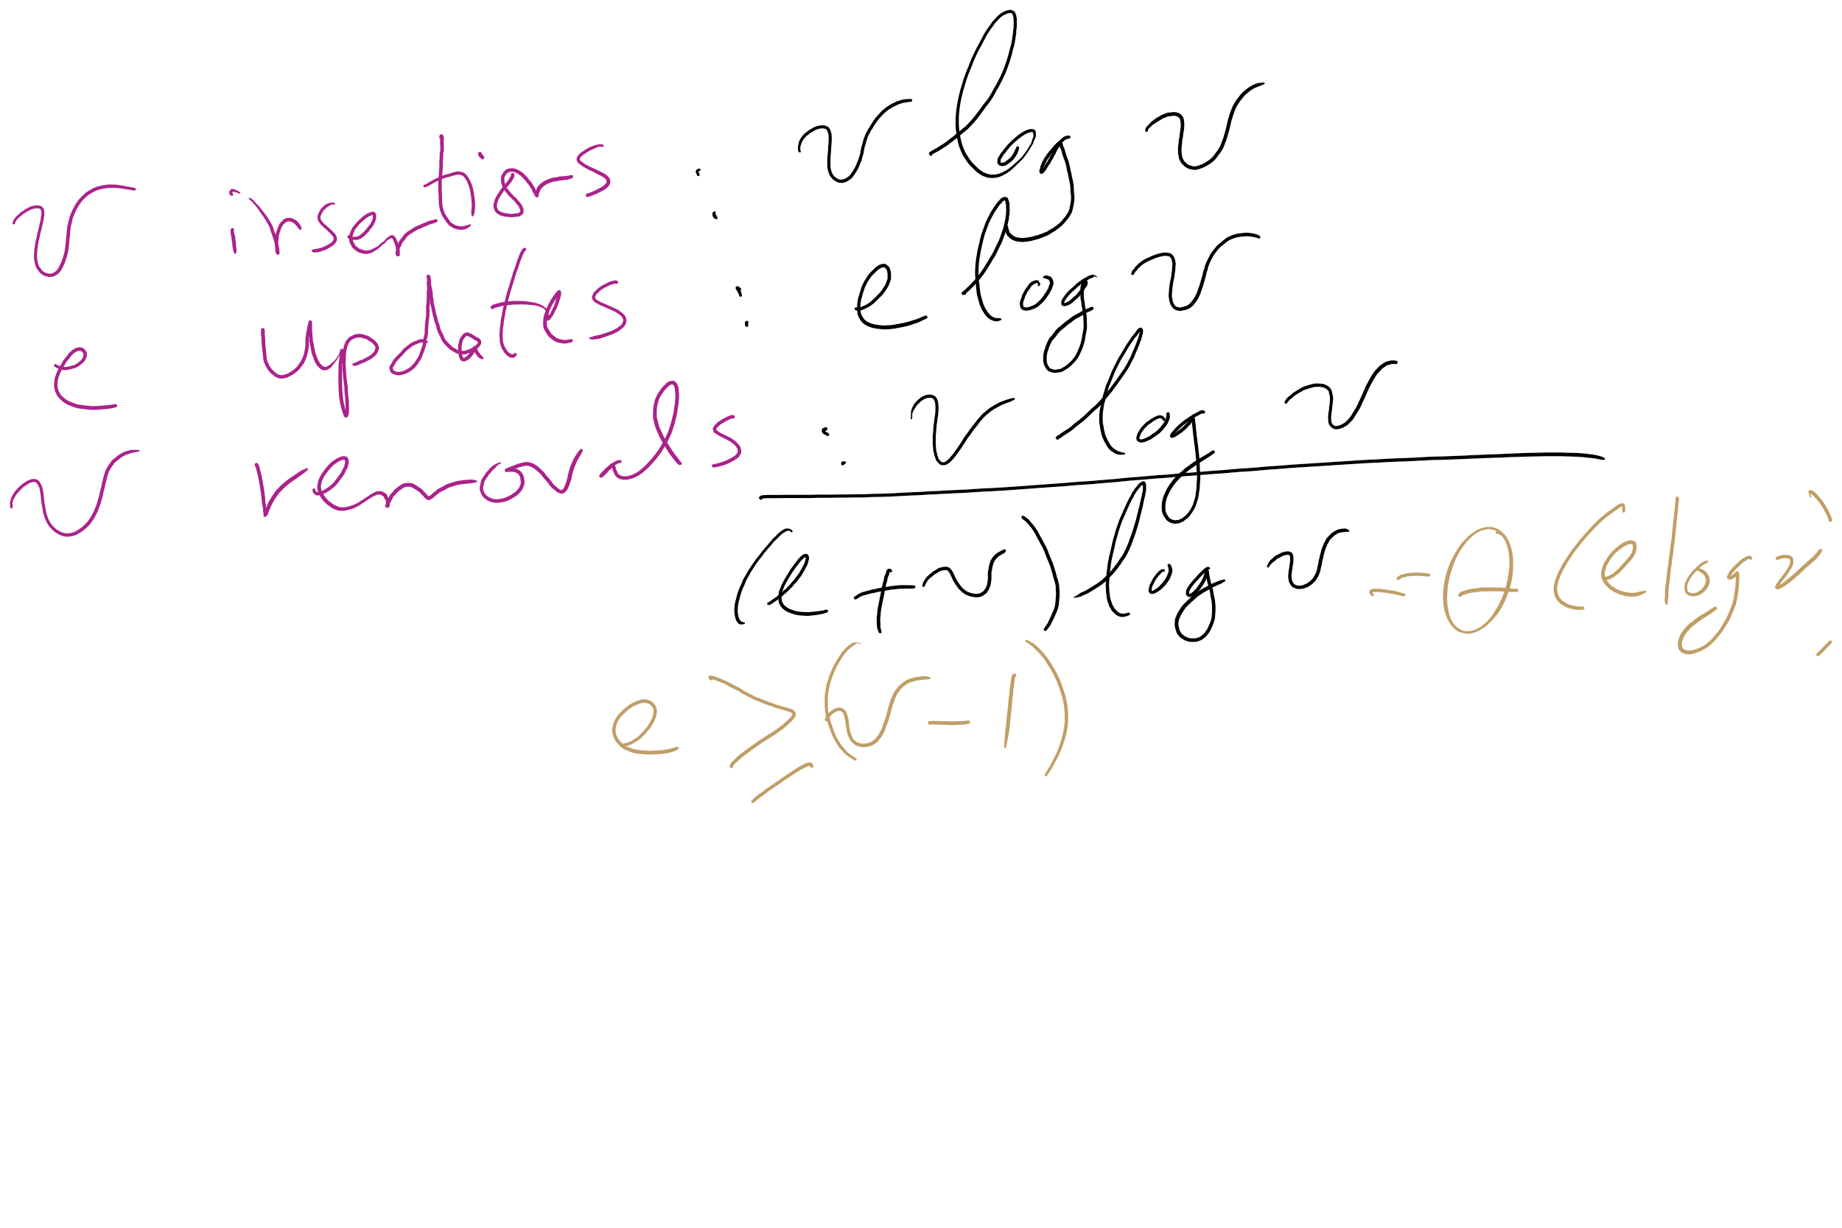
Eager Prim’s Runtime

Slide 24
Comparison of Prim’s implementations
Parent/Best Edge array Prim’s
Runtime: Θ(v²)
Space: Θ(v)
Lazy Prim’s
Runtime: Θ(e lg e)
Space: Θ(e)
Requires a PQ
Eager Prim’s
Runtime: Θ(e lg v)
Space: Θ(v)
Requires an indexable PQ
How do these compare?
Notes:
note that space requirements by these algorithms is space overhead on top of the input (how we represent the graph)

Slide 25
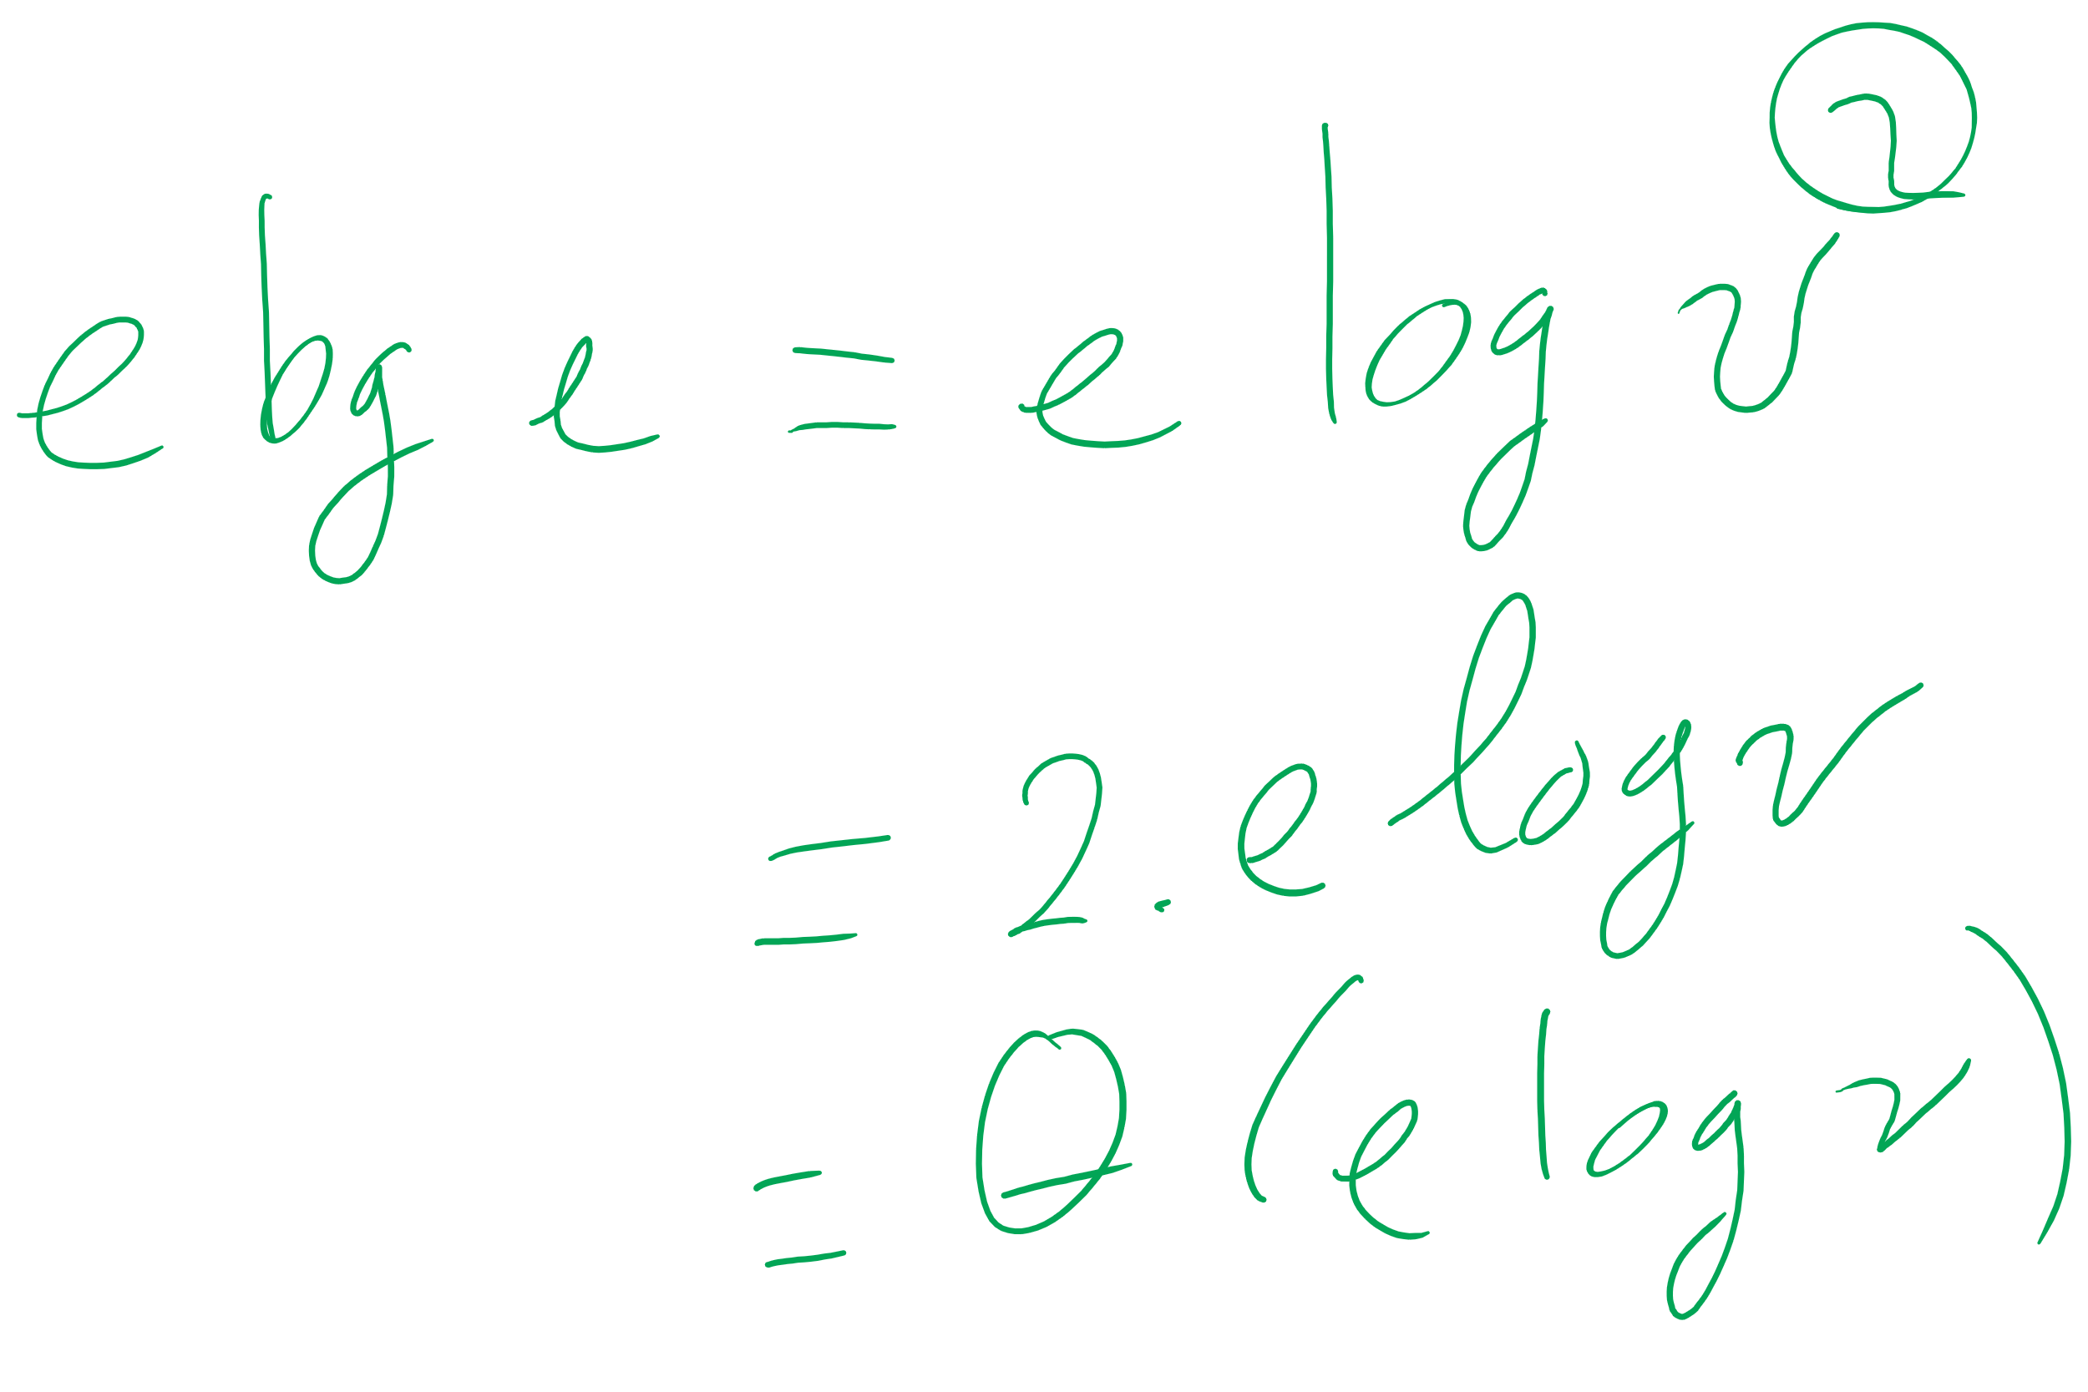
Eager vs. Lazy Prim’s

Slide 26
Back to MSTs: Another MST algorithm
Kruskal’s MST:
Insert all edges into a PQ
Grab the min edge from the PQ that does not create a cycle in the MST
Remove it from the PQ and add it to the MST

Slide 27
Kruskal's example
0
PQ:
6
5
1
1
3
1: (0, 2)
2: (3, 5)
5
5
3: (1, 4)
2
3
2
4: (2, 5)
6
4
5: (2, 3)
5: (0, 3)
4
5
6
5: (1, 2)
6: (0, 1)
6: (2, 4)
6: (4, 5)
Notes:
note that we can stop after we add (1, 2)
get the students to realize why
its connected, adding any more edges would create a cycle
do we have to stop or can we keep popping and doing cycle detection?
is it better to stop or keep going and doing cycle check for each remove?
why?
depends on time to do connected detection vs time to continue popping/cycle detection

Slide 28
Kruskal’s runtime
Instead of building up the MST starting from a single vertex, we build it up using edges all over the graph
How do we efficiently implement cycle detection?

Slide 29
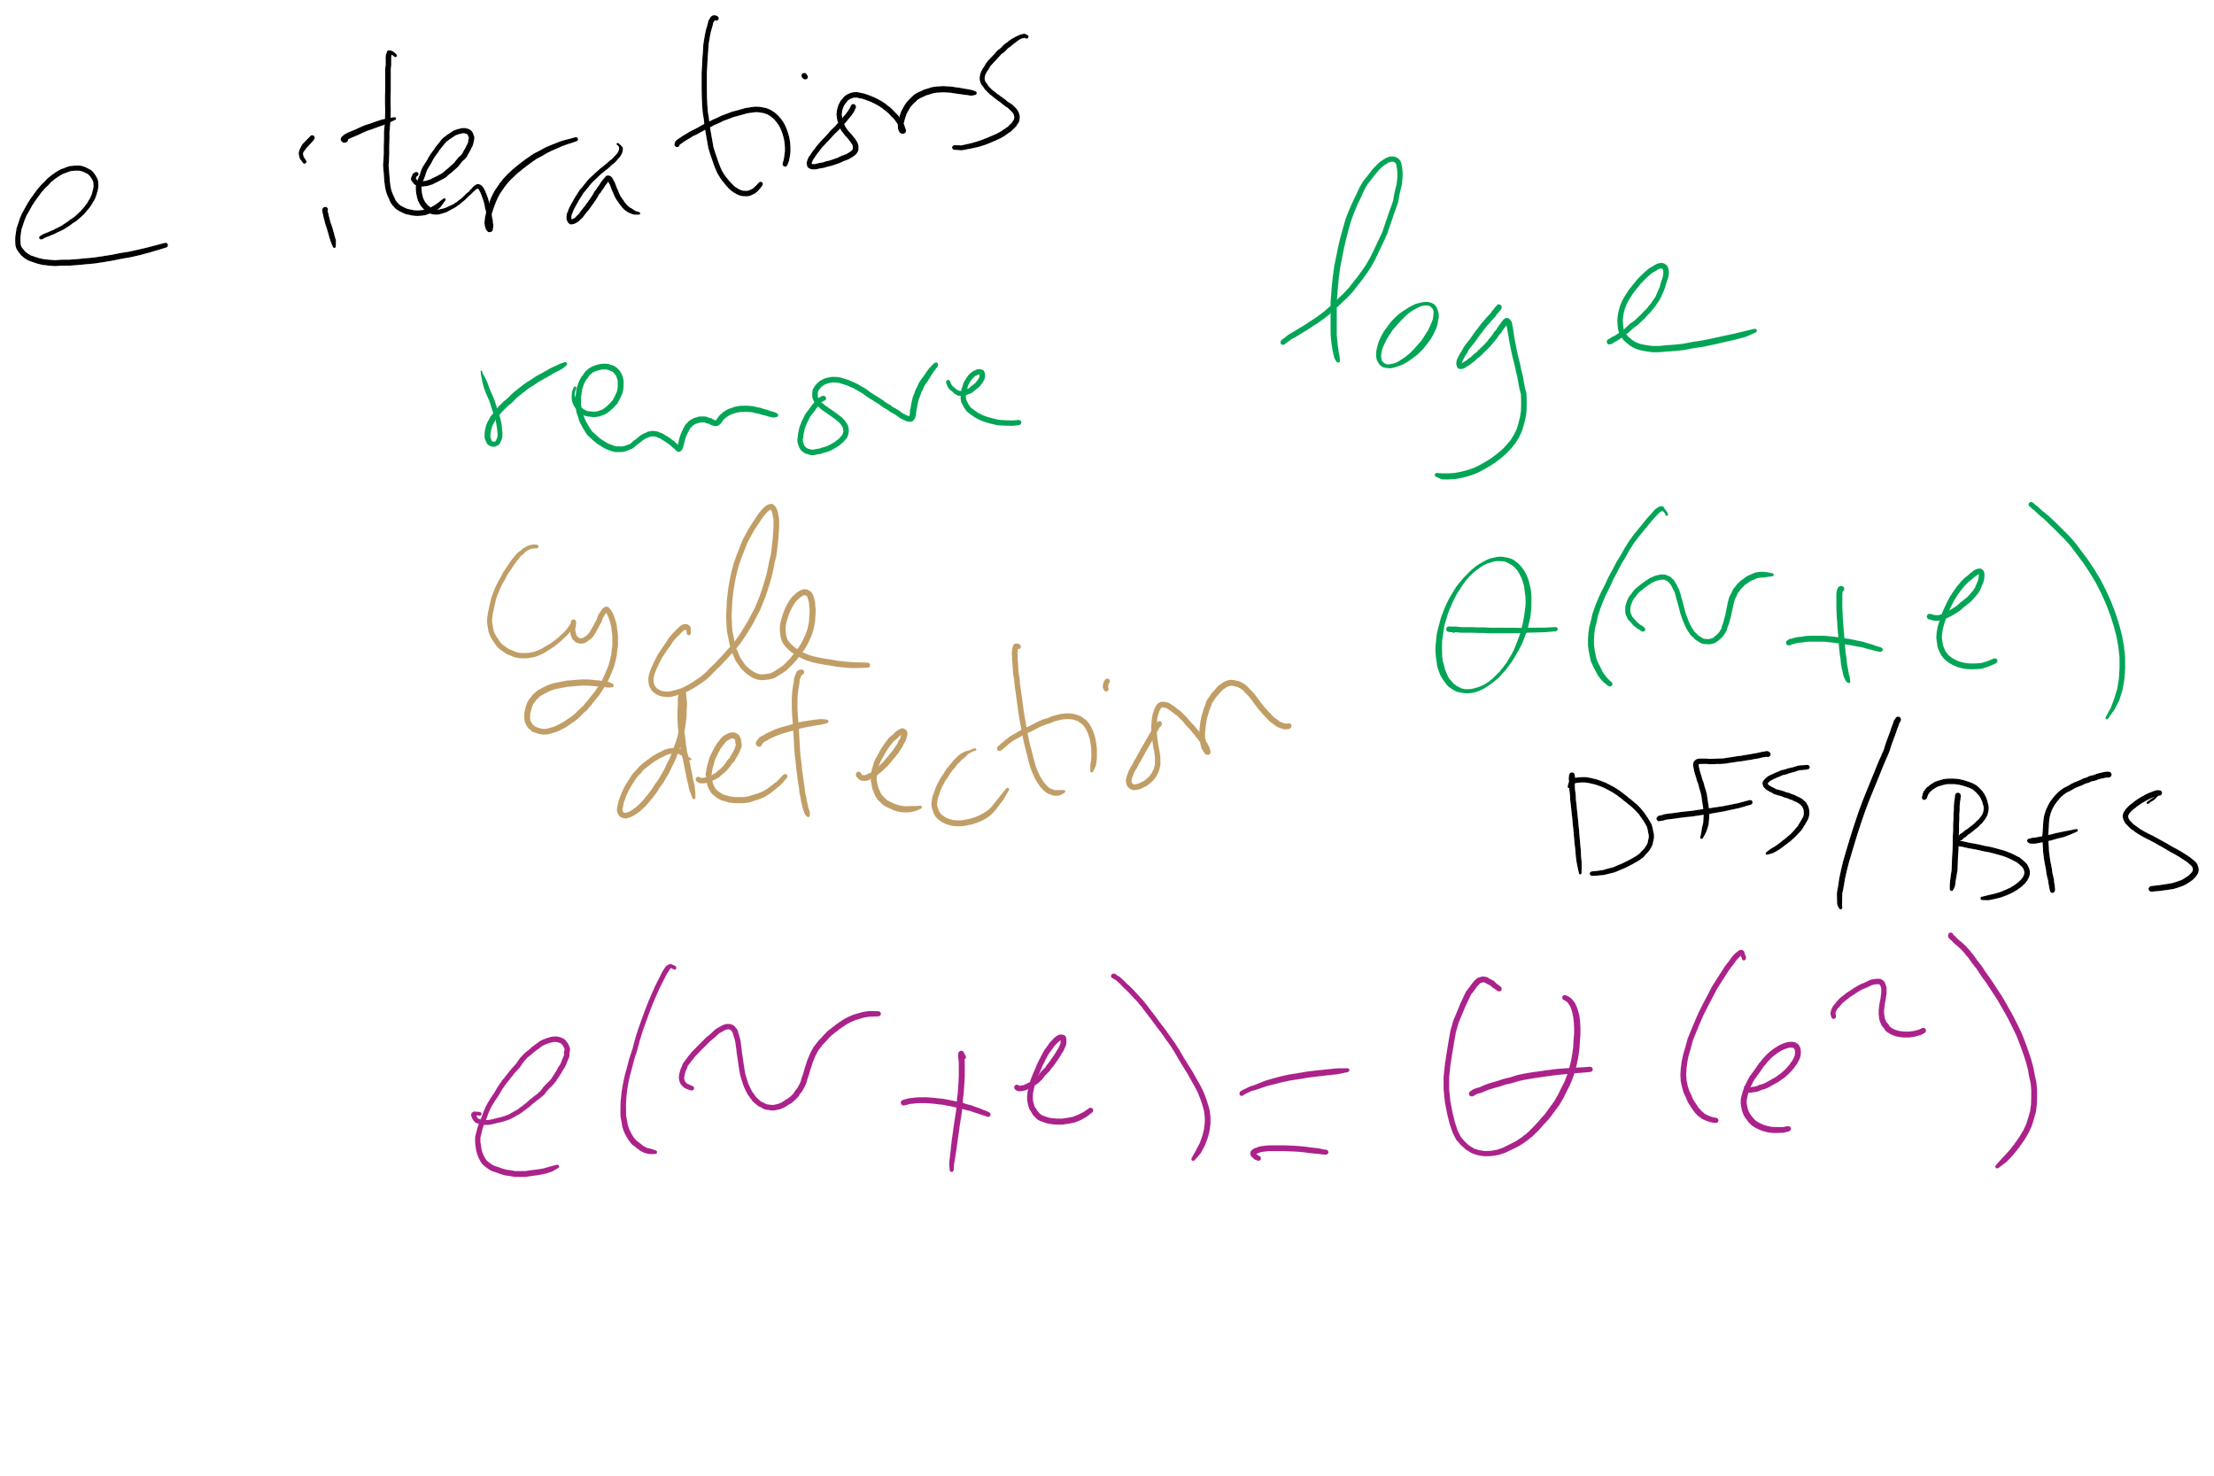
Kruskal’s Runtime: Take 1

Slide 30
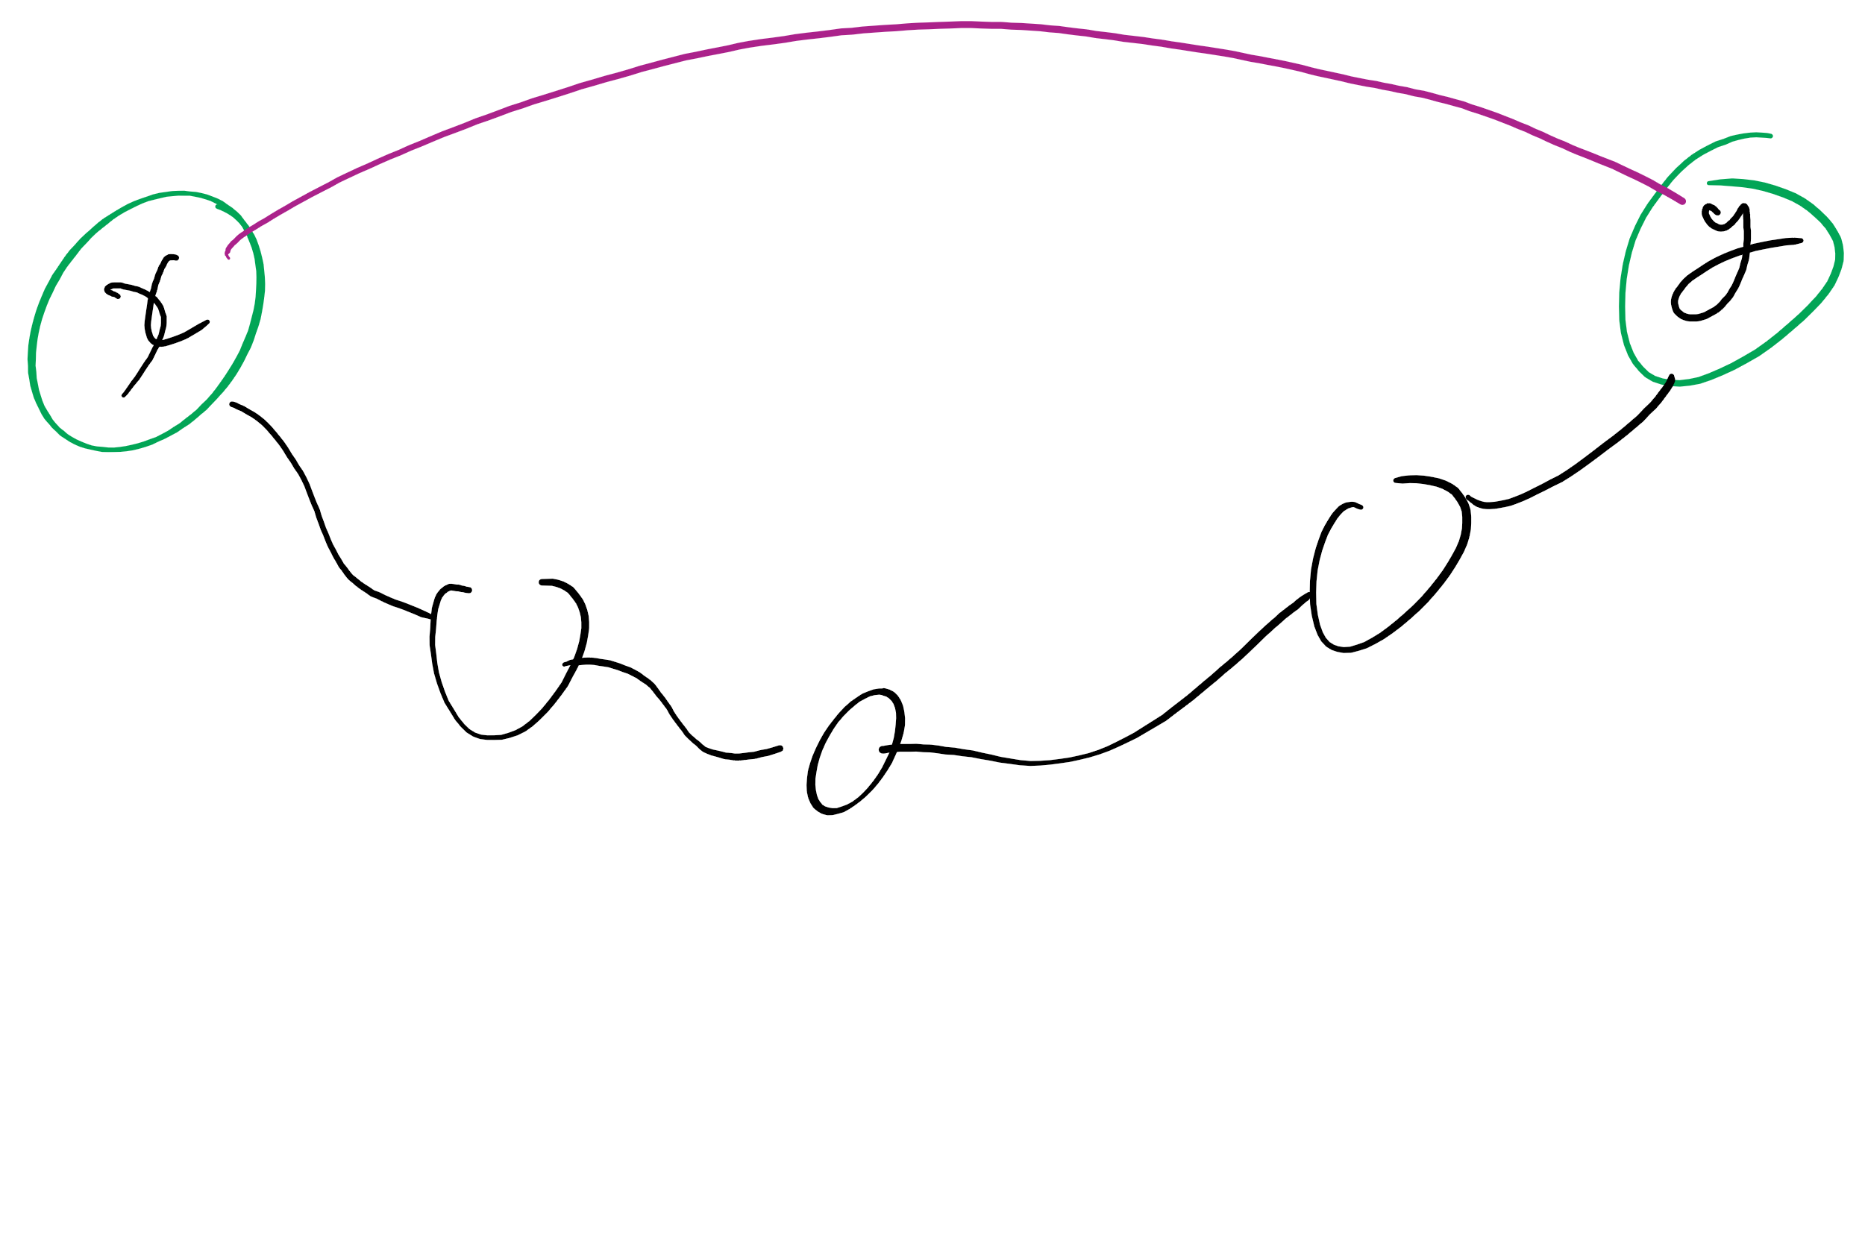
Dynamic connectivity problem
For a given graph G, can we determine whether or not two vertices are connected in G?
Can also be viewed as checking subset membership
Important for many practical applications
We will solve this problem using a union/find data structure
Notes:
after describing the problem (bullet 1), ask for a solution
Work towards getting BFS approach
Runtime?
θ(e) using adj list
How can we do better? UF

Slide 31
A simple approach
Have an id array simply store the component id for each item in the union/find structure
How do we determine if two vertices are connected?
How do we establish the connected components?
Add graph edges one at a time to UF data structure using union operations
Notes:
Ask for connected component def

Slide 32
Example
U(2, 0)
1
4
U(7, 4)
U(2, 1)
0
2
5
7
U(2, 3)
U(5, 4)
U(5, 7)
3
6
U(3, 6)
0
1
2
3
4
5
6
7
ID:
0
6
3
1
1
6
3
2
0
6
3
1
3
6
4
5
4
6
7
4
Notes:
mention how this can be view as subset membership

Slide 33
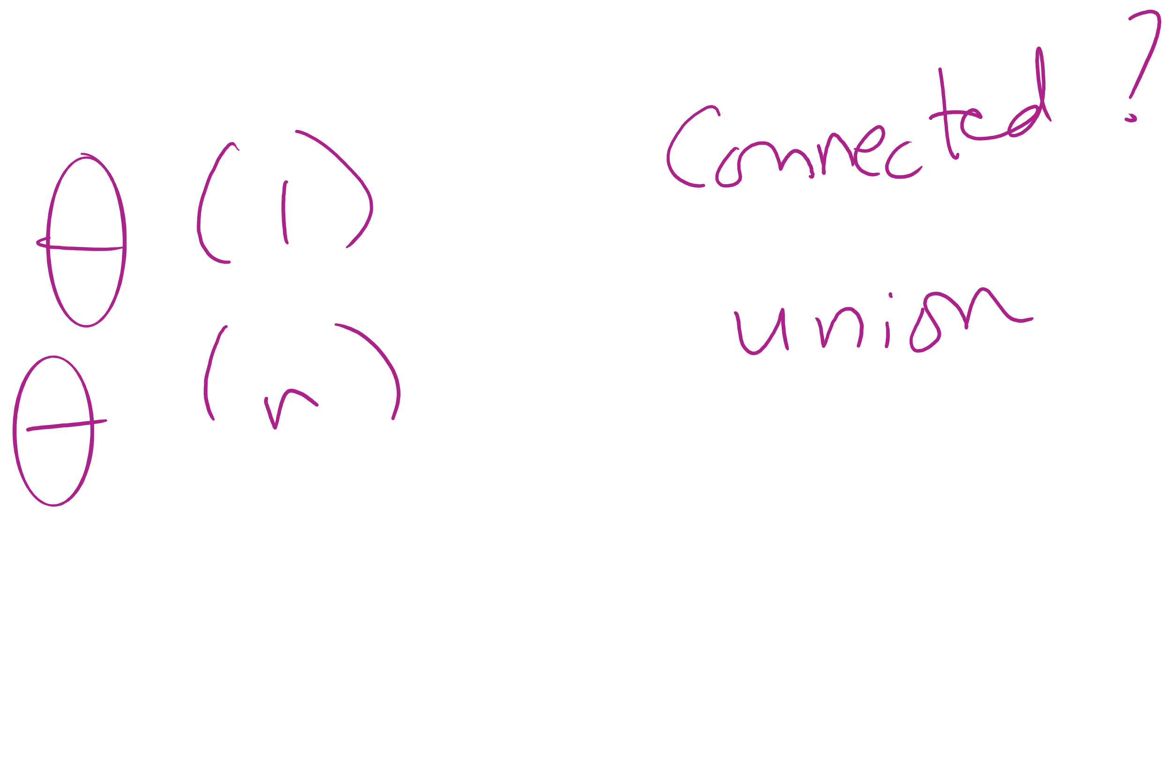
Analysis of our simple approach
Runtime?
To find if two vertices are connected?
For a union operation?
Notes:
"fast find" approach
find:
Θ(1)
union:
Θ(n)

Slide 34
Union Find API
Initialize with n items numbered 0 to n-1
UF (int n)
void union(int p, int q)
int find (int p)
boolean connected (int p, int q)
int count()
Connect p with q
Return id of the connected component that p is in
True if p and q are connected
Number of connected components

Slide 35
Covering the basics
public int count() {
return count;
}
public boolean connected(int p, int q) {
return find(p) == find(q);
}

Slide 36
Implementing the Fast-Find approach
public UF(int n) {
count = n;
id = new int[n];
for (int i = 0; i < n; i++) { id[i] = i; }
}
public int find(int p) { return id[p]; }
public void union(int p, int q) {
int pID = find(p), qID = find(q);
if (pID == qID) return;
for(int i = 0; i < id.length; i++)
if (id[i] == pID) id[i] = qID;
count--;
}

Slide 37
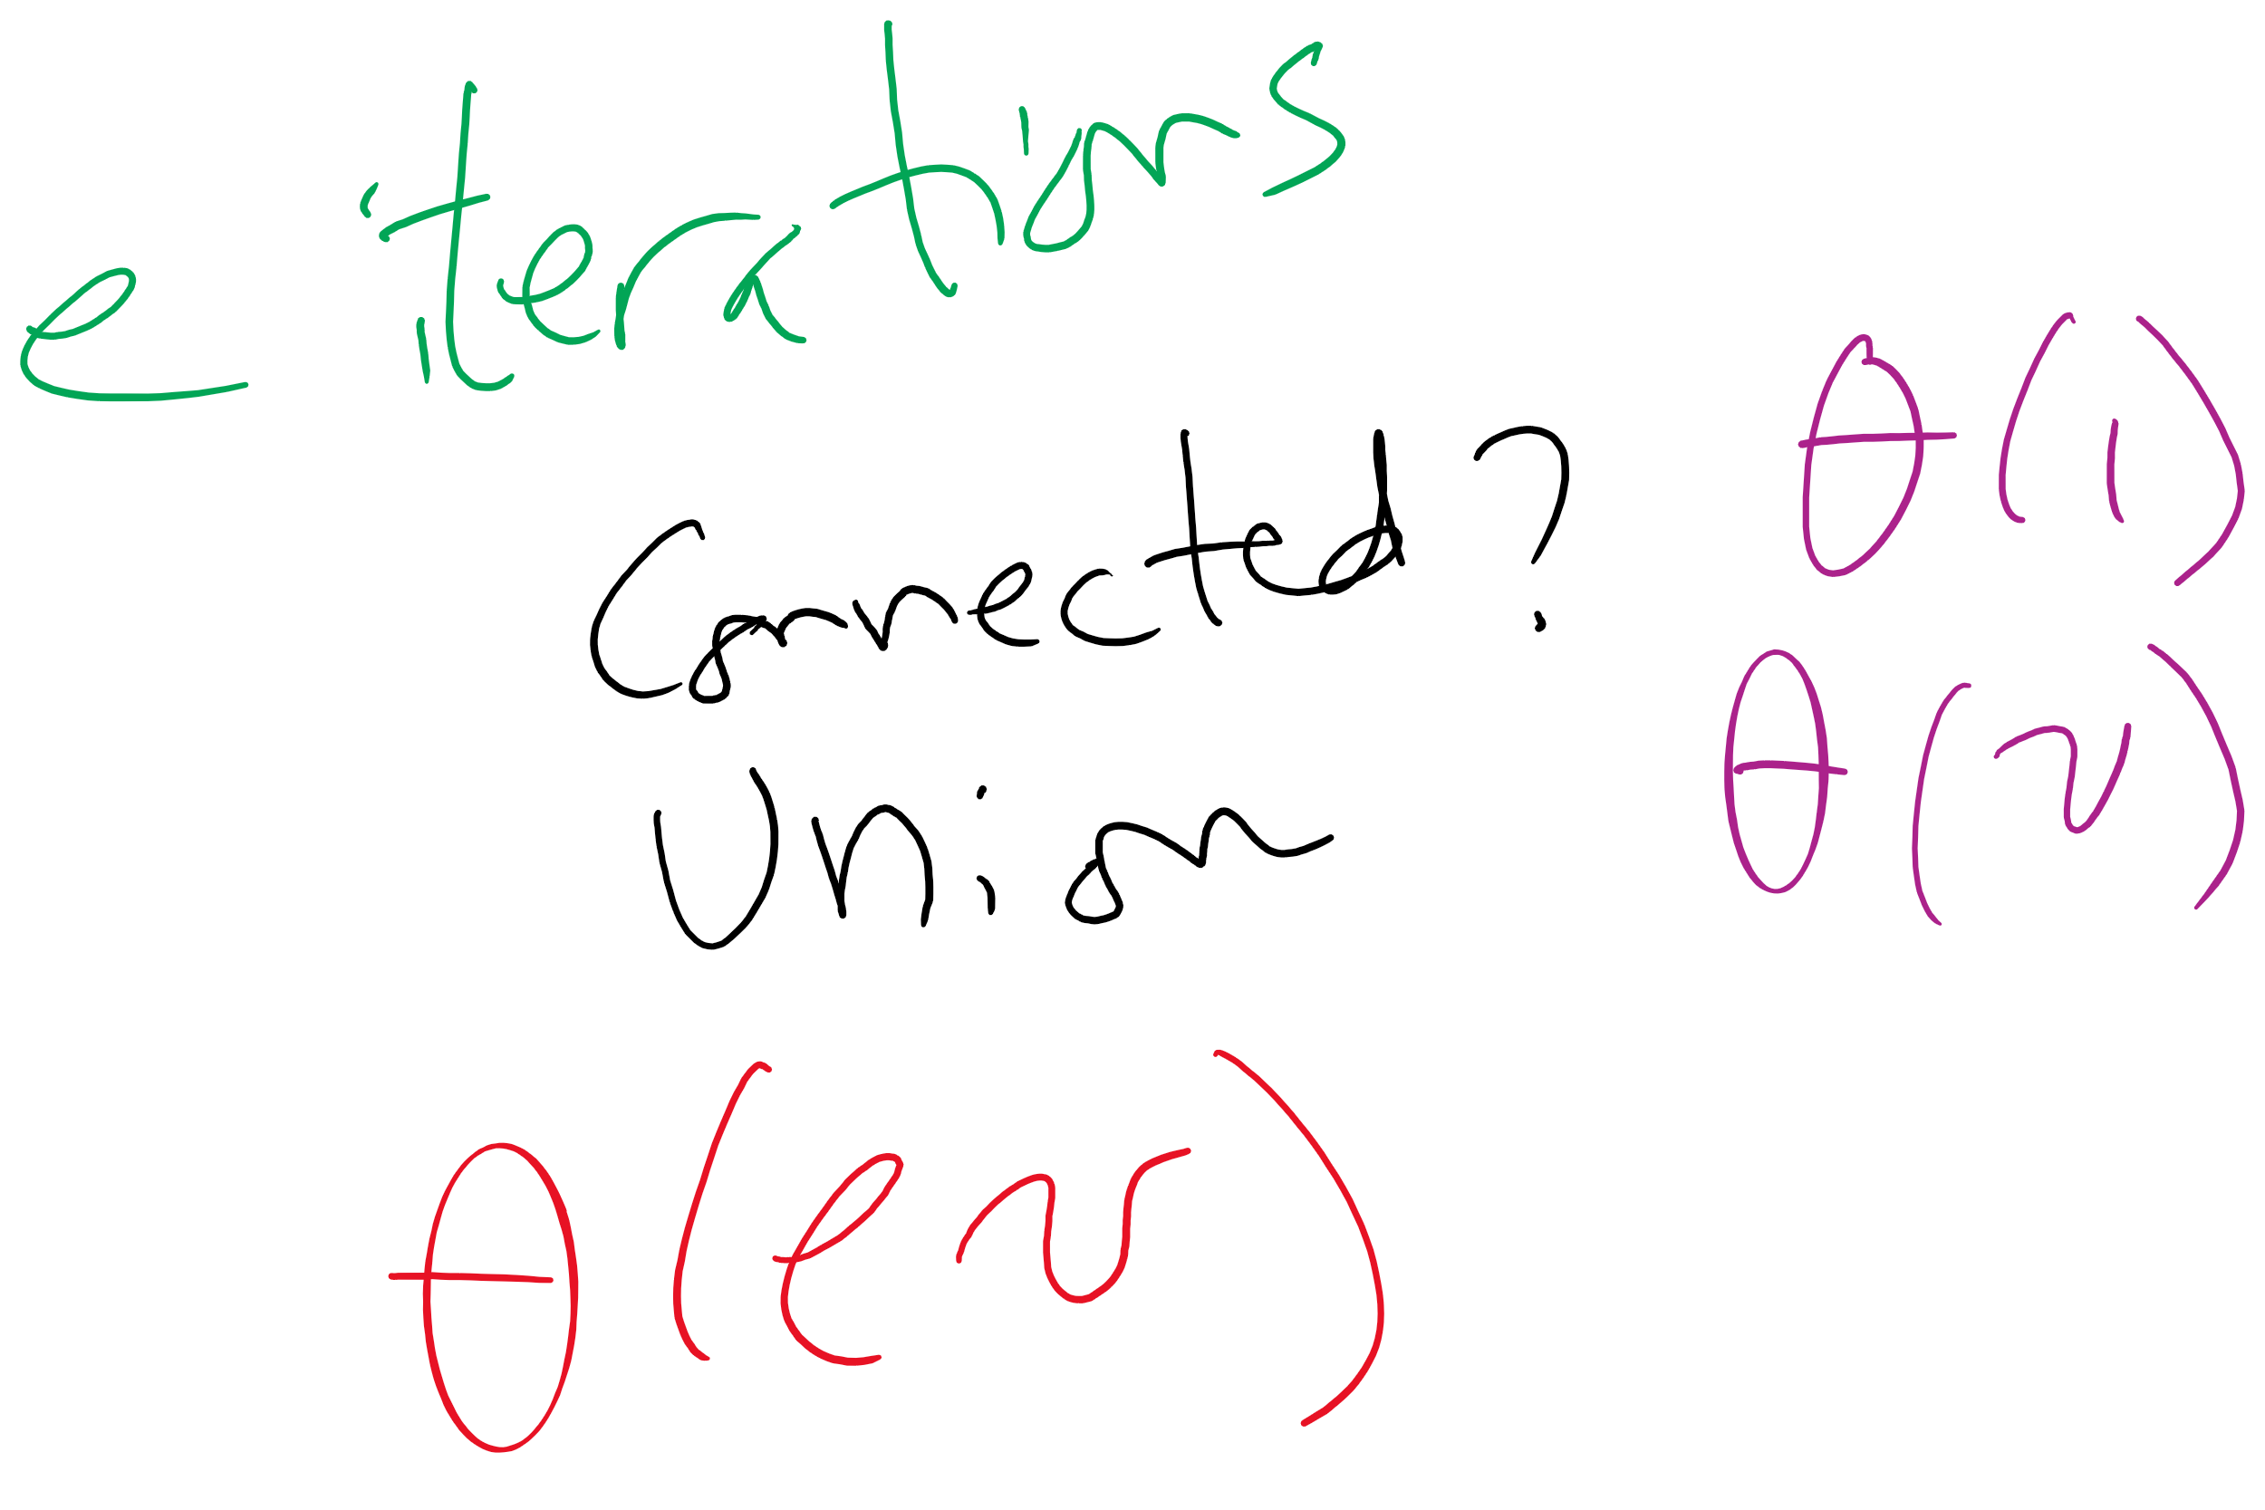
Kruskal’s algorithm Runtime: Take 2
With this knowledge of union/find, how, exactly can it be used as a part of Kruskal’s algorithm?
What is the runtime of Kruskal’s algorithm?
Notes:
Fast-Find's θ(v) union will lead to a θ(v²) runtime for Kruskal's
Each time an edge is added to the MST, need to union, hence v θ(v) union operations
These v union operations dominate runtime

