Slide 1

Algorithms and Data Structures 2 CS 1501
Fall 2021
Sherif Khattab
ksm73@pitt.edu
(Slides are adapted from Dr. Ramirez’s and Dr. Farnan’s CS1501 slides.)

Slide 2
Announcements
Upcoming deadlines:
4/9: Lab 9
4/12: Homework 11
4/16: Lab 10
4/19: Assignment 4
5/2: Assignment 5
Tophat questions are due one week after each lecture

Slide 3
Last lecture …
Ford-Fulkerson Maximum Flow “Algorithm”
Backwards Edges
Edmonds Karp
Priority-First Search

Slide 4
Muddiest points
what is an augmenting path
residual graph
Backwards edges
Finding the values of backwards edges
Why you can put flow through a backwards edge since it is not the direction that the flow is supposed to move in. (especially when the normal edge is full)
How can we go from an edge like 3/5 and then take a backwards edge 0/1 without losing flow
Is it implied that all graphs where we are considering a flow network will have backwards edges?
Second Tophat question I thought there was no path?
Are there any conventions for drawing backwards/forwards edges? Is there a way to distinguish between the two?
difference between flow and capacity for forward vs backward edges
Why the runtime goes to 2000 in the example with the /1
PFS
How we choose the path
Determining priority values using PFS
Edmonds Karp and using BFS and PFS
the last top hat example?

Slide 5
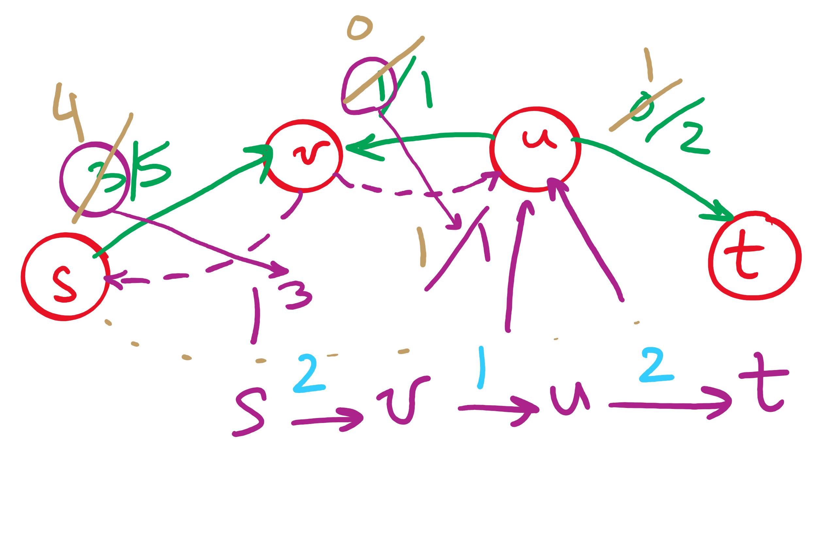
Backwards edges
Adding flow to a backwards edge means rerouting flow from the corresponding forward edge

Slide 6
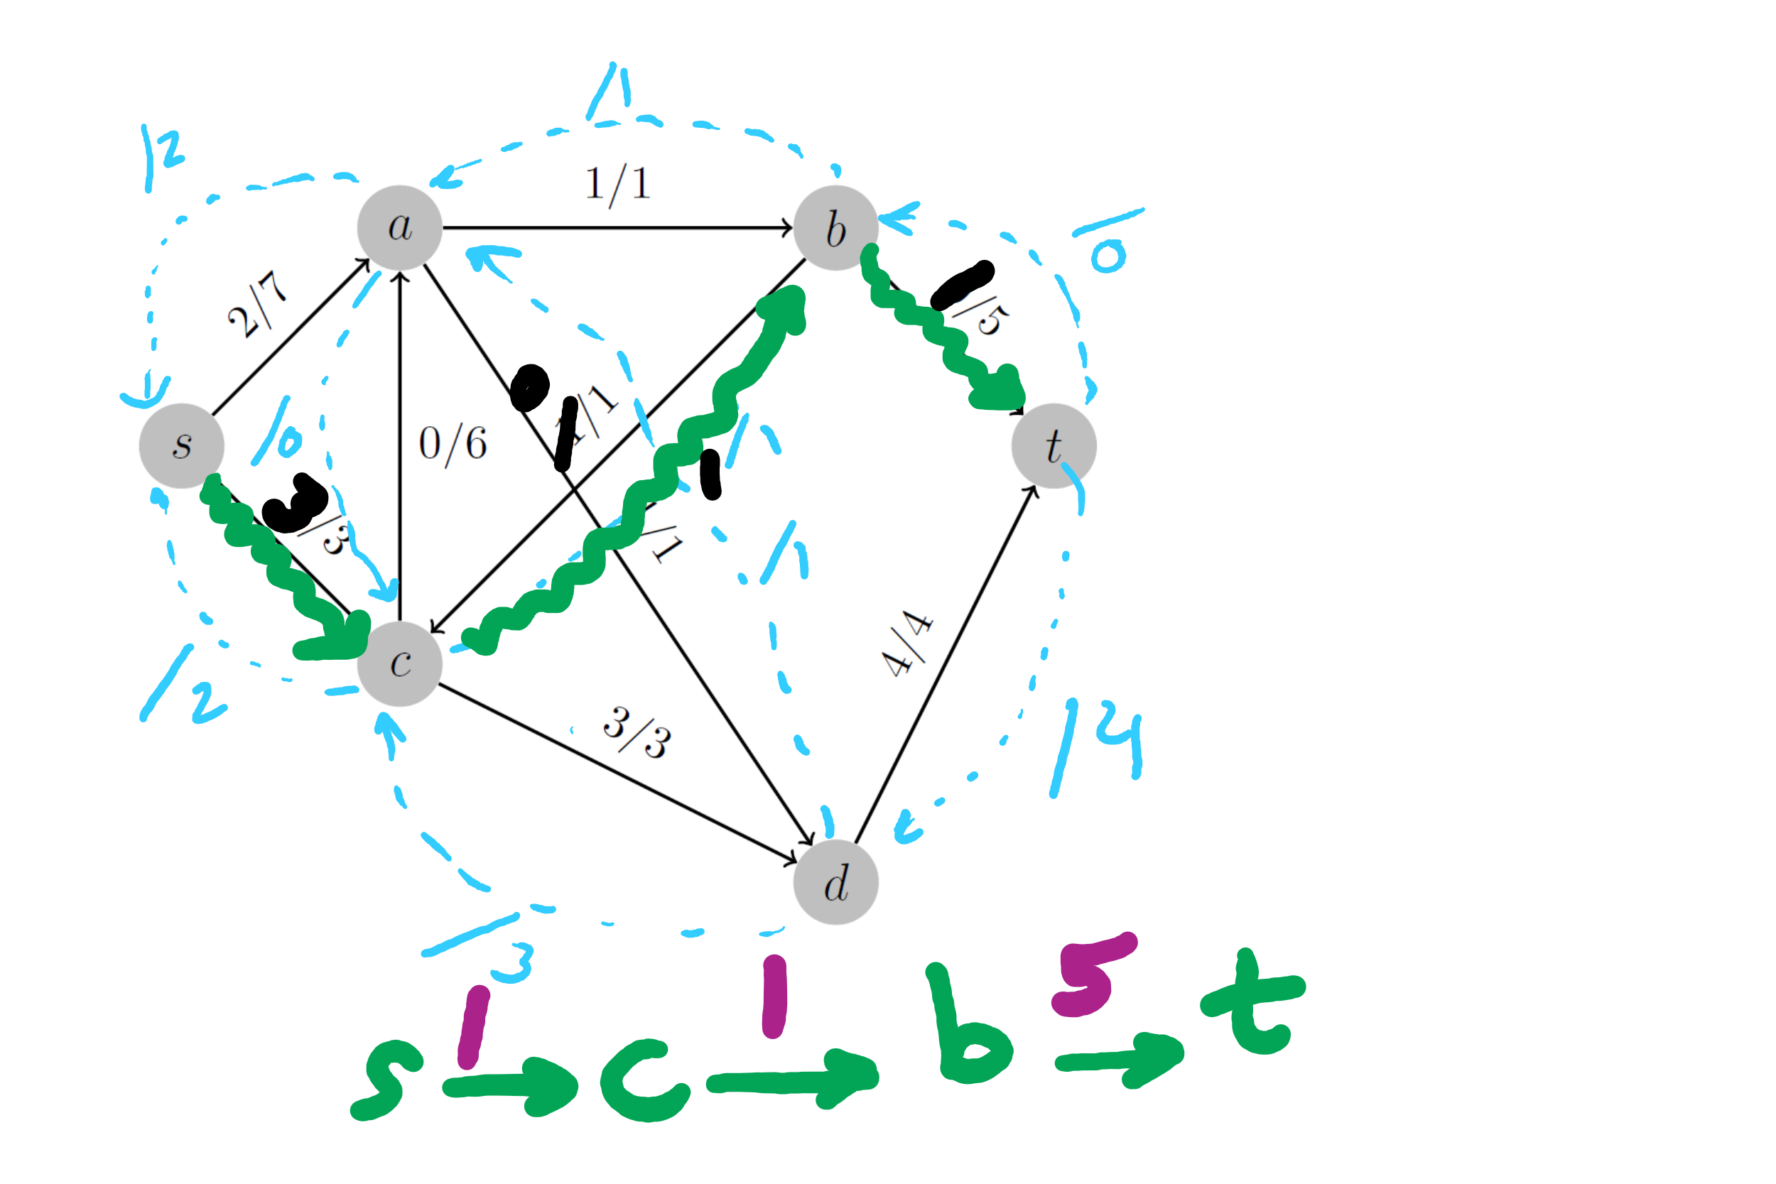
2nd Tophat Question

Slide 7
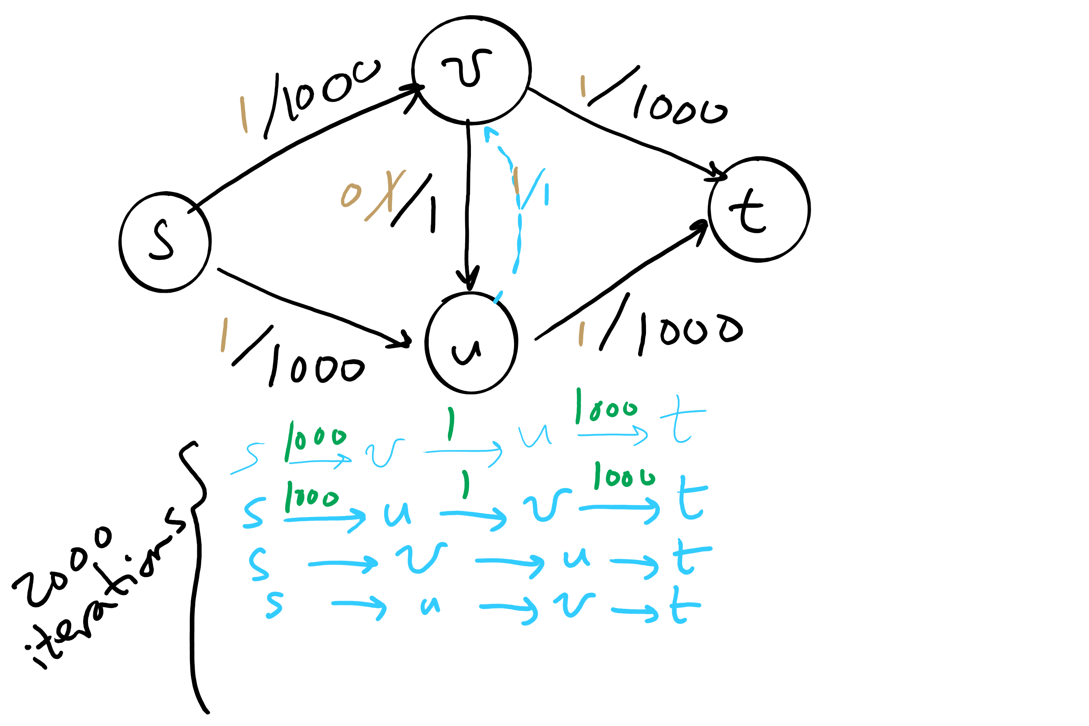
Worst-case runtime of Ford-Fulkerson

Slide 8
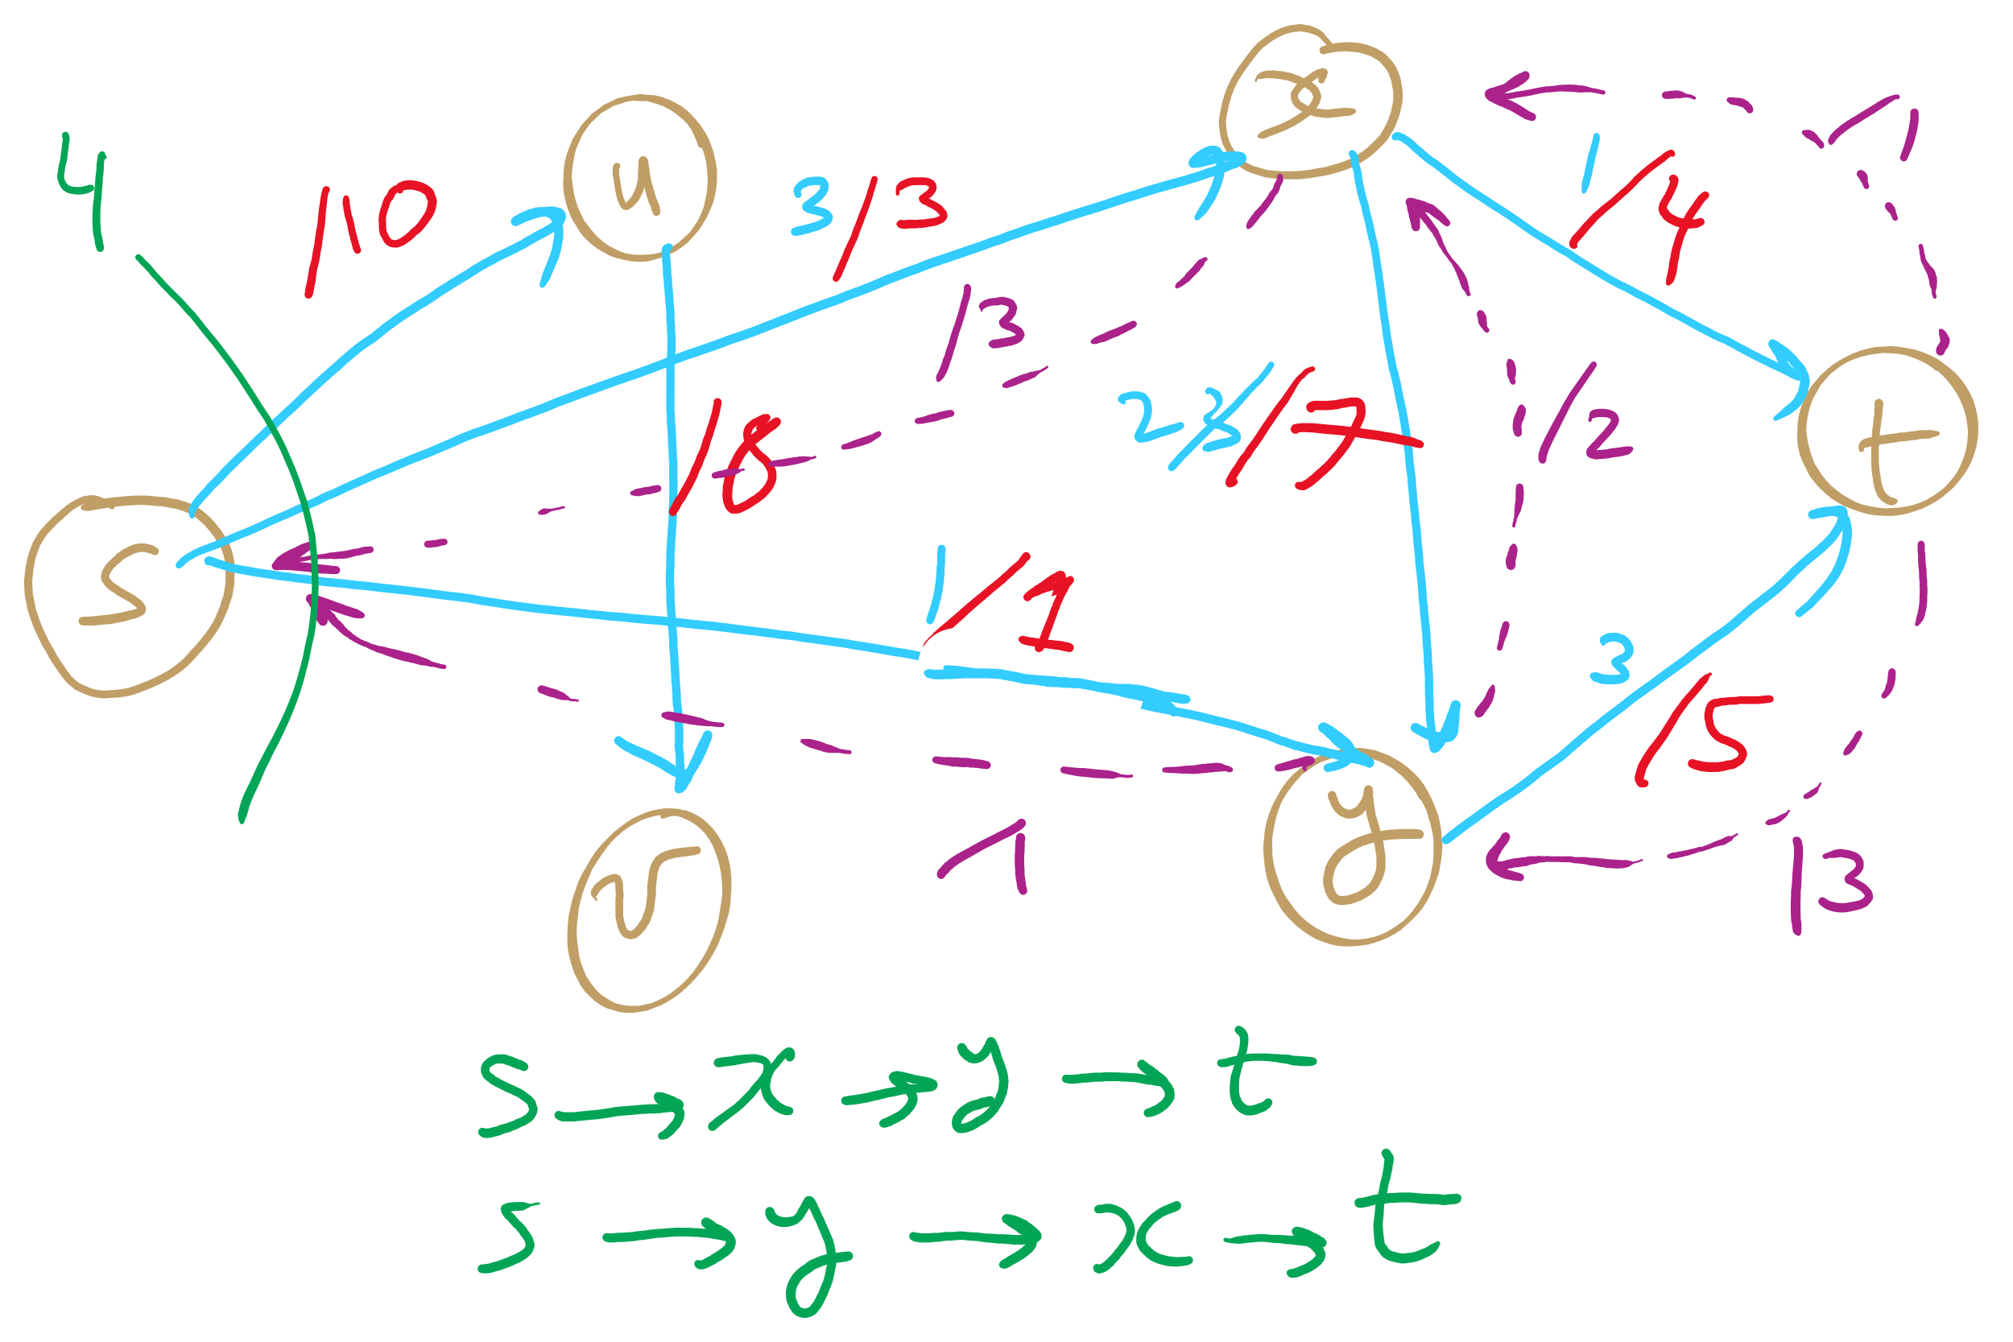
PFS Example 1

Slide 9
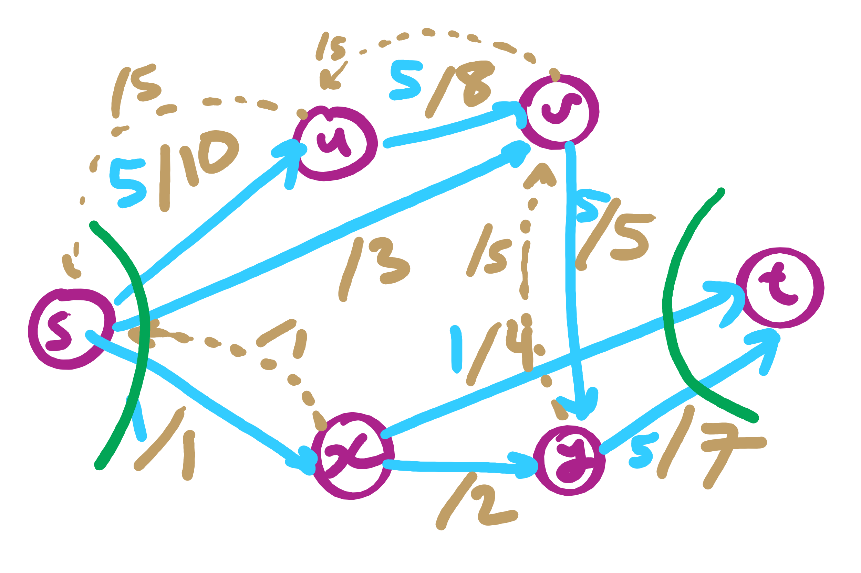
PFS Example 2

Slide 10
This Lecture
Max Flow implementation issues
Min Cut
(Big)Integer Algorithms
multiplication
exponentiation
GCD

Slide 11
Implementation concerns
Representing the graph:
Similar to a directed graph
Can store an adjacency list of directed edges
Actually, more than simply directed edges
Flow edges

Slide 12
Flow edge implementation
For each edge, we need to store:
Start point, the from vertex
End point, the to vertex
Capacity
Flow
Residual capacities
For forwards and backwards edges

Slide 13
FlowEdge.java
public class FlowEdge {
private final int v; // from
private final int w; // to
private final double capacity; // capacity
private double flow; // flow
…
public double residualCapacityTo(int vertex) {
if (vertex == v) return flow;
else if (vertex == w) return capacity - flow;
else throw new
IllegalArgumentException("Illegal endpoint");
}
…
}

Slide 14
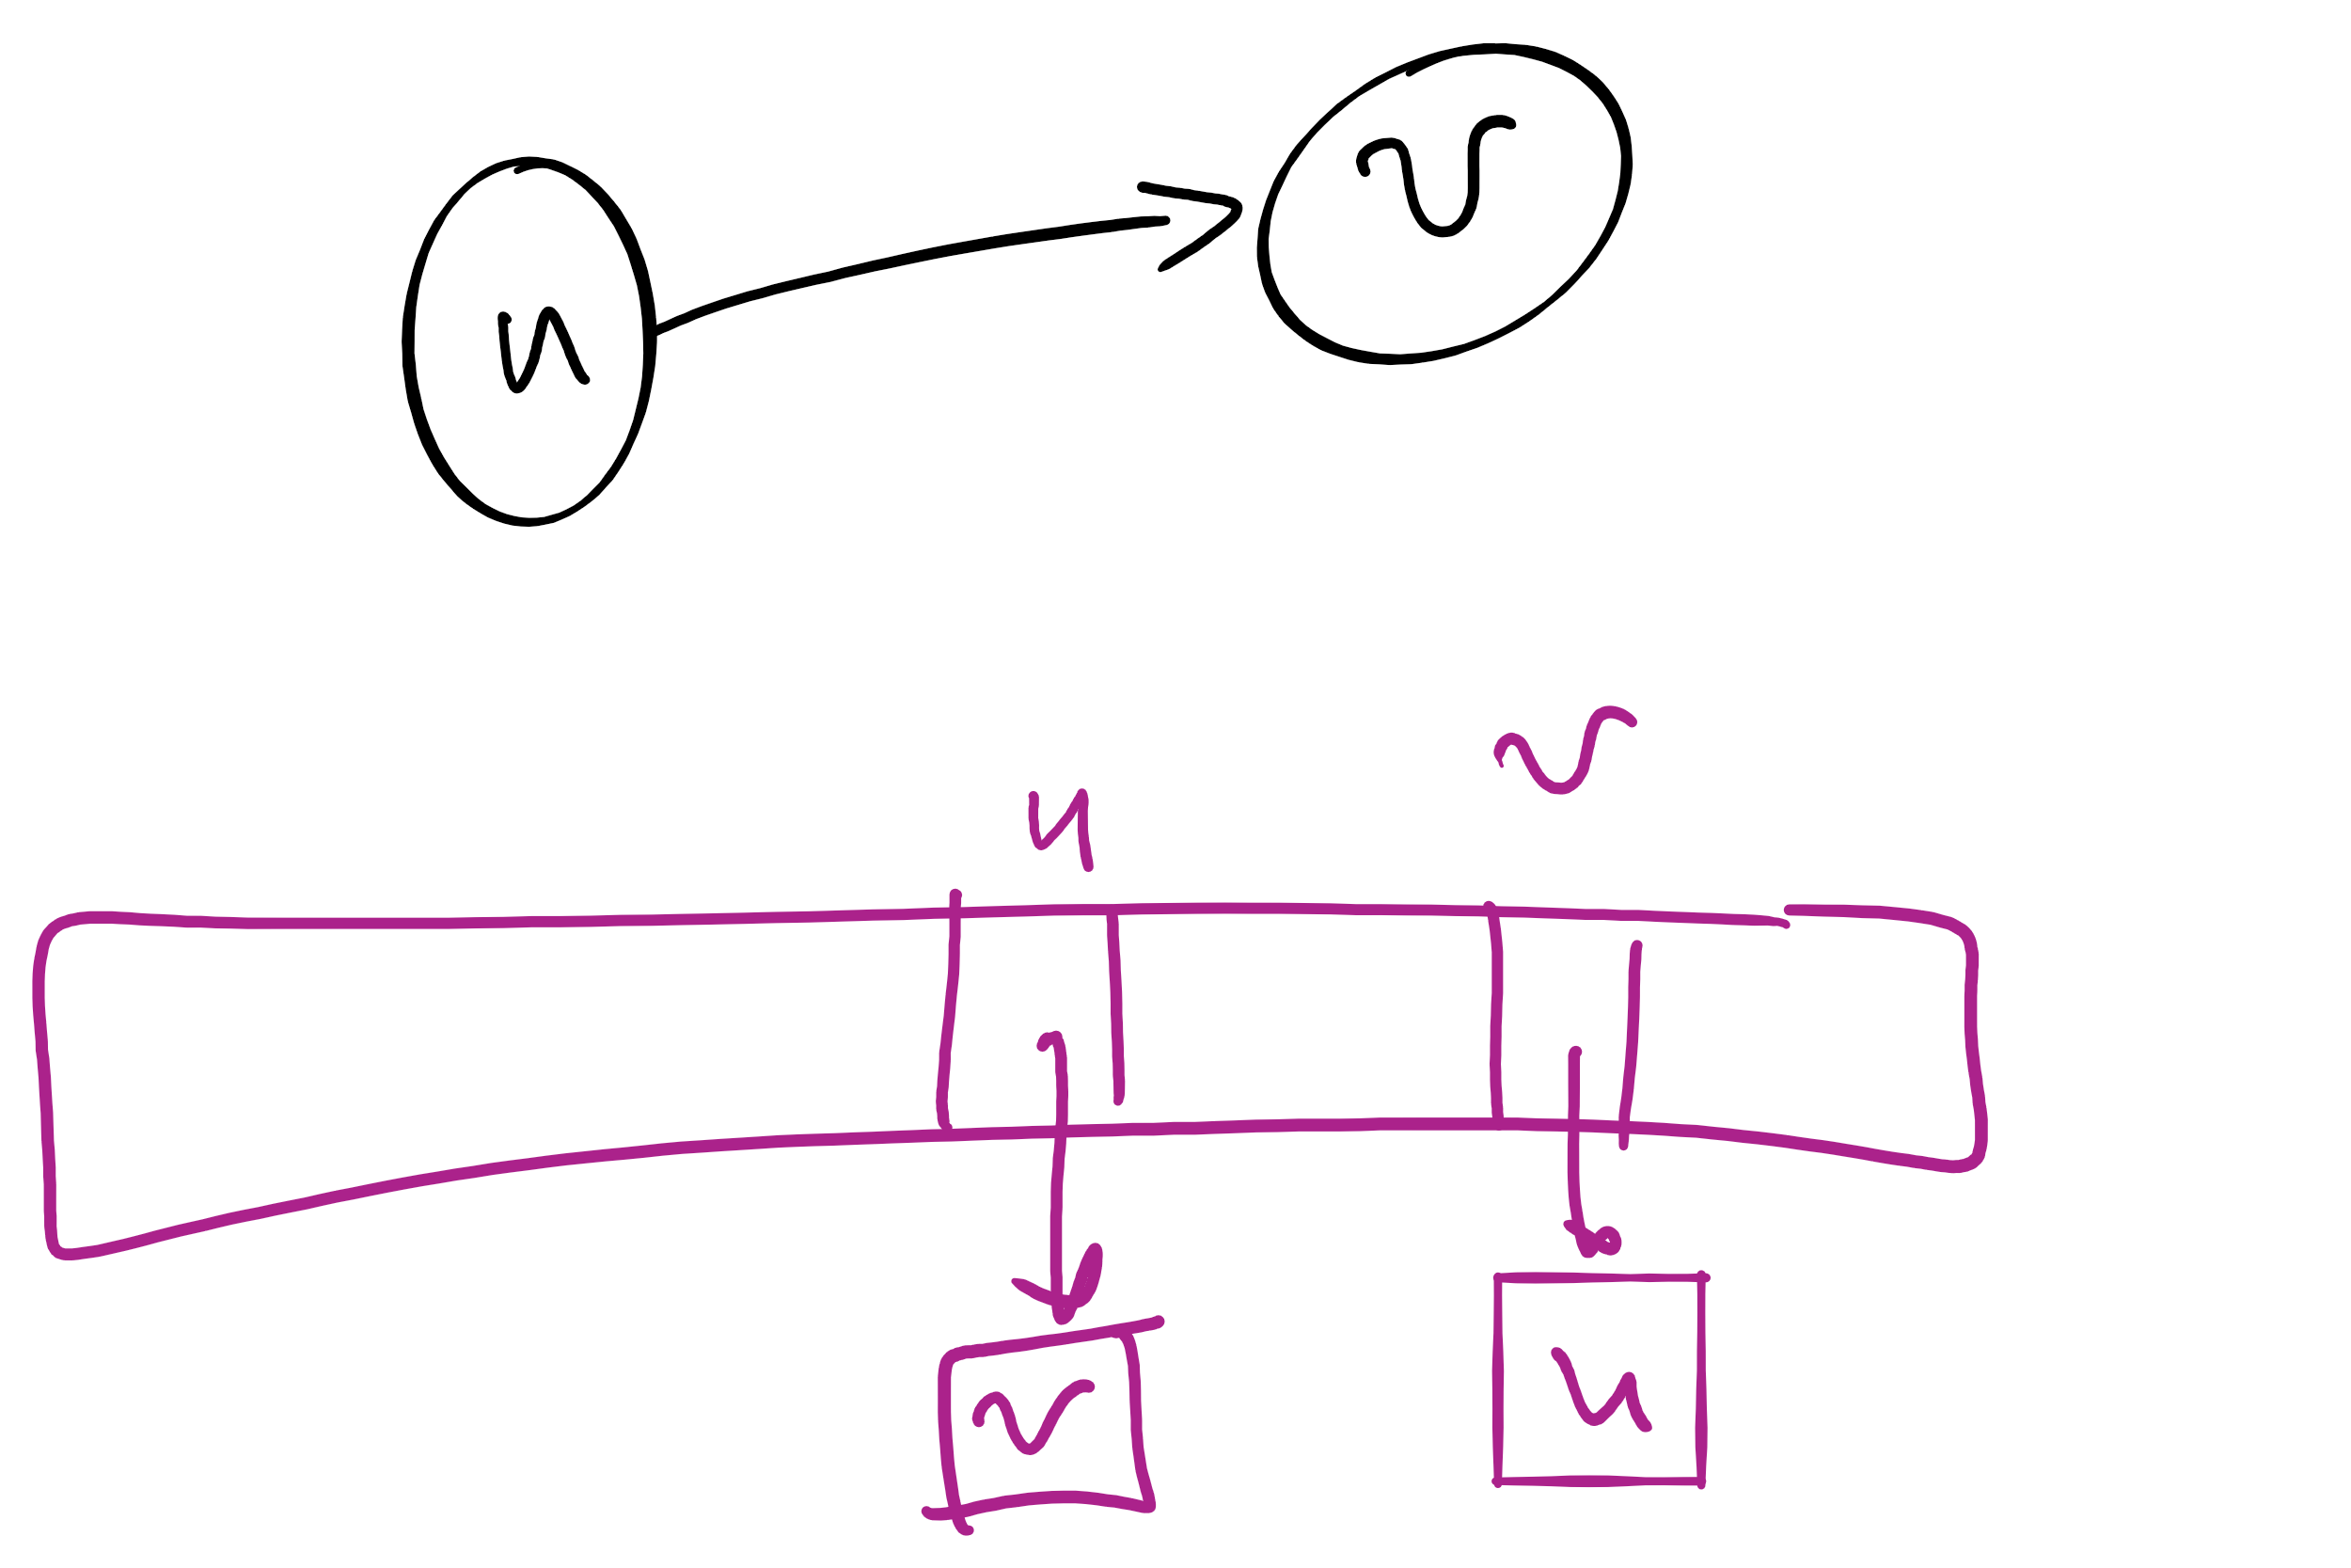
BFS search for an augmenting path (pseudocode)
edgeTo = [|V|]
marked = [|V|]
Queue q
q.enqueue(s)
marked[s] = true
while !q.isEmpty():
v = q.dequeue()
for each (v, w) in AdjList[v]:
if residualCapacity(v, w) > 0:
if !marked[w]:
edgeTo[w] = v;
marked[w] = true;
q.enqueue(w);
Each FlowEdge object is stored in the adjacency list twice:
Once for its forward edge
Once for its backwards edge

Slide 15
An example to review
A
1
/1
/3
1
3
/7
2
s
C
t
2
/5
5
/7
3
3
/9
B
Notes:
Will the max flow always be the edges going into or out of the source/sink?
No! get the students to imagine a graph where this is the case

Slide 16
Let's separate the graph
An st-cut on G is a set of edges in G that, if removed, will partition the vertices of G into two disjoint sets
One contains s
One contains t
May be many st-cuts for a given graph
Let’s focus on finding the minimum st-cut
The st-cut with the smallest capacity
May not be unique

Slide 17
How do we find the min st-cut?
We could examine residual graphs
Specifically, try and allocate flow in the graph until we get to a residual graph with no existing augmenting paths
A set of saturated edges will make a minimum st-cut

Slide 18
Min cut example
A
1
/1
/3
1
3
/7
2
s
C
t
2
/5
5
/7
3
3
/9
B
Notes:
Will the max flow always be the edges going into or out of the source/sink?
No! get the students to imagine a graph where this is the case

Slide 19
Max flow == min cut
A special case of duality
I.e., you can look at an optimization problem from two angles
In this case to find the maximum flow or minimum cut
In general, dual problems do not have to have equal solutions
The differences in solutions to the two ways of looking at the problem is referred to as the duality gap
If the duality gap = 0, strong duality holds
Max flow/min cut uphold strong duality
If the duality gap > 0, weak duality holds

Slide 20
Determining a minimum st-cut
First, run Ford Fulkerson to produce a residual graph with no further augmenting paths
The last attempt to find an augmenting path will visit every vertex reachable from s
Edges with only one endpoint in this set comprise a minimum st-cut

Slide 21
Determining the min cut
A
A
/1
1
/3
2
3
/7
s
s
C
C
t
5
/5
/7
3
3
/9
Min Cut
B
B
Notes:
Green is the set of seen vertices reachable from s

Slide 22
Max flow / min cut on unweighted graphs
Is it possible?
How would we measure the Max flow / min cut?
What would an algorithm to solve this problem look like?

Slide 23
Unweighted network flow
A
F
s
B
E
t
C
D
Notes:
Red: edge begin used in BFS pathfinding alg
Blue: edge has flow allocated to it

Slide 24
Integer multiplication
Say we have 5 baskets with 8 apples in each
How do we determine how many apples we have?
Count them all?
That would take a while…
Since we know we have 8 in each basket, and 5 baskets, lets simply add 8 + 8 + 8 + 8 + 8
= 40!
This is essentially multiplication!
8 * 5 = 8 + 8 + 8 + 8 + 8

Slide 25
What about bigger numbers?
Like 1284 * 1583, I mean!
That would take way longer than counting the 40 apples!
Let's think of it like this:
1284 * 1583 = 1284*3 + 1284*80 + 1284*500 + 1284*1000
1284
x 1583
3852
+ 102720
+ 642000
+ 1284000
= 2032572

Slide 26
OK, I’m guessing we all knew that...
… and learned it quite some time ago …
So why bring it up now? What is there to cover about multiplication
What is the runtime of this multiplication algorithm?
For 2 n-digit numbers:
n²
Notes:
What is the size of our input?
Note that as stated this is also n² space, but need not be

Slide 27
Yeah, but the processor has a MUL instruction
Assuming x86
Given two 32-bit integers, MUL will produce a 64-bit integer in a few cycles
What about when we need to multiply large ints?
VERY large ints?
RSA keys should be 2048 bits
Back to grade school…

Slide 28
Gradeschool algorithm on binary numbers
10100000100
x 11000101111
10100000100
101000001000
1010000010000
10100000100000
000000000000000
1010000010000000
00000000000000000
000000000000000000
0000000000000000000
10100000100000000000
101000001000000000000
111110000001110111100

Slide 29
How can we improve our runtime?
Let’s try to divide and conquer:
Break our n-bit integers in half:
x = 1001011011001000, n = 16
Let the high-order bits be x_{H} = 10010110
Let the low-order bits be x_{L} = 11001000
x = 2^{n/2}x_{H} + x_{L}
Do the same for y
x * y = (2^{n/2}x_{H} + x_{L}) * (2^{n/2}y_{H} + y_{L})
x * y = 2^{n}x_{H}y_{H} + 2^{n/2}(x_{H}y_{L} + x_{L}y_{H}) + x_{L}y_{L}

Slide 30
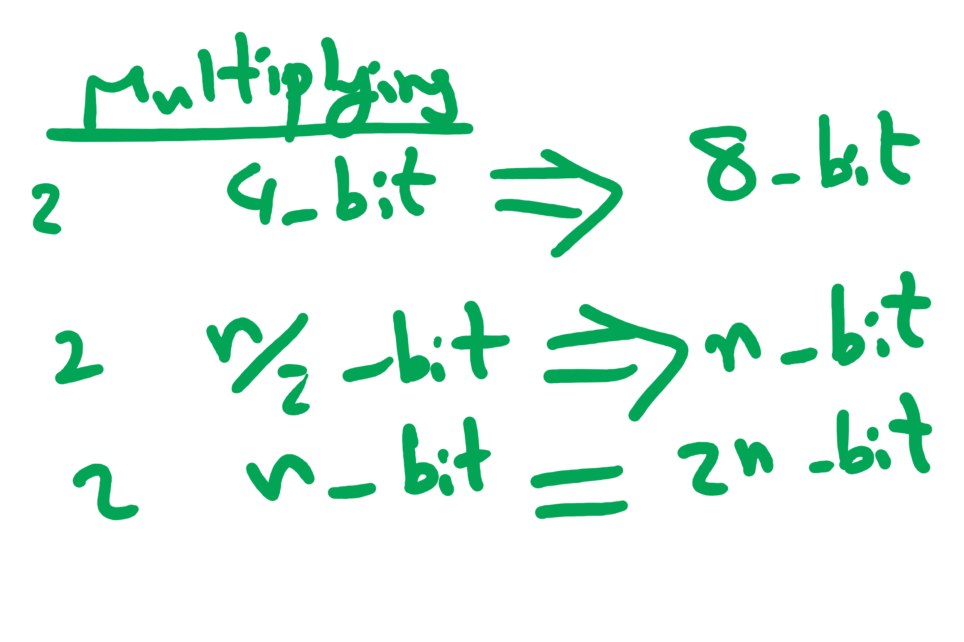
So what does this mean?
4 multiplications of n/2 bit integers
3 additions of n-bit integers
2^{n}x_{H}y_{H} + 2^{n/2}(x_{H}y_{L} + x_{L}y_{H}) + x_{L}y_{L}
A couple shifts of up to n positions
Actually 16 multiplications of n/4 bit integers
(plus additions/shifts)
Actually 64 multiplications of n/8 bit integers
(plus additions/shifts)
...

Slide 31
So what's the runtime???
Recursion really complicates our analysis…
We’ll use a recurrence relation to analyze the recursive runtime
Goal is to determine:
How much work is done in the current recursive call?
How much work is passed on to future recursive calls?
All in terms of input size

Slide 32
Recurrence relation for divide and conquer multiplication
Assuming we cut integers exactly in half at each call
I.e., input bit lengths are a power of 2
Work in the current call:
Shifts and additions are Θ(n)
Work left to future calls:
4 more multiplications on half of the input size
T(n) = 4T(n/2) + Θ(n)

Slide 33
Soooo… what’s the runtime?
Need to solve the recurrence relation
Remove the recursive component and express it purely in terms of n
A “cookbook” approach to solving recurrence relations:
The master theorem

Slide 34
The master theorem
Usable on recurrence relations of the following form:
T(n) = aT(n/b) + f(n)
Where:
a is a constant >= 1
b is a constant > 1
and f(n) is an asymptotically positive function
Notes:
Note this does NOT cover nearly all possible recurrence relations, just really handy for alot of them
We will need more different techniques for more problematic recurrences

Slide 35
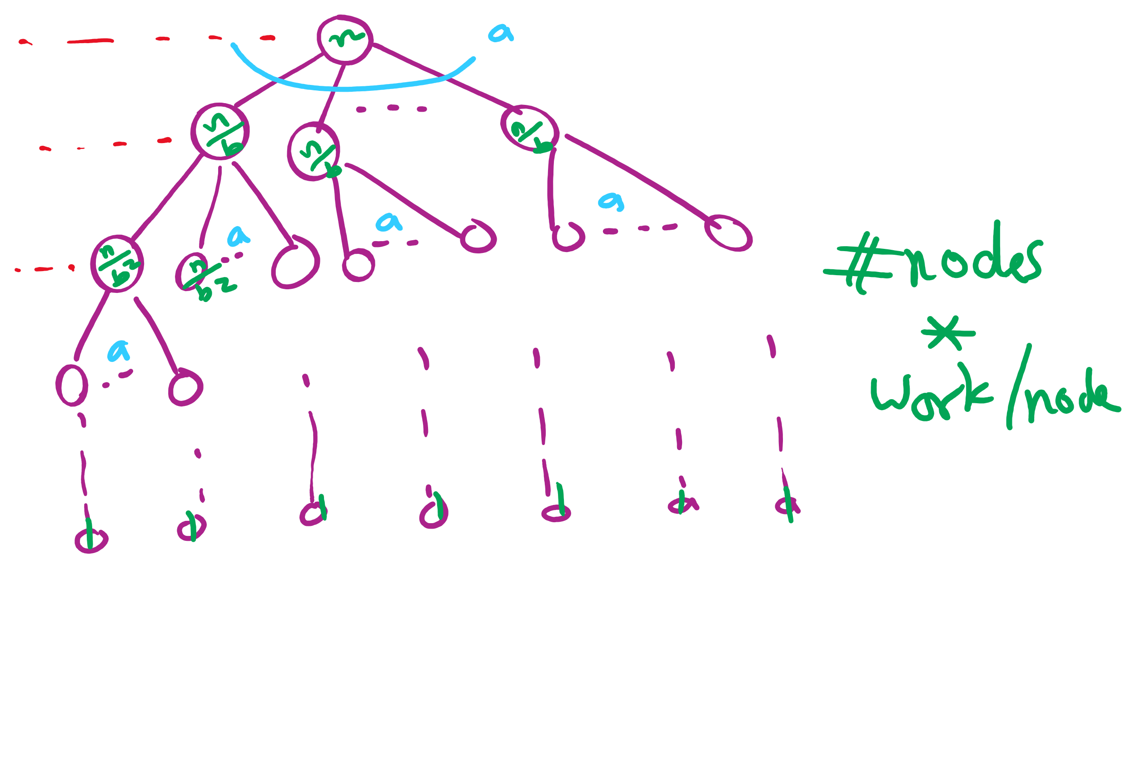
Recursion Tree

Slide 36
Applying the master theorem
T(n) = aT(n/b) + f(n)
If f(n) is O(n^{log_b(a) - ε}):
T(n) is Θ(n^{log_b(a)})
If f(n) is Θ(n^{log_b(a)})
T(n) is Θ(n^{log_b(a)} lg n)
If f(n) is Ω(n^{log_b(a) + ε}) and (a * f(n/b) <= c * f(n)) for some c < 1:
T(n) is Θ(f(n))
Notes:
T(n) = 2T(n/2) + n lg n
falls into a gap
n lg n is asymptotically larger than n, but not polynomially larger

