Slide 1

Algorithms and Data Structures 2 CS 1501
Fall 2021
Sherif Khattab
ksm73@pitt.edu
(Slides are adapted from Dr. Ramirez’s and Dr. Farnan’s CS1501 slides.)

Slide 2
Announcements
Upcoming deadlines:
4/12: Homework 11
4/16: Lab 10
4/19: Homework 12
4/19: Assignment 4
4/23: Lab 11
4/30: Lab 12
5/2: Assignment 5
Tophat questions are due one week after each lecture
OMETs
1 bonus point for entire class when response rate >= 80%

Slide 3
Last lecture …
Max Flow implementation issues
Min Cut
(Big)Integer Algorithms
multiplication

Slide 4
Muddiest points
min cut
finding minimum st cut
Could you restate what a min cut is?
min st cut finding and duality, how does it equal max flow??
why to use min cut / max flow
Min cut implementation/actual code
Can you explain duality again?
Master Theorem
master theorem pros/cons
divide and conquer. Honestly, im very confused about the last 10 minutes content of today's lecture.
The tree of nodes at the end of the lecture
The big integer recurrence relations
Difference between recurrence relation and recursion tree and how to derive a recurrence relation

Slide 5
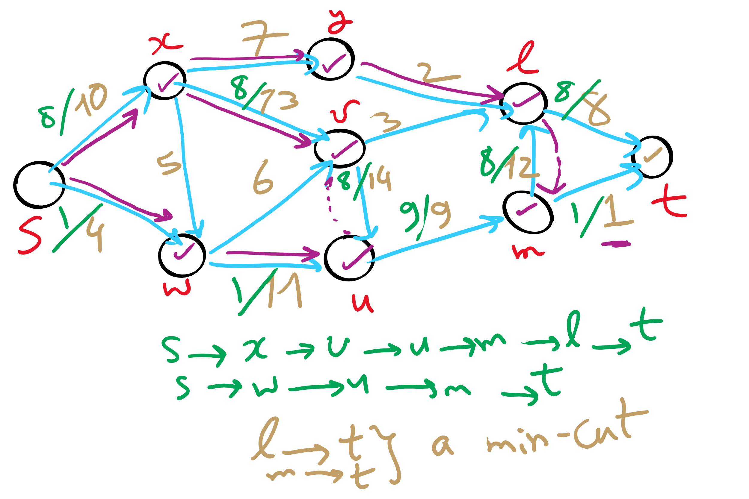
Min st-cut Example 1

Slide 6
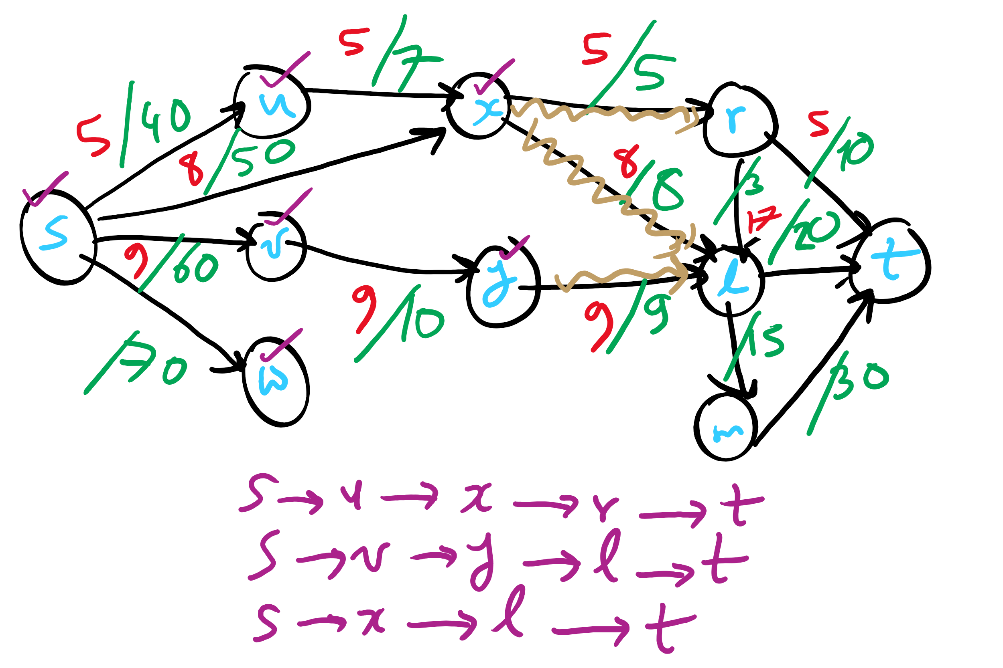
Min st-cut Example 2

Slide 7
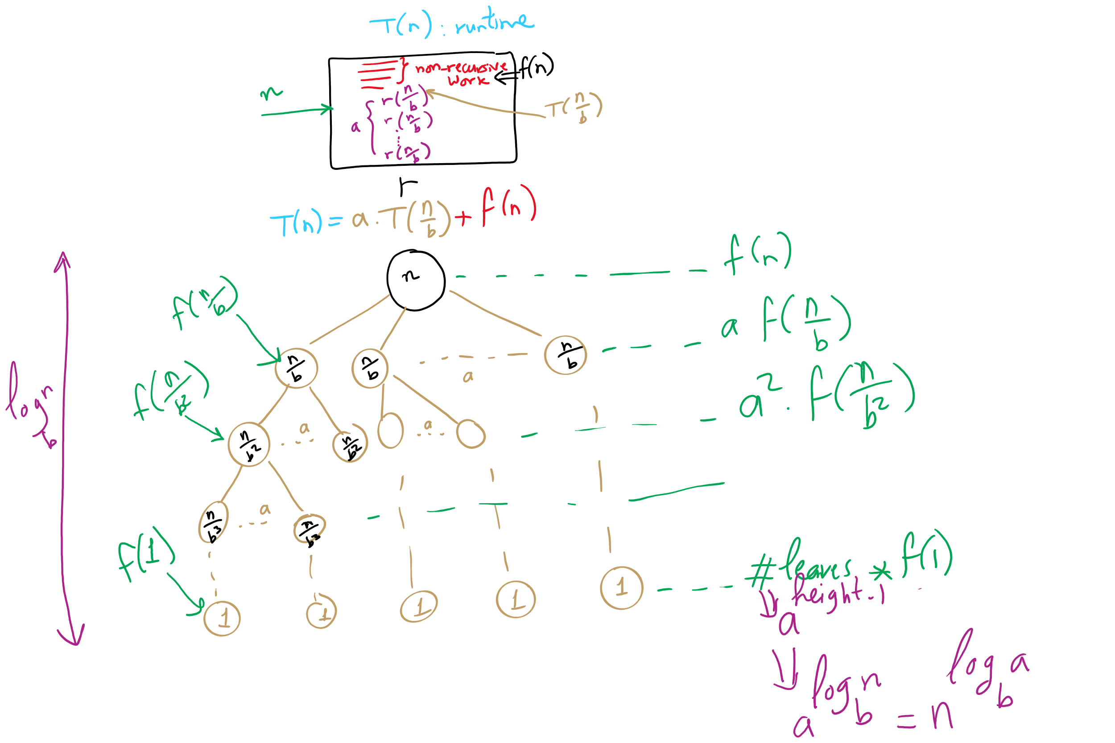
Recurrence vs. Recursion Tree

Slide 8
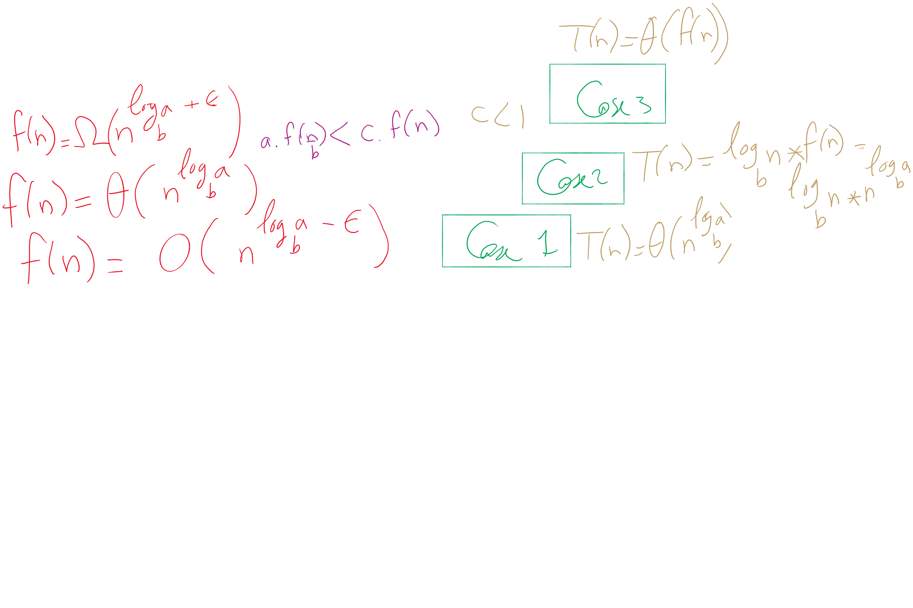


The 3 cases of the Master Theorem

Slide 9
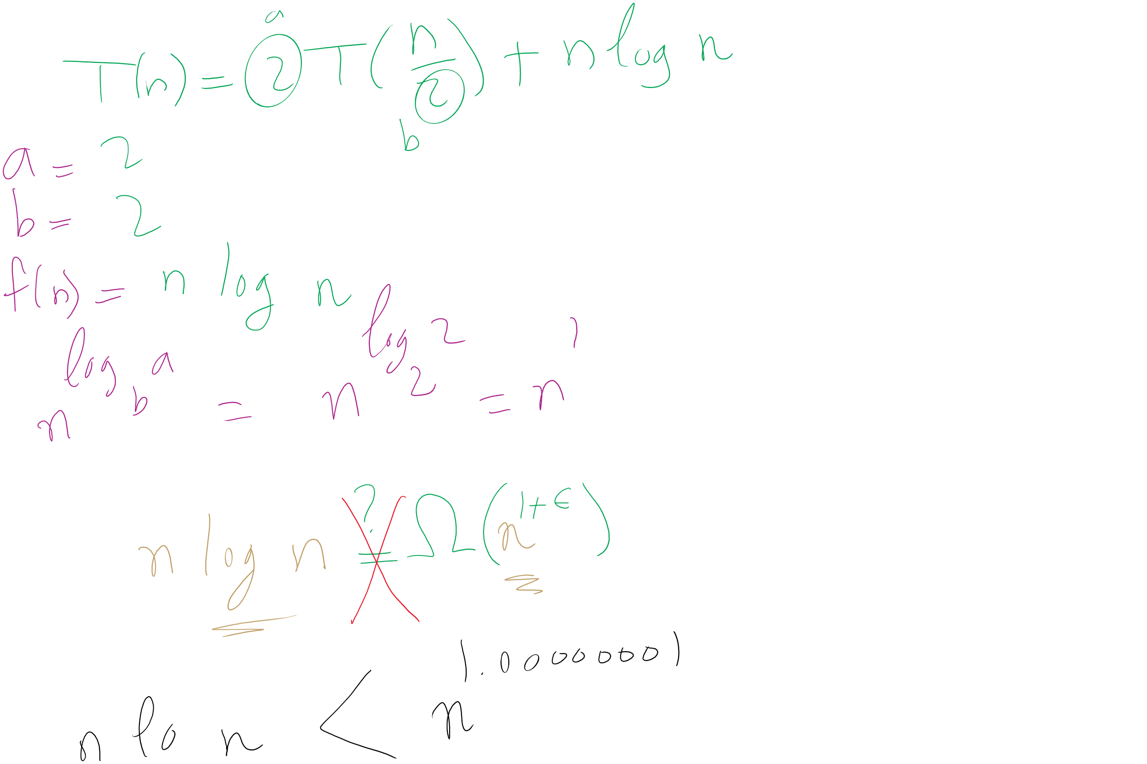
When Master Theorem doesn’t apply: Example

Slide 10
This Lecture
(Big)Integer Algorithms
Karatsuba multiplication
exponentiation
GCD
RSA encryption

Slide 11
Applying the master theorem
T(n) = aT(n/b) + f(n)
If f(n) is O(n^{log_b(a) - ε}):
T(n) is Θ(n^{log_b(a)})
If f(n) is Θ(n^{log_b(a)})
T(n) is Θ(n^{log_b(a)} lg n)
If f(n) is Ω(n^{log_b(a) + ε}) and (a * f(n/b) <= c * f(n)) for some c < 1:
T(n) is Θ(f(n))
Notes:
T(n) = 2T(n/2) + n lg n
falls into a gap
n lg n is asymptotically larger than n, but not polynomially larger

Slide 12
Mergesort master theorem analysis
Recurrence relation for mergesort?
T(n) = 2T(n/2) + Θ(n)
T(n) = 2T(n/2) + Θ(n)
If f(n) is O(n^{log_b(a) - ε}):
T(n) is Θ(n^{log_b(a)})
If f(n) is Θ(n^{log_b(a)})
T(n) is Θ(n^{log_b(a)} lg n)
If f(n) is Ω(n^{log_b(a) + ε}) and (a * f(n/b) <= c * f(n)) for some c < 1:
T(n) is Θ(f(n))
a = 2
b = 2
f(n) is Θ(n)
So...
n^{log_b(a)} = …
n^{lg 2} = n
Being Θ(n) means f(n) is Θ(n^{log_b(a)})
T(n) = Θ(n^{log_b(a)} lg n) = Θ(n^{lg 2} lg n) = Θ(n lg n)

Slide 13
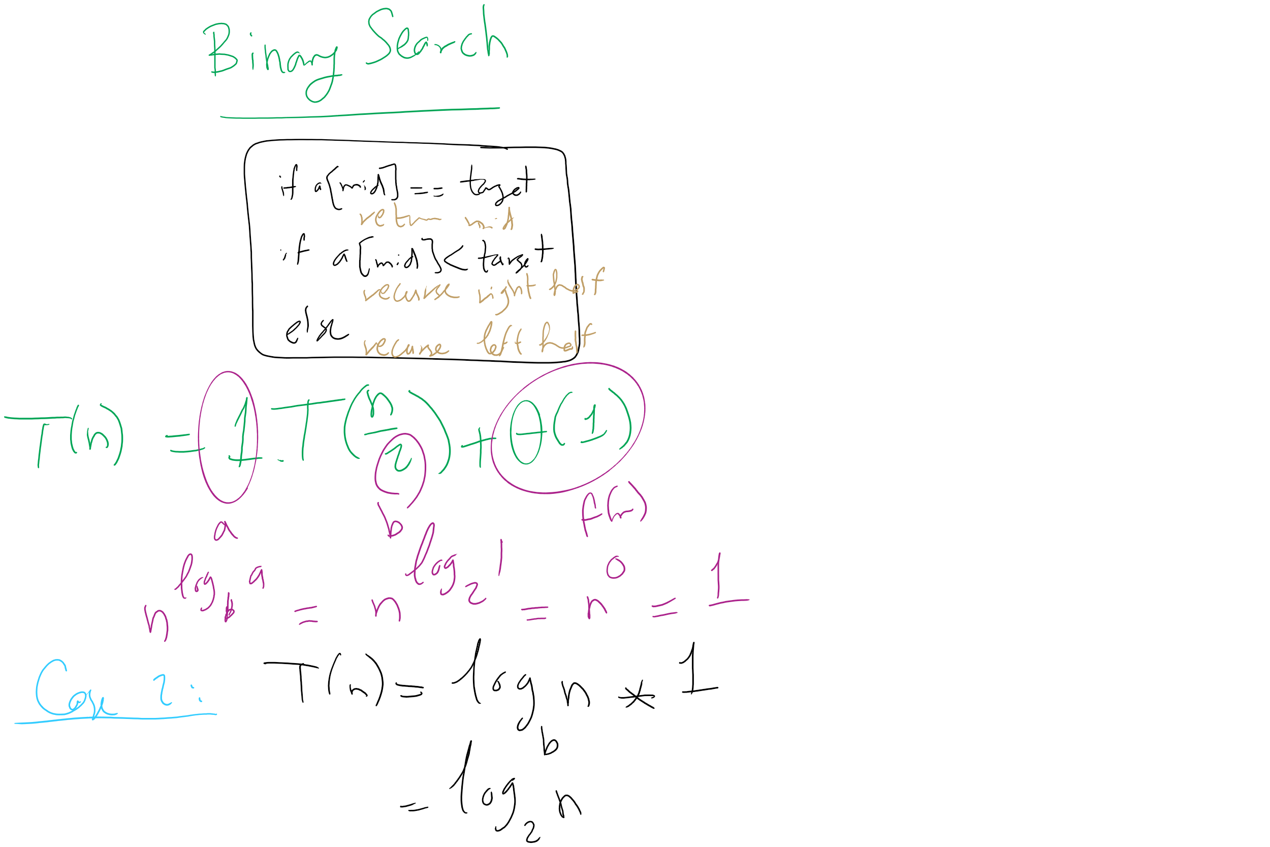
Binary Search Master Theorem Analysis

Slide 14
For our divide and conquer multiplication approach
T(n) = 4T(n/2) + Θ(n)
a = 4
b = 2
f(n) is Θ(n)
So...
n^{log_b(a)} = …
n^{lg 4} = n²
If f(n) is O(n^{log_b(a) - ε}):
T(n) is Θ(n^{log_b(a)})
If f(n) is Θ(n^{log_b(a)})
T(n) is Θ(n^{log_b(a)} lg n)
If f(n) is Ω(n^{log_b(a) + ε}) and (a * f(n/b) <= c * f(n)) for some c < 1:
T(n) is Θ(f(n))
Being Θ(n) means f(n) is polynomially smaller than n²
T(n) = Θ(n^{log_b(a)}) = Θ(n^{lg 4}) = Θ(n²)

Slide 15
@#$%^&*
Leaves us back where we started with the grade school algorithm…
Actually, the overhead of doing all of the dividing and conquering will make it slower than grade school

Slide 16
SO WHY EVEN BOTHER?
Let’s look for a smarter way to divide and conquer
Look at the recurrence relation again to see where we can improve our runtime:
T(n) = 4T(n/2) + Θ(n)
Can we reduce the amount of work done by the current call?
Can we reduce the number of subproblems?
Can we reduce the subproblem size?

Slide 17
Karatsuba’s algorithm
By reducing the number of recursive calls (subproblems), we can improve the runtime
x * y = 2^{n}x_{H}y_{H} + 2^{n/2}(x_{H}y_{L} + x_{L}y_{H}) + x_{L}y_{L}
M1
M2
M3
M4
We don’t actually need to do both M2 and M3
We just need the sum of M2 and M3
If we can find this sum using only 1 multiplication, we decrease the number of recursive calls and hence improve our runtime

Slide 18
Karatsuba craziness
M1 = x_{h}y_{h}; M2 = x_{h}y_{l}; M3 = x_{l}y_{h}; M4 = x_{l}y_{l};
The sum of all of them can be expressed as a single mult:
M1 + M2 + M3 + M4
= x_{h}y_{h} + x_{h}y_{l} + x_{l}y_{h} + x_{l}y_{l}
= (x_{h} + x_{l}) * (y_{h} + y_{l})
Lets call this single multiplication M5:
M5 = (x_{h} + x_{l}) * (y_{h} + y_{l}) = M1 + M2 + M3 + M4
Hence, M5 - M1 - M4 = M2 + M3
So: x * y = 2^{n}M1 + 2^{n/2}(M5 - M1 - M4) + M4
Only 3 multiplications required!
At the cost of 2 more additions, and 2 subtractions

Slide 19
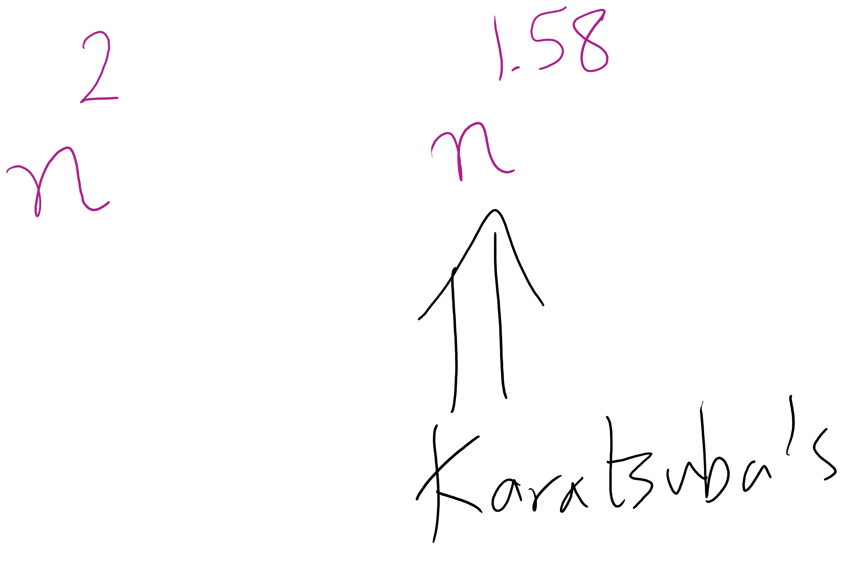
Karatsuba runtime
To get M5, we have to multiply (at most) n/2 + 1 bit ints
Asymptotically the same as our other recursive calls
Requires extra additions and subtractions…
But these are all Θ(n)
So, the recurrence relation for Karatsuba’s algorithm is:
T(n) = 3T(n/2) + Θ(n)
Which solves to be Θ(n^{lg 3})
Asymptotic improvement over grade school algorithm!
For large n, this will translate into practical improvement

Slide 20
Large integer multiplication in practice
Can use a hybrid algorithm of grade school for large operands, Karatsuba’s algorithm for VERY large operands
Why are we still bothering with grade school at all?
Notes:
Practical penalties of extra additions/subtractions
estimates say 320-640 bits is the tipping point for karatsubas

Slide 21
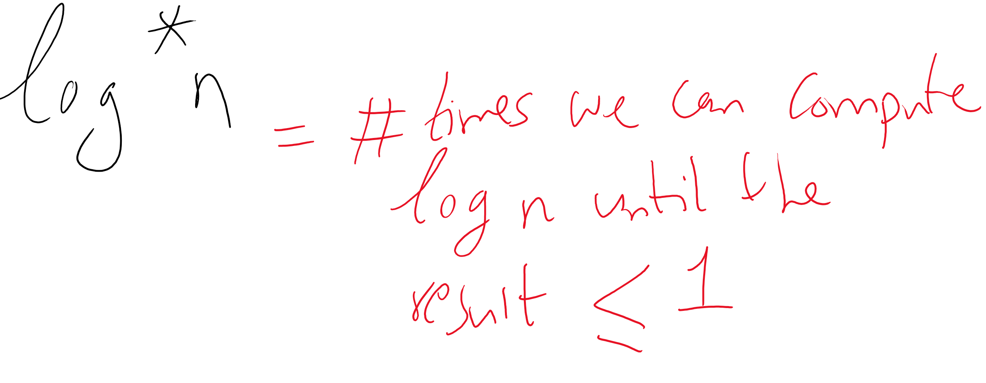
Is this the best we can do?
The Schönhage–Strassen algorithm
Uses Fast Fourier transforms to achieve better asymptotic runtime
O(n log n log log n)
Fastest asymptotic runtime known from 1971-2007
Required n to be astronomical to achieve practical improvements to runtime
Numbers beyond 2^{2^15} to 2^{2^17}
Fürer was able to achieve even better asymptotic runtime in 2007
n log n 2^{O(log^* n)}
No practical difference for realistic values of n
Notes:
The GNU Multi-Precision Library uses Schönhage–Strassen for 1728 to 7808 64-bit words
BigInteger will look over gradeschool, karatsuba, and toom3 (toom-cook variant)
There is a Java implementation of Schönhage–Strassen which uses it above 74,000 decimal digits

Slide 22
Exponentiation
x^{y}
Can easily compute with a simple algorithm:
ans = 1
i = y
while i > 0:
ans = ans * x
i--
Runtime?
Notes:
looking for θ(y) or "linear"

Slide 23
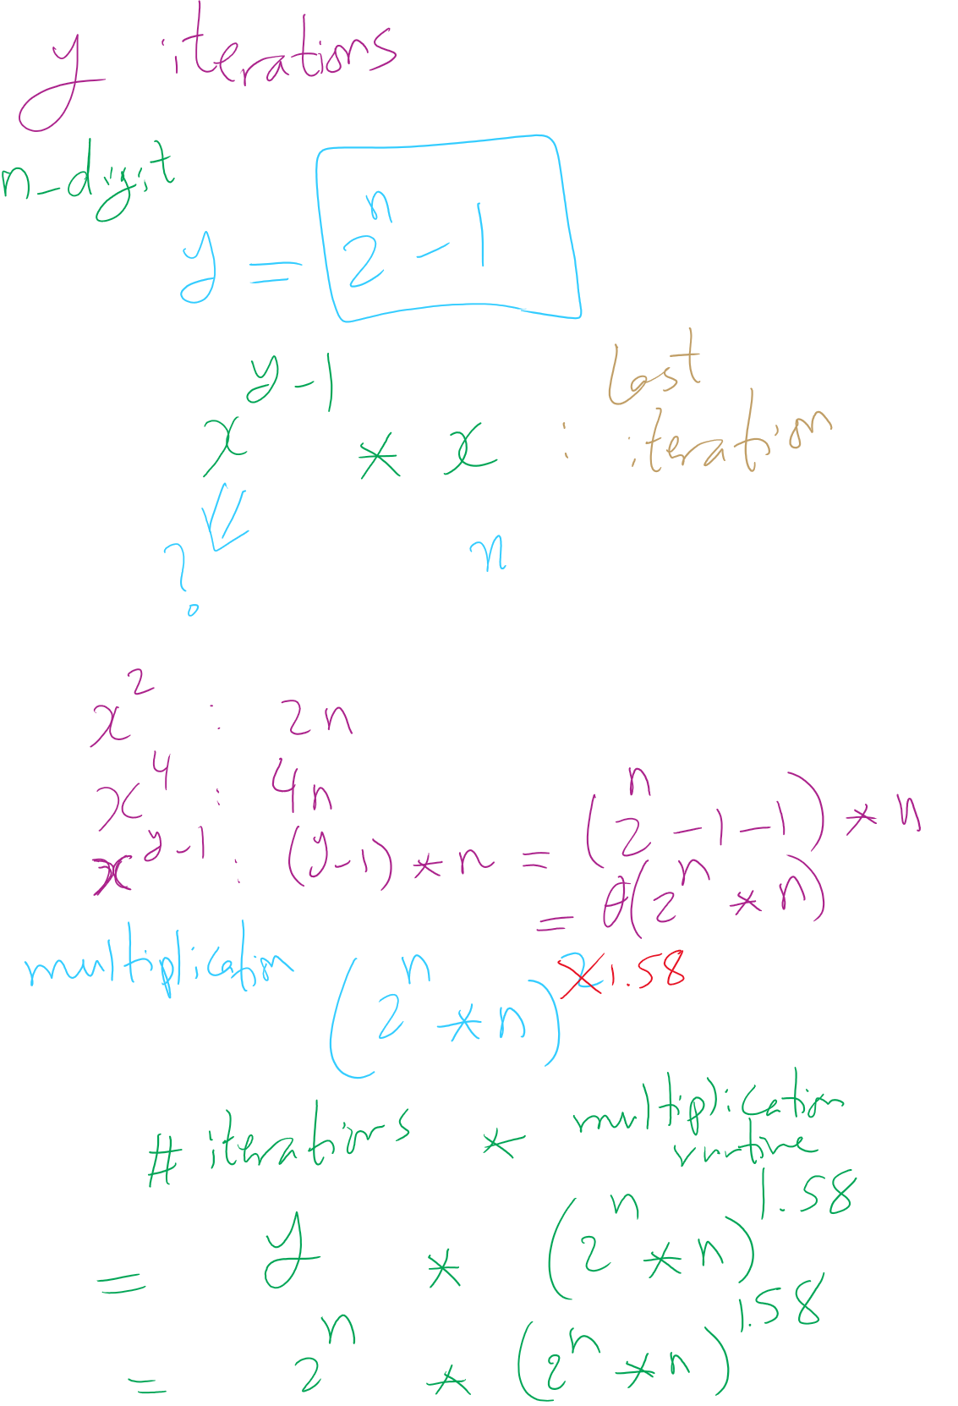
Runtime Analysis

Slide 24
Just like with multiplication, let's consider large integers...
Runtime = # of iterations * cost to multiply
Cost to multiply was covered in the last lecture
So how many iterations?
Single loop from 1 to y, so linear, right?
What is the size of our input?
n
The bitlength of y…
So, linear in the value of y…
But, increasing n by 1 doubles the number of iterations
Θ(2^{n})
Exponential in the bitlength of y
Notes:
What is the size of our input?
Cost to multiple using gradeschool: n^2

Slide 25
This is RIDICULOUSLY BAD
Assuming 512 bit operands, 2⁵¹²:
13407807929942597099574024998205846127479365820592393377723561443721764030073546976801874298166903427690031858186486050853753882811946569946433649006084096
Assuming we can do mults in 1 cycle…
Which we can’t as we learned last lecture
And further that these operations are completely parallelizable
16 4GHz cores = 64,000,000,000 cycles/second
(2⁵¹² / 64000000000) / (3600 * 24 * 365) =
6.64 * 10¹³⁵ years to compute

