Slide 1

Algorithms and Data Structures 2 CS 1501
Fall 2021
Sherif Khattab
ksm73@pitt.edu
(Slides are adapted from Dr. Ramirez’s and Dr. Farnan’s CS1501 slides.)

Slide 2
Announcements
Upcoming deadlines:
4/16: Lab 10
4/19: Assignment 4
4/21: Homework 12
4/23: Lab 11
4/30: Lab 12
5/2: Assignment 5
Tophat questions are due one week after each lecture
OMETs
1 bonus point for entire class when response rate >= 80%

Slide 3
Last lecture …
(Big)Integer Algorithms
Karatsuba multiplication
exponentiation

Slide 4
Muddiest points
Karatsuba
can you go over another example using Karatsuba's step by step?
karatsuba runtime
can we have a table for all the run time complexity about graph?
what does the 2^n-1 in the exponential example mean
roughly what is the int size cutoff for grade school vs Karatsuba
applications of karatsubas algorithm
When is it even necessary to multiply numbers of these size?
what does “M” represent in Karatsubas algorithm?
Master Theorem
How to differentiate which edge cases do not fit into master theorem
what do we do when master's theorem doesn't help
why binary search has only one recursive call
Exponentiations
Why is exponentiation important?
why in x*x^(y-1), we only consider the runtime of x^(y-1)

Slide 5
Karatsuba Example 1

Slide 6
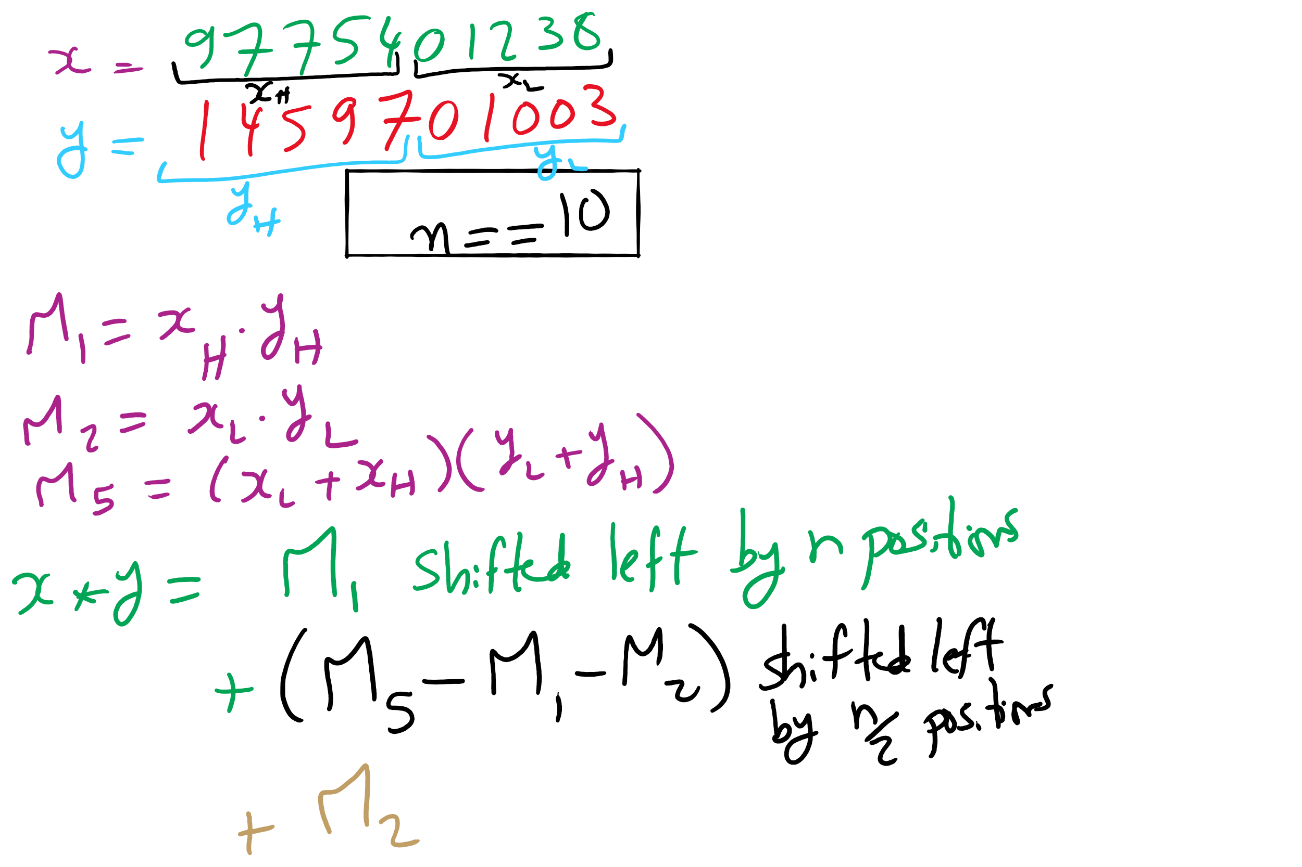
Karatsuba Example 2

Slide 7
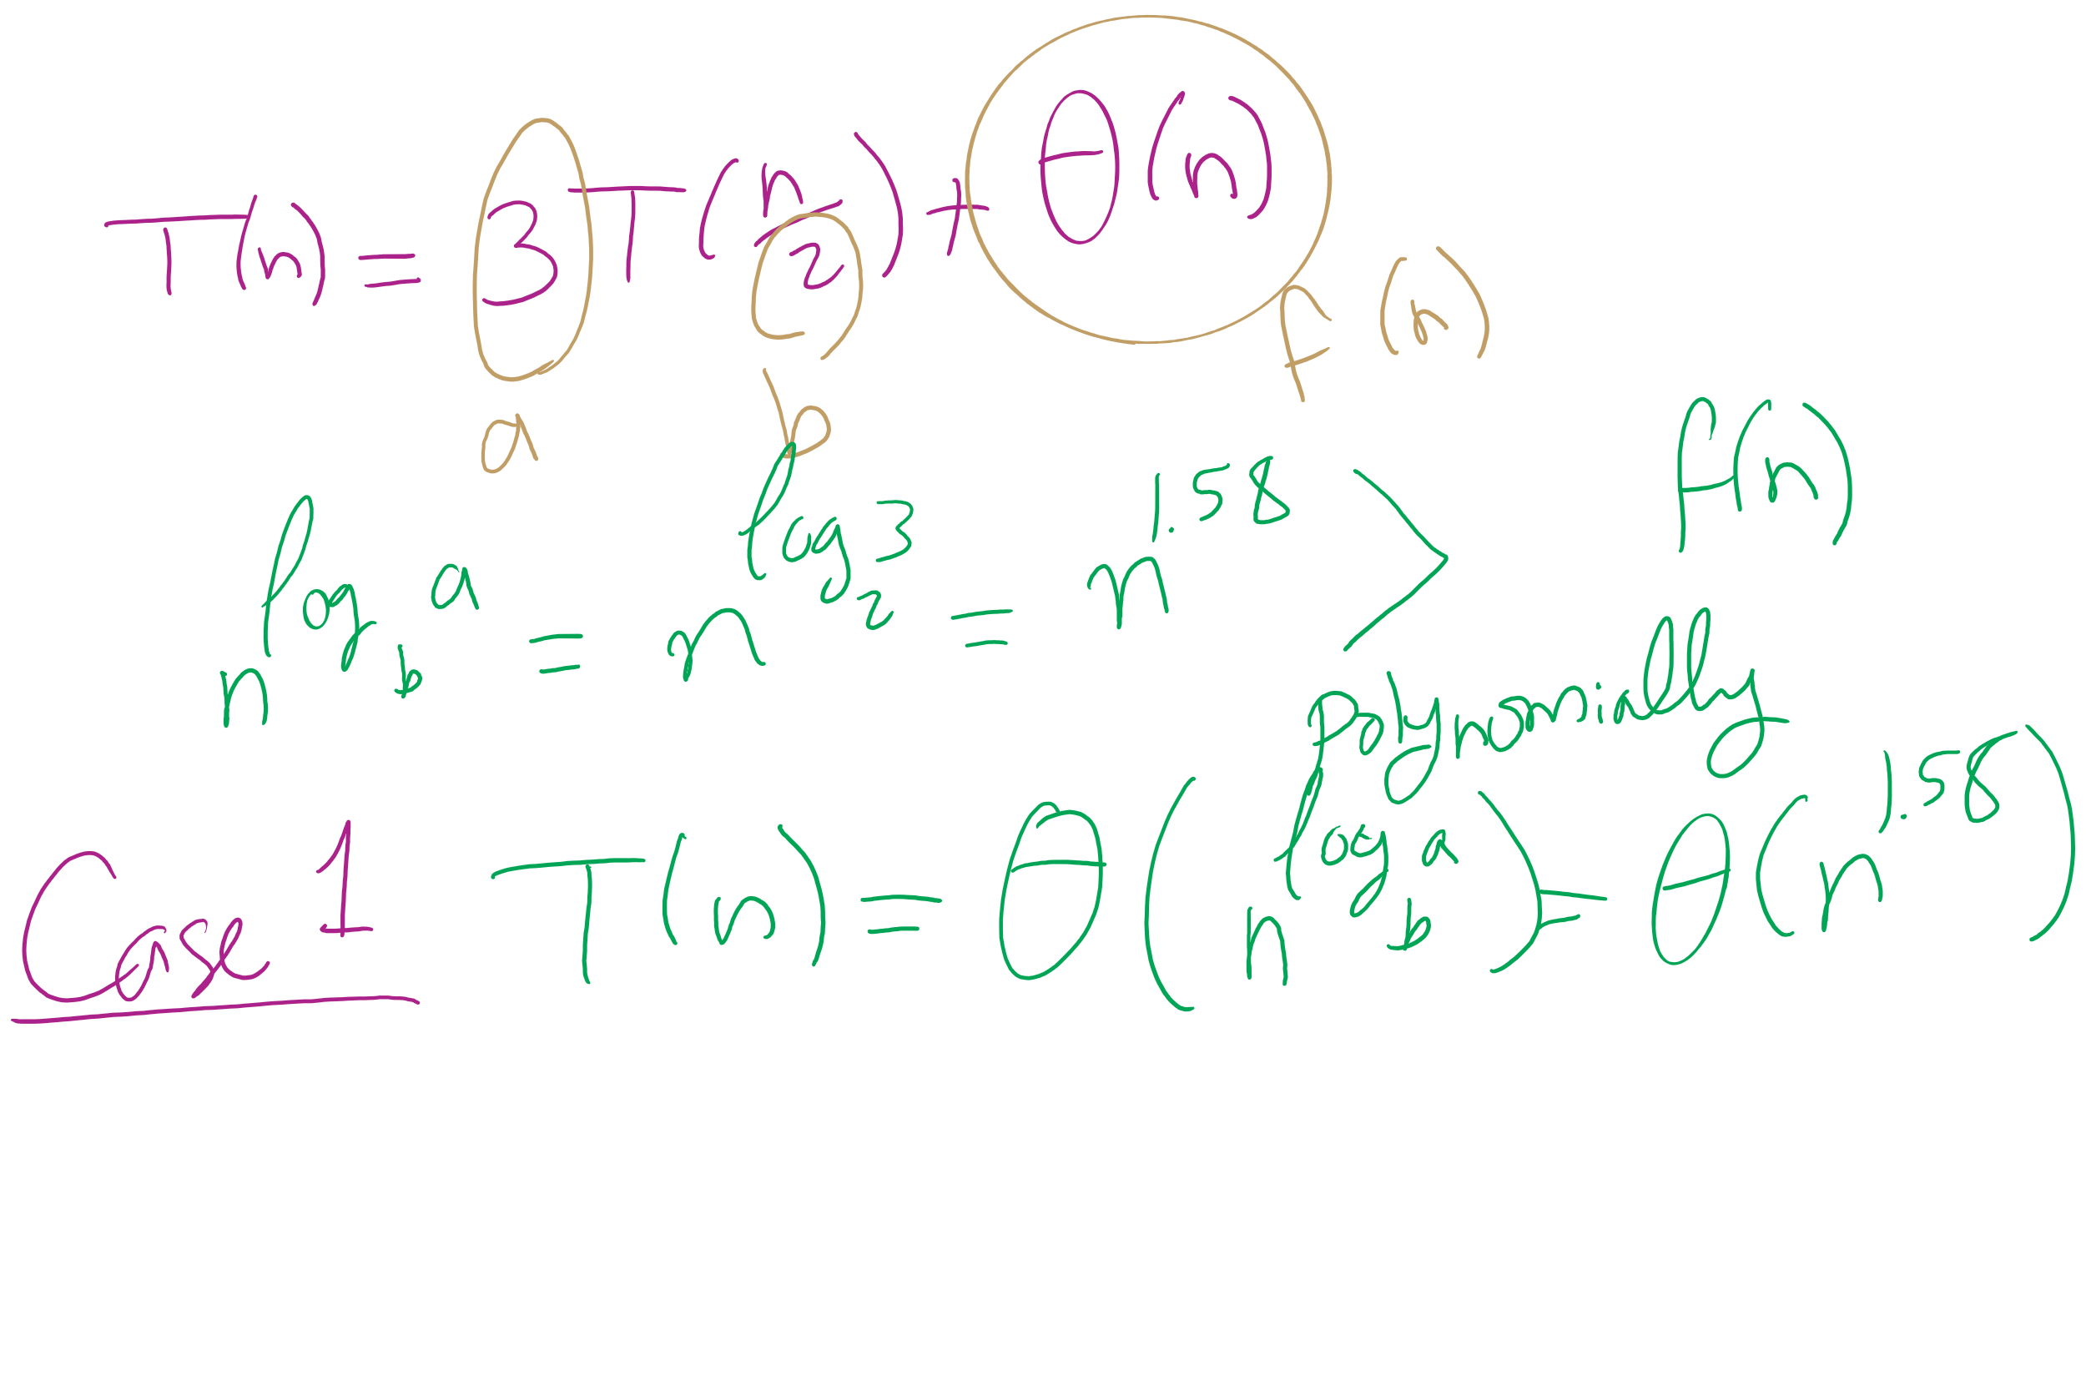
Karatsuba Runtime

Slide 8
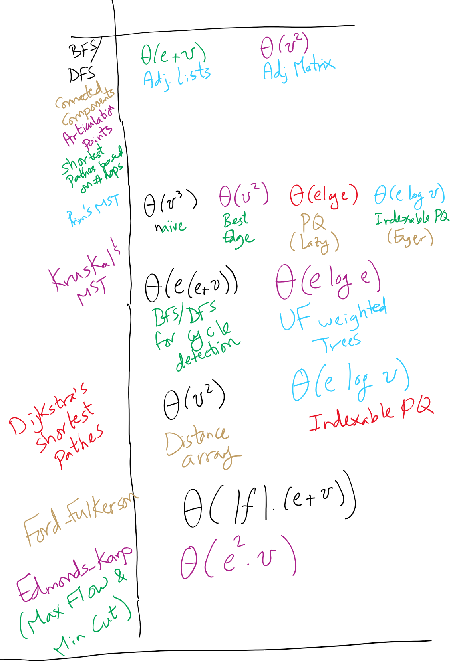
Graph Algorithms Runtime

Slide 9
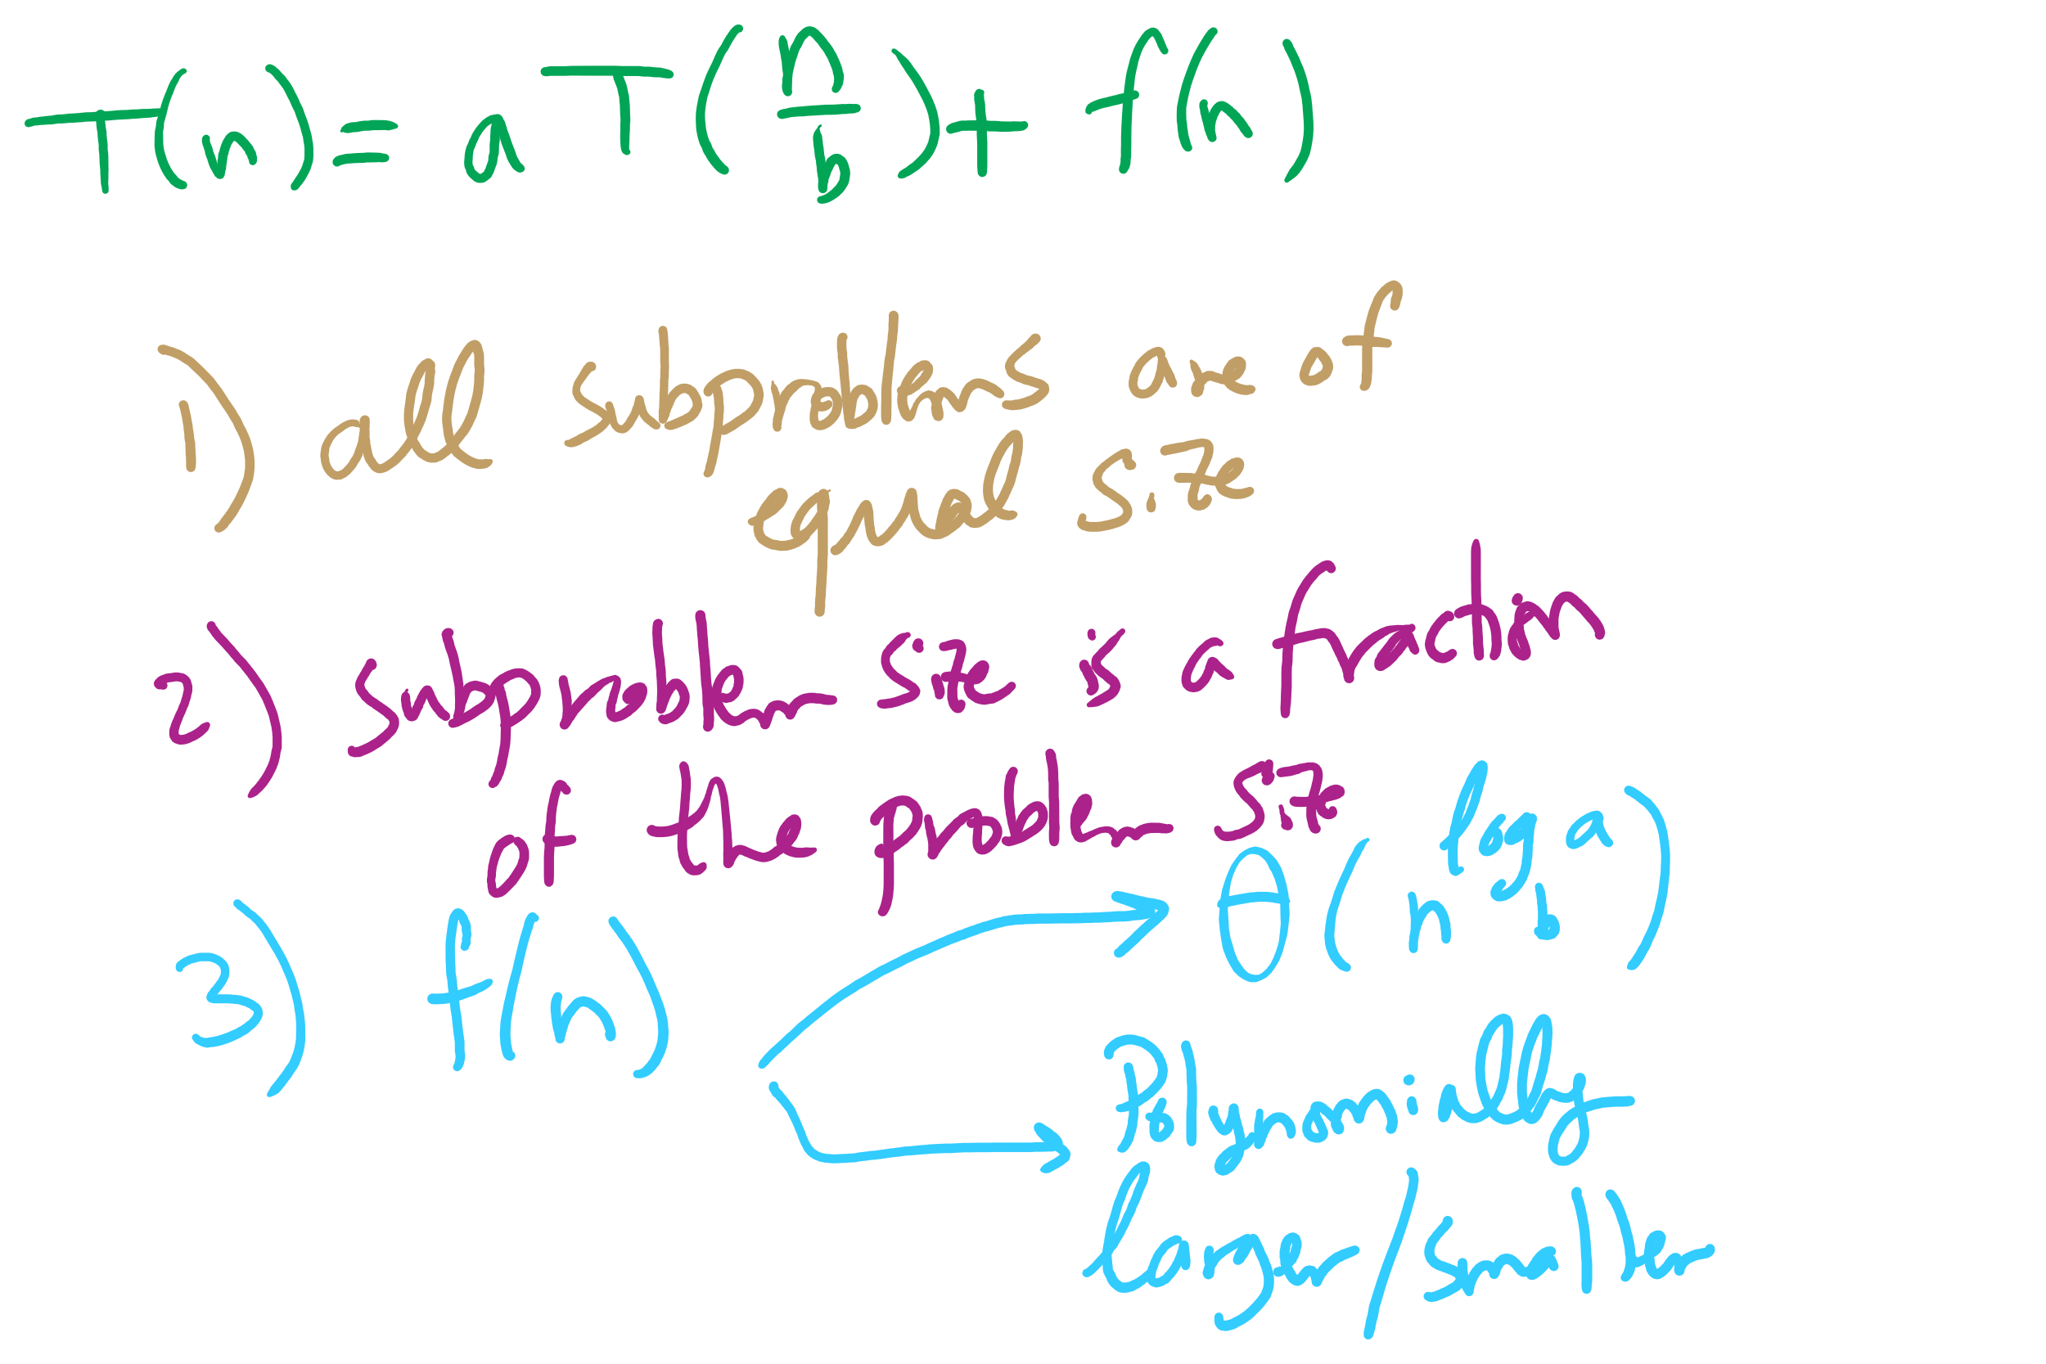
Master Theorem Conditions

Slide 10
This Lecture
(Big)Integer Algorithms
exponentiation
GCD
RSA encryption

Slide 11
This is way too long to do exponentiations!
So how do we do better?
Let’s try divide and conquer!
x^{y} = (x^{(y/2)})²
When y is even, (x^{(y/2)})² * x when y is odd
Analyzing a recursive approach:
Base case?
When y is 1, x^{y} is x; when y is 0, x^{y} is 1
Runtime?

Slide 12
Building another recurrence relation
x^{y} = (x^{(y/2)})² = x^{(y/2)} * x^{(y/2)}
Similarly, (x^{(y/2)})² * x = x^{(y/2)} * x^{(y/2)} * x
So, our recurrence relation is:
T(n) = T(n-1) + ?
How much work is done per call?
1 (or 2) multiplication(s)
Examined runtime of multiplication last lecture
But how big are the operands in this case?

Slide 13
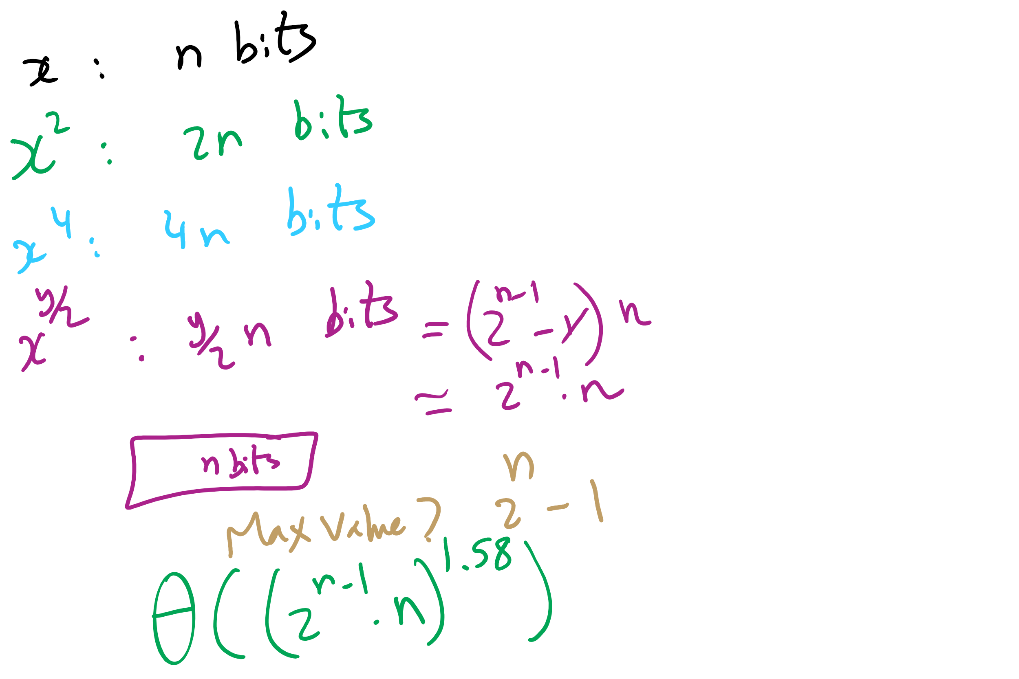
Non-recursive Work

Slide 14
Determining work done per call
Base case returns x
n bits
Base case results are multiplied: x * x
n bit operands
Result size?
2n
These results are then multiplied: x² * x²
2n bit operands
Result size?
4n bits
…
x^{(y/2)} * x^{(y/2)}?
(y / 2) * n bit operands = 2^{(n-1)} * n bit operands
Result size? y * n bits = 2^{n} * n bits

Slide 15
Multiplication input size increases throughout
Our recurrence relation looks like:
T(n) = T(n-1) + Θ((2^{(n-1)} * n)²)
squared from the use of the gradeschool algorithm
multiplication input size

Slide 16
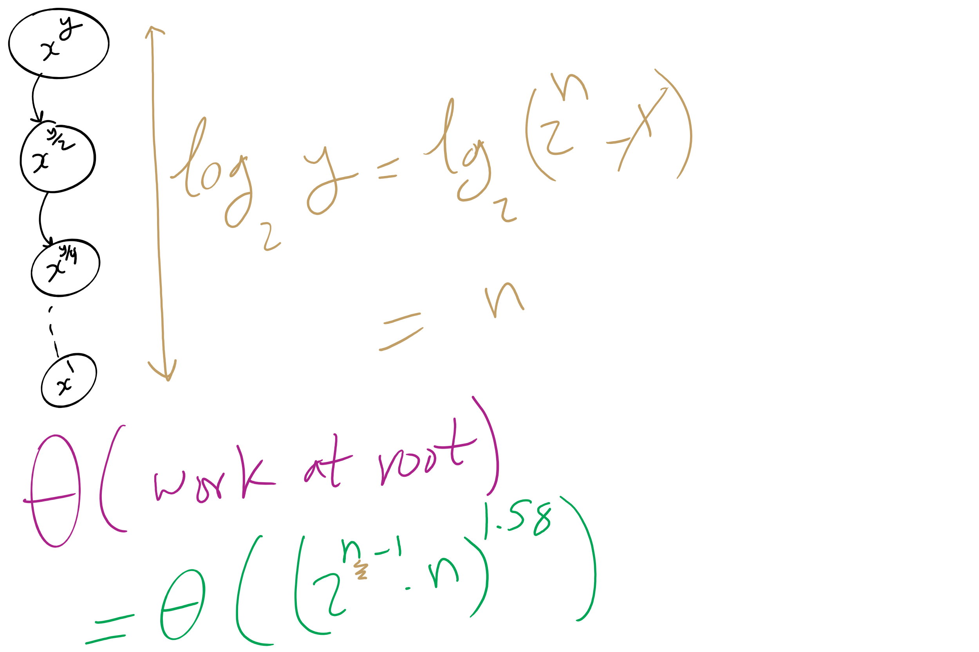
Runtime Analysis

Slide 17
Runtime analysis
Can we use the master theorem?
Nope, we don’t have a b > 1
OK, then…
How many times can y be divided by 2 until a base case?
lg(y)
Further, we know the max value of y
Relative to n, that is:
2^{n}
So, we have, at most lg(y) = lg(2^{n}) = n recursions

Slide 18
But we need to do expensive mult in each call
We need to do Θ((2^{(n-1)} * n)²) work in just the root call!
Our runtime is dominated by multiplication time
Exponentiation quickly generates HUGE numbers
Time to multiply them quickly becomes impractical

Slide 19
Can we do better?
We go “top-down” in the recursive approach
Start with y
Halve y until we reach the base case
Square base case result
Continue combining until we arrive at the solution
What about a “bottom-up” approach?
Start with our base case
Operate on it until we reach a solution

Slide 20
A bottom-up approach
To calculate x^{y}
ans = 1
foreach bit in y:
ans = ans²
if bit == 1:
ans = ans * x
From most to least significant

Slide 21
Bottom-up exponentiation example
Consider x^{y} where y is 43 (computing x⁴³)
Iterate through the bits of y (43 in binary: 101011)
ans = 1
ans = 1² = 1
ans = 1 * x = x
ans = x² = x²
ans = (x²)² = x⁴
ans = x⁴ * x = x⁵
ans = (x⁵)² = x¹⁰
ans = (x¹⁰)² = x²⁰
ans = x²⁰ * x = x²¹
ans = (x²¹)² = x⁴²
ans = x⁴² * x = x⁴³
Notes:
3⁴³ = 328256967394537077627

Slide 22
Does this solve our problem with mult times?
Nope, still squaring ans everytime
We’ll have to live with huge output sizes
This does, however, save us recursive call overhead
Practical savings in runtime

Slide 23
Greatest Common Divisor
GCD(a, b)
Largest int that evenly divides both a and b
Easiest approach:
BRUTE FORCE
i = min(a, b)
while(a % i != 0 || b % i != 0):
i--
Runtime?
Θ(min(a, b))
Linear!
In value of min(a, b)...
Exponential in n
Assuming a, b are n-bit integers

Slide 24
Euclid’s algorithm
b
GCD(a, b) = GCD(b, a % b)
a % b
a
Notes:
GCD(1071, 462) = 21
If students don't believe me, tell them to make a 1071 x 462 pixel image in paint and try it out

Slide 25
Euclidean example 1
GCD(30, 24)
= GCD(24, 30 % 24)
= GCD(24, 6)
= GCD(6, 24 % 6)
= GCD(6, 0)...
Base case! Overall GCD is 6

Slide 26
Euclidean example 2
= GCD(99, 78)
99 = 78 * 1 + 21
= GCD(78, 21)
78 = 21 * 3 + 15
= GCD(21, 15)
21 = 15 * 1 + 6
= GCD (15, 6)
15 = 6 * 2 + 3
= GCD(6, 3)
6 = 3 * 2 + 0
= 3

Slide 27
Analysis of Euclid’s algorithm
Runtime?
Tricky to analyze, has been shown to be linear in n
Where, again, n is the number of bits in the input

Slide 28
Extended Euclidean algorithm
In addition to the GCD, the Extended Euclidean algorithm (XGCD) produces values x and y such that:
GCD(a, b) = i = ax + by
Examples:
GCD(30,24) = 6 = 30 * 1 + 24 * -1
GCD(99,78) = 3 = 99 * -11 + 78 * 14
Can be done in the same linear runtime!

Slide 29
Extended Euclidean example
= GCD(99, 78)
99 = 78 * 1 + 21
= GCD(78, 21)
78 = 21 * 3 + 15
= GCD(21, 15)
21 = 15 * 1 + 6
= GCD (15, 6)
15 = 6 * 2 + 3
= GCD(6, 3)
6 = 3 * 2 + 0
= 3
3 = 15 - (2 * 6)
6 = 21 - 15
3 = 15 - (2 * (21 - 15))
= 15 - (2 * 21) + (2 * 15)
= (3 * 15) - (2 * 21)
15 = 78 - (3 * 21)
3 = (3 * (78 - (3 * 21))) - (2 * 21)
= (3 * 78) - (11 * 21)
21 = 99 - 78
3 = (3 * 78) - (11 * (99 - 78))
= (14 * 78) - (11 * 99)
= 99 * -11 + 78 * 14
Notes:
Solve for 3 (the end result and GCD)
Then solve for 6, substitute into prev result
Then solve for 15, substitute into prev result
Then solve for 21, substitute into prev result

Slide 30
OK, but why?
This and all of our large integer algorithms will be handy when we look at algorithms for implementing…
CRYPTOGRAPHY

Slide 31
Introduction to crypto
Cryptography - enabling secure communication in the presence of third parties
Alice wants to send Bob a message without anyone else being able to read it
Alice
M
Encrypt
C
Decrypt
M
Bob

Slide 32
Enter the adversary
Consider the adversary to be anyone that could try to eavesdrop on Alice and Bob communicating
People in the same coffee shop as Alice or Bob as they talk over WiFi
Admins operating the network between Alice and Bob
And mirroring their traffic to the NSA…
Will have access to:
The ciphertext
The encrypted message
The encryption algorithm
At least Alice and Bob should assume the adversary does
The key material is the only thing Bob knows that the adversary does not

Slide 33
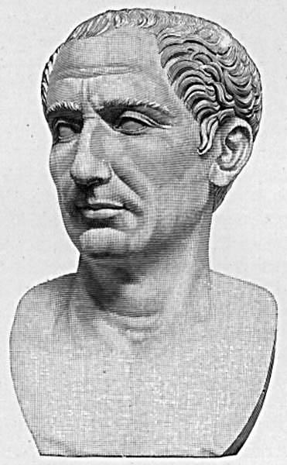
Cryptography has been around for some time
Early, classic encryption scheme:
Caesar cipher:
“Shift” the alphabet by a set amount
Use this shifted alphabet to send messages
The “key” is the amount the alphabet is shifted
Yes, that Caesar
Alphabet
ABCDEFGHIJKLMNOPQRSTUVWXYZ
XYZABCDEFGHIJKLMNOPQRSTUVW
Shift 3
Notes:
ROT3(OVALTINE) = LSXIQFKB

Slide 34
By modern standards, incredibly easy to crack
BRUTE FORCE
Try every possible shift
25 options for the English alphabet
255 for ASCII
OK, let's make it harder to brute force
Instead of using a shifted alphabet, let's use a random permutation of the alphabet
Key is now this permutation, not just a shift value
R size alphabet means R! possible permutations!

Slide 35
By modern standards, incredibly easy to crack
Just requires a bit more sophisticated of an algorithm
Analyzing encrypted English for example
Sentences have a given structure
Character frequencies are skewed
Essentially playing Wheel of Fortune

Slide 36
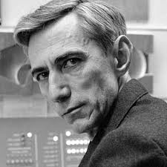
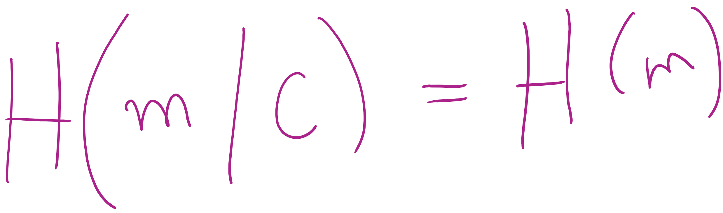
So what is a good cipher?
One-time pads
List of one-time use keys (called a pad) here
To send a message:
Take an unused pad
Use modular addition to combine key with message
For binary data, XOR
Send to recipient
Upon receiving a message:
Take the next pad
Use modular subtraction to combine key with message
For binary data, XOR
Read result
Proven to provide perfect secrecy

Slide 37
One-time pad example
Encoding:
0 1 2 3 4 5 6 7 8 9 10 11 12 13 14 15 16 17 18 19 20 21 22 23 24 25
A B C D E F G H I J K L M N O P Q R S T U V W X Y Z
Message:
H E L L O
Pad:
Q J C W T
7 4 11 11 14
16 9 2 22 19
+
16 9 2 22 19
(mod 26)
23 13 13 7 7
Encrypted Message:
X N N H H
23 13 13 7 7
-
16 9 2 22 19
(mod 26)
7 4 11 11 14
H E L L O
Notes:
Live demo perfect forward secrecy. Have students pick any other 5 character string and find the codeword.
Ex: WORLD = (22, 14, 17, 11, 3)
pad should be (1, 25, 22, 22, 4) = BZWWE

Slide 38
Difficulties with one-time pads
Pads must be truly random
Both sender and receiver must have a matched list of pads in the appropriate order
Once you run out of pads, no more messages can be sent

