Slide 1

Algorithms and Data Structures 2 CS 1501
Fall 2021
Sherif Khattab
ksm73@pitt.edu
(Slides are adapted from Dr. Ramirez’s and Dr. Farnan’s CS1501 slides.)

Slide 2
Announcements
Upcoming deadlines:
2/8: Homework 1, Homework 2, Lab 1
2/12: Homework 3
2/19: Assignment 1
Tophat questions are due one week after each lecture
String matching video available on Canvas

Slide 3
Last lecture …
TreeADT Implementation
TreeInterface and BinaryTreeInterface
Linked Implementation
BinaryNode
BinaryTree

Slide 4
Muddiest points
buildTree
this reference
Pointers
the cases we need to be aware of (cutting those links)
Checking if the left and right trees are the same
.equals subtrees
left sub tree right sub tree and root reference passing in object or address?
Say why not connect node to root node but binary node
when to point to a node and when to point to a tree
Understanding the logic of tree is not hard, but transferring the logic into code using recursion is very hard for me. i don’t know how to write recursive functions
getHeight
copy method
why would we use binaryTree if binaryNode is basically the same thing,
How we might edit one node of a tree?
Could use a quick refresher on templated classes & implements
The data being connected to something beyond just the object containing it

Slide 5
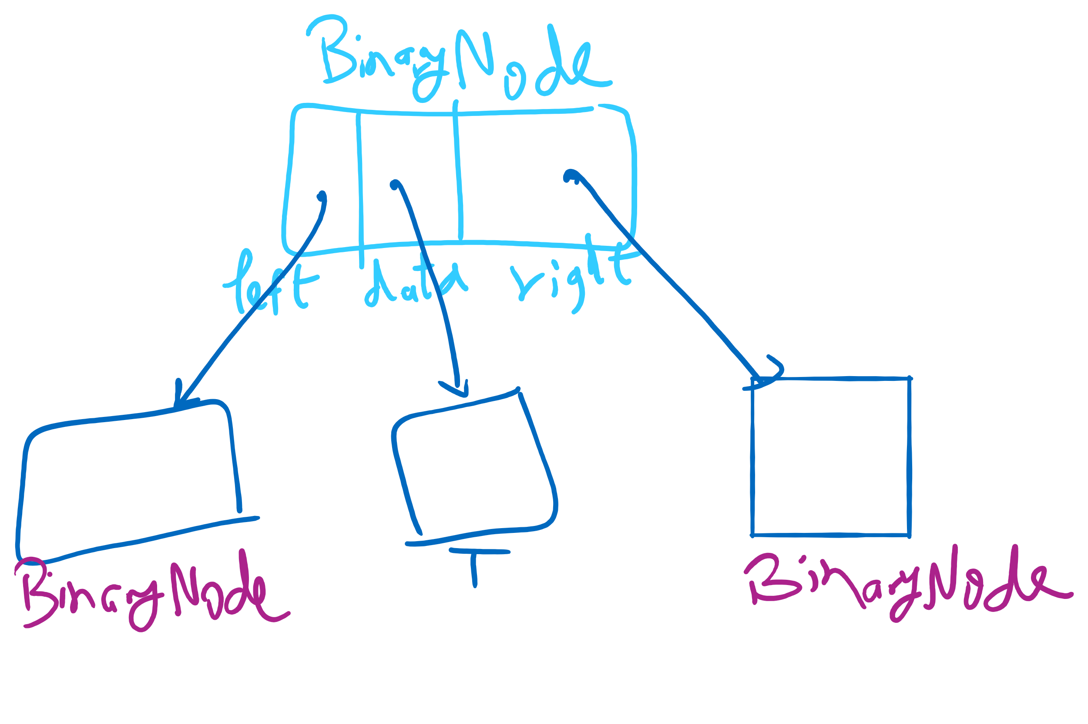
BinaryNode

Slide 6
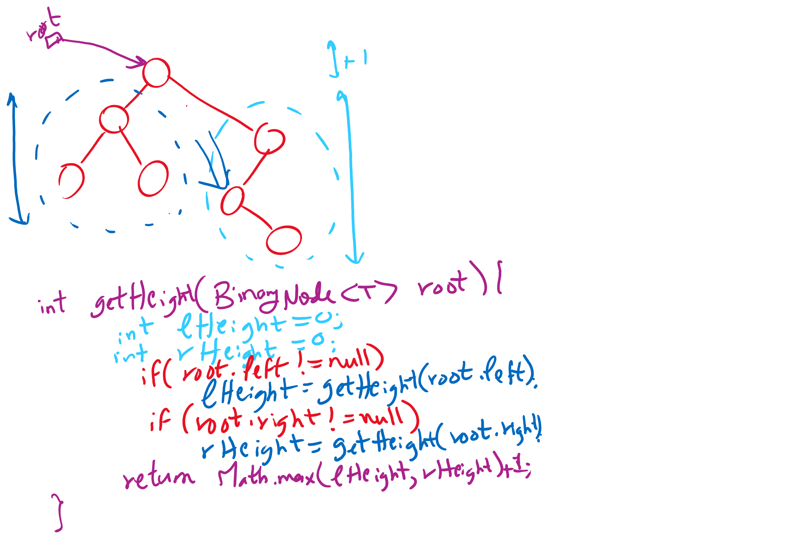
getHeight

Slide 7
This Lecture
BinaryTree (continued)
BinarySearchTree
SearchTreeInterface
BinarysearchTree
Run-time of search, add, and remove

Slide 8
Code Walkthrough
Available online at:
https://cs1501-2214.github.io/handouts/TreeADT/Slides/
The slides are under the TreeADT/slides folder in the handout repository
https://github.com/cs1501-2214/handouts

Slide 9
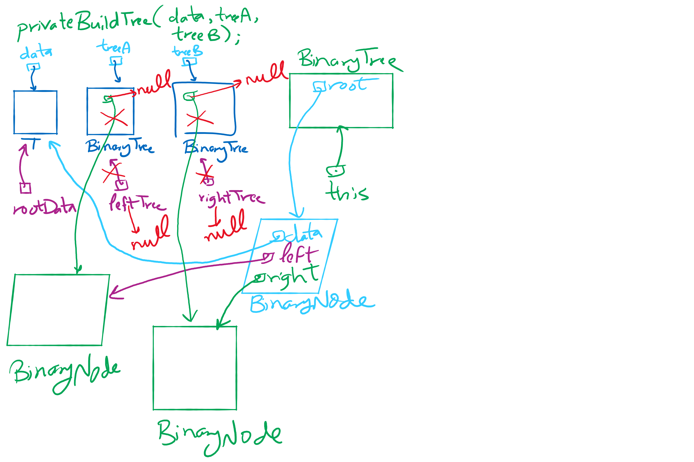
privateBuildTree()

Slide 10
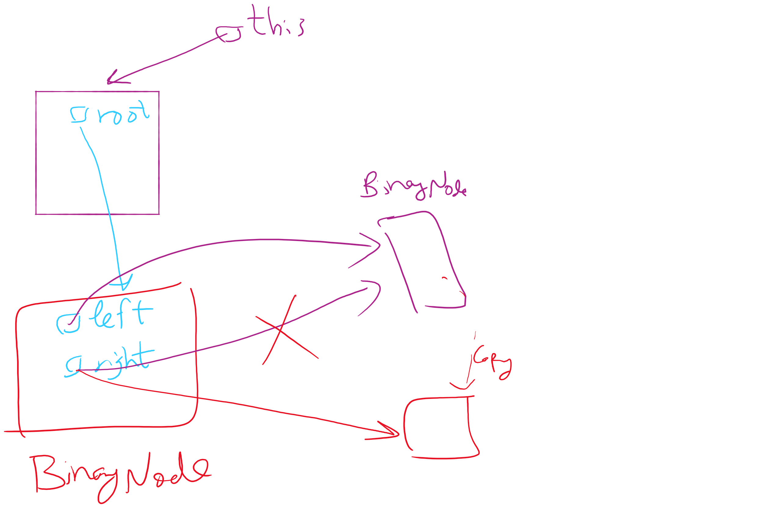
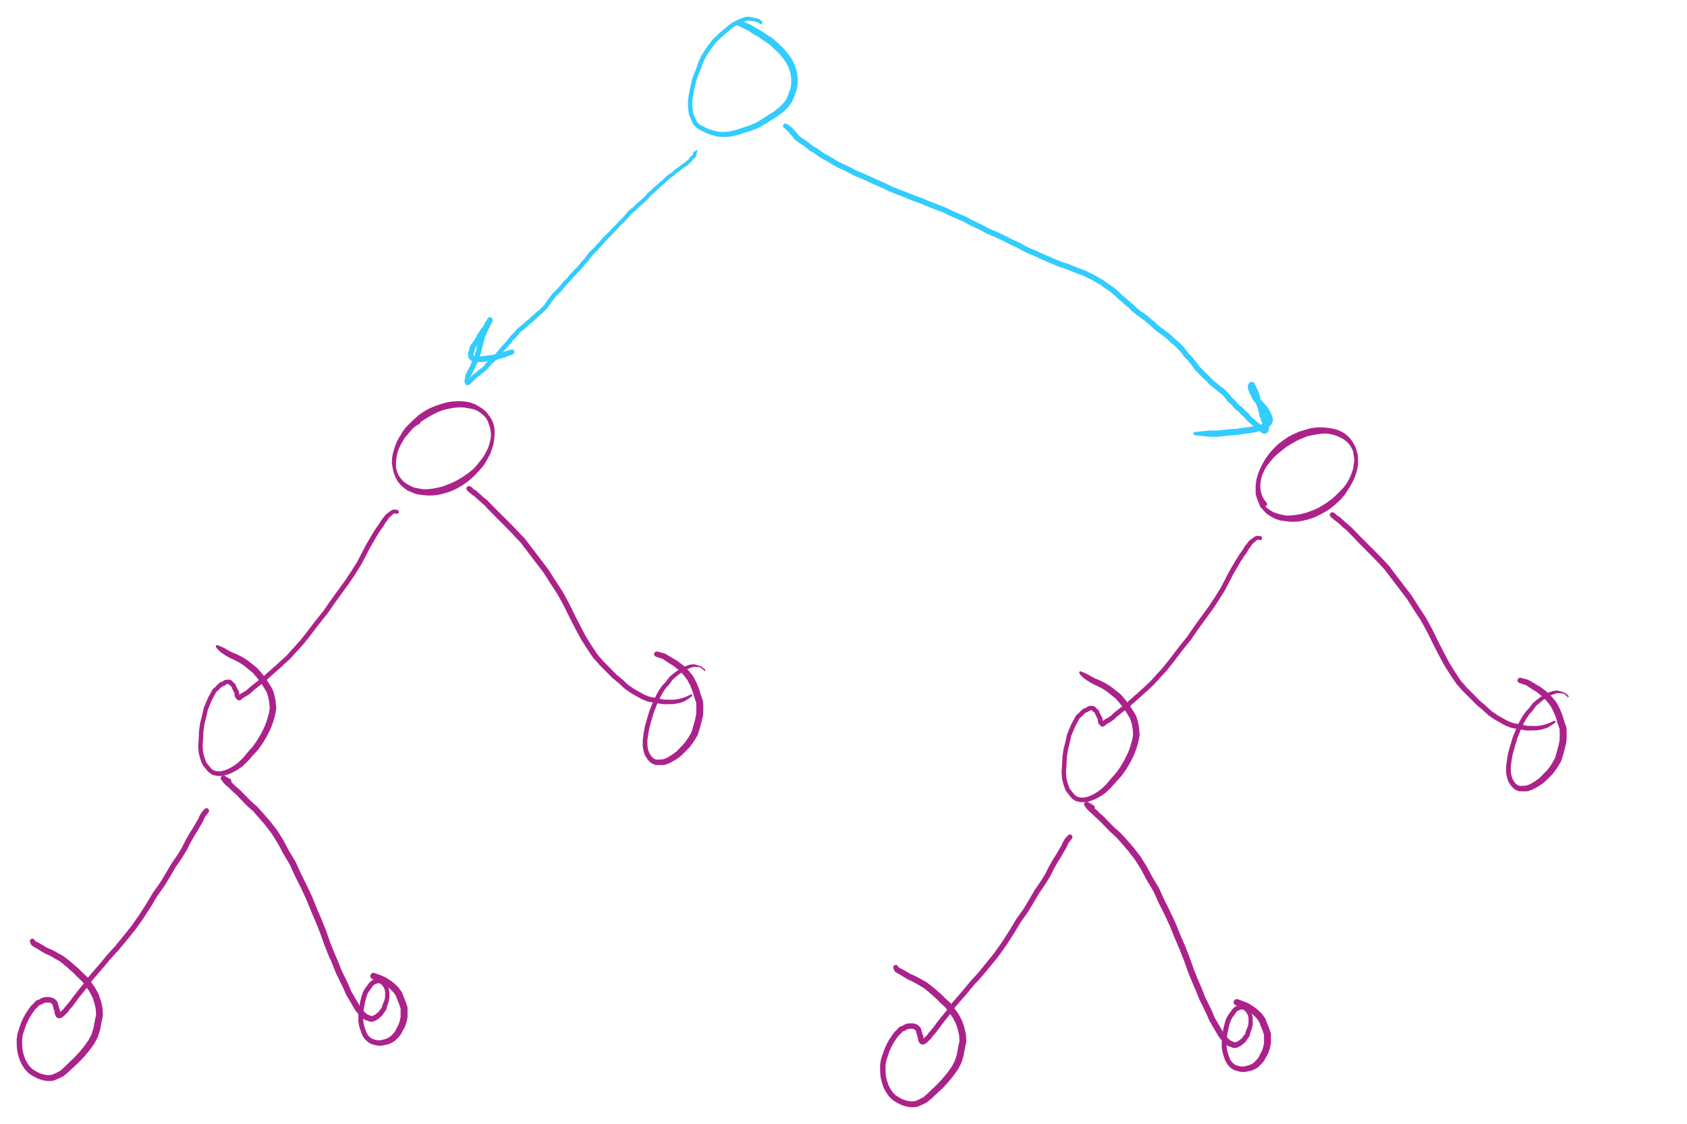
privateBuildTree Special Case #1
leftTree == rightTree

Slide 11
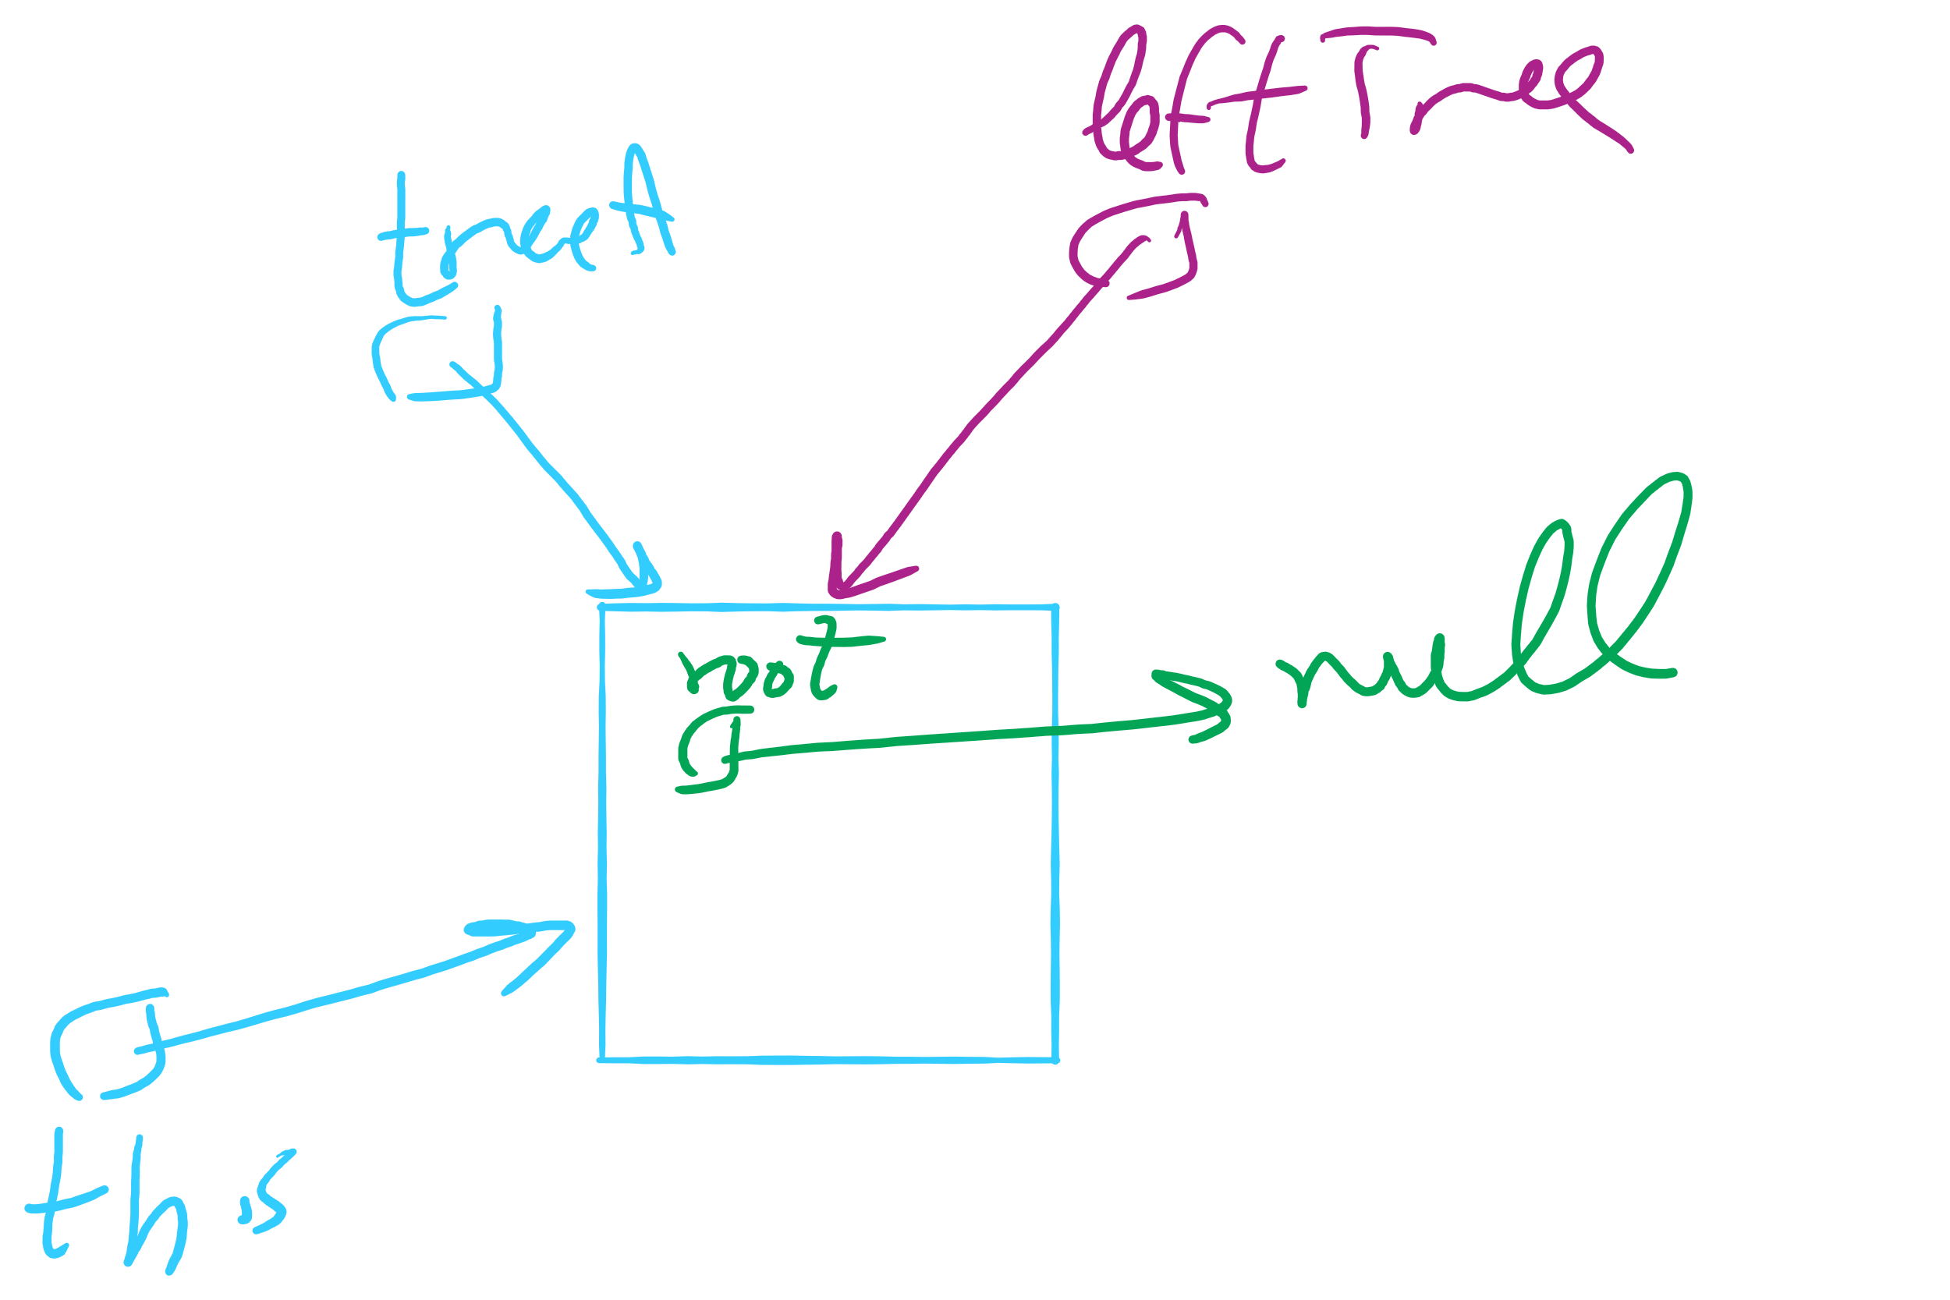
privateBuildTree Special Case #2
leftTree (or rightTree or both) == this

Slide 12
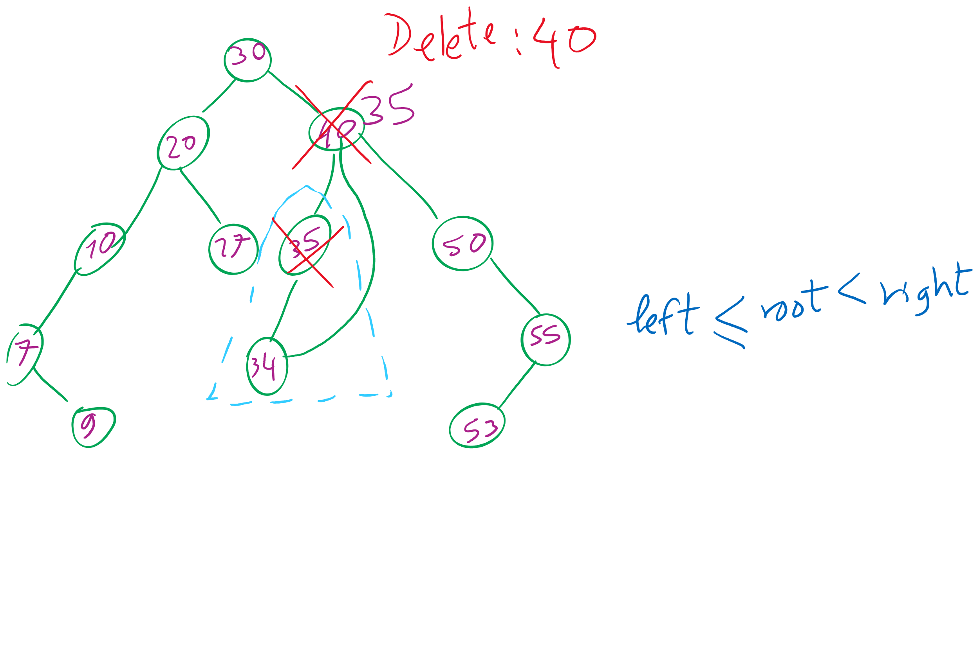
BinarySearchTree

